Slide 1

Embedding English to Welsh MT in a private company
Myfyr Prys and Dewi Bryn Jones

Slide 2



Knowledge Transfer Partnership (KTP)
Intended to pass knowledge from academia to private sector
The goal: increase Cymen’s productivity using machine translation technology
Notes:
Thank you for the opportunity to give this presentation. I’m here to talk about a two year project that was completed recently between Bangor University and Cymen, which is a small translation company in North Wales. The project was part of a research initiative called a KTP - which stands for Knowledge Transfer Partnership. There are normally three partners in these projects: a university, a private company and a KTP associate whose work it is to implement the changes – at was me in this case. The aim of the project was to implement the use of statistical machine translation throughout the company, and hopefully by doing this increase productivity.

Slide 3
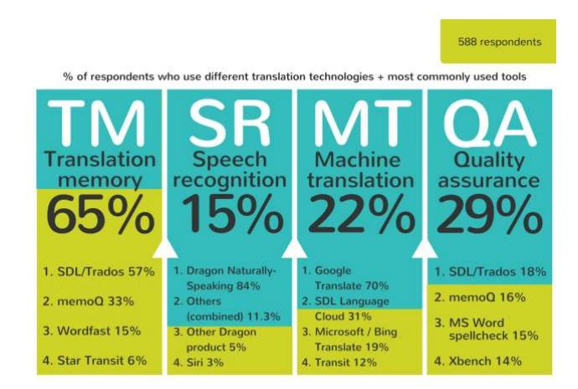
Challenges facing the Welsh translation industry
Demand outstrips supply (Prys et al 2009)
Politically driven demand is growing across the sector (Welsh Language Act 1993)
Technological solutions could :
Lead to savings of up to 40% (Prys et al 2009)
Strengthen a sector crucial to rural, highly skilled graduates
Play a role in increasing numbers of Welsh Speakers (Welsh Government 2018)
Technological solutions have not been widely implemented
Welsh use of translation memories reported at 47% (Prys et al 2009) and 45% (Andrews 2010) while international use at 82.5% (Lagoudaki 2006)
UK-wide use of translation memories at 65% while use of machine translation is at 22% (CIOL 2017)
Notes:
The backdrop of this study is the huge growth that we’ve seen in the English to Welsh translation sector over the last twenty years. The growth has been driven by successive waves of legislation enforcing the use of Welsh by institutions in the public and voluntary sectors. The main challenge facing the sector is how to increase capacity to deal with this rise in demand, and technological aids such as machine translation offer one solution, given that they have been shown to increase translation rate. The CAT Cymru report (Prys et al 2009) argued that using various forms of translation technology could lead to savings of up to 40% for translators and that these kinds of savings would also strengthen employment prospects for a demographic of highly skilled graduates in a rural society vulnerable to brain drain. Another argument is that an effective, highly developed translation sector strengthens the Welsh language – the Welsh Government itself has argued this in its recently published strategy to reach a million Welsh speakers by 2050.
“In order to facilitate an increase in the number of Welsh speakers, raise their confidence and enable the language to be used in a variety of settings […] a modern and responsive translation profession which makes full benefit of the latest technology, and language resources (dictionaries, terminologies, and corpora) are required. These are all elements that reflect and maintain the Welsh language’s status as a living language, and are essential for Welsh speakers whatever their ability.“
Technological solutions have arguably not been widely adopted in Wales. Studies back in 2009 and 2010 found that the use of Translation Memory technology was relatively low in Wales at around 45%. The authors of the CAT Cymru report (Prys et al 2009) contrasted these numbers unfavourably with an internationally reported figure of 80% by Lagoudaki (2006) around the same time. The most recent UK-wide study (shown in the infographic here) found the rate of translation memory usage across Britain to be at around 65%, with machine translation at 22%.
**Lagoudaki - Even the author says it was biased towards those from English speaking countries (because it was in English),

Slide 4
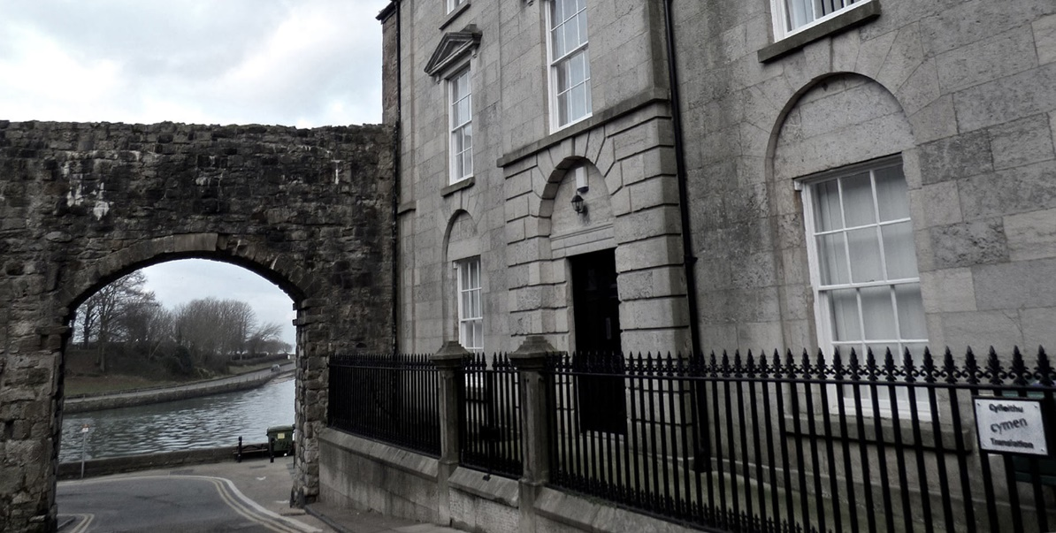
Mainly English Welsh translation
21 internal and 23 external translators
Often works to tender and with long-standing clients
The use of translation memories and glossaries integrated since previous KTP (in 2000)
Notes:
Just to give some more detail about the company – it’s based in Caernarfon in North Wales (the medieval castle is just out of the shot) and specializes in English to Welsh translation. We have 21 internal translators who work on site, but Cymen also regularly sends work out to external translators because of the capacity issues I just discussed. Although we have a lot of clients, we tend to work to tender and with long-term clients – which means that the company has to apply for and win contracts to work with clients who supply repeat business throughout the year. Cymen actually took part in a previous KTP twenty years ago in the year 2000, which embedded the use of translation memories and glossaries in the company, and since then the use of this technology has become crucial to the way the company operates.

Slide 5
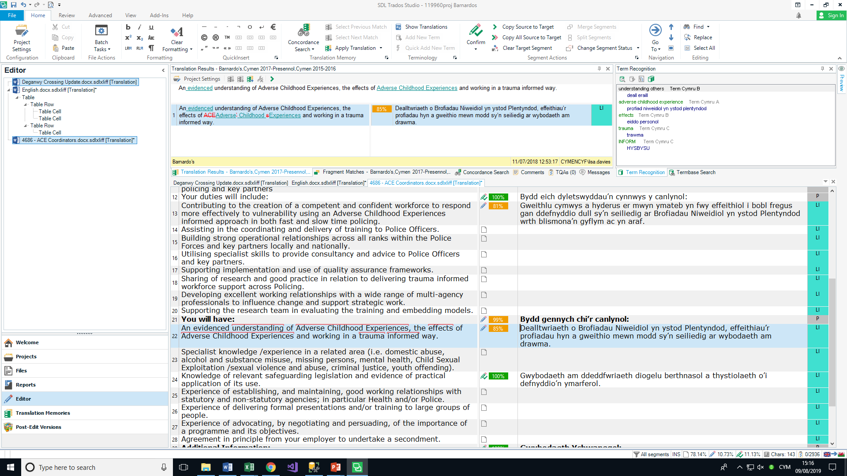
Notes:
This is a screenshot of translation memories and glossaries being used by one of our translators in the SDL Trados CAT program. Translation memories are useful because they essentially allow you to recycle previous work, avoid repetitions and remain consistent with past work. You can see on the left how some segments have been filled in automatically, either partially or fully, because the translation memory has found a match for them. Another feature you can see here is the use of glossaries in the box at the top corner – the feature can detect terms that a client wants translated a particular way and make sure you use it. The use of these technologies is so useful because two of the main things that clients want are quick turnaround and consistency.

Slide 6



Project aims
Use the company’s own archive of previous translations to train domain-specific translation engines
Integrate our engines into the CAT tool used by our staff (SDL Trados)
Train company staff to use these engines, transfer knowledge
Notes:
The project as a whole had three main areas or stages that we wanted to follow. 1. The first step would be to train translation engines based on data belonging to specific clients (so domain-specific engines) 2. the second step was to integrate these engines into the Trados interface so that translators can really use them. 3. and then the final step is to transfer knowledge throughout the company, make sure that everybody understands what is happening and so on.

Slide 7
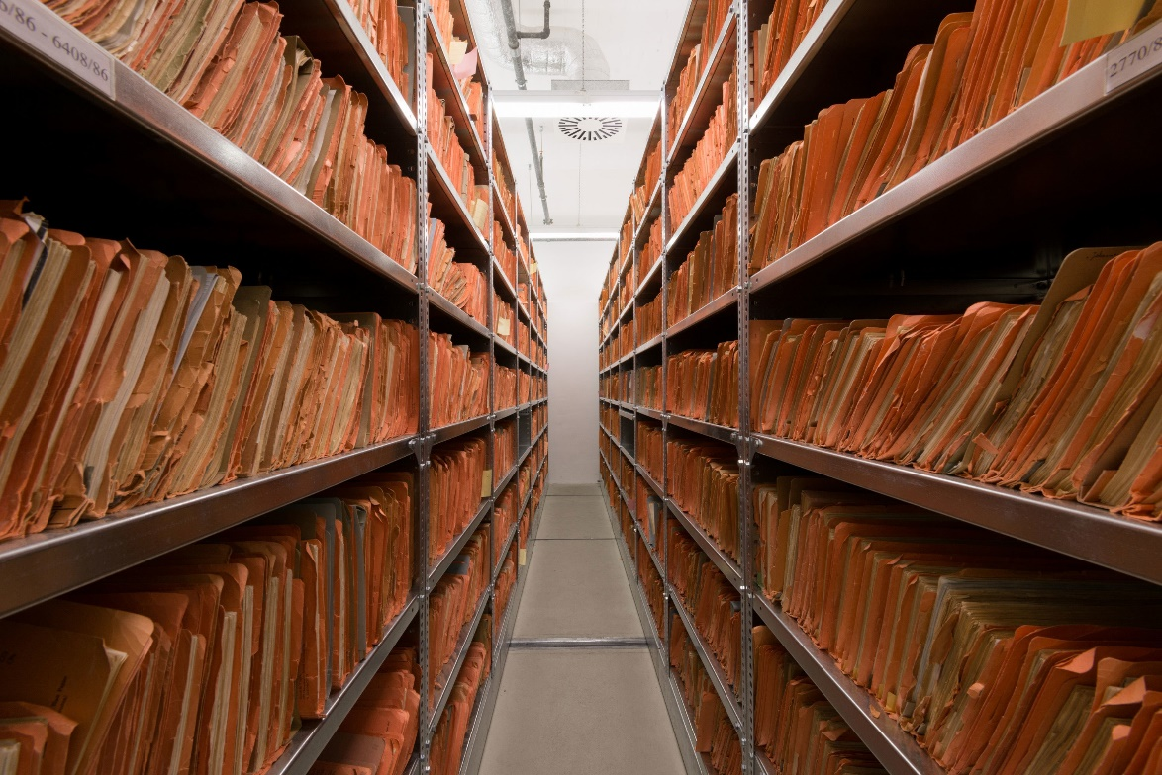
1. Preparing the archive
An initial directory scan:
20 years of previous translations (!)
~150 million Welsh words
All kinds of formats...
Translation memory (TMX) files chosen as primary data source
No alignment necessary
Relatively clean
Plentiful (4.4 million segments)
Notes:
We began the project with a directory scan to see exactly what kind of resources we were working with – the analysis showed that it potentially contained 150 million Welsh Words which is obviously a great data set if retrievable. That data was spread across all kinds of different formats however, like Word, Excel files and more, and we would have needed to align all these documents, which is a pretty complicated process.
In the end we decided to focus on TMX files, which is basically a format for storing translation memories. The advantages of using TMXs are clear – the first is that no alignment is necessary. Secondly, translation memories are quite carefully curated by the company so there’s not a lot of cleaning work to do on them, and finally quite a lot of our data turned out to be in our translation memories, maybe about half of that 150 million.

Slide 8
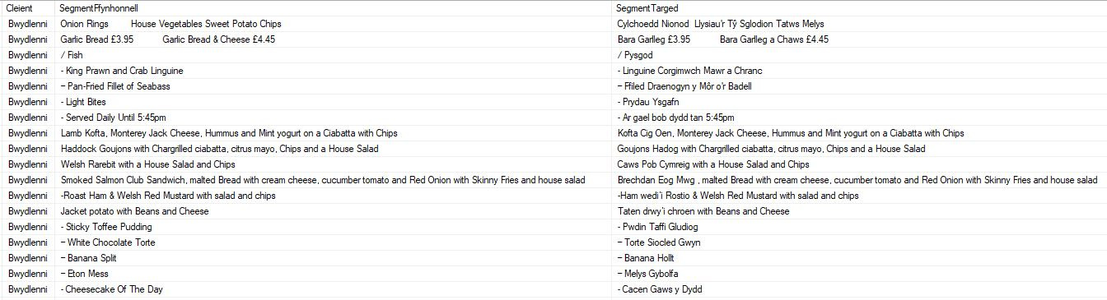

2. Building the archive
All TMX data was imported to an SQL Database and tagged with metadata (client, date, etc.)
This allows easy selection and export of domain-specific paralel corpora
ACME.en
ACME.cy
Notes:
The next step was to create an SQL Database for our data and to import and tag all our translation Memory files. You can see a very simple example here of a table containing source and target translations for a food-based client. Using SQL it’s quite easy then to select and export either a paralel corpus for a single client or for a combination of clients who fall within a broader domain like health or education. What you have after export is a pair of perfectly-aligned text files which are ready for the translation engine training process.

Slide 9

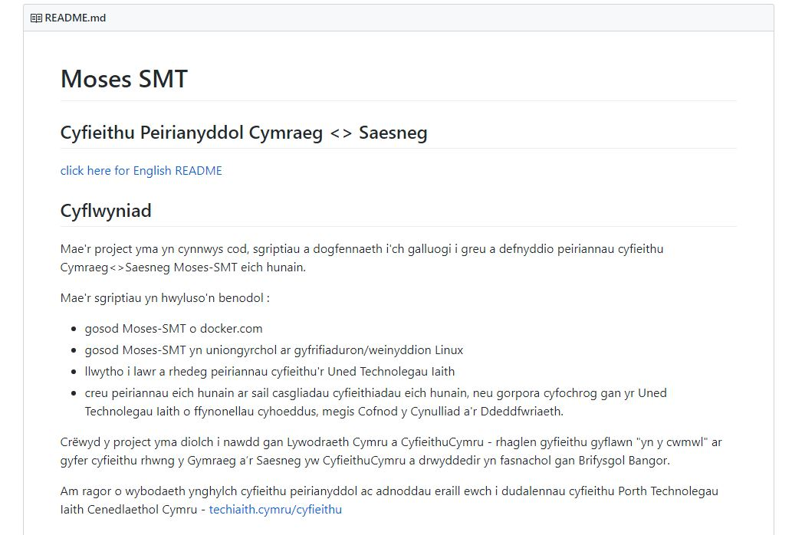

3. Training the machine
We used the LTU’s Moses Implementation (https://github.com/PorthTechnolegauIaith/moses-smt)
Automatic training pipeline (bash and Python)
Tuning and evaluation steps added during the KTP
Translation engines are run from separate Docker containers
Notes:
For training we used a Moses Implementation developed by Bangor University’s Language Technology unit. This basically facilitates the whole training pipeline with bash and python scripts, and it’s obviously available for anyone to download from GitHub at the address here. During the course of the KTP I added some very simple tuning and evaluation steps to the pipleine. After training, the client-specific engines were run as processes out of individual containers in docker.

Slide 10
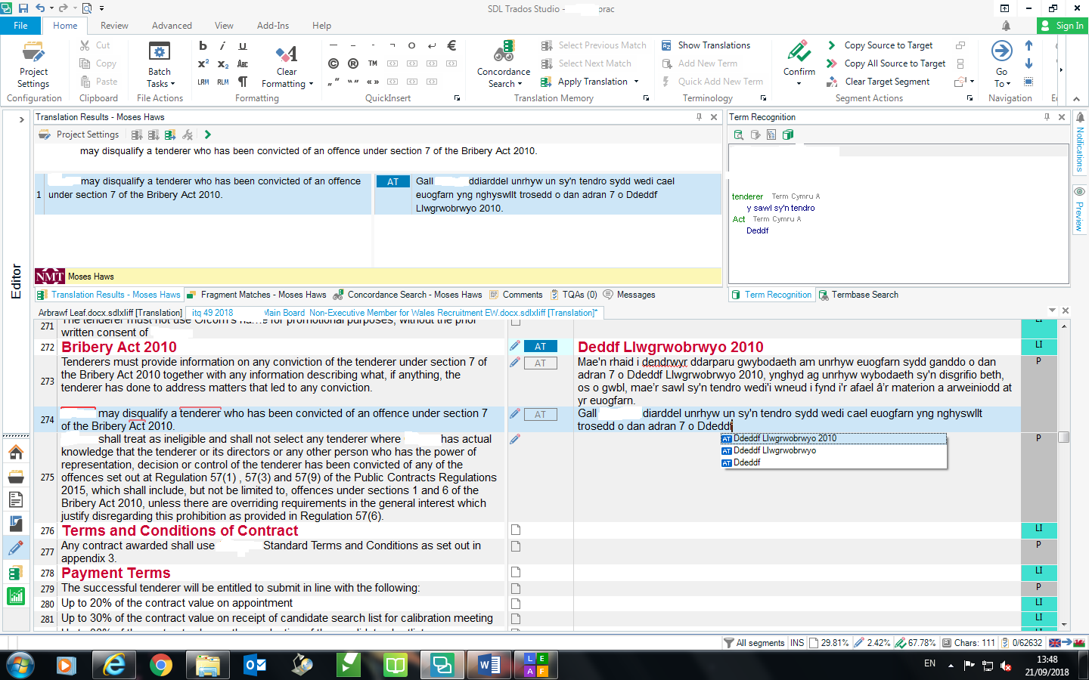
Notes:
In this screenshot you can see the Trados environment once again with our plugin attached. The translator doesn’t need to do anything because the creation of projects is based on template files which collate all the various resources necessary for a project together, and these are managed by the admin staff. The relevant client-specific engine appears for the translator as soon as they open the program.
The translation engine’s hypothesis (or suggested translation) appears in the top window as you select each segment, and the translator can then choose whether to accept it or not. There’s also a very handy autosuggest feature that allows the translator to select individual chunks or phrases from the hypothesis – this was something that many of the translators specifically mentioned when we asked them for feedback, as they could leverage specific parts of the translation even if it isn’t perfect as a whole.

Slide 11
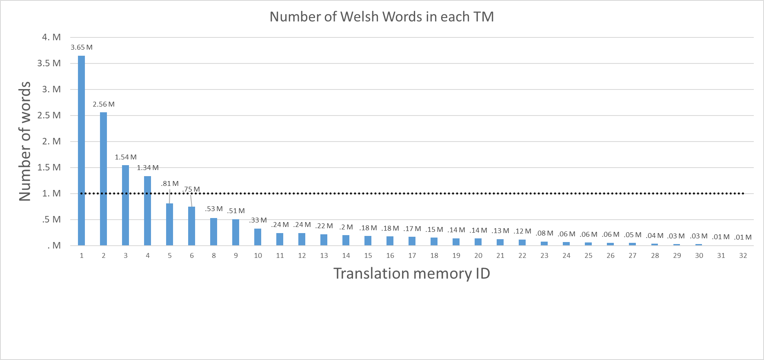
Translation memories
Notes:
This slide illustrates how we choose which client-specific translation memories we attempt to create engines for. We have set an arbitrary threshold at about a million Welsh words (represented by the dotted line on this chart) before we attempt to train an Engine for a client. Most of our translation memories clearly don’t reach the threshold yet but they are growing quite quickly.

Slide 12
BLEU Scores
Engine ID | Domain | Welsh words | BLEU
1 | Technical | 3.65 million | 59.06
2 | Industrial/Scientific | 2.56 million | 58.75
3 | Media | 1.54 million | 50.92
4 | Legal | 1.34 million | 48.53
5 | Education | 0.80 million | 46.54
6 | Care | 0.75 million | 42.70
CYMEN | General | 65.3 million | 54.23
Greater size correlates with a higher BLEU score
BUT specificity of domain is also a factor
The general-domain CYMEN engine comes in at 3rd place
Notes:
This table shows the BLEU scores the seven best engines we have, as you can see they range in size from nearly four million words to about seven hundred thousand words. It’s pretty clear from the outset that the size of the training corpus is the main thing affecting the quality of the resulting engine. Engine ID 1, which is for a client in the telecommunications field, has both the most data and possibly the most specific domain with very repetitive, technical language. The translators really love using this engine and it’s actually won people over who seemed very resistant at first. The engine at the bottom is a general domain engine trained on everything we have – about 65 million words/4 million segments. I think it shows the value of using domain-specific engines that two of our client-specific engines are around 5 BLEU points better in quality than this general domain one.

Slide 13
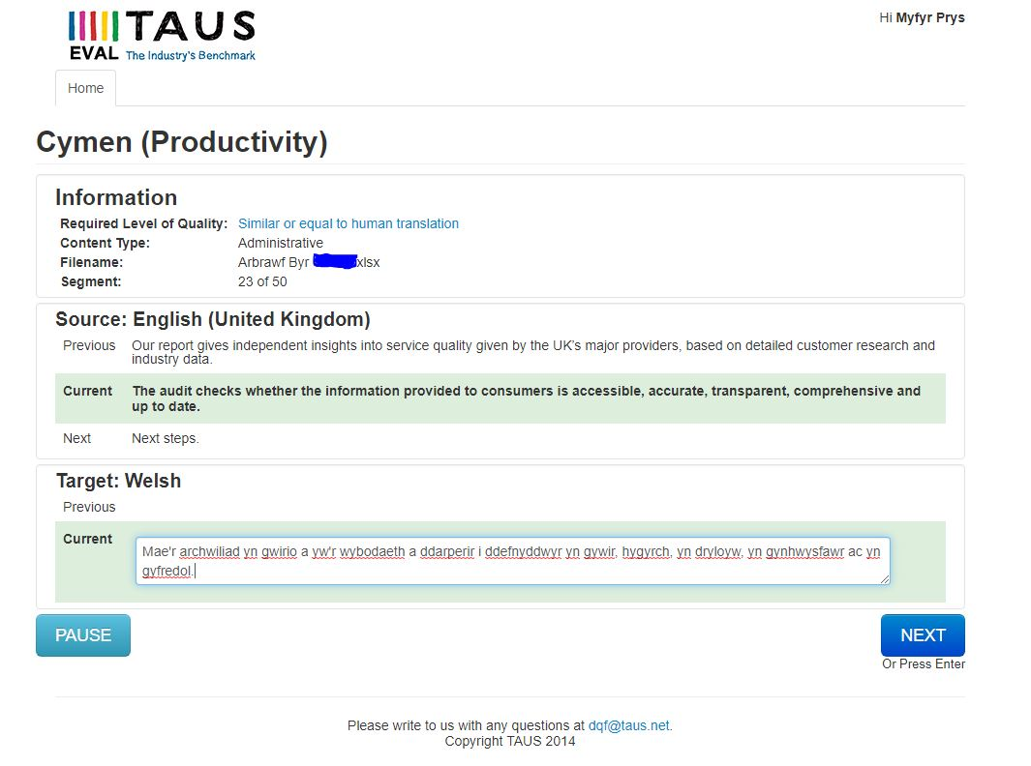
Productivity experiment
Experiment using the TAUS DQF platform: https://dqf.taus.net/
8 staff took part
Randomized data set taken from engine ID 1
Notes:
The last thing I want to show you is a productivity experiment we carried out to get a sense of how well the engines were working. We used the TAUS DQF platform for this, which you can see being used in this screenshot. To create the experiment, we randomly selected some of the output of our best-performing engine – engine ID 1 that I showed you earlier – and uploaded it to the platform. TAUS then shuffles the data and presents it to be translated in this interface, with half of the segments to be translated from scratch and half to be post-edited from our translation engines’ output. 8 translators were kind enough to take part in the experiment.

Slide 14
Productivity experiment results
All staff increased productivity with the translation engine
The average productivity gain was 30%
However this varied between 41% and 14% for individual translators
Notes:
So here you can see the result of the experiment – the chart shows the word per hour translation rate of each translator for both conditions – translating without the help of the engine is in blue while translating with the engine is in beige. What you can see quite clearly is that all of the translators were quicker and more productive with the translation engine, although the boost that they got did vary quite a lot. The average gain was 30%, but for individuals it varied between 41% to 14%. So clearly people benefit to differing degrees from the technology, and this could have some implications for training and so on. We would hope that maybe some will get more benefit from the engines as time goes by.

Slide 15
Looking forwards
1-year SMART partnership project on NMT starting in September
Focus on anticipating problems of data sparsity (Koehn and Knowles 2017, Dowling et al 2018)
Omnivorous data search of Cymen’s archives
Integrating external translators to capture their output
Domain-adaptation techniques
Advocating for more public-domain parallel corpora
Notes:
Finally, looking forwards – we recently won a grant to extend the project by another year looking into using Neural Machine Translation (or NMT) technology at Cymen. It’s early days yet, but we’ve mainly been talking about how to counteract problems with data sparsity. As many of you know NMT is known to be even more sensitive than SMT to the size and domain of training corpora. Dowling et al’s recent study has been particularly useful as it shows that NMT is not always better for lesser-resourced and morphologically complex languages.
One thing we want to do to prepare for this is to go back and look at our archives again – we know that there’s a lot of client specific data that could be aligned and brought back into play. Secondly, we want to try and integrate as many external translators as possible into our translation memory workflow so that we capture all of their work too. Finally, different domain adaptation techniques have been described in the literature for leveraging out of domain corpora to complement sparse in-domain training data in various ways. Thank you!

Slide 16
Thanks!

