Slide 1

COMP5584 · LARGE LANGUAGE MODELS FOR AGENTS
IncidentLens
Evidence-driven multi-agent incident investigation
Cited root causes, or explicit abstention — measured against four
matched multi-agent architectures.
Final Project · Fall 2026 · Group ID: ____________
Team members to be completed by the group
LangGraph · Python · Starlette
Notes:
Opening (Speaker 1, 20 s):
Good morning. We are presenting IncidentLens, a multi-agent system that investigates
software incidents. Its contract is simple: every accepted root cause must cite the
records that support it, and when the evidence is insufficient the system must say so.
We report a matched four-architecture evaluation on a 36-case development corpus.

Slide 2

Incident review is an evidence problem
Why a general-purpose LLM agent is not enough
01 PROBLEM
One incident, four partial views
01
Plausible stories
Logs
Metrics
An LLM can produce a fluent cause with no record-level support.
02 DESIGN
error chronology, propagation
scope, saturation, dependencies
Database
Changes
03 SYSTEM
sessions, locks, slow queries
deploys, config, onset alignment
02
Permission blindness
A general agent reads whatever is in context, including evaluator-only data.
04 EVALUATION
No single source establishes causation. An investigator must align time, service identity and mechanism across all four — and say what remains unexplained.
03
Confident guessing
05 DISCUSSION
When evidence is thin, the default is still to answer.
THE REVIEWER'S TEST
— Follow every claim to a record.
— See which agent observed it, and when.
— Check why the alternatives were rejected.
Contract: cite exact records — or abstain
COMP5584
Final Project
IncidentLens · Evidence-driven multi-agent incident investigation
2
Notes:
Speaker 1 (42 s):
Incident review is not a summarisation task. Logs, metrics, database state and changes
each show only part of the mechanism. A generic agent can write a convincing story
without citing a single record, can read data it should not see, and will usually answer
even when the evidence is thin. IncidentLens is built around the opposite contract:
every accepted conclusion cites exact records, or the system returns INCONCLUSIVE.

Slide 3
The question we set out to test
Scope: synthetic, read-only incident packs; no production changes
01 PROBLEM
Can a coordinated multi-agent system investigate incidents with evidence a reviewer can audit, and abstain when the visible evidence is insufficient — at an acceptable cost?
01
Dynamic coordination
A supervisor allocates 1–2 specialist tasks per round from the current evidence gap, inside a hard budget.
02 DESIGN
03 SYSTEM
02
Cited-or-abstain gates
RESEARCH QUESTION
Merge and FinalizeGate are deterministic: model confidence never decides acceptance.
04 EVALUATION
Why multi-agent, specifically
The four evidence sources need different tools and different questions. Roles create scoped access; a coordinator decides which gap matters next. This is specialisation and coordination — not four independent LLM calls.
03
Matched measurement
Four architectures, 144 slots, six difficulty levers, and an explicit failure analysis.
05 DISCUSSION
Non-goals: production changes, real telemetry, a model leaderboard.
Evaluation in one line: 4 matched architectures × 36 cases × 1 repeat = 144 runs; 136 completed.
COMP5584
Final Project
IncidentLens · Evidence-driven multi-agent incident investigation
3
Notes:
Speaker 1 (38 s):
Our research question has two halves: can the system produce an auditable answer, and
can it refuse when the evidence is thin, without paying an unreasonable cost? Multi-agent
design is justified by evidence specialisation and by coordination: the coordinator
chooses the next gap, rather than running every specialist every time. We test this with
four matched architectures and 144 attempted runs.

Slide 4
One auditable investigation pipeline
Model-driven steps are light; deterministic state and gates are outlined
01 PROBLEM
PUBLIC INPUT
COORDINATOR
FINALIZE GATE
• logs
supervisor · budget owner
citations · causal chain · blockers
02 DESIGN
• metrics
1–2 tasks / round
SPECIALIST POOL
• database
Logs
Metrics
Report · RESOLVED
chronology
scope
cited root cause + causal chain
03 SYSTEM
• changes
Optional monitor
Database
Changes
locks / pools
triggers
Abstain · INCONCLUSIVE
what is missing, what to check next
04 EVALUATION
MERGE deterministic
Hypothesis
board
identity · citations · reconciliation
Remediation · PLAN_ONLY
05 DISCUSSION
Verifier (ablation): reviews hypotheses; its review returns to the coordinator.
proposal only; no execution
Stock budget: 4 rounds · 12 tool calls · 16 LLM requests · 600 s. Dynamic = primary runtime; single, fixed-4 and dynamic+verifier are ablation controls.
COMP5584
Final Project
IncidentLens · Evidence-driven multi-agent incident investigation
4
Notes:
Speaker 2 (45 s):
This is the whole system. Public evidence enters; an optional monitor can raise an alert.
The coordinator owns the budget and assigns at most two specialist tasks per round.
Specialists can only call tools allowed for their role. Merge validates identity, task,
role and every citation, then updates a shared hypothesis board. FinalizeGate makes the
deterministic accept/abstain decision. Remediation runs only after acceptance and is
plan-only. The verifier is an optional ablation, not part of the primary runtime.

Slide 5
Roles are real; permissions are code
Access ceilings are enforced by the runtime, not by prompt wording
01 PROBLEM
Agent | Responsibility | Allowed read-only tools
Coordinator | Reads the evidence gap; assigns or replans 1–2 tasks; chooses finalize or abstain | none (state only)
Log Investigator | Reconstructs error chronology and separates cause from symptom | query_logs
Metrics & Dependency | Locates scope, saturation and dependency anomalies | query_metrics · get_dependencies
Database Investigator | Inspects sessions, locks, pools and slow queries | 5 database tools
Change Investigator | Aligns deployments and config changes with onset | query_changes · get_config_diff
Verifier (ablation) | Challenges a candidate and requests a discriminating check | fetch_evidence_by_ids
Remediation | Produces a plan with preconditions, risks, verification and rollback | none (accepted findings only)
02 DESIGN
03 SYSTEM
04 EVALUATION
05 DISCUSSION
The single-agent baseline receives the union of investigator tools; every other role is scoped.
Immutable AgentContext
Actual-query ledger
Public file allowlist
COMP5584
Final Project
IncidentLens · Evidence-driven multi-agent incident investigation
5
Notes:
Speaker 2 (38 s):
Roles are not personas in a prompt. The coordinator has no evidence tools; each
specialist has only the tools for its source. The verifier can fetch only records already
observed, by ID. The context object is immutable, an actual-query ledger records what was
read, and the data provider exposes only public files. These are code-level boundaries,
which is what makes the architecture meaningful rather than cosmetic.

Slide 6
Coordination follows the evidence gap
Dynamic dispatch, bounded rounds, deterministic merge
01 PROBLEM
ONE ROUND, FOUR MOVES
COORDINATOR DECISION CONTRACT
1
Read the gap
INVESTIGATE
02 DESIGN
Coordinator sees the public summary, current hypotheses and unresolved questions.
1–2 assignments; no selected hypothesis
2
Assign ≤ 2 tasks
FINALIZE
03 SYSTEM
Each task names a role, a question and a cause-specific discriminator.
One selected hypothesis; stop reason
3
Investigate
ABSTAIN
Specialists query within their ACL; results return as cited findings.
No selection; explicit stop reason
04 EVALUATION
4
Merge + reconcile
HARD BOUNDS (STOCK)
05 DISCUSSION
Validated batches update stable hypotheses; conflicts become OPEN, never silently closed.
4
rounds
12
tool calls
An assignment without a discriminator cannot change the answer.
16
LLM requests
600 s
wall clock
COMP5584
Final Project
Exhaustion = runtime failure; insufficiency = INCONCLUSIVE.
The benchmark raised these to 8 rounds · 40 tool calls · 64 requests · 7,200 s.
IncidentLens · Evidence-driven multi-agent incident investigation
6
Notes:
Speaker 2 (42 s):
Dynamic coordination is the core design claim. Each round starts from the current
evidence gap, not from a fixed checklist. The coordinator emits one of three contracts:
investigate, finalize or abstain. It can assign at most two tasks, each with a
discriminator that would move the hypothesis. Merge reconciles support and conflict, and
hypothesis IDs stay stable across rounds. Budgets are physical requests and retries, so
the loop cannot run forever.

Slide 7
Grounding is a deterministic gate
Not a prompt style: citations, identity and blockers are checked in code
01 PROBLEM
Candidate
hypothesis
Citations exist
in observed set
Identity + state
match
Gate decision
Report or
abstain
02 DESIGN
FOUR CHECKS, ALL DETERMINISTIC
RESOLVED
Every cited evidence ID exists in the records actually observed in this run.
Finding identity matches run, incident, task and role before it can influence a hypothesis.
A resolved root cause needs a supported hypothesis and a causal chain, not just a top score.
Unresolved blockers, open contradictions and missing discriminators force abstention.
A root cause with supporting citations, a causal chain, and no blocking gap.
03 SYSTEM
04 EVALUATION
INCONCLUSIVE
No cause accepted. The report preserves observations, gaps and next checks.
WHAT THE GATE USES — AND NEVER USES
05 DISCUSSION
Uses: hypothesis, findings, cited IDs, observed-ID set, blocker list.
Never: model confidence, chain-of-thought, evaluator labels.
BEST_SUPPORTED_AVAILABLE is still not proof: it is the strongest supported explanation given visible evidence.
COMP5584
Final Project
IncidentLens · Evidence-driven multi-agent incident investigation
7
Notes:
Speaker 3 (33 s):
This is the trust mechanism. A candidate must cite records that were actually observed;
the finding must match the run, task and role that produced it; a resolved answer needs a
supported chain; and any unresolved blocker forces abstention. The gate does not ask the
model how confident it feels. The strongest accepted statement is
BEST_SUPPORTED_AVAILABLE, which is deliberately weaker than proof.

Slide 8
Implementation is reproducible
Failure-aware and offline-capable; the same contracts behind CLI, web and replay
01 PROBLEM
Python 3.11+
LangGraph StateGraph
Pydantic v2
Starlette + ES modules
pytest
02 DESIGN
REPRODUCIBLE BY DEFAULT
FAILURE HANDLING IS PART OF THE DESIGN
Deterministic Mock provider: no API key, no model weights, same public evidence.
40 public incident packs; 36 hardened development cases used for evaluation.
Replay validates a saved trace and re-renders it without calling graph, tools or provider.
CLI and web share the same runtime contracts; downloaded trace.json is the artifact.
Bounded provider recovery with atomic request permits and classified transport errors.
One targeted structured-output repair per stage; a failed repair becomes a technical failure.
Task-local stage budgets; partial batch failure can continue when safe.
Unified stop protocol with acknowledgement and a bounded timeout.
03 SYSTEM
04 EVALUATION
CURRENT TEST SUITE
1,179 passed · 3 skipped · no failures
Full pytest run · 2026-11-02 · 463.2 s
Exit code 0
05 DISCUSSION
RUN IT
.venv/Scripts/python.exe -m incident_lens.cli validate-data
.venv/Scripts/python.exe -m incident_lens.cli run --case incident_001 --provider mock --out results/quickstart
.venv/Scripts/python.exe -m incident_lens.cli replay --trace results/quickstart/trace.json
COMP5584
Final Project
IncidentLens · Evidence-driven multi-agent incident investigation
8
Notes:
Speaker 3 (33 s):
The implementation is a LangGraph state machine with typed Pydantic contracts. The same
runtime powers the CLI and the web console; a saved trace can be replayed without touching
the graph, tools or model provider. Failure handling is explicit: bounded recovery,
request permits, one structured-output repair, task budgets and a unified stop protocol.
This matters because the evaluation counts technical failures rather than hiding them.

Slide 9
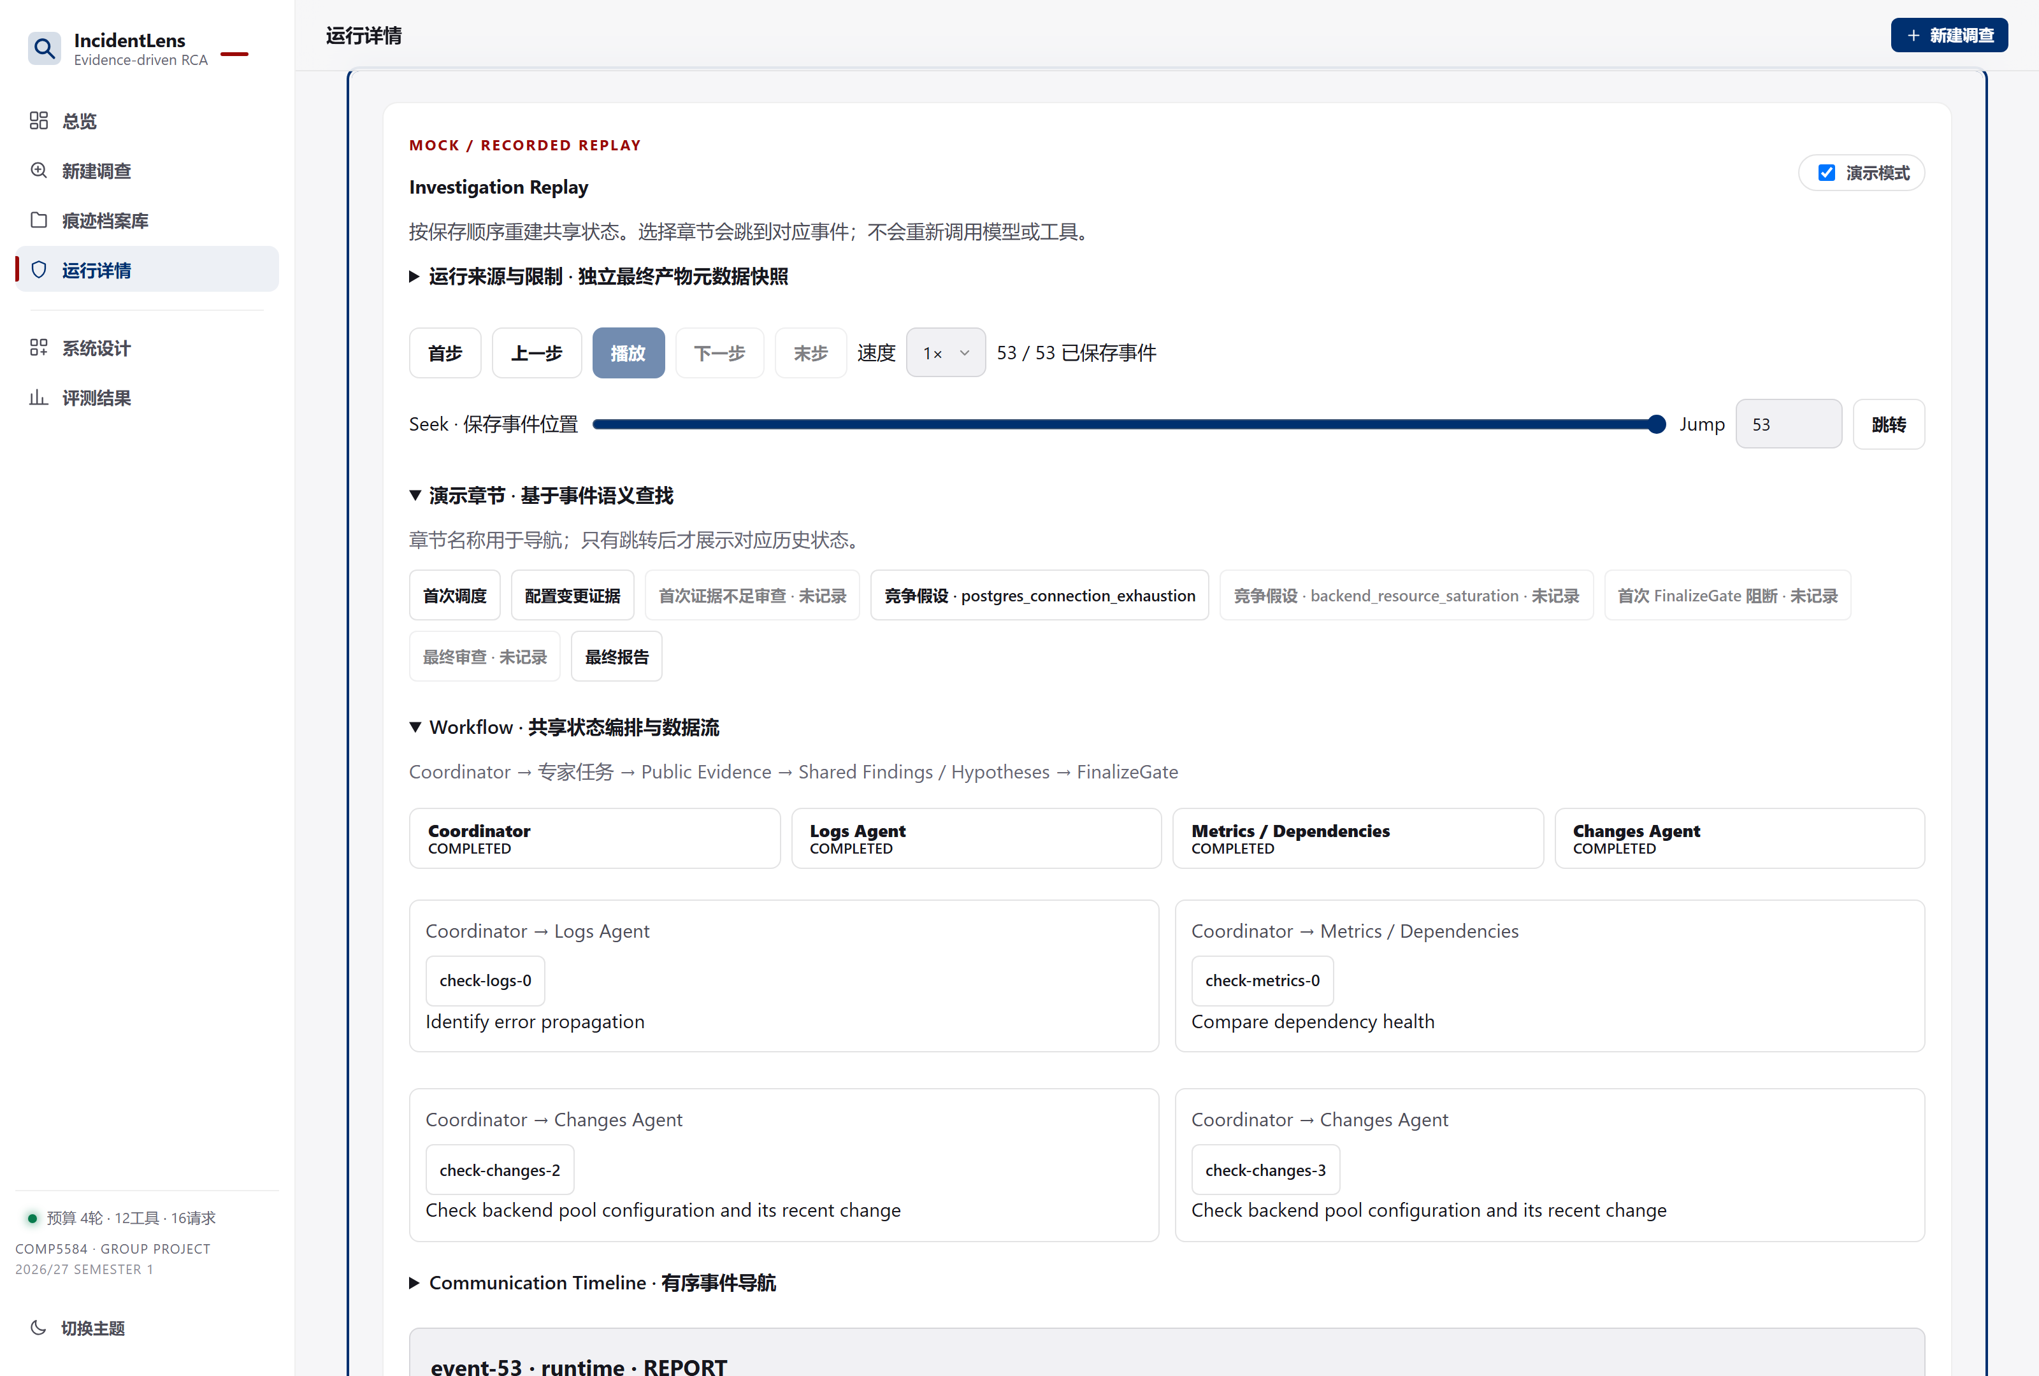
Demo: live run, then replay
The console exposes the same evidence the gates used
01 PROBLEM
THREE CUES
1
Run live
02 DESIGN
Mock provider, incident_001; watch IDs, budget and gate status change.
2
Replay
03 SYSTEM
Open the same trace; confirm the badge says Recorded Replay.
04 EVALUATION
3
Audit
Click a citation: source file, query, agent and timestamp are shown.
05 DISCUSSION
The UI labels Live vs Recorded Replay and Mock vs Real. Screenshots are captured from the running app.
COMP5584
Final Project
IncidentLens · Evidence-driven multi-agent incident investigation
9
Notes:
Speaker 3 (70 s, includes demo):
We will run incident_001 with the Mock provider. Point out that the coordinator chooses
two tasks, then a second round; the budget counters move; FinalizeGate accepts only after
citations are present. Then we open the same trace as a recorded replay: the badge changes
and the graph, tools and provider are not called. Finally we click one citation to show
its source file, the query that produced it, the agent and the timestamp.

Slide 10
Does coordination earn its cost?
Matched comparisons on a development-visible corpus
01 PROBLEM
36
4
02 DESIGN
hardened cases
matched architectures
29 identifiable · 7 must abstain
Single · Fixed-4 · Dynamic · Dynamic + verifier
03 SYSTEM
144
6
attempted slots
difficulty levers
04 EVALUATION
136 completed; failures retained
competing · counterfactual · boundary · missing · misleading · standard
SCORING DISCIPLINE
05 DISCUSSION
Principle | Consequence
Technical failure stays in the attempted denominator | Quality is success / 36, not success / completed
Root correctness uses identifiable completed runs only | 27/27 is not inflated by abstentions
Abstention uses unidentifiable completed runs only | 6/6 or 7/7 is separate from root accuracy
COMP5584
Final Project
Labels are evaluator-only and provisional; the corpus is not a blind test set.
IncidentLens · Evidence-driven multi-agent incident investigation
10
Notes:
Speaker 4 (38 s):
The evaluation is a matched comparison, not a leaderboard. All four architectures use
the same public evidence, tools, budgets, model and decoding settings. Technical failures
stay in the denominator, root accuracy is computed only on identifiable completed runs,
and abstention only on unidentifiable completed runs. The labels are evaluator-only and
provisional, and the corpus is development-visible.

Slide 11
Dynamic leads on quality
Hardened 36-case batch, 2026-11-01; zero wrong root causes
01 PROBLEM
Architecture | Completed | Root correct | Abstain | Quality | Latency | Tokens
Single | 35/36 | 25/28 | 7/7 | 32/36 | 680.9 s | 246.0k
Fixed-4 | 34/36 | 15/27 | 7/7 | 22/36 | 196.3 s | 58.0k
Dynamic (primary) | 33/36 | 27/27 | 6/6 | 33/36 | 412.9 s | 149.2k
Dynamic + Verifier | 34/36 | 23/27 | 7/7 | 30/36 | 503.8 s | 233.8k
02 DESIGN
03 SYSTEM
Quality success counts technical failures; root correct and abstention use their own eligible denominators.
04 EVALUATION
33/36
27/27
0
Quality success
Root correct
Wrong root causes
05 DISCUSSION
highest of the four
every identifiable completed run
19 misses, all INCONCLUSIVE
Fixed-4 is cheap but wrongly abstains on 12 of 27 identifiable cases. Dynamic is the only variant at 7/7 on competing causes and 6/6 on counterfactual pairs.
COMP5584
Final Project
IncidentLens · Evidence-driven multi-agent incident investigation
11
Notes:
Speaker 4 (42 s):
On quality, Dynamic completes 33 of 36 and is the only architecture to get every
identifiable completed case right: 27 of 27. The more important result is the zero:
across 144 attempts, no run named a wrong root cause. All 19 identifiable misses ended in
INCONCLUSIVE. Fixed-4 is cheaper but wrongly abstains on 12 of 27 identifiable cases.
Dynamic is also strongest on competing causes and counterfactual pairs.

Slide 12
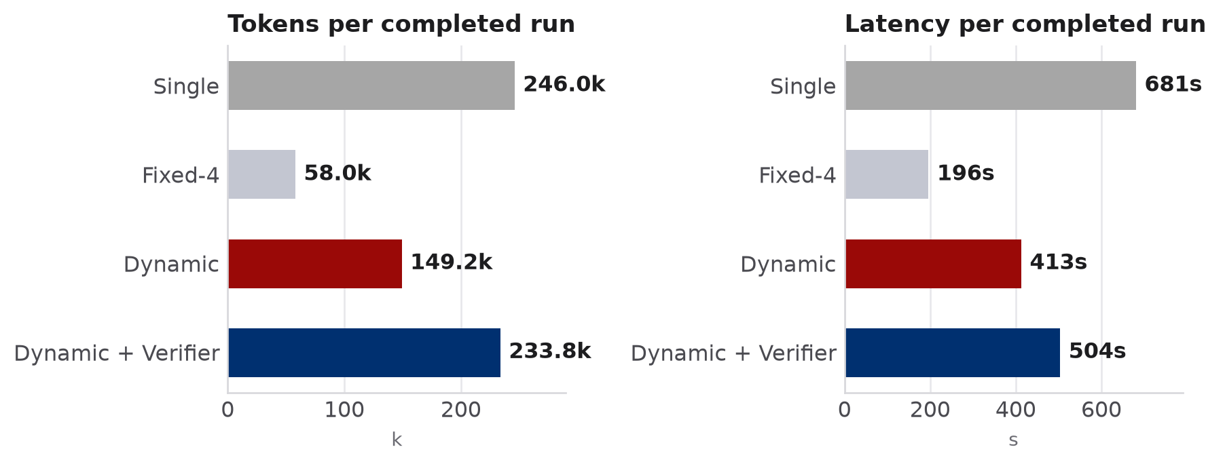
Coordination pays for itself
The verifier added cost without a measured gain; one model, one repeat
01 PROBLEM
RELATIVE TO DYNAMIC
vs Single
02 DESIGN
+1 quality
−39.4% latency
−39.3% tokens
03 SYSTEM
vs Dynamic + Verifier
+3 quality
−18.0% latency
−36.2% tokens
04 EVALUATION
Per completed run; lower is better.
Verifier loop
Fixed-4 is the cheapest design, but 11 quality successes behind Dynamic. The difference is targeted evidence, not more calls.
no measured gain
+56.7% tokens
05 DISCUSSION
Latency and tokens are averaged over completed runs only; the verifier is an ablation, not the primary architecture.
COMP5584
Final Project
IncidentLens · Evidence-driven multi-agent incident investigation
12
Notes:
Speaker 4 (42 s):
Cost changes the conclusion. Dynamic beats Single on quality by one while using about
39 percent less latency and 39 percent fewer tokens. Against the verifier variant it gains
three quality successes while using 18 percent less latency and 36 percent fewer tokens.
The verifier cost 57 percent more tokens and produced no measurable quality gain in this
batch. These are descriptive differences from one model and one repeat; we do not claim
statistical significance.

Slide 13
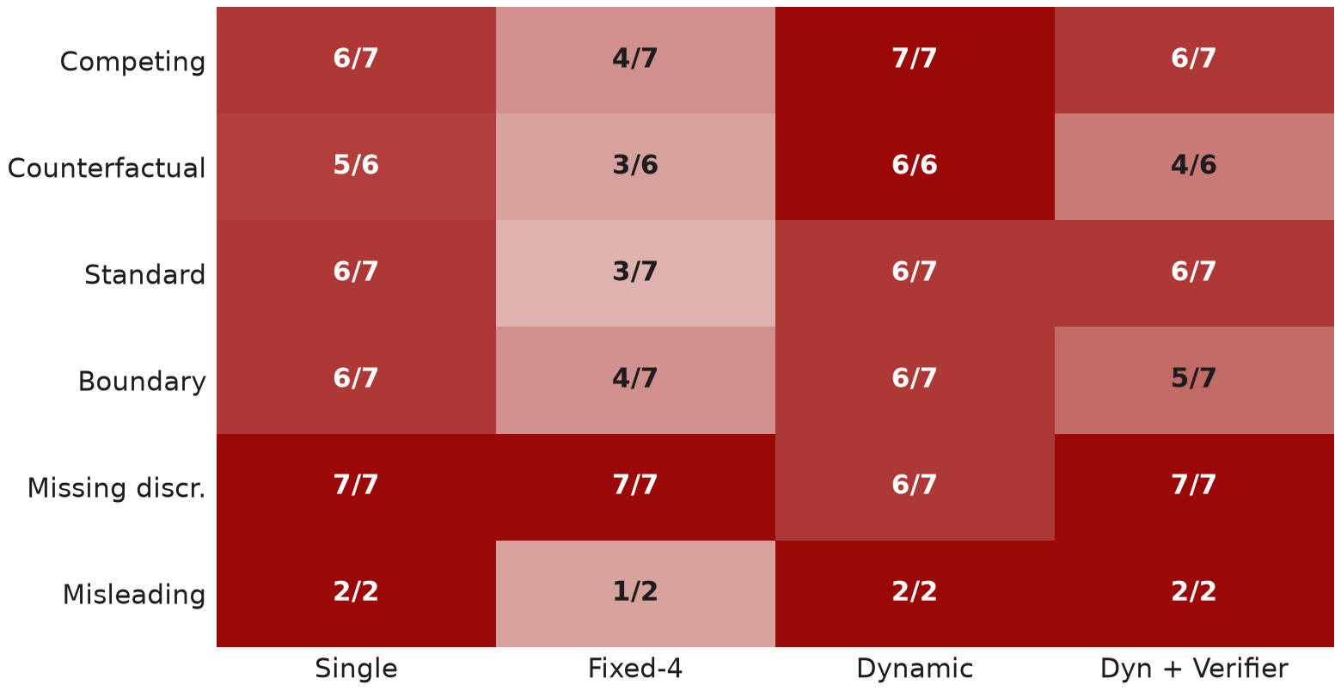
The failure mode is conservative
The dominant error is a missed conclusion, not an invented cause
01 PROBLEM
WHAT WENT WRONG
19
identifiable misses
02 DESIGN
all ended INCONCLUSIVE — none named a wrong cause
03 SYSTEM
8 / 144
technical failures
6 invalid structured outputs · 2 identity mismatches
04 EVALUATION
12 / 27
Fixed-4 over-abstentions
one fixed batch cannot recover a missed gap
05 DISCUSSION
Correct / eligible runs by lever and architecture.
Dynamic is strongest on the hard levers; its remaining errors are missed conclusions, not invented ones.
COMP5584
Final Project
IncidentLens · Evidence-driven multi-agent incident investigation
13
Notes:
Speaker 5 (38 s):
This slide is the honest failure analysis. The dominant error is over-abstention: 19
identifiable cases ended INCONCLUSIVE, including 12 under Fixed-4. There were eight
technical failures out of 144, six invalid structured outputs and two identity
mismatches, and we keep them in the denominator. Dynamic is strongest on competing
causes and counterfactual pairs. The risk profile is conservative: missed conclusions,
not fabricated causes.

Slide 14
What this evaluation does not establish
Boundaries are part of the result, not a disclaimer at the end
01 PROBLEM
No blind test
One model, one repeat
The corpus is development-visible; labels are evaluator-only and provisional.
No confidence intervals, significance tests or cross-model replication.
02 DESIGN
03 SYSTEM
Over-abstention
Replay-estimated guard
19 identifiable runs ended INCONCLUSIVE (Fixed-4 12, verifier variant 4, Single 3, Dynamic 0); none named a wrong cause.
The −44% / −22% / −12% token estimates are replayed, not live.
04 EVALUATION
Mock-only recovery
Synthetic corpus
Cache and recovery paths are validated on Mock traces, not production traffic.
Read-only packs; no production telemetry, users or remediation execution.
05 DISCUSSION
Not claimed: production-ready · state-of-the-art · hallucination eliminated.
COMP5584
Final Project
IncidentLens · Evidence-driven multi-agent incident investigation
14
Notes:
Speaker 5 (36 s):
We are explicit about the boundary: no blind test, provisional labels, one model, one
repeat, and no significance claim. The dominant error is over-abstention. The cost-guard
savings are replay estimates, not live savings, and cache and recovery were validated on
Mock traces. This is a research and teaching prototype: we do not claim production
readiness or state-of-the-art performance.

Slide 15
What we learned
Three design lessons, three concrete next steps
01 PROBLEM
01
Coordinate around evidence gaps
NEXT
A fixed expert batch wastes queries; two targeted tasks per round recovered cases Fixed-4 could not.
Blind holdout with independent human labels, then a significance-tested replication.
Live evaluation of the evidence-gap cost guard and conservative abstention thresholds.
A verifier triggered only on conflict, instead of an always-on feedback loop.
02 DESIGN
02
Make grounding deterministic
03 SYSTEM
Citations, identity and blockers belong in code — model confidence is not an acceptance signal.
04 EVALUATION
03
Measure abstention as a first-class outcome
The main failure mode was over-abstention, not fabrication; it belongs in the headline metrics.
IncidentLens turns agent investigation into an auditable evidence process — and reports what it cannot conclude.
05 DISCUSSION
Thank you.
Code, traces, evaluation scripts and the full limitations note are in the repository.
COMP5584
Final Project
IncidentLens · Evidence-driven multi-agent incident investigation
15
Notes:
Speaker 6 (40 s):
To close, three lessons: coordination should follow evidence gaps; grounding must be
deterministic, because model confidence is not an acceptance signal; and abstention has to
be measured as a first-class outcome. Next steps: a blind holdout with independent labels,
a live test of the cost guard, and a verifier that runs only on conflict. IncidentLens makes
investigation auditable, and it reports what it cannot conclude. Thank you; we welcome
questions.

Slide 16
Backup · Decision semantics
Every terminal path is typed and testable
01 PROBLEM
Decision / terminal | Required payload | Meaning
INVESTIGATE | 1–2 assignments; no selected hypothesis | A concrete gap can still be closed
FINALIZE | One selected hypothesis; stop reason | Evidence satisfies the cited-or-abstain gate
ABSTAIN | No selection; explicit stop reason | Visible evidence cannot identify a cause
INCONCLUSIVE | Report with observations, gaps, next checks | Normal abstention, not a runtime failure
BUDGET_EXHAUSTED | Failure stage + cost snapshot | Runtime failure; retained in denominator
02 DESIGN
03 SYSTEM
04 EVALUATION
05 DISCUSSION
Stable hypothesis IDs
No silent closure
Frozen termination
IDs never change across rounds, so reviews and citations stay attached.
A contradiction stays OPEN until new evidence resolves it.
Stop cancels in-flight work and freezes tools before reporting.
Stop reasons also include PLAN_READY, DIAGNOSIS_READY, PLAN_FAILED, NO_ALERT, UNRECOVERABLE_ERROR and STOP_TIMEOUT.
COMP5584
Final Project
IncidentLens · Evidence-driven multi-agent incident investigation
16
Notes:
Backup: use if asked how the coordinator can terminate.

Slide 17
Backup · Metrics and denominators
Each number on the results slides is defined here
01 PROBLEM
Metric | Numerator / denominator | Why
Technical completion | completed runs / attempted runs | Availability of the pipeline
Root correct | correct roots / identifiable completed runs | Accuracy only where a cause exists
Correct abstention | abstentions / unidentifiable completed runs | Calibration on missing evidence
Quality success | resolved-correct + correctly-abstained / 36 | One headline that retains failures
Tokens / latency | mean over completed runs | Cost of the runs that finished
02 DESIGN
03 SYSTEM
04 EVALUATION
WORKED EXAMPLE (DYNAMIC)
05 DISCUSSION
33 completed = 27 root-correct + 6 correct abstentions; + 3 technical failures → 33/36 quality. Root correct is 27/27; abstention is 6/6.
A run that fails to produce a schema-valid result is not silently dropped.
COMP5584
Final Project
IncidentLens · Evidence-driven multi-agent incident investigation
17
Notes:
Backup: use if asked why 33/36 rather than 33/33.

Slide 18
Backup · Paired outcomes and levers
Dynamic versus each control, case by case
01 PROBLEM
Comparison | Wins | Losses | Ties
Dynamic vs Single | 3 | 2 | 31
Dynamic vs Fixed-4 | 12 | 1 | 23
Dynamic vs Dyn+Ver | 5 | 2 | 29
Lever | Single | Fixed-4 | Dynamic | Dyn+Ver
Competing | 6/7 | 4/7 | 7/7 | 6/7
Counterfactual | 5/6 | 3/6 | 6/6 | 4/6
Standard | 6/7 | 3/7 | 6/7 | 6/7
Boundary | 6/7 | 4/7 | 6/7 | 5/7
Missing | 7/7 | 7/7 | 6/7 | 7/7
Misleading | 2/2 | 1/2 | 2/2 | 2/2
02 DESIGN
03 SYSTEM
A win means Dynamic succeeds where the control fails; a loss is the reverse. Ties dominate because most cases are solvable by every architecture.
04 EVALUATION
THE 12 WINS VS FIXED-4
WHY ONLY 3 WINS VS SINGLE
05 DISCUSSION
Mostly identifiable cases where one fixed batch never revisited a missed source.
Single is already strong; Dynamic's larger advantage is cost, not raw quality.
COMP5584
Final Project
IncidentLens · Evidence-driven multi-agent incident investigation
18
Notes:
Backup: paired outcomes and per-lever detail.

Slide 19
Backup · Failures and evidence
Eight technical failures, six of one class
01 PROBLEM
Failure | Count | Handling
Invalid structured output | 6 | Five invalid response envelopes; one truncated output that stayed invalid after its one repair
Identity-mismatched finding | 2 | Merge rejects the finding; run fails or continues without it
Wrong root cause | 0 | No accepted answer contradicted the evaluator label
Total | 8 / 144 | All retained in attempted denominators
02 DESIGN
03 SYSTEM
04 EVALUATION
The 8 technical failures were spread across all four variants, so they do not explain the quality ordering. The corpus labels are evaluator-only and provisional; the public development packs share encoder lineage and are not independent blind Test data.
The cost-guard figures on the limitations slide are replay estimates over frozen traces, not live savings; under the stock 4-round budget the 5-round guard cannot fire, so the recorded 27 guard stops come from the hardened 8-round batch and are counted as measured cost, not saving.
05 DISCUSSION
COMP5584
Final Project
IncidentLens · Evidence-driven multi-agent incident investigation
19
Notes:
Backup: use if asked about failures or label provenance.

Slide 20
Backup · Security and replay
What the system can read, and what replay can open
01 PROBLEM
RUNTIME
REPLAY AND PACKAGING
Role ACL
Replay root
02 DESIGN
Coordinator has no evidence tools; each specialist is limited to its source; verifier fetches only observed IDs.
Trace paths are confined to results/ and the filename must be trace.json.
Immutable context
Offline replay
03 SYSTEM
The agent context is frozen at issuance; a finding must match the identity that produced it.
The orchestrator, tools and provider are not called; only saved state is read.
04 EVALUATION
Public allowlist
Download guard
Only incident.json, logs.jsonl, metrics.csv, changes.jsonl, configs.jsonl and database.jsonl are readable.
Downloaded artifacts are resolved inside the run directory and reject reparse points.
05 DISCUSSION
Path safety
Secrets
Symlinks, traversal and private/oracle paths are rejected before any read.
The repository contains .env.example only; no API key or endpoint is committed.
COMP5584
Final Project
IncidentLens · Evidence-driven multi-agent incident investigation
20
Notes:
Backup: use if asked about prompt injection, privacy or replay safety.

Slide 21
Backup · Reproduce the demonstration
From a clean checkout to a saved trace
01 PROBLEM
Install
python -m venv .venv
.venv\Scripts\python.exe -m pip install -r requirements.lock
.venv\Scripts\python.exe -m pip install -e ".[dev]"
02 DESIGN
Validate
.venv\Scripts\python.exe -m incident_lens.cli validate-data
03 SYSTEM
Run
.venv\Scripts\python.exe -m incident_lens.cli run --case incident_001
--provider mock --cache-mode off --out results/quickstart
04 EVALUATION
Replay
.venv\Scripts\python.exe -m incident_lens.cli replay --trace results/quickstart/trace.json
05 DISCUSSION
Web
.venv\Scripts\python.exe -m incident_lens.cli web
COMP5584
Final Project
Mock is offline and deterministic. Real provider settings live in .env; the repository ships .env.example only.
IncidentLens · Evidence-driven multi-agent incident investigation
21
Notes:
Backup: use for a live reproduction request.

