Slide 1

CV Assist: A Real-Time Visual Assistance System for the Visually Impaired
Empowering Independence Through Open-Vocabulary Detection, Monocular Depth, Hand Tracking & LLM-Vision
Developed by [Your Name / Team]
OWL-VIT
MIDAS
MEDIAPIPE
DEEPSEEK LLM-VISION

Slide 2

Visually Impaired Users Lack Intuitive, Real-Time Spatial Guidance
THE CHALLENGE
Over 2.2 billion people live with vision impairment. Daily tasks like object localization and grasping remain major barriers to independence.
CURRENT GAP
Existing tools lack real-time spatial guidance. Current AI solutions often require specialized hardware or fixed categories, limiting their utility.
OBJECT: DETECTED
THE OPPORTUNITY
CV ASSIST OVERLAY
CV ASSIST VISION
Integrating open-vocabulary search with depth-aware spatial guidance and natural voice interaction into a single, accessible pipeline.
Bridging the gap between perception and action through intuitive guidance.
OUR GOAL
A "Virtual Eye" that guides the user's hand to any object using natural language and real-time audio feedback.

Slide 3

Four Decoupled Modules Work in Concert for Real-Time Guidance
SYSTEM PIPELINE
PERCEPTION
OWL-VIT + MIDAS
LOGIC
INPUT
GUIDANCE
OUTPUT
WEBCAM + VOICE
CONTROLLER
TTS + OVERLAY
TRACKING
MEDIAPIPE
Modular Pipeline
Multimodal Input
Real-Time Output
Decoupled perception modules (OWL-ViT, MiDaS, MediaPipe) run in parallel, allowing for independent upgrades and optimizations.
Fuses continuous RGB video streams with asynchronous voice commands to create a flexible, hands-free interaction model.
The controller synthesizes spatial data to deliver immediate, actionable audio instructions and visual feedback.

Slide 4

Search for Any Object by Name — No Retraining Required
TECHNOLOGY: OWL-VIT V2
Utilizes the Open-Vocabulary Vision Transformer, a CLIP-based detector that accepts free-text queries instead of relying on predefined classes.
DETECTION SIMULATION
ZERO-SHOT CAPABILITY
"RED COFFEE CUP"
Detects any object category described in natural language (e.g., "red coffee cup", "TV remote") without requiring model fine-tuning or retraining.
"TV REMOTE"
BOUNDING BOX OUTPUT
Provides precise 2D object location coordinates, serving as the foundational input for downstream spatial guidance and depth computation.
"MEDICINE BOTTLE"
ROBUSTNESS
Maintains reliable detection accuracy across diverse lighting conditions, varying angles, and highly cluttered real-world environments.
THE IMPACT
NATURAL LANGUAGE
QUERY
Eliminates the rigid category constraints of traditional detectors, making the system universally applicable to any user's specific needs.
Find the medicine bottle

Slide 5
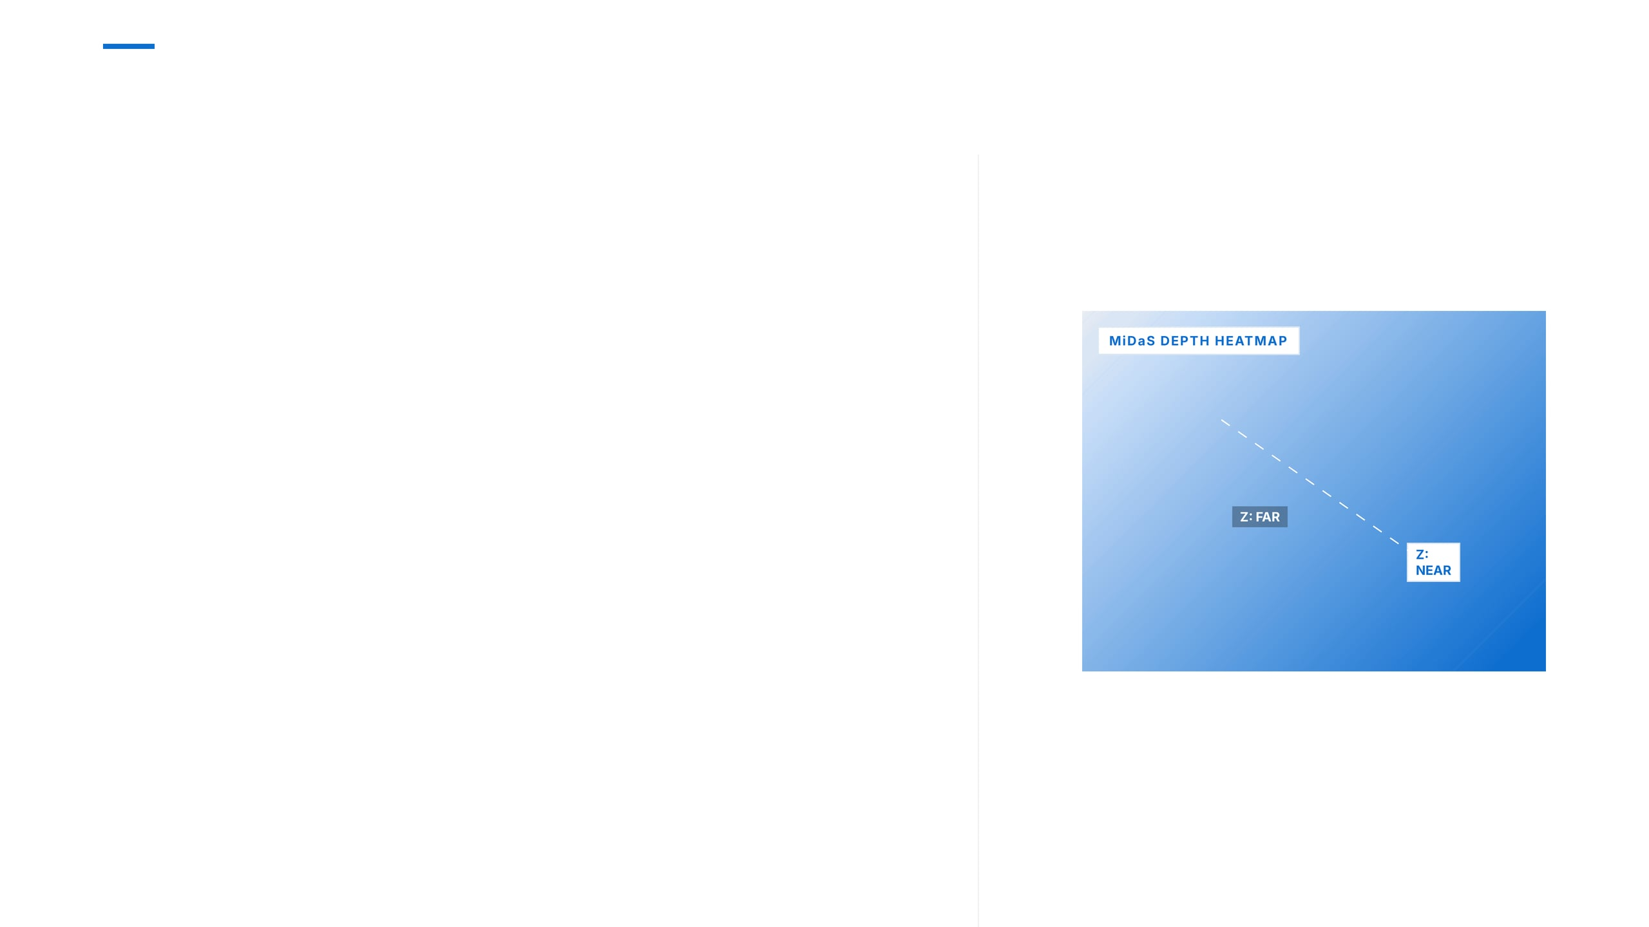
Accurate Distance Sensing from a Single Consumer Camera
TECHNOLOGY
MiDaS_small — a lightweight monocular depth estimation model optimized for real-time inference on standard hardware.
FUNCTION
MiDaS DEPTH HEATMAP
Generates a per-pixel relative depth map from a single RGB frame, estimating distance to both the target and the user's hand.
KEY ADVANTAGE
Eliminates the need for expensive stereo cameras or LiDAR — runs entirely on any standard consumer-grade webcam.
Z: FAR
Z: NEAR
INTEGRATION
Depth values are sampled at the object center and hand landmark to compute the Z-axis guidance component.
Computing Z-axis offset between hand and target using relative depth estimation.
PERFORMANCE
Optimized inference ensures zero lag in spatial perception, maintaining high frame rates for fluid interaction.

Slide 6

High-Fidelity 3D Hand Landmarks Enable Precise Spatial Alignment
TECHNOLOGY
Google MediaPipe Hands tracks 21 3D hand landmarks in real time, providing robust skeletal tracking from a standard RGB feed.
MEDIAPIPE HANDS
HAND POSITION
The centroid of key landmarks (wrist + finger bases) is calculated as the definitive "hand location" for spatial offset computation.
GESTURE STATES
OPEN HAND:
Reaching / Ready to grasp.
CLOSED FIST:
Object grabbed; task complete.
SPATIAL ALIGNMENT
The X-Y offset between the hand centroid and the object center drives the directional audio instructions.
STATE: OPEN
PRECISION
Sub-centimeter accuracy enables fine-grained, highly responsive guidance as the hand approaches the target.
Real-time tracking of 21 3D landmarks for precise hand-to-object alignment.

Slide 7

Dual-Threshold Logic Delivers Stable, Professional-Grade Audio Instructions
THE PROBLEM: INSTRUCTION JITTER
Naive threshold-based guidance causes rapid oscillation ("Left… Right… Left…") when the hand is near the alignment boundary, making the system confusing.
ENTER THRESHOLD (TIGHT)
THE SOLUTION: HYSTERESIS ALGORITHM
EXIT THRESHOLD (LOOSE)
Implements two distinct thresholds for state transitions: Enter Threshold (Outer): A new directional instruction is triggered only when the offset exceeds a larger boundary. Exit Threshold (Inner): The instruction is cancelled only when the offset drops below a smaller boundary.
DEAD ZONE (SILENCE)
ALIGNED
TRIGGER "MOVE RIGHT"
TRIGGER "MOVE LEFT"
THE RESULT: STABLE GUIDANCE
1D Spatial Offset Axis demonstrating dual-threshold state transitions for jitter-free interaction.
Creates a stable "dead zone" around alignment. Instructions are issued decisively and cancelled cleanly, ensuring calm and confident spatial audio feedback.

Slide 8

DeepSeek-v3 Uses Live Camera Frames to Fix Voice Recognition Errors
THE PROBLEM
ASR (Whisper) frequently mishears object names due to accents or noise (e.g., "cut" instead of "cup").
MICROPHONE INPUT
"Find the cup"
MULTIMODAL SOLUTION
Whisper transcribes the command; the last 4 camera frames are encoded. DeepSeek-v3 uses both to return the most likely object name based on visual context.
WHISPER ASR
CAMERA BUFFER
"Find the cut"
4 Recent Frames
ROBUSTNESS
Handles accents and phonetically similar object names by grounding audio in the visual scene.
MULTIMODAL LLM
DeepSeek-v3 Vision
ASYNCHRONOUS EXECUTION
LLM correction runs in a background thread, ensuring it does not block the real-time CV pipeline.
CORRECTED TARGET
"cup"
DOWNSTREAM TASK
OWL-ViT Detection

Slide 9

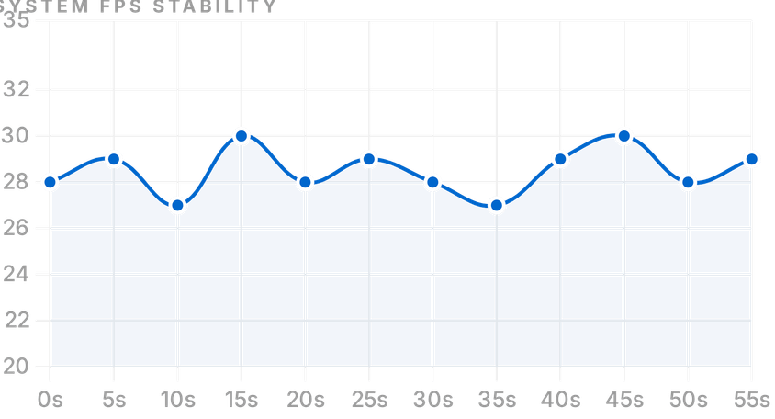
Real-Time Performance on Consumer Hardware — No Specialized Sensors Needed
FP16 INFERENCE
All models run in FP16, halving memory use and boosting throughput.
INTELLIGENT FRAME SKIPPING
Detection runs every N frames; depth and hand tracking run each frame to balance accuracy and speed.
SYSTEM FPS STABILITY
ASYNCHRONOUS AUDIO
TTS runs in a background thread so audio never blocks the video processing loop.
CONSUMER HARDWARE
Stable 25–30 FPS on mid-range GPUs (e.g., NVIDIA RTX 3060) without LiDAR or special sensors.
LOW LATENCY
End-to-end latency is under 200ms for intuitive, real-time feedback.
28.5
<200ms
AVERAGE FPS
END-TO-END LATENCY

Slide 10

CV Assist Demonstrates That Consumer AI Can Meaningfully Restore Independence
IMPACT
CV Assist provides visually impaired users with a practical, low-cost "virtual eye" for independent object grasping — a task previously requiring sighted assistance.
SYSTEM
TECHNICAL ACHIEVEMENT
VISION
Successfully integrates four state-of-the-art AI modules (OWL-ViT, MiDaS, MediaPipe, DeepSeek LLM-Vision) into a coherent, real-time pipeline.
“
KEY INNOVATIONS
Seeing the world, one object at a time.
Zero-shot open-vocabulary object search
Hysteresis-based jitter-free spatial guidance
LLM-Vision multimodal ASR error correction
FUTURE DIRECTIONS
Expand gesture vocabulary for richer interaction.
A FUTURE WHERE AI-POWERED COMPUTER VISION IS A STANDARD ACCESSIBILITY LAYER.
Deploy on edge devices (Raspberry Pi 5, NVIDIA Jetson).
Integrate haptic feedback (vibration wristband).

