Slide 1


CV Assist
A Real-Time Visual Assistance System
for the Visually Impaired
Key Technologies:
• Open-Vocabulary Detection (OWL-ViT v2)
• Monocular Depth Estimation (MiDaS)
• Hand Tracking (MediaPipe)
• LLM-Vision Error Correction
Developer: CV Assist Team

Slide 2

1
Project Motivation & Challenges
2
System Architecture Design
CONTENTS
3
Core Perception Technologies
4
Interaction & Stability Optimization
5
Conclusion & Future Work

Slide 3


01
PART ONE
Project Motivation & Challenges

Slide 4


1. Motivation: Breaking Barriers
Motivation
"Existing tools lack real-time, intuitive spatial guidance for daily object interaction."
Core Pain Point: Independent Grasping
Architecture
Technologies
Blurred Perspective (Current)
CV Assist Guided (Goal)
Conclusion
Design Goals & Vision
Real-Time
Versatility
Intuitiveness
Millisecond visual feedback & voice commands
Support for any object via open-vocabulary search
Natural language guidance for precise touch

Slide 5
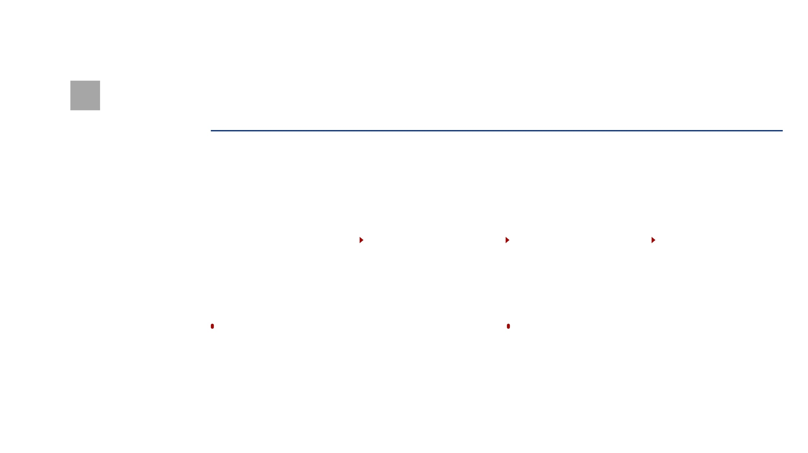

2. Architecture: Modular Pipeline Design
Architecture
Implementation
Input Layer
Perception Layer
Control Layer
Output Layer
Technologies
OWL-ViT (Detection) MiDaS (Depth) MediaPipe (Hand)
RGB Video Stream Voice Commands
Hysteresis Algorithm LLM Error Correction
Real-time Audio (TTS) Visual Assistance UI
Conclusion
Decoupled Design: Modular pipeline ensures independent optimization of each detector.
Multimodal Fusion: Combining visual depth and voice semantics for robust guidance.

Slide 6
02
PART TWO
Core Perception Technologies

Slide 7



Perception: OWL-ViT & MiDaS
OWL-ViT v2
MiDaS_small
Open-Vocabulary Detection
Monocular Depth Estimation
Zero-Shot Capability:
Spatial Awareness:
Identify any object without pre-training
Real-time depth map from a single lens
Support natural language search commands
Estimate relative distance to hand/target
Robust performance in complex backgrounds
Low-power design for mobile deployment

Slide 8

Motivation
04 Interaction: MediaPipe & LLM Error Correction
Architecture
MediaPipe Hand Tracking
LLM-Vision Interaction
Core Tech
High-Precision Tracking: Real-time 21 3D hand landmarks for spatial alignment.
Multimodal Fusion: Combines Whisper ASR text with recent 4 video frames.
Implementation
Gesture Recognition: Detects "Open" and "Closed" states for user intent.
Semantic Alignment: DeepSeek-v3.2 corrects ASR errors (e.g., "cup" vs "cap").
Conclusion
Centimeter Precision: Fine-grained navigation via real-time distance calculation.
Robustness: Maintains interaction accuracy in noisy environments via visual context.
"By fusing visual perception with linguistic intelligence, the system evolves from 'seeing objects' to 'understanding intent,' providing a natural and reliable user experience."

Slide 9
03
PART THREE
Conclusion & Future Work

Slide 10


Thanks for listening
CV Assist: Empowering the Future of the Visually Impaired
Developer: CV Assist Team

