Slide 1

CV Assist: A Real-Time Visual Assistance System for the Visually Impaired
Empowering Independence Through Open-Vocabulary Detection, Monocular Depth, Hand Tracking & LLM-Vision
Developed by Group 1

Slide 2

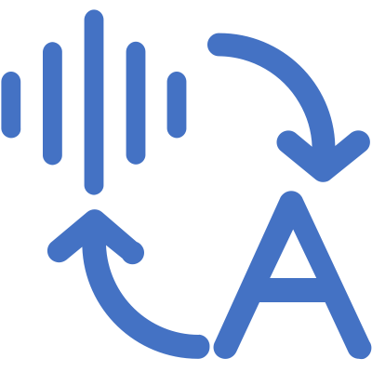

Complete Data Flow Architecture
OWL-ViT
Webcam
Detection
Input
Guidance
TTS
MiDaS
Output
Real-time Audio Guidance
Depth Est.
Controller
LOGIC PROCESSING LAYER
Microphone
Input
MediaPipe
Hand Track
Whisper ASR
DeepSeek LLM-Vision
Speech-to-Text Recognition
Multimodal Error Correction

Slide 3
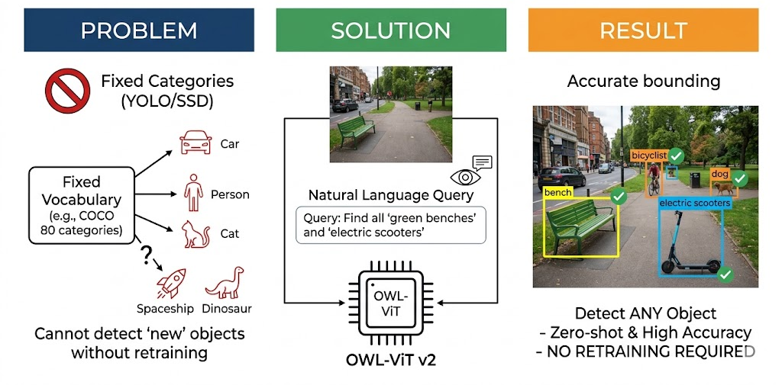
Search for Any Object by Name
Model: OWL-VIT V2
Key Capability
Utilizes the Open-Vocabulary Vision Transformer, a CLIP-based detector that accepts free-text queries instead of relying on predefined classes.
Open-vocabulary, zero-shot detection from natural language queries.

Slide 4
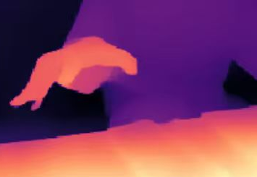
Accurate Distance Sensing from a Single Consumer Camera
CORE TECHNOLOGY
MiDaS_small — a lightweight monocular depth estimation model optimized for real-time inference on standard hardware.
FUNCTION
Dynamically generates per-pixel relative depth maps from a single RGB stream, enabling precise distance estimation between the user's hand and the target object without additional sensors.
KEY ADVANTAGE
Eliminates the need for expensive stereo cameras or LiDAR — runs entirely on any standard consumer-grade webcam.

Slide 5
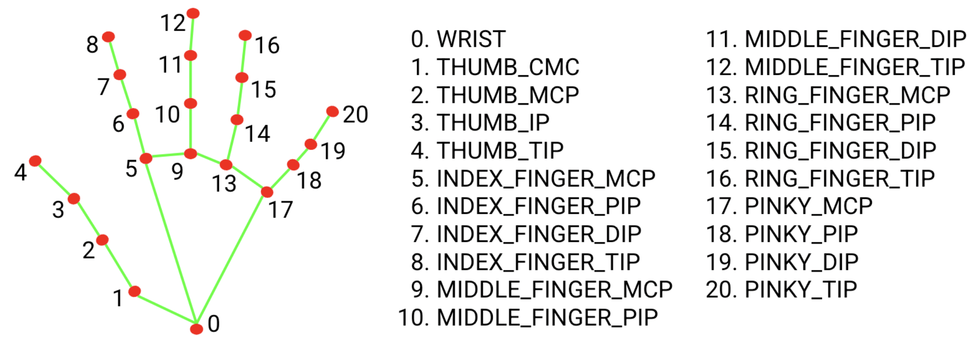
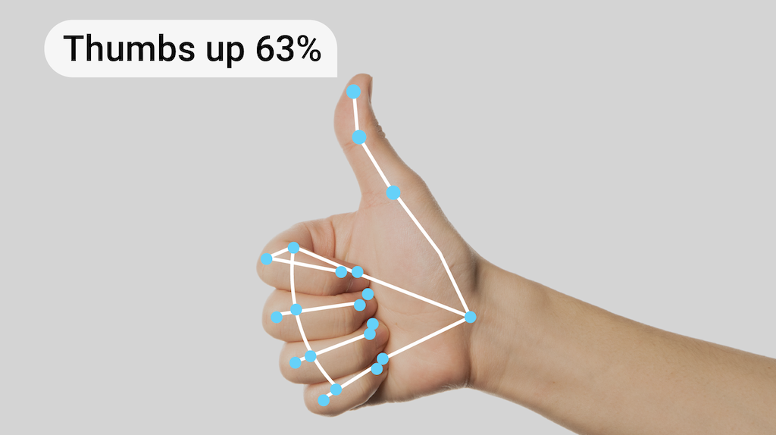
High-Fidelity 3D Hand Landmarks Enable Precise Spatial Alignment
TECHNOLOGY
Google MediaPipe Hands tracks 21 3D hand landmarks in real time, providing robust skeletal tracking from a standard RGB feed.
HAND POSITION
The centroid of key landmarks (wrist + finger bases) is calculated as the definitive "hand location" for spatial offset computation.
GESTURE STATES
OPEN HAND:
Reaching / Ready to grasp.
CLOSED FIST:
Object grabbed; task complete.
SPATIAL ALIGNMENT
The X-Y offset between the hand centroid and the object center drives the directional audio instructions.
PRECISION
Sub-centimeter accuracy enables fine-grained, highly responsive guidance as the hand approaches the target.

Slide 6
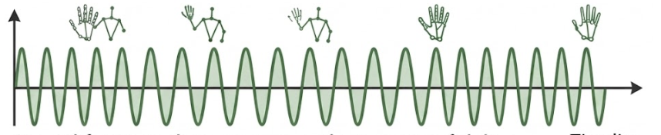
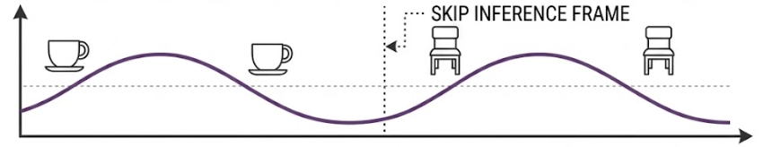
Spatial Guidance and Control Logic
Guidance Controller
DYNAMIC FRAME SKIPPING
The GuidanceController is the system's decision-making core, transforming raw detection data into actionable spatial instructions.
HIGH-FREQUENCY (30 HZ): HAND TRACKING (MediaPipe)
Input:
Object bbox, depth value, hand landmarks
Process:
Spatial relationship calculation
Output:
Natural language instructions
LOW-FREQUENCY (5 HZ): OBJECT DETECTION (OWL-ViT/MiDaS)
Hysteresis-Based Guidance
Prevents oscillation when hand is near alignment boundaries by implementing directional hysteresis thresholds.
Example: Horizontal Alignment
Enter "left" zone:
x < -50px
Intelligently skip LLM inference for object & depth when motion is low, maintaining high perceived smoothness on ordinary devices.
Exit "left" zone:
x > -30px
Enter "right" zone:
x > 50px
Exit "right" zone:
x < 30px
20px deadband prevents rapid instruction switching

Slide 7
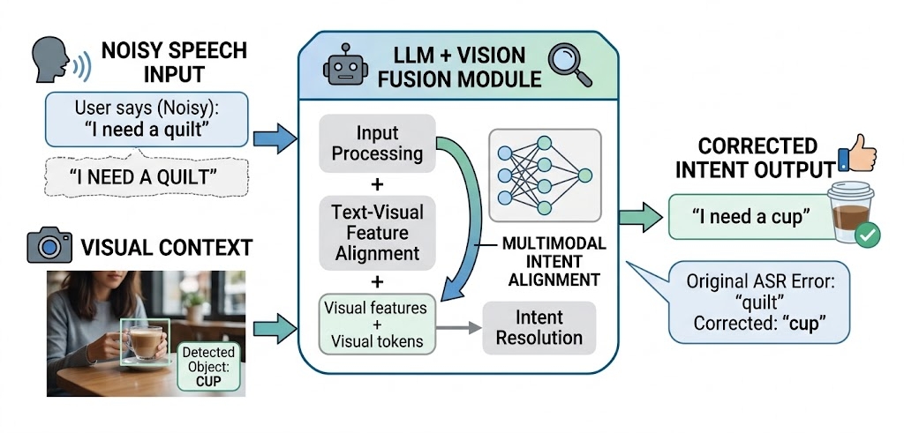
Voice Interaction: ASR and TTS
ASR: Automatic Speech Recognition
High Light：LLM-Assisted Keyword Extraction
Engine:
OpenAI Whisper (local execution)
Language:
Chinese (zh)
English (en)
Activation: Press 'v' key to start voice input
TTS: Text-to-Speech
Backend Options
Whisper transcribes the command; DeepSeek-v3 uses both to return the most likely object name based on visual context.
The system uses LLM-Vision multimodal fusion to correct ASR errors in real time, achieving precise user intent alignment.
pyttsx3
Offline
Basic quality, no setup required
MiMo (Xiaomi)
Cloud
High quality, requires API key

Slide 8

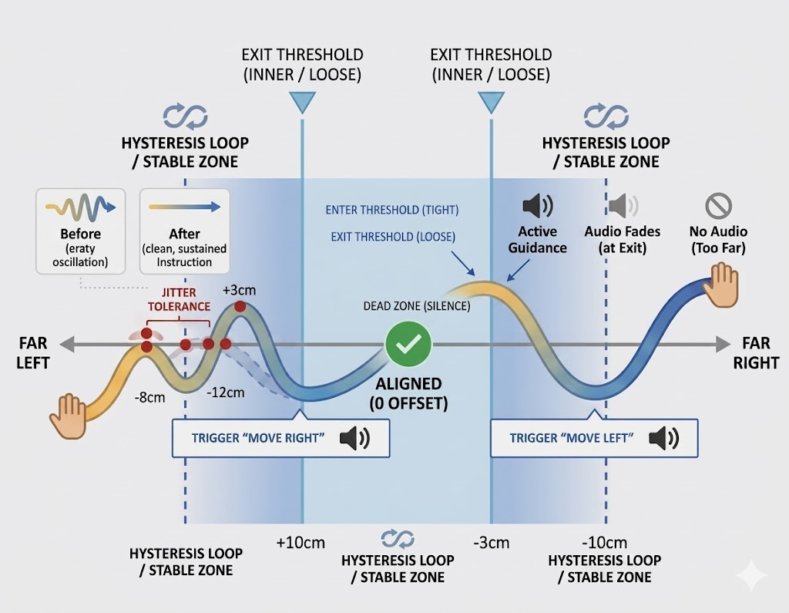
Dual-Threshold Logic Delivers Stable, Professional-Grade Audio Instructions
THE PROBLEM: INSTRUCTION JITTER
Naive threshold-based guidance causes rapid oscillation ("Left… Right… Left…") when the hand is near the alignment boundary, making the system confusing.
THE SOLUTION: HYSTERESIS ALGORITHM
Implements two distinct thresholds for state transitions: Enter Threshold (Outer): A new directional instruction is triggered only when the offset exceeds a larger boundary. Exit Threshold (Inner): The instruction is cancelled only when the offset drops below a smaller boundary.
THE RESULT: STABLE GUIDANCE
Creates a stable "dead zone" around alignment. Instructions are issued decisively and cancelled cleanly, ensuring calm and confident spatial audio feedback.
1D Spatial Offset Axis demonstrating dual-threshold state transitions for jitter-free interaction.

Slide 9
System Performance Metrics
Task-Level Metrics
Task Lifecycle Timing
Resource Monitoring
session_id
Session identifier (UUID)
s2act
Search-to-Activate
cpu
Process CPU utilization
task_id
Incremental task ID
task_duration
Wall-clock time
mem
Resident Set Size (RSS)
end_reason
Completion cause
sup1
Post-suppression processing
gpu
CUDA allocated memory
target_visible_frames
Stable detection count
tts1
First TTS offset
net↑
Network upload throughput
first_target_detected_ts
First detection timestamp
confirm_window
Pre-activation duration
net↓
Network download throughput
report_status
JSON report emitted
Frame Processing Pipeline
FPS & Latency Stats
Voice Metrics
det1
Object detection (OWL-ViT)
fps_avg
Average processing FPS
poe
hand1
Hand detection/tracking
e2e_avg
Average end-to-end FPS
Poe vision parsing
d1
p50
Processing time median
asr_latency
Speech recognition time
Depth estimation (MiDaS)
record_time
Audio recording duration
g1
Guidance calculation
p95
95th percentile
first_tts_latency
proc1
Total algorithm processing
jitter
Standard deviation
First TTS response
e2e1
det_run
Detection execution rate
cam_fail
Camera read failure count
End-to-end frame loop
depth_run
Depth estimation rate

Slide 10
Empowering Independence Through
Intelligent Assistance
Future work will expand gesture vocabulary and optimize deployment for edge devices. By integrating haptic feedback, we aim to evolve the system into a multi-sensory ecosystem for more intuitive human-spatial interaction.
Computer Vision
AI Integration
Human-Centered
Open-vocabulary detection with zero-shot capability
LLM-enhanced voice recognition with visual context
Designed for real users with real accessibility needs

