Slide 1





When you want to meet a friend halfway but can’t decide on where to go….

Slide 2
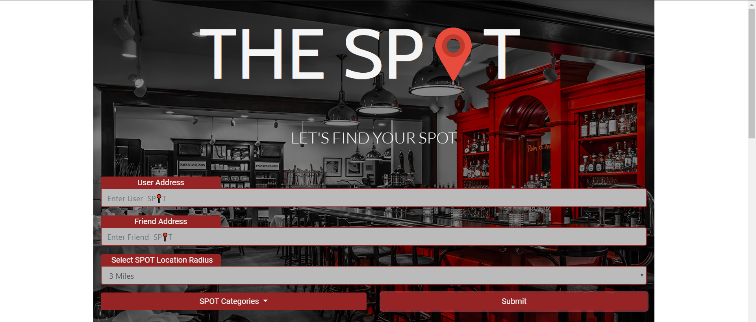
The Spot takes two addresses:
One for yourself, and one for your friend
The app will find the center point between the two of you, which you can give the search radius of, as well as choose the type of venue you want in terms of Restaurant, Cafes and Bars.

Slide 3
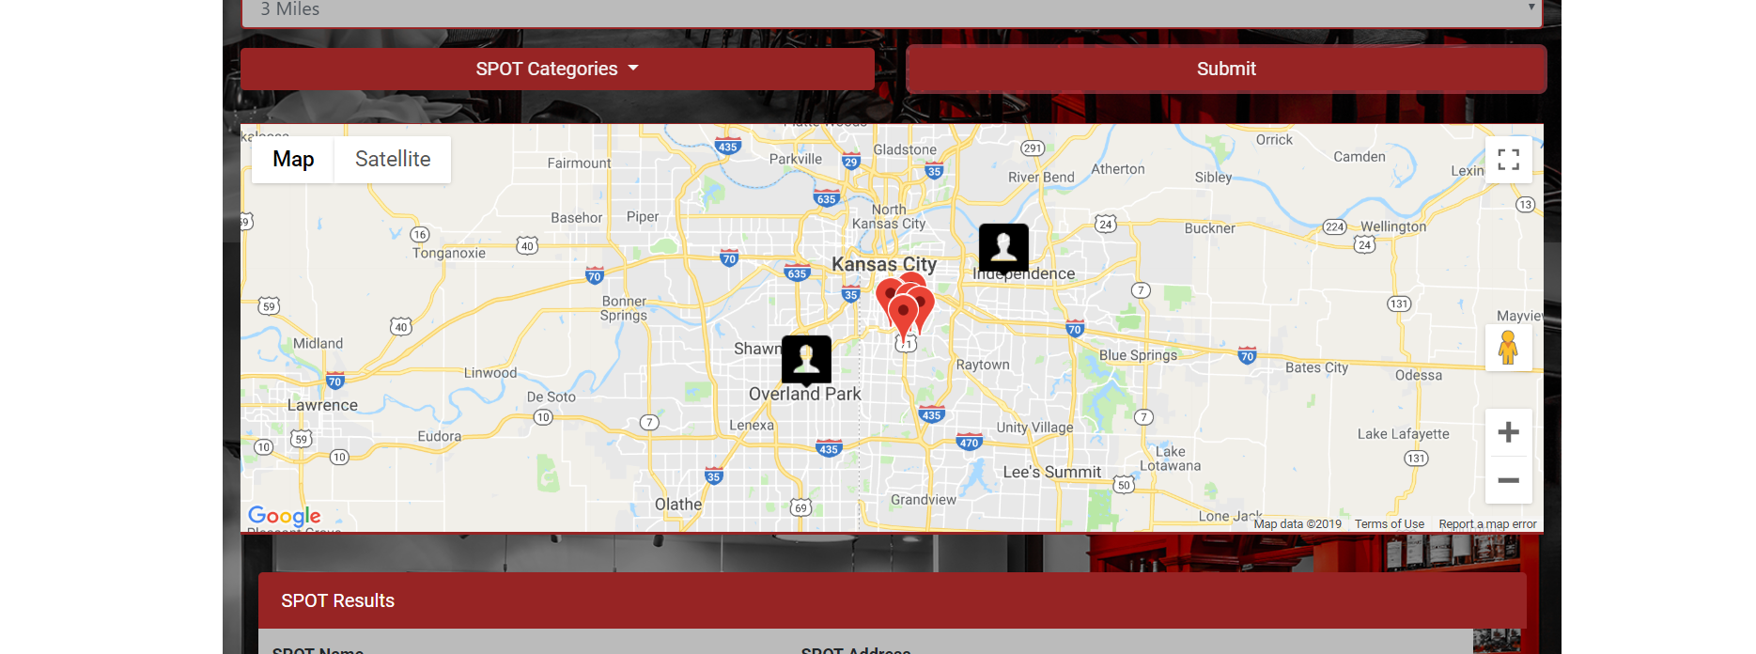
After clicking submit , your map, which is below the form, will populate your position as well as your friends.
On top of this, between the two user locators, will be markers showing potential places you can choose from based on the choices that you selected in the form.

Slide 4
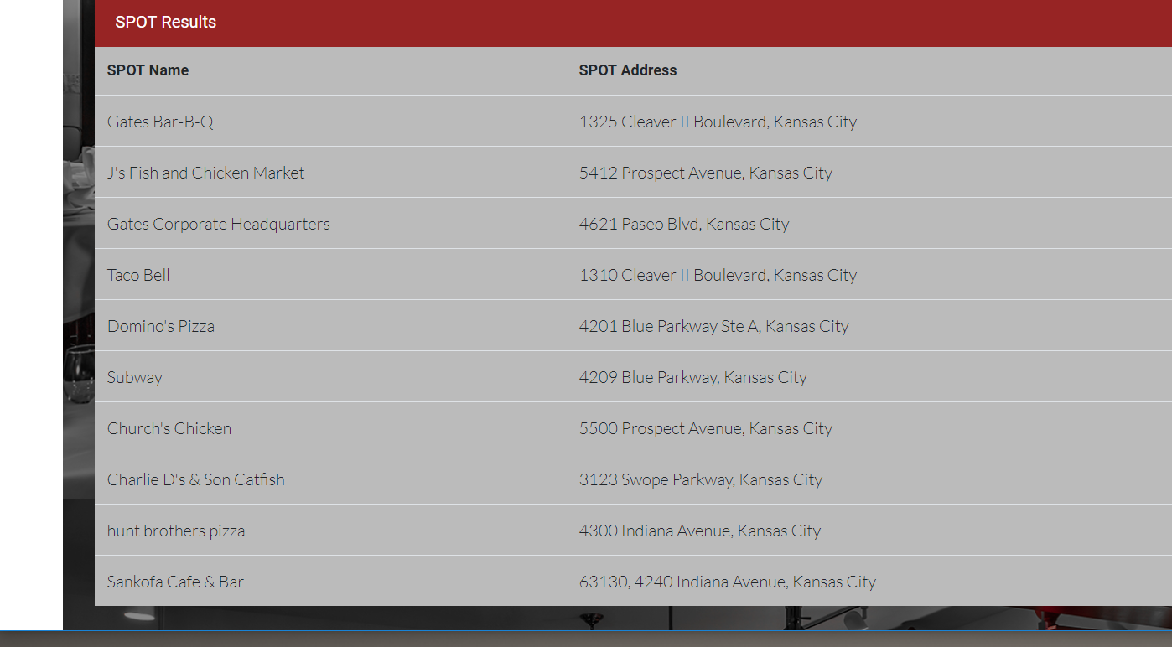
Below the map a table will populate with a list of all the places within the search radius that you provided earlier.
Along with the name of the places, you can see the address as well

Slide 5
