Slide 1
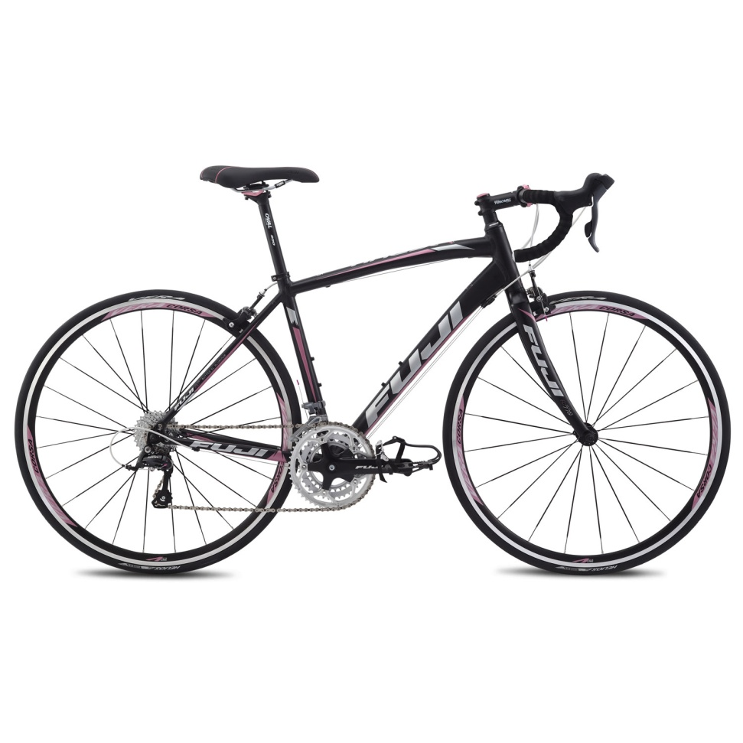
Bike Odometer
Carolyn Mason
ASEN 5519
December 10, 2015

Slide 2
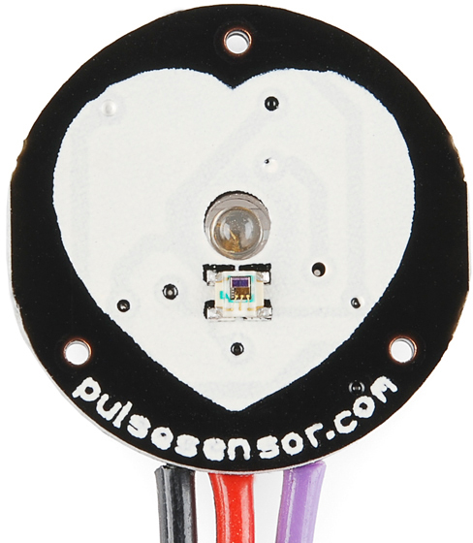
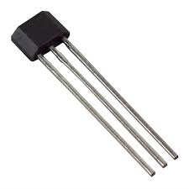
Project Overview
Sensors:
Sparkfun Pulse Sensor (Sen 11574)
Sparkfun Hall Latching Effect Sensor (US1881)
Display ride statistics to user:
Current Speed
Average Speed
Max Speed
Distance
Ride Time
Pulse

Slide 3

Hardware Schematic
Hall Effect Sensor
+5V
LCD
Output Signal
GND
10k Ω
Port A Pin 10, AN11
Port C
PIC18F87K22
Port B Pin 7, RB7
LED 1
J10 Pin1, GND
+5V
Port A Pin 11, AN10
Port B Pin 6, RB6
Pulse Sensor
Port B Pin 5, RB5
GND
LED 2
Output Signal
LED 3
+5V, Portable USB
Battery Pack

Slide 4
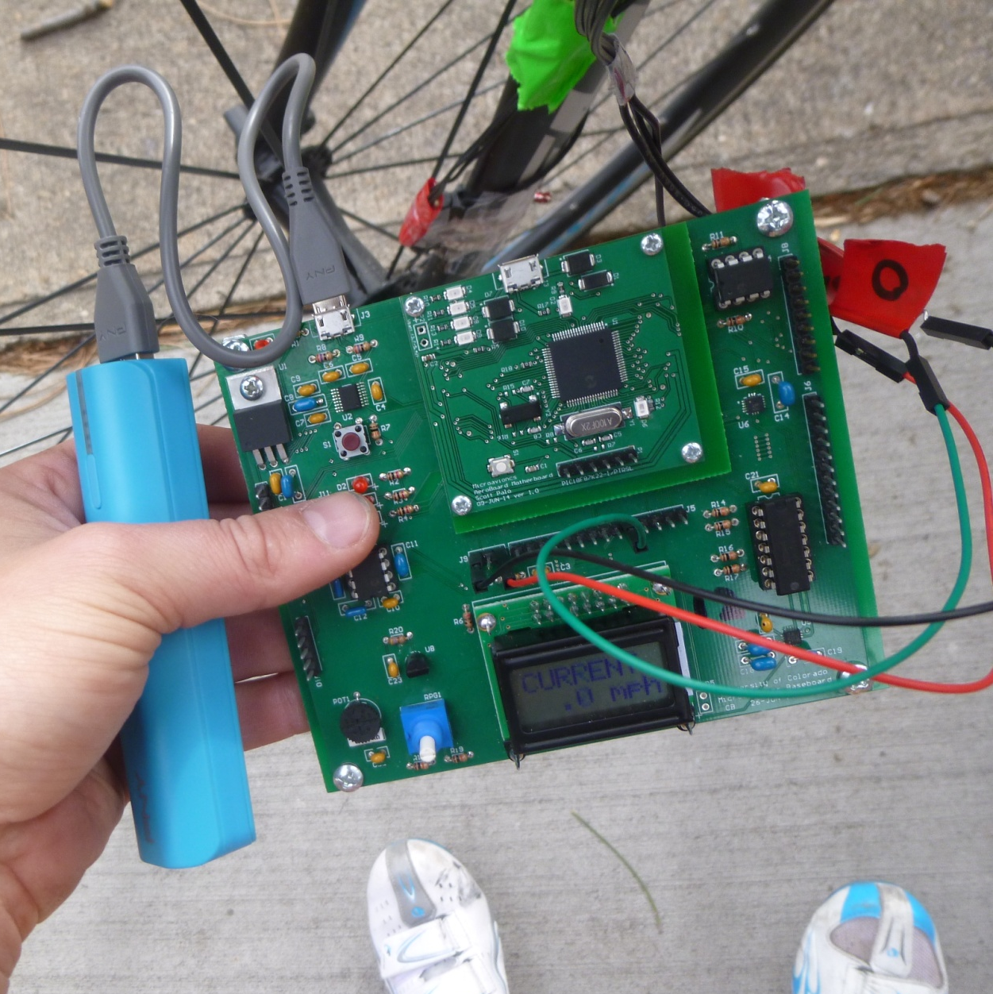
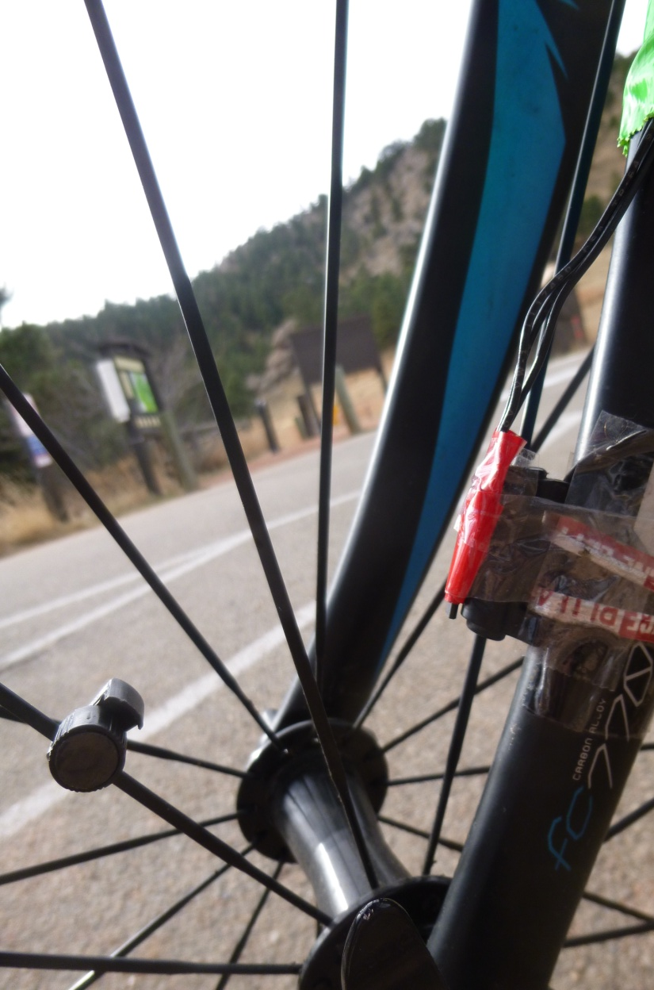
Physical Hardware

Slide 5
Software: Overview
Interrupts
Pulse Sensor
Main
Hall Effect Sensor
Initialize
Initialize Ports
Set up ADC
Timer0/ interrupts
Initialize LCD
Loop
Cnt1
Cnt2
Cnt3
Cnt4
Cnt5
Cnt6
Current Speed
Average Speed
Max Speed
Distance
Ride Time
Pulse

Slide 6
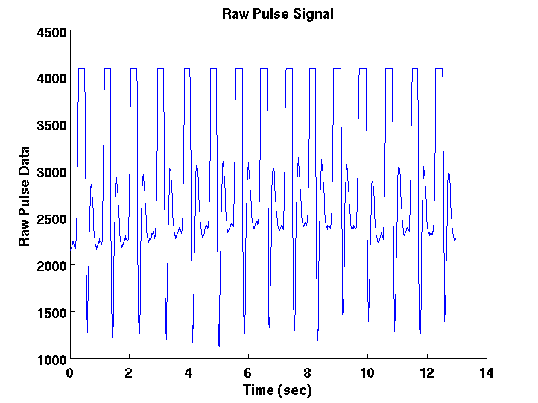
Software: Pulse Sensor
Start
Increment counter
Store ADRES [previous, new]
Counter > 2^16
New > 4000
Reset counter
Previous < 4000
Save to string
Calculate BPM from counter
End

Slide 7
Software: Hall Effect Sensor
Start
Increment counter
Current speed >0
Store ADRES [precious, new]
Counter > 2^16
New > 3000
Calculate
-Average speed
-Max speed
-Ride time
-Ride distance
Reset counter
Previous < 3000
Save to string
Calculate current speed from counter
End

Slide 8
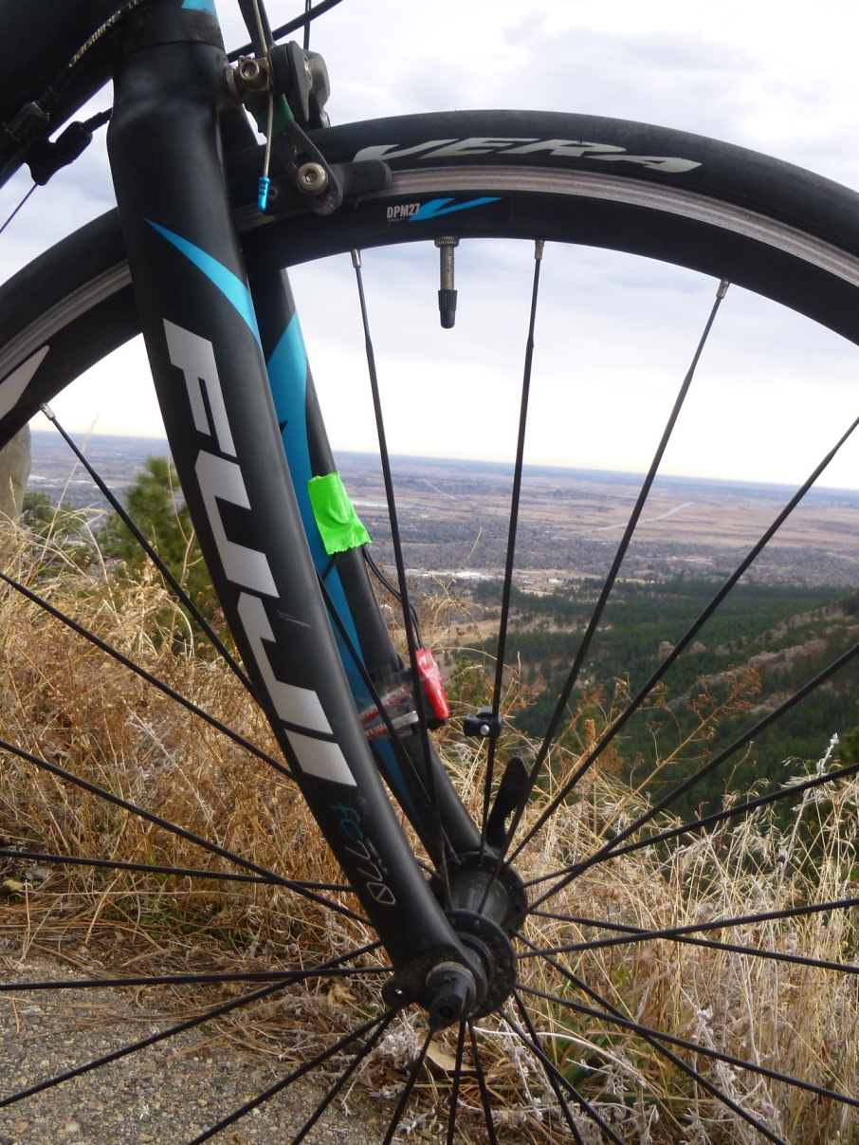
Obstacles
Physical connections
Solution: Watch connections closely when riding and use more tape
Portability
Solution: Bought a potable charger (5V, 1amp)
Timing resolution
Solution: Use an oscilloscope to view and measure peaks. Use USART to plot data for easier viewing.

