Slide 1
Unified Model Nesting Suite tutorial
Chris Dearden, CEMAC
bit.ly/2CDeUMns

Slide 2
Rough schedule
Opening presentation: Overview and Nesting Suite tour (~30 mins)
Quick exercise (~30 mins)
Break (~15 mins)
How to run from ECMWF operational data (~15 mins)
On-line tutorial (~1hr)
Wrap-up / Q&A (~15 mins)

Slide 3
UM Nesting Suite Introduction
____________________________

Slide 4
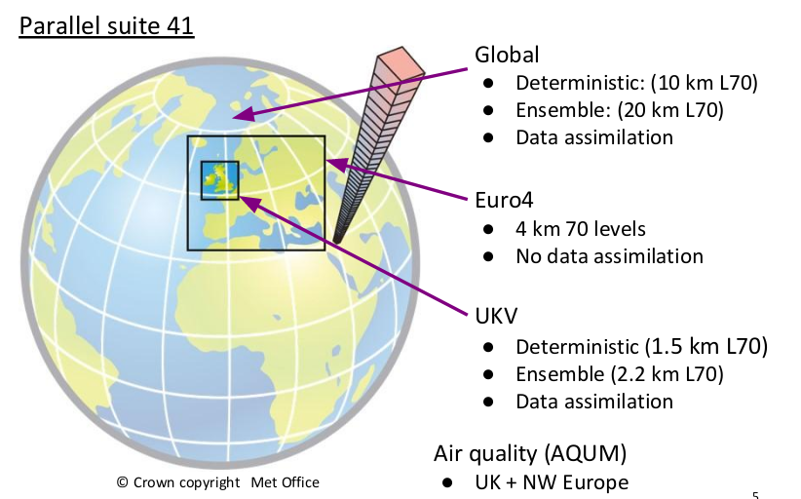
Operational NWP at the Met Office

Slide 5
What is the Nesting Suite?
A specific type of Rose suite that allows users to automatically run the UM as a Limited Area Model (LAM) for any region of your choice
Born out of a need to be able to set up different domain configurations as easily as possible, to support forecasting of high-impact weather events (e.g. Hurricanes, tropical cyclones)
Lots of ongoing development (Stu Webster, Met Office)

Slide 6
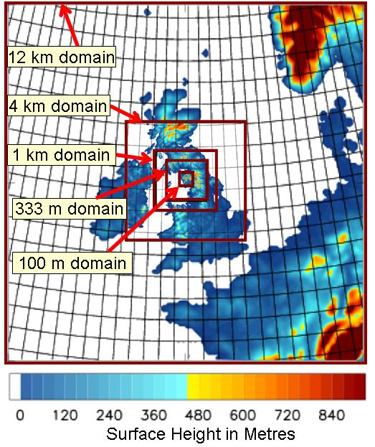
Nesting Suite Example #1
Using multiple nests to downscale to sub-km resolution over the UK

Slide 7
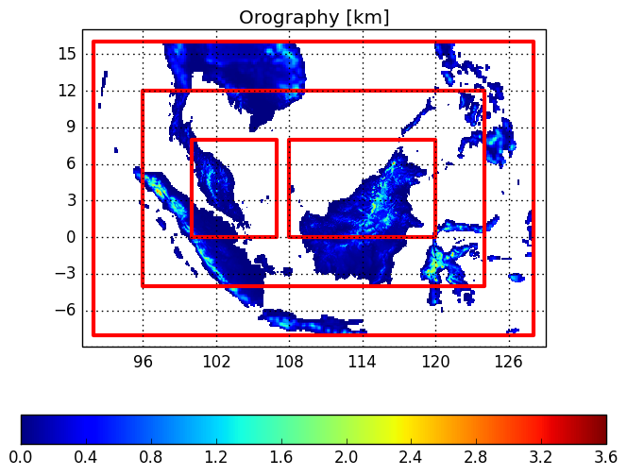
Example #2: Newton funded Malaysia Project
12 km
T+36h forecasts initialised every 6 hours between 17/12/14 and 6/1/15
4.4 km
1.5 km
1.5 km
Off-centering option added to this suite to enable pair of 1.5 km models within the 4.4km domain

Slide 8
Links to Nesting Suite info
Lot of info under the ‘rmed’ project pages on MOSRS: https://code.metoffice.gov.uk
Direct link:
https://code.metoffice.gov.uk/trac/rmed/wiki/suites/nesting

Slide 9
What data do I need to drive the
nesting suite?
Need initial conditions, just as any model does
But you also need lateral boundary conditions (LBCs)
Thankfully, the nesting suite automates the process of generating LBCs for your chosen domain(s)
UM LAMs can be driven by global UM data, and also ECMWF operational IFS data (more on this later)
http://cms.ncas.ac.uk/wiki/UM/GettingInitialData

Slide 10
Global UM or ECMWF:
Which driving model to choose?
Preference is to use ECMWF driving data where possible
Why? Because UM global start dumps are LARGE!
~25GB each prior to August 2017 (N768, ~17km)
~75GB after! (N1280, ~10km)
ECMWF grib data can be sub-set for the region of interest as part of the retrieval process; dramatically reduces file sizes
Also, global UM suffers from a wet bias in the upper atmosphere that can affect the quality of LAM simulations (Stu Webster, pers. comm.)

Slide 11
Science Configurations
How do I know what science settings are optimal for my chosen LAM?
Thankfully, the Met Office and its partner institutions have tested LAMs for different regions of the globe, so a set of recommended physics options already exist…

Slide 12
Introduction to RA1 configurations RA1-T and RA1-M
(Slide courtesy of Stuart Webster, Met Office)
RA1 builds in latest science
RA1-M versus RA1-T:
Smith (diagnostic) v PC2 (prognostic) cloud scheme
Other differences are in the boundary layer implementation, affecting convection
RA1
RA1-T
(Tropical)
RA1-M
(Mid-latitude)
Improved fog and boundary layer temperatures
Moisture Conservation
(operational in OS39 UKV)
Improvements to cloud droplet taper
Reduced bare soil fraction
+ additional physics upgrades
Improved shower initiation
Revision to free-atmosphere mixing length
Time-correlated stochastic PBL perturbations
Improved convective precipitation
PC2 cloud scheme
Revised unstable stability functions
www.metoffice.gov.uk © Crown Copyright 2017, Met Office

Slide 13
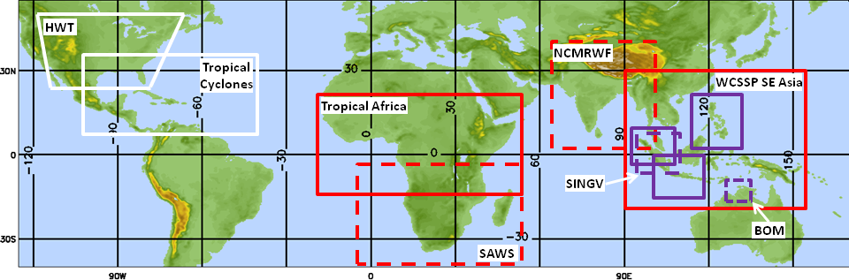
Testing RA1-T Looking at domains across the tropics
(Slide courtesy of Stuart Webster, Met Office)
Temporary domains
4km Met Office running in real time
1.5km Met Office running in real time
4km UM Partner
1.5km UM Partner
www.metoffice.gov.uk © Crown Copyright 2017, Met Office
Notes:
HWT = Hazardous Weather Testbed

Slide 14
A note on sub-km domains (1)
In general, the RA1 configurations are ‘scale-aware’ and do not need to be adjusted for different model resolutions
The exception is when you go to sub-km grid spacings; some changes are then recommended (mainly to the RHcrit values)…
https://code.metoffice.gov.uk/trac/rmed/wiki/subkm

Slide 15
A note on sub-km domains (2)
It is advisable to generate the orography ancillaries using a dataset that best matches the resolution of your chosen domain
The standard orography dataset is the GLOBE dataset (dx=1km)
For sub-km domains, it is recommended to use the SRTM orography dataset instead (dx=100m)
NB - ancillary generation using the SRTM orography is only available on MONSooN currently, not ARCHER

Slide 16
UM Nesting Suite Tour
___________________________

Slide 17
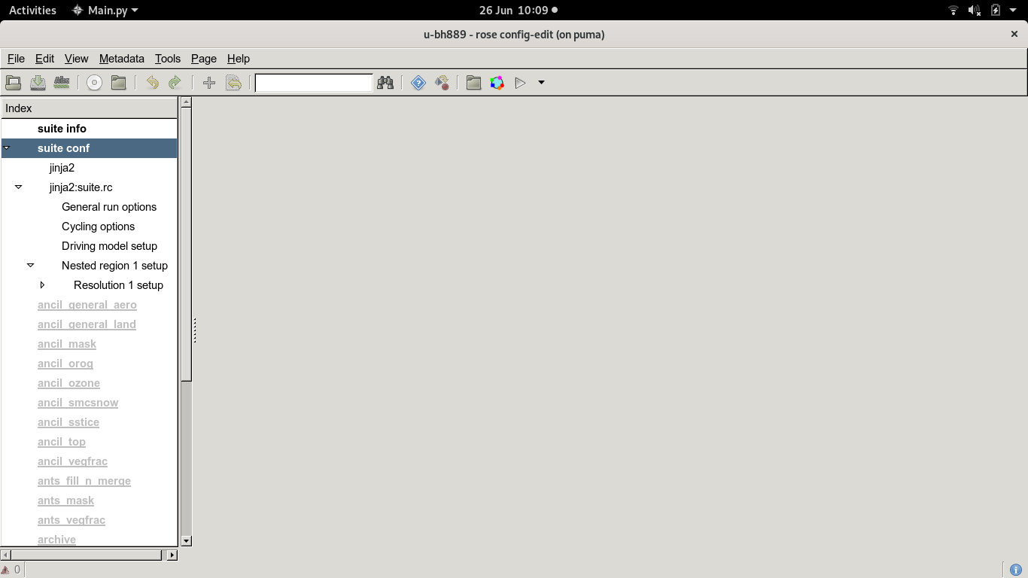
Example of a Rose nesting suite at UM vn11.1
All settings relating to the nesting suite configuration are contained in these panels
These panels are greyed-out because in most cases you shouldn’t need to alter their settings (the exception being the UM STASH panel for adding in diagnostics)

Slide 18
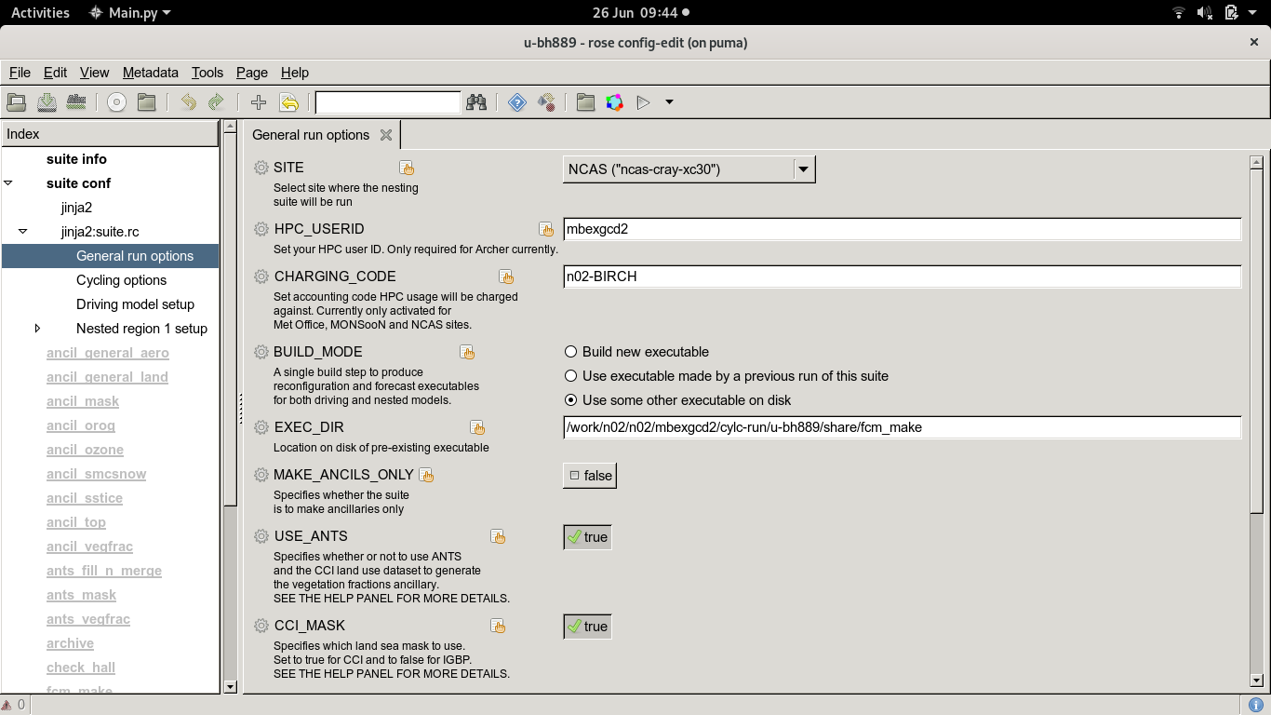
General Run Options Panel

Slide 19
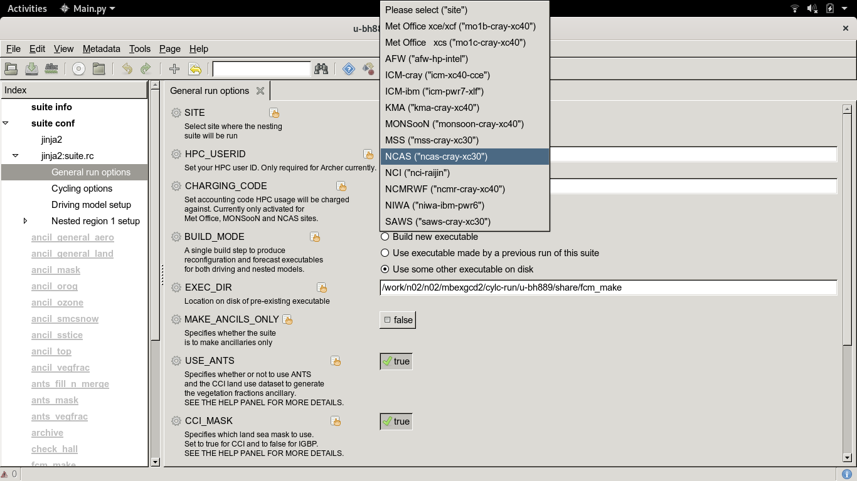
General Run Options Panel

Slide 20
General Run Options Panel

Slide 21
General Run Options Panel
metadata has been written for most options
You will find help by clicking the cog wheel

Slide 22
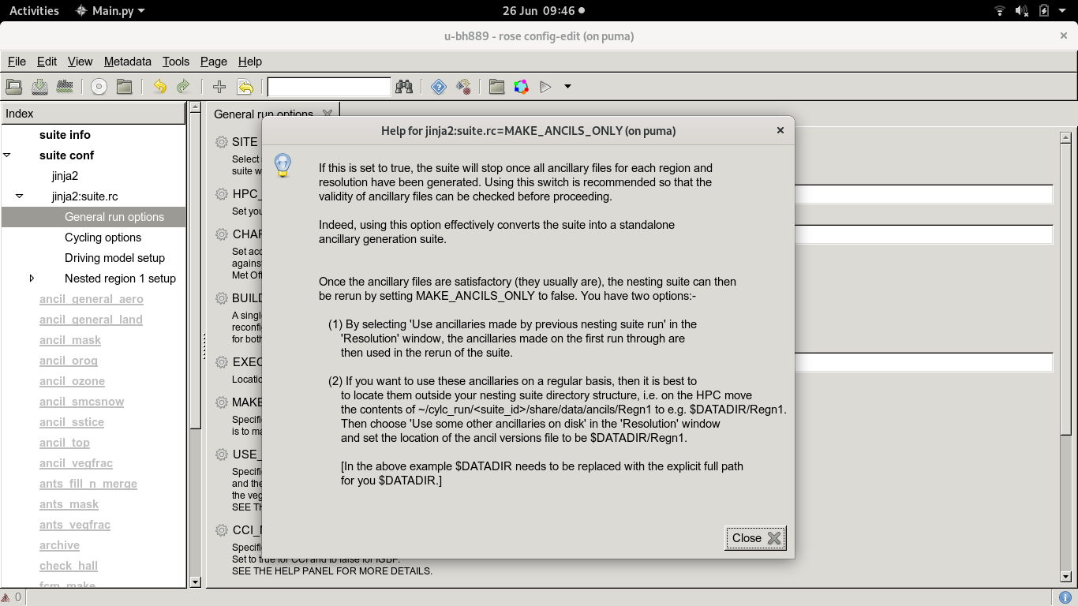
General Run Options Panel

Slide 23
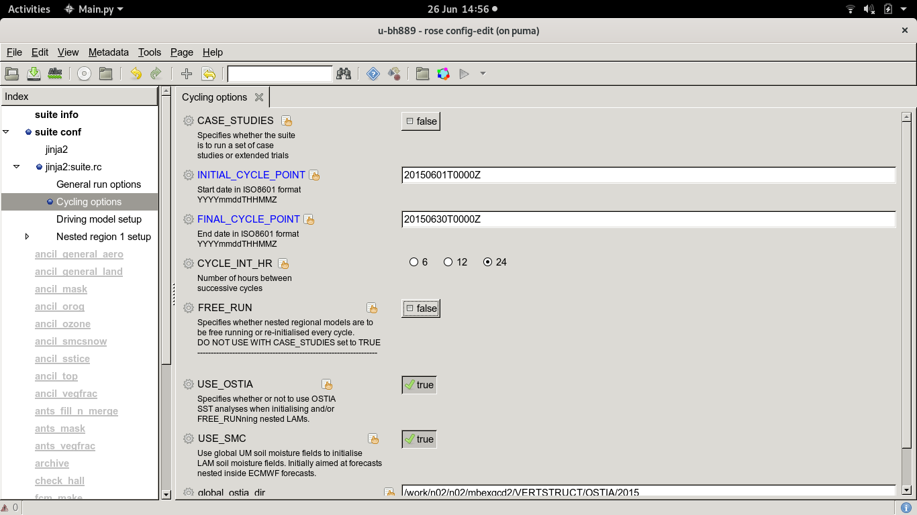
Cycling Options Panel
Loop over analysis time for the dates specified, every CYCLE_INT_HR
FREE_RUN = FALSE means that LAMs are re-initialised after each cycle (in this case, a new LAM forecast is produced every 24 hours)

Slide 24
T+0h
LBCs from driving model every n hours
T+24h
CYCLE
START POINT
20150601T0000Z
20150602T0000Z
20150603T0000Z
20150604T0000Z
…….
20150630T0000Z
Timeline of LAM forecast
This would trigger a set of 30 independent forecast cycles, each initialised 24 hours apart
NB – the forecast run length does not have to be the same as the cycling interval
Notes:
Each cycle point would need its own start dump for initialisation. Also the forecast run length is set independently of the cycling interval, so forecasts are not limited to T+24hrs, they could run for T+36h or T+54 h for example

Slide 25
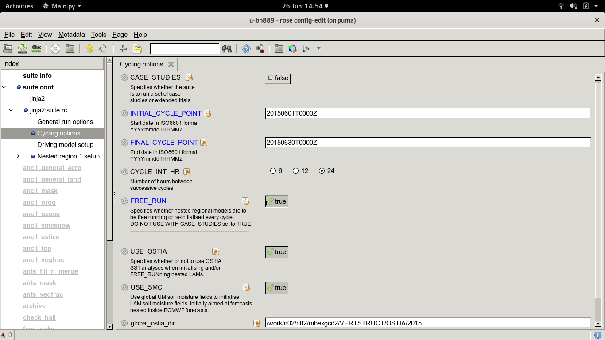
Cycling Options Panel
Cycling Options
If Free_Run = TRUE, there is no reinitialisation of the LAMs after each cycle. This allows LAMs to be run for extended periods with LBCs being provided by the reinitialised driving model (to keep LBCs close to reality)

Slide 26
Schematic for FREE_RUN = TRUE
T+0h
LBCs from driving model
T+30days
20150601T0000Z
20150630T0000Z
Timeline of LAM forecast
This results in a single LAM run that simulates the entire 30 day period continuously, constrained by LBCs from the driving model that still gets re-initialised every 24 hours

Slide 27
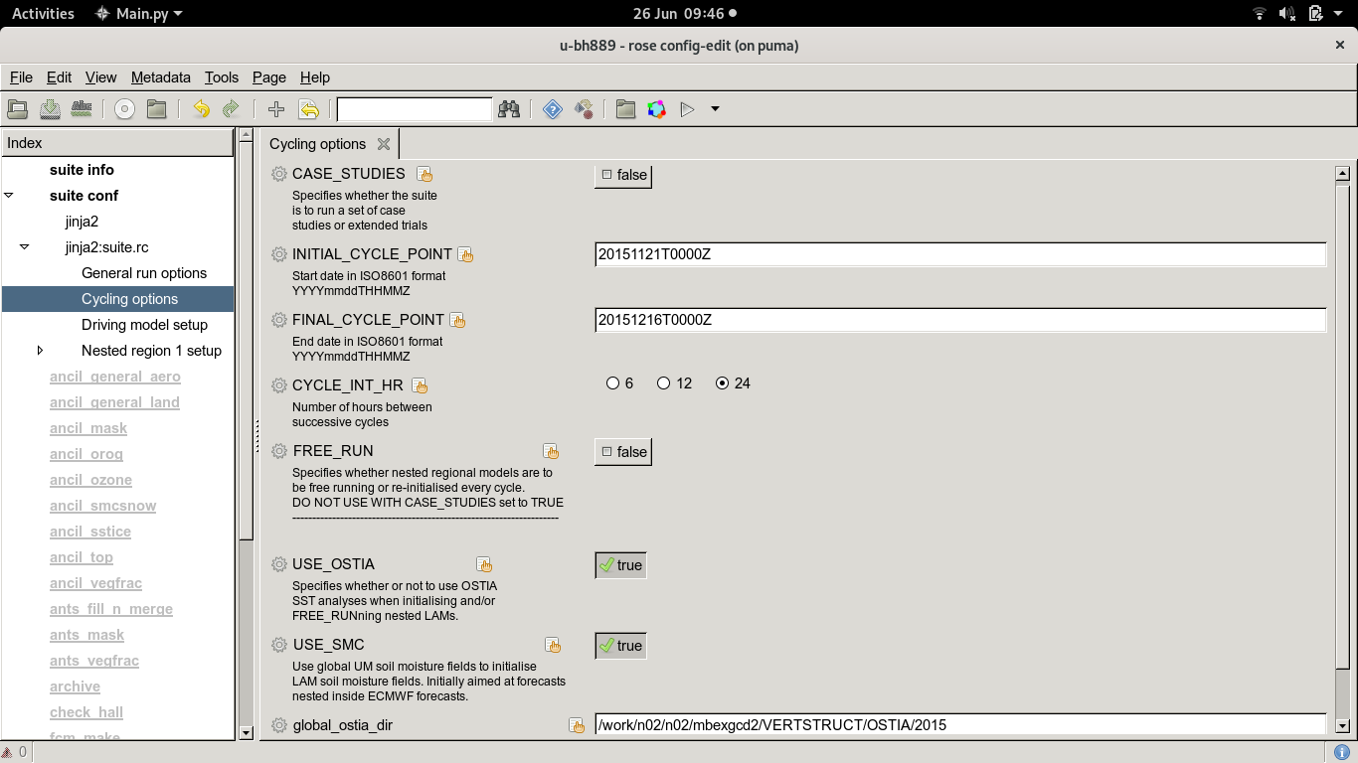
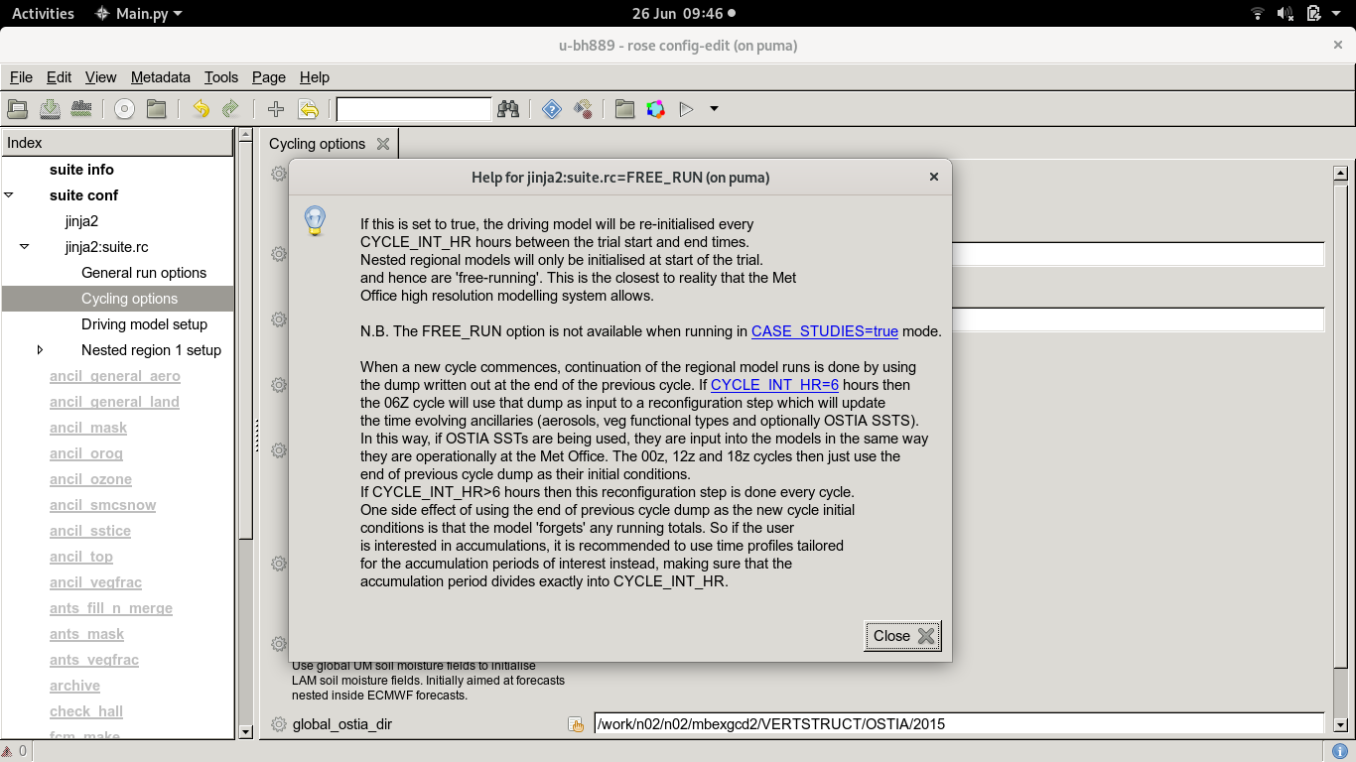
Help Panel for FREE_RUN option

Slide 28
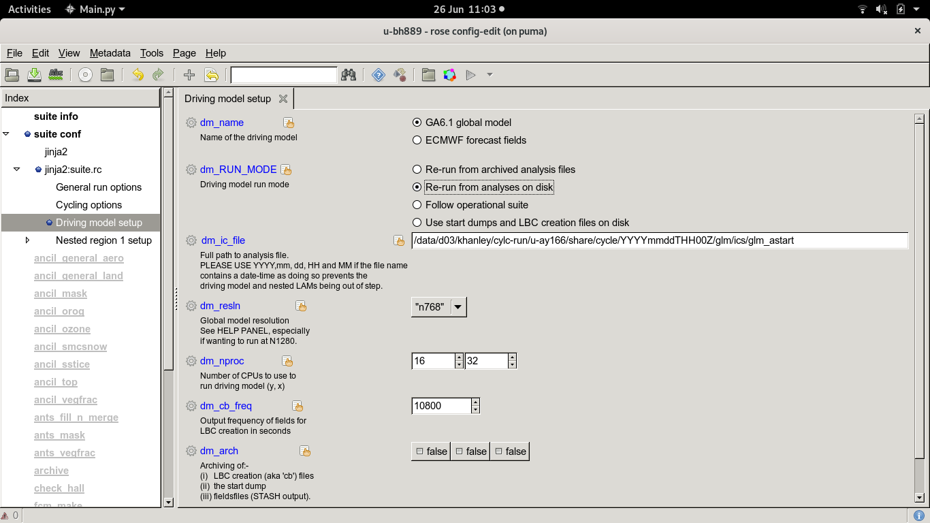
Driving Model Panel

Slide 29
Driving Model Panel
Non-Met Office sites will use this option. Requires you to retrieve global analysis files from MASS first
Specify the full path to the
UM global analyses on disk

Slide 30
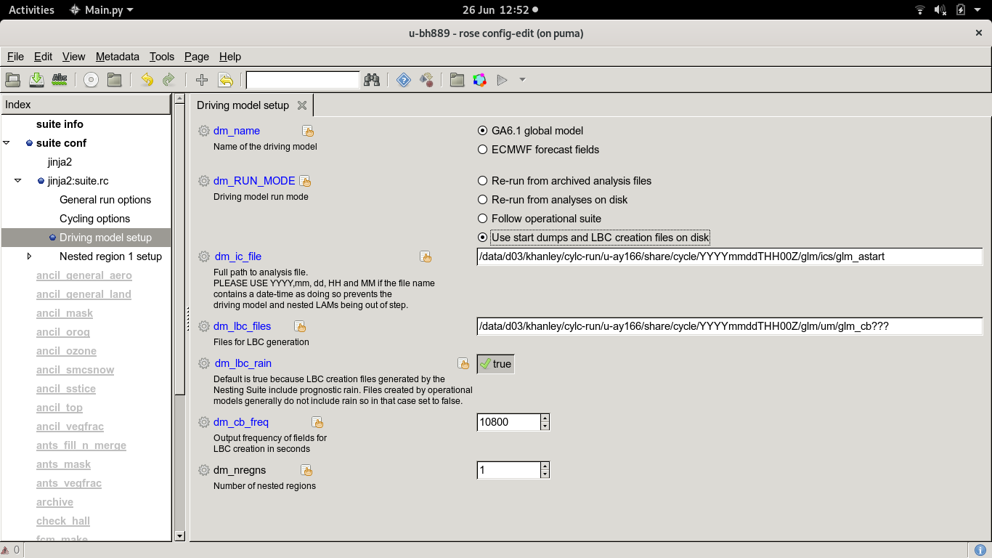
Driving Model Panel
Use this option to use output from a previous driving model run
In which case, you need to specify the path to the LBC creation files as well
Notes:
The glm_cb* files contain global prognostic fields (e.g. U, V, W winds; theta; humidity) at an interval of ‘dm_cb_freq’. These files are subsequently used to create the boundary conditions for your chosen domain. When running from ECMWF data, the glm_cb files are replaced by the ECMWF T+3h forecast fields, which are used to create the LBCs instead

Slide 31
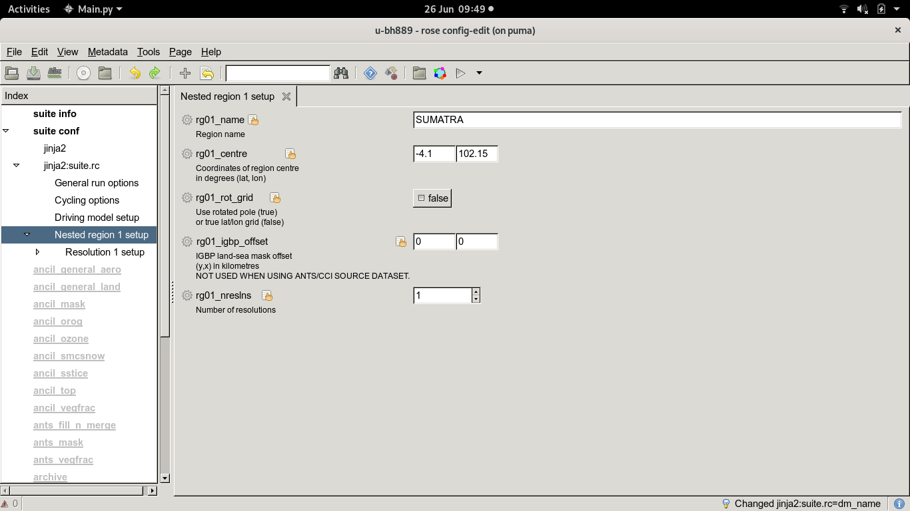
Nested Region 1 Panel
Use this option to use output from a previous driving model run
Choose a name to describe your nested region
Choose point to centre domain on
Choose whether to use true lat/lon grid or rotated pole grid.
In which case, you need to specify the path to the LBC creation files as well

Slide 32
Nested Region 1 Panel
Use this option to use output from a previous driving model run
Defines the number of nested model resolutions for this region
In which case, you need to specify the path to the LBC creation files as well

Slide 33
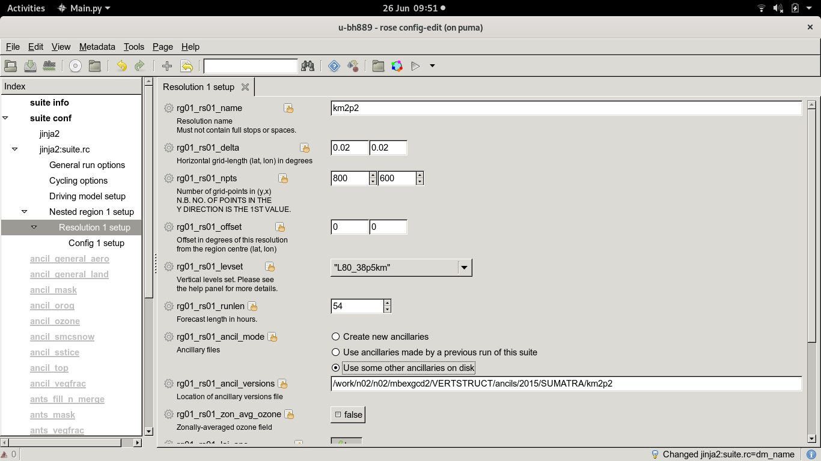
Resolution 1 Panel
Use this option to use output from a previous driving model run
Give your nested domain a name
Specify the grid-spacing and number of gridpoints
In which case, you need to specify the path to the LBC creation files as well

Slide 34
Resolution 1 Panel
Use this option to use output from a previous driving model run
Choose where to place the nest relative to the region centre specified in the previous panel (0,0) means no offset
In which case, you need to specify the path to the LBC creation files as well

Slide 35
Resolution 1 Panel
Use this option to use output from a previous driving model run
Choose vertical levels set (dependent on horizontal resolution; further details in the Help panel)
In which case, you need to specify the path to the LBC creation files as well

Slide 36
Resolution 1 Panel
Use this option to use output from a previous driving model run
Choose your forecast run length for the current domain (T+54 hours in this example)
In which case, you need to specify the path to the LBC creation files as well

Slide 37
Resolution 1 Panel
Use this option to use output from a previous driving model run
Choose whether to create new ancillaries for your chosen domain, or run from existing ancillaries already generated from a previous run
In which case, you need to specify the path to the LBC creation files as well

Slide 38
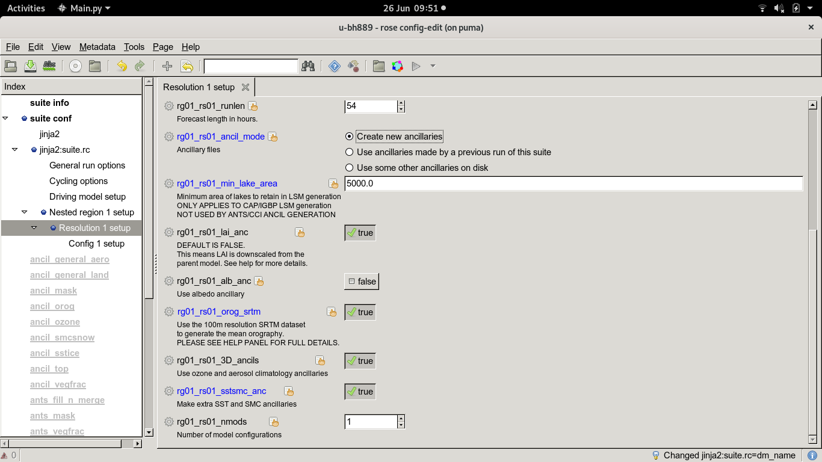
Resolution 1 Panel
Use this option to use output from a previous driving model run
If you choose to create new ancillaries, you will be given the option to use the high-res SRTM orography dataset (needs an IDL licence though, doesn’t work on ARCHER!)
In which case, you need to specify the path to the LBC creation files as well

Slide 39
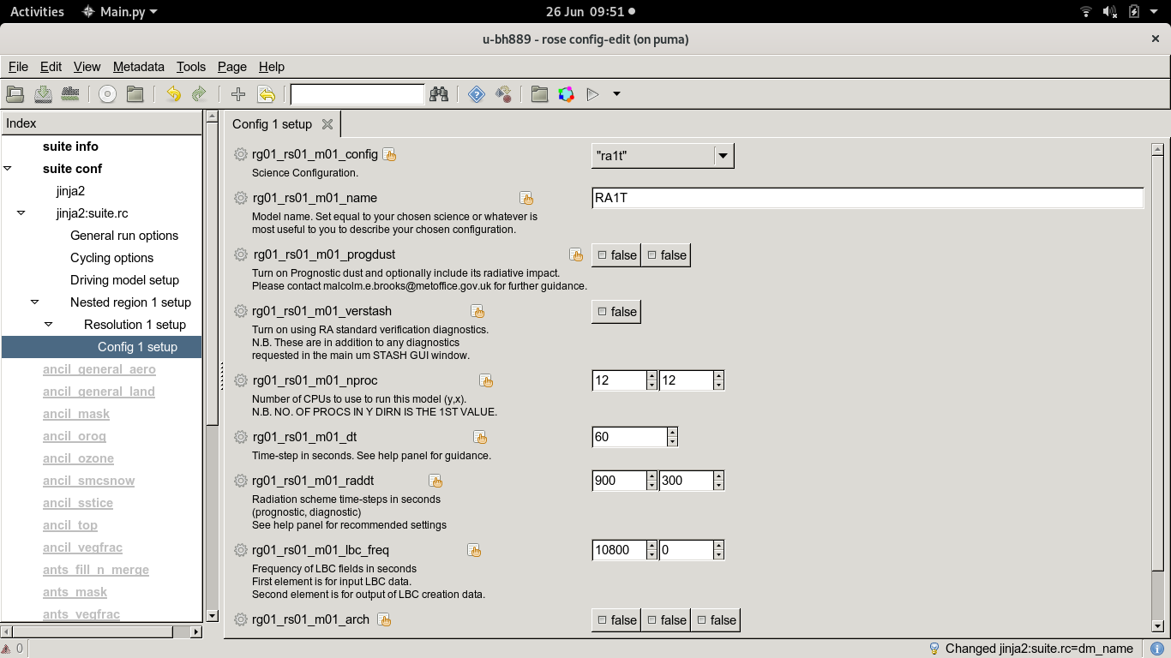
Config 1 Panel
Use this option to use output from a previous driving model run
Science configuration for your domain is specified here
If you choose to create new ancillaries, you will be given the option to use the high-res SRTM orography dataset (needs an IDL licence though, so doesn’t work on ARCHER!)
In which case, you need to specify the path to the LBC creation files as well

Slide 40
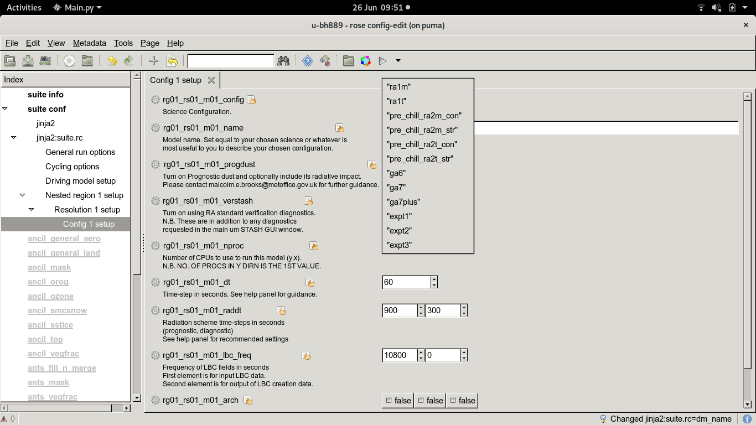
Config 1 Panel
Use this option to use output from a previous driving model run
If you choose to create new ancillaries, you will be given the option to use the high-res SRTM orography dataset (needs an IDL licence though, so doesn’t work on ARCHER!)
Choose from a list of predefined options (RA1-M and RA1-T included), or define your own using the ‘expt’ options
In which case, you need to specify the path to the LBC creation files as well

Slide 41
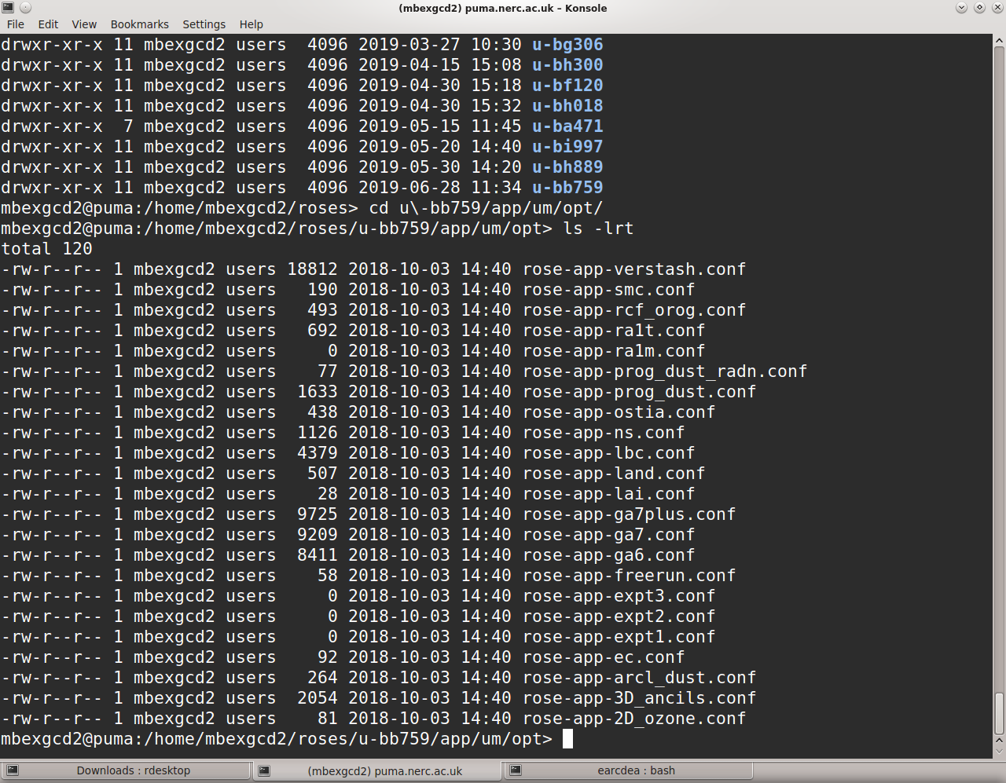
Defining your own science configuration
This is done using optional configuration files which can add or overwrite the default configuration (RA1-M)
They can be found at:
<suite-id>/app/um/opt
Placeholder files
rose-app-expt[1-3].conf already exist

Slide 42
Config 1 Panel
Use this option to use output from a previous driving model run
If you choose to create new ancillaries, you will be given the option to use the high-res SRTM orography dataset (needs an IDL licence though, so doesn’t work on ARCHER!)
Specify number of CPU cores to run this domain in X and Y direction
Best to keep the MPI decomposition as ‘square’ as possible
In which case, you need to specify the path to the LBC creation files as well

Slide 43
Config 1 Panel
Use this option to use output from a previous driving model run
Set main dynamical timestep (in seconds)
Also need to specify radiation scheme timesteps as well
In both cases, see the help panel for guidance
If you choose to create new ancillaries, you will be given the option to use the high-res SRTM orography dataset (needs an IDL licence though, so doesn’t work on ARCHER!)
In which case, you need to specify the path to the LBC creation files as well

Slide 44
Quick exercise #1: Browsing a suite
1) Take a copy of suite u-bb759: rosie copy u-bb759
2) cd to your new working copy and open it using rose edit
3) Browse the panels and find out the following information:
How many forecast cycles are being performed?
What is the forecast run length?
What region of the globe is being simulated?
How many nested domains does this suite use, and what is the horizontal resolution of each?

Slide 45
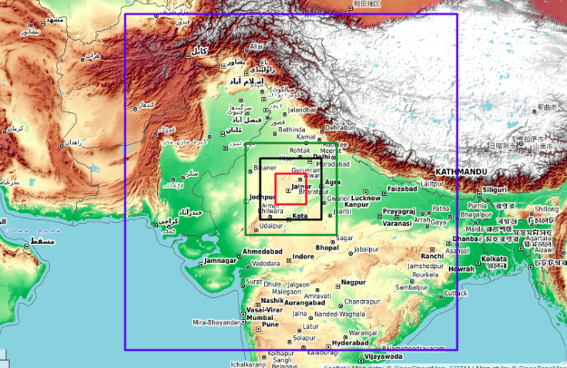
Domains for u-bb759
4.4km
Centred at 27N, 76E
200m

Slide 46
Using ECMWF operational
data to drive the Nesting Suite
____________________________

Slide 47
Nesting UM LAMs inside ECMWF analyses and forecast fields
This is supported by the nesting suite; lots of useful info at https://code.metoffice.gov.uk/trac/rmed/wiki/suites/nesting/ECdriver
Main difference compared to running from UM global fields is that an intermediate domain needs to be introduced, onto which the EC grib data is interpolated using the reconfiguration program

Slide 48
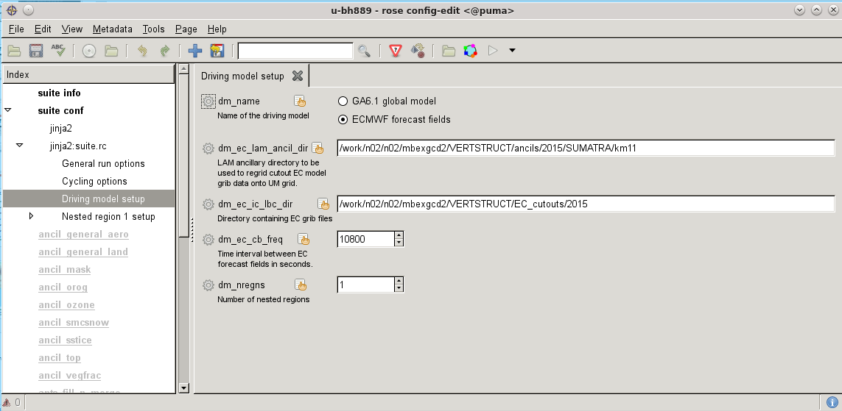
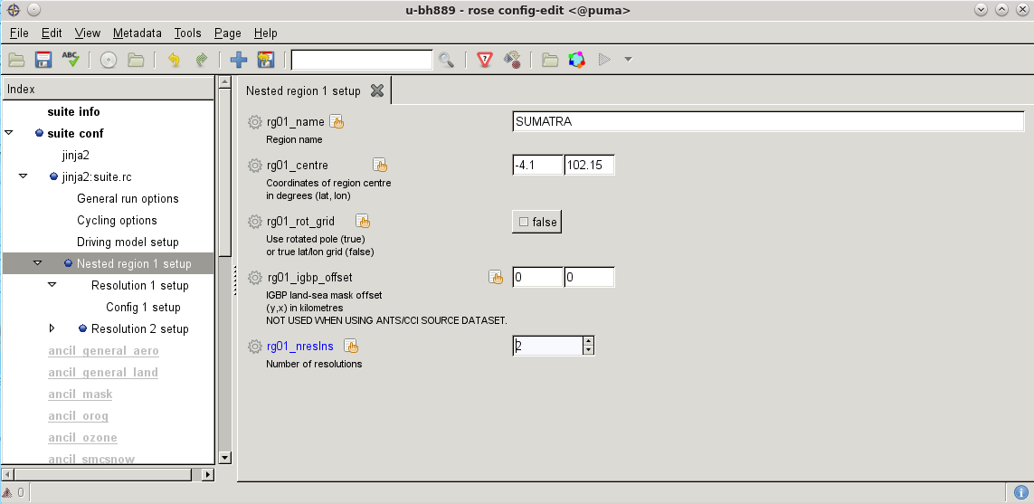
Step 1: Add extra domain to re-grid ECMWF data onto

Slide 49
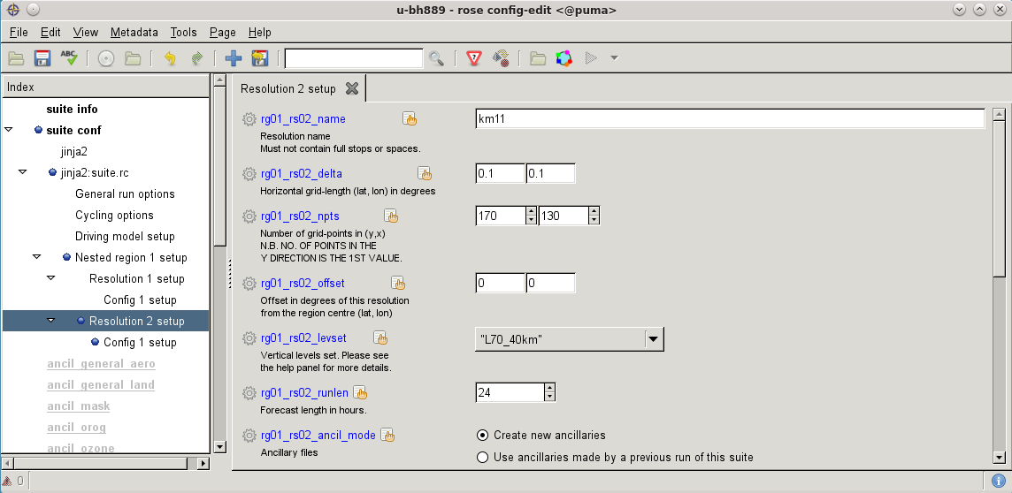
Step 2: Choose domain size and resolution
Domain size must be slightly bigger than that of the UM LAM you intend to run

Slide 50
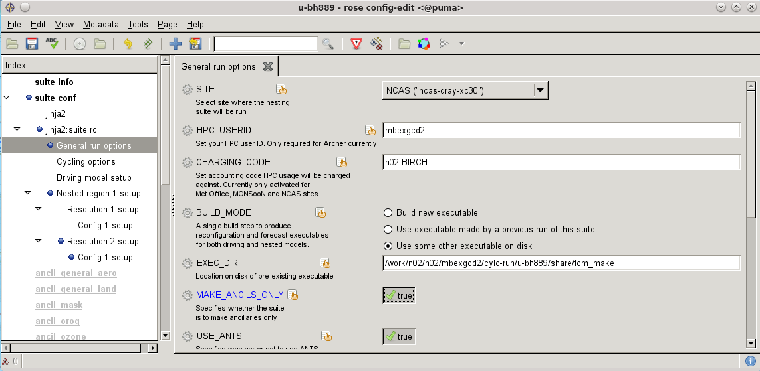
Step 3: Set MAKE_ANCILS_ONLY=TRUE and run

Slide 51
Step 4: Choose ECMWF as driving model
Set paths for ancillary directory (intermediate domain) and ECMWF grib files here

Slide 52
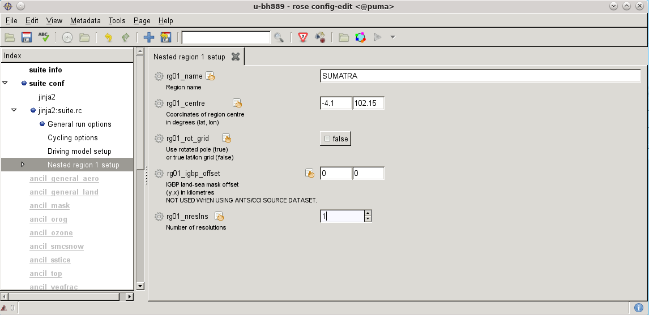
Step 5: Set no. of resolutions back to 1

Slide 53
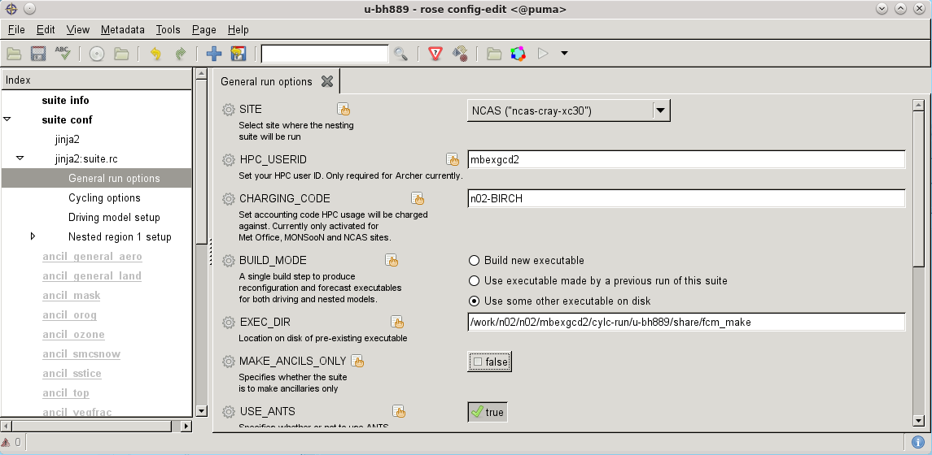
Step 6: Set MAKE_ANCILS_ONLY=FALSE, then submit suite

Slide 54
Obtaining ECMWF operational data
Raise a request with NCAS-CMS via the help desk ticketing system; see http://cms.ncas.ac.uk/wiki/UM/GettingInitialData
Otherwise, you can apply for an ECMWF MARS account and then retrieve the data yourself using the scripts at: https://code.metoffice.gov.uk/trac/rmed/wiki/suites/nesting/ECdriver
Applications for access to the ECMWF MARS system can be made by contacting the ECMWF Computing Representative for the UK; see
https://www.ecmwf.int/en/about/contact-us/computing-representatives

Slide 55
On-line Nesting Suite tutorial:
https://code.metoffice.gov.uk/trac/rmed/wiki/suites/nesting/worked_eg_2019
→ Ignore instructions written in green italics! These are specific to the UM Users 2019 Workshop
Paths to UM analyses files on disk:
MONSooN: /projects/cascade/hadsw/um_analyses/YYYYmmddTHHMMZ_glm_t+0
ARCHER: /work/n02/n02/mbexgcd2/um_analyses/YYYYmmddTHHMMZ_glm_t+0
Paths to pre-built executables on disk:
MONSooN: /projects/cascade/hadsw/uai769_execs/r118685
ARCHER: /work/n02/n02/mbexgcd2/cylc-run/u-bk285/share/fcm_make

Slide 56
Wrap Up
___________________________

Slide 57
Some useful nesting suites for reference
1) Multiple nests from 4.4km down to 200m centred over Jaiphur, India
u-bf793: MONSooN suite used to generate ancillaries only
u-bb759: ARCHER suite running from ancillaries generated on MONSooN
2) Multiple cycles at 2.2km resolution over Sumatra, driven by ECMWF data
u-bh872: MONSooN suite used to generate ancillaries only
u-bh889: ARCHER suite running from ancillaries generated on MONSooN

Slide 58
Questions?
____________________________

