Slide 1
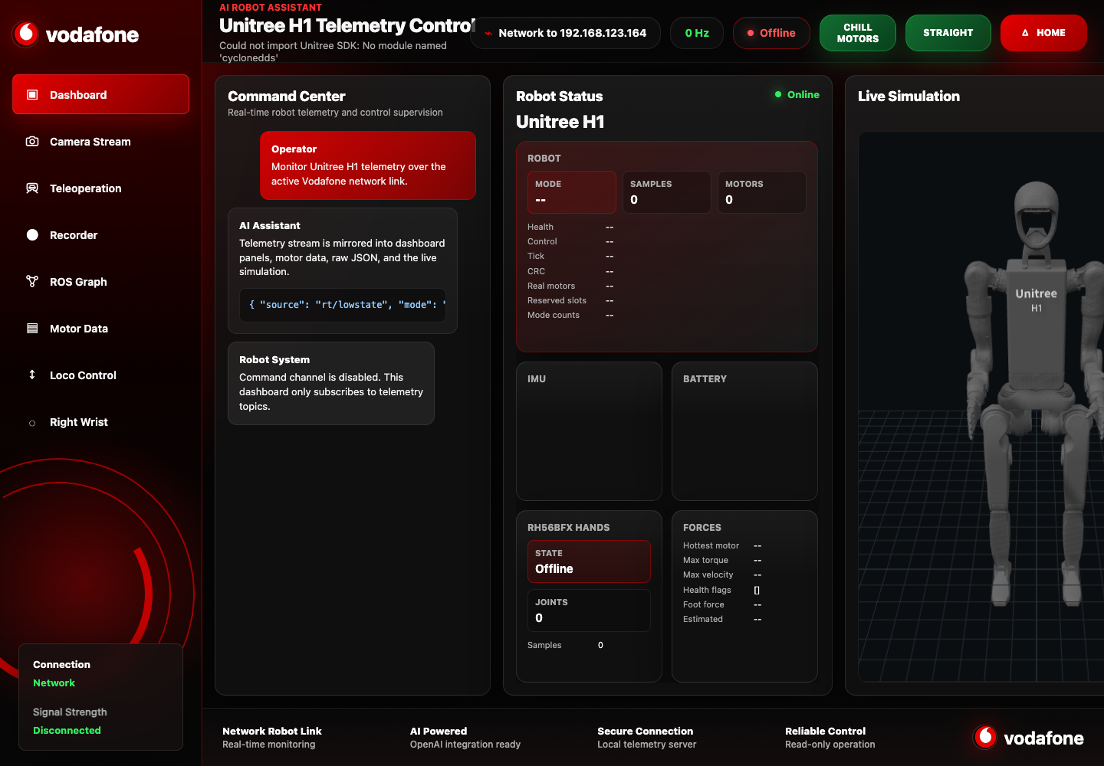
UNITREE H1-2 EXPERIENCE
AI-ready robot control.
Live awareness. Immersive control. Demo-grade presence.
Operator confidence
Premium robotics showcase

Slide 2
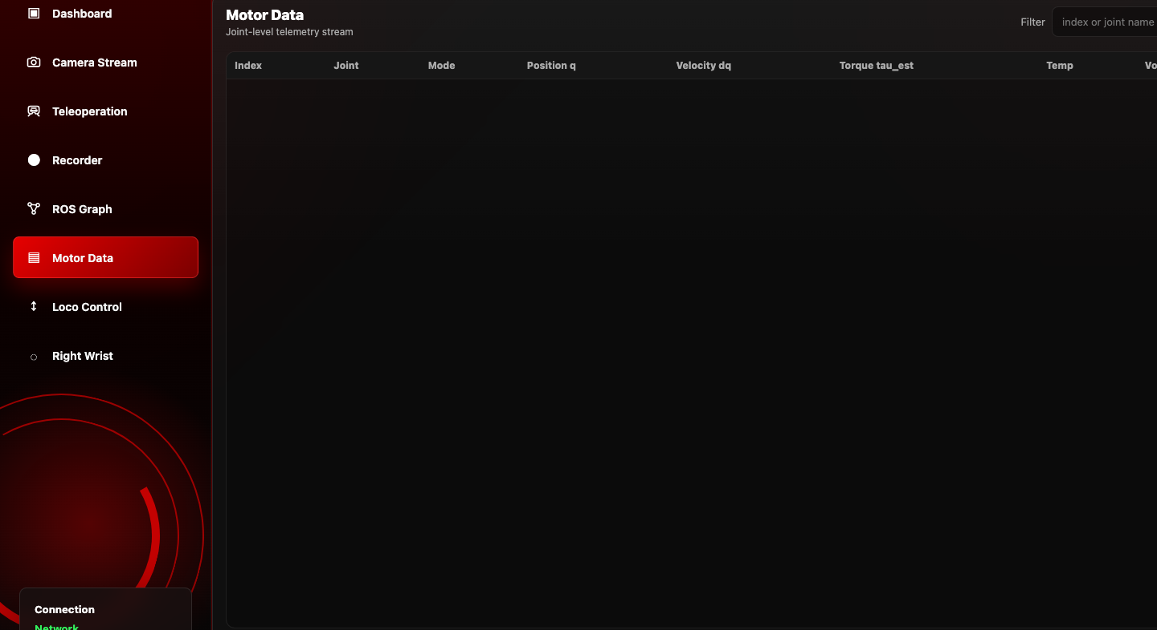
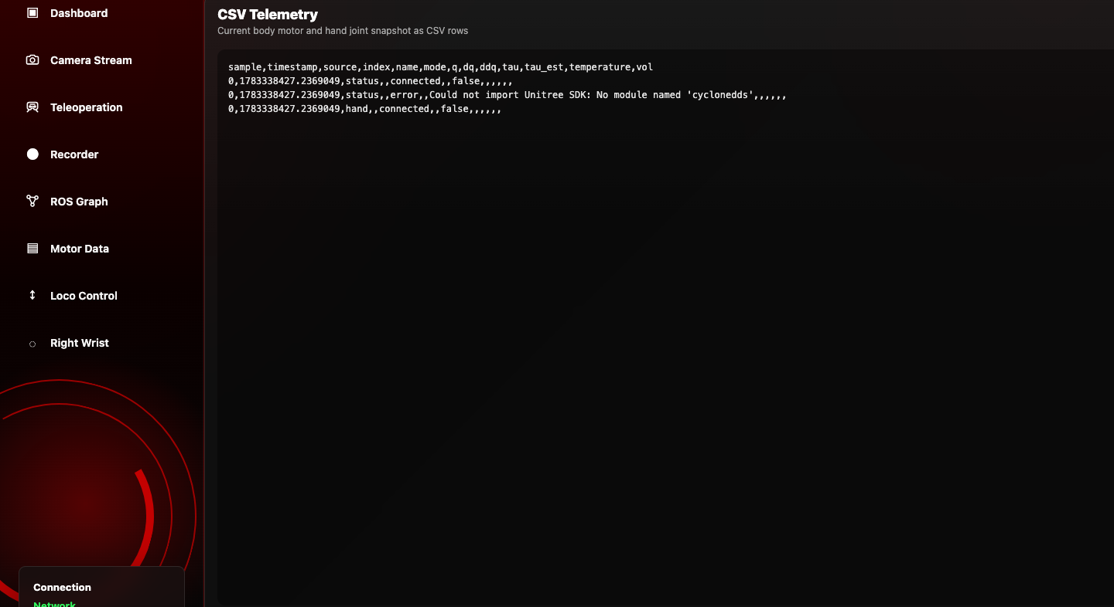
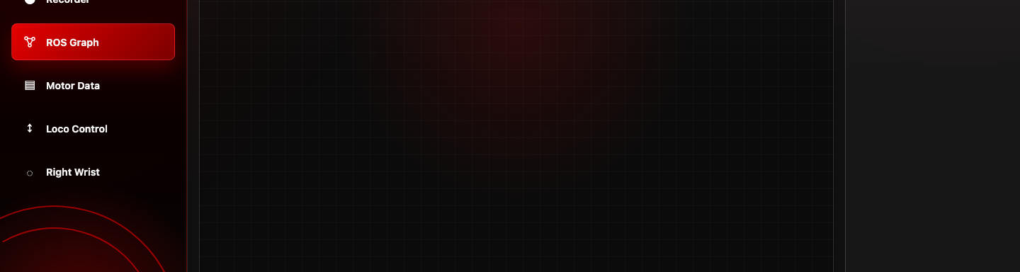
COMMAND CENTER
Everything visible at once.
A single surface for live status, robot presence, motor insight, and instant readability.
Real-time awareness
Clean signal layer
Instant operator readout

Slide 3
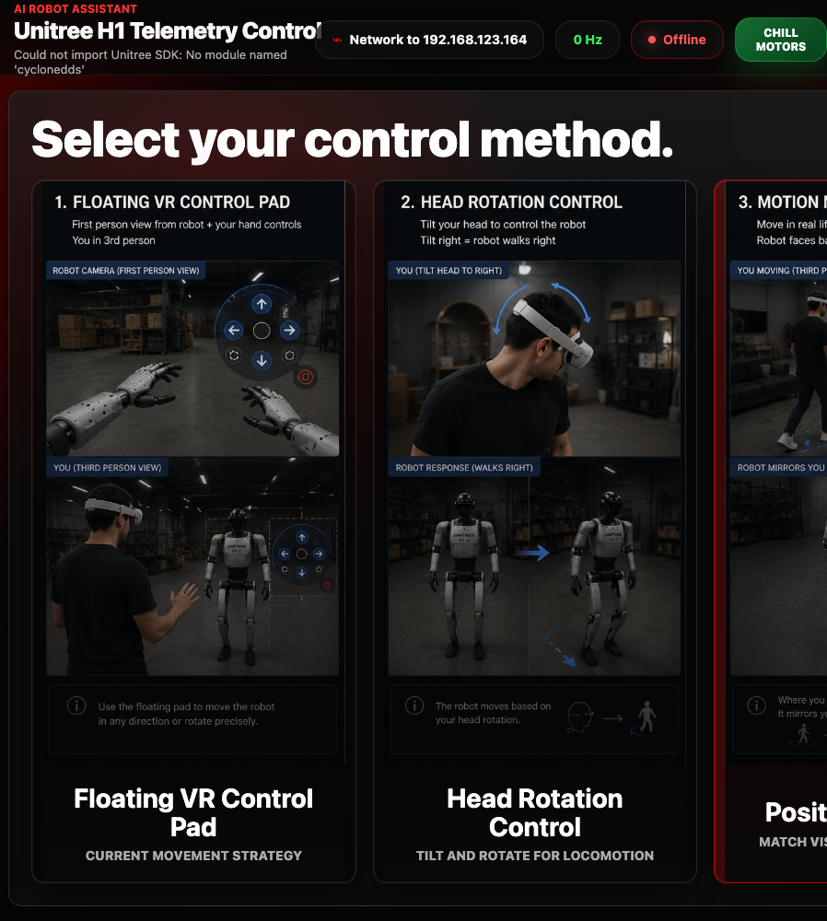
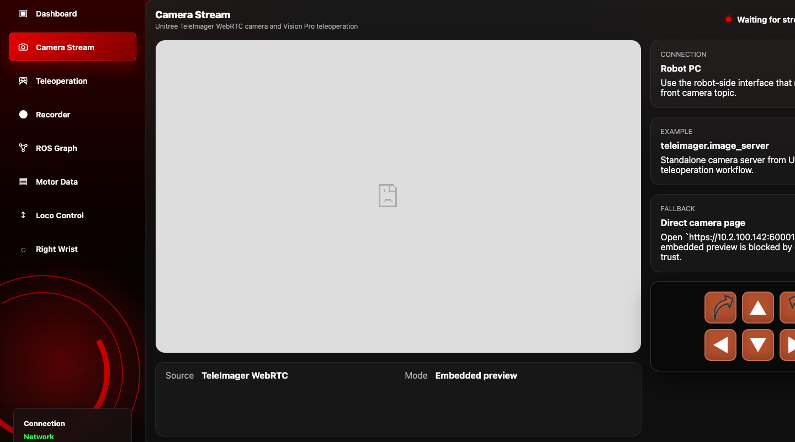
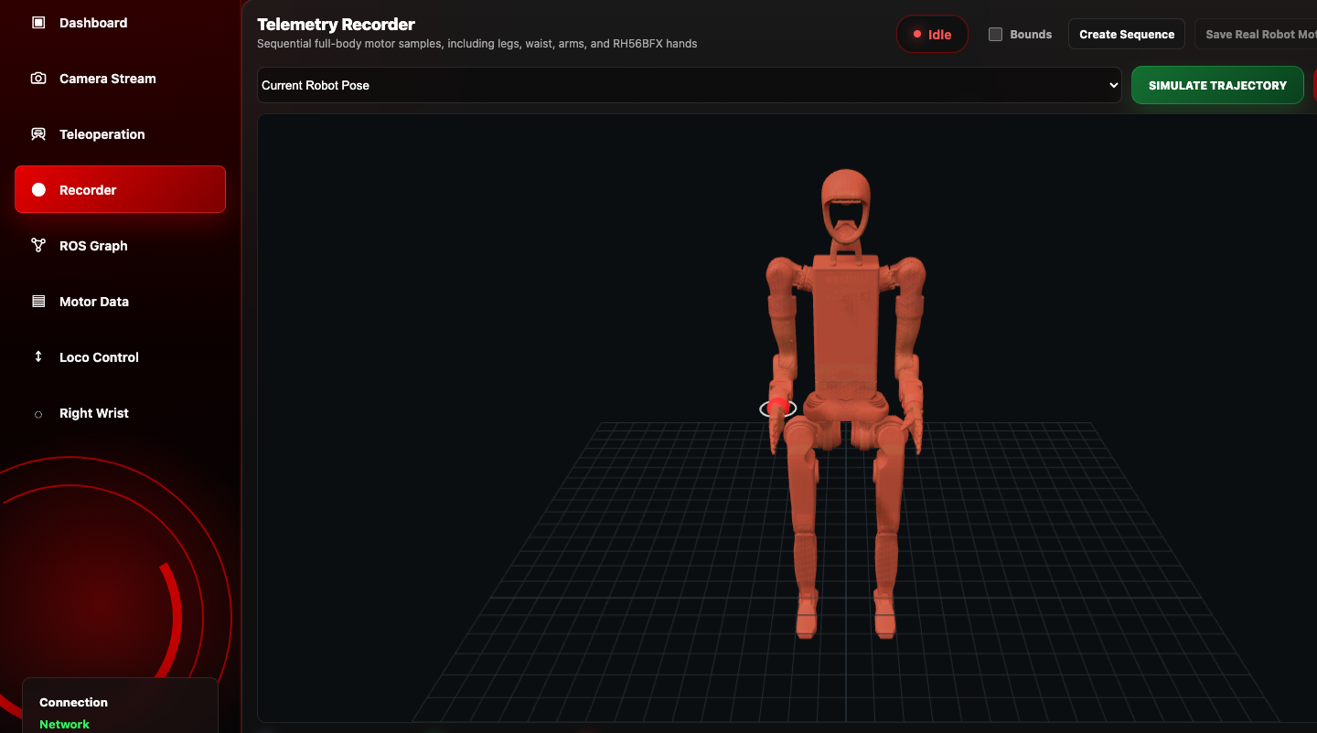
IMMERSIVE CONTROL
The robot feels present.
Vision-led operation with selectable control modes and a recording workflow for repeatable moments.
VR Control Pad
Position Matching
Head Rotation
Motion Replay

Slide 4
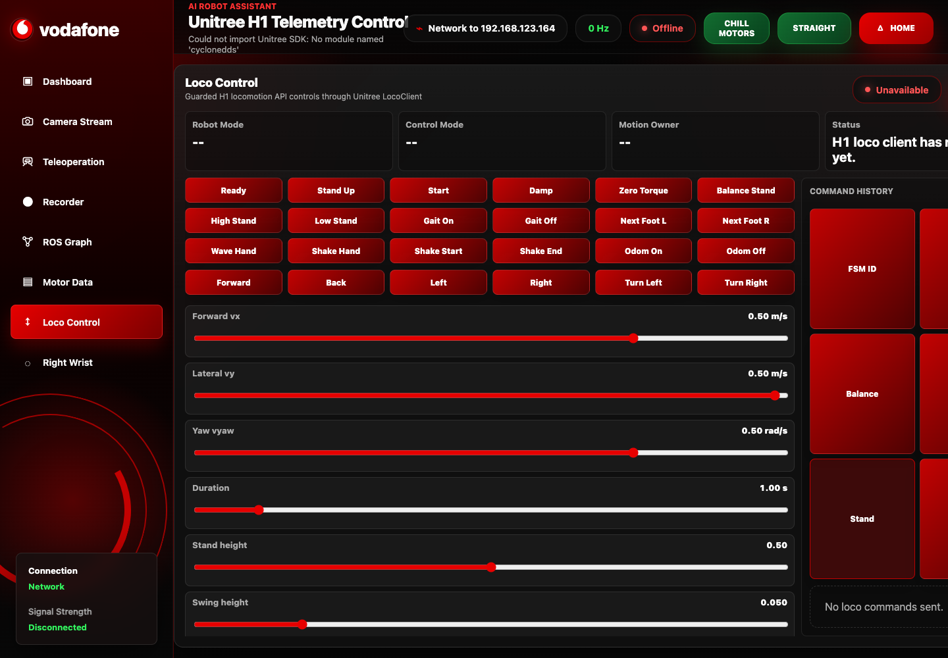
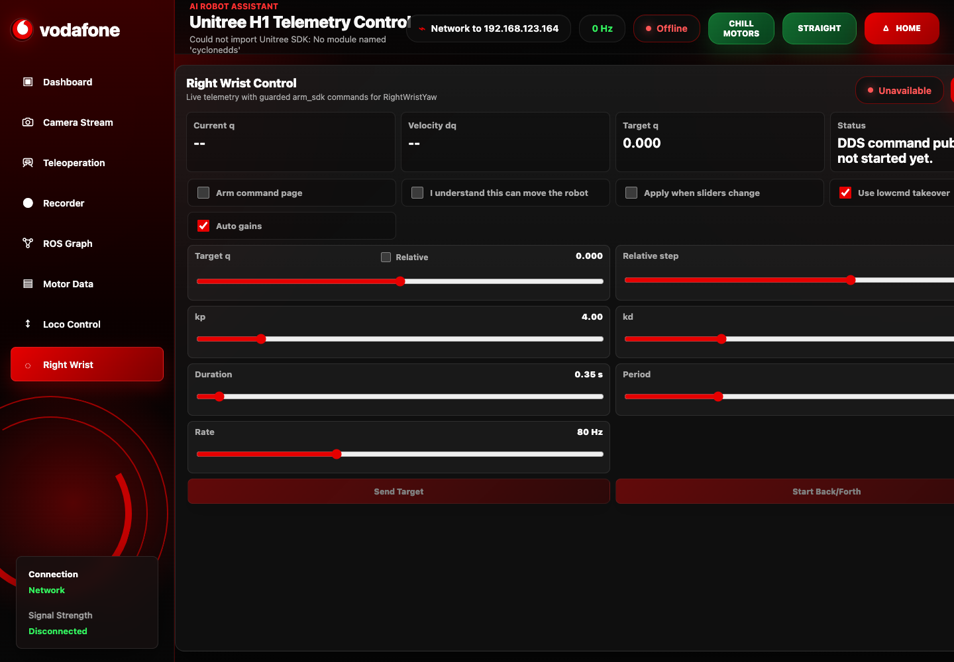
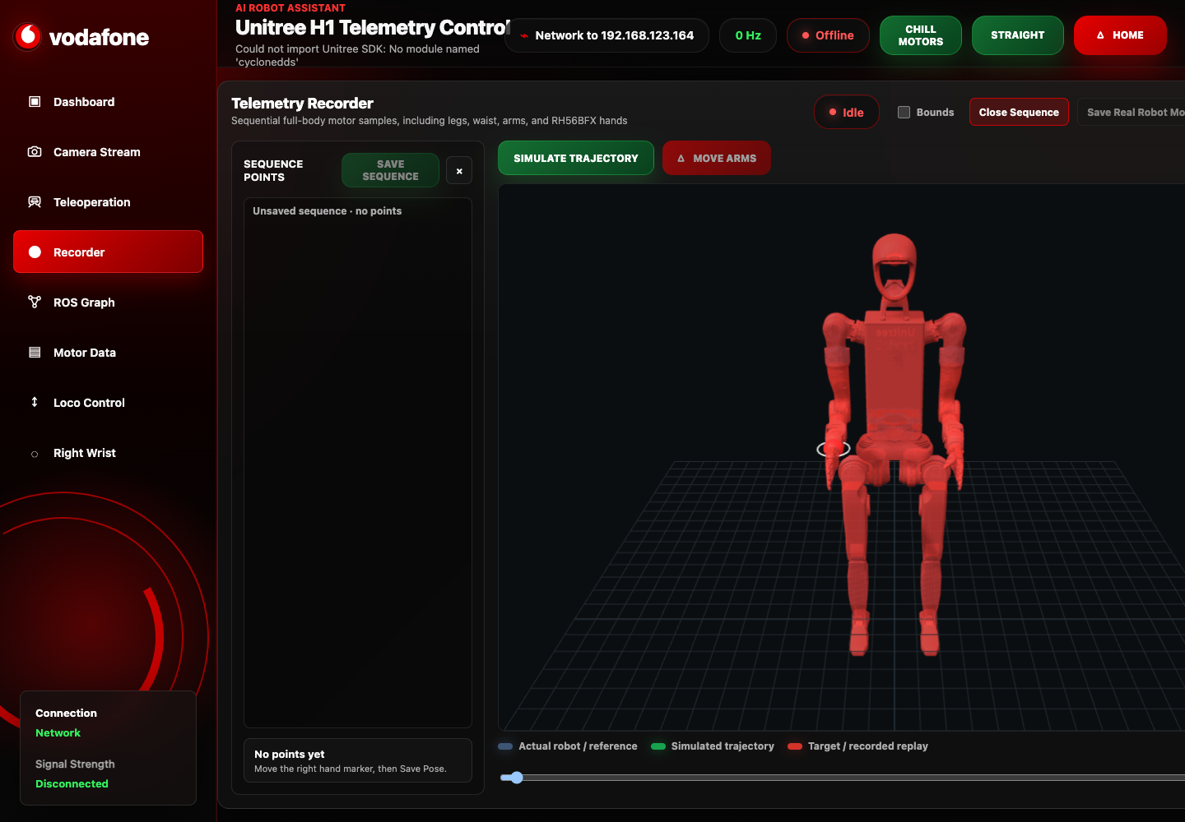
DEMO-READY PLATFORM
Built for pilots, showcases, and remote operations.
Locomotion energy
Gesture moments
Repeatable demos
Remote presence
Premium robotics experience.

