Slide 1
Is Asylum International Biased?
Is Asylum International’s coverage on asylum seekers biased against certain regions?
Casey Mallon
12/10/12

Slide 2

Why is this important?
Conservative political movements challenging the reliability of NGOs
NGOs provide information to persuade international actors to their cause
Reaction against recent “migrant crisis”
Lines between migrants and asylum-seekers are blurred

Slide 3
Data Collection
r<- "https://www.amnesty.org/en/latest/news/?contentType=2561&issue=1613&sort=date&p="
page=c(1:11)%>%as.character()
webpages<- str_c(base, page)
all_URLs<- function(i){
URLs<- read_html(i)%>%
html_nodes(".search-item__link")%>%
html_attr("href")%>%
as.character()
results<- paste0("https://www.amnesty.org", URLs)
return(results)
}
#all of the news articles
ALL_URLS<- map(webpages, all_URLs)%>%
unlist()

Slide 4
Data Collection
#function to get the region, title, date, and text of each article
scrape_text <- function(url){
webpage<- read_html(url)
text <- html_nodes(webpage, ".wysiwyg") %>%
html_text()
title<- html_nodes(webpage,".heading--main")%>%
html_text()
region<-html_nodes(webpage, ".tags__item--bold--sm+ .tags__item--discrete .tags__link--discrete--md")%>%
html_text()
date<- html_nodes(webpage, "time")%>%
html_text()
all_info<- data.frame(date=ifelse(length(date)==0, NA, date),
region=ifelse(length(region)==0,NA, region),
title= ifelse(length(title)==0,NA,title),
text= ifelse(length(text)==0,NA,text))
return(all_info) }

Slide 5
Data Collection
#Need to include the ifelse part in the data.frame in case articles aren't formatted in the same way
#Apparently its too much money to have uniform structure
#some of the articles aren't actually formatted using the same nodes,
#some titles use nodes that mean different things on different pages
#Making a giant data frame
Amenesty_International_Asylum<- map_dfr(ALL_URLS,scrape_text)
#Creating a csv file
write.csv(Amenesty_International_Asylum,file= "Amenesty_International_Asylum.csv")

Slide 6
Cleaning the Data
Asylum<- read.csv(file="/Users/cemallon/Documents/Computational-Tools/plsc31101-final-project/Data/Amenesty_International_Asylum.csv",stringsAsFactors = FALSE)
#filter out all the NAs
Asylum_Full<- Asylum%>%
filter(!is.na(region), !is.na(date), !is.na(text), !is.na(title))%>%
subset(select=-c(X))
#filter out all the incorrect titles
#these are titles like "Amnesty's Experts"
#the reason is that these pages are coded differently than
Asylum_Title<-Asylum_Full%>%
filter(title!="Amnesty's experts")
#number of observations dropped from 159 to 132

Slide 7
Cleaning the Data
#This gives everything a nice name and simplifies the date to just the year
Asylum_Tidy<-Asylum_Title%>%
rename(Date=date, Region=region, Title=title, Text=text)%>%
mutate(Date=as.numeric(str_extract(Date,"\\d{4}")))
#Next I need to manually collapse the regions
#For some reason, Amnesty International doesn't stick to regions
#In a few cases they list specific countries
#I'll continue to keep the Turkey, Afghanistan, and Russia left as separate entities
#Miscoding on the original site for two articles, marked the regions as Refugees and Detention
#Recoded to Europe

Slide 8
Cleaning the Data
Region_clean<- recode(Asylum_Tidy$Region,"Burundi"="Africa", "Congo"="Africa", "Kenya"="Africa", "Eritrea"="Africa",
"Libya"="Middle East and North Africa","Middle East and North Africa " = "Middle East and North Africa",
"Hungary"= "Europe and Central Asia", "Spain"="Europe and Central Asia",
"France"="Europe and Central Asia","Greece"="Europe and Central Asia","Italy"="Europe and Central Asia",
"Ecuador"="Americas","Venezuela"="Americas", "Cuba"="Americas",
"Nauru" = "Asia and The Pacific", "Australia"="Asia and The Pacific", "Malaysia"="Asia and The Pacific",
"Refugees"="Europe and Central Asia","Detention"="Europe and Central Asia",
"United States of America"="Americas")
Asylum_Tidy$Region_clean<- as.character(Region_clean)

Slide 9
Cleaning the Data
#Removing the old Region
Asylum_Tidyer<- Asylum_Tidy%>%
subset(select= -c(Region))%>%
rename("Region"="Region_clean")%>%
subset(select=c(1,4,2,3))
write.csv(Asylum_Tidyer,file= "Amenesty_International_Asylum_CLEAN.csv")

Slide 10
Pre-Processing
Asylum<-Corpus(VectorSource(Asylum.dat$Text))
Asylum_dtm <- DocumentTermMatrix(Asylum,
control = list(stopwords = TRUE,
tolower = TRUE,
removeNumbers = TRUE,
removePunctuation = TRUE))
Asylum_dtm<-as.data.frame(as.matrix(Asylum_dtm))
#Using bing lexicon for simple binary positive v. negative categorization
Asylum_sentiments<- get_sentiments("bing")
Asylum_sentiments$score<-ifelse(Asylum_sentiments$sentiment=="positive",1,-1)

Slide 11
Transforming for Text Analysis
#Score each article
Words<- data.frame(word=colnames(Asylum_dtm))
Words<-merge(Words,Asylum_sentiments,all.x=T)
Words$score[is.na(Words$score)]<-0
Scores<- as.matrix(Asylum_dtm)%*%Words$score
##Edit the dataframe
Asylum.dat$Scores= Scores
Asylum.dat<- Asylum.dat%>%
subset(select=-c(X))
#Write a CSV file of the data
write.csv(Asylum.dat, "Amnesty_International_Asylum_Text_Analysis.csv")

Slide 12
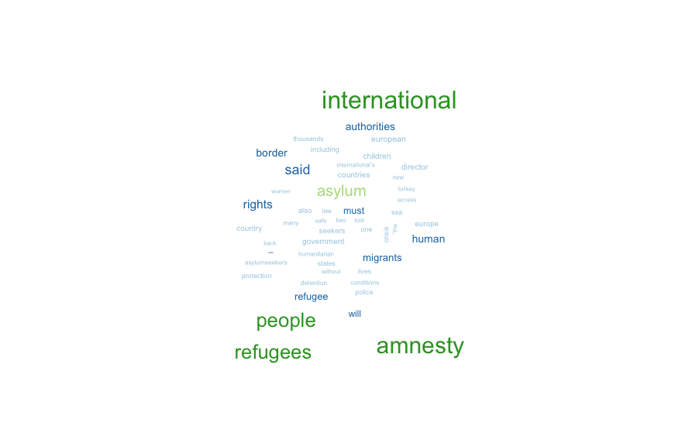
Which words appear most frequently?

Slide 13
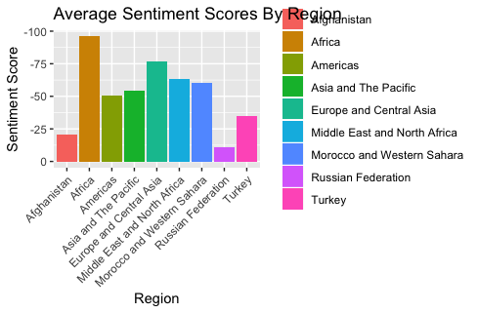

Slide 14
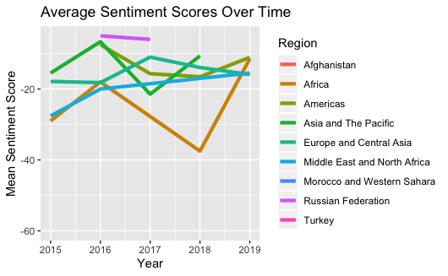

Slide 15
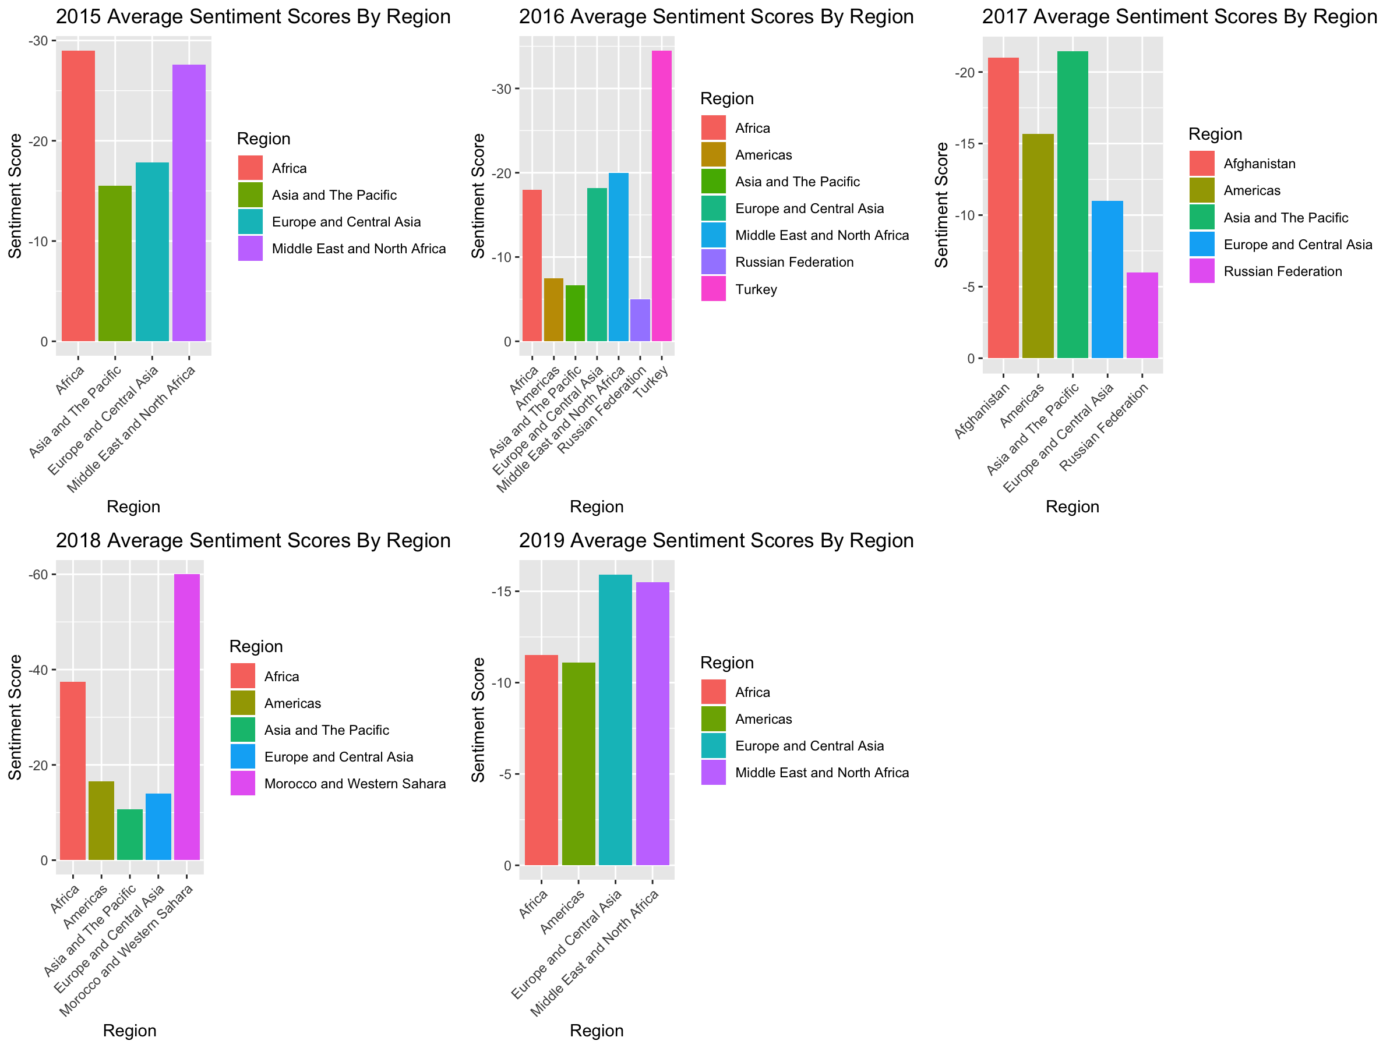

Slide 16
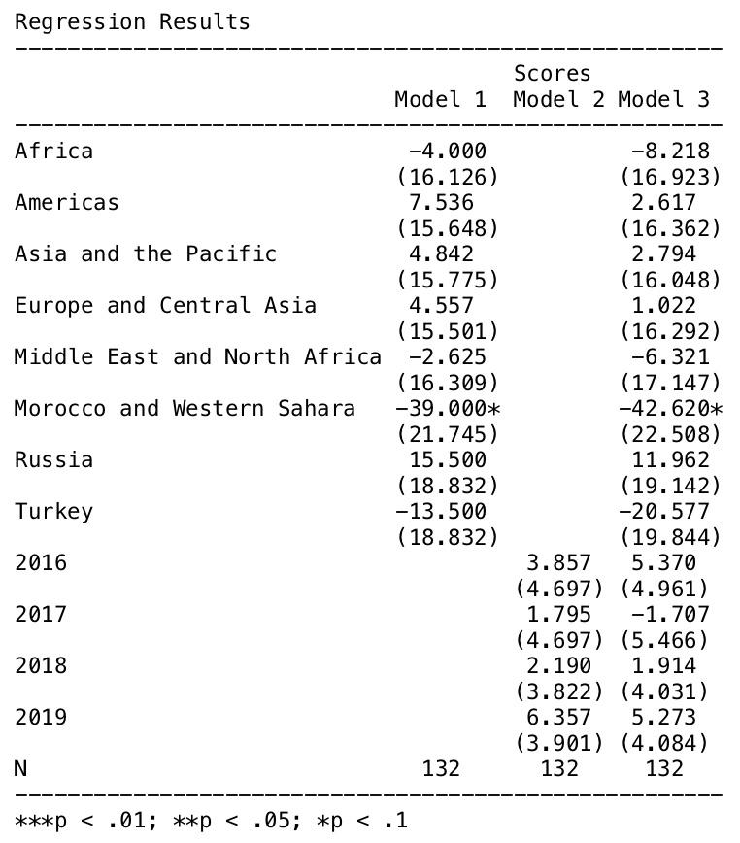
No significant evidence found
Fail to find evidence supporting that Amnesty International is biased towards certain regions based on its coverage of asylum-seekers.

