Slide 1
BioSense Institute / FlexiGroBots
Optimized Routing for a Blueberry
Sampling Robot
Stanislav Čeman
Research internship at BioSense Institute, University of Novi Sad
Robo Router
Notes:
Conference-style design based on the SOR 2023 presentation. This deck describes the later Robo Router benchmark.
https://drive.google.com/file/d/1XEVJejX45tymtpE-W9gNmp1GDg2Y0aJE/view
https://github.com/cemanst/robo-router

Slide 2
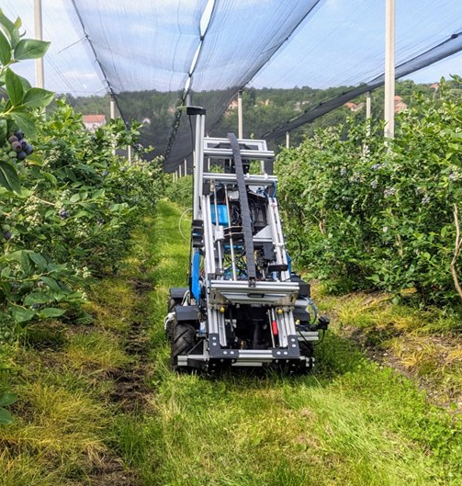
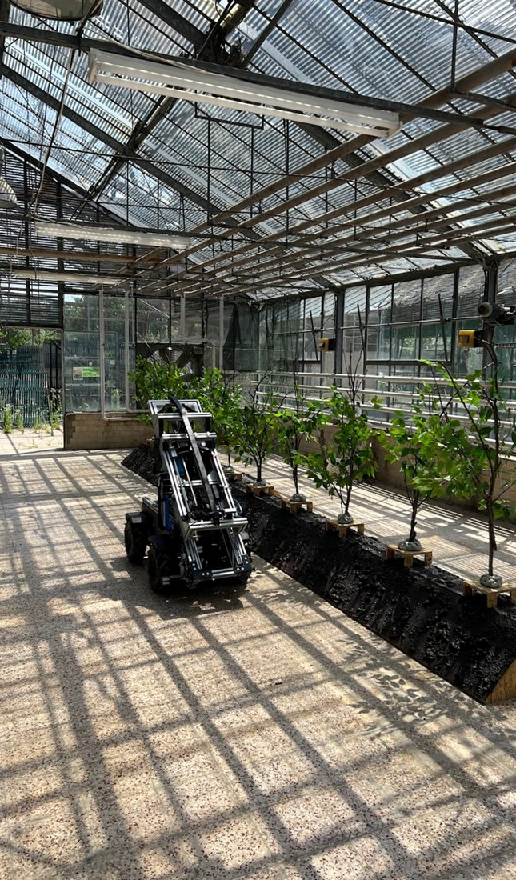
Context
FlexiGroBots blueberry pilot
BioSense supplied the ground robot for the EU Horizon 2020 pilot in Serbia and Lithuania.
Drone surveys help select soil sampling locations. Gari travels to those locations and analyzes the samples in the field.
The battery limits how much ground Gari can cover on each mission.
Gari in the field
Greenhouse test site
Photos from FlexiGroBots
2
Notes:
https://flexigrobots-h2020.eu/blog/pilot-3-demonstrator-integration-testing-and-deployments
https://flexigrobots-h2020.eu/blog/pilots-progress
https://drive.google.com/file/d/1XIn8_83KDI_fiLDewJU_Hfha21a1xmLI/view
https://drive.google.com/file/d/1XEVJejX45tymtpE-W9gNmp1GDg2Y0aJE/view
Greenhouse photo: https://flexigrobots-h2020.eu/sites/flexig/files/public/content-images/media/2022/image1_1.png
Field photo: https://flexigrobots-h2020.eu/sites/flexig/files/public/content-images/media/2023/ugv.jpg

Slide 3
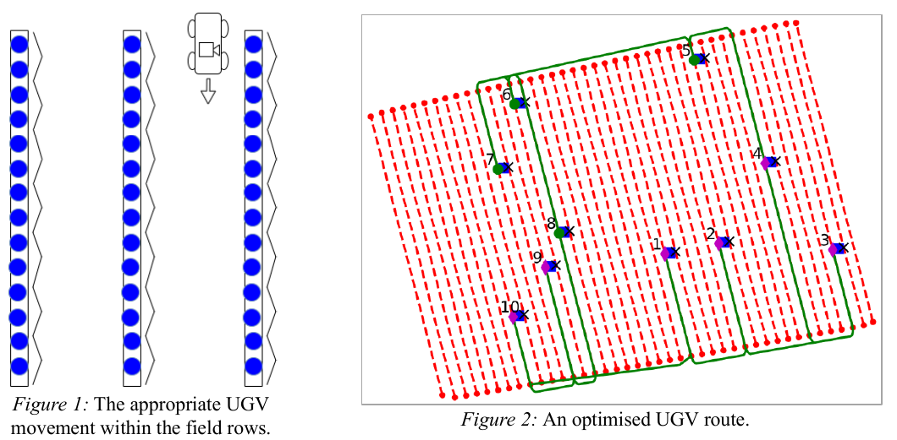
Problem Setting
Find a tour that visits every sampling point and returns to the depot.
Gari follows corridors between the crop rows and changes corridors at the row ends.
A drainage trench restricts which side of each row the robot can approach.
If the camera faces away from the sampling point, the robot needs an additional rotation to align itself.
Field movement and an example route
Figures 1 and 2 from the SOR 2023 paper
3
Notes:
https://drive.google.com/file/d/1XE1Fxd6JzcBwx4ZEwwY27sEY6V7f5imi/view
https://drive.google.com/file/d/1XIn8_83KDI_fiLDewJU_Hfha21a1xmLI/view

Slide 4
Solution Approach
1. Build the field graph 2. Construct a greedy tour 3. Improve the tour
Cost function used in this benchmark
$$J(r) = D_{3D}(r) + 100 × N(r)$$
The distance term sums 3D travel, including the return to the depot. N(r) counts sampling stops approached from the side that requires a rotation.
Example
420 m with two penalized rotations scores 620. A 470 m route with one penalized rotation scores 570, so the benchmark prefers it.
The score estimates travel effort in model units.
4
Notes:
https://drive.google.com/file/d/1XIn8_83KDI_fiLDewJU_Hfha21a1xmLI/view
https://drive.google.com/file/d/1XE1Fxd6JzcBwx4ZEwwY27sEY6V7f5imi/view
https://github.com/cemanst/robo-router/blob/main/algorithm2/distance.py
https://github.com/cemanst/robo-router/blob/main/postprocessing/complete_solution.py
https://github.com/cemanst/robo-router/blob/main/model/params.py

Slide 5
Heuristics in Robo Router
GA
Genetic algorithm
Place an inherited block from a through b where the added connection cost is lowest, then improve the offspring.
algorithm2/ga.py
Δ = c(i,a) + c(b,j) − c(i,j)
ACO
Ant colony optimization
On larger routes, pheromone τ discounts the estimated cost of an edge during some insertion moves.
algorithm2/aco.py
c′(i,j) = c(i,j) − λ ln(1 + τ(i,j)/τ₀)
VNS
Variable neighborhood search
Shake the best route with k relocations, then descend using stop relocations and segment reversals.
algorithm2/vns.py
r′ = LocalDescent(Shakeₖ(r*))
ALNS
Adaptive large neighborhood search
Remove and reinsert groups of stops. A cost increase ΔJ can be accepted at temperature T.
algorithm2/alns.py
P(accept uphill move) = exp(−ΔJ / T)
Four search implementations by Stanislav Čeman / github.com/cemanst/robo-router
5
Notes:
GA omits the constant cost inside the inherited segment when comparing insertion positions. ACO uses c′ to choose some insertions and scores all completed routes with J. The 10-stop ACO retains the original construction search.
https://github.com/cemanst/robo-router/blob/main/algorithm2/ga.py
https://github.com/cemanst/robo-router/blob/main/algorithm2/aco.py
https://github.com/cemanst/robo-router/blob/main/algorithm2/vns.py
https://github.com/cemanst/robo-router/blob/main/algorithm2/alns.py

Slide 6
Experimental Setup
Instances and starting locations
10, 50 and 100 stops from the repository. The 75-stop case uses the first 75 points of the 100-stop input. Each size uses the same 30 supplied depots and 20 generated headland depots.
Search budget
40,040 complete route evaluations per search run. Methods share the depot, seed and turn-aware objective within each trial.
Greedy baseline
Start with the nearest-neighbor route. Keep its turn repair only when the full route cost decreases.
The tables aggregate 50 depots. The convergence plots and route maps show depot 1.
6
Notes:
Revised ACO and GA use the same 50 starts and evaluation budget as the earlier versions. The retained Greedy, ALNS and VNS results use the same route scorer and depots.
https://github.com/cemanst/robo-router

Slide 7
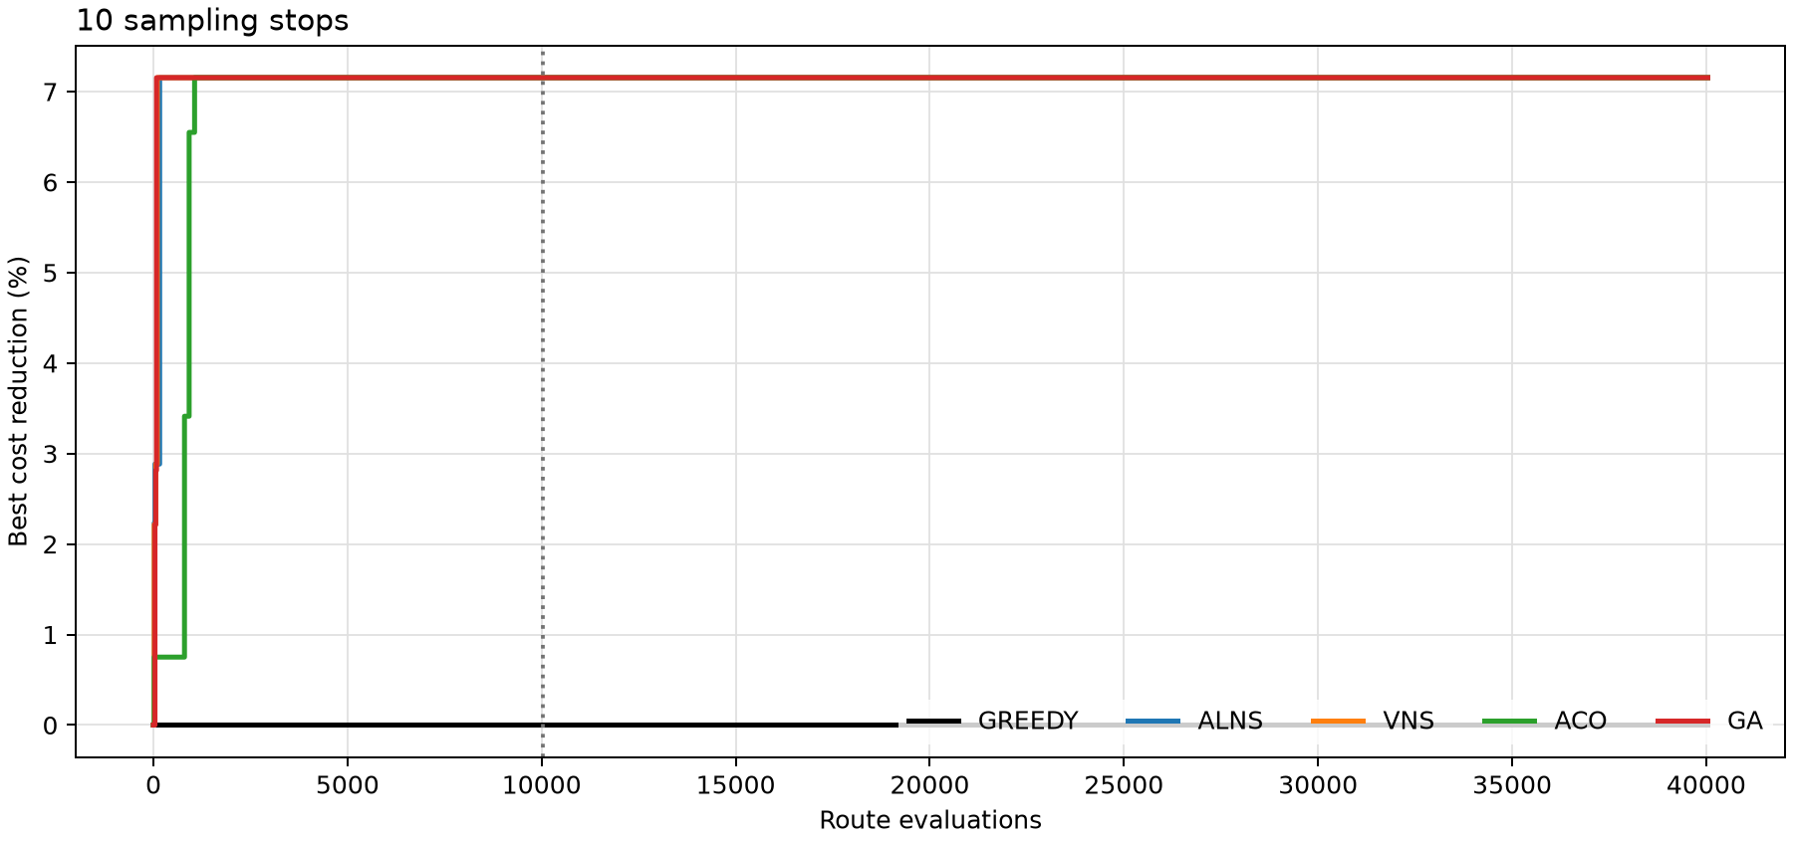
Results for 10 Sampling Stops
Reduction across 50 depots
Method | Mean | Median | Best
GREEDY | 0.00% | 0.00% | 0.00%
ALNS | 6.03% | 5.95% | 9.82%
VNS | 6.10% | 6.04% | 9.82%
ACO | 6.10% | 6.04% | 9.82%
GA | 6.10% | 6.04% | 9.82%
ACO and GA both average 6.10%. The exact mean ceiling is 6.10%.
Graph shows depot 1. The dotted line marks 10,040 evaluations.
7
Notes:
The table reports 50 matched depot runs at 40,040 complete route evaluations per search. The plot replays seed 202301 at the first repository depot and matches the corresponding final costs in the benchmark files.
https://github.com/cemanst/robo-router

Slide 8
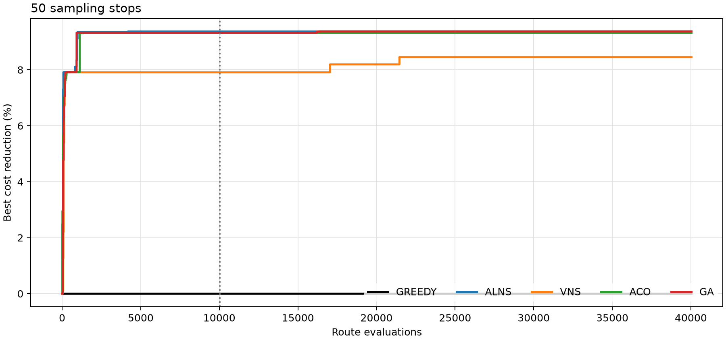
Results for 50 Sampling Stops
Reduction across 50 depots
Method | Mean | Median | Best
GREEDY | 0.00% | 0.00% | 0.00%
ALNS | 9.35% | 9.56% | 12.03%
VNS | 8.73% | 8.90% | 11.16%
ACO | 9.12% | 9.34% | 12.03%
GA | 9.25% | 9.47% | 12.03%
ALNS leads at 9.35% mean reduction. GA reaches 9.25% and ACO reaches 9.12%.
Graph shows depot 1. The dotted line marks 10,040 evaluations.
8
Notes:
The table reports 50 matched depot runs at 40,040 complete route evaluations per search. The plot replays seed 202301 at the first repository depot and matches the corresponding final costs in the benchmark files.
https://github.com/cemanst/robo-router

Slide 9
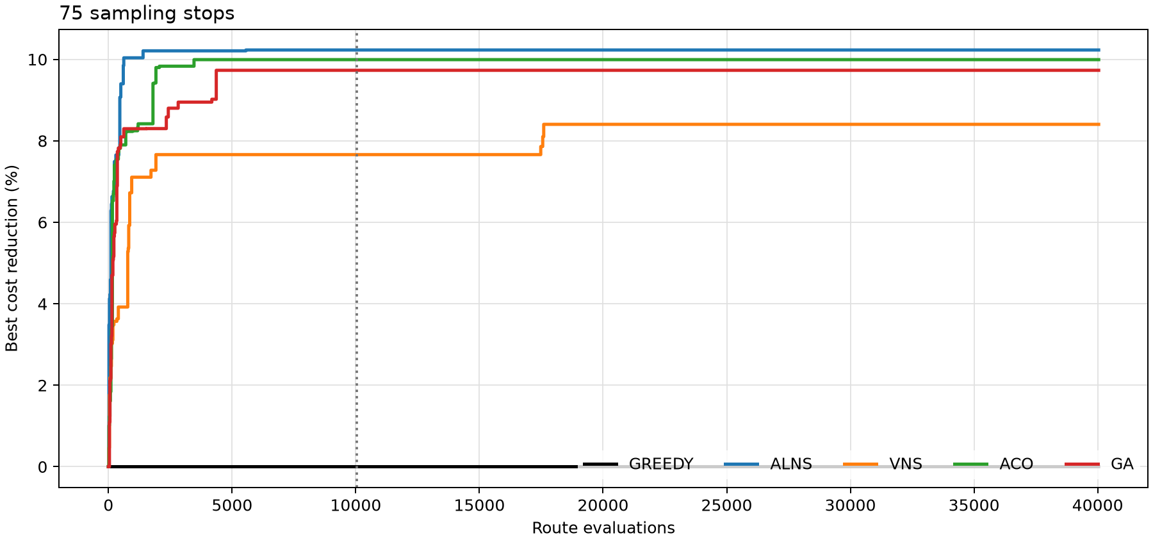
Results for 75 Sampling Stops
Reduction across 50 depots
Method | Mean | Median | Best
GREEDY | 0.00% | 0.00% | 0.00%
ALNS | 10.75% | 10.31% | 13.72%
VNS | 8.50% | 8.37% | 12.08%
ACO | 10.09% | 9.72% | 13.33%
GA | 10.35% | 9.84% | 13.62%
ALNS leads at 10.75% mean reduction. GA reaches 10.35% and ACO reaches 10.09%.
Derived 75-stop subset. Graph shows the original repository depot (depot 1).
9
Notes:
The table reports 50 matched depot runs at 40,040 complete route evaluations per search. The plot replays seed 202301 at the first repository depot and matches the corresponding final costs in the benchmark files.
https://github.com/cemanst/robo-router

Slide 10
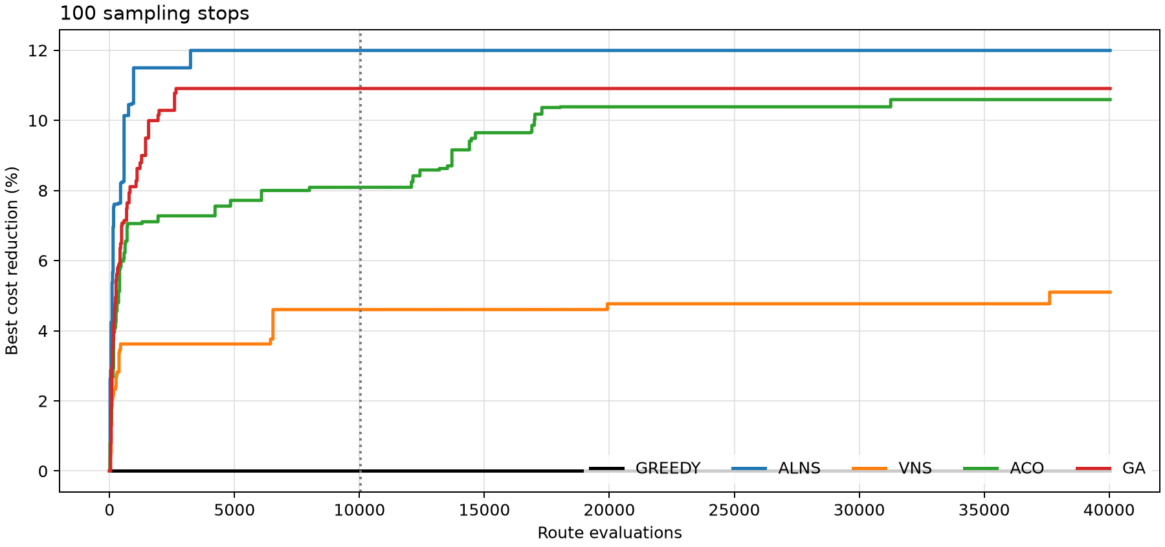
Results for 100 Sampling Stops
Reduction across 50 depots
Method | Mean | Median | Best
GREEDY | 0.00% | 0.00% | 0.00%
ALNS | 11.18% | 11.24% | 12.09%
VNS | 6.06% | 5.82% | 8.60%
ACO | 8.98% | 8.78% | 12.03%
GA | 10.70% | 10.71% | 12.04%
ALNS leads at 11.18% mean reduction. GA reaches 10.70% and ACO reaches 8.98%.
Graph shows depot 1. The dotted line marks 10,040 evaluations.
10
Notes:
The table reports 50 matched depot runs at 40,040 complete route evaluations per search. The plot replays seed 202301 at the first repository depot and matches the corresponding final costs in the benchmark files.
https://github.com/cemanst/robo-router

Slide 11
Exact Check for 10 Sampling Stops
How much can a search improve on Greedy?
For this small instance, we can compute the lowest possible route cost at every depot and use it to check the heuristics.
6.10% mean improvement ceiling across 50 depots
ACO finds the optimal route at all 50 depots. GA finds it at 49.
Exact dynamic programming over the same field graph and cost function.
11
Notes:
The dynamic program considers every subset of stops and the last stop visited, then adds the cost of returning to the depot.
https://github.com/cemanst/robo-router

Slide 12
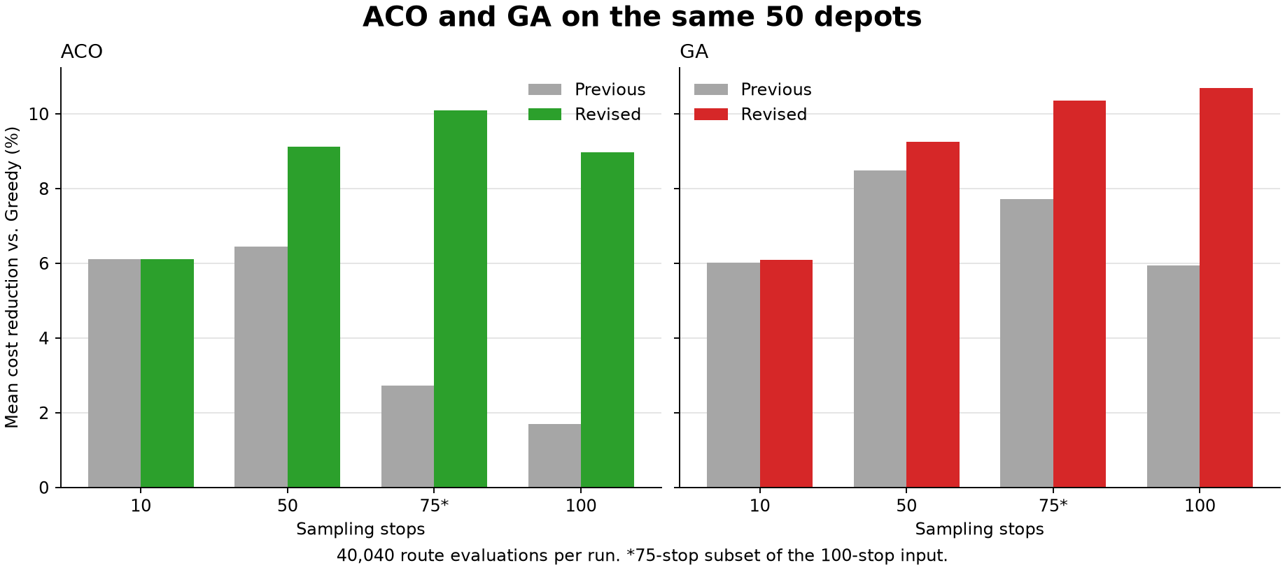
Effect of the GA and ACO Revisions
On 100 stops, GA improves from 5.95% to 10.70% and ACO from 1.70% to 8.98%.
Matched depots, seeds, route objective and evaluation budget.
12
Notes:
Data: robo-router-figures/hybrid-search/paired-summary.csv. GA preserves donor blocks and refines offspring. ACO mixes exploratory tours with pheromone-guided rebuilding of archived routes.
https://github.com/cemanst/robo-router

Slide 13
Comparison with the SOR Results
Mean reduction in route cost
Stops | Revised ACO | Revised GA | Reported ALNS
10 | 6.10% | 6.10% | 16.47%
50 | 9.12% | 9.25% | 12.47%
75* | 10.09% | 10.35% | 10.13%
100 | 8.98% | 10.70% | 7.76%
At 100 stops, ACO and GA exceed the reported 7.76% numerically. At 50 stops, both remain below 12.47%.
The studies use different starting locations and implementations.
*75 stops compares a derived subset with the manuscript’s separately generated instance.
13
Notes:
The SOR conference paper reports 50 runs with randomly selected starts at 10, 50 and 100 stops. The 75-stop value comes from the supplied manuscript, which reports 30 starts. The present benchmark uses 30 supplied and 20 generated depots, and its scoring and implementations differ.
https://www.open.uns.ac.rs/bitstream/123456789/32695/1/M33-2023-Optimised%20Routing%20of%20the%20Blueberry%20Cultivating%20Unmanned%20Ground%20Vehicle.pdf
https://drive.google.com/file/d/1XIn8_83KDI_fiLDewJU_Hfha21a1xmLI/view

Slide 14
Discussion
10 stops
The exact check puts the mean improvement ceiling at 6.10%.
50 stops
The revised ACO closes most of the gap to GA. ALNS has the highest mean at 9.35%.
75 stops
ALNS, GA and ACO average above 10% on the derived subset.
100 stops
ALNS leads at 11.18%. GA follows at 10.70%, and ACO improves on its previous result at all 50 depots.
Reductions are relative to the Greedy route for each depot.
14
Notes:
The matched runs compare completed routes on the same evaluator.
https://github.com/cemanst/robo-router

Slide 15
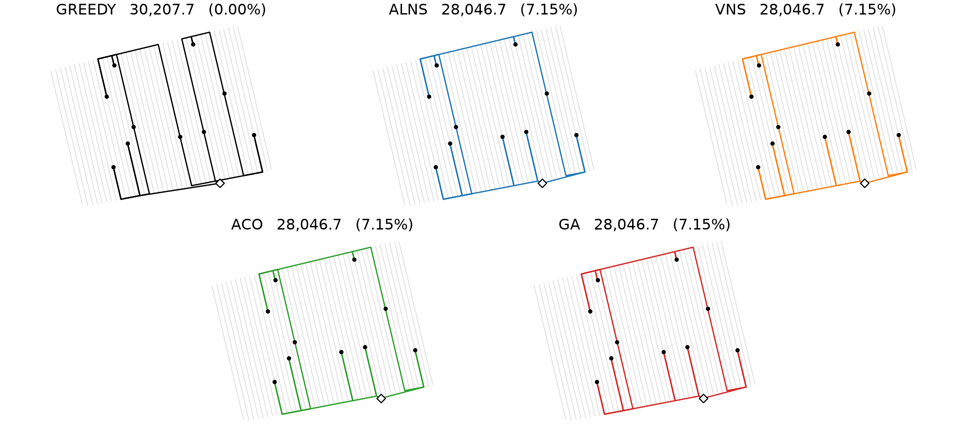
Route Comparison for 10 Sampling Stops
All routes start from depot 1. Labels show cost and reduction versus Greedy.
15
Notes:
Replayed routes use the same depot, seed and evaluation budget as the corresponding benchmark trial. All five route costs were verified against the CSV results.
https://github.com/cemanst/robo-router

Slide 16
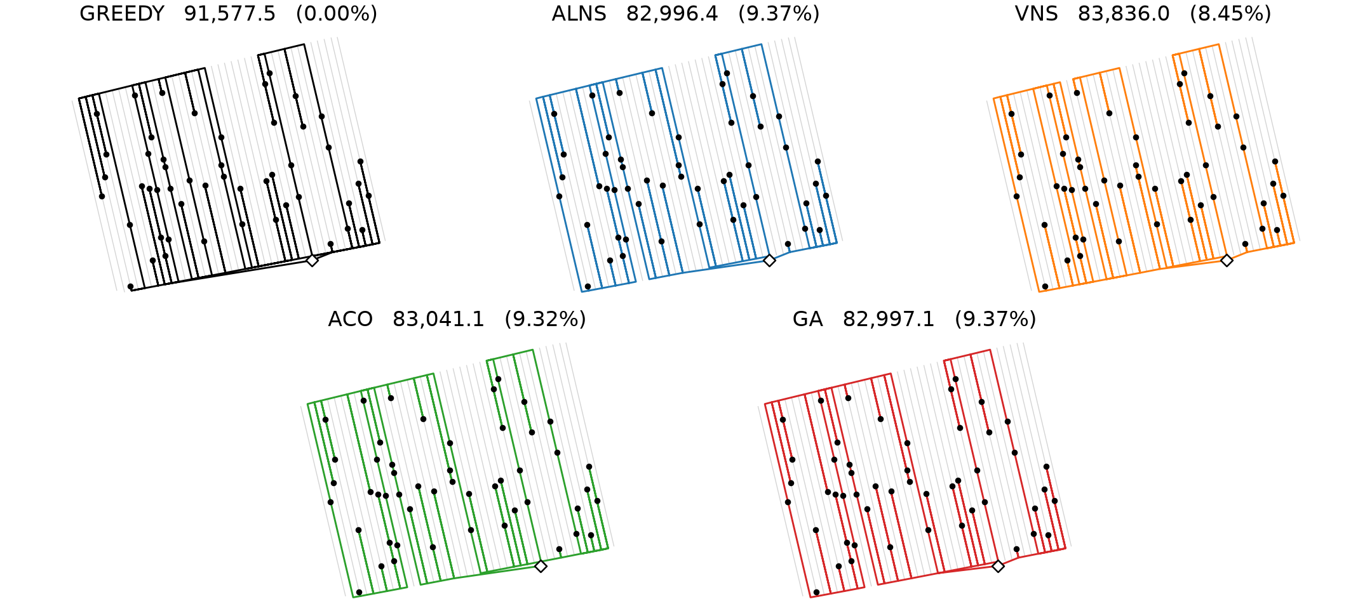
Route Comparison for 50 Sampling Stops
All routes start from depot 1. Labels show cost and reduction versus Greedy.
16
Notes:
Replayed routes use the same depot, seed and evaluation budget as the corresponding benchmark trial. All five route costs were verified against the CSV results.
https://github.com/cemanst/robo-router

Slide 17
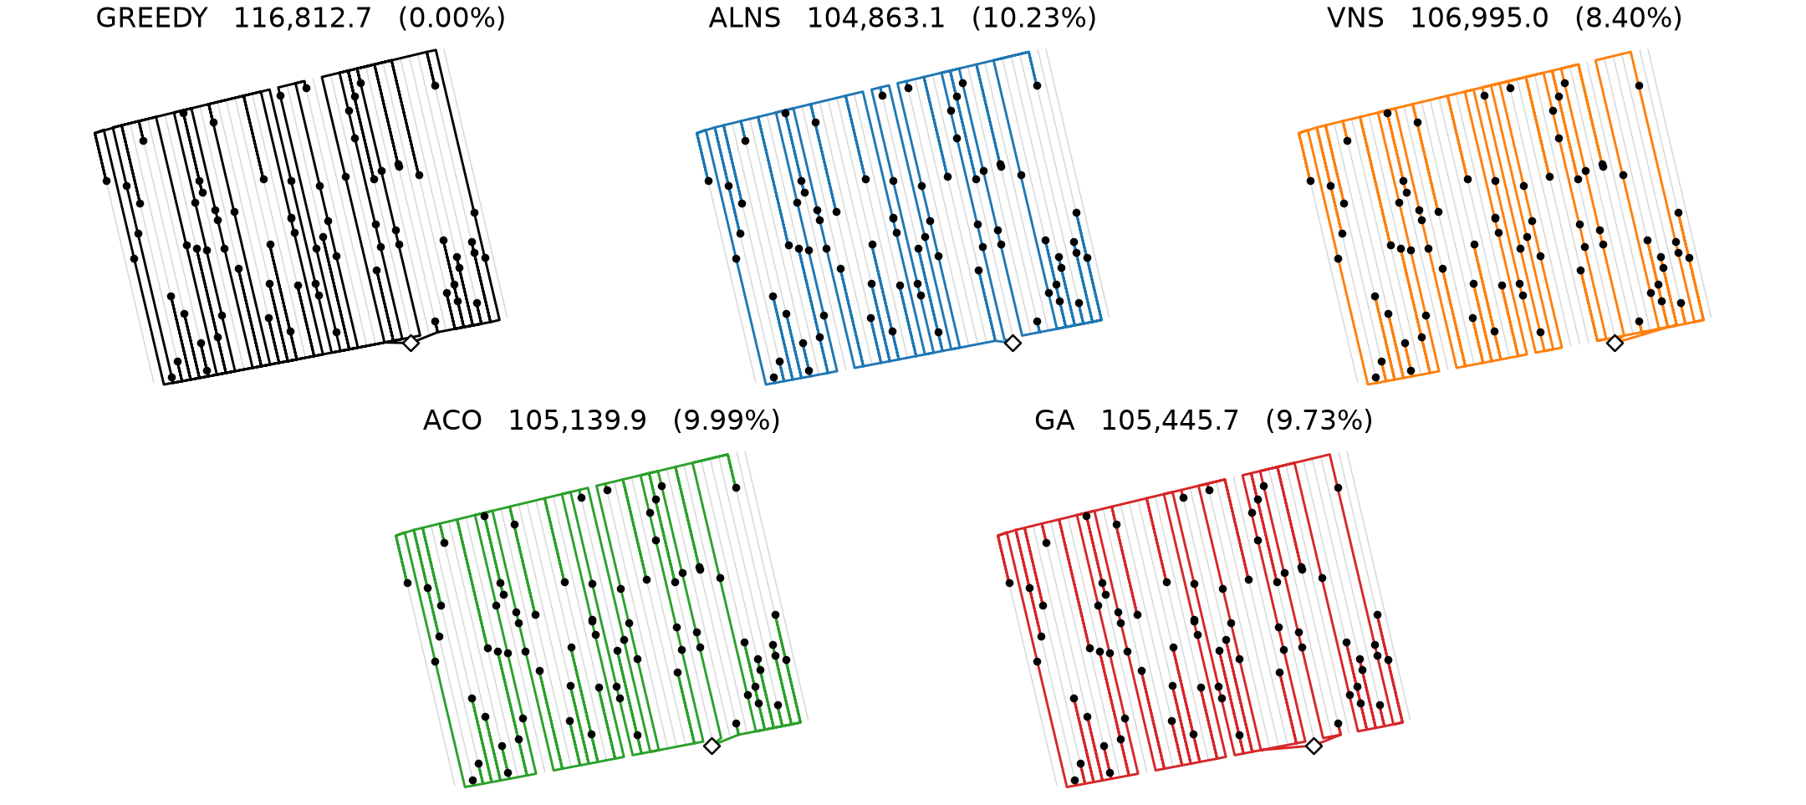
Route Comparison for 75 Sampling Stops
Derived subset. All routes start from depot 1. Labels show cost and reduction.
17
Notes:
Replayed routes use the same depot, seed and evaluation budget as the corresponding benchmark trial. All five route costs were verified against the CSV results.
https://github.com/cemanst/robo-router

Slide 18
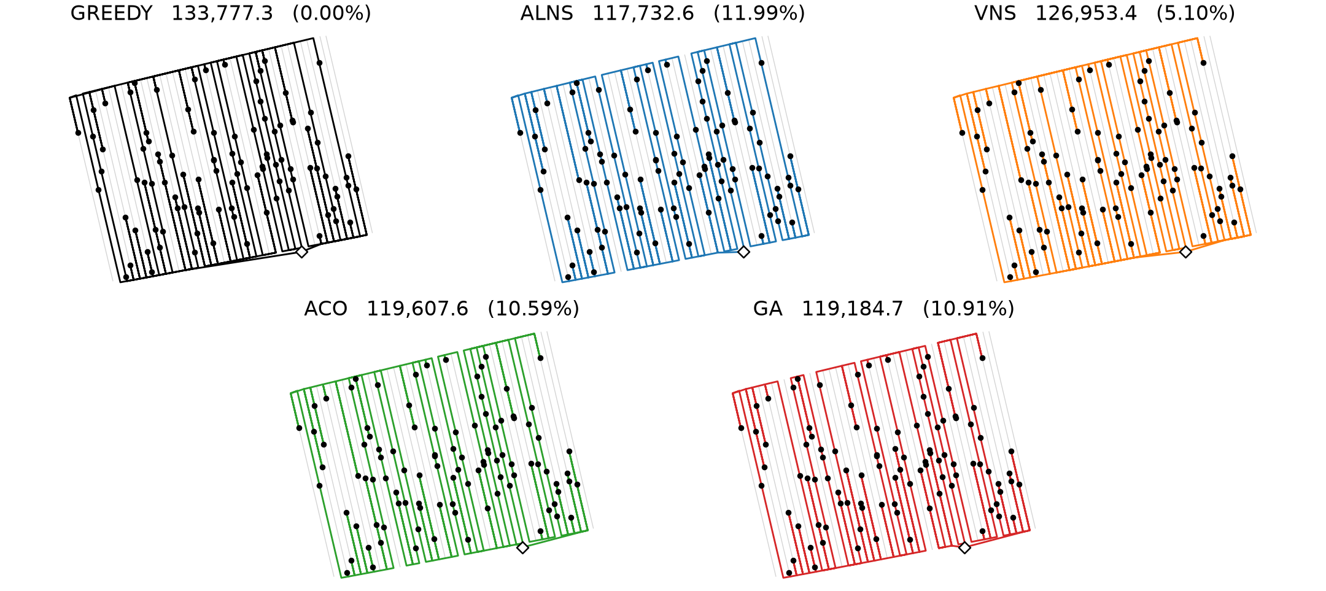
Route Comparison for 100 Sampling Stops
All routes start from depot 1. Labels show cost and reduction versus Greedy.
18
Notes:
Replayed routes use the same depot, seed and evaluation budget as the corresponding benchmark trial. All five route costs were verified against the CSV results.
https://github.com/cemanst/robo-router

