Slide 1
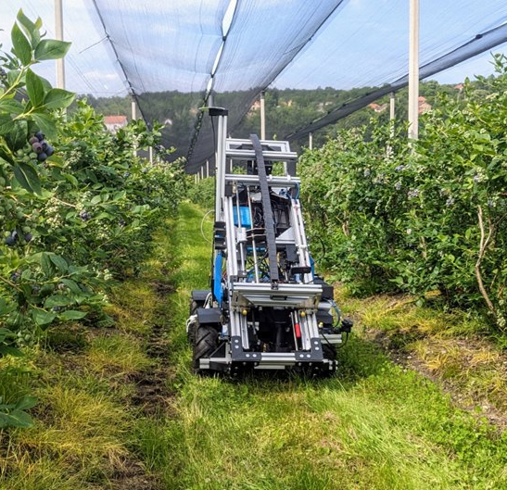
BIOSENSE INSTITUTE
Robo Router
Route optimization for
robotic soil sampling
Stanislav Čeman
FlexiGroBots research internship
Photo: FlexiGroBots
Notes:
The cover shows AgRobot Gari at the FlexiGroBots blueberry pilot. The algorithm results later in the deck are a repository benchmark.
https://flexigrobots-h2020.eu/blog/pilot-3-demonstrator-integration-testing-and-deployments
Photo: https://flexigrobots-h2020.eu/sites/flexig/files/public/content-images/media/2023/ugv.jpg
https://github.com/cemanst/robo-router

Slide 2
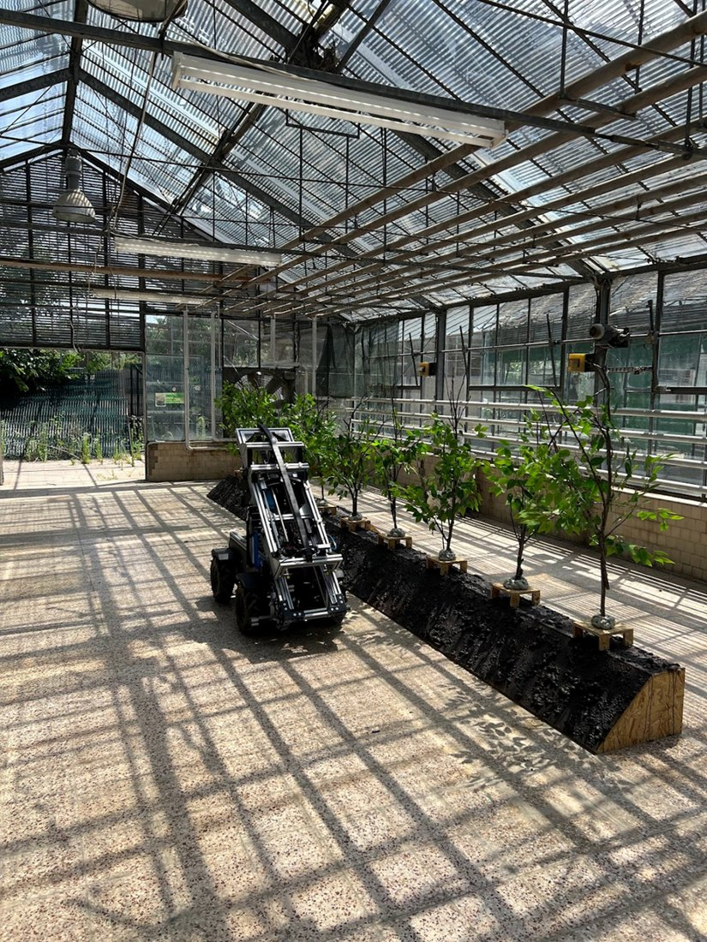
The FlexiGroBots
blueberry pilot
BioSense provided the ground robot for the EU Horizon 2020 pilot in Serbia and Lithuania.
The field workflow
Drone surveys help select sampling locations. A route planner orders the stops for AgRobot Gari, which collects and analyzes soil in the field.
Heuristic optimization
Implementation of 4 optimization heuristics for route planning.
Photo: FlexiGroBots greenhouse test site
02
Notes:
https://flexigrobots-h2020.eu/blog/pilot-3-demonstrator-integration-testing-and-deployments
https://flexigrobots-h2020.eu/blog/pilots-progress
BioSense’s role: https://flexigrobots-h2020.eu/node/257
Pilot scope: https://flexigrobots-h2020.eu/pilot-3-blueberries
Photo: https://flexigrobots-h2020.eu/sites/flexig/files/public/content-images/media/2022/image1_1.png
https://github.com/cemanst/robo-router

Slide 3
Heuristics in Robo Router
Four route optimization methods implemented by Stanislav Čeman
GA
Genetic algorithm
Starts with variations of the greedy route. Combines segments from parent routes and mutates the stop order.
algorithm2/ga.py
ACO
Ant colony optimization
Builds routes using edge cost and pheromone. Reinforces the edges used by the strongest tours.
algorithm2/aco.py
VNS
Variable neighborhood search
Tries combinations of segment reversals. Switches neighborhoods when progress stalls.
algorithm2/vns.py
ALNS
Adaptive large neighborhood search
Adapts how often it chooses each segment-reversal operator. Repairs routes and uses a cooling schedule to accept some higher-cost moves.
algorithm2/alns.py
github.com/cemanst/robo-router
03
Notes:
The nearest-neighbor greedy route is the baseline for the four heuristics.
https://github.com/cemanst/robo-router/blob/main/algorithm2/ga.py
https://github.com/cemanst/robo-router/blob/main/algorithm2/aco.py
https://github.com/cemanst/robo-router/blob/main/algorithm2/vns.py
https://github.com/cemanst/robo-router/blob/main/algorithm2/alns.py
https://github.com/cemanst/robo-router

Slide 4
BENCHMARKING
Search budget
About 40,000 route evaluations per run, with five seeded runs per search method. Each dataset uses a fixed depot and a common route evaluator.
On 50 stops, the previous GA and ACO both improved when the budget rose from 10,000 to 40,000 evaluations. Median gains rose from 4.22% to 4.70% for GA and from 5.65% to 7.49% for ACO.
The objective includes movement costs and turn penalties.
04
Notes:
The greedy baseline counts as one route evaluation in the GA initialization. ACO, ALNS and VNS count evaluations after establishing the baseline.
https://github.com/cemanst/robo-router

Slide 5
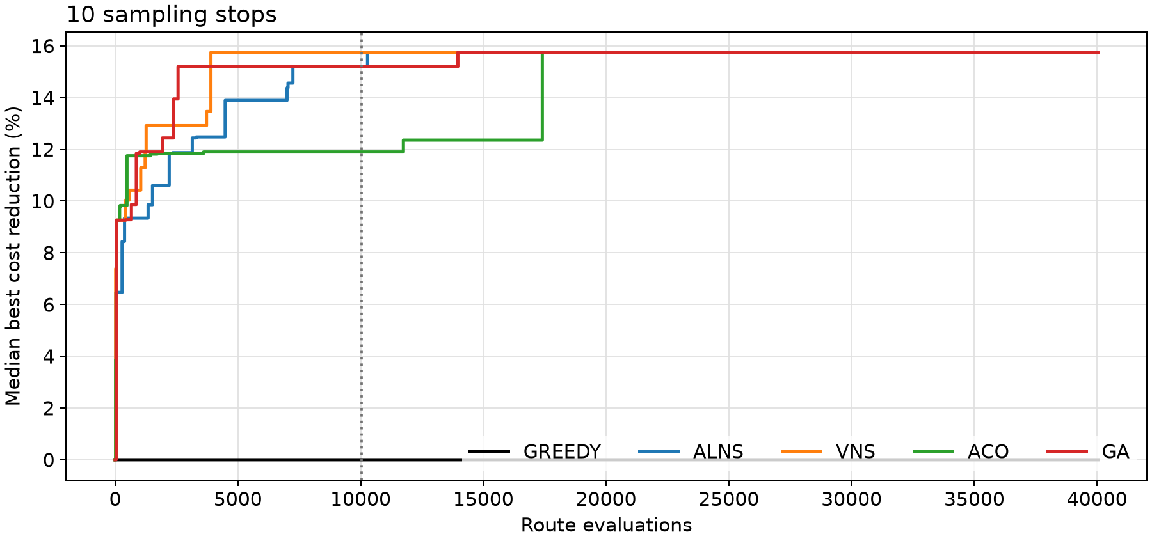
Five methods on 10 sampling stops
Greedy baseline 33,291.0 · Lower route cost is better
Reduction versus greedy
Method | Median ~10k | Median ~40k | Best ~40k
GREEDY | 0.00% | 0.00% | 0.00%
ALNS | 15.20% | 15.75% | 15.75%
VNS | 15.75% | 15.75% | 15.75%
ACO | 11.90% | 15.75% | 15.75%
GA | 15.20% | 15.75% | 15.75%
All four searches reach a median reduction of 15.75%.
Five runs per search method. The dotted line marks 10,040 evaluations.
05
Notes:
Run data: benchmarks/results/with_elev_10/checkpoint-results.csv.
https://github.com/cemanst/robo-router

Slide 6
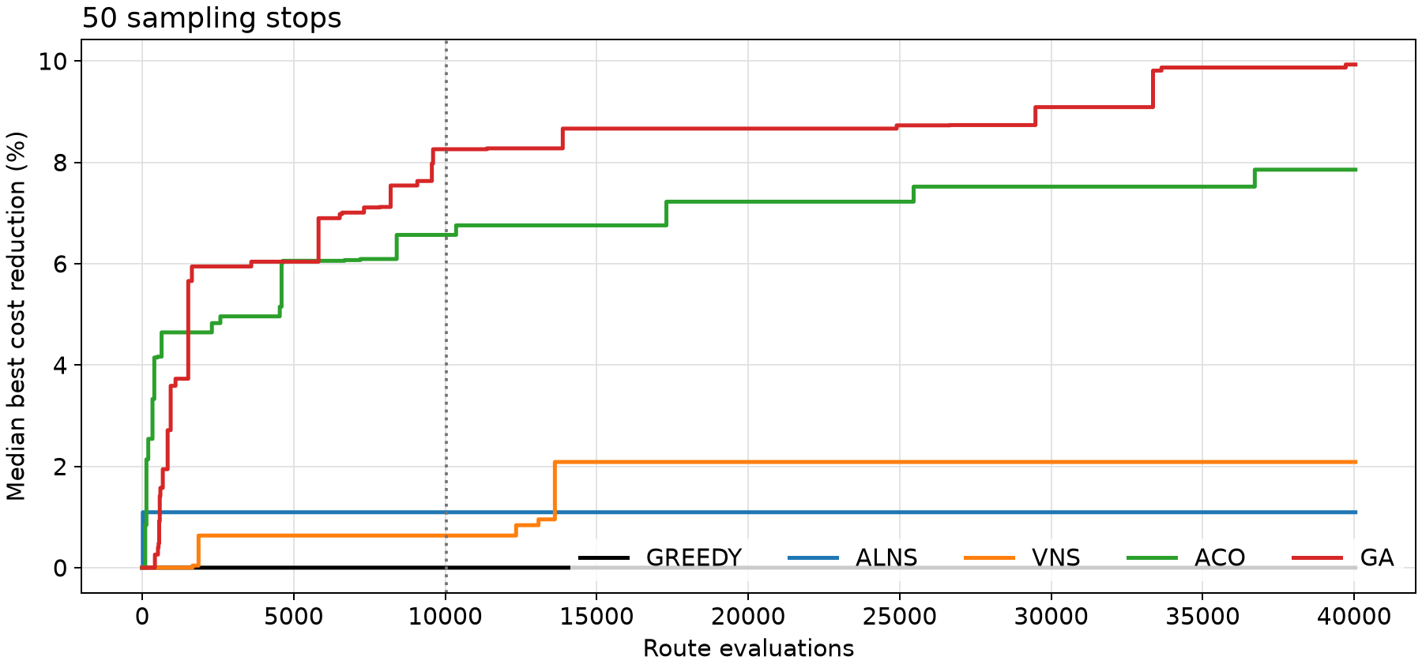
Five methods on 50 sampling stops
Greedy baseline 102,818.3 · Lower route cost is better
Reduction versus greedy
Method | Median ~10k | Median ~40k | Best ~40k
GREEDY | 0.00% | 0.00% | 0.00%
ALNS | 1.09% | 1.09% | 2.96%
VNS | 0.63% | 2.09% | 4.68%
ACO | 6.57% | 7.85% | 8.56%
GA | 8.26% | 9.93% | 10.70%
GA has the highest median reduction at 9.93%.
Five runs per search method. The dotted line marks 10,040 evaluations.
06
Notes:
Run data: benchmarks/results/with_elev_50/checkpoint-results.csv.
https://github.com/cemanst/robo-router

Slide 7
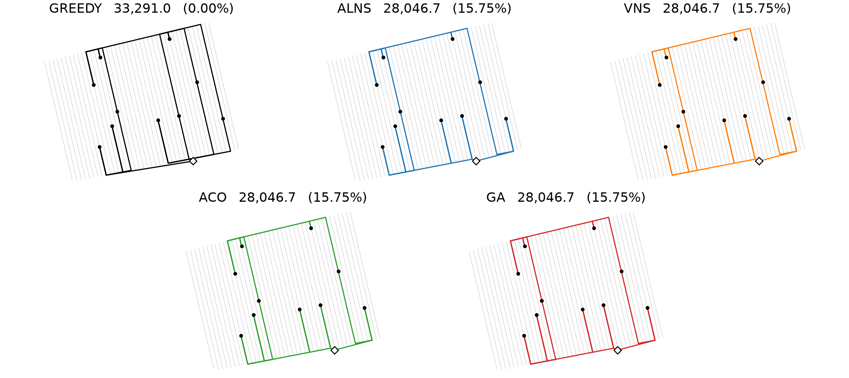
Route comparison · 10 sampling stops
Greedy baseline and the best route from each of the four searches
Labels show route cost and reduction versus Greedy. Dots mark sampling stops and the diamond marks the depot.
07
Notes:
Each map uses the same bounds and scale for this dataset. The winning seeds were replayed and their route costs were checked against the original benchmark.
https://github.com/cemanst/robo-router/tree/main/benchmarks

Slide 8
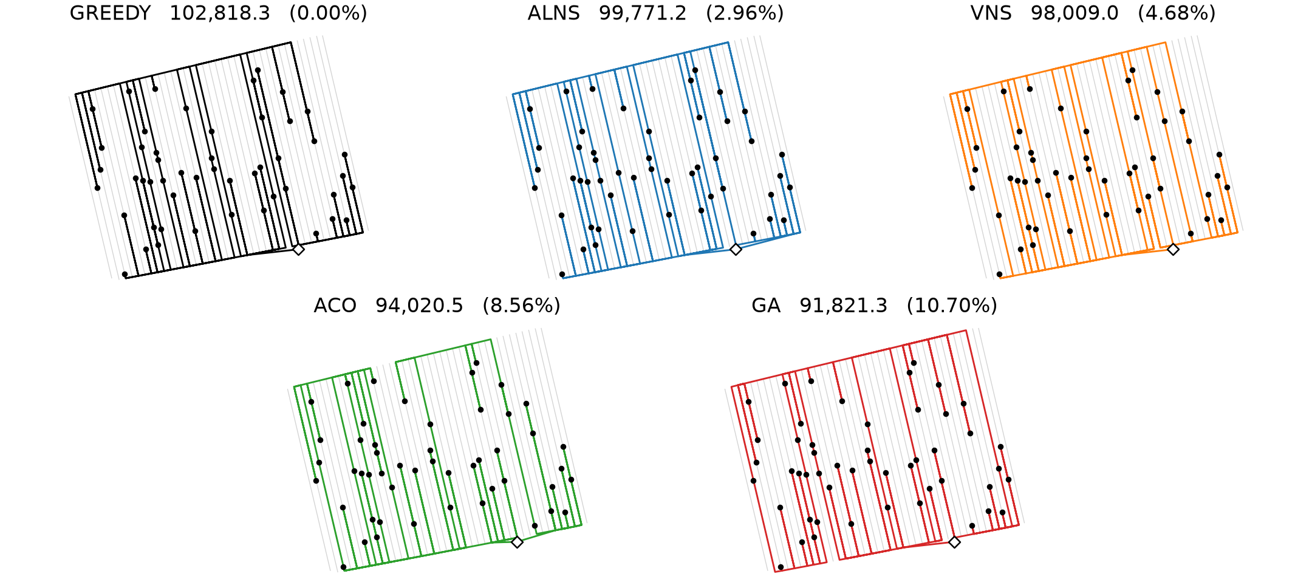
Route comparison · 50 sampling stops
Greedy baseline and the best route from each of the four searches
Labels show route cost and reduction versus Greedy. Dots mark sampling stops and the diamond marks the depot.
08
Notes:
Each map uses the same bounds and scale for this dataset. The winning seeds were replayed and their route costs were checked against the original benchmark.
https://github.com/cemanst/robo-router/tree/main/benchmarks

