Slide 1


Airline Flight Delay Project
CIS 9660 QMWA / Data Mining For Business Analytics
Prof. Arturo Castellanos / December 9, 2019
Group 2: Michael S. Bonetti | Cem Davran | Tom Javett
Wen Ouyang | Xuming Shi | Yoyo Wu | Hailey Zhang

Slide 2
WHAT WE WILL TALK ABOUT
01
02
03
04
BACKGROUND
CHALLENGES
METHODS THAT
DIDN’T WORK
METHODS THAT
DID WORK
05
06
BEST RESULT
INSIGHTS/
FINAL THOUGHTS

Slide 3
01
BACKGROUND
BUSINESS PROBLEM
DATA CLEANING
Understand Flight Delays
Airline / Airport Connection
How Bad
Data Source
US Bureau of Transportation Statistics.
Data Choice
Chose off-month (June 2019)
Omitted focus on weather / mechanical issues.
Target Variable
Classification: Binary
Military Time
Avoid AM / PM Confusion
Easier for RapidMiner to process.
Data Balanced
60 / 40
No Missing Attributes

Slide 4
02
CHALLENGES
WITH DATA
WITH PERFORMANCE IMPROVEMENT
Large Dataset (600,000+ instances)
Sampling mandatory (@ 10%)
Infinite models to combine.
Multiple combinations.
Small improvements
f-measure increases but recall may decrease, and vice versa.
Performance doesn’t always increase
Trying different things (i.e.: models, parameters, new ways, etc. …).
Bias
Discovered at least 2 variables leaking answer.
WITH MODEL SELECTION
Processing times.
Cross-validation took too long.
Infinite models to combine.
Multiple combinations.
Occam’s Razor

Slide 5

02
PREDICTIVE MODELING
FEATURE SELECTION & ENGINEERING
OPTIMIZATION
Domain Knowledge & Intuition
Correlation Matrix & Information Gain
One-hot encoding
Parameter Tuning
Depth of trees, Cross-Validation folds
Testing of Certain Attributes on Baseline
Distance, Day-of-Week, Time-of-Day
Ensemble Methods
Ada Boost, Voting
SMOTE, PCA, LARS / Lasso Regression
Bragging (significant drop in recall)
MODEL BUILDING & EVALUATION
Developing a baseline
Comparing 5+ multiple algorithms
Gradient Boosted Trees, Deep Learning, etc
Cross Validation vs Train/Test Split
DID NOT WORK

Slide 6

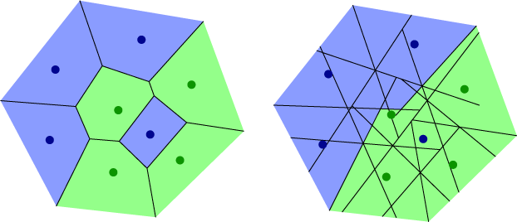
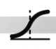

03
METHODS THAT DIDN’T WORK
VIA PREDICTION MODELS
VIA OPERATORS
Models with different parameters:
Decision Trees
k-NN
Logistic Regression
Ensemble Learning: Bagging
Performance dramatically decreased.
Long processing times
Other Methods
SMOTE
PCA / SVM
Clustering

Slide 7

04
METHODS THAT WORKED
VIA PREDICTION MODELS
VIA OPERATORS
Deep Learning
Performance slightly decreased.
Not as good as GBT.
Gradient Boosted Trees
Harder to find correct combination of parameters, compared with Deep Learning.
Performed better than Deep Learning.
Ensembles
AdaBoost
Vote
Bragging (but poor performance)
Select Attributes
by weight of information gain.
+

Slide 8
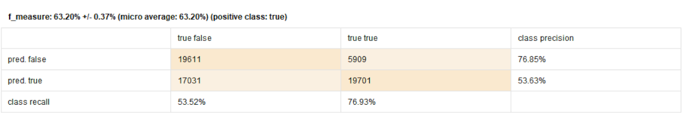
05
BEST RESULT
Group | Precision | Recall | F-measure
2 | 0.5363 | 0.7693 | 0.6320
 | F-measure
Baseline | 57.93%
Final | 63.20%
11% Improvement

Slide 9
06
INSIGHTS / FINAL THOUGHTS
Future Enhancements
Model Implications & Value
Increase sample data and apply model on unseen data
Incorporate additional airport and aviation metrics and data points
Load factor, staffing levels, gate capacity, fleet type, vendor, etc
Anticipate controllable delays and minimize quick turns
Strengthen operations planning, crew scheduling, and supply chain management
Enhance network and routing strategy

Slide 10
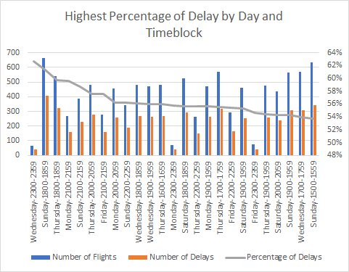
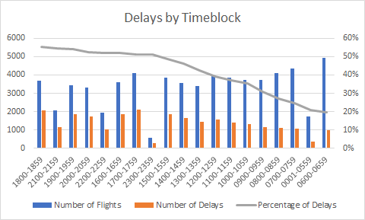
06
Time and Day Insights

Slide 11
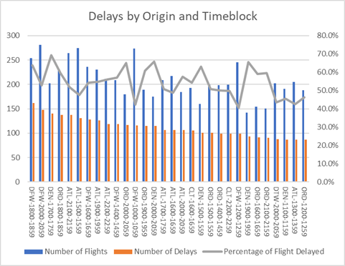
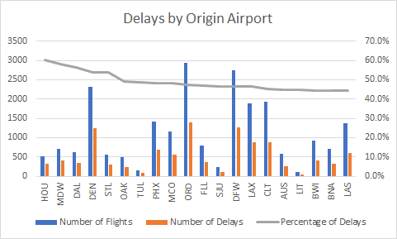
06
Origin-Time Insights

Slide 12
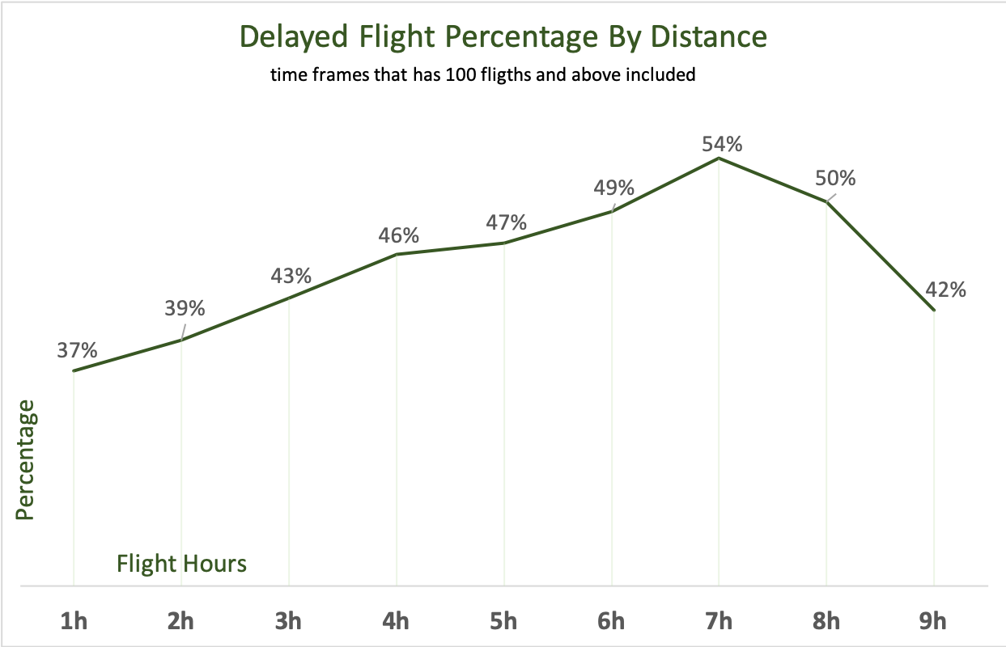
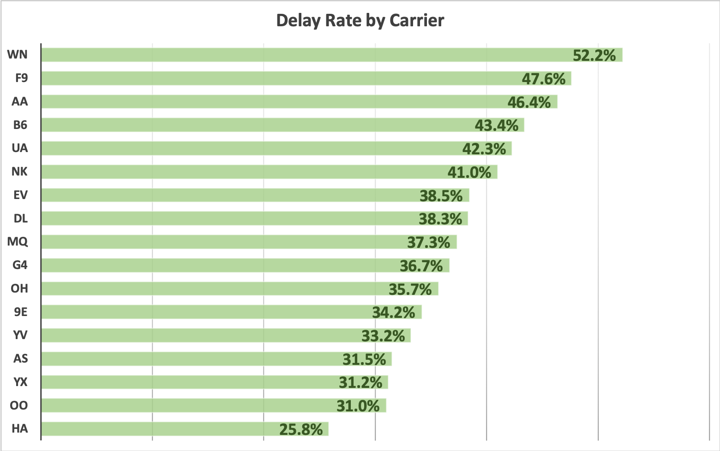
06
Carrier/Distance Insights

Slide 13

THANK YOU!
Q&A

Slide 14


04
METHODS THAT WORKED
VIA PREDICTION MODELS
VIA OPERATORS
Deep Learning
Best performance under good parameters (layers, activation, etc. …).
Better model than GBT.
Gradient Boosted Trees
Harder to find correct combination of parameters, compared with Deep Learning.
Will never be the best performer when compared to Deep Learning.
Vote operator
Vote among different answers.
Before: stalled at 27% f-measure
After: 28%+ f-measure
PCA (principal component analysis)
Generate new attributes.
Improved f-measure to 29.60%.
Select Attributes
by weight of information gain.
+

Slide 15
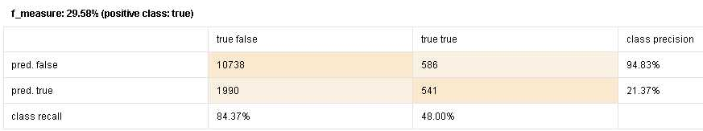
05
BEST RESULT
Group | Section | Precision | Recall | F-measure | Position
210 | 2 | 0.26119403 | 0.345395 | 0.297450425 | 1
 | F-measure
Training | 29.58%
Scoring | 29.75%

Slide 16
06
INSIGHTS / FINAL THOUGHTS
IN GENERAL
Unusual attribute correlations.
FLAG_OWN_CAR
HOUR_APPR_PROCESS_START
OTHER METHODS TRIED
Random forest and SVM.
FINAL THOUGHTS
We thought many attributes were useless, but proved to be vital.
Voting proved very useful!
Result: more reliable data for lenders!

Slide 17

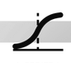
01
k-NN
DECISION TREE
DEEP LEARNING
Classifying new data based on nearest neighbors. Simplest machine learning technique.
Initial f-measure: 10.0676218%
Uses split ruling to create a tree-like collection of nodes, intended to create a decision. (i.e.: Titanic)
Initial f-measure: 1.9655766%
Data fed through artificial neural network, with many layers of neurons. One of the better machine learning operators.
Initial f-measure: 0.5964215%
GRADIENT
BOOSTED TREES
+
LOGISTIC REGRESSION
Boosts the weaker data. One of the more powerful machine learning techniques.
Initial f-measure: 13.6978417%
A classification model that outputs a binomial result.
Initial f-measure: 8.8013865%
Notes:
Red = update numbers.

