Slide 1
Inequality and Decentralized Governance in Brazil
Marta Arretche
22nd IPSA World Congress
Inequality and Decentralised Governance. The IMO Project
Joint panel RC05 & RC28
Madrid, 8th -12th July, 2012

Slide 2
Socio-spatial inequality in metropolitan regions
(Gini coefficients)

Slide 3
Brazilian Regime of place-equality
Revenues: three-layers of regulation
1. Local government tax-raising powers
  Subnational governments are limited to define the rate of their own taxes
  the authority to define the tax base of subnational governments is exclusive to the central government
2. Constitutionally-based transfers from the federal government to all municipalities
Federal transfers: based on population
State transfers: rebates
3. Universal earmarked transfers in redistributive policies (health and education)

Slide 4
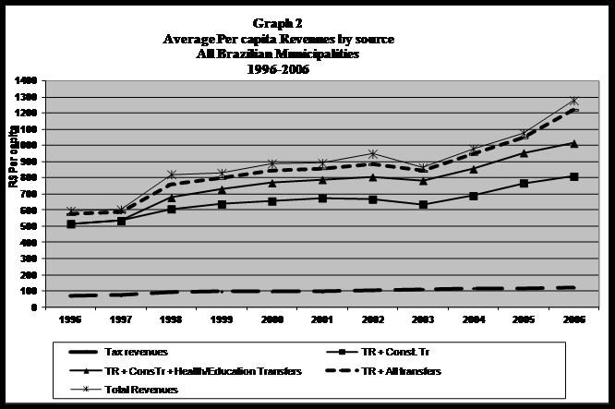
Constitutional transfers are a central component of the Brazilian RPE

Slide 5
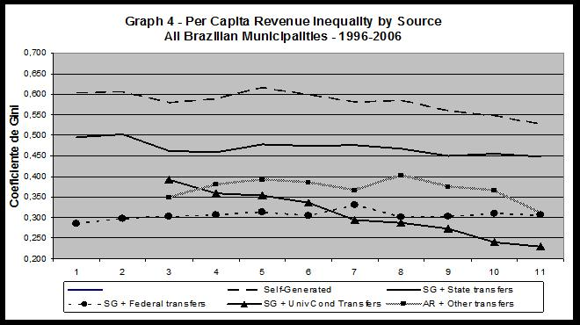
Transfers greatly reduce place-inequality on the revenue side

Slide 6
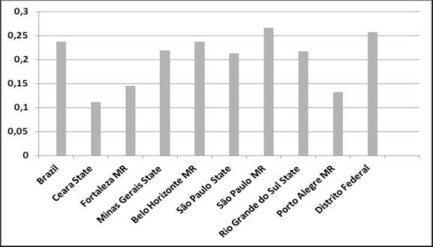
Cross-Municipality Inequality on Percapita total revenues
Brazil and Metro areas
(Gini coefficients – 2010)

Slide 7
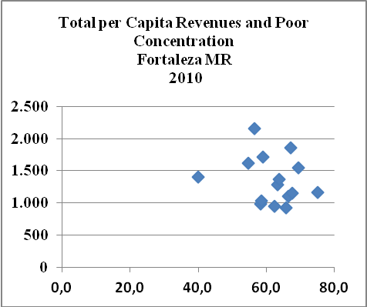

Slide 8
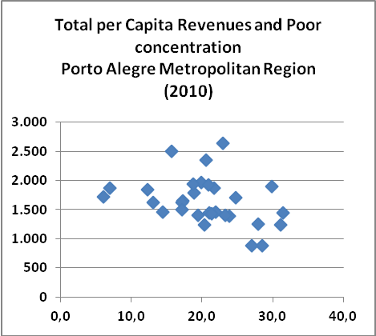
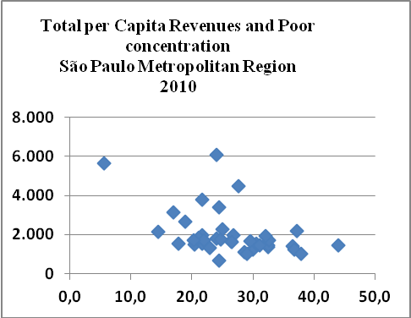
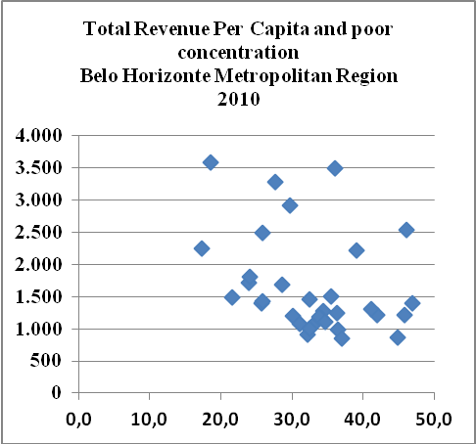
Mismatch between need and revenues in metro areas

Slide 9
National policies towards place-equality
Expenditures:
  Constitutionally earmarked local government expenditures
    education policy:
      1998-2006: states and municipalities should spend at least 15% of their overall revenues on primary education
      60 % of such expenditure should be used entirely to pay teachers actually teaching
      from 2007 on: states and municipalities should spend at least 20% of their transfers on basic education
      national wage floor for teachers
    health policy:
      since 2000: municipalities should spend 15% of their total revenues on health
      since 2000: states should spend 12% of their total revenues

Slide 10
National policies towards place-equality
In combination with fiscal policies (that reduce inequalities in municipalities revenues), national rules on the expenditure side reduce inequalities in local service capacities (Denters and Sterkenburg (2007)
the scope for local decision-making autonomy on expenditures is policy-specific
  large in developmental policies (urban infrastructure and transport)
  large: culture, recreation and sports policies
  limited in redistributive policies (health and education)
    education:
      constitutionally earmarking of expenditures
    health:
      federal universal earmarked transfers (attached to policies)
      constitutionally earmarking of expenditures

Slide 11
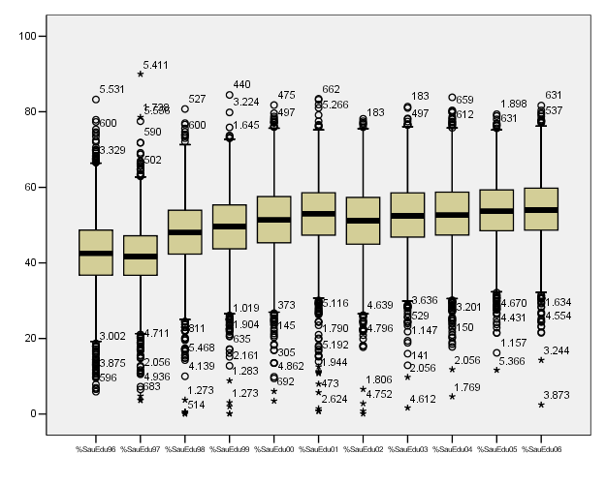
Municipalities’ share of redistributive expenditures 1996-2006

Slide 12
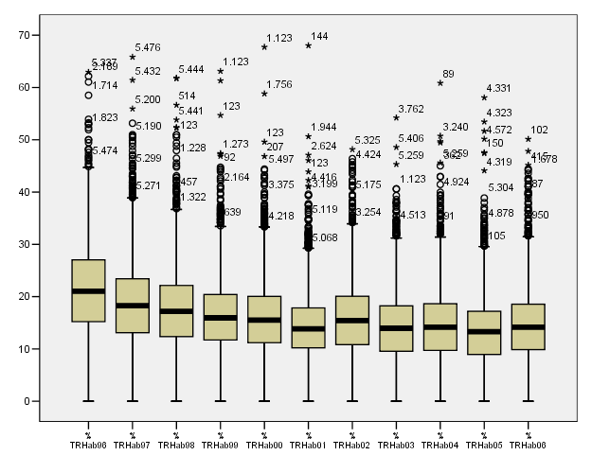
Municipalities’ share of developmental expenditures 1996-2006

Slide 14
A similar pattern of spending for Brazilian and metro areas

Slide 15
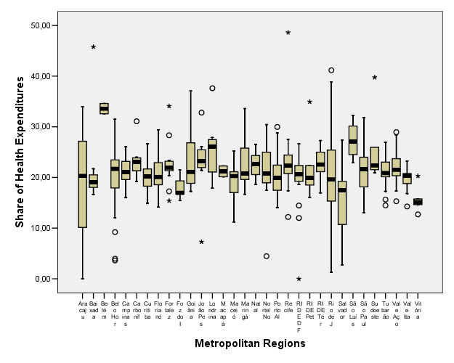
MR’s Municipalities Share of Health Expenditures – 2006

Slide 16
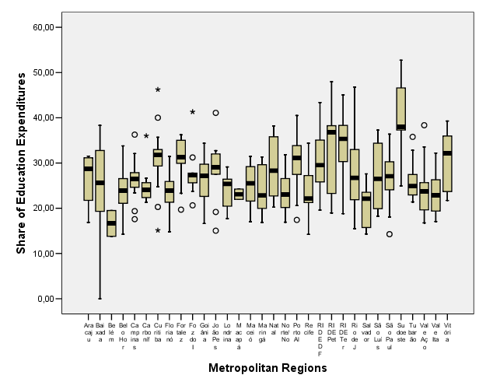
MR’s Municipalities Share of Education Expenditures – 2006

Slide 17
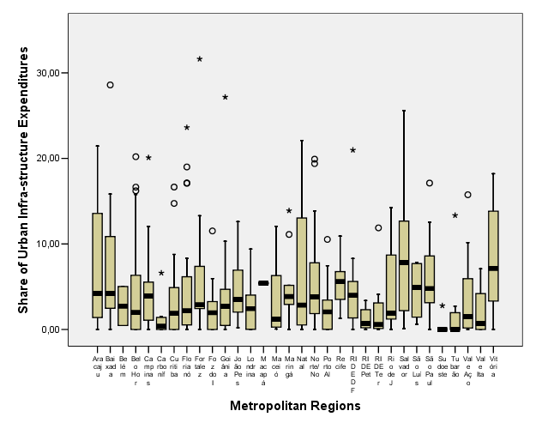
MR’s Municipalities Share of Urban Infra-structure Expenditures – 2006

Slide 18
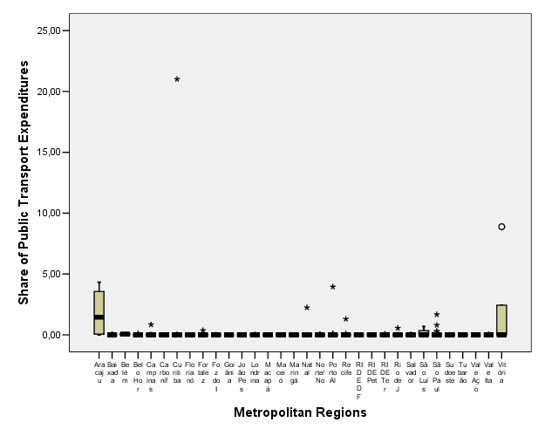
MR’s Municipalities Share of Public Transport Expenditures – 2006

Slide 19
Main results
Revenues:
revenue inequality among Brazilian municipalities would be much greater if they were to count solely on their self-generated tax receipts
Shared-revenues have a great inequality-reduction impact on local government revenues
BUT, they favour mostly small size municipalities
AND SO, in metropolitan cities, there is a mismatch between need and per capita revenues

Slide 20
Main results
Pattern of Local Government Expenditures:
  local governments give higher priority to redistributive policies than to developmental ones
  inequality of per capita expenditures is higher in developmental policies than in redistributive ones
  being a metropolitan city does not affect neither municipalities’ spending priorities nor per capita spending on specific policies
Expenditure inequality is best explained by disposable revenues and spending legacies
  belonging to an official metropolitan region does not affect per capita expenditure

Slide 21
Propositions for the IMO project
Moderate systems of central-local relations may coexist with the constitutional autonomy of local governments, but tend to render ineffective their potential impact over local government decisions
Metropolitan level arrangements based on the voluntary cooperation of municipalities tend to reproduce the outcomes of the central-local relations. This occurs because metropolitan governance is, in this case, an activity of inter-municipal cooperation, and so, municipalities decisions will be affected by central-level rules and supervision.
Moderate supervision of local government expenditures restrict the impact of variables of a local character on the spending inequality among municipalities. This occurs because, by suppressing local governments’ decision-making autonomy on matters regulated by the central legislation, the effect that local attributes may generate on citizens’ and elected governments’ preferences is eliminated.

Slide 22
Propositions for the IMO project
Hence, systems of moderate supervision of local government expenditures reduce the impact that the theories of the median voter and of the distribution of party preferences attribute to local governments’ expenditures decisions, given that part of the decisions on expenditures will be outside local governments’ decision-making remit.
Equally, systems that have nationalised spending decisions for redistributive policies limit an affluent municipality’s ability to prioritise developmental expenditures, since national regulation affects the agenda of local governments, limiting the incentive to use this type of expenditure as a strategy to attract investments.
Systems of moderate supervision of local governments may be policy-specific, that is, geared to reducing their decision-making autonomy in specific fields, which means such systems may coexist with broad decision-making autonomy over those policies for which there is no intention of obtaining reductions in inequalities.

Slide 23
Propositions for the IMO project
The formal designation of responsibilities for policies, combined with moderate systems of centre-local relations, tends to produce similar spending patterns.
In moderate systems of central-local relations, the formal designation of responsibilities and egalitarian aims tend to produce a spending pattern in which social expenditure is up to local governments.

