Slide 1
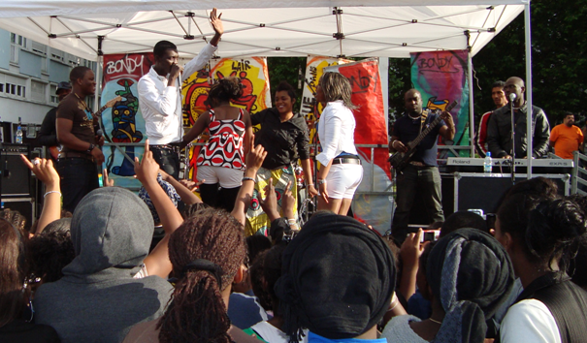

British multiculturalism versus French color-blind integrationism:
Youth ethnicities in working-class neighbourhoods of Paris and London
Agathe Voisin
PhD candidate, Sciences Po, Observatoire Sociologique du Changement (OSC)

Slide 2
A twofold research question
→ How is ethnicity shaped in France and Britain?
Impact of national models mediated by local contexts on young people’s identities, sociabilities and representations.
→ How do young people strategically use ethnicity to invent new forms of individuation that challenge traditional models of identity and citizenship?

Slide 3
Ethnicity
A constructionist perspective
Weber (1922): subjective belief in a common descent
Barth (1969): Attention to boundaries
Macro processes
Ethnicity derives from national models and philosophies (Favell 1998; Anderson 1983; Gilroy 1987).
Micro processes
Everyday interactions in specific local contexts: repeated interactions foster structural and durable representations of one’s place and belonging (Joseph 1984; Amin 2002).
→ A “full circle” explanation:
From macro structuring processes to micro resistances and negotiations (Wimmers 2008).

Slide 4
Comparing France and Britain
European post-industrial and post-colonial societies...
Important european, post-industrialised societies. 63 000 000 inhabitants of Metropolitan France, just under 59 million in UK.
After WWII: Immigration from former colonial empire: North Africa and Africa in France; the Carribean and Indian subcontinent (India, Pakistan, Bangladesh) in UK.
1970's Economic crisis: from lone workers to families.
1980s: Unemployment, right-wing populist parties and riots : moral panics around “second generation”.
UK: Riots in Brixton (south of London, confrontation between young caribbean men and the police).
France: Riots in « les Minguettes » (Deprived east periphery of Lyon, confrontation between young maghrebian men and the police)
Since then : recurrent riots considered as touchstone of national models and philosophies.
… But opposite national models and philosophies.

Slide 5
 | BRITAIN | FRANCE
philosophy | Multiculturalism | Color-blind integration.
The Nation | Cultural | Civic and political
The State | unifies several nations and cultures (England, Wales, Ireland, Scotland) | Centralization from 17th Cent. No intermediary between the citizens and the State.
Individuals/ communities | Collective rights. Communities and ethnic minorities have a social and political function. | Pre-eminence of individual rights. Cultural differences contained to private sphere.
colonization | Rely upon traditional authorities | Civilising project. Assimilation.
Reception of immigration | 1948 : British national act. Immigrants → minorities | Immigrants have to go back or to assimilate.
Public policies toward immigration and minorities | Anti-discrimination policies : Race Relation Acts (1965, 1968, 1976). Commission for Racial Equality, Race Relations Units. Equal opportunity policies Affirmative action (public employment and access to social services), monitoring of private practices. Housing, employment, justice, education. municipal multiculturalism : local political market. | No specific policies. “Politiques de la ville” : Target deprived (and immigrant) territories by giving more provisions: education, youth unemployment and qualification, local activities and sociability. Low representation of minorities. Strict secularism but implicit ethnic management in school, social housing, associations, municipal politics.
Ethnic Statistics | In the census since 1991. « Equality Opportunity Forms » | No ethnic statistics. Unconstitutional.

Slide 6
Some convergence ?
A focus on Islam after September 11
the roll back of multiculturalism in UK:
Tightening of anti-terrorism measures, restriction of the autonomy, visibility and recognition previously accorded to Islam.
Cantle report (after 2001 riots in Bradford, Burnley and Oldham): « comunity cohesion » and « citizenship ».
David Cameron (after 2011 riots in London): a “moral problem” and the failure of multiculturalism.
French ambiguity:
A step towards UK? Creation of the HALDE (2004), public debate on ethnic statistics, civil society organisations (the CRAN).
A reinforced integrationism : « Ministry of immigration, integration and national identity »; National debate on « laïcité » (secularism); Ban on Hidjab in school (2004) and on Niqab in public space (2009).

Slide 7
a twofold research question
How do these national models in transition structure local ethnicity in working-class immigrant neighbourhoods?
Impact on young people sociabilities, representations, cultural practices, citizenship...
How do young people contest, question and challenge theses models ?

Slide 8
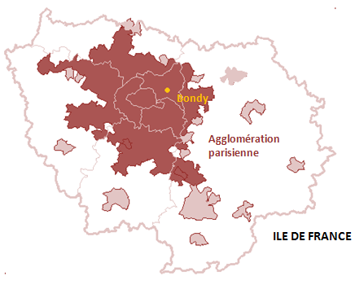
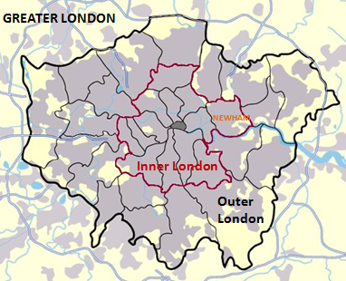
Field work
Two outlying working-class immigrant neighborhoods: Bondy (Seine-Saint-Denis) ; London Borough of Newham (East London)
Qualitative research with young people aged 15 to 25, with different family backgrounds and school trajectories. Individual interviews, participant and non-participant observations in local organisations, focus groups in secondary schools.

Slide 9
 | FRANCE | AGGLO PARIS | BONDY
Population |  | 9 643 880 | 53 600*
Under 20 years old | 24,6 % | 24,8 % | 28,2 %
Unemployment | 12,8 % | 11,8 % | 17,1 %
15 – 24 years old
Unemployment | 25,6 % | 19,8 % | 27,1 %
No qualification | 20 % | 18,8 % | 27 %
Social housing | 16 % | 24,7 % | 41,8 %
Lone parents | 12,3 % | 15 % | 18,1 %
4 children and more | 2,9 % |  | 6,3 %
Non nationals | 5,6 % | 12,7 % | 18,6 %
BONDY NORTH
10 299
33,5 %
24,2 %
36,2 %
32,8 %
77,9 %
25,6 %
26,8 %
Recensement 1999
*Estimation 2005

Slide 10
2001 | England and wales | London agglo. | Newham
Population | 52 041 916 | 8 278 251 | 243,891
Under 20 years old | 25,07% | 22,55 % | 32,42 %
Unemployment No qualification (16-74 years old) | 5,5 % 29.1 % | 7,6 % 23,73 % (GL) | 12,2 % 33.6 %
Council housing Overcrowding | 13,21 % 7 % | 17,12% (GL) | 25,44 % 26,3 %
Lone parents | 6,5 % |  | 11,9 %
Born outside EU | 6,63 % | 19,85 % | 35,61 %
Ethnicity
Asian | 4,36 % | 11,09 % (GL) | 32,52 %
White british | 87,49 % | 63,50 % (GL) | 33,77 %
Black | 2,18 % | 9,56 % (GL) | 21,58 %
Multiple deprivation index : 3d out of 326 Local authorities

Slide 11
I. How do national models and local contexts structure ethnicity ?
- “local consensus”
- Peer groups and youth cultures
- Families
- School and cultural institutions

Slide 12
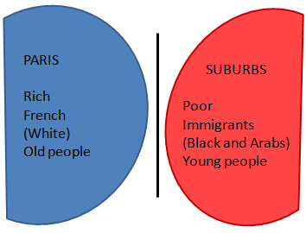
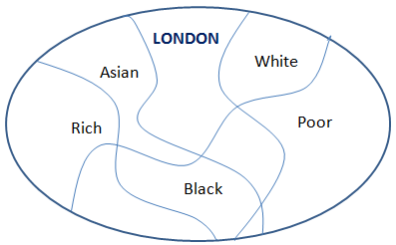
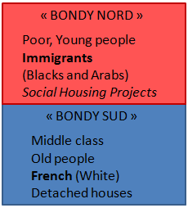
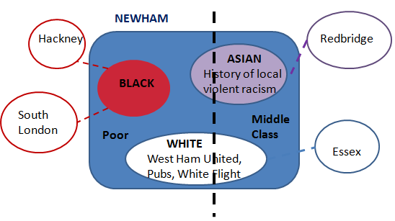
Local Consensus
→ dual opposition between “immigrants” (Blacks and Arabs) and “French”
→ three-cornered competition between “Black”, “Asian” and “White”
/ Newcomers (Asian immigrants in Bondy, Somalian refugees and East-Europeans immigrants in Newham) and traditional outsiders: Gypsies

Slide 13
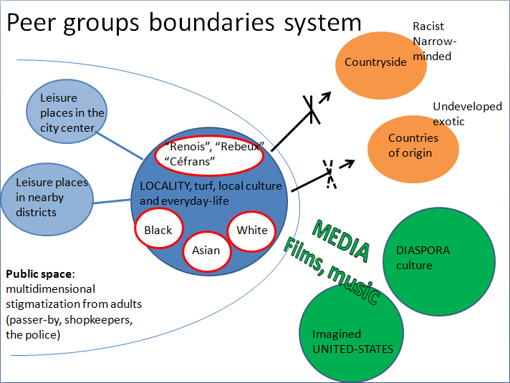

Slide 14
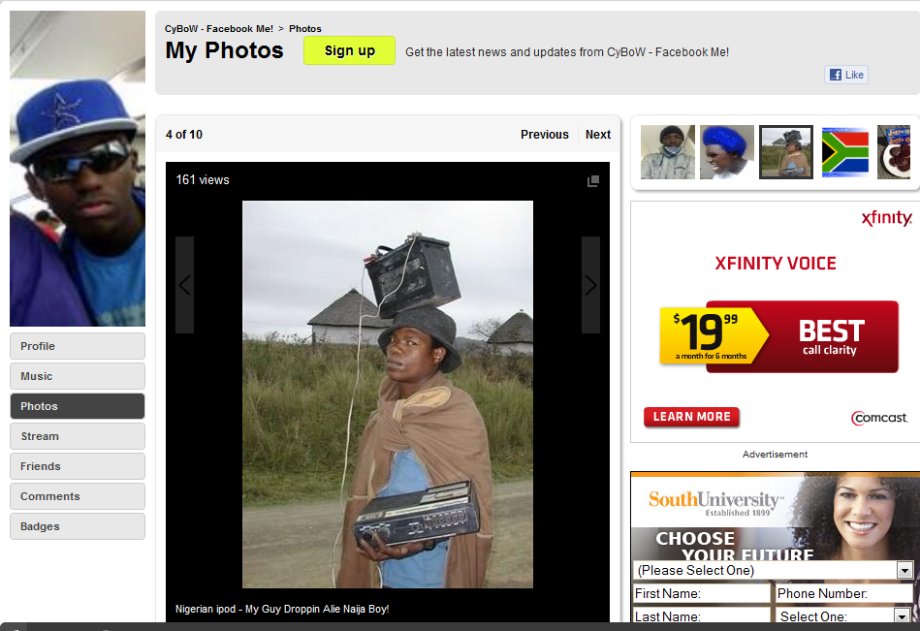
“Nigerian Ipod”: poking fun at countries of origin

Slide 15
Family boundaries system
Country of emigration
Local community, cultural and religious organizations
Nationality,
Region, city, village of emigration,
Castes…
Relationships
Between men and women, generations
Religious practices
Diaspora relationships
Family members in the same country
Culture and Decency

Slide 16
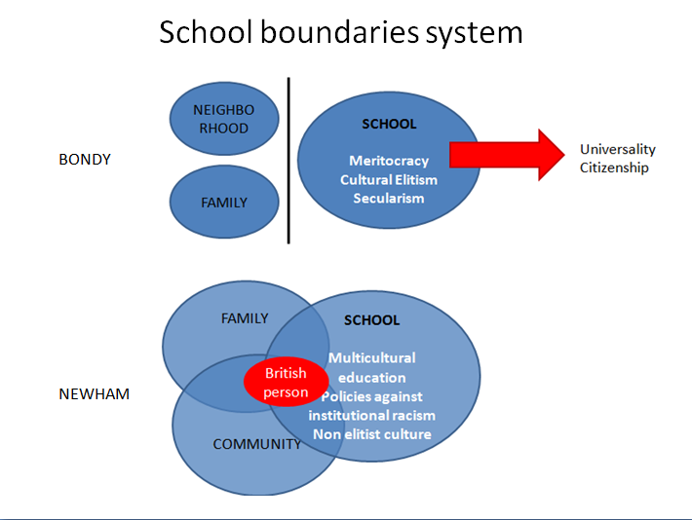

Slide 17
Conclusion I.: National models do impact forms and meanings of ethnicity in both countries:
A French contradiction: Republican discourse / practices
Shared identity as “young immigrants”
Conflicting relations to institutions
Being or not being French ?
→ Paradoxical politization of cultural and religious practices
UK: less ambitious political discource, concrete action against discriminations
No common identification
Less opposition to institutions
Being British isn’t an issue
Low politization of cultural and religious practices
→ A focus on social class

Slide 18
« Ce serait revenir à t’expliquer tout mon parcours, toute ma vie. Y a des évènements dans ma vie qui m’ont fait prendre conscience que putain merde je suis française et on ne me reconnaît même pas française ! tout ça pour quoi ? parce que je suis un peu plus bronzée que la norme ; ça va pas ou quoi ?! parce que je suis un peu plus bronzée je suis plus conne qu’une autre c’est ça !!! (…) Tout mon combat politique, ce qui me donne envie de me réveiller le matin, c’est de me dire putain merde je suis dans un pays comme la France, qui est censé incarner les Droits de l’Homme et y a encore de l’injustice ! »
Girl, high school student, Bondy.
“I don’t know, I just can’t define the world “British”: I say “I’m half British”.
- I’m born here, my parents are born here as well, it’ just their parents that came over like in the 60s, but I don’t feel British. I don’t feel British at all, to be honest. I just feel like me.”
“They’re a lot of intelligent working class people out there, and they never think you know, I don’t think he ever think, David Cameron, because he can’t... The reason why he’s doing what he’s doing is, because he never had to understand what it feels like to be a working class person, and because of that, he doesn’t know that there are people out there, young people out there who are bright intelligent, who could make this economy so much better, and other things like that. (…)
- You know, we’re doing poverty sociology yeah, and we’re going through those causes, original causes and thing, and they say: the boys weren’t into education and blablabla. And that’s not our fault. It’s because we’re put down, they’re putting us down, and they’re making us think working class people can’t do anything, so therefore we’re just ok, fine, I’ll back up, why should I lose my time in school when I can’t go and get into a good uni? When I can’t get a good qualification?
- I’m gonna get into a great university, and I’m gonna get good qualification, I’m getting a good job, I don’t care, I don’t care.”
Girls, high school students, Newham

Slide 19
II. How do individual identity strategies challenge national models ?
Finding a shelter: boundaries inversion, shifting, contracting
Escaping the neighbourhood and entering mainstream society : boundaries crossing
- Facing the system: boundaries blurring and challenging national models

Slide 20
Low resources, harsh discrimination: finding a shelter
(Boys, law socio-economic status, school drop-outs, social housing projects, stigmatized groups)
 | Processes | Topologies | Categories | Identity strategies
Peer groups, street and gang culture | Strong identity and belonging | Local turf; Symbolic places of wealth and success | Youth culture “bouffonisation” overplaying stereotypes | Boundaries Inversion
Youth work | Cultural resources, Role models | From involvement in the local community to integration in larger society | Youth work ethic and Anti-racism (contesting salience of ethnic categories in the local consensus) | Soft boundaries blurring
New socialization groups Ex: Salafist groups | Religious and cultural resources | Local and international Ummah, Islamic countries (Hijra) | Muslim/non Muslim | Boundaries shifting
Family | Back to tradition | Family and country of origin | Family boundaries | Boundaries contraction

Slide 21
cultural resources / segregated and stigmatized environment:
Escaping the neighborhood
(successful school students/Deprived Neighborhoods)
 | Processes | Topology | Categories | Identity strategy
 | Escaping through school or professional success | Rejection of the local place: (segregation and stigmatization) Entering mainstream society, Moving to foreign western countries | Rejection of categorization; longing for invisibility; affirmation of personal individuality | Crossing boundaries

Slide 22
“I don’t like. I don’t like nothing. I find them all childish. Apart from people I talk to but… anyway I don’t like here: I don’t like the neighbourhood, I don’t like the town, I don’t like nothing. I just want stuffs from Paris and… no, I hate here. I think they aren’t open-minded. The smallest the community is, the best it’s for me. I’m weird, but I prefer countryside, quiet places and… very far from here! It’s horrible! ”
Girl, 17 years old, high school student, living in poor social housing. Bondy
“The Rnb and Hip Hop, will be kind of music that was predominant. And later: jungle, jungle came along with, more of that. But again it just felt like… you know: subgroups, identity and stuffs. This is what it means to be Asian. You have to listen to certain kind of music, you have to use the same kind of language when you speak, you have to…. You know behave in a certain way. (…) I never felt comfortable with that, because for me it has always been: you are who you are. You got so many different parts to you characters anyway, so… You can’t say to me: I can’t listen to this, or I can’t do that”.
Boy, 30 years, PhD student, father retired manual worker. Newham

Slide 23
Better resources, lower discrimination: Blurring boundaries challenging national models
(Girls, upper working-class/lower middle-class, successful school students)
 | Articulation | Topology | Discourses | New individuations | Identity strategies
Newham | No contradiction | Involvement in local community – involvement in society – changing the world | Criticism of (individual) racism and (institutional) ethnic categorization: out-of-date and meaningless | Neither ‘member of a cultural community’ ( too restrictive), neither ‘English’ (too odd!), neither ‘British’ (no meaning) | Boundaries Blurring
Bondy | Contradiction: support to republican values/ lack of recognition of family heritage |  | Contesting Republican discourse in the name of Republican values | ‘Bricolage’ of new Black, African, Muslim… French identities

Slide 24
“I remember, in year ten, my Friend and I were applying for work experience and he ticked that he’s white European, when he’s actually a Black Ghanaian. And when he showed up at his workplace they asked him: “why did you tick the wrong box?” and he says “oh, that’s because I think I’m from there”. And then they found it difficult to accept why he had picked this. They called the school. They stopped him for the whole day at work. And then at the end of the day they decided just not to call him to work the next day, because they didn’t want him, because they thought: “oh, there must be something wrong with him”. And then when his mum rang up the work place, she asked them: “what does it really matter to you if he thinks that he’s white European?” (…). And then, at the end of the day, what does it matter to you what people think they are?”.
Boy, highschool student, Newham

Slide 25
Thank you for your attention!
Back 1996, New Ethnicities and Urban Culture: Racisms and Multiculture in Young Lives, London: UCL Press [Routledge]
Barth (dir.) 1969, Ethnic Groups and Boundaries: The social organization of culture difference, Bergen/Oslo.
Baumann 1996, Contesting Culture: ethnicity and community in west London, Cambridge University Press, Cam bridge.
Lamont and Molnar 2002, "The Study of Boundaries in the Social Sciences“, Annual Review of Sociology, 28:167-95.
Poche 1996, L'espace fragmenté : éléments pour une analyse sociologique de la territorialité, Paris, L'Harmattan.
Schwartz 1998, La notion de « classes populaires », habilitation à diriger des recherches en sociologie, Université de Versailles-Saint-Quentin-en-Yvelines.
Weber 1922, Economy and Society.
Wimmers 2004, “Does ethnicity matters? Everyday group formation in three Swiss immigrant neighborhoods”, Ethnic and Racial Studies 27(1):1-36.
Wimmers 2008, “The Making and Unmaking Of Ethnic Boundaries: A Multi-Level Process Theory.”, American Journal of Sociology 113: 970–1022

