Slide 1
The Cost, Intelligence & Energy of AI Models
Token cost vs. intelligence — and what a shift to open-weight models could mean for data-center capacity
~0.24–0.34 Wh
−25.8% J/token
5 → >50 GW
per AI query today (~10× below old estimates)
open MoE (GPT-OSS) vs dense (Qwen3) — measured
US AI power, today → 2030 (Epoch/EPRI)
Prepared 19 Jul 2026 · Intelligence data: Artificial Analysis v4.1 (your table) · Energy/capacity data: primary sources, verified

Slide 2
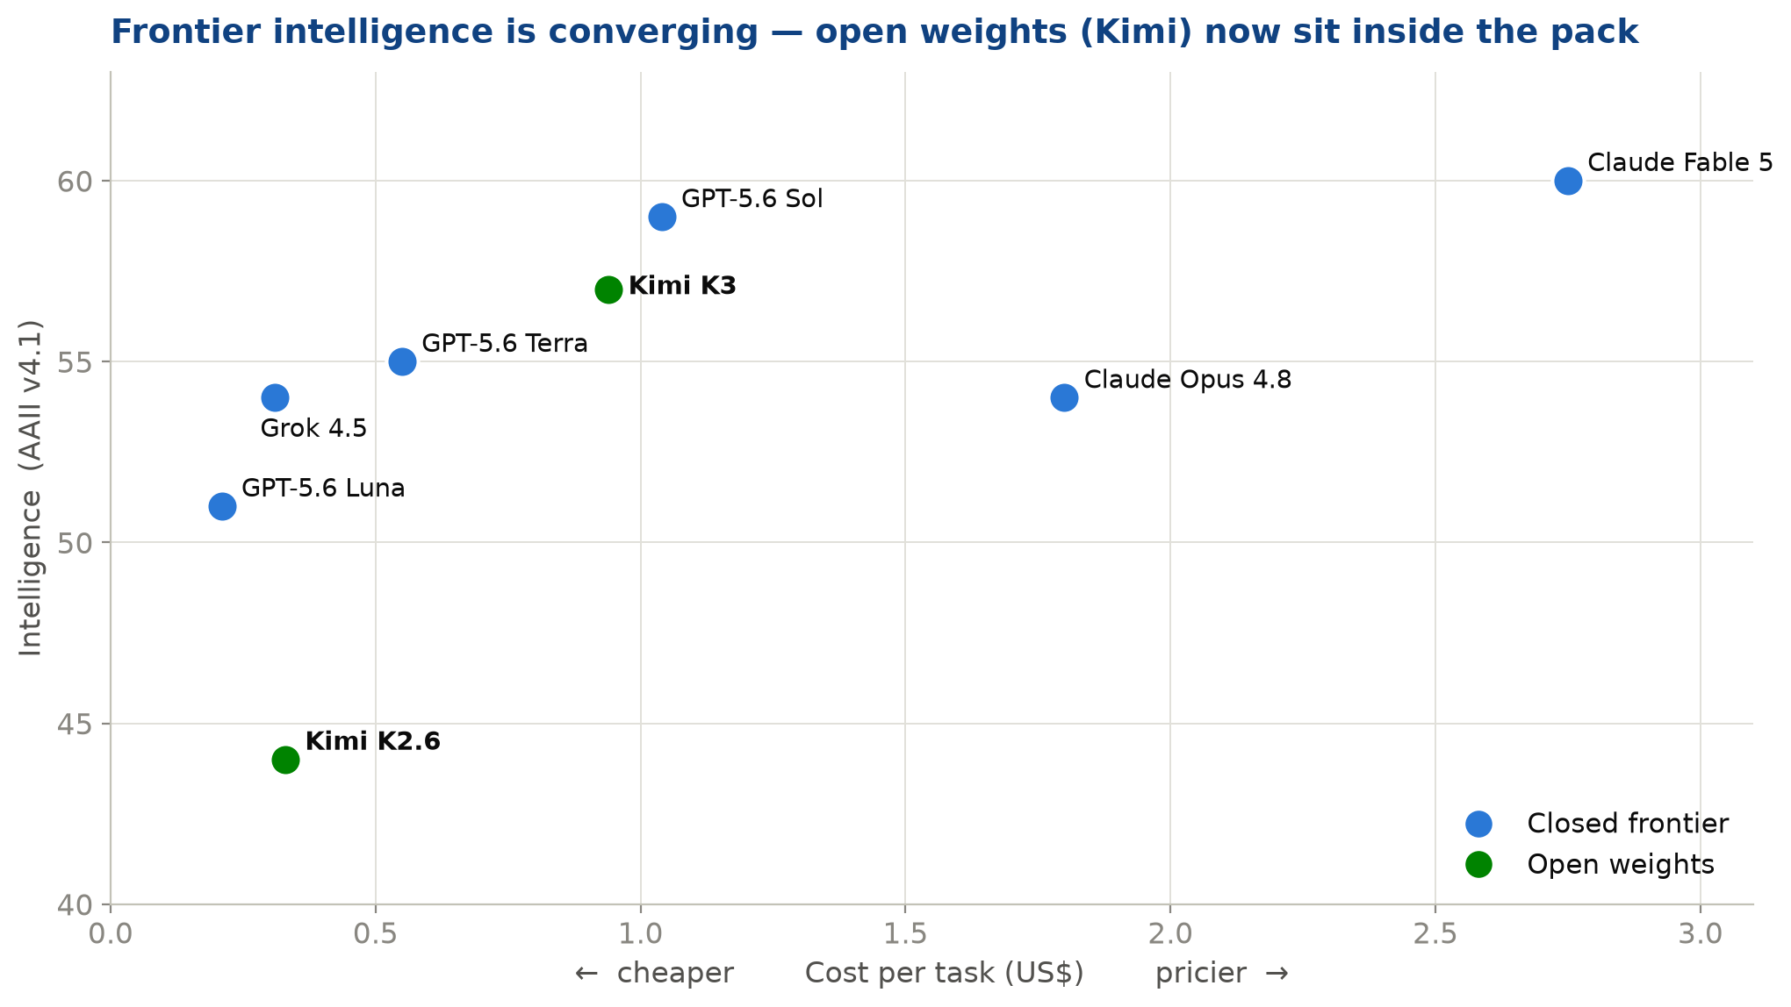
COST VS INTELLIGENCE
Frontier intelligence is converging — and open weights are inside the pack
▍ Top 8 models span just 44–60 on the index — the intelligence gap is narrowing.
▍ Kimi K3 (open, 2.8T) scores 57 at $0.94/task — matching closed frontier models.
▍ Cost varies ~13× across similar-intelligence models ($0.21 → $2.75).
▍ Cheapest capable tier (Luna, Grok, Terra) clusters under $0.55/task.
Source: Artificial Analysis Intelligence Index v4.1 (your table). Not independently re-verified in this pass — confirm at artificialanalysis.ai. $/task = AA blended cost metric.

Slide 3
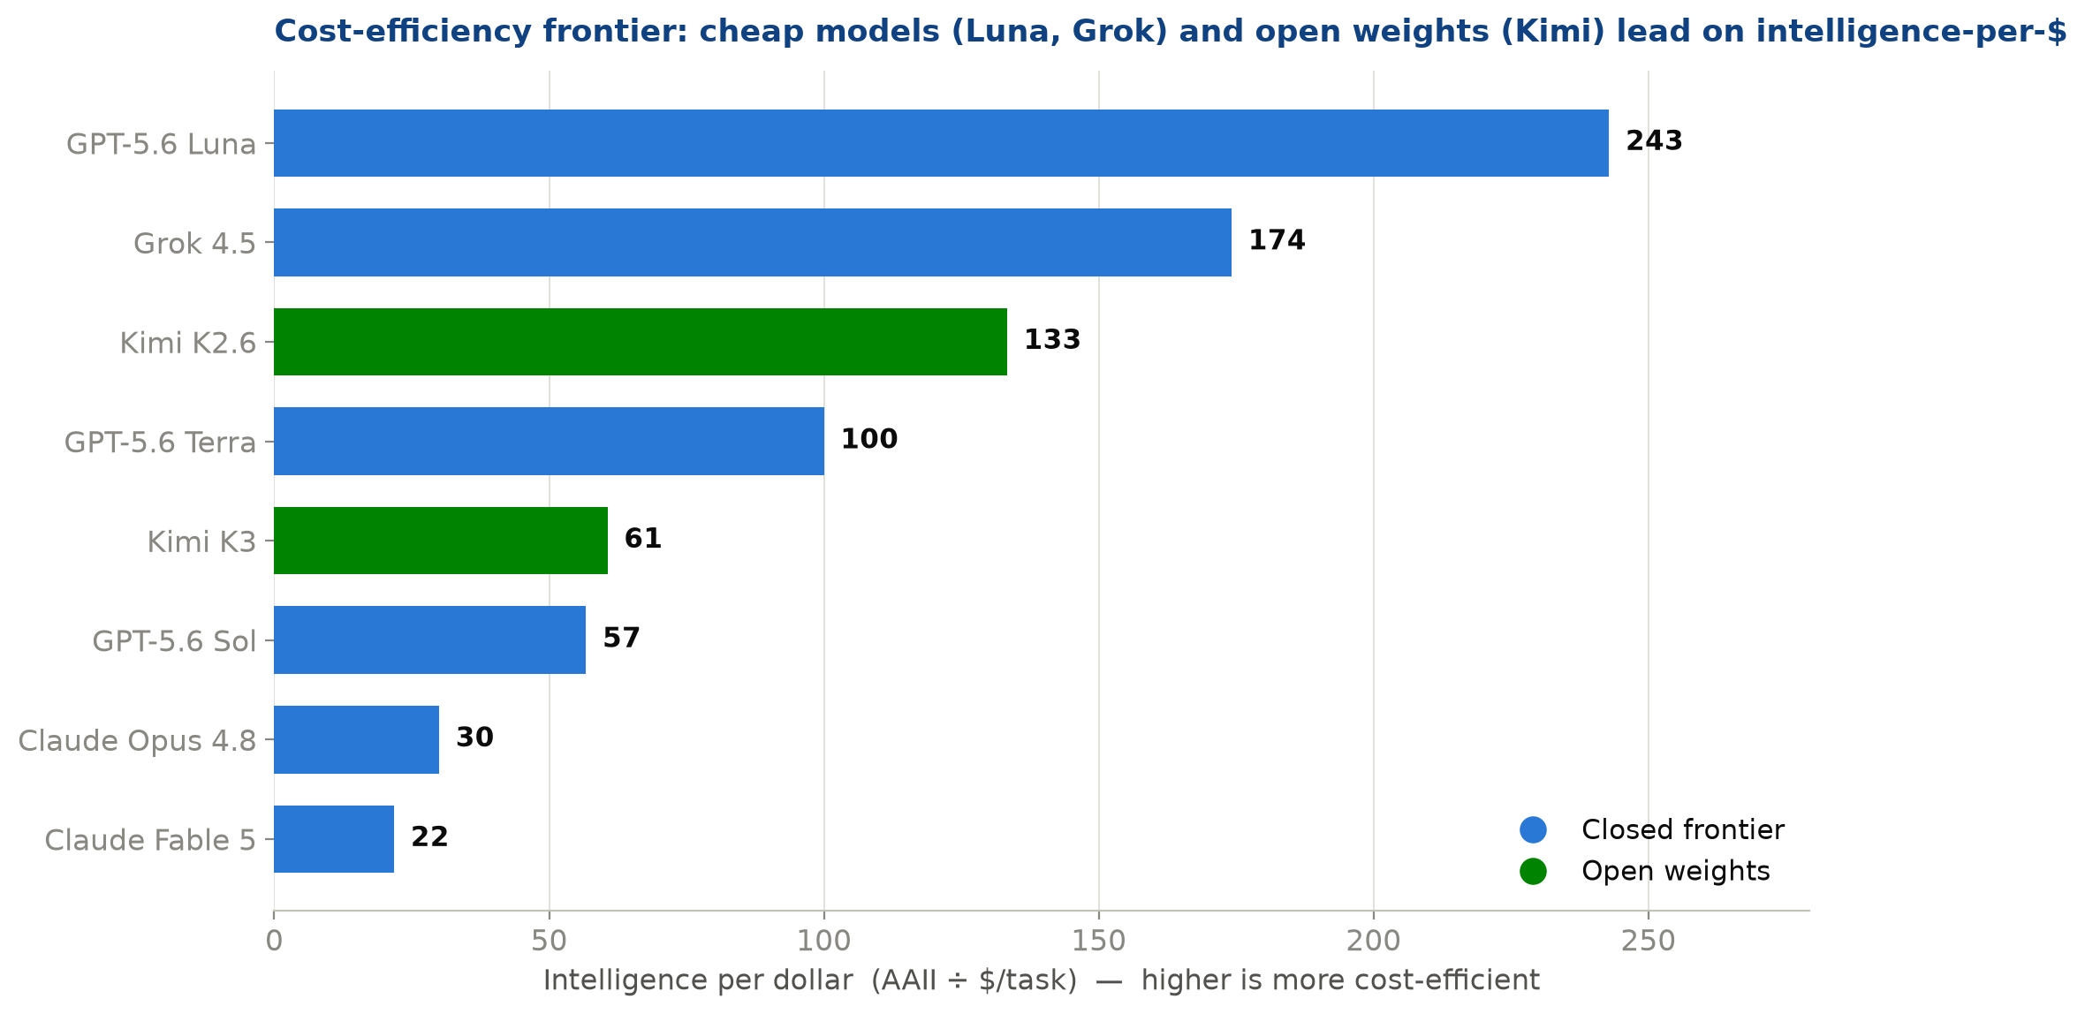
COST-EFFICIENCY
Intelligence per dollar: cheap closed models and open weights lead
▍ Intelligence-per-$ = AAII ÷ $/task. A pure efficiency ratio.
▍ GPT-5.6 Luna & Grok 4.5 deliver the most intelligence per dollar of the closed models.
▍ Kimi K2.6 (open) is highly cost-efficient — open weights compete hard on price.
▍ Premium models (Fable 5, Opus 4.8) trade $/task for top-end capability.
Derived live in the workbook (tab 1). Ratio uses your AAII v4.1 scores and $/task figures verbatim.

Slide 4
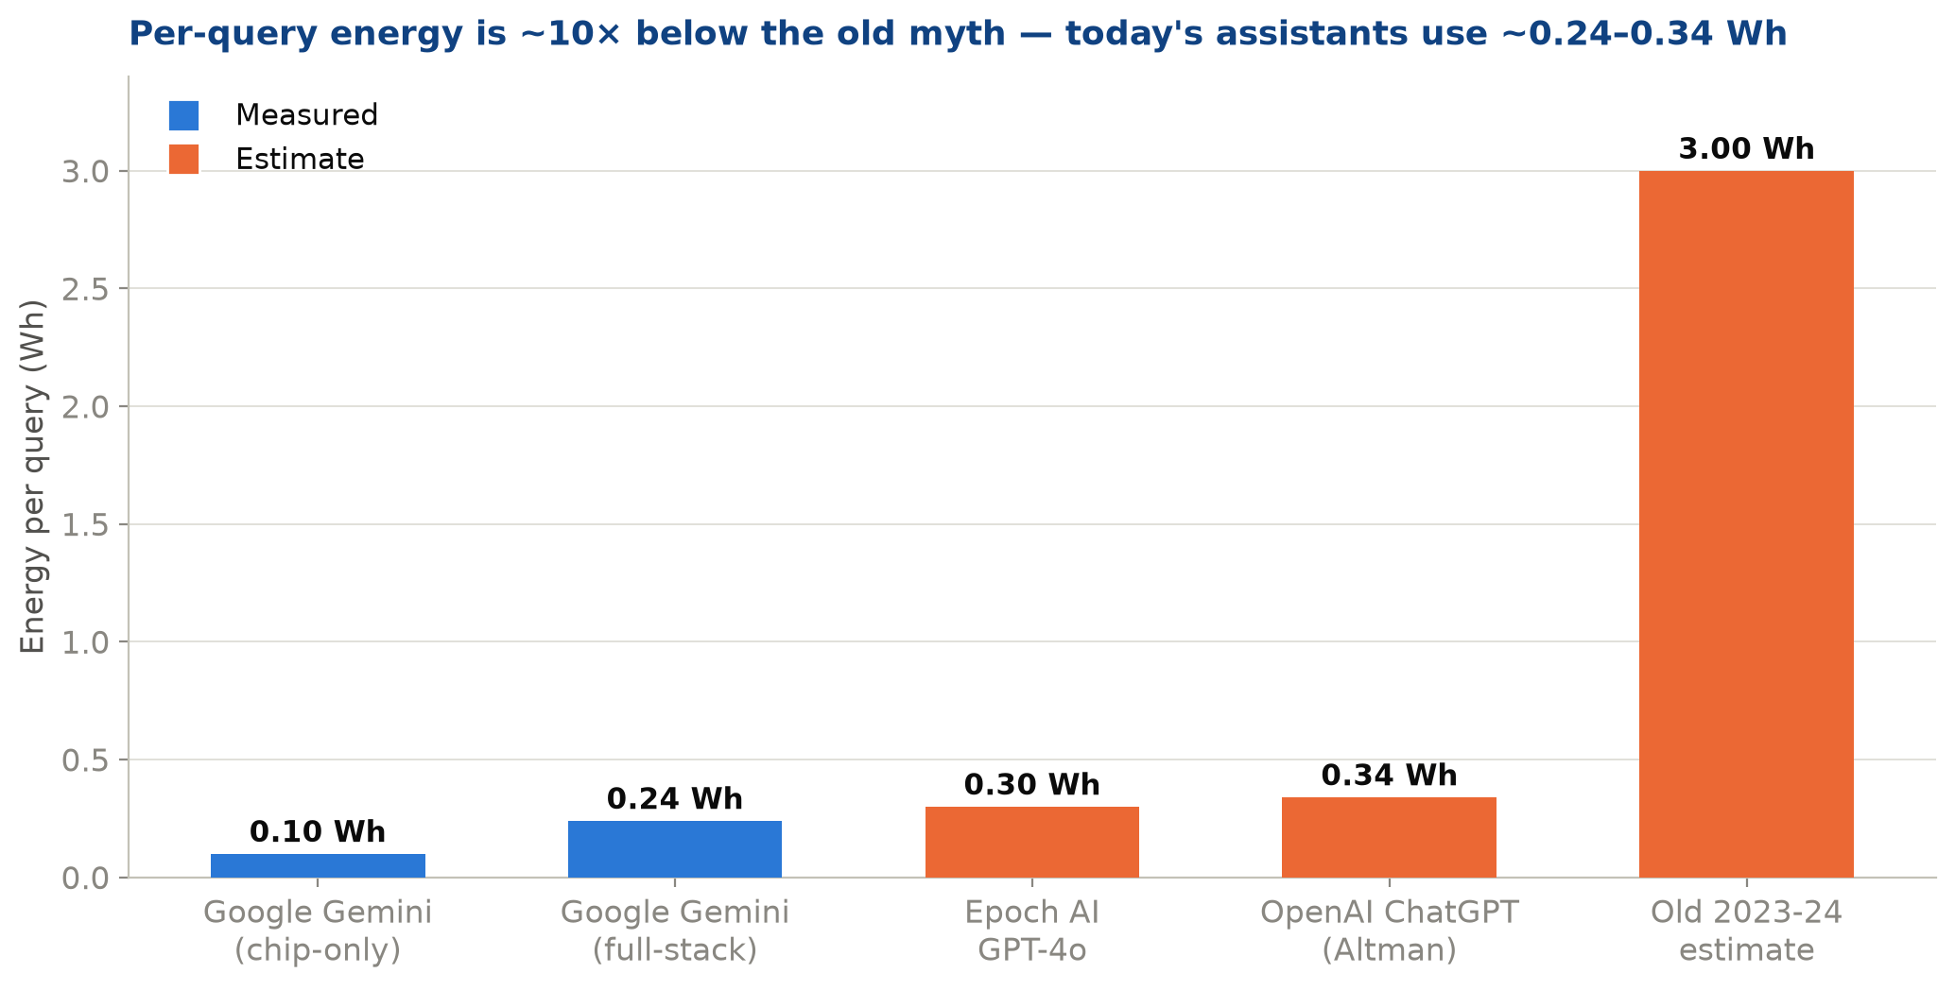
ELECTRICITY PER QUERY
A single query now costs ~0.24–0.34 Wh — about 10× less than the old myth
▍ Google Gemini: 0.24 Wh full-stack (measured); 0.10 Wh chip-only.
▍ OpenAI: 0.34 Wh average query (Altman, estimate).
▍ Google cut this 33× in a single year (May '24 → May '25).
▍ Per token: ~1.7 J measured; decode dominates. 70× params → only 7.3× energy.
▍ Excludes training energy and reasoning/long queries (which run higher).
Sources: Google Cloud & arXiv:2508.15734 (Aug 2025); Altman 'Gentle Singularity' (Jun 2025); Epoch AI (Feb 2025); ML.ENERGY / TokenPowerBench. Blue = measured, orange = estimate.

Slide 5
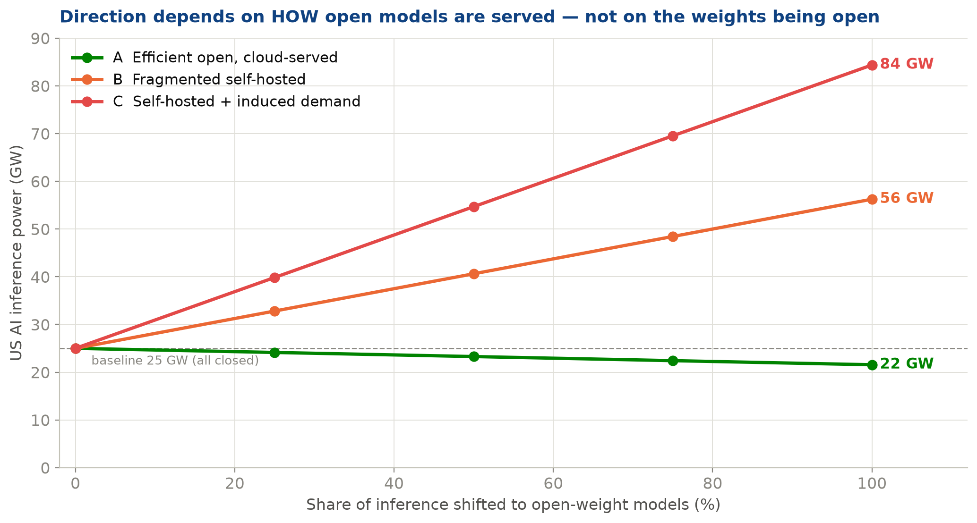
OPEN-SOURCE SHIFT → DC CAPACITY
The data-center impact depends on HOW open models are served
▍ Open weights ≠ automatically greener. The deployment decides.
▍ A — cloud-served, efficient: −14% power. MoE sparsity wins at high utilisation.
▍ B — fragmented self-hosting: +125%. Idle low-utilisation GPUs still draw power.
▍ C — self-hosted + induced demand: +238%. Cheaper access drives more usage (Jevons).
▍ Levers that decide direction: utilisation & induced demand — not the license.
Illustrative parametric model (workbook tab 5): P0=25 GW, k=0.75, M=1.15/3.0, J=1.5. Baseline anchored to Epoch/EPRI >50 GW US AI by 2030. Change the inputs to test your own assumptions.

Slide 6
SOURCES & METHOD
What's measured, what's estimated, what to double-check
▍ VERIFIED — primary sources
▍ Google Cloud + arXiv 2508.15734 Gemini 0.24 Wh, PUE 1.09, 33×/yr (Aug 2025)
▍ Epoch AI GPT-4o ~0.3 Wh; US 5→50 GW by 2030
▍ ML.ENERGY (NeurIPS'25) 0.12–0.20 J/token, 40 models — measured
▍ arXiv 2508.16700 GPT-OSS MoE −25.8% J/1k tok — measured
▍ TokenPowerBench (AAAI'26) engine 25–40%; 7.3× scaling — measured
▍ TREAT WITH CARE
▍ AA Intelligence Index v4.1 not machine-verifiable — confirm on the live site
▍ IEA 415→945 TWh global DC fetch failed this pass — confirm at iea.org
▍ Vendor self-reported Wh Google/OpenAI; exclude training energy
▍ MoE energy edge measured single-GPU; may shrink at hyperscaler batch
▍ Scenario model illustrative, not a forecast — shows the levers
Full source list, URLs and dates in the workbook (tab 6). 24 of 25 extracted claims passed 3-way adversarial verification.

