Slide 1
CME4436 IoT Presentation Smart Parking-Control System
Cem HAFIZOĞULLARI - 2016510034
Berkay HAN - 2017510040

Slide 2
What is IoT
IoT is the communication network where physical objects are connected with each other or with larger systems. It is embedded with sensors, software and other technologies to connect and exchange data with other devices and systems over the Internet. It is envisaged that objects can be marked with a unique identifier so that they can work together over the Internet infrastructure, thus creating values larger than the sum of the small parts.

Slide 3
Smart Parking-Control System
This project is designed to show whether the areas that can be parked for vehicles in the car parks are occupied or available. For the determined area, the system is in a compatible connection with the sensors. After the incoming instruction, the sensors work and check whether there is an object that will prevent parking in the area it is responsible for or not. After the result, it sends an output to the system again and informs the user.

Slide 4
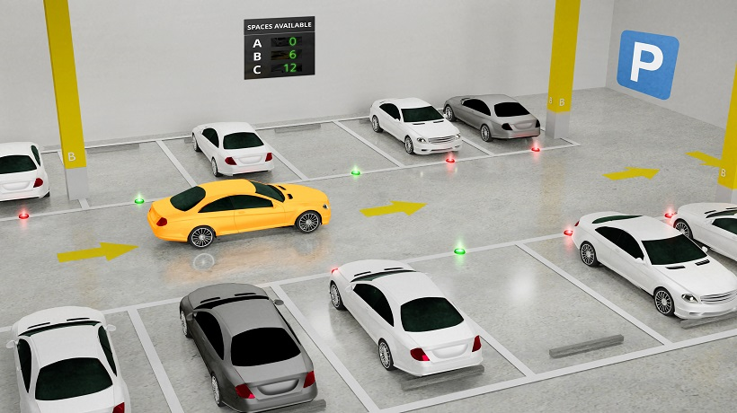

Slide 5
ULTRASONIC DISTANCE MEASUREMENT SENSOR
The HC-SR04 Ultrasonic Sensor is a sensor that calculates the distance to the opposite object using sonar communication. The system we call sonar helps us calculate the distance of the object using sound waves. The HC-SR04 Ultrasonic Distance Sensor is a very popular sensor involved in almost all robotic projects. The principle of operation of the sensor is simple. When a signal is given from the TRIG pin, a sound wave with a frequency of 40 Khz is produced by the sensor, and when this sound wave hits an object and returns, the ECHO pin becomes active. Since we know the propagation speed of the sound in the air, you can easily calculate the distance between the signal given to the TRIG pin, by measuring the time until the ECHO pin is active.

Slide 6
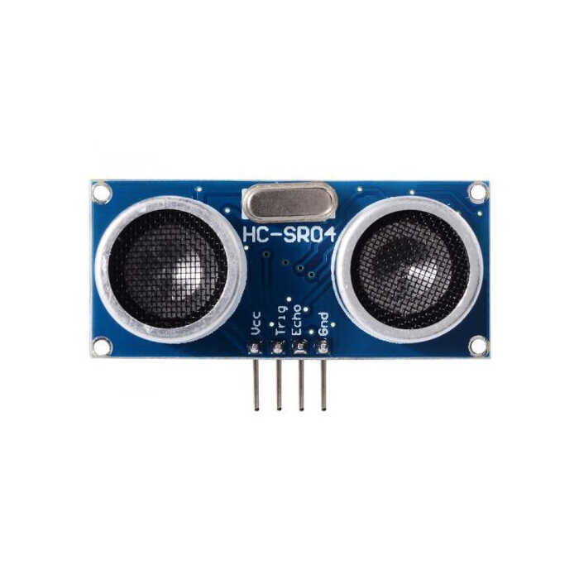

Slide 7
LCD
In electronic projects, mostly 16×2 character LCDs and 128×64 pixel graphic LCDs are preferred. 16×2 character LCDs, as the name suggests, have 2 lines and 16 characters that can be controlled separately on each line. There is no such limitation in graphic LCDs, it is possible to display the information you want on a pixel basis to the desired position of the screen. In addition to all these, there are also LCDs with colour that can be used with boards such as Arduino. This type of LCDs usually has an SPI communication interface. Since microcontroller boards such as Arduino do not have enough memory to create advanced graphics, they can generally be used to draw simple graphics or to display photo and image files on media such as SD cards.

Slide 8
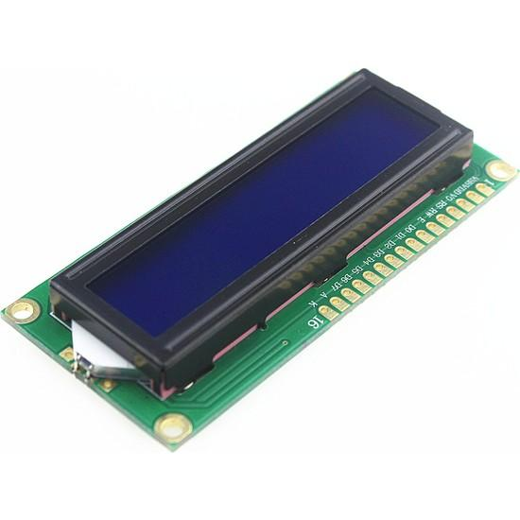

Slide 9
The ESP8266
The ESP8266 module, briefly, is a module that you can use in your electronic projects, has a small size that allows you to connect to the internet, upload and retrieve data, and control your projects over the internet. Due to its small size and cost-effectiveness, it has started to be preferred a lot in projects where direct access to the Internet is required. In fact, many smart device (switches, sockets, etc.) manufacturers of Chinese origin use the ESP8266 chip or module in their products. You can use this module as a client to connect to a WIFI port, as a WIFI point (AccessPoint), or as both a client and an AccessPoint.

Slide 10
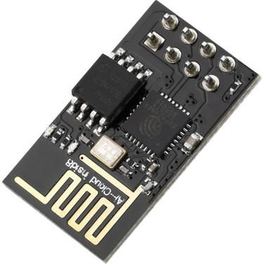

Slide 11
ThingSpeak
ThingSpeak is an API (application programming interface). Provides channels that includes fields for IoT devices to send and read data. Unfortunately, the free account has limitations such as 15 seconds rate limit, 4 channels, etc. which can cause problems, for example our Smart Parking-Control System can only send data between every 15 seconds due to this problem. We are using HTTP protocol for data transmission.

Slide 12
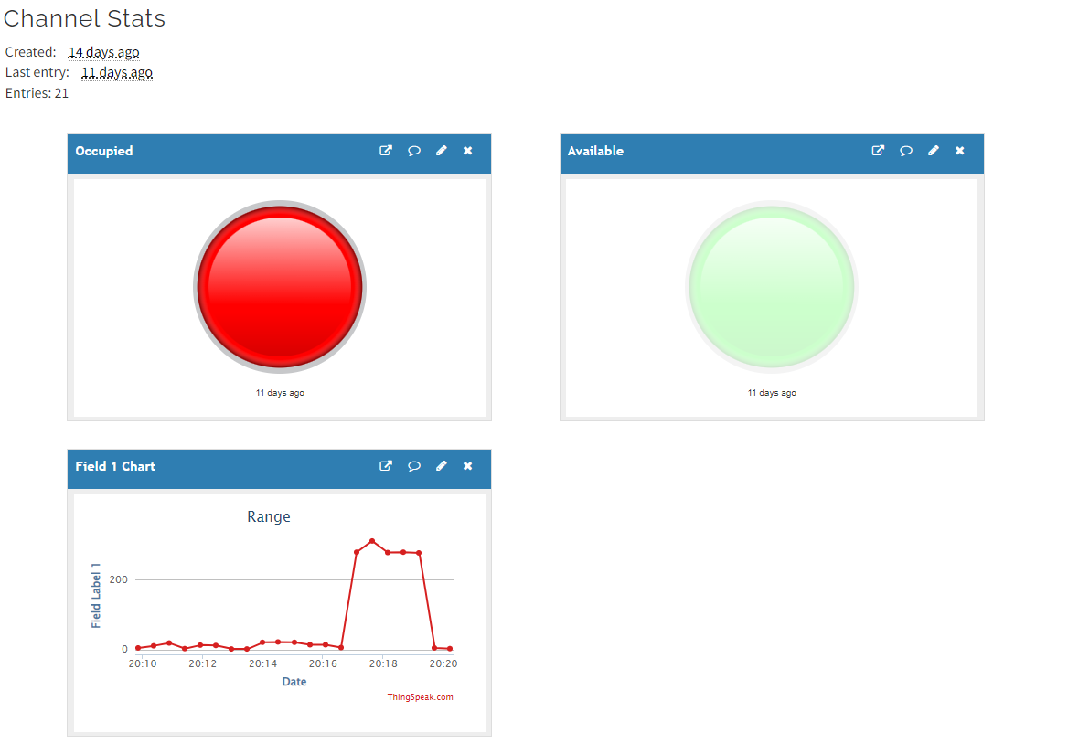

Slide 13
Hardwares
-Arduino UNO
-ESP8266
-HC-SR04
-QAPASS (LCD)
-Leds
-Potentiometer

Slide 14
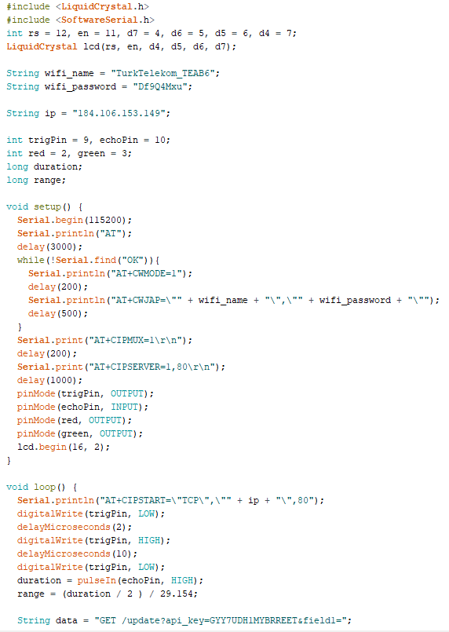
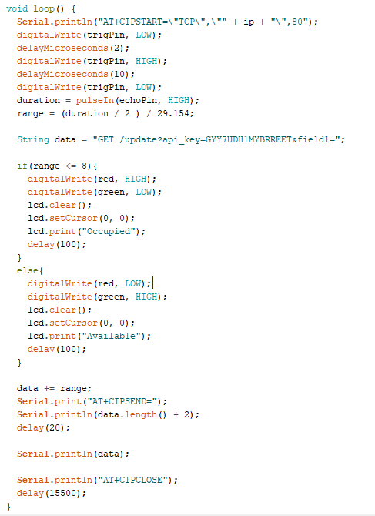
Software

Slide 15
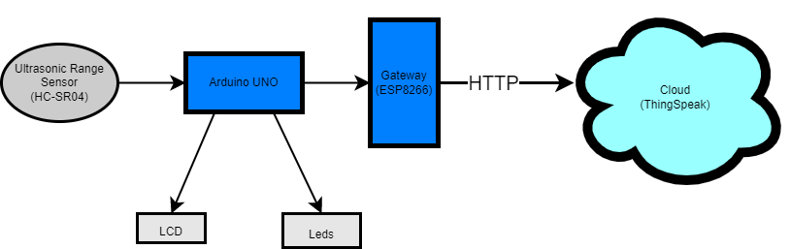
Architecture

Slide 16
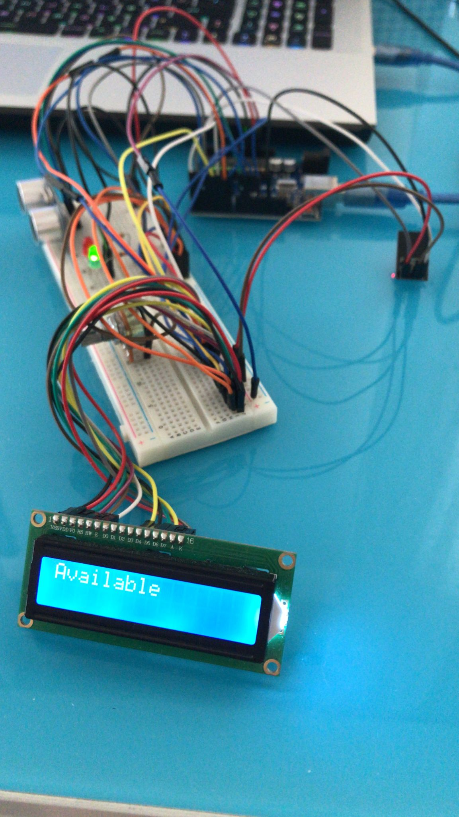
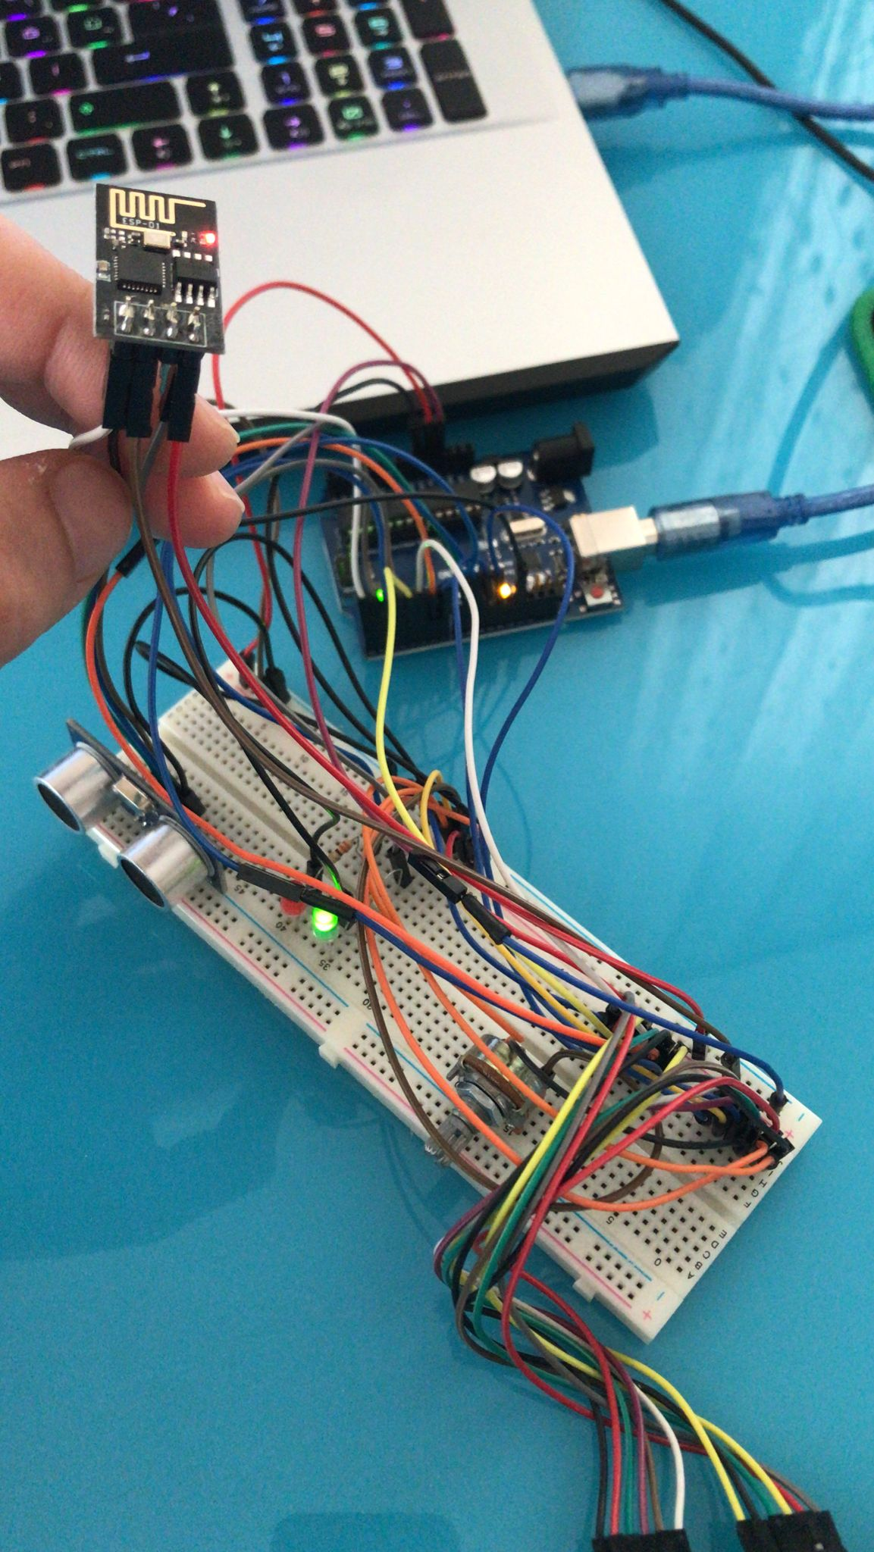
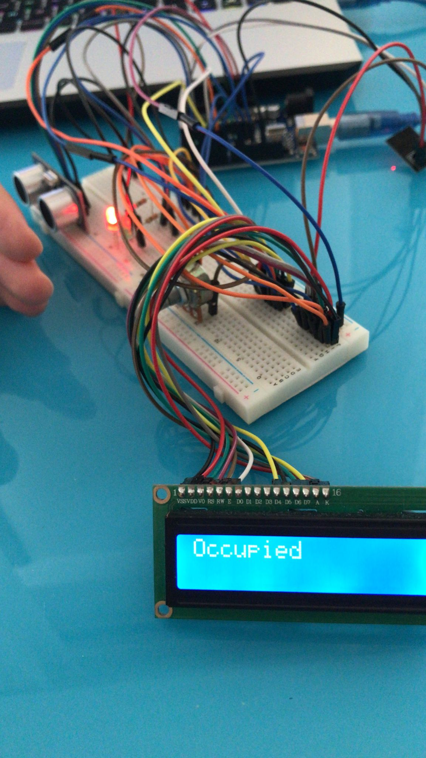
Photos

Slide 17

Any Questions?

