Slide 1


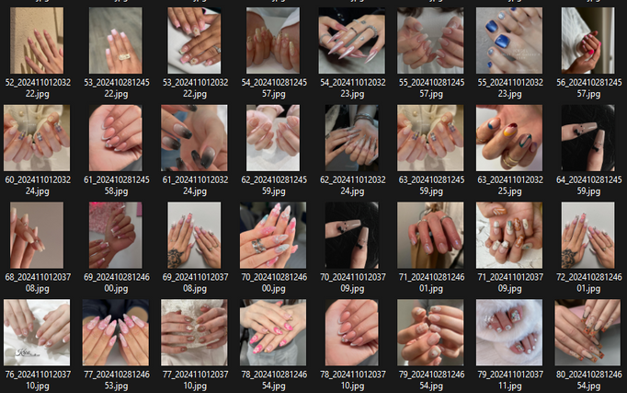


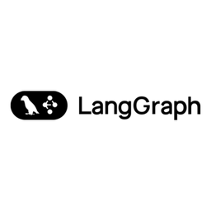


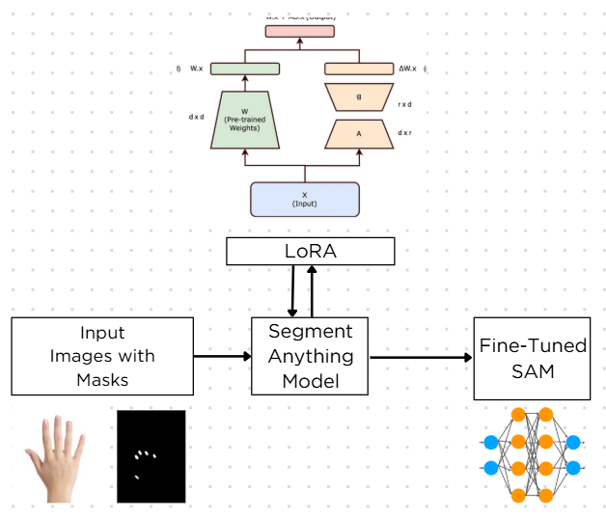


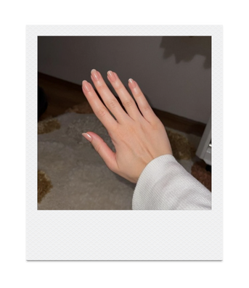
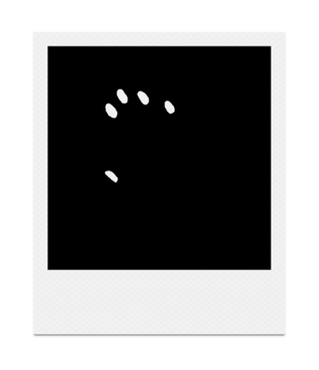
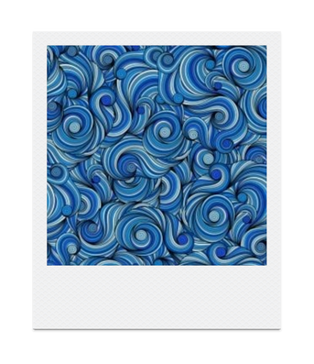
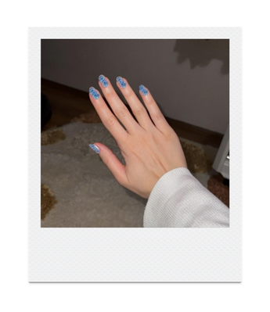

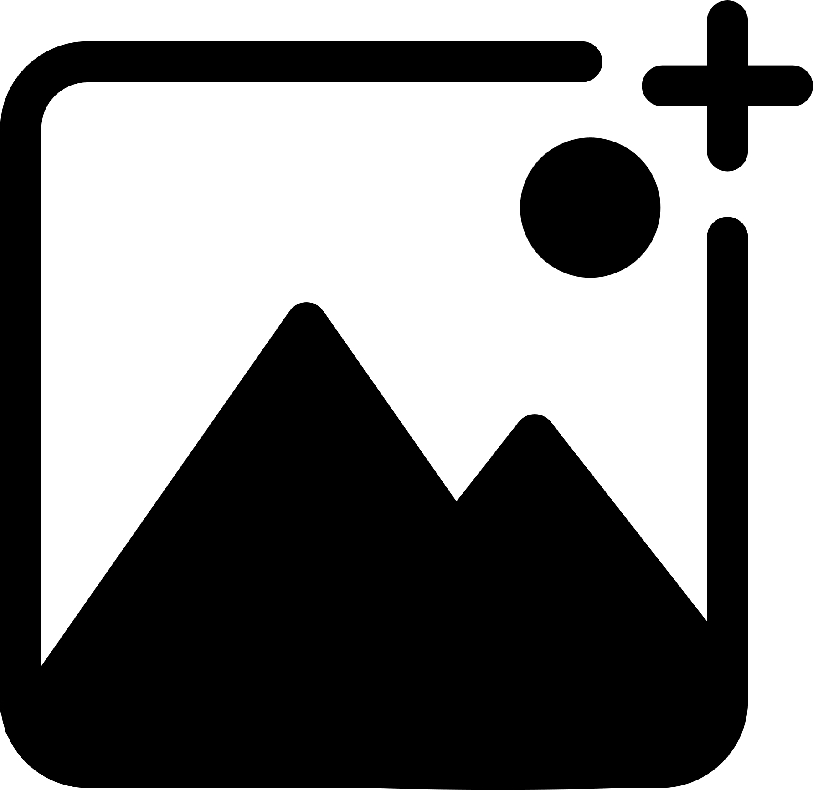
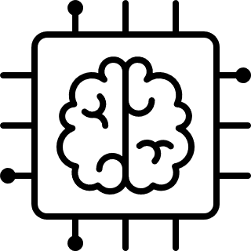
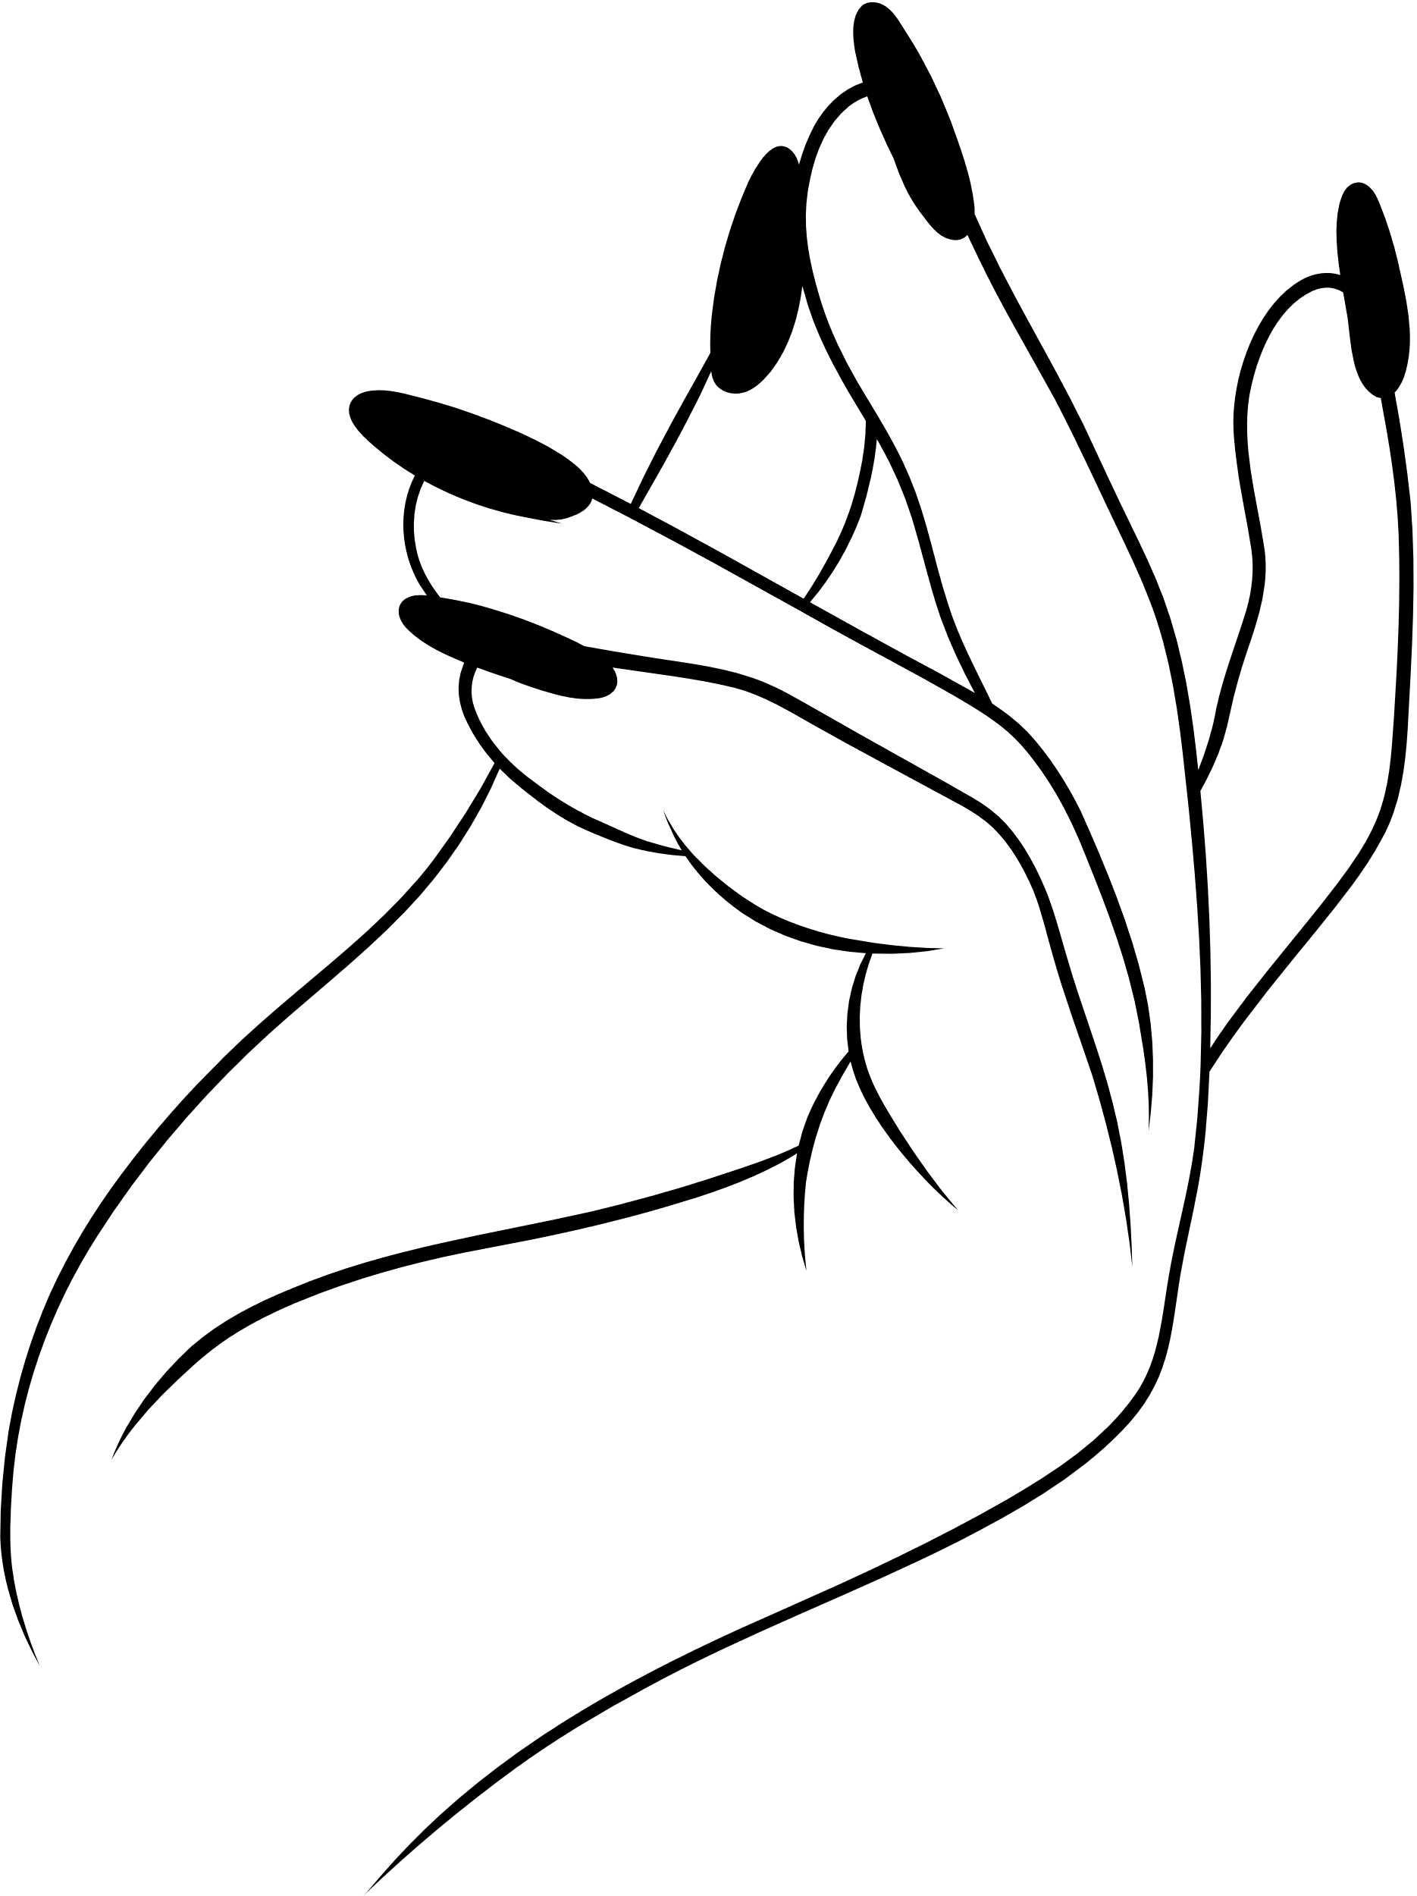
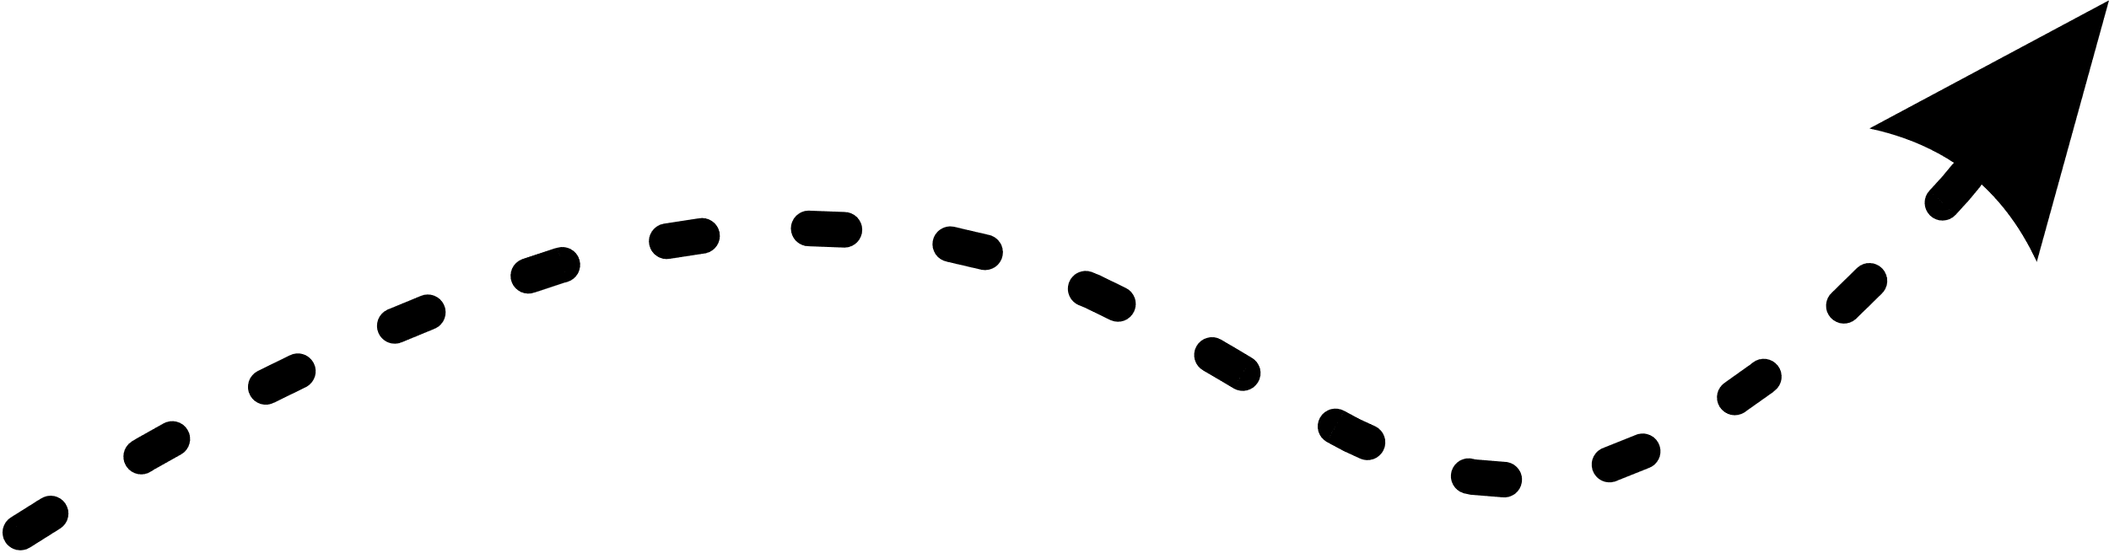
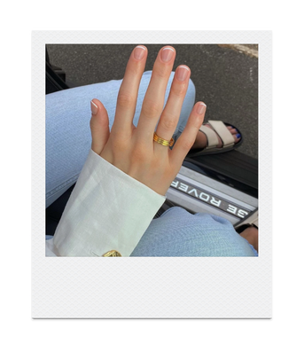
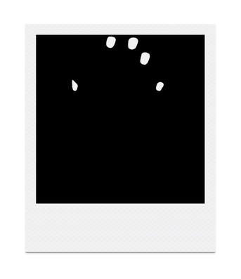
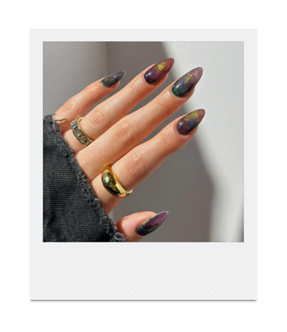
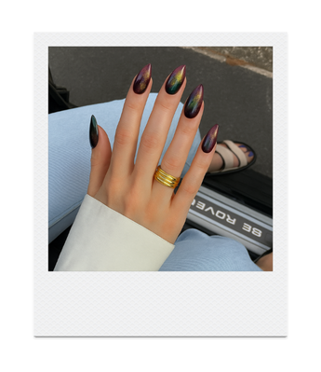

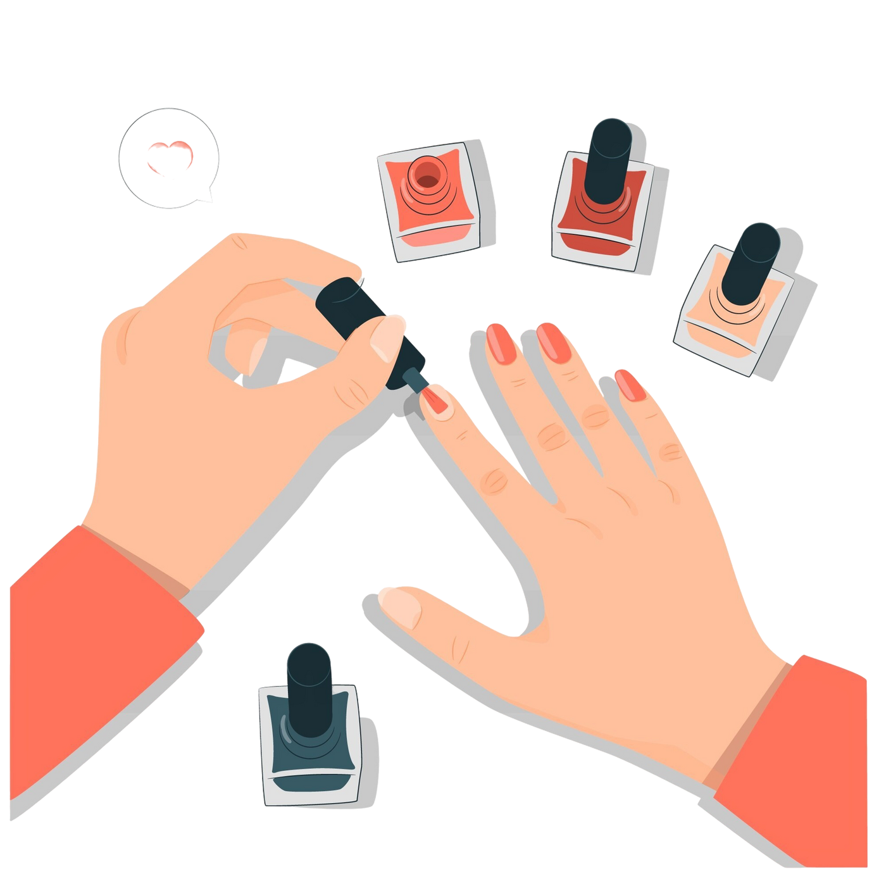
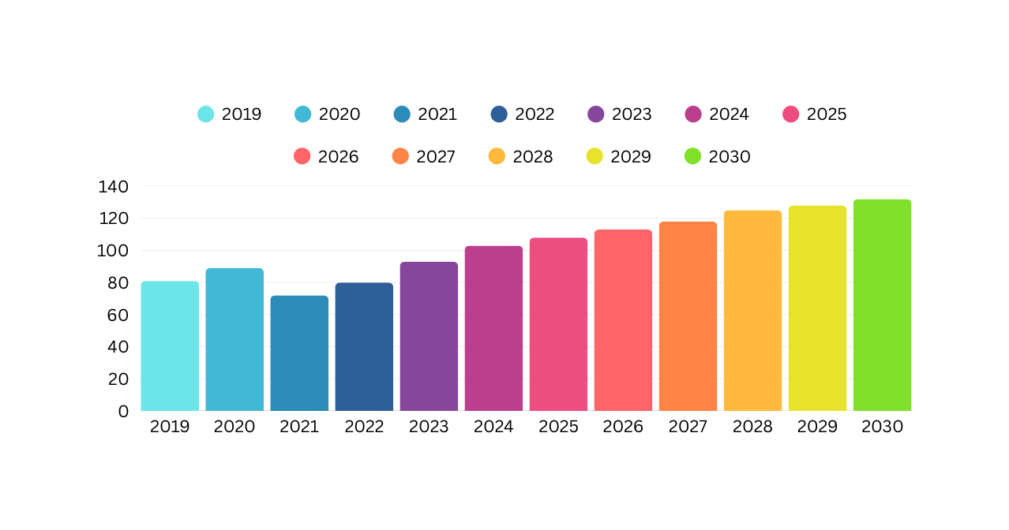
NAILART WITH AI
Dr. Atilla Özgür, Dr. Fatih Nar
Erencan Yakut, Beyza Nur Deliktaş, Mustafa Erdem Gülsoy, Gürkan Er
Department of Computer Engineering, Ankara Yıldırım Beyazıt University
2209-A - Üniversite Öğrencileri Araştırma Projeleri Destekleme Programı
INTRODUCTION
DATA PREPARATION
The project introduces an AI-powered platform that lets users preview nail styles by uploading photos of their hands. Leveraging advanced models such as SAM for segmentation, Neural Style Transfer, and Prompt Engineering for style transfer, it provides a personalized and innovative solution for digital nail art in the cosmetics industry.
We developed an automated data scraping system using Selenium to collect nail images from Instagram and Google Images.
RESEARCH PROBLEM
AI has advanced in areas like medical imaging and recognition, yet its use in cosmetic nail styling is still limited. Users cannot easily preview personalized nail designs digitally. This project fills that gap with an AI-powered platform for real-time nail style visualization, driving digital innovation in the beauty industry.
SOFTWARE DEVELOPMENT
SAM WITH LoRA
SEGMENTATION
SEGMENTATION
The SAM model was fine-tuned for the nail segmentation task using the LoRA technique. High accuracy was achieved after training for 50 epochs on a dataset of 25,000 labeled images.
PostgreSQL
CRUD
RESTFUL API
ASP.NET Core
JWT Security
C#
Nail Segmentation
Fine Tune SAM with LoRA
25000 Images
50 epoch
A100 GPU with GoogleColab
React
TailwindCSS
Modern Design
OpenCV
Image Enhacement
Pre-Processing
CHANGE METHODS
Style Transfer
Prompt Engineering
Upload your hand photo
Nail area detected using SAM
Choose your favorite nail art style
Final preview with applied style
Upload your hand photo
Nail area detected using SAM
Choose your favorite nail art style
Final preview with applied style
TARGET MARKET

