Slide 1
PromoCatch
Campaign and Deal Tracking System
Project Explanation and Phase 2 Demo
Team: Cemil Tekin, Kaan Kesen, Omer Tarik Candir
Local URL used for screenshots: http://127.0.0.1:8010
Prepared: 15.05.2026 16:14

Slide 2
Presentation Flow
The story we will use to explain the project
1. Explain the problem and the goal of PromoCatch.
2. Introduce users and main campaign management use cases.
3. Show the layered architecture and how each code file fits into it.
4. Summarize what was completed in Phase 2.
5. Walk through local UI, Swagger, and API screenshots.
6. Close with deployment and submission package information.
Presentation Goal
Make the architecture understandable
Show that the system runs locally
Connect screenshots to real features
Prepare a clear instructor-facing story
PromoCatch | Software Architecture Project | Phase 2

Slide 3
Problem and Project Goal
Why PromoCatch exists
Problem
Campaigns are spread across different platforms.
Users need a simple way to view active opportunities.
Campaign data should be searchable, editable, and stored persistently.
Goal
Build a web-based campaign tracking system.
Provide a frontend for users and a REST API for data operations.
Apply layered architecture and document it using SAD Version 2.
PromoCatch | Software Architecture Project | Phase 2

Slide 4
Users and Main Use Cases
What the system allows users to do
Actors
User: tracks, searches, creates, edits, and deletes campaigns.
System: validates data, stores records, and serves API responses.
View campaign list
Search campaigns by title or description
Filter campaigns by platform and discount range
Create new campaign records
Update existing campaign records
Delete campaign records
View campaign details through the API
PromoCatch | Software Architecture Project | Phase 2

Slide 5
What We Completed in Phase 2
Small summary of the work added after Phase 1
Extended SAD Version 2 with completed use case, logical, process, development, and deployment views.
Completed frontend flows: list, search, filter, create, update, and delete campaigns.
Completed backend REST API endpoints for campaign CRUD and health checks.
Added Dockerfile and docker-compose.yml for deployment-ready execution.
Improved Discount Rate input behavior and added fast selection including 100%.
PromoCatch | Software Architecture Project | Phase 2

Slide 6
Layered Architecture
How the code maps to the architecture
Presentation
static/index.html
Forms, campaign cards
Fetch API client
Control
main.py
routers.py
REST endpoint definitions
Domain
schemas.py
services.py
Validation and workflow
Resource
database.py
models.py
repository.py
SQLite access
The browser sends HTTP requests to FastAPI routes.
Routes delegate work to services instead of accessing the database directly.
Repository functions are responsible for SQLAlchemy database operations.
PromoCatch | Software Architecture Project | Phase 2

Slide 7
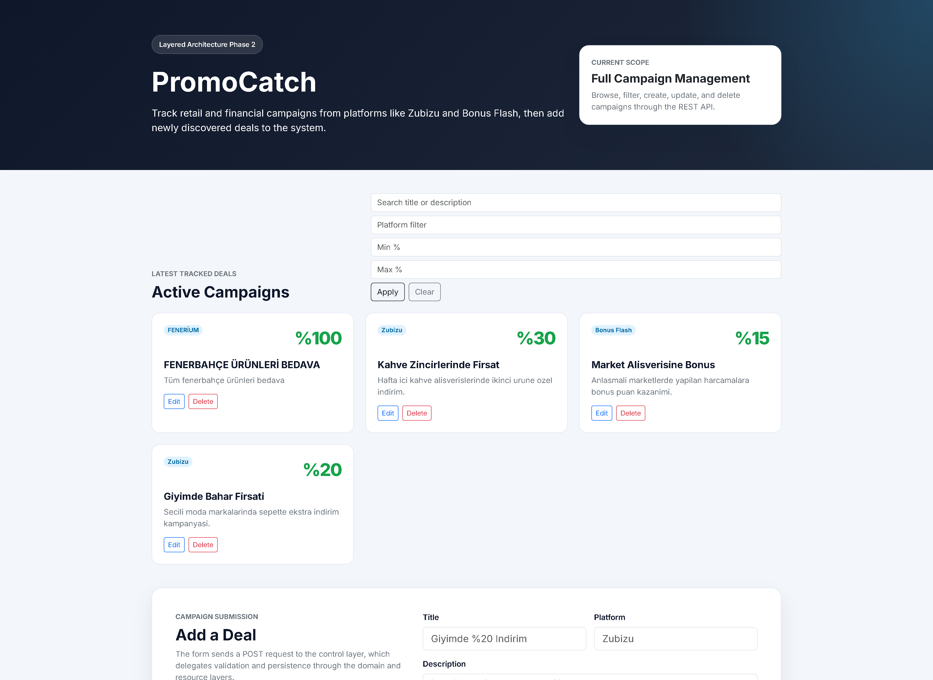
Local Screen 1: Campaign Management UI
What we built on the frontend and what it is used for
What we did
Built a responsive campaign dashboard.
Added search, platform filter, discount range filter, and CRUD actions.
Improved the Discount Rate input and fast selection buttons.
Why it matters
Users can manage campaigns without using the API manually.
The screen proves the frontend is connected to backend data.
PromoCatch | Software Architecture Project | Phase 2

Slide 8
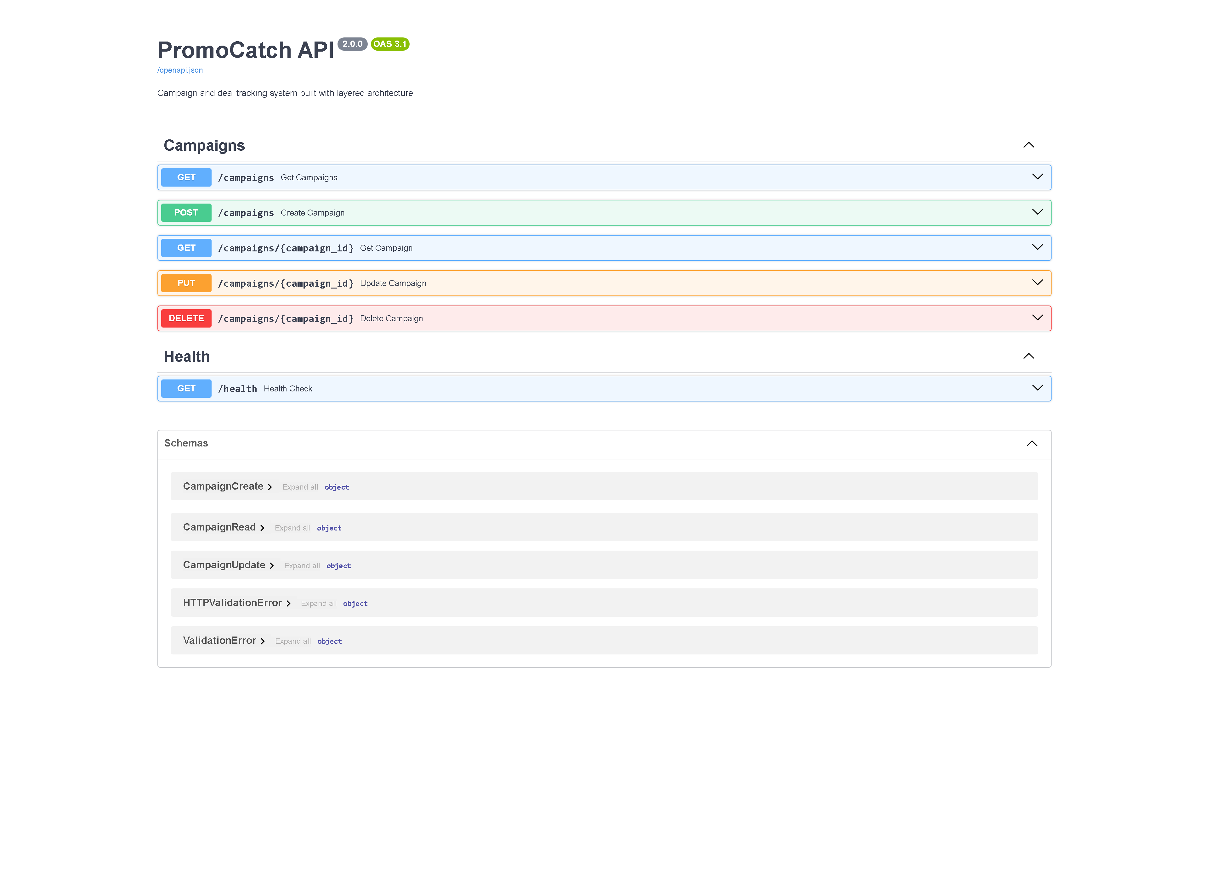
Local Screen 2: Swagger API Documentation
What backend endpoints exist and why they are important
What we did
Exposed campaign endpoints with FastAPI.
Documented GET, POST, PUT, DELETE, and health check routes.
Used Pydantic schemas for request and response contracts.
Why it matters
Swagger makes the backend testable and easy to understand.
It shows the REST API contract used by the frontend.
PromoCatch | Software Architecture Project | Phase 2

Slide 9
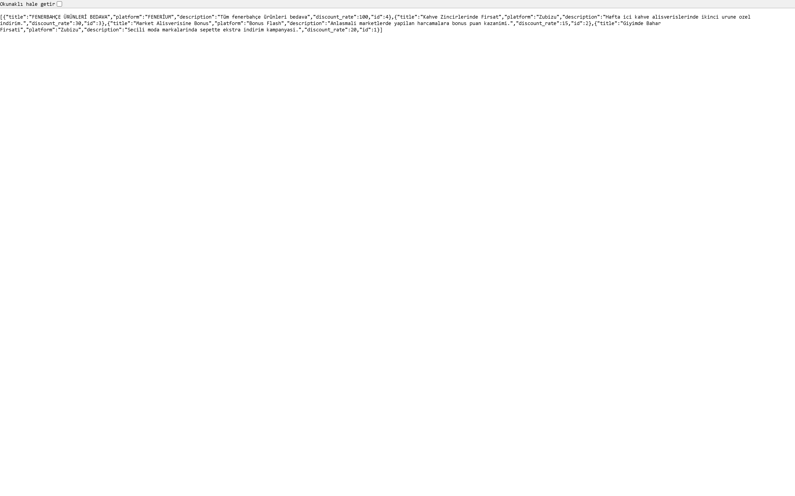
Local Screen 3: Live API Response
How the backend returns real campaign data
What we did
Returned campaign records as JSON from /campaigns.
Stored and retrieved data through SQLite and SQLAlchemy.
Used the same response format for frontend rendering.
Why it matters
This proves persistence and backend integration.
It connects the resource layer to the user-facing UI.
PromoCatch | Software Architecture Project | Phase 2

Slide 10
Deployment and Run Instructions
Files included for running the Phase 2 project
Local run: python -m uvicorn main:app --reload
Local test URL used here: http://127.0.0.1:8010
Docker run: docker compose up --build
Persistent data file: data/promocatch.db
Main documentation: docs/SAD_Phase2.pdf and docs/SAD_Phase2.md
PromoCatch | Software Architecture Project | Phase 2

Slide 11
Files to Submit to the Instructor
Recommended Phase 2 delivery package
1. Phase2_SAD_Code_CemilTekin_KaanKesen_OmerTaricandir.zip
2. docs/SAD_Phase2.pdf
3. docs/SAD_Phase2.md
4. docs/PromoCatch_Project_Explanation_Presentation.pptx
5. README.md
6. Source code: main.py, routers.py, services.py, repository.py, models.py, schemas.py, database.py
7. Frontend: static/index.html
8. Deployment files: Dockerfile, docker-compose.yml, requirements.txt
PromoCatch | Software Architecture Project | Phase 2

Slide 12
Conclusion
PromoCatch Phase 2 is complete, functional, documented, and ready for presentation.
PromoCatch | Software Architecture Project | Phase 2

