Slide 1
Clustering US Cities Based on Crime Statistics
Cemile Sahin
for
IBM Data Science Professional Certificate on Coursera

Slide 2
Introduction
One of the important considerations for people to make a city home is the safety record of the city. Everything else being the same, people would prefer cities with lower criminal profiles to those with higher criminal profiles.
This report will analyze the crime statistics for the largest 100 US cities and cluster the cities based on these statistics. This will help people to care about the crime statistics to compare cities in terms of their safety record.

Slide 3
Introduction
Amenities available in the city is also an important consideration.
The second part of the report uses the Foursquare data to cluster cities based on the venues available in these cities.
It also investigates if there is any relation between the clusters based on crime statistics and clusters based the venues.

Slide 4
Data – Crime Statistics
I obtained the crime statistics from a Wikipedia page which is based on FBI Uniform Crime Reports statistics from 2017 for the largest 100 US cities:
https://en.wikipedia.org/wiki/List_of_United_States_cities_by_crime_rate
Number of crimes committed per 100,000 people in three major categories:
Violent Crime: Murder, Rape, Robbery, and Aggravated Assault.
Property Crime: Theft, Burglary, and Motor Vehicle Theft
Arson: Arson

Slide 5
Data – Foursquare Location Data
100 venue names and venue categories for each of the 100 cities in the crime statistics data
The purpose of using Foursquare venue data is twofold:
to see if there is any connection between crime statistic clusters and venue clusters, and
to look at the top venues available in the lowest crime cities if we can choose among them based on the venues available.

Slide 6
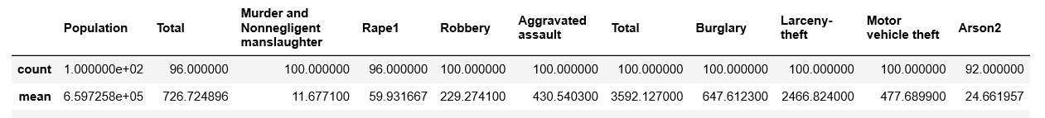
Methodology - Standardization
There is large variation across the mean values for different variables. The mean number of murders is less than 12 while the mean number of burglaries is 647.
Not to distort analysis towards variables with higher means, I standardize all the numerical values in the data frame.

Slide 7
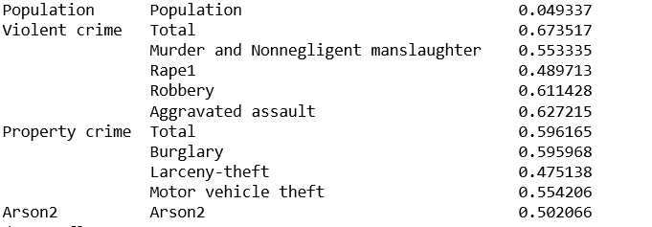
Methodology – Correlation between crimes
Rape has a low correlation with other types of crimes. One reason could be the fact that most rape is not related to the safety of the city as 80% of rape is committed by someone the victim knows.
I drop Rape.

Slide 8
Methodology – Burglary vs Robbery vs Larceny
Robbery involves a threat of violence.
Burglary involves entering a building and violating the privacy of one's home.
I decide to drop Larceny/Theft and Arson as Arson is not random and Larceny is not much about safety.

Slide 9
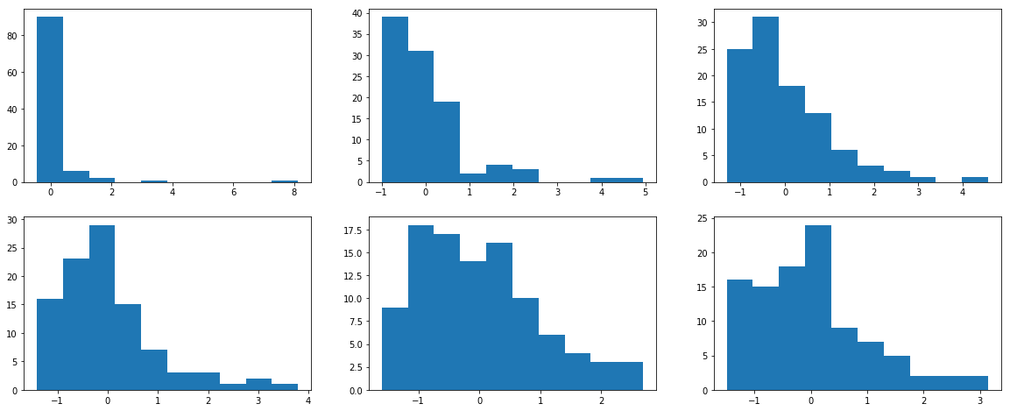
Histogram of Population and Crimes
Safest places are about one standard deviation below the mean in all crime categories. Most crimes are a major problem in a handful of cities. Based on these we may expect to get one small cluster with a huge crime problem.

Slide 10
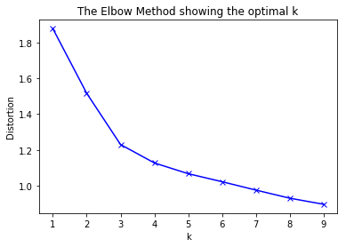
Methodology - Choosing Number of Clusters
The elbow method indicates that k=3 is a reasonable choice for the number of clusters. The decline in distortion as we go from 3 clusters to 4 clusters is smaller than that as we go from 2 clusters to 3 clusters.

Slide 11
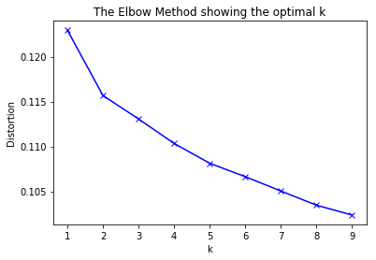
Methodology – Number of Venue Clusters
The Elbow Method suggests that k=2 is a reasonable choice for the number of venue clusters.

Slide 12
Results – Safety Clusters
This is a summary of the three clusters:
Safety Cluster | 0 | 1 | 2
Number of cities | 38 | 11 | 51
Population | -0.023131 | -0.196266 | 0.059567
Murder | -0.623741 | 1.836600 | 0.068619
Robbery | -0.782984 | 1.991968 | 0.153760
Assault | -0.784848 | 1.897106 | 0.175609
Burglary | -0.868993 | 1.561164 | 0.310763
MV Theft | -0.776015 | 1.654719 | 0.221307

Slide 13
Results – Safety Clusters
"Safe Cities“: Cluster 0 - 38 cities
The average population is about average.
All crime statistics are below the mean values.
“Dangerous Cities”: Cluster 1 - 11 cities
The average population is slightly lower than the average.
All crime statistics are significantly higher than the average: from 1.56 standard deviations above the mean for Burglary to 1.99 standard deviations above the mean for Robbery.
"Larger Cities“: Cluster 2 - 51 cities
The average population is slightly higher than the average population.
The average crime rate is slightly higher than the average.

Slide 14
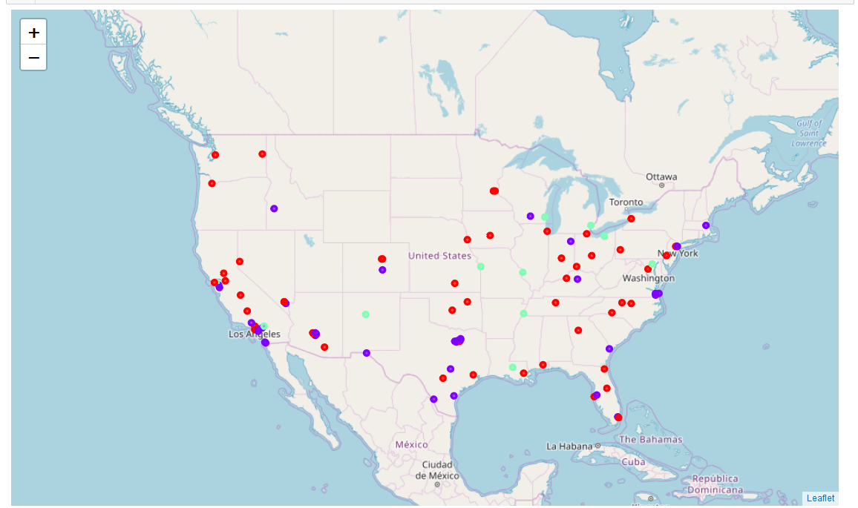
Results – Mapping Safety Clusters
Purple: “Safe Cities”
Green: ‘Dangerous Cities’
Red: ‘Larger Cities’

Slide 15
Results – Venue Clusters
The first cluster consists of 70 cities and the second one consists of 30 cities.
The first cluster has a slightly higher population than the average and slightly lower crime rates across all crime categories.
The second cluster has a slightly smaller population than the average and its crime rates are slightly higher than the average.
Scanning through the common venue categories does not offer much difference.

Slide 16
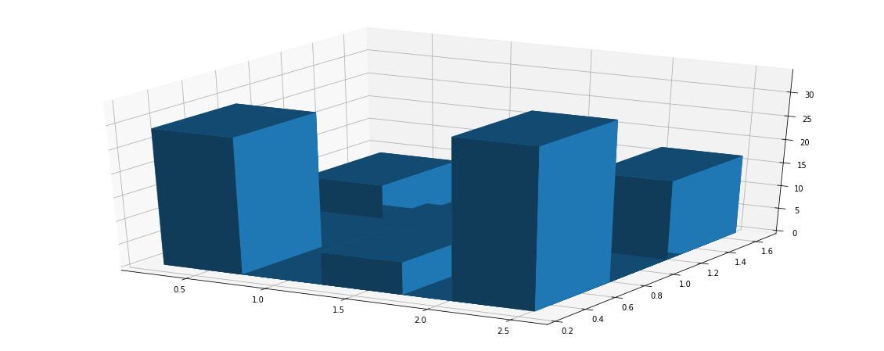
Results - 3-D Histogram of Two Types of Clusters
There does not seem to be any pattern:

Slide 17
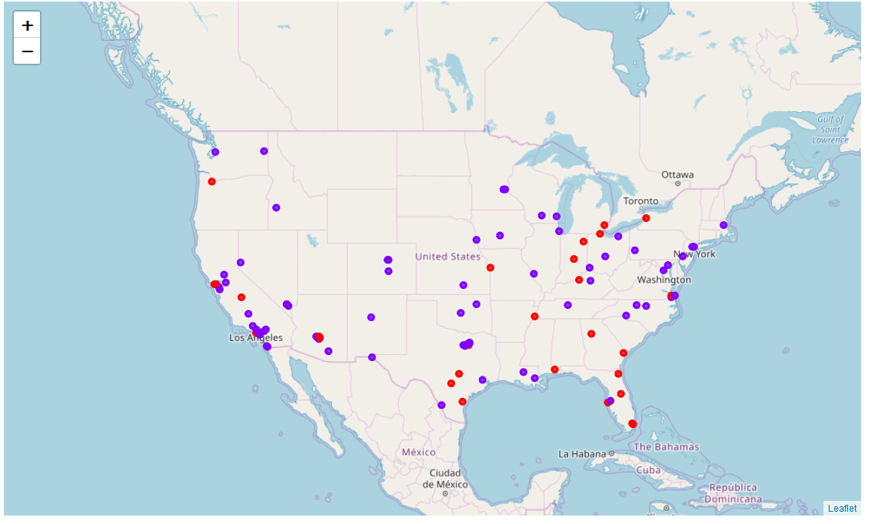
Results – Mapping Venue Clusters
No geographic pattern is observable.

Slide 18
Discussion
Although it is possible to have a meaningful clustering based on crime statistics, it is not the case for the venue categories.
All the largest cities in the US offer a variety of venues to their large number of residents. The venues are not related to the crime statistics in cities, and these cities are not that different from each other.
It is possible to see that from the Elbow Method plots as well. Even with a single cluster, the distortion is 0.1225 while the distortion at a single cluster with crime statistic is around 1.9.

Slide 19
Conclusions
Some US cities have significantly higher crime statistics than others. For someone who prefers to live in a low crime city, 11 cities should be avoided.
The largest 100 US cities do not differ much from each other in terms of the venues they offer.
There is not much of a relation between the crime statistics and the type of venues common in a city.

