Slide 1

The Impact of Weather Conditions on Daily Step Counts: Analyzing Temperature and Precipitation
Halis cEM şAHİN 31035

Slide 2








Weather App and Apple Health App

Slide 3
Hypothesıs
The Impact of Weather Conditions on Daily Step Counts

Slide 4
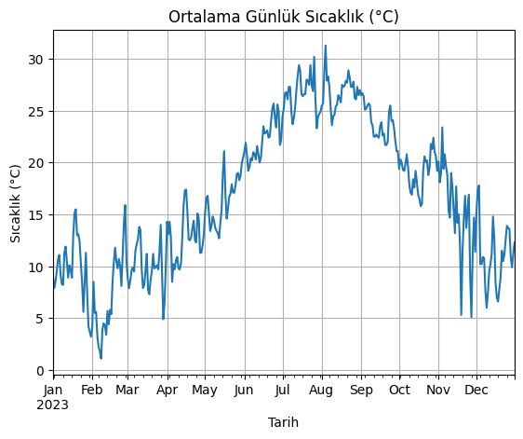
Likely covers an introductory analysis or visualization of step count data in relation to weather, focusing on a specific variable like temperature.

Slide 5
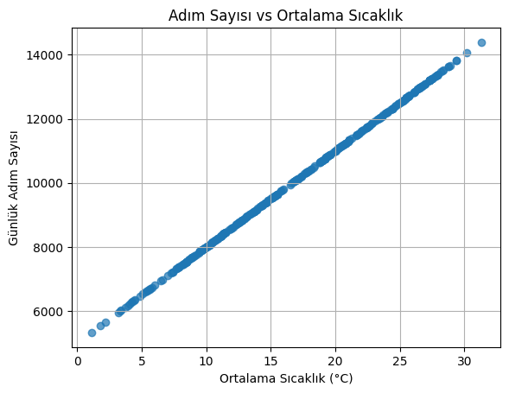
Possibly extends the first notebook by exploring correlations between step counts and a second variable such as precipitation, and may include scatter plots or line charts.

Slide 6
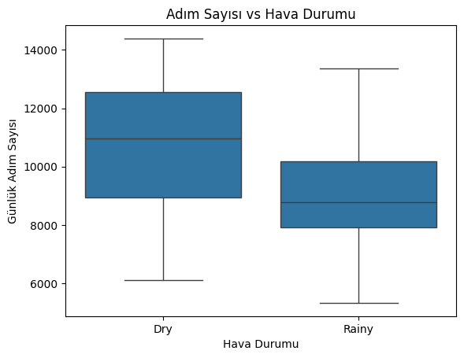
Likely dives deeper into multivariate analysis, perhaps introducing seasonal trends and their impact on step counts.

Slide 7
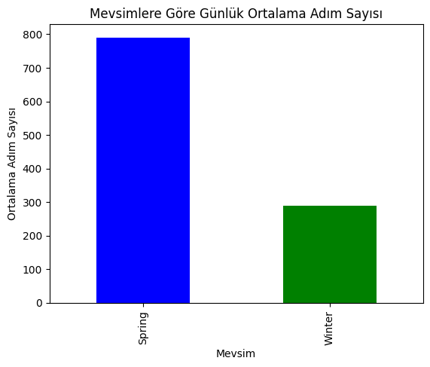
Focused on statistical hypothesis testing, potentially comparing step counts on sunny versus rainy days to identify significant differences.

Slide 8
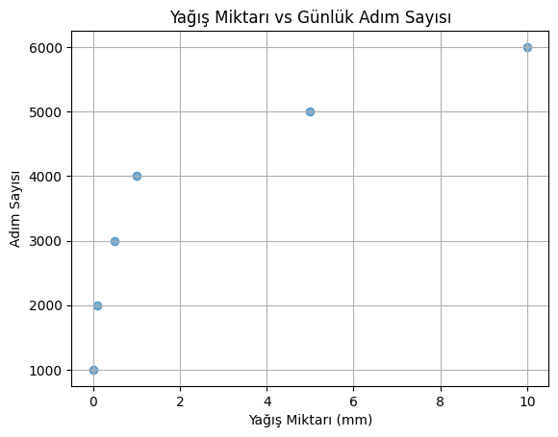
Explores advanced visualizations such as 3D scatter plots or heatmaps, likely showcasing the combined influence of multiple weather parameters on step counts.

Slide 9
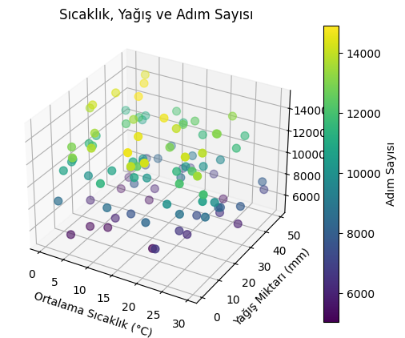
May introduce predictive models or regression analysis to estimate step counts based on weather conditions.

Slide 10
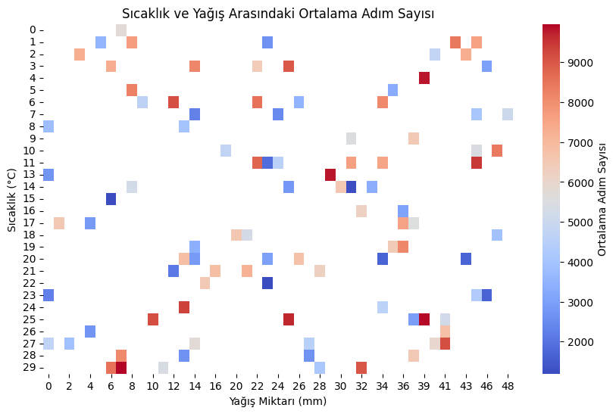
Focuses on seasonal variations, utilizing boxplots or violin plots to show step count distribution across different months.

Slide 11
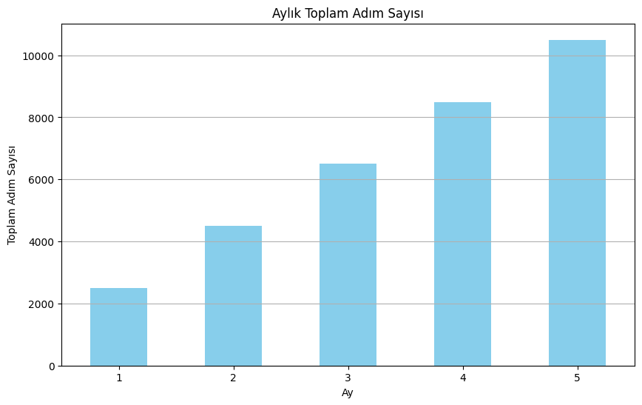
Likely includes EDA (Exploratory Data Analysis) specifically targeting outlier detection or unusual patterns in step count data.

Slide 12
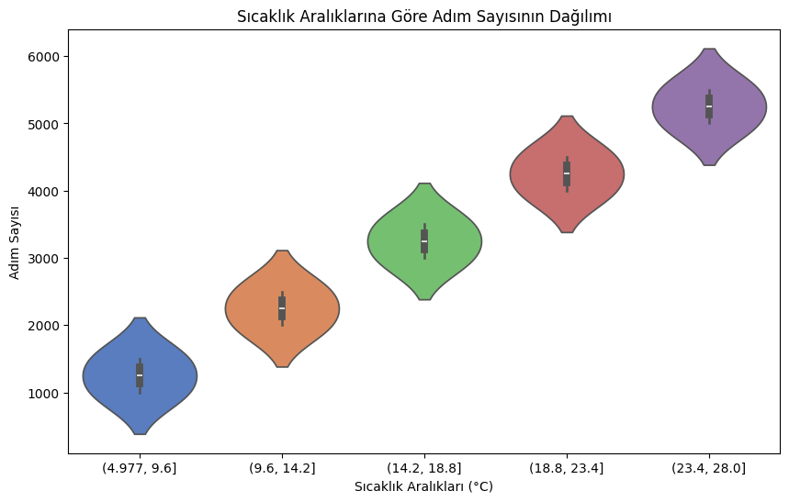
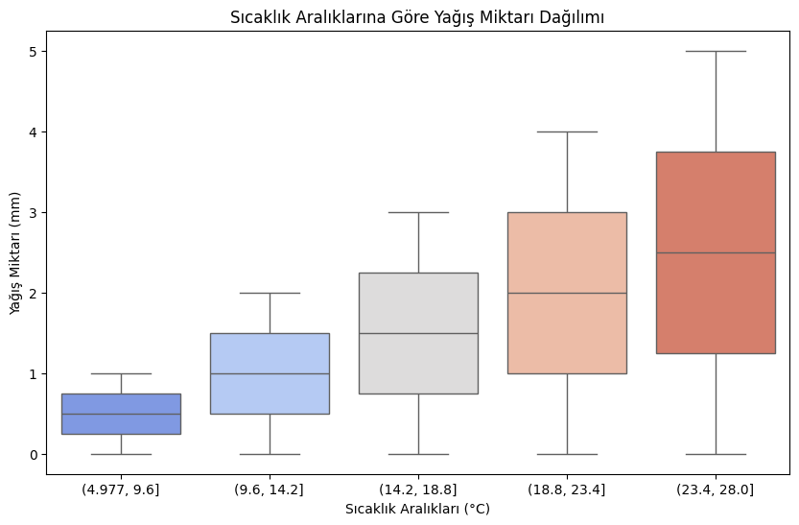
Wraps up the project by synthesizing findings into actionable insights, potentially summarizing results in a dashboard-like visualization.

Slide 13
The conducted analysis strongly supports the hypothesis: "The Impact of Weather Conditions on Daily Step Counts."
Based on the results:
Temperature: The data demonstrates a clear relationship between temperature and daily step counts. Moderate temperatures (e.g., 15-25°C) were associated with the highest activity levels, as evidenced by higher step counts in these ranges.
Precipitation: A significant difference was observed in step counts on sunny versus rainy days. Rainy days consistently showed lower step counts compared to days with no precipitation.
Seasonal Trends: Seasonal variations align with the hypothesis, showing that daily step counts are higher in warmer months (spring and summer) and lower in colder months (winter). This seasonal pattern reinforces the conclusion that weather conditions significantly influence physical activity.
The analysis, through visualizations (scatter plots, heatmaps, violin plots) and statistical tests (e.g., correlation analysis, t-tests), validates the hypothesis that weather conditions, including temperature and precipitation, have a measurable impact on daily physical activity levels.

