Slide 1

Mining Chrome Repository
Group 17:
Cem Yusuf Aydoğdu
İrem Ertürk
İstanbul Technical University
May 15, 2016

Slide 2
Required Data Sets
File Name List
with folders: $ls -ld $(find .) | awk '{print $9}' | sed 's/^..//' | sed -n 'p;$='
without folders: $ls -ldp $(find .) | grep -v '/$' | awk '{print $9}' | sed 's/^..//'
Developer List
alphabetic developer names:
$git log --pretty=format:"%cn" | sort | uniq
developer names and comit counts in numeric order:
$git log --pretty=format:"%cn" | sort | uniq --count | sort -nr

Slide 3
Implementation Details: Top Developers

Slide 4
Implementation Details: Top Edited Files

Slide 5
Implementation Details: Create Adjacency Matrix
Map each developers name to an integer value and use it whenever the developer contibute the change in file.
To create the adjacency matrix for representing contributions to each files, we first create and initialize the Adjacency matrix with all zeros by using the initializeMatrix() function. Rows represent the files and the columns represents the developers.

Slide 6
Implementation Details: Create Adjacency Matrix
Modify value fuction takes the row, column and new_value as parameters. Because we store adjacency matrix in one one dimensional array rather than 2d array, we calculate the index by using row and column values. And change the value with one.

Slide 7
Implementation Details: Create Adjacency Matrix
The main flow of algorithm is done here. The blue highlighted code loops through the "440_F_FileList.txt" file and for each file finds the file contributers. As you can see in the inner while loop we call the modifyValuefunction to change value in adjacency matrix. After all contributers of files modified in inner loop we print the rows.

Slide 8
Implementation Details: Matrix Visualization
At the last step of our project, we encounter with problem about visualization tools. First of all, there exists no download link in given SocialAction website. Then, we try to use Gephi social network visualization tool.
However, its comma separated format is not suitable for our adjacency matrix format. For that reason we write a python code which represents our adjacency matrix.

Slide 9
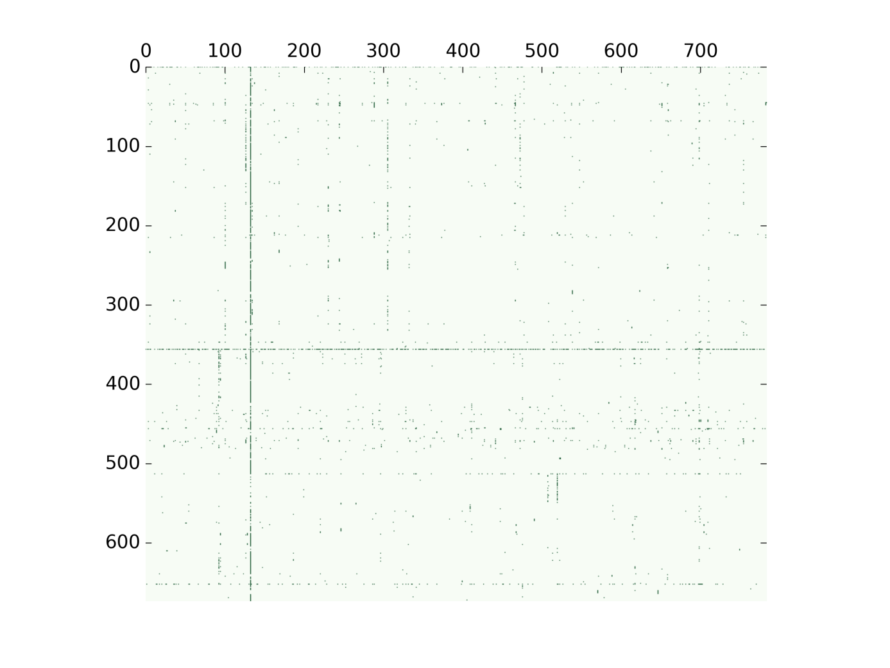

Slide 10
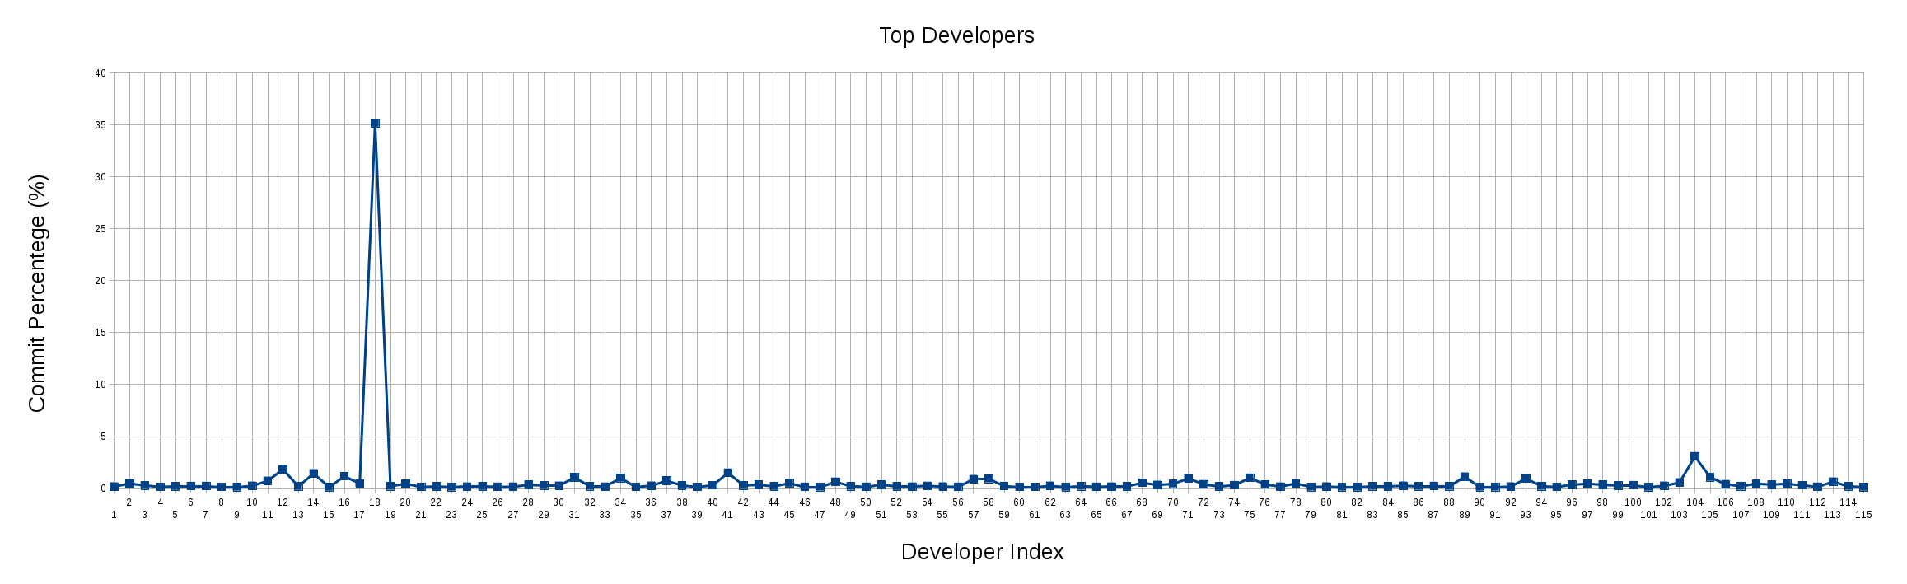
Results: Top Developers
35.1569671379 Commit bot
3.0934459335 thakis@chromium.org
1.8450523224 brettw@chromium.org
1.5145951900 ilevy@chromium.org
1.4503396365 bulach@chromium.org
1.1749586929 cjhopman@chromium.org

Slide 11
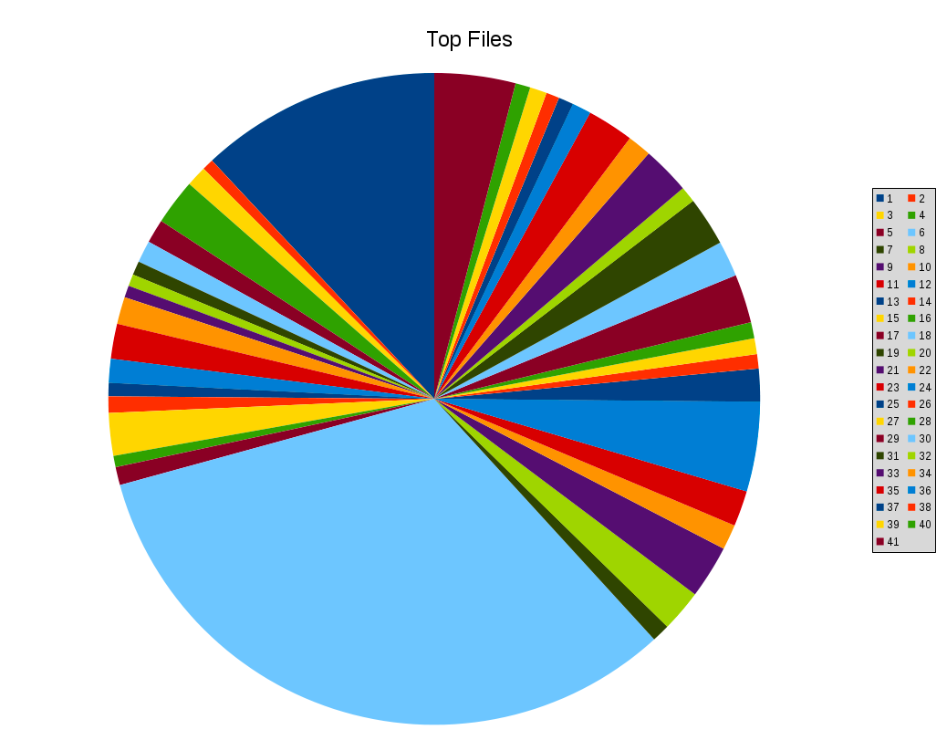
Results: Top Files
% | File
9.5557187443 | all.gyp
0.4589682394 | android/adb_install_apk.py
0.8169634661 | android/buildbot/bb_device_status_check.py
1.817514228 | android/buildbot/bb_device_steps.py
0.9454745732 | android/buildbot/bb_run_bot.py
0.8720396549 | android/envsetup.sh
0.5507618873 | android/gyp/javac.py
0.4681476042 | android/gyp/util/build_utils.py
0.477326969 | android/PRESUBMIT.py
1.0739856802 | android/provision_devices.py
1.386084083 | android/pylib/device/device_utils.py
0.9454745732 | android/pylib/gtest/filter/content_browsertests_disabled
0.5324031577 | android/pylib/gtest/gtest_config.py
0.6517348999 | android/pylib/perf/test_runner.py
1.689003121 | android/test_runner.py
0.4497888746 | android/tombstones.py
0.7159904535 | build_config.h
26.0234991739 | common.gypi
0.7159904535 | config/android/config.gni
1.6614650266 | config/android/internal_rules.gni
2.1112539012 | config/android/rules.gni
1.0005507619 | config/BUILDCONFIG.gn
1.4136221773 | config/BUILD.gn
3.5524141729 | config/compiler/BUILD.gn
1.3034697999 | config/features.gni
0.5691206169 | config/linux/BUILD.gn
0.6241968056 | config/win/BUILD.gn
0.6425555352 | get_landmines.py
1.9276666055 | gn_migration.gypi
1.4136221773 | gyp_chromium
1.946025335 | install-build-deps.sh
0.6333761704 | isolate.gypi
1.9093078759 | java_apk.gypi
0.9454745732 | java.gypi
1.8450523224 | linux/system.gyp
0.7527079126 | sanitizers/tsan_suppressions.cc
0.5966587112 | toolchain/gcc_toolchain.gni
0.5232237929 | toolchain/mac/BUILD.gn
0.6700936295 | toolchain/win/BUILD.gn
0.5966587112 | vs_toolchain.py
3.2127776758 | whitespace_file.txt

Slide 12
Thank You For Listening

