Slide 1
Modulation Techniques In Wired Networks
Cem Yusuf Aydoğdu

Slide 2
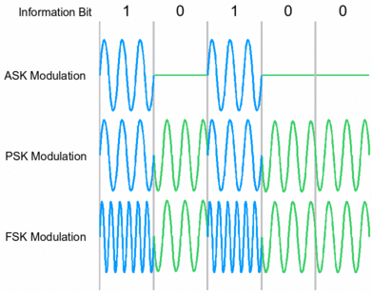
Common modulation
techniques:
ASK
FSK
PSK
QAM
Used in voice-band modems, DSL, coaxiacal cable modem applications

Slide 3
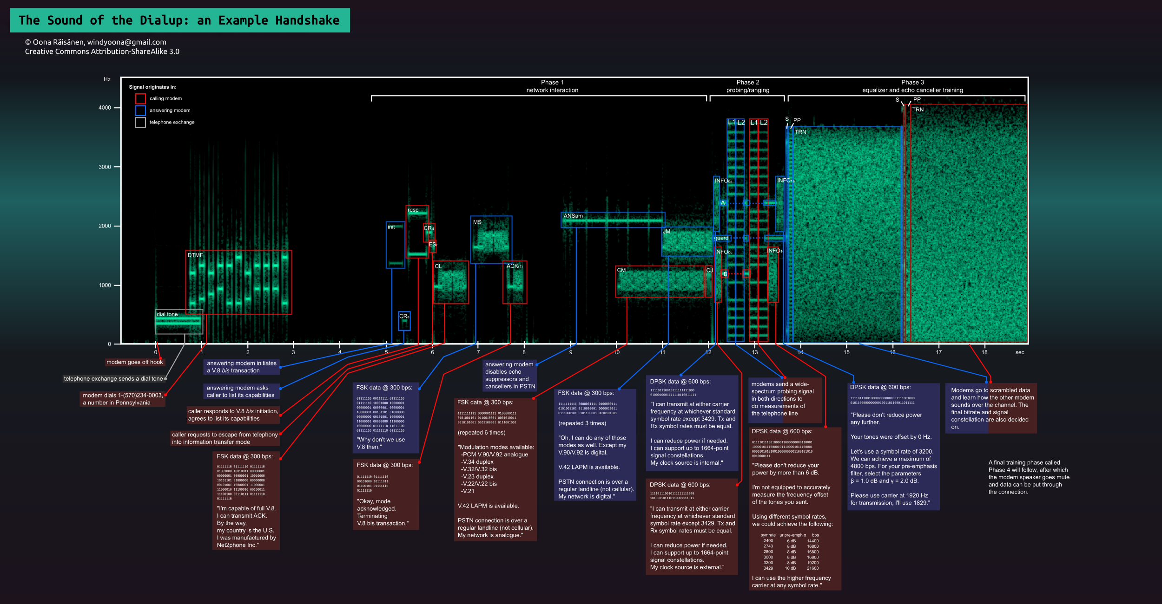

Slide 5
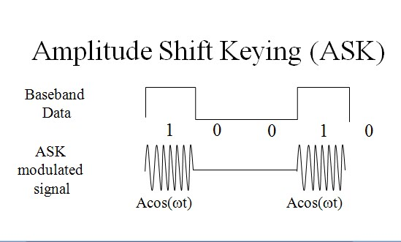
ASK
Binary representation of data with amplitudes
Advantages:
Simple, cheap
Disadvantages:
Susceptible to
noise
Less efficient
Application:
Fiber optic cables

Slide 6
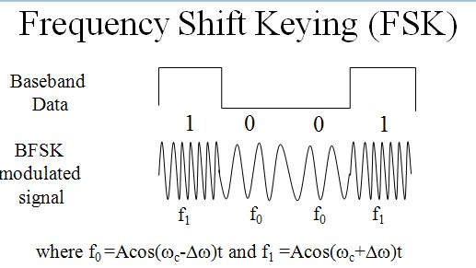
FSK
Data bits are represented by frequency change
Advantages:
Less susceptible to
noise than ASK
Disadvantages:
Higher cost than ASK
Need more spectrum
compared to ASK
Application:
Over voice lines

Slide 7
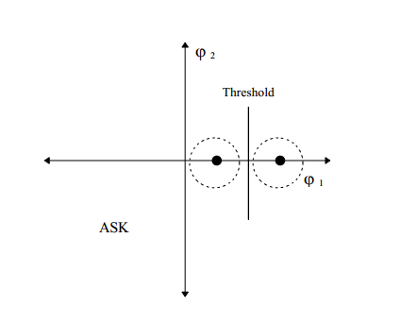
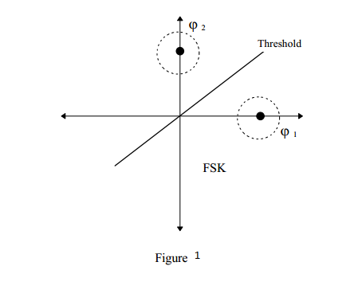
Comparision of ASK and FSK in terms of error
Noise represented with dash

Slide 8
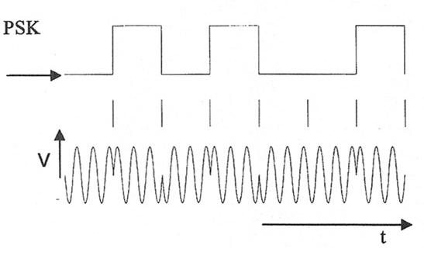
PSK
Phase of carrier signal is changed to represent data
Advantages:
Less susceptible to noise
Requires less bandwidth
than FSK
Disadvantages:
Higher cost than ASK
More complex to detect signal
Application:
Fiber-optic and coaxial communications

Slide 9
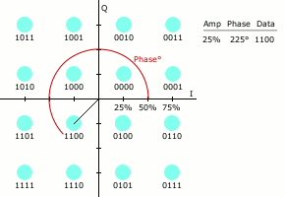
QAM
Combination of amplitude and phase modulation
Advantages:
Higher data rate
Disadvantages:
High complexity
Application:
Digital cable TV
Cable modem

Slide 10
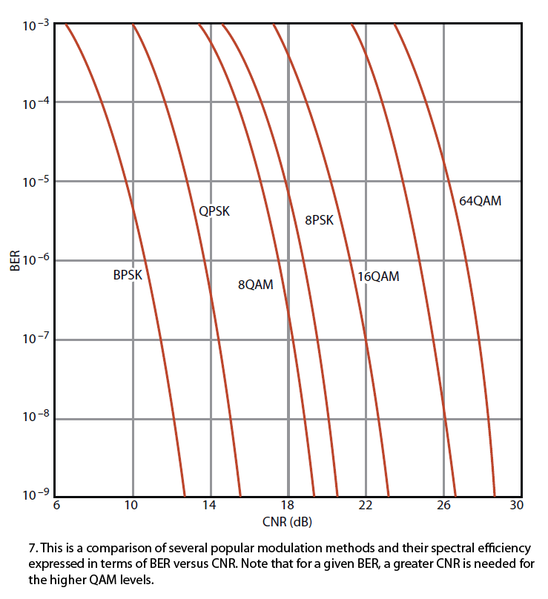

Slide 11
References
http://www.magnadesignnet.com/en/booth/technote/ofdm/page2.php
http://www.cwins.wpi.edu/publications/pown/
http://www.eecs.yorku.ca/course_archive/2010-11/F/3213/CSE3213_07_ShiftKeying_F2010.pdf
http://www.radio-electronics.com/info/rf-technology-design/quadrature-amplitude-modulation-qam/8qam-16qam-32qam-64qam-128qam-256qam.php
http://searchnetworking.techtarget.com/definition/QAM
http://electronicdesign.com/communications/understanding-modern-digital-modulation-techniques#2
http://www.slideshare.net/abdurrehmanabdurrehman391/chap-05-dsn?next_slideshow=1

