Slide 1
Software engIneerIng Project presentatIon drone delIvery system
Ozan ÖZYEĞEN
Cem Yusuf AYDOĞDU
Mehmet Taner ÜNAL

Slide 2
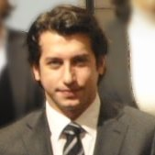
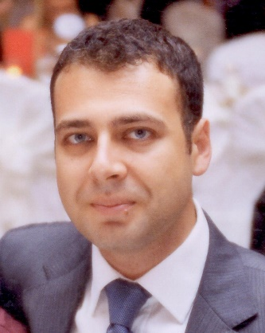
Who are we ?
Market Valuation, received funding

Slide 3
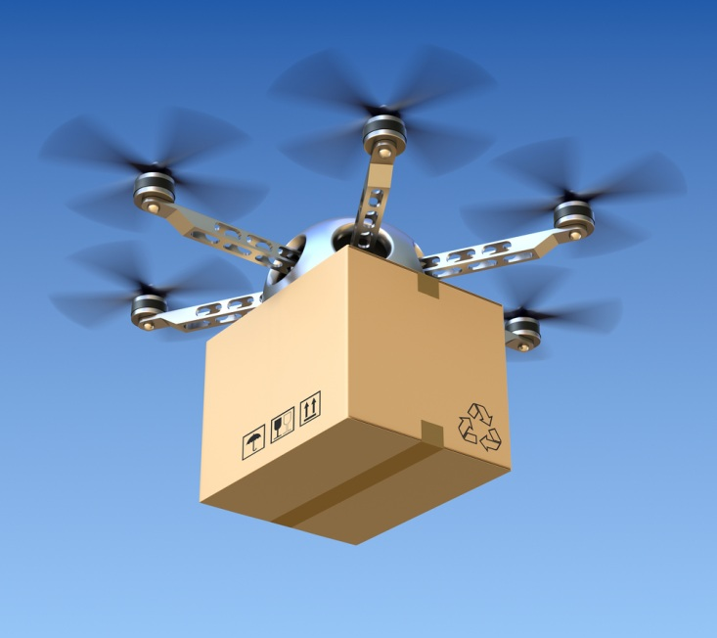
What IS IT?
autonomous
We provide intelligent drone delivery systems (DDS).
fast

Slide 4
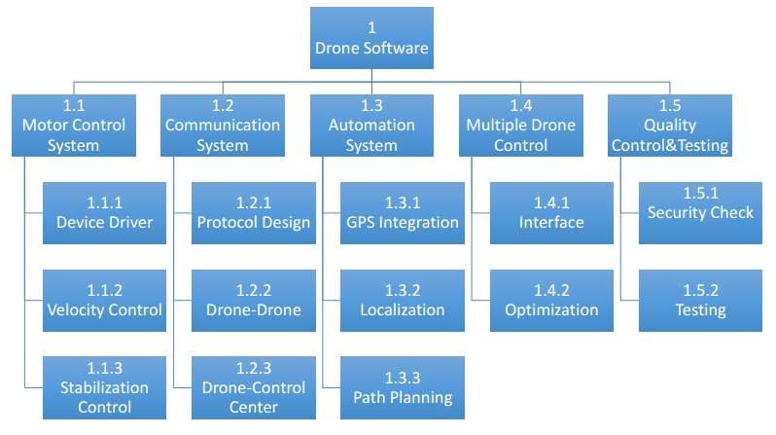
How IT WORKS?
1) Modules

Slide 5
How IT WORKS?
2) User Types
User Type | Description
Package Sender | Provides the package and destination information
Package Receiver | Receiver of the package
Drone Crew | Responsible for general maintenance of the drone and loads package to drone
Control Operator | Responsible to provide location coordinates to drone and checks the delivery operation in real time

Slide 6
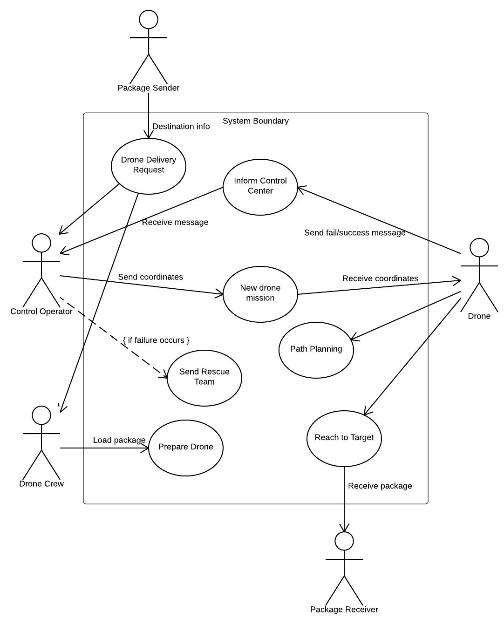
How IT WORKS?
3) Use Case Diagram

Slide 7
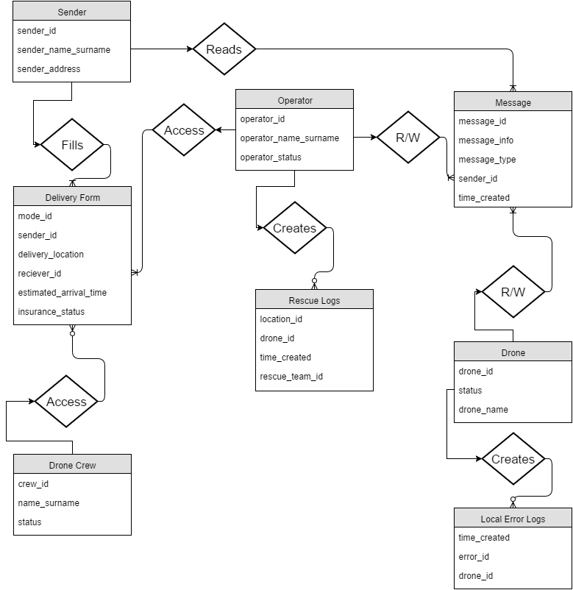
How IT WORKS?
4) Entity Relationship Diagram

Slide 8
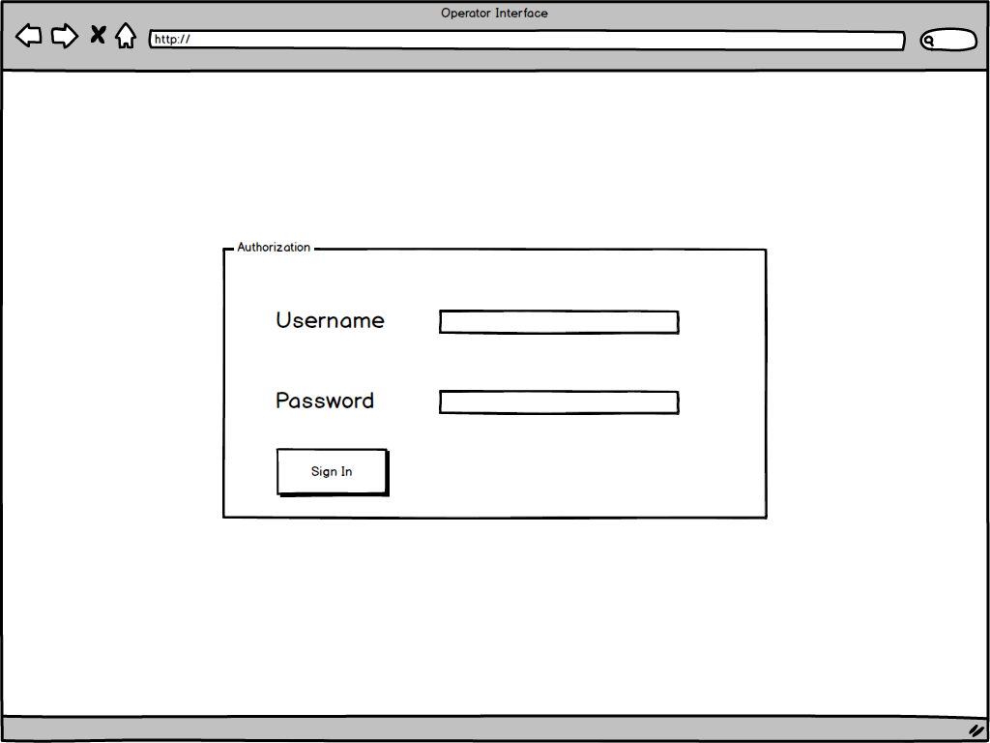
How IT WORKS?
User Interfaces

Slide 9
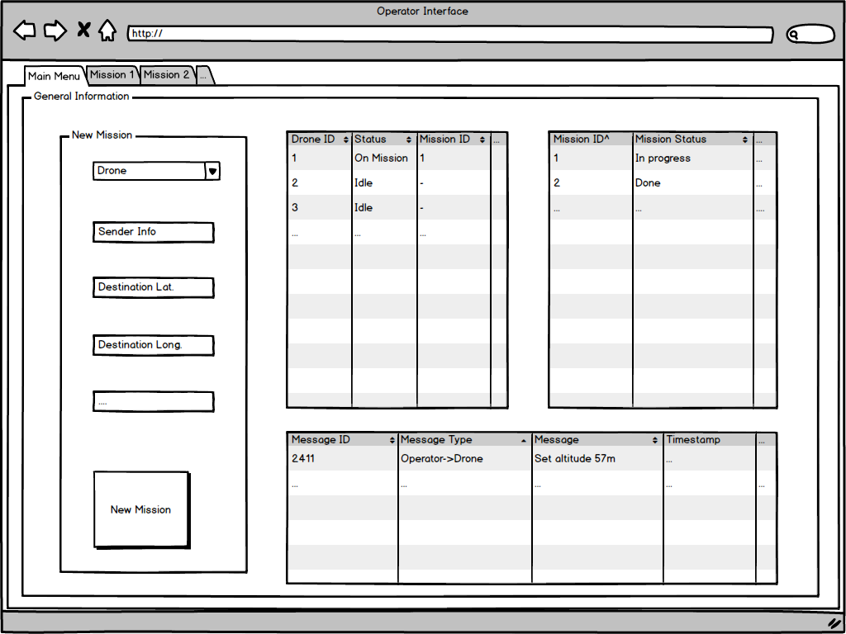
How IT WORKS?
User Interfaces

Slide 10
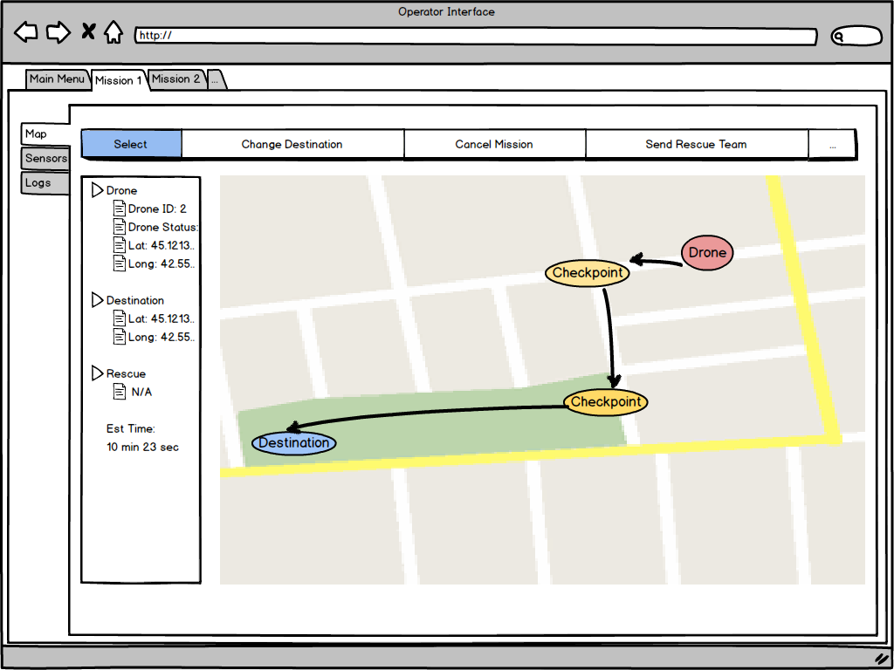
How IT WORKS?
User Interfaces

Slide 11
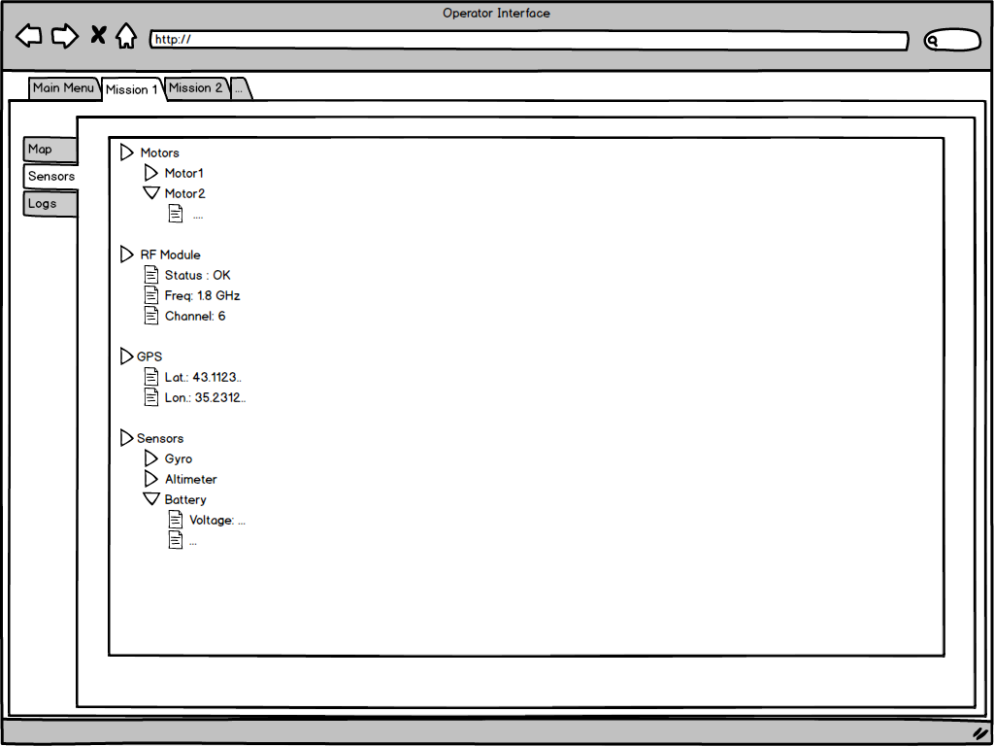
How IT WORKS?
User Interfaces

Slide 12
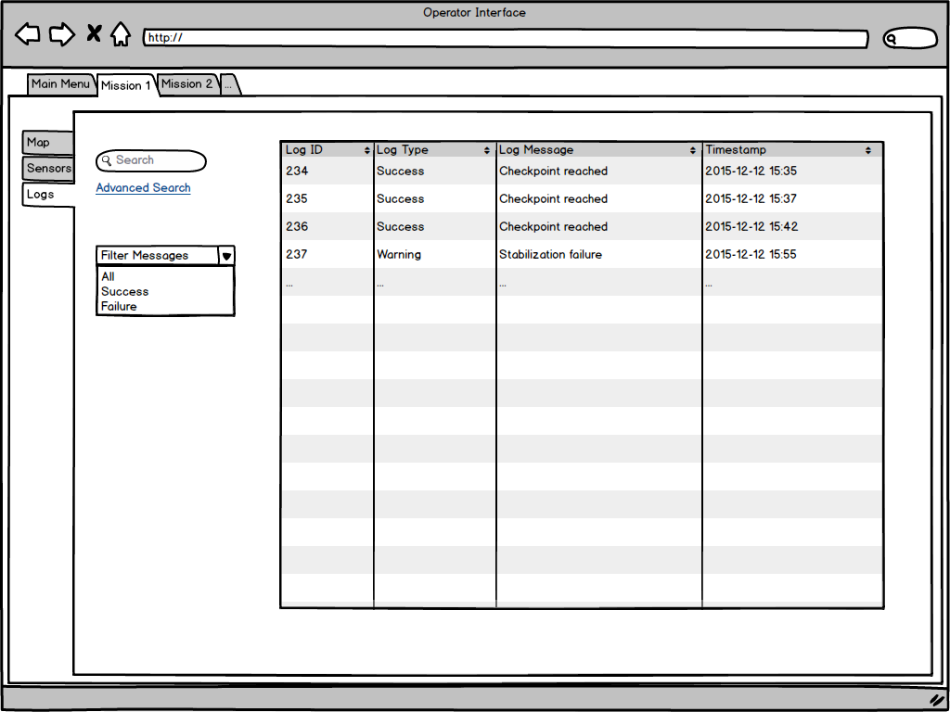
How IT WORKS?
User Interfaces

Slide 13
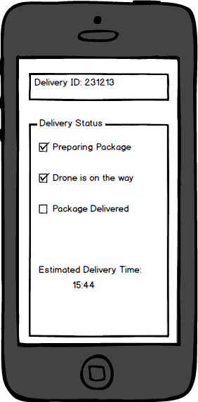
How IT WORKS?
User Interfaces

Slide 14
RISKS
Main risks involve security issues, change requests, deadline times
But,
We created first prototypes successfully
We have experience in all aspects of drone delivery systems

Slide 15
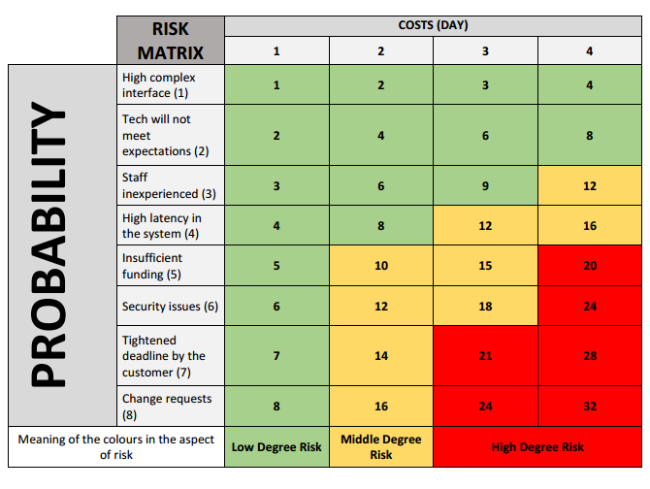
RISKS

Slide 16
How can your company get It?
Buy drones and software
Elemanlarini egitelim drone crew ve operatorler
ANDDDDD iTS ONNNNNNNNNNNNNN

Slide 17
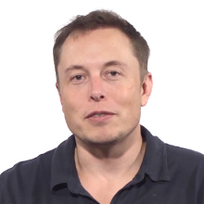
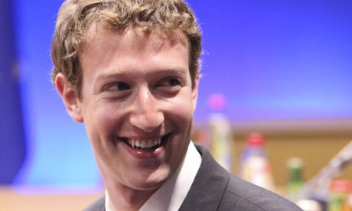
What do people say about us?
“I do like the idea of a drone delivery system. I think one could do a pretty efficient systems by using drones. That would be really fun…I have a design in mind for that. But I already have many things on my plate to do.”
“I am looking forward to buy your company. Keep up the good work.”

