Slide 1
Computer Project II
Mining Chromium repository

Slide 2
Project details
Writing scripts to mine Chromium’s version control system
Identifying top developers
Identifying mostly edited file sets
Building socio-technical network of Chrome project
Team should consist of 3-4 people

Slide 3
Chromium project
https://www.chromium.org/chromium-os/chromiumos-design-docs/source-code-management
As version control system, they use Git.
Check the chromium project in Github to learn more on where and how they store the source code.

Slide 4
Mining version control system
Learn how to mine a project’s development history from git
Choose a particular time of development (e.g. last six months) OR a release OR a component/directory
Get all commits done on that time/release/component/directory

Slide 5
Extracting useful data
Learn to extract socio-technical information:
Social: List of developers who contributed to the project
Technical: Collaboration between developers in terms of contributed files

Slide 6
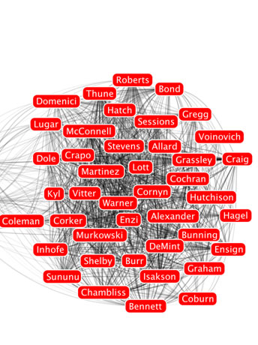
Visualizing social-technical network
Use a graphic toolbox (e.g. SocialAction-http://www.cs.umd.edu/hcil/socialaction)
Nodes will represent Developers
Edges will represent Collaborations between Developers (in terms of commonly edited files)
Nodes can grow to indicate top developers who has the most collaboration with the others
Edges can be thicker based on the number of files contributed together
Graphic taken from http://www.cs.umd.edu/hcil/science20/

Slide 7
More on socio-technical dependencies in Chromium data
Andrew Meneely, Alberto C. Rodriguez Tejeda, Brian Spates, Shannon Trudeau, Danielle Neuberger, Katherine Whitlock, Christopher Ketant, & Kayla Davis, An Empirical Investigation of Socio-technical Code Review Metrics and Security Vulnerabilities, Proceedings of the 6th International Workshop on Social Software Engineering pp. 37–44, 2014
Felivel Camilo, Andrew Meneely, & Meiyappan Nagappan, Do Bugs Foreshadow Vulnerabilities? A Study of the Chromium Project, 2015 International Working Conference on Mining Software Repositories

