Slide 1
H.264/AVC
Cem Yusuf Aydoğdu
Mehmet Taner Ünal

Slide 2
What will we cover?
Introduction
Definitions, background and history, improvements, methods, comparisons
System
Terminology, structure for the encoder and decoder of H.264, profiles
Experimental Results
Testing, PSNR, SSIM

Slide 3
Introduction

Slide 4

Background
A video compression standard H.264, in the other words a codec, was cooperatively advanced by the International Telecommunications Union and International Organization for Standardization/International Electrotechnical Commission Moving Picture Experts Group.
It was known as "H.264" by ITU and "MPEG-4 Part 10, Advanced Video Coding (AVC)" by ISO/IEC. So they both are basically the same thing.

Slide 5
What is x264?
x264 is a free software library and application for encoding video streams into the H.264/MPEG-4 AVC compression format, and is released under the terms of the GNU GPL.
It achieves dramatic performance, encoding 4 or more 1080p streams in realtime on a single consumer-level computer
It has the most advanced psychovisual optimizations

Slide 6
Some Softwares using x264
Avidemux
ELDER
Ffdshow
ffmpeg
GordianKnot
Handbrake
LiVES
MeGUI
Mencoder
Bencos (RealAnime)
StaxRip
VLC Media Player
x264 forms the core of many web video services, such as Youtube, Facebook, Vimeo, and Hulu. It is widely used by television broadcasters and ISPs.

Slide 7
Main Objectives of H.264/AVC Standardisation
to increase compression performance
to boost provision of a network-friendly video representation addressing conversational (video telephony) and non-conversational (storage, streaming, or broadcasting) applications

Slide 8
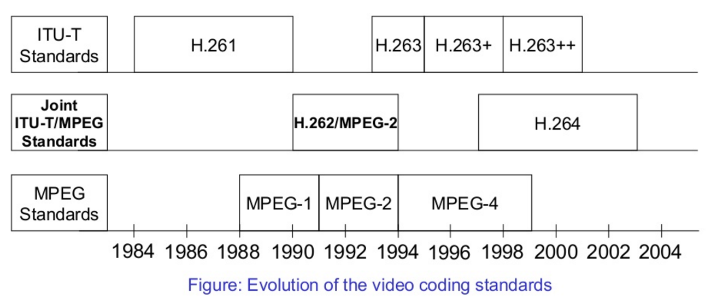
History of Video Coding Standards till H.264
( Reference: http://www.slideshare.net/sajan45/h264-video-standard )

Slide 9
Improvements and Methods
H.264 can convey MPEG-4 quality with a frame size up to four times greater.
It provides MPEG-2 quality at a reduced data rate.

Slide 10
To achieve better compression and perceptual quality these are used:
Motion estimation
Intra estimation
Transformation of motion estimation and intra estimation into the frequency domain
Reduction of compression artifacts
Entropy coding

Slide 11
Some more information
To obtain very exact portrayal of the displacements of moving areas, H.264 grants quarter-pixel precision for motion compensation.
For video network delivery and for delivery of high definition video, H.264 is more charming than MPEG-4

Slide 12




H.264 is promising to be the next standard for format convergence in the digital video industry disregarding of the platform and it is backed by big internet players like Google/YouTube, Adobe, and Apple iTunes

Slide 13
System

Slide 14
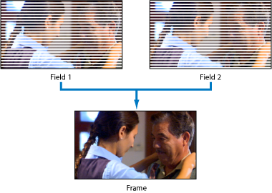
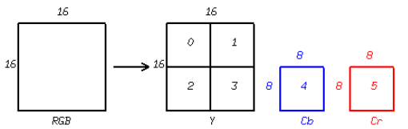
Terminology
Field: Partial frame
Frame consists combined fields
Macroblock: Fixed size region

Slide 15

Terminology
Slice: Set of macroblocks
Different frame types:
I : Intra
P : Predictive
B : Bi-predictive
SI : Switching I
SP : Switching P

Slide 16
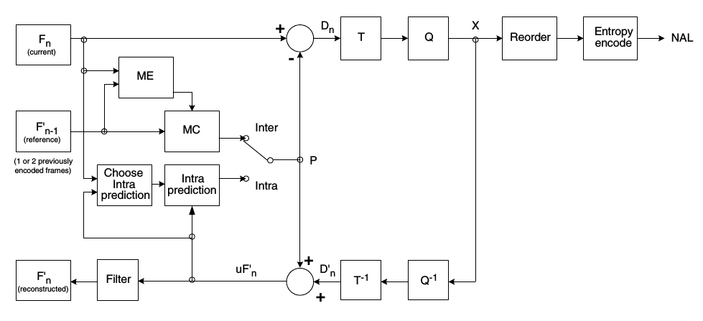
Block Diagram of Encoder
X: Quantization coefficients
P: Prediction block
Dn: Residual difference block
uF’n: Unfiltered deconstructed block
ME: Motion Estimation T: Transform NAL: Network Abstraction Layer
MC: Motion Compensation Q: Quantization

Slide 17
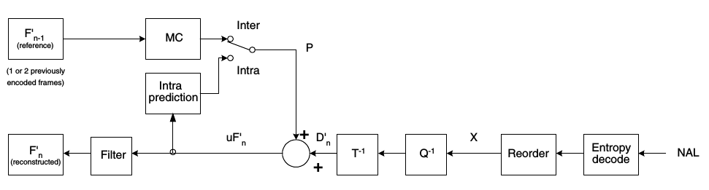
Block Diagram of Decoder
MC: Motion Compensation D’n: Residual difference block
uF’n: Unfiltered deconstructed block P: Prediction block

Slide 18
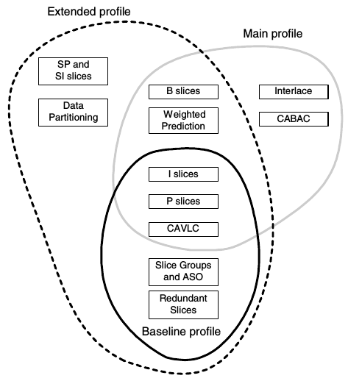
Profiles
Baseline Profile
Basic Functionalities
Main Profile
Storing, broadcasting
Extended Profile
Streaming

Slide 19
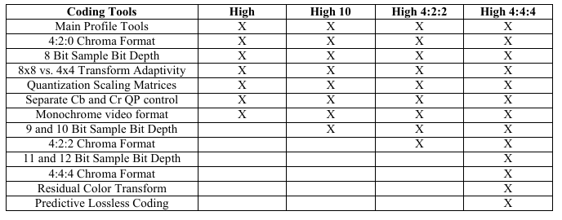
Profiles
High Profiles
For better quality

Slide 20
Experimental Results

Slide 21
Testing
Video Name | Resolution | Frame Per Second | Chroma Format
coastguard | 352 x 288 | 29.97 | 4 : 2 : 0
container | 352 x 288 | 29.97 | 4 : 2 : 0
news | 352 x 288 | 29.97 | 4 : 2 : 0
riverbed | 1920 x 1080 | 25 | 4 : 2 : 0

Slide 22
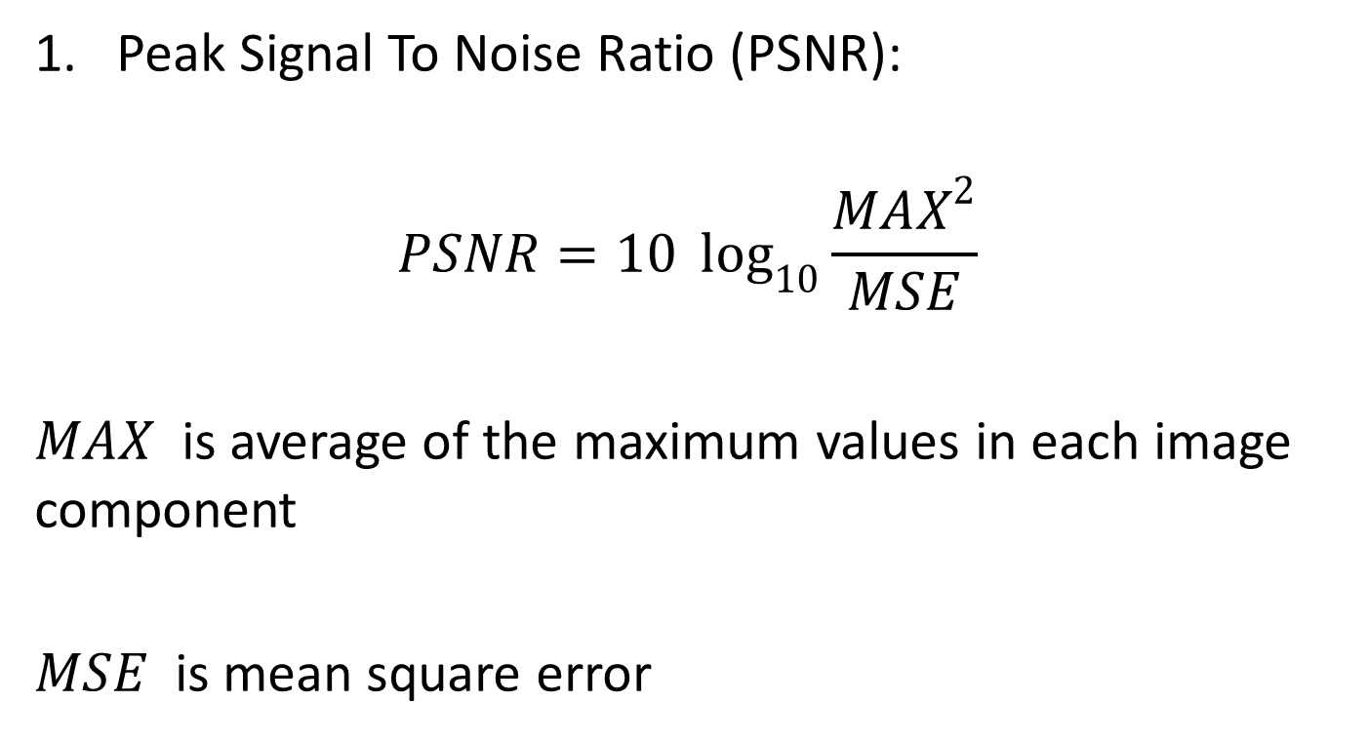
Metrics
Peak Signal To Noise Ratio (PSNR):
$$PSNR=10 \log_{10}{\frac{MAX^{2}}{MSE}}$$
$MAX$ is average of the maximum values in each image component
$MSE$ is mean square error

Slide 23
Comparing Average PSNR Values

Slide 24
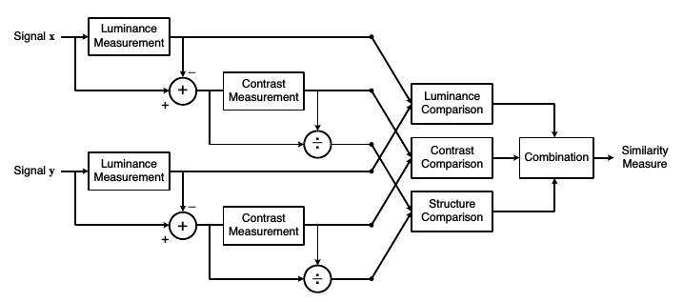
Metrics
Structural Similarity Metric (SSIM):

Slide 25
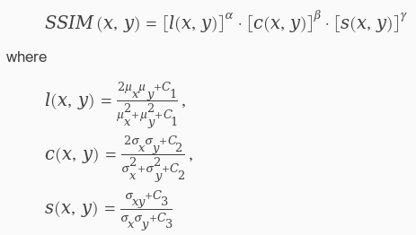
Metrics
μ values denote local means
σ values denote standard deviations

Slide 26
Comparing SSIM Values

