Slide 1
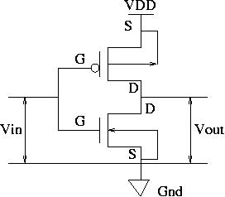
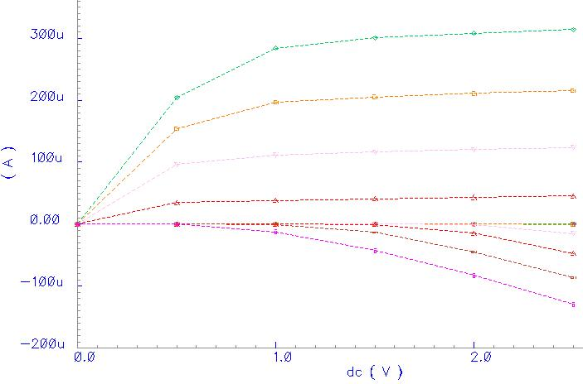
DC Characteristics of a CMOS Inverter
A complementary CMOS inverter consists of a p-type and an n-type device connected in series.
The DC transfer characteristics of the inverter are a function of the output voltage (V_{out}) with respect to the input voltage (V_{in}).
The MOS device first order Shockley equations describing the transistors in cut-off, linear and saturation modes can be used to generate the transfer characteristics of a CMOS inverter.
Plotting these equations for both the n- and p-type devices produces the traces below.

Slide 2
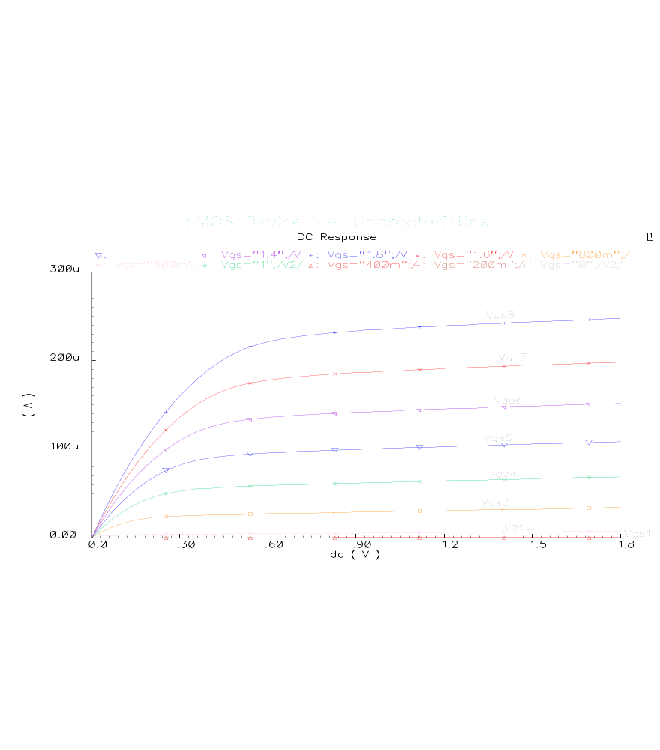
IV Curves for nMOS

Slide 3
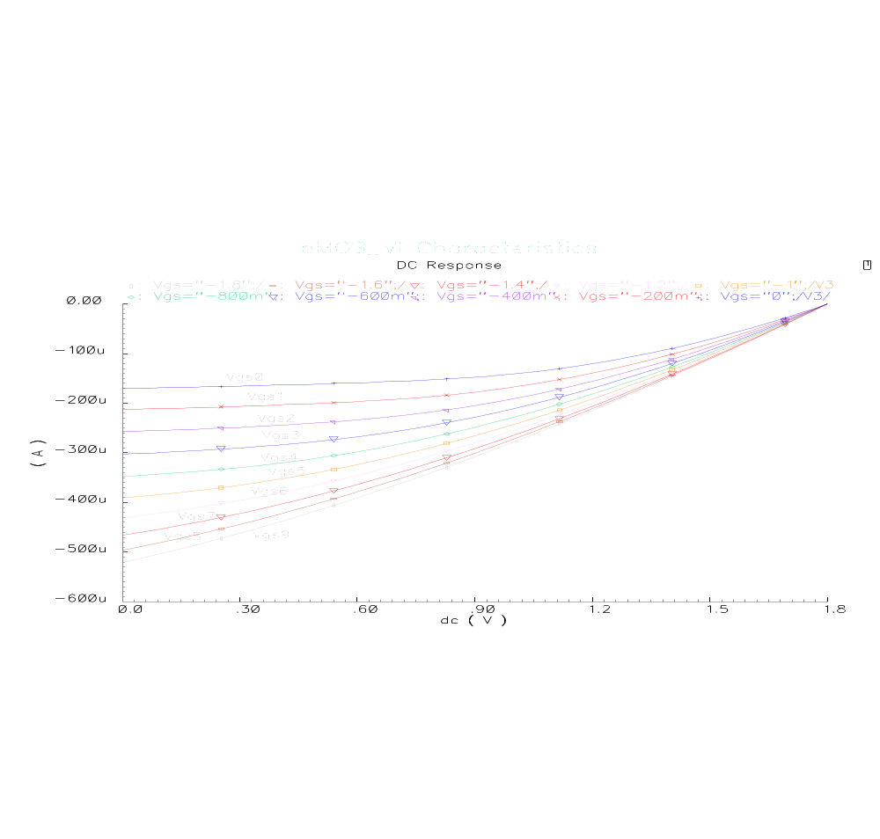
PMOS IV Curves

Slide 4

DC Characteristics of a CMOS Inveter
The DC transfer characteristic curve is determined by plotting the common points of V_{gs} intersection after taking the absolute value of the p-device IV curves, reflecting them about the x-axis and superimposing them on the n-device IV curves.
We basically solve for V_{in(n-type)} = V_{in(p-type)} and I_{ds(n-type)}=I_{ds(p-type)}
The desired switching point must be designed to be 50 % of magnitude of the supply voltage i.e. V_{DD}/2.
Analysis of the superimposed n-type and p-type IV curves results in five regions in which the inverter operates.
Region A occurs when 0 leqV_{in} leq V_{t(n-type)}.
  The n-device is in cut-off (I_{dsn =0}).
  p-device is in linear region,
  I_{dsn} = 0 therefore -I_{dsp} = 0
  V_{dsp} = V_{out} – V_{DD}, but V_{dsp} =0 leading to an output of V_{out} = V_{DD}.
Region B occurs when the condition V_{tn} leq V_{in} le V_{DD}/2 is met.
  Here p-device is in its non-saturated region Vds neq 0.
  n-device is in saturation
Saturation current Idsn is obtained by setting V_{gs} = V_{in} resulting in the equation:

Slide 5
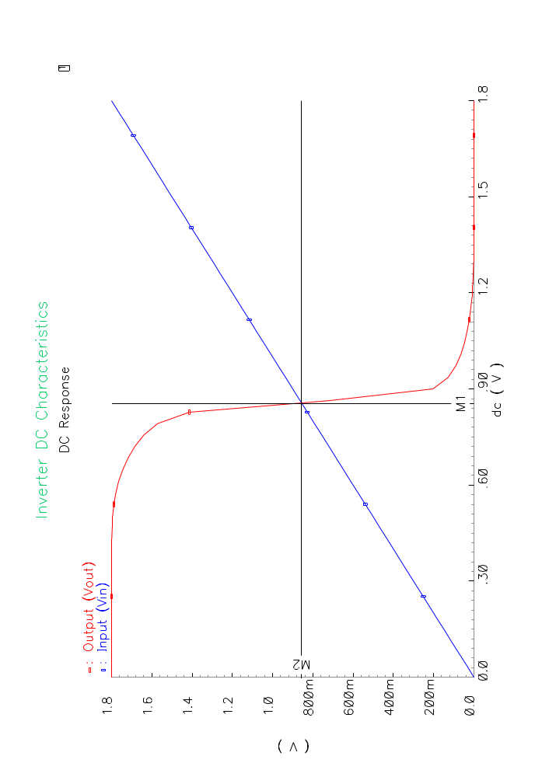
CMOS Inverter DC Characteristics

Slide 6

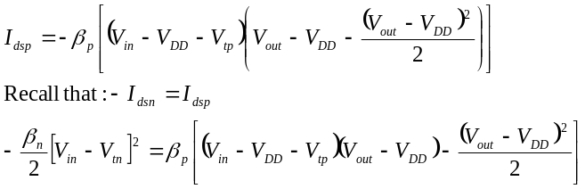
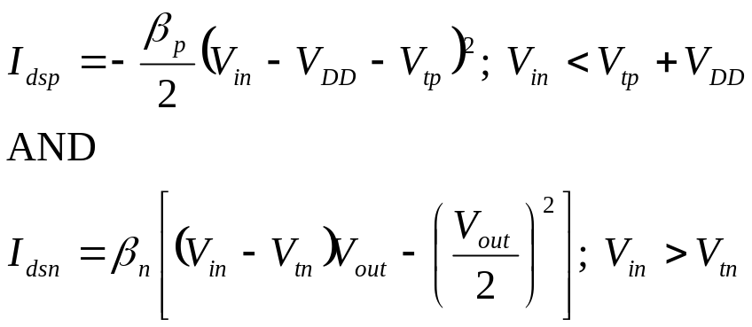
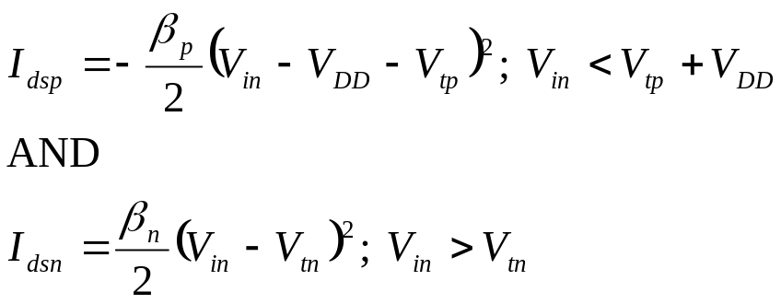
CMOS Inverter Transfer Characteristics
In region B I_{dsp} is governed by voltages V_{gs} and V_{ds} described by:
Region C has that both n- and p-devices are in saturation.
Saturation currents for the two devices are:
Region D is defined by the inequality
p-device is in saturation while n-device is in its non-saturation region.
Equating the drain currents allows us to solve for Vout. (See supplemental notes for algebraic manipulations).

Slide 7
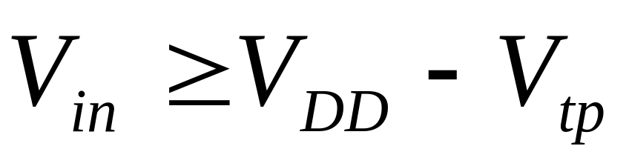
CMOS Inverter Static Charateristics
In Region E the input condition satisfies:
The p-type device is in cut-off: I_{dsp}=0
The n-type device is in linear mode
V_{gsp} = V_{in} –V_{DD} and this is a more positive value compared to V_{tp}.
V_{out} = 0
nMOS & pMOS Operating points
V_{out} =V_{in}-V_{tp}
A
V_{DD}
B
V_{out} =V_{in}-V_{tn}
Both in sat
C
nMOS in sat
Output Voltage
pMOS in sat
D
E
0
V_{tp}
V_{tn}
V_{DD}/2
V_{DD}+V_{tp}
V_{DD}

