Slide 1
Circuit Characterization and Performance Estimation
CMOS circuit performance is generally determined by equivalent RC delays
  Equivalent resistance of driver circuit (N and P devices) driving a receiver circuit plus wire
Load capacitance is comprised of C_{gate} + C_{wire} + C_{diffusion} + C_{parasitic}
  C_{gate} is the total parallel gate capacitance of receiving circuit(s)
  C_{wire} is the total wiring capacitance of the interconnect line (metal or poly)
  C_{diffusion} is the total combined PN junction capacitance of the driving circuit
  C_{parasitic} is the total equivalent capacitance of the internal integrated wire, etc.
Driver resistance consists of some equivalent combination of pull-up and pull-down devices
    Rp is equivalent resistance of the PFET pull-up device
    Rn is the equivalent resistance of the NFET pull-down device
    Metal wire resistance may or may not be important depending on length of net
    Polysilicon gate resistance may or may not be important depending on length of poly line
R. W. Knepper
SC571, page 4-1

Slide 2
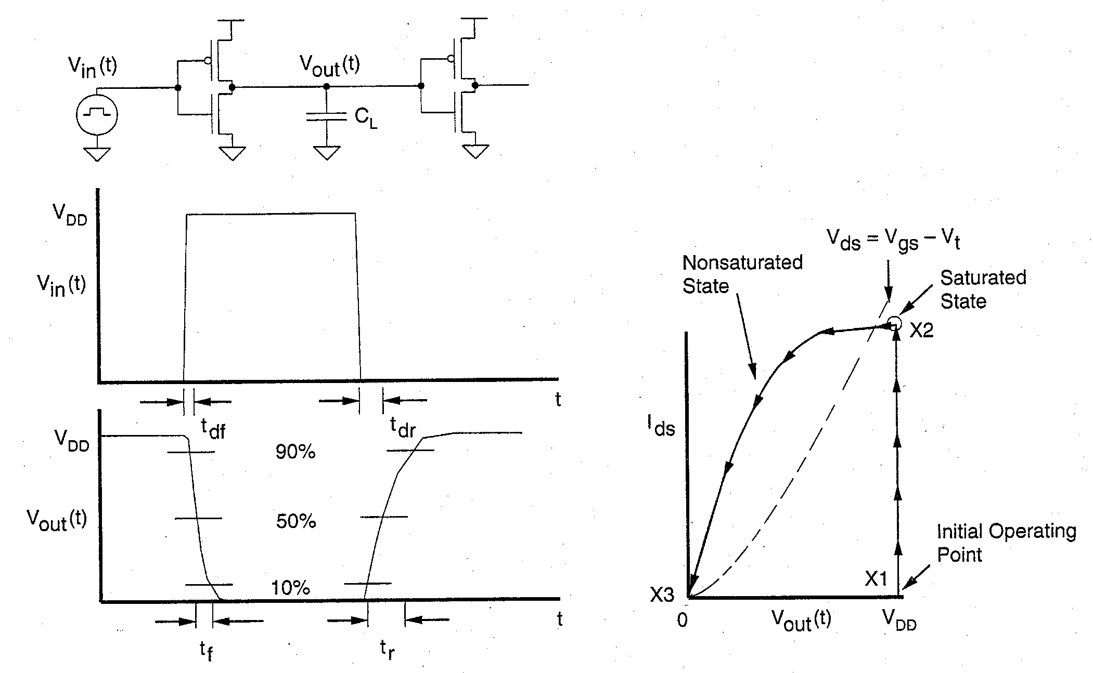
CMOS Inverter Switching Characteristics
Define:
  Rise time t_{r} = time required for a node to charge from the 10% point to 90% point
  Fall time t_{f} = time required for a node to discharge from 90% to 10% point
  Delay time t_{d} = delay from the 50% point on the input to the 50% point on the output
  Falling delay t_{df} = delay time with output falling
  Rising delay t_{dr} = delay time with output rising
R. W. Knepper
SC571, page 4-2

Slide 3
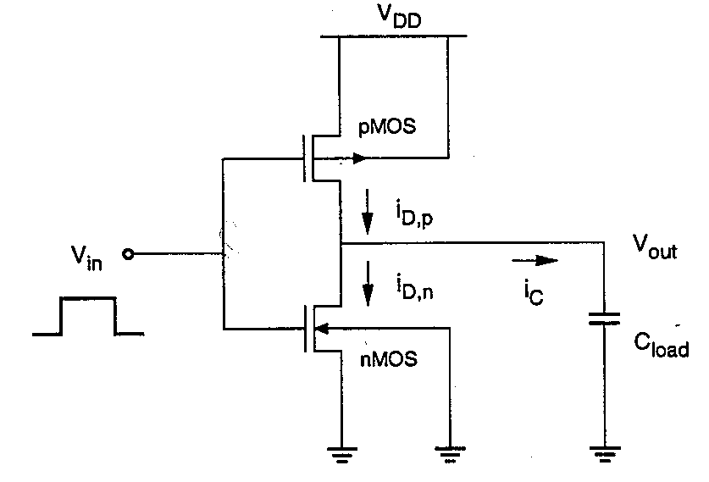
CMOS Inverter Driving a Lumped Capacitance Load
CMOS Inverter can be viewed as a single transistor either charging the Cload or discharging the Cload
  Vin is assumed to switch abruptly
  If Vin switches high, the NMOS Tx discharges Cload while the PMOS Tx turns OFF
  If Vin switches low, the PMOS Tx charges Cload while the NMOS Tx turns OFF
Cload is comprised of
  Cgate due to the gate capacitance of receiving circuits
  Cwire of the interconnect metal
  Cdiffusion of the inverter output junctions
Transient Response:
  Approximate as a simple RC network where R is given as an equivalent resistance of the NMOS and PMOS devices and C is given as the total lumped Cload capacitance
R. W. Knepper
SC571, page 4-3

Slide 4
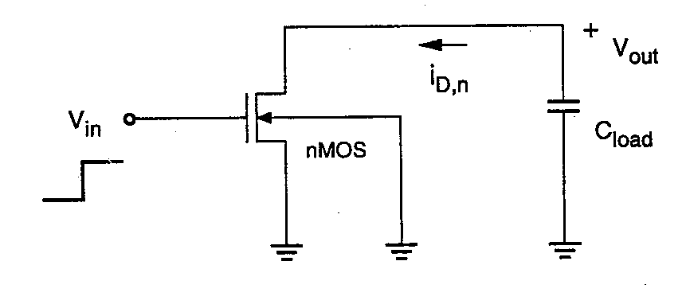
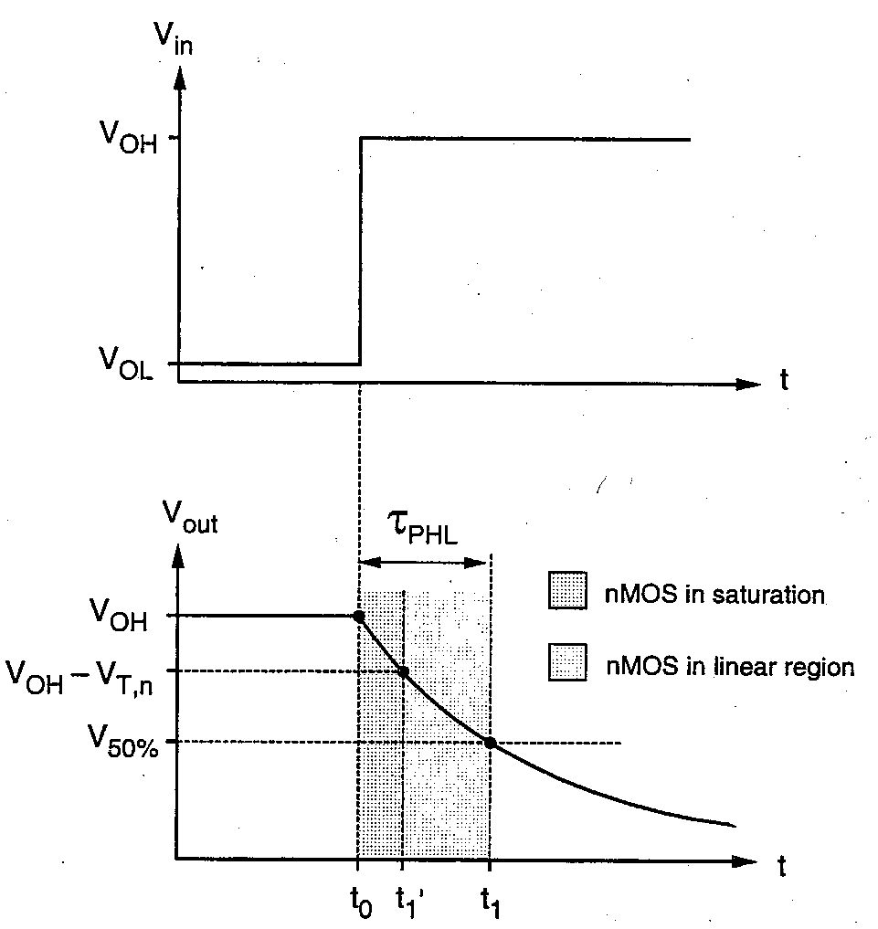
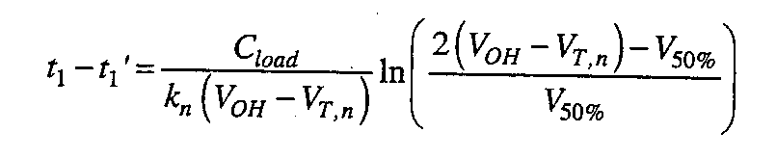
Delay Time Derivation: NMOS Discharging C_{load}
Assume Vin switches abruptly from V_{OL} to V_{OH} (V_{OL} = 0 and V_{OH} = V_{DD} for CMOS)
We are interested in the delay time for Vout to fall from V_{OH} to the 50% point, i.e. to the value 0.5 x (V_{OH} + V_{OL}), = ½ V_{DD} for CMOS
  For Vout between V_{OH} and V_{OH} – V_{TN}, the NMOS is in saturation
    Integrate C_{load} dv = I dt between t_{o} and t_{1’}
    I_{DS} = ½ k_{n} (V_{in} – V_{TN})²
    t_{1’} – t_{o} = 2 C_{load} V_{TN}/k_{n} (V_{OH} – V_{TN})²
  For Vout between V_{OH} – V_{TN} and V_{OL}, the NMOS is in the linear region
    Integrate C_{load} dv = I dt between t_{1’} and t₁
    I_{DS} = k_{n} V_{DS} (V_{GS} – V_{TN} – ½ V_{DS})
R. W. Knepper
SC571, page 4-4

Slide 5
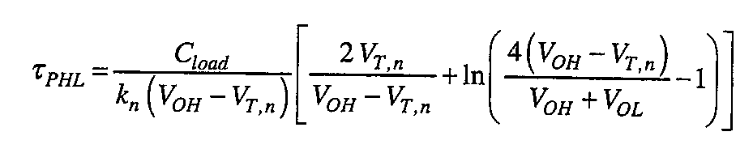
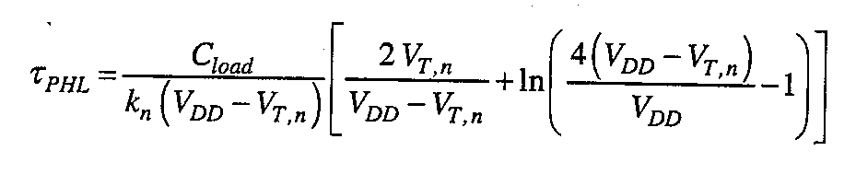
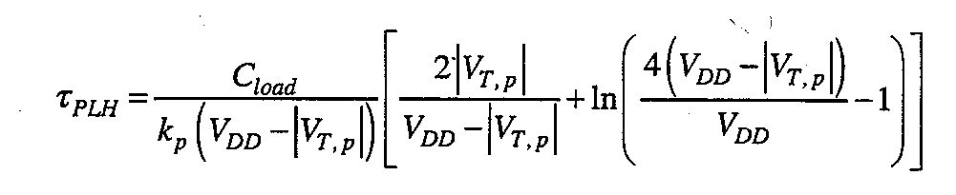
CMOS Inverter Propagation Delay Summary
Summing the two delay components from the previous chart, we obtain the expression (at left) for the propagation delay (high-to low) for an NMOS transistor discharging C_{L}
For CMOS, V_{OH} = V_{DD} and V_{OL} = 0, so the propagation delay (output falling) becomes the expression shown (at left)
A similar expression (left) is obtained by considering the derivation of charging C_{load} with the PMOS transistor when the input abruptly falls from V_{DD} to 0 and the output rises (low-to-high propagation delay)
The above expressions for propagation delay can be reduced to the following simplified form
by defining n = V_{TN}/V_{DD} for falling output (n = |V_{TP}|/V_{DD} for rising output), and β= β_{N} for
falling output (β= β_{P} for rising output) :
τ_{P} = k C_{L}/βV_{DD} where k = [2n/(1-n) + ln (3 – 4n)]/[1-n] = 1.61 for n = 0.2
R. W. Knepper
SC571, page 4-5

Slide 6
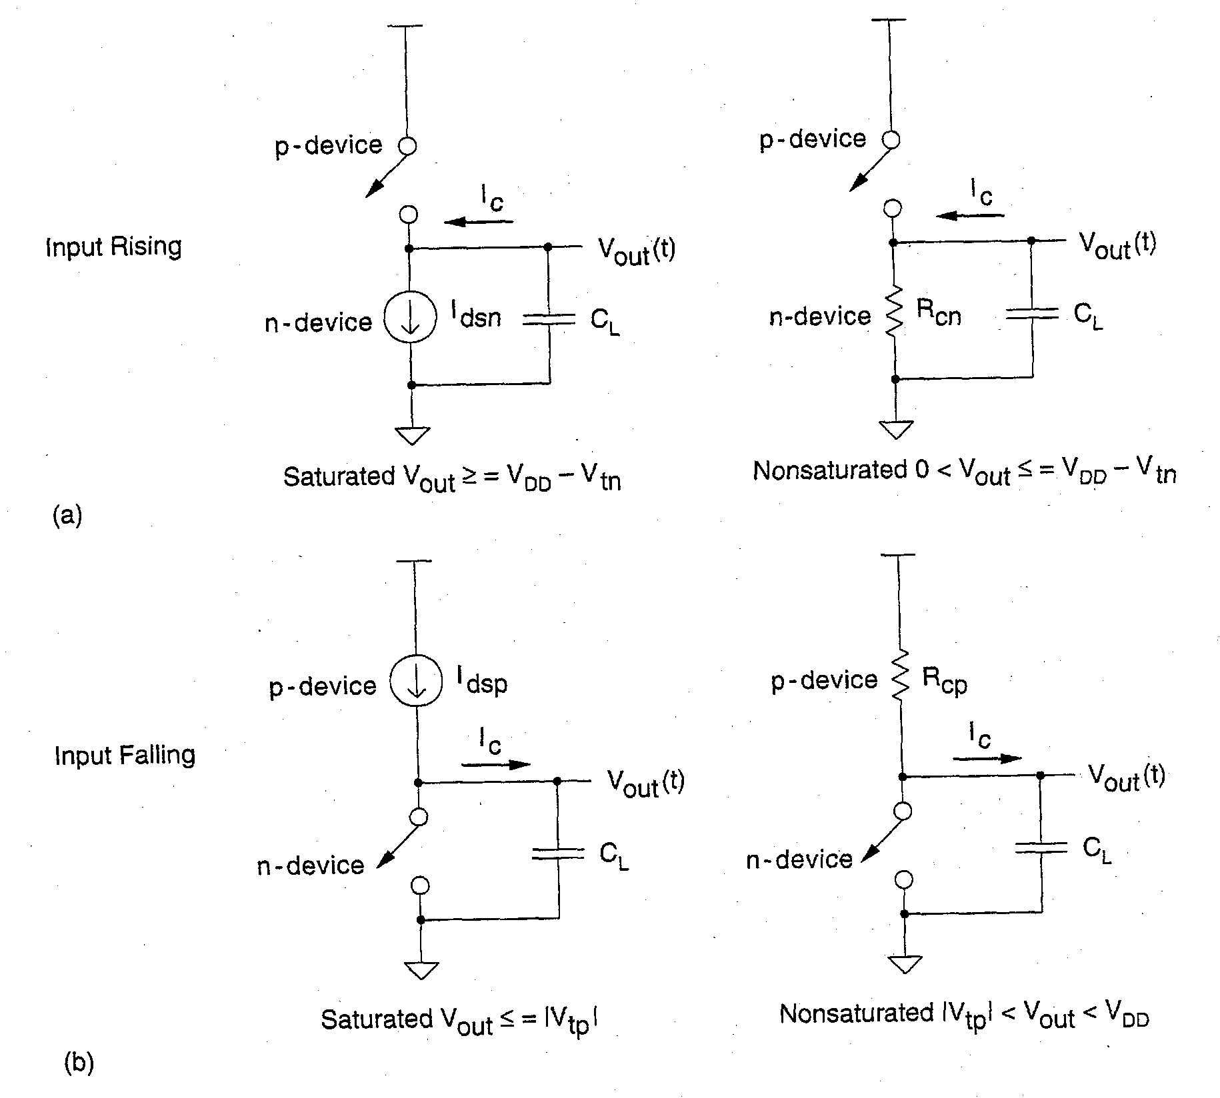
CMOS Inverter Fall Time & Rise Time Derivation
Discharge Transient: (p device OFF)
  N Saturation region (0.9Vdd>vout>Vdd-Vtn)
    C_{L}dv/dt + ½ β_{n} (V_{dd} – V_{tn})² = 0
    t₁ = 2C_{L}(Vtn – 0.1Vdd)/β_{n}(Vdd – Vtn)²
  N Linear Region (Vdd-Vtn>vout>0.1Vdd)
    C_{L}dv/dt + β_{n} v (Vdd – Vtn – 0.5 v) = 0
    t₂ = (C_{L}/β_{n}V_{dd})[{ln (19-20n)}/{1-n}] where n = V_{tn}/V_{dd}
  The combined fall time t_{f} is given by
  t_{f} = k C_{L}/β_{n}V_{dd} where
  k = [2/(1-n)][(n-0.1)/(1-n) + 0.5 ln(19-20n)] k = ~3.7 for n = Vtn/Vdd = 0.2
Charging Transient: (n device OFF)
  Due to the symmetry of CMOS, a similar expression is obtained for rise time where n is replaced by p = |Vtp|/Vdd
  Equal CMOS rise and fall times requires β_{n} = β_{p} due to the difference in e & h mobilities.
R. W. Knepper
SC571, page 4-6

Slide 7
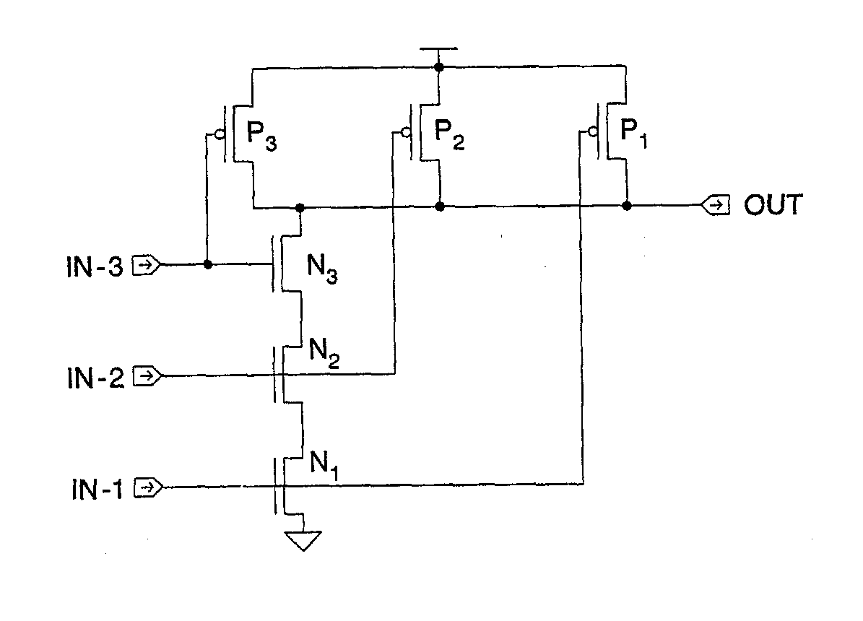
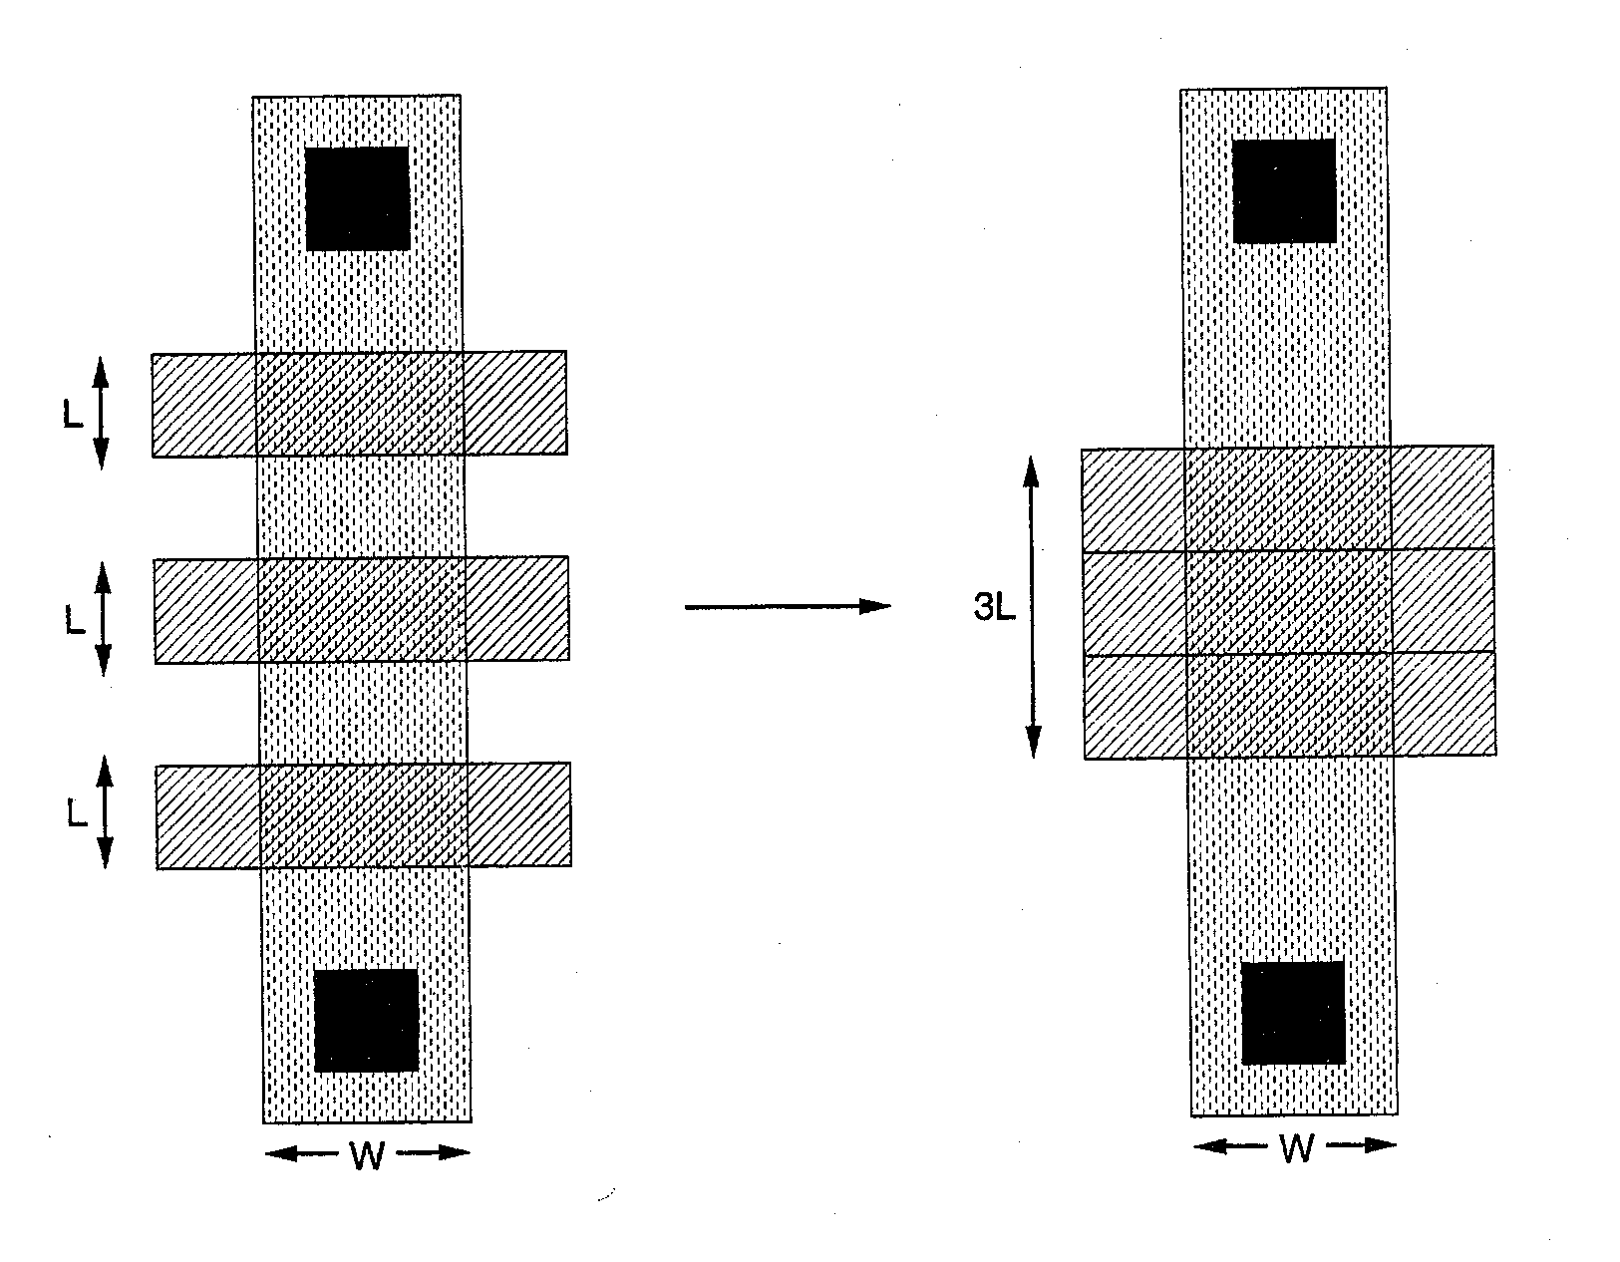
Transistors in Series: CMOS NAND
Several devices in series each with effective channel length L_{eff} can be viewed as a single device of channel length equal to the combined channel lengths of the separate series devices
  e.g. 3 input NAND: a single device of channel length equal to 3L_{eff} could be used to model the behavior of three series devices each with L_{eff} channel length, assuming there is no skew in the increasing gate voltage of the three N pull-down devices.
  The source/drain junctions between the three devices essentially are assumed as simple zero resistance connections
  During saturation transient, the bottom two devices will be in their linear region and only the top device will be pinched off.
R. W. Knepper
SC571, page 4-7

Slide 8
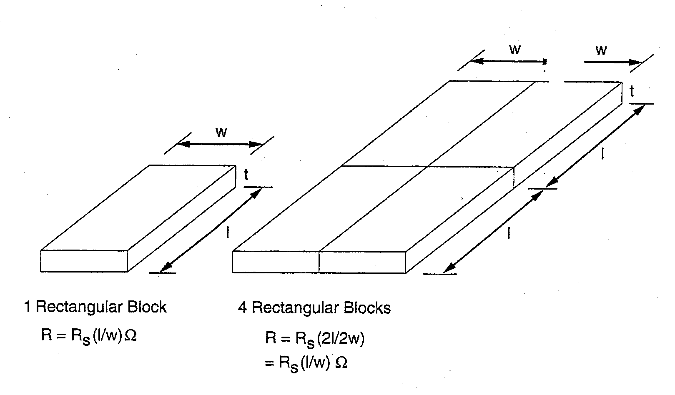
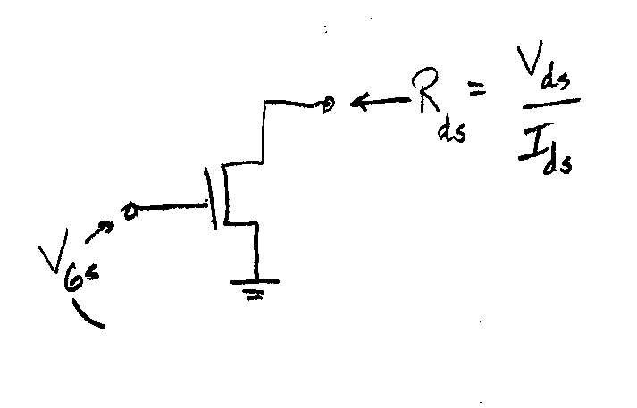
Resistance of a Wire (Rectangular Geometry)
Resistance of a uniform slab:
  R = ρ (l/A) = (ρ/t) (L/W) where ρ is the resistivity in ohm-cm, t is the thickness in cm, L is the length, W is the width, and A is the cross-sectional area
  Using the concept of sheet resistance, R = R_{s} (L/W) where R_{s} is called the sheet resistance and given in ohms per square
    Rs = ρ / t
  Apply to metal wire, poly line, or even a diffused P+ or N+ area of sufficient length
Resistance of an FET transistor (linear):
  R = V_{ds}/I_{ds} = 1/[β(V_{gs} – V_{t} – 0.5 V_{ds})]
  As V_{ds} → 0,
  R_{ds} → 1/[β(V_{gs} – V_{t})] = k(L/W)
  where k = 1/[μC_{ox}(V_{gs} – V_{t})]
R. W. Knepper
SC571, page 4-8

Slide 9
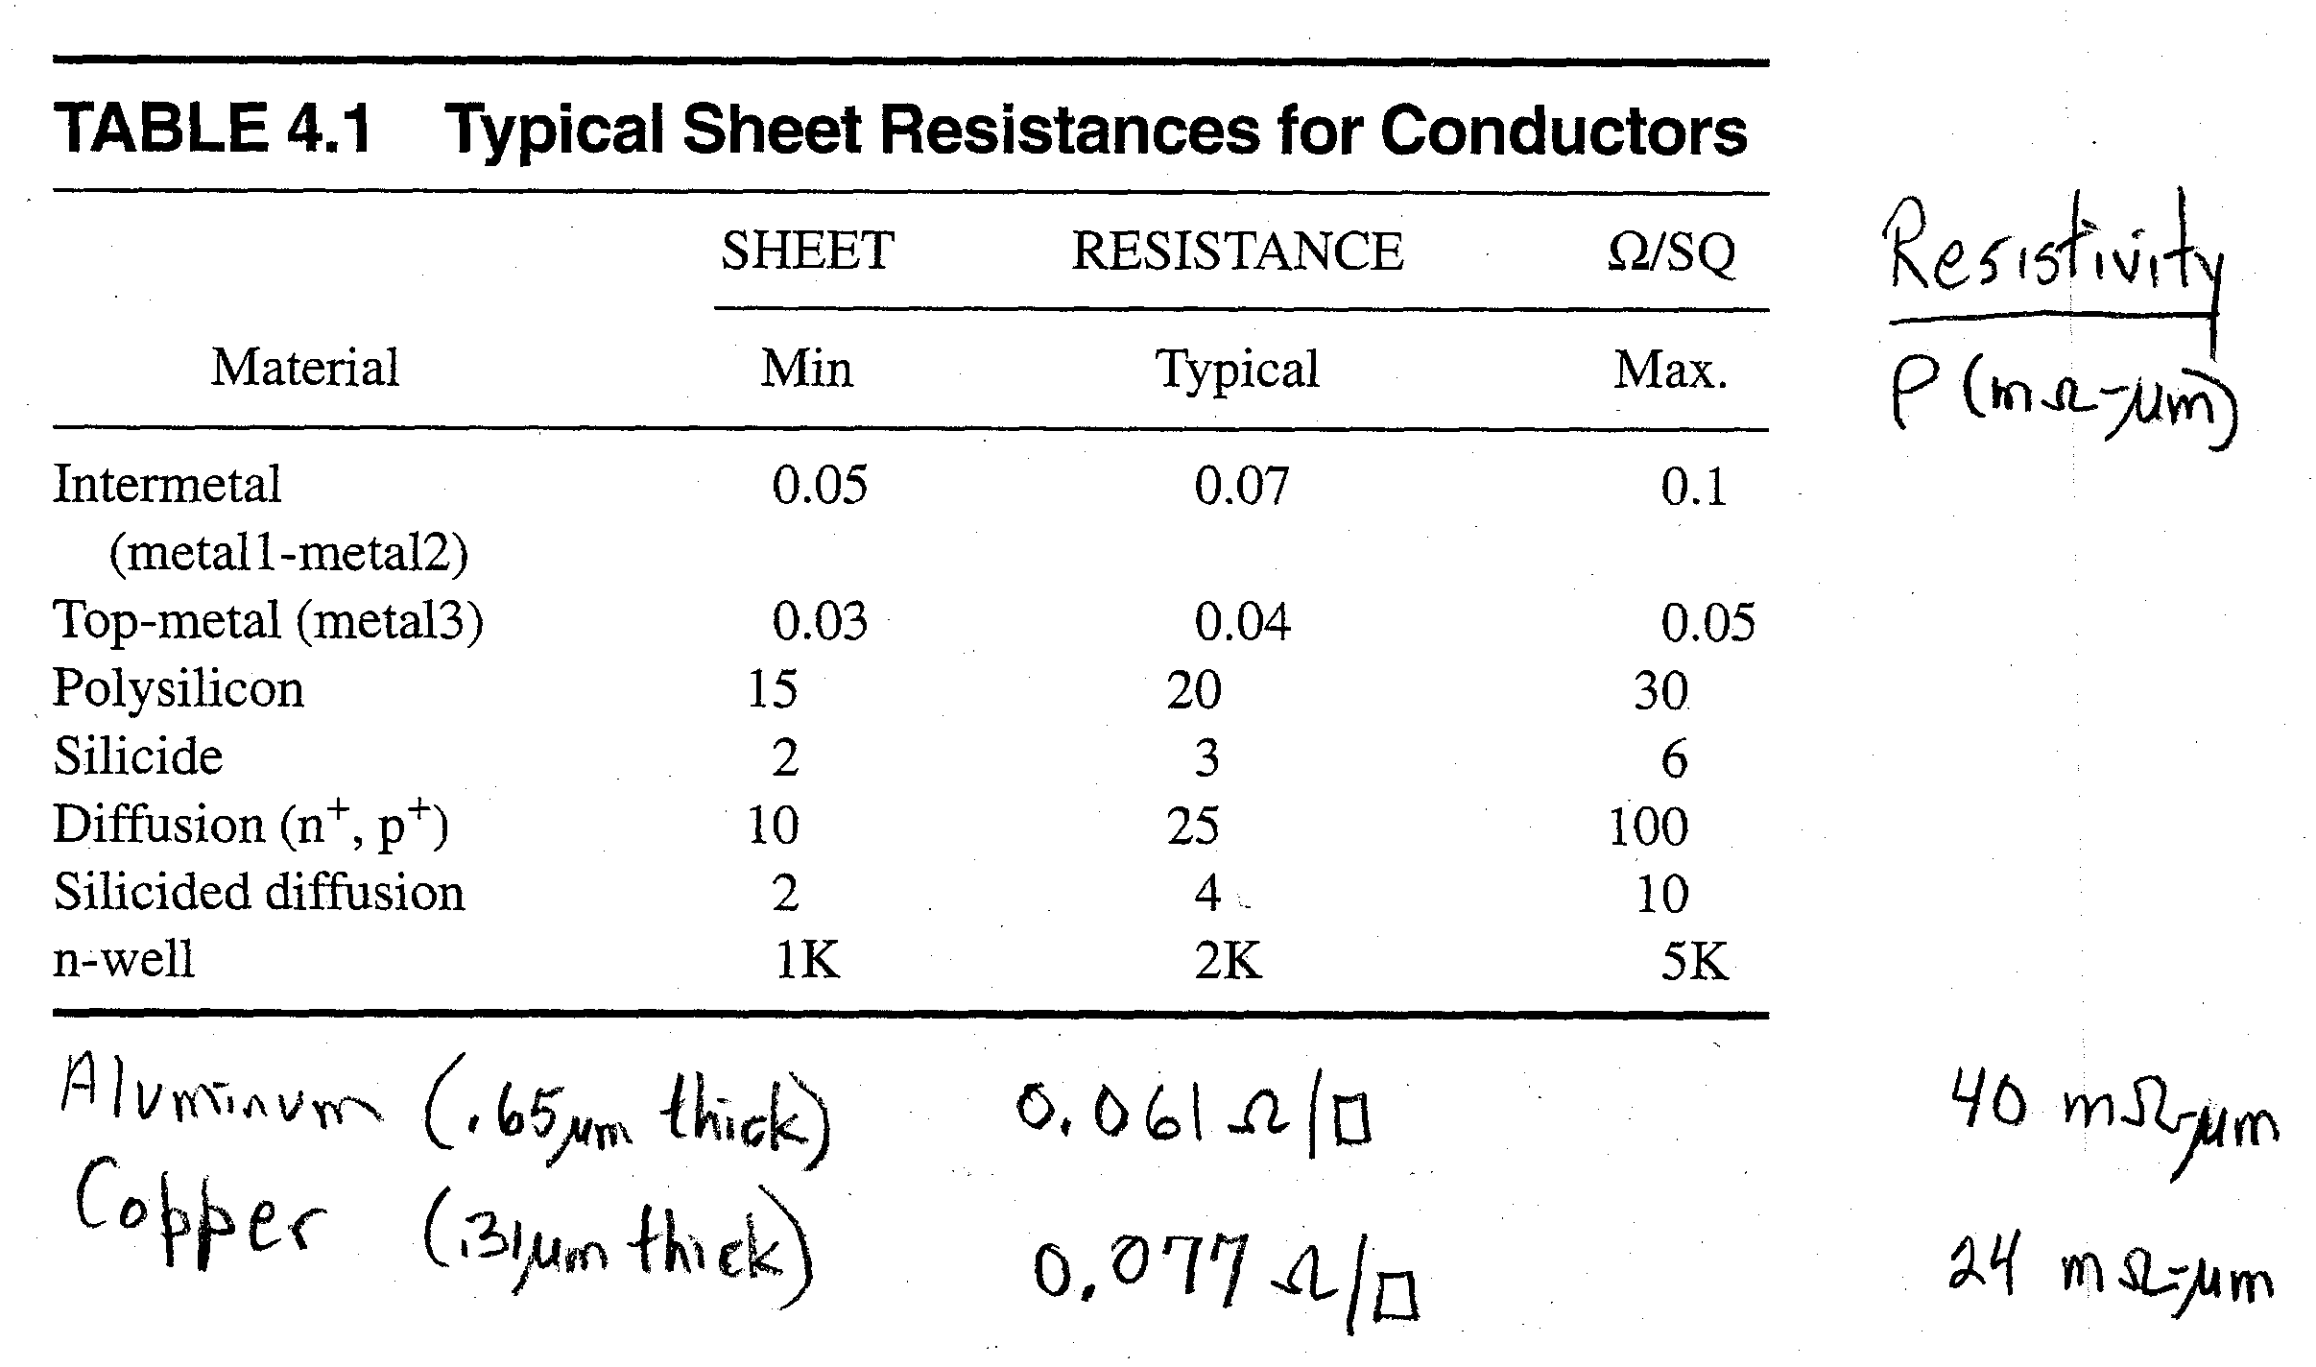
Sheet Resistance for Metal, Poly, Diffusion Conductors
Sheet resistance for various conductors used in S/C fabrication is given below
  depends on thickness of the conductor (Rs = ρ/t)
  typical thickness assumed
Aluminum and copper metal interconnect values given for 0.18 um technology
R. W. Knepper
SC571, page 4-9

Slide 10
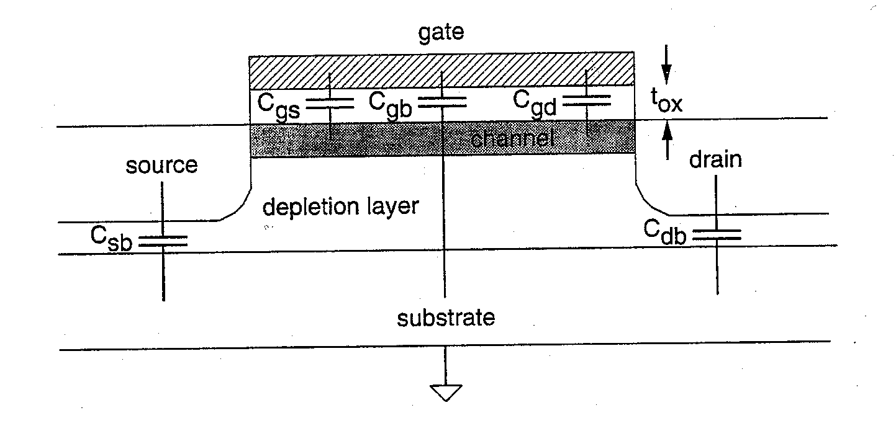
MOSFET Device Capacitance
C_{gs} and C_{gd} are lumped at gate-to-source and gate-to-drain, respectively
C_{gb} (or C_{gx}) is gate-to-substrate (or gate-to-well) capacitance
Csb (or Csx) and Cdb (or Cdx) are the source-to-substrate and drain-to-substrate capacitances and are due to reverse-biased PN junctions of source/drain diffusions.
Regions of operation:
  OFF
    Cgs and Cgd are zero (or very small due to gate overlap capacitance); Cgb is C_{ox} A in series with C_{depl}
  Linear
    Cgs = Cgd = (1/2) C_{ox} A; Cgx = ~ 0
  Saturation
    Cgs =~ (2/3) C_{ox} A; Cgd =~ 0; Cgx =~ 0 where C_{ox} = ε_{o}ε_{SiO2}/t_{ox}
R. W. Knepper
SC571, page 4-10

Slide 11
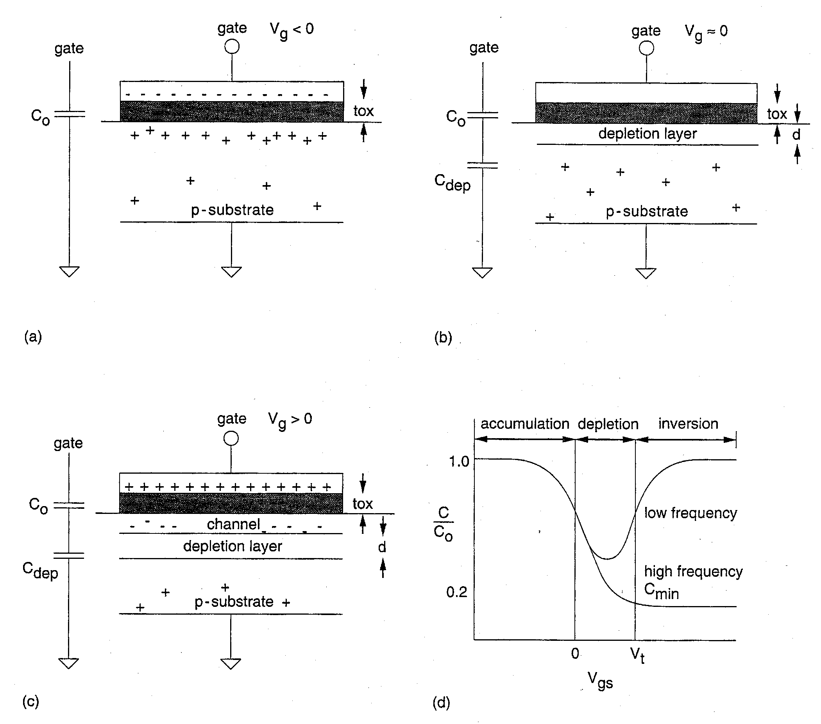
MOS Gate Capacitance
MOS gate oxide capacitance can be divided into three regions:
  (a.) Accumulation occurs when Vg is negative (for P material). Holes are induced under the oxide. Cgate = C_{ox} A where C_{ox} = ε_{SiO2}ε_{o}/t_{ox}
  (b.) Depletion occurs when Vg is near zero but < Vtn. Here the Cgate is given by C_{ox} A in series with depletion layer capacitance C_{dep}
  (c.) Inversion occurs when Vg is positive and > Vtn (for P material). A model for inversion in comprised of C_{ox} A connecting from gate-to-channel and C_{dep} connecting from channel-to-substrate.
(d.) shows a plot of normalized gate capacitance versus gate voltage Vgs
  High freq behavior is due to the distributed resistance of channel
R. W. Knepper
SC571, page 4-11

Slide 12
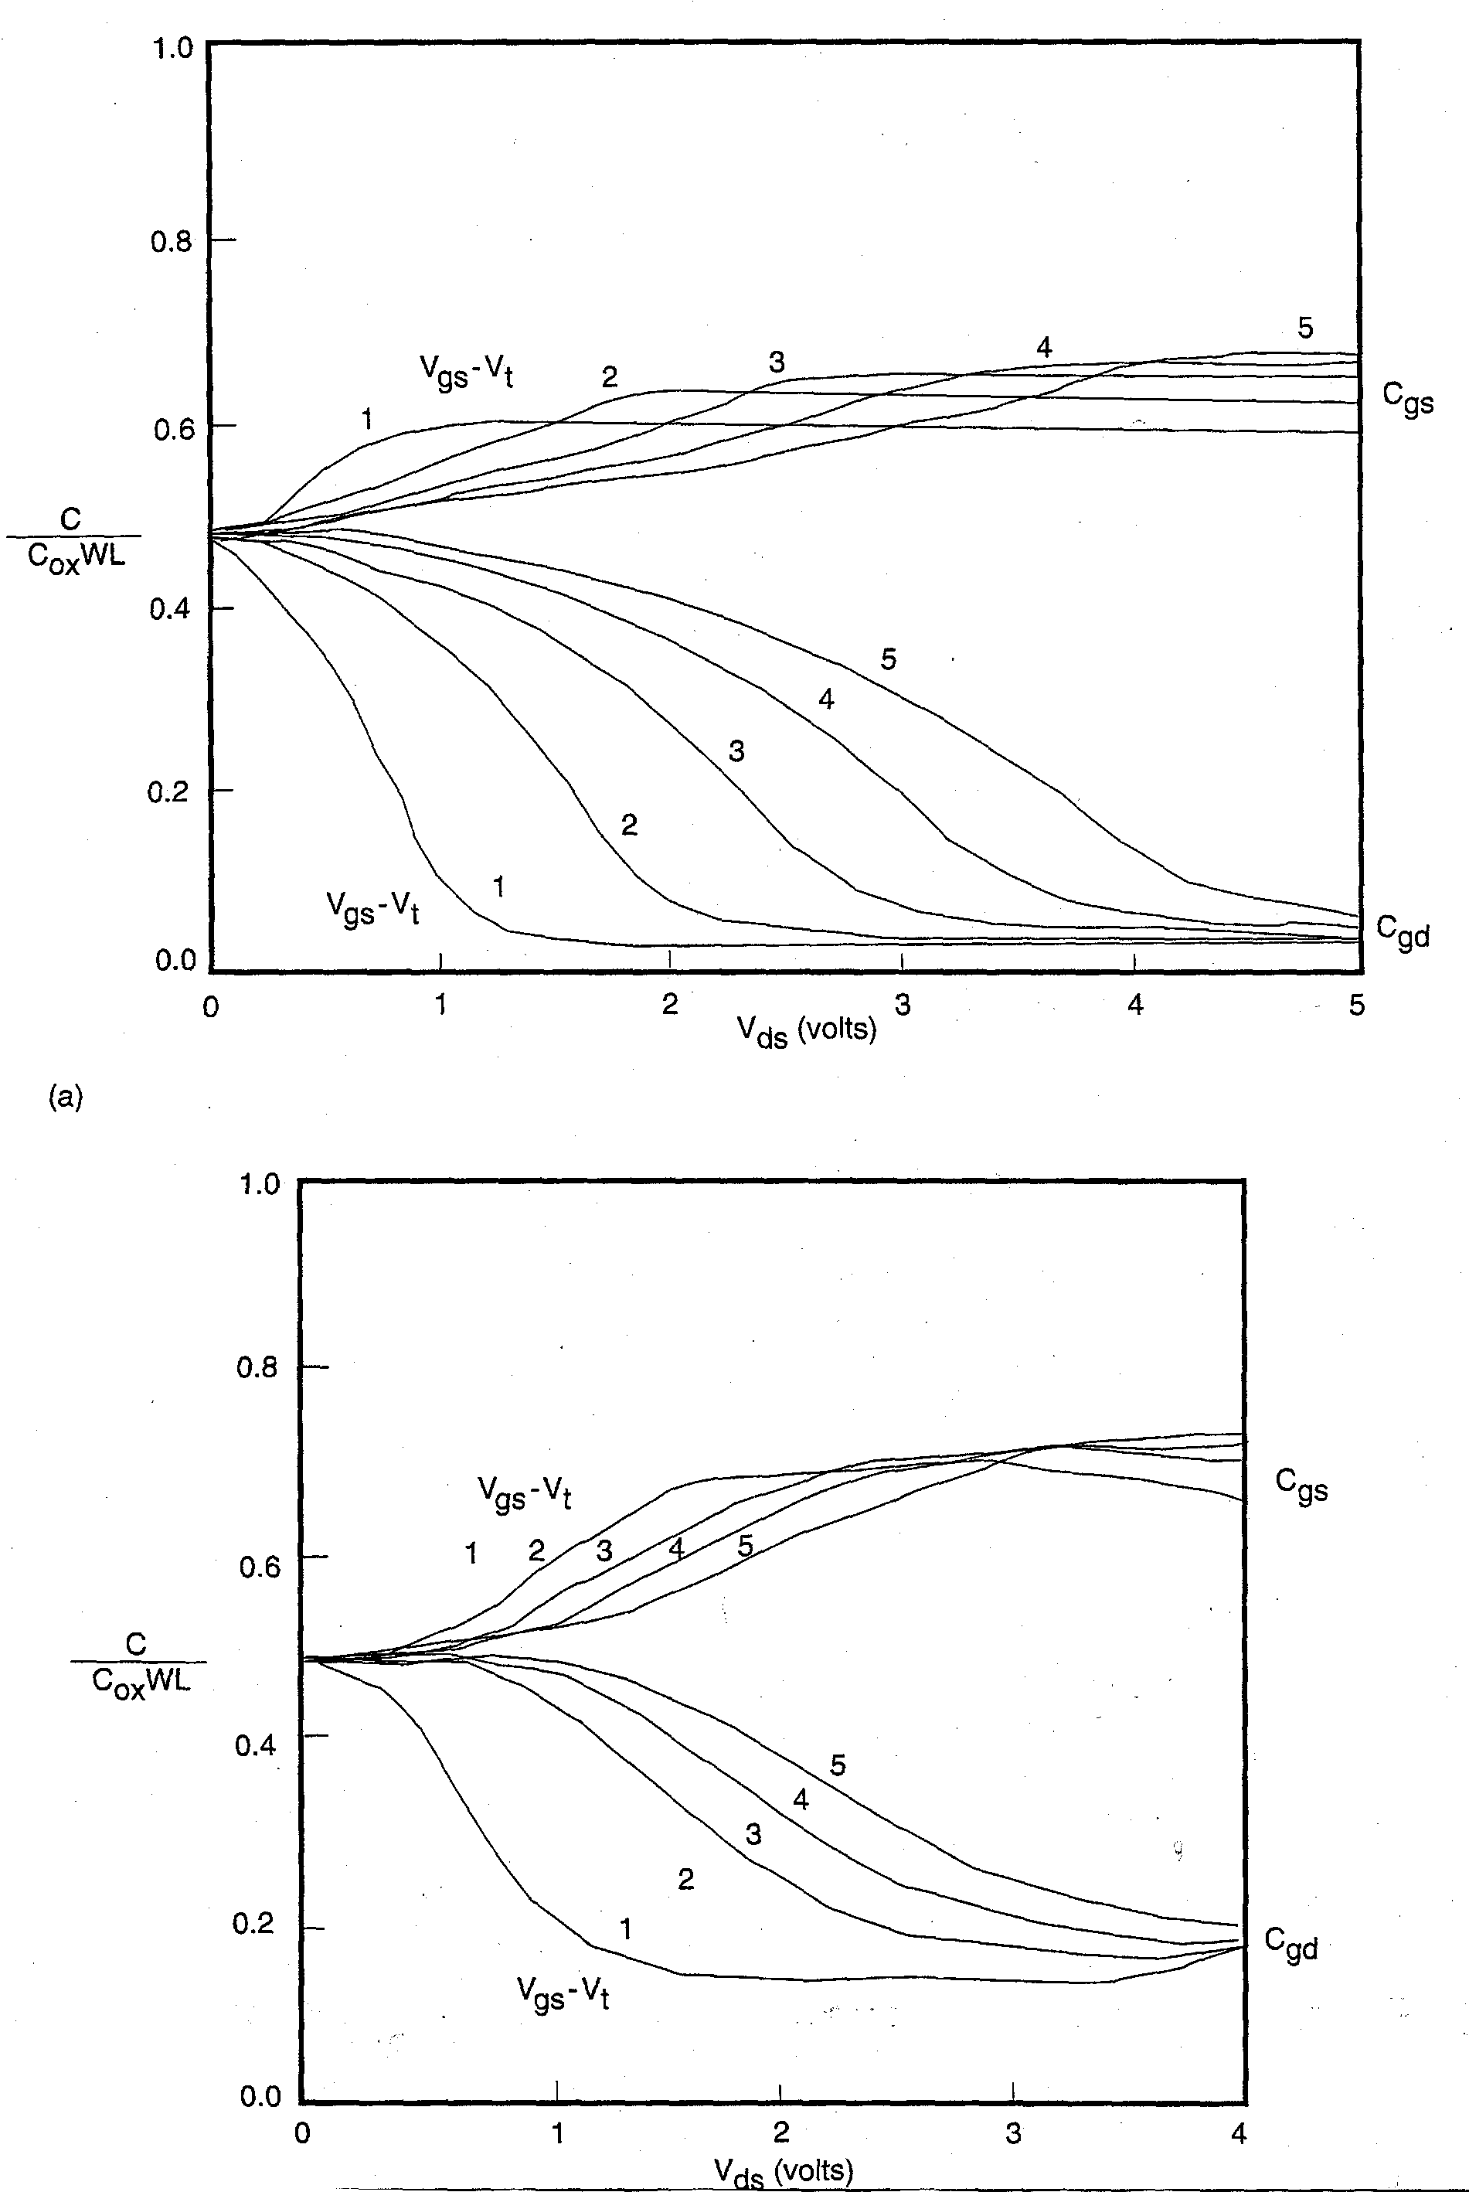
Normalized Experimental MOS Gate Capacitance Measurements vs Vds, Vgs
Shown at the left are plots of normalized gate capacitance versus Vds with Vgs – Vt as the parameter for the curves
  Top figure is for a long channel MOSFET
  Bottom figure is a short channel MOSFET
Explanation:
  Note that for Vds = 0, the total gate capacitance Cox A splits equally to the drain and source of the transistor.
  For Vds > 0, the gate capacitance tilts more toward the source and becomes roughly 2/3 Cox A to the source and 0 to the drain for high Vds
    Higher Vgs – Vt forces this tilting to occur later, since the device is linear up to Vgs – Vn = Vds
  For short channel devices, the fringing fields from gate to source and drain are more important and add a component to the total normalized cap (called overlap cap)
R. W. Knepper
SC571, page 4-12

Slide 13
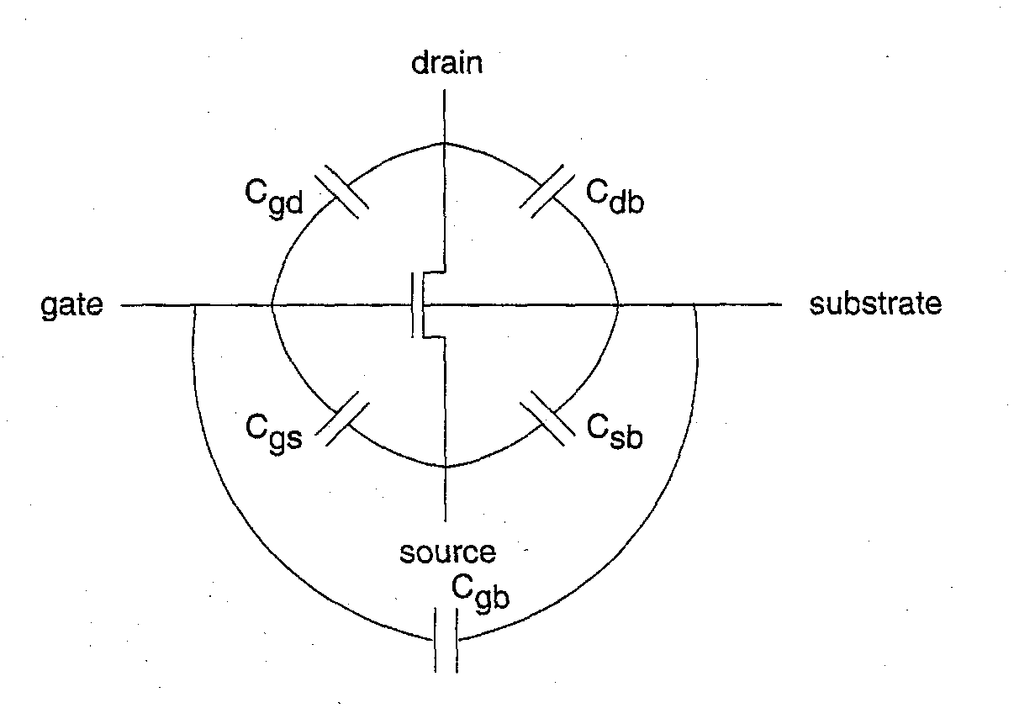
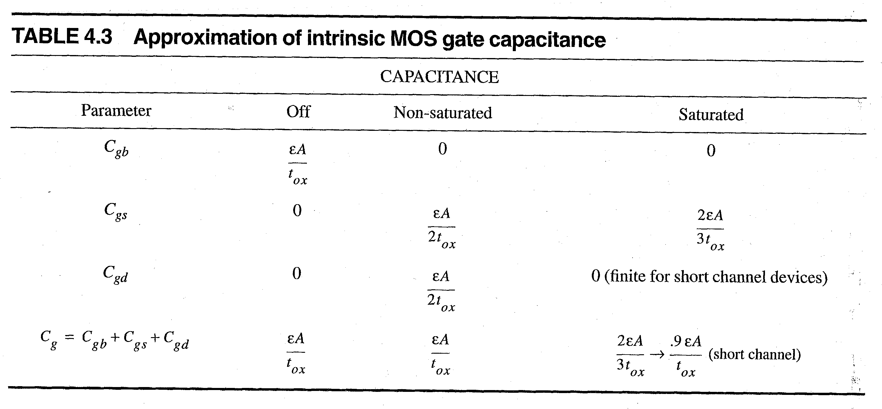
MOS Transistor Gate Capacitance Model
A model of the MOSFET gate capacitance is given at the left with representative values below for OFF, linear, and saturated regions of operation
Cox (per unit area) for t_{ox} = 100A is given by
C_{ox}= ε_{SiO2}ε_{o}/t_{ox} = (3.9 x 8.85E-14 F/cm)/(100 x 1E-8 cm) = 3.5 E-7 F/cm² = 3.5 fF/um²
For a unit-sized transistor (min L and min W with a single contact), W = 4λ and L = 2λ, giving Cgate = 28 fF for λ = 1 um.
R. W. Knepper
SC571, page 4-13

Slide 14
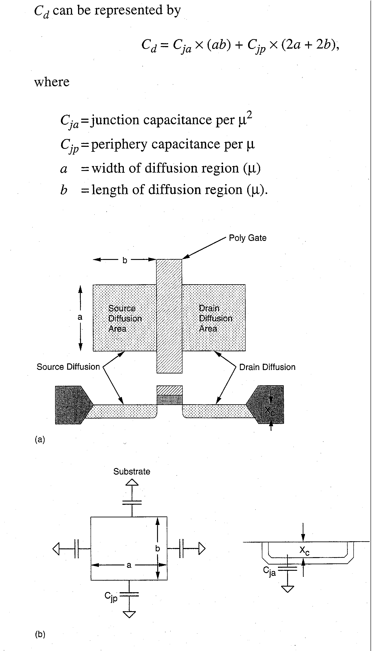
Device Junction Capacitance: Area + Perimeter Terms
PN junction capacitance is given by both an area term and a perimeter term (as shown by equation at left).
SPICE models allow specification of the source & drain area and perimeter
  SPICE computes the total capacitance for each source and drain junction
Junction capacitance has a voltage dependency (reversed-bias junction)
C_{j} = C_{jo}[1 – V_{j}/V_{b}] ^{-m} where m = 2 for an abrupt junction and m=1.5 for a linear-graded junction.
R. W. Knepper
SC571, page 4-14

Slide 15
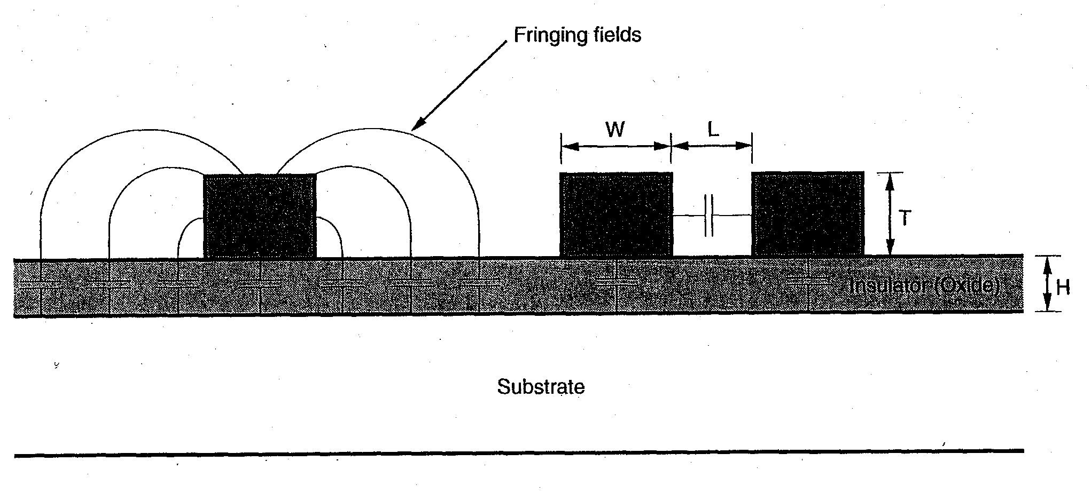
Capacitance of the Interconnect Metal Wires
For wide conductors with W >> H, capacitance to substrate (of any ground plane) can be determined as a parallel plate capacitor
  C = εA/t where A is the planar area of the wire and t is the thickness of the oxide
For most real conductors in today’s IC technology, fringing fields contribute a major part of the line capacitance and must be included in the capacitance calculations.
  For W =~ H (below), fringing fields add more than the parallel plate portion to the total line capacitance.!
R. W. Knepper
SC571, page 4-15

Slide 16
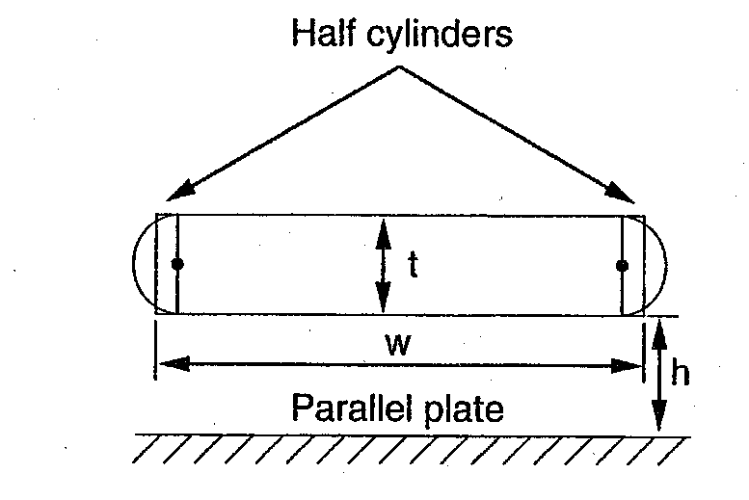
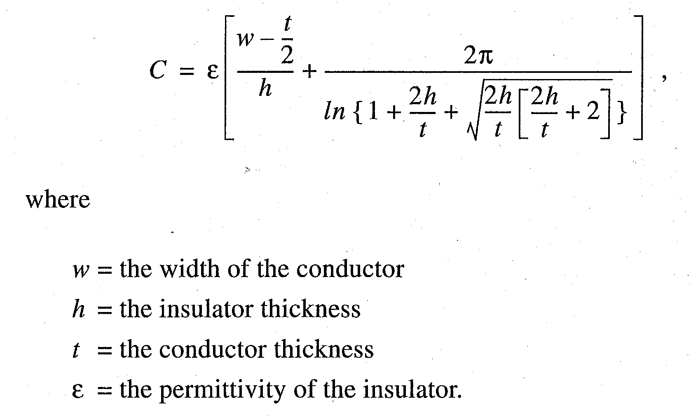
Metal Line Capacitance with Fringing Effect
Solution by Yuan and Trick given at right assumes the wire can be approximated by a piece of metal with thickness t and two rounded edges
  parallel plate portion with width equal to W – t/2
  fringing term due to two hemispherical ends with exact solution to field equation
Example for wire of width W=0.30 um, thickness t = 0.30 um, and dielectric thickness h =0.35 um, gives a result
C = 0.13 fF/um
where the fringing part is over ¾ of the total capacitance.
R. W. Knepper
SC571, page 4-16

Slide 17
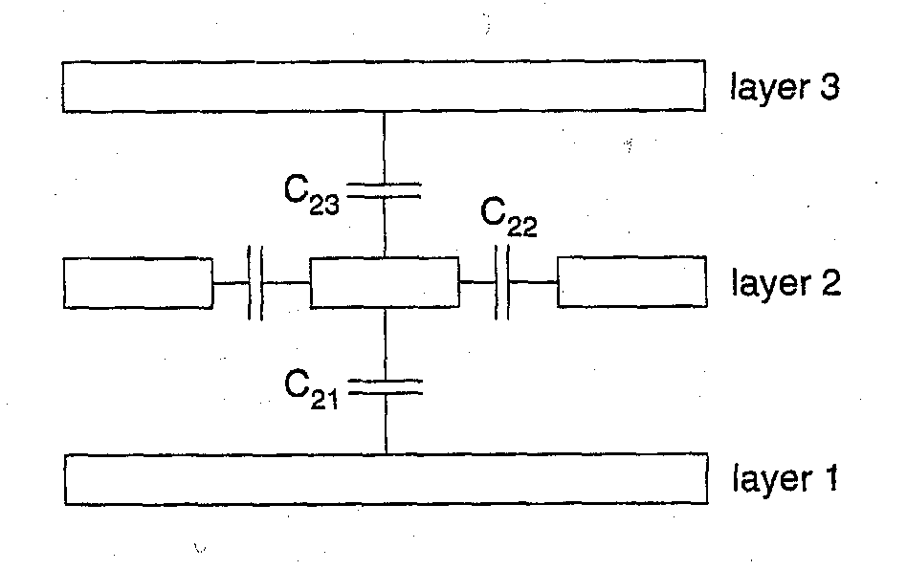
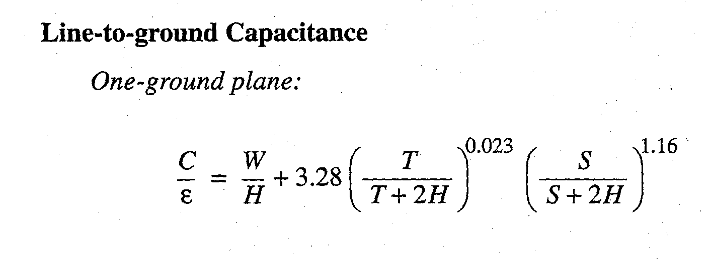
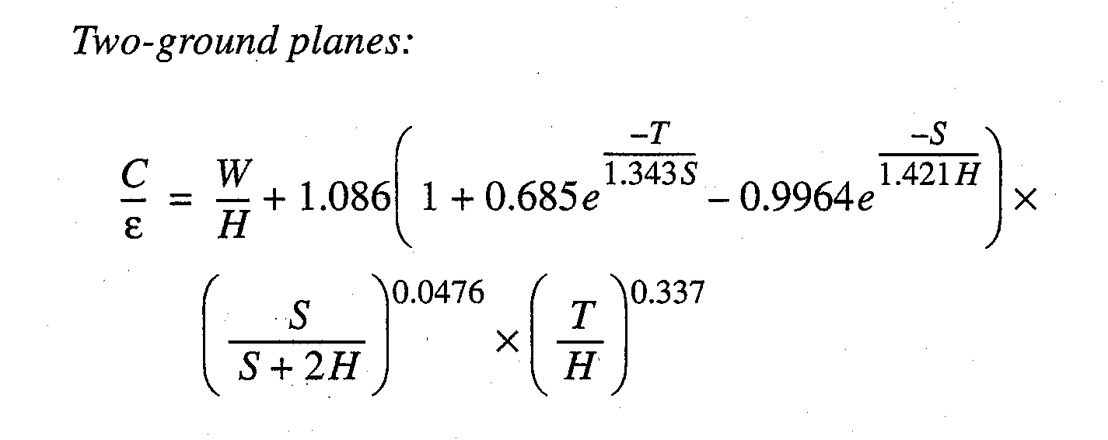
Capacitance of Layered Multiple Conductors
Structure of Interconnect:
  Layers 1 and 3 run along page
    each can be assumed to act as a ground plane (solid plane)
  Layer 2 runs out of the page
Equivalent capacitances per unit length:
  Ctotal = C21 + C23 + 2 x C22
  C21 is from center conductor to lower ground plane (layer 1)
  C23 is from center conductor to upper ground plane (layer2)
  C22 is from center conductor to adjacent wire on the right
  C22 also occurs from center conductor to adjacent wire on right assuming spacings are symmetrical
Equations at left give capacitance from center conductor to one or both ground planes
R. W. Knepper
SC571, page 4-17

Slide 18
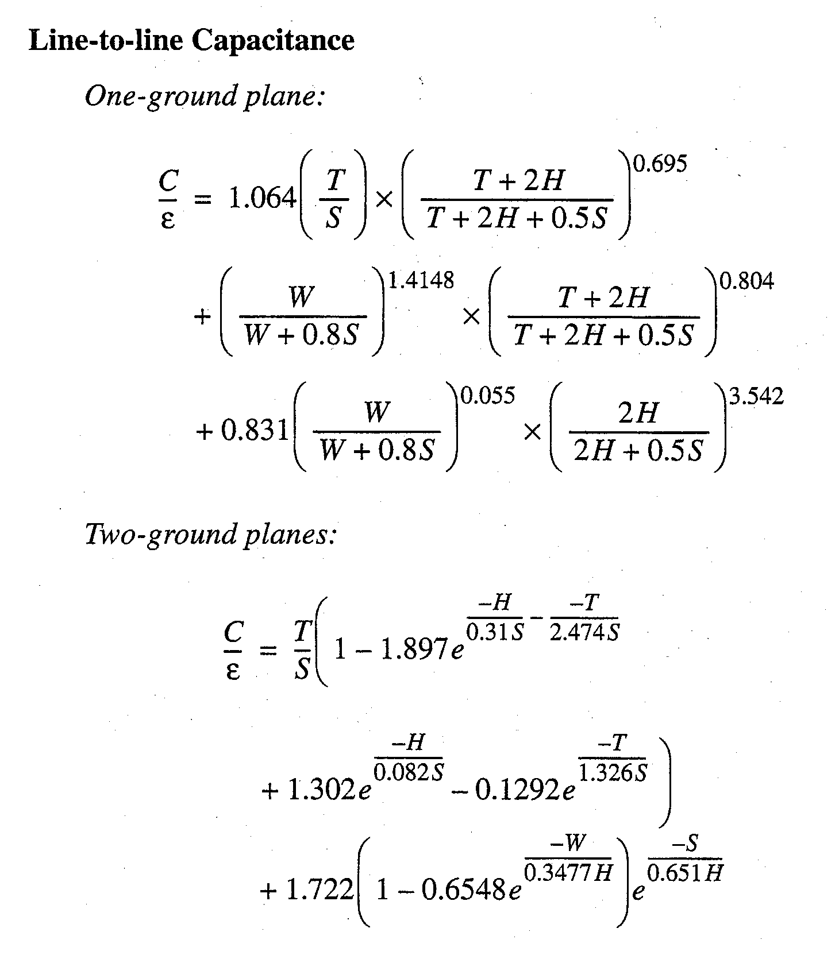
Capacitance of Layered Multiple Conductors
Equations at left give capacitance per unit length between center conductor and adjacent conductor (C22) for both cases
  One ground plane only (layer 1)
  Two ground planes (layers 1 & 2)
Parameters:
  T = wire thickness
  H = interlayer dielectric thickness
  S = wire spacing
  W = wire width
R. W. Knepper
SC571, page 4-18

Slide 19
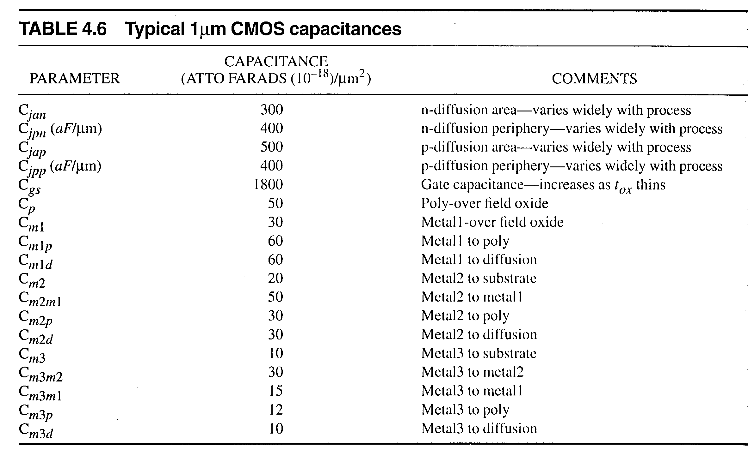
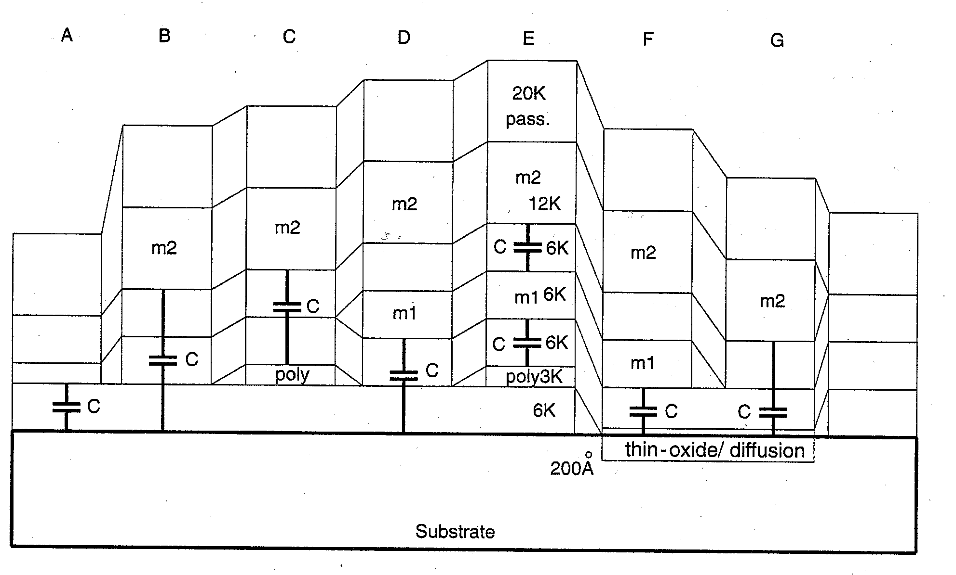
Interconnect Cross-section for Dual Metal, Single Poly System
R. W. Knepper
SC571, page 4-19

Slide 20
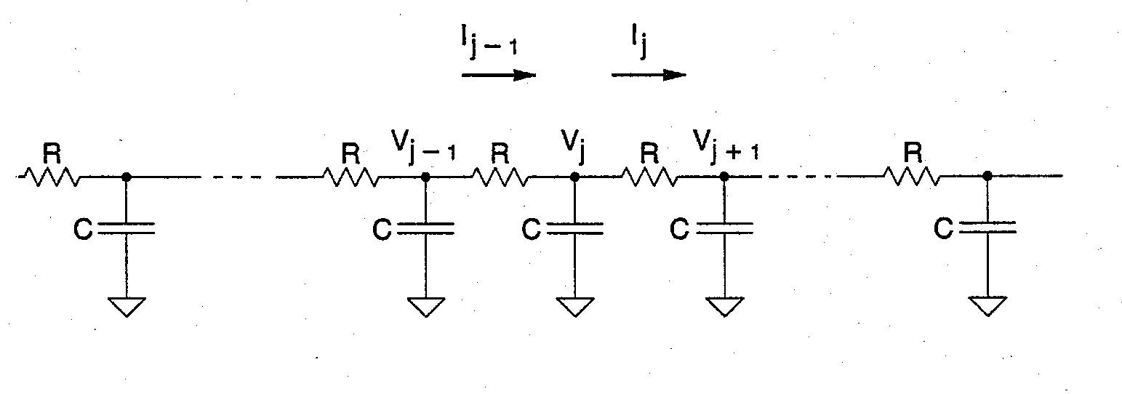
Interconnect Wire as a Distributed RC Network
Delay in a distributed RC ladder network is given by
τ_{n} = ½ R C n (n+1)
where R and C are the series resistance and nodal capacitance for each section, and n is the number of sections.
For n large, the above expression reduces to
τ = ½ r c l²
where r and c are the resistance and capacitance per unit length, and l is the total length of the wire.
Note that interconnect delay is proportional to the square of wire length.
R. W. Knepper
SC571, page 4-20

Slide 21
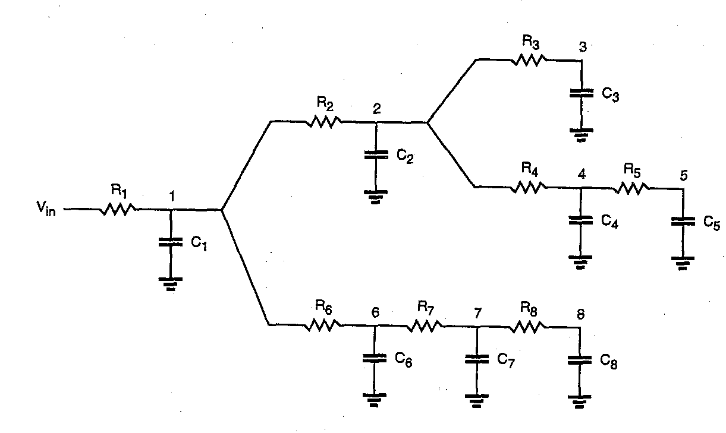
The Elmore Delay Estimation Technique
For a step input Vin, the delay at any node can be estimated with the Elmore delay equation
  t_{Di} = Σ C_{j} Σ R_{k}
For example, the Elmore delay at node 7 is give by
  R1 (C1 + C2 + C3 + C4 + C5)
  + (R1 + R6) C6
  + (R1 + R6 + R7) (C7 + C8)
R. W. Knepper
SC571, page 4-20a

Slide 22
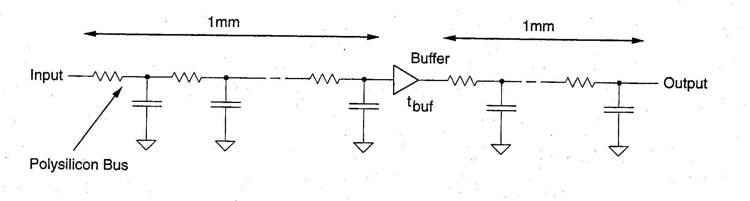
Use of a Buffer Amplifier in a Long Line
Buffers may be used in long lines to reduce the total line delay
  Non-inverting line driver circuit having an intrinsic delay τ_{buf}
  Total line delay becomes ½ rcl₁² + τ_{buf} + ½ rcl₂² where l₁ is the first line segment and l₂ is the second line segment (l₁ + l₂ = l)
  Reduction in overall line delay is achieved if τ_{buf} < ½ x ½ rcl² where l is the line length
Example:
  What is the intrinsic wire delay of a 0.18 um CMOS technology minimum Cu wire on level M2 with length 10 mm, thickness 0.3 um, width 0.3 um and height 0.35 um above a M1 ground plane with SiO2 dielectric (neglecting M3 and above)?
    r = ρ/A = 24 mohm-um/(0.3 um x 0.3 um) = 0.266 ohms/um
    c = 0.13 fF/um from equation on slide 4-11
    τ = ½ rcl² = 0.5 x 0.226 ohms/um x 0.13 fF/um x (10,000 um)² = 1.4 ns
  How much will the delay become if a buffer with a 200 ps delay is inserted in the line center?
    τ = 2 x (¼ x 1.4 ns) + 200 ps = 0.9 ns
R. W. Knepper
SC571, page 4-21

Slide 23
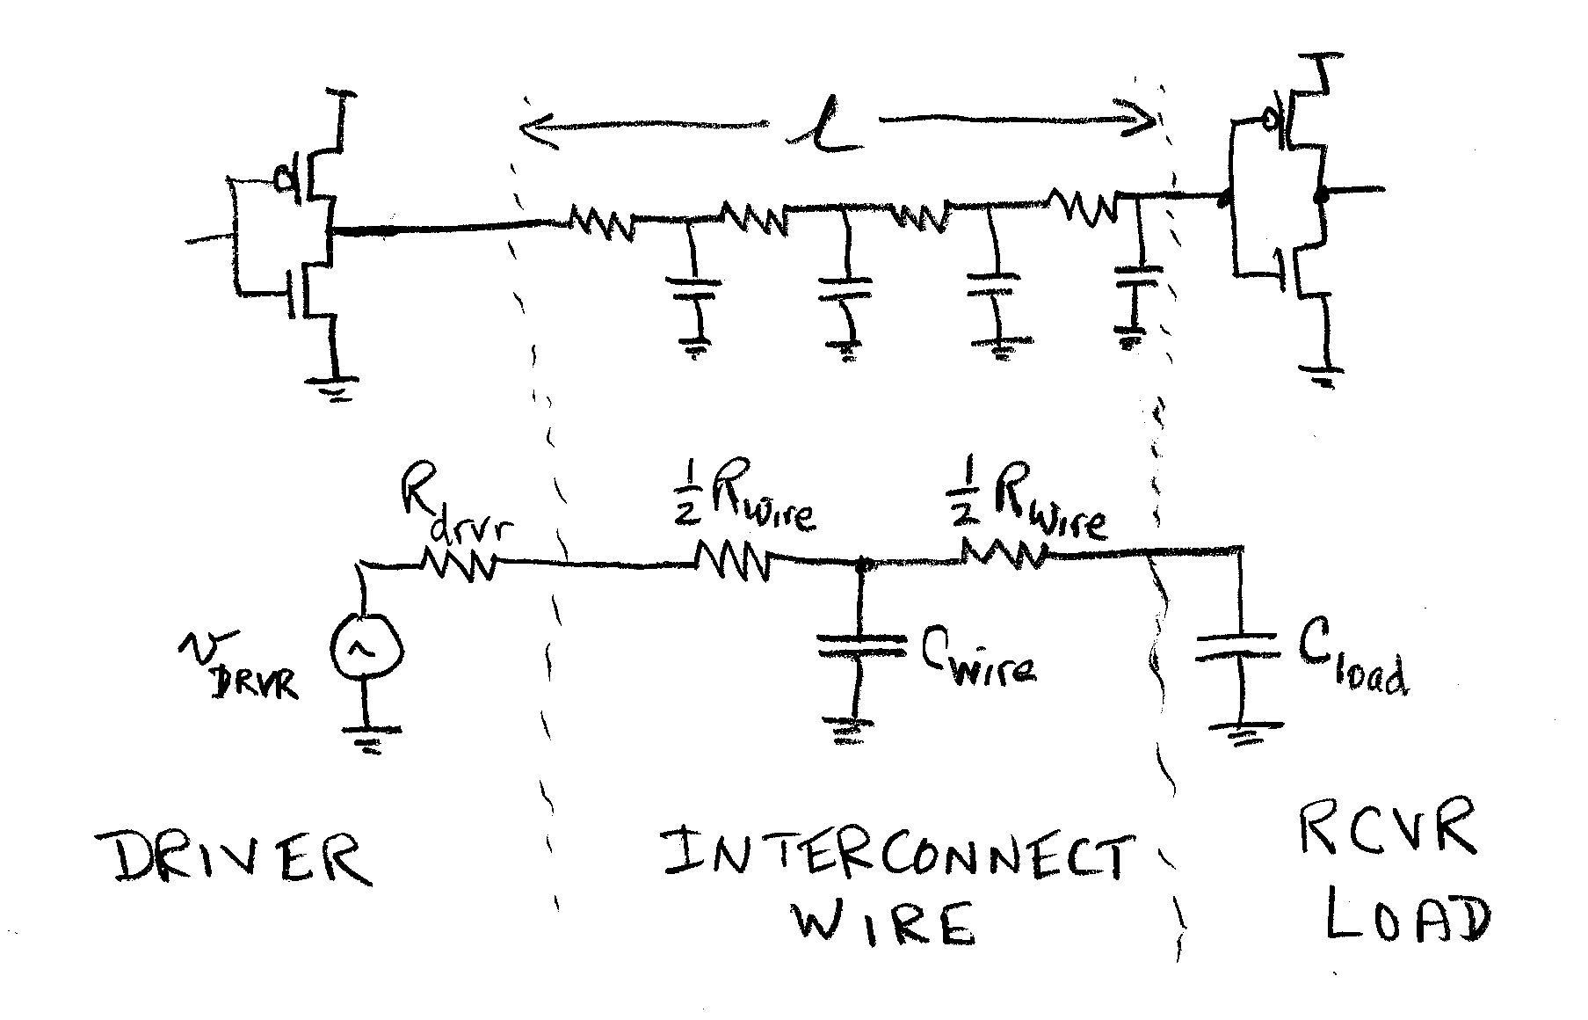
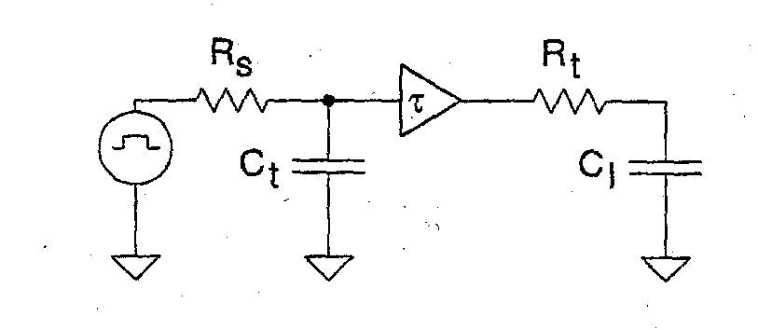
Model for Distributed RC Line with Capacitive Load
A simple model for a distributed RC interconnect wire can be represented as shown at left:
  driver circuit with equivalent R_{drvr}
  Receiver circuit with capac load C_{load}
  Interconnect with total resistance R_{wire} and total capacitance C_{wire}
  The total delay of the wire and load can be written as
τ_{t} = (R_{drvr}+ R_{wire})(C_{wire}+ C_{load}) – ½ R_{wire}C_{wire}
The equivalent circuit at the bottom left gives identical result to above RC model given that delay τ = ½ rcl² = ½ R_{wire}C_{wire}
R. W. Knepper
SC571, page 4-22

