Slide 1
PATENTS
1
Notes:
The following slides provide a general introduction to the different types of intellectual property.

Slide 2
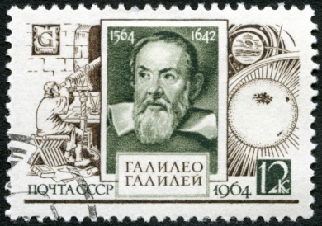
The patent system yesterday and today
Optional
Senate of Venice, 1474
"Any person in this city who makes any new and ingenious contrivance, not made heretofore in our dominion, shall, as soon as it is perfected so that it can be used and exercised, give notice of the same to our State Judicial Office, it being forbidden up to 10 years for any other person in any territory of ours to make a contrivance in the form and resemblance thereof".
Today:
New to the world
Up to 20 years of protection
Publication
Incentive to innovate and to share knowledge
EPO/OHIM Intellectual Property Teaching Kit – IP Advanced Part I Patents
4
Notes:
2
Under the Venice patent law of 1474, an invention had to be new to a certain region. The resulting patent was valid for up to 10 years. The details of the invention were not published.
Galileo Galilei obtained a patent on a water pump in 1594.
Today, patents must, according to European patent law, be new to the world. They last for up to 20 years. The details of the invention are published.
The main goals of today's patent system are to provide an incentive to innovate - protecting the results of innovation means that the inventor can reap the benefits, which in turn makes it easier to attract investment - and to provide an incentive to share knowledge. To get protection the inventor must publish the details of his invention.
This dual nature of the patent system is sometimes referred to as a contract between society, which gets the knowledge, and the patent applicant, who gets the exclusive rights.
2

Slide 3



The role of the patent system
To encourage technological innovation
To promote competition and investment
To provide information on the latest technical developments
To promote technology transfer
EPO/OHIM Intellectual Property Teaching Kit – IP Advanced Part I Patents
5
Notes:
3
This slide summarises the role of the patent system.
The patent system encourages technological innovation by rewarding intellectual creativity. In providing patent owners with protection for their inventions, patents offer them recognition for their creativity and the possibility of obtaining financial reward if they commercialise or exploit their inventions.
The patent system can also promote competition and investment in developing new or improved products or processes by encouraging research and development. Investors are more likely to provide financial backing if there is the potential for a return on their investment from inventions that can be patented.
Because the information disclosed in patents is published, the patent system encourages the dissemination of information that may be of benefit to society.
It can promote technology transfer by way of the publicly available information in patent databases. Thanks to these databases, anyone can find patented technologies that they may want to access and use themselves.

Slide 4


Patents as a social contract
Reveal
invention (disclosure)
Patent applicant
Get
exclusivity
(patent)
Public
EPO/OHIM Intellectual Property Teaching Kit – IP Advanced Part I Patents
6
Notes:
4
As we have already seen, patents are sometimes considered as a kind of contract between the applicant and society.
Applicants and patent owners are interested in benefiting from their inventions.
Owning a patent gives them the right to prevent others from making, using, offering for sale, selling or importing a product that infringes the patent, for a limited amount of time and the country for which the patent has been granted.
The exceptions to this are use of the patent for non-commercial purposes, including private use and academic research.
Society is interested in:
Encouraging innovation so that better products can be made and better production methods can be used for the benefit of all;
Protecting new and innovative companies so that they can compete with larger established companies, in order to maintain a competitive economy;
Finding out the details of new inventions so that other engineers and scientists can further improve them; and
Promoting technology transfer, that is from universities to industry.
In return for this protection, applicants must reveal their inventions to the public, so others can build on them. This takes the form of publication of the application by the relevant patent office.
This social contract is institutionalised in the form of patent law.
4

Slide 5




Rights conferred by patents
Right to prevent others from making, using, offering for sale, selling or importing infringing products in the country where the patent was granted
Exception: non-commercial purposes (private use, academic research)
Right to assign, sell or license these rights
These rights belong to the patent holder.
Notes:
Patent owners have the right to prevent others from making, using, offering for sale, selling or importing a product that infringes their patent, for a limited amount of time.
Exceptions include use for non-commercial purposes, such as private use or academic research.
Further options include licensing inventions to others, or allowing everybody to use the invention for free.
Many important technologies such as CDs, DVDs, mobile phone technology and digital TV are covered by numerous individual patents that companies license to each other in a process known as cross-licensing.
If commercialising your invention means using the intellectual property of others, then you need to have their permission!
5

Slide 6
What is a patent?
Does a patent give you the right to exploit an invention?
A patent is a negative right. It gives you the right to prevent others from exploiting the invention. It is not an enabling right.
Patents owned by others may overlap or encompass your own patent. -> Seek a licence before commercialising
For example:
- NO!
Patent A: Electric kettle
Your patent B: Electric kettle with
ceramic heating
elements
Notes:
The key concept of this slide is to show that a patent is a negative right, not a positive one.
For example, let us imagine that you have invented the first-ever electric kettle to have a ceramic heating element as its base-plate. This kettle has advantages over kettles which have a metal heating element upon which limescale forms. Such a kettle might be novel and inventive, and could get you a patent, which we will call patent B.
However, your patent does not grant you the right to use your invention, because it falls within the scope of an earlier patent for all electric kettles, which we will call patent A.
For you to make, use and sell your invention you need a licence from the owner of the earlier, broader patent, patent A.
But they in turn would need a licence from you to make kettles with ceramic heating elements.
This is where you could enter into a cross-licence agreement. Indeed, this is where the vast majority of industrial collaborations start.
Patents owned by others may overlap or encompass your own patent. In this case, you need to obtain the right to use other people’s inventions – for example by way of a licence – before you can start commercialising your own patented invention, and vice versa.

Slide 7
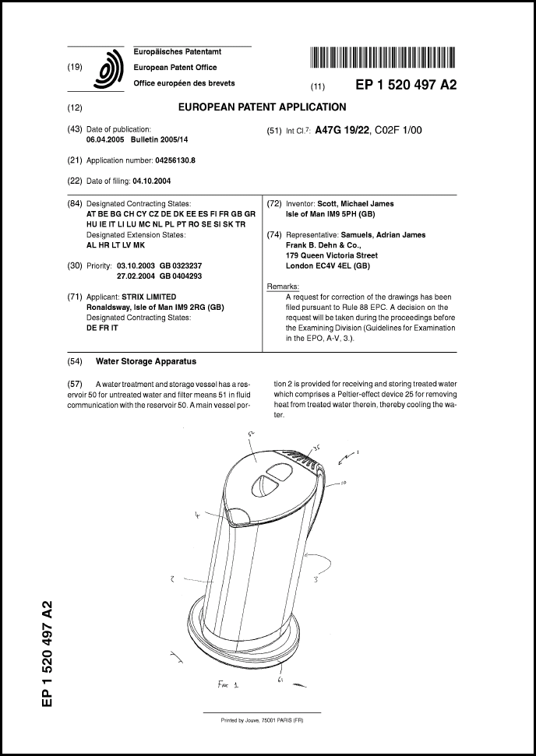


What do patent documents look like?
Application
number
Date of publication
Technical
class
Date of
filing
Inventor
Applicant
Description
Abstract
Claim(s)
Drawing(s)
EPO/OHIM Intellectual Property Teaching Kit – IP Advanced Part I Patents
9
Notes:
7
Patent applications can be filed by the inventor or the inventor's employer.
Inventions are usually the property of the company that employs the inventor. This is also the case for university researchers in many countries.
A European patent application contains a full and detailed description of the invention so that others can understand and replicate it, one or more claims which define the technical features of the invention for which protection is sought - this is called the "scope of protection“ - and optional drawings which help with understanding and interpreting the claims and description.
The cover sheet contains bibliographic information about the applicant and the inventor.
It also contains an abstract, one of the drawings, and details of the technical class.
The abstract and the technical class are useful when it comes to searching for patents.

Slide 8
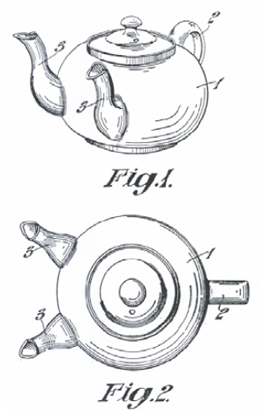
What does the description contain?
Optional
Prior art
teapot with one spout
Drawback of prior art
time-consuming
Problem to be solved
reduce filling time for multiple cups
Solution
provide a second spout
Advantage of the invention
filling time is reduced
Notes:
8
This slide shows the what a typical description contains. The description also refers to the drawings.

Slide 9
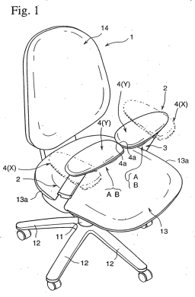





What can and can’t be patented
Patents protect technical inventions which solve technical problems:
Products, devices, systems
Chemical substances, pharmaceuticals
Processes, methods, uses
For an invention to be patentable, it must usually be
new to the world (i.e. not available to the public anywhere in the world)
inventive (i.e. not an "obvious" solution), and
susceptible of industrial application
In most countries, patents are not granted for mere business methods or rules of games, or for methods of treatment, diagnostics and surgery of the human or animal body, or for inventions that are contrary to ordre public or morality, or for plant and animal varieties.
EPO/OHIM Intellectual Property Teaching Kit – IP Advanced Part I Patents
11
Notes:
9
9
Under the European Patent Convention or EPC, "European patents shall be granted for any inventions, in all fields of technology, provided that they are new, involve an inventive step and are susceptible of industrial application."
“New” means that there should have been no previous public disclosure of the invention before the date of filing. If an invention has already been revealed to the public there is nothing to "trade" for exclusivity, and therefore no social contract.
The concept of inventive step is quite difficult to assess. The EPO must compare the invention with what would have been obvious to an imaginary skilled person at the time of filing.
The EPC does not provide a definition of what is meant by the term "invention“.
It does, however, provide a non-exhaustive list of subject-matter that are not considered inventions. The items listed at the bottom of this slide are expressly excluded from patentability.

Slide 10


When is an invention "new"?
Keep your invention confidential until you have filed your application!
When it is not part of the state of the art
State of the art = everything made available to the public before the date of filing
Patent application
Date of filing
State of the art
Year
2008
2009
2010
2011
2012
2013
2014
EPO/OHIM Intellectual Property Teaching Kit – IP Advanced Part I Patents
12
Notes:
10
For a European patent to be granted by the EPO, the invention must be new at the date of filing of the patent application.
“New" means that the invention does not form part of the state of the art.
The state of the art comprises everything made available to the public by means of a written or oral description, by use, or in any other way, before the date of filing of the European patent application.
It is vital that you keep your invention confidential until you have filed your application.

Slide 11





Do’s and don’ts for safeguarding novelty
Don’ts
Do not publish any articles, press releases, conference presentations/ posters/ proceedings, lectures or blog posts, etc. before you file
Do not sell any products incorporating the invention before you file
Do’s
Sign a non-disclosure agreement (NDA)
Seek professional advice at an early stage
File before anyone else does!
NDA
EPO/OHIM Intellectual Property Teaching Kit – IP Advanced Part I Patents
13
Notes:
11
If you disclose your invention before the filing date you risk invalidating your patent application.
Remember the social contract? If you have already revealed your invention to the public, you will have nothing to "trade", so you won't get a patent, even if it was you who made the invention public!
Under the EPC, the first to file the patent application will be entitled to the grant of a patent on a particular invention.
If you disclose your invention before filing, it will no longer be considered "new“, regardless of the form the disclosure took, including written form (even in a publication that no-one might have read), oral disclosure (such as in a presentation or lecture), actual use or sale, and regardless of the place. In other words, all material made available to the public anywhere in the world forms part of the state of the art.
So the key message is keep it confidential! Do not disclose your invention to anyone, not even orally, until you have filed your patent application.
If you need to talk to potential customers or investors before you file, make sure you sign a non-disclosure agreement with them first.
Once you have filed your application, you are free to present, publish or sell your invention as you wish.
11

Slide 12

When is an invention "inventive"?
When it is not obvious to the person skilled in the art in view of the state of the art
The person skilled in the art
is a skilled practitioner in the relevant technical field
has access to the entire state of the art
is aware of general technical knowledge
is capable of routine work
He knows EVERYTHING, but has ZERO imagination!
EPO/OHIM Intellectual Property Teaching Kit – IP Advanced Part I Patents
14
Notes:
At the EPO, inventive step is assessed using the problem-solution approach.
This approach assesses in an objective manner whether the solution proposed to the problem presented in the patent application is obvious or not to the person skilled in the art.
The person skilled in the art is a legal fiction. He or she is considered to be a practitioner with a general technical knowledge in the relevant field, with access to the entire state of the art and capable of performing routine work and experimentation.
He does not, however, have any inventive skills.

Slide 13
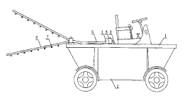



Assessing novelty
Claim: A pouring vessel comprising
(a) a compartment for liquids (1),
(b) a handle (2),
(c) a lid, and
(d) two spouts (5) extending from the compartment (1),
(e) whereby the tops of the two spouts are arranged at the same height.
Stage 1: Prior art
The prior art search revealed the following documents:
Document D1:
A teapot with one spout.
Document D2:
High efficiency distributor for fertilizer. Each rod has several nozzles for spraying liquid.
Document D3:
A filter handle with two spouts to be used with a coffee-maker.
Document D4:
An oil and vinegar bottle which reveals a second bottle inside. The two spouts are cleverly arranged to ensure the second bottle never drips while the first one is in use.
EPO/OHIM Intellectual Property Teaching Kit – IP Advanced Part I Patents
15
Notes:
13
13
The claim describes the technical features of the invention.
In order to be able to decide whether an invention is new, the patent examiner responsible for examining the application first has to define the prior art. To do this, he has to perform a search into the prior art, which will usually involve consulting databases containing patent documents and scientific journals, as well as searching the internet and other media.
In the example shown here, the search revealed four documents. The patent examiner compared the claim with each document in turn and checked whether the invention differs from it. None of the documents discloses all the features of the claim, so the invention as expressed in the claim is new.

Slide 14
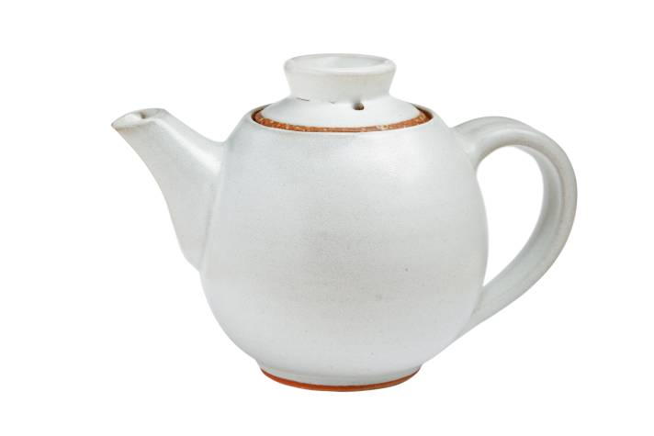

Assessing inventive step (I)
Determine the closest prior art and common features: (a) a compartment for liquids
(b) a handle
(c) a lid
(d) one spout
Differences over D1:
- two spouts instead of one - particular arrangement of the spouts
Drawback of prior art:
- time-consuming
Advantage/effect of the invention:
- the time needed to fill multiple cups is reduced
Objective problem to solve:
- how to modify the teapot of D1 to reduce the time needed to fill multiple cups
Stage 1
Stage 2: Problem
14
Notes:
14
To ensure an objective assessment of inventive step, the EPO, for example, uses a structured problem-solution approach which lessens the risk of hindsight.
The questions asked during this analysis can be grouped into three stages.
In stage 1, the examiner considers the differences between the claim and each document. He then chooses the document which comes closest to the invention. This is normally the document which has the most features in common with the invention. In our example, this is document D1 and we have identified the features that the claim has in common with it.
In stage 2, the examiner notes down differences between the claim and this document. He thinks of advantages based these differences. In this case it is the reduction in the time needed to fill several cups thanks to the second spout.
The next question is whether the skilled person would have overcome the drawback of document D1 in the same manner as the inventor did. To answer this question, the examiner formulates a so-called objective problem, which is usually how to achieve the same effect as the invention. In this case the question would be "How can we modify the teapot of D1 in order to reduce the time needed to fill multiple cups?“ We will look at the answer to this question on the next slide.

Slide 15



Assessing inventive step (II)
Stage 3: Solution
Is the claimed solution obvious in view of the prior art?
+
D2
?
D1
D4
D3
Objective problem for the skilled person: How to modify the teapot of D1 in order to reduce the time needed to fill multiple cups
EPO/OHIM Intellectual Property Teaching Kit – IP Advanced Part I Patents
15
Notes:
15
15
In stage 3, the examiner is looking for an answer to the question: How would the skilled person modify the teapot of D1 in order to reduce the filling time for multiple cups?
[Click 1]
The skilled person realistically only has access to the prior art in the technical field of the invention, which in this case is the field of kitchen utensils for food processing, in particular beverages. To come to a fair judgement, the skilled person should look at documents from this field only. The fertiliser distributor in D2 does not belong to this field, so should not be considered any further
Next, the examiner checks if the other documents - D3 and D4 - are concerned with filling several cups simultaneously and whether they offer the same advantage as the invention. D4 does not disclose the same effect, as it only uses one spout at a time, and not two together. Thus, D4 teaches away from the invention and must be discarded.
D3 discloses an espresso maker with a filter handle that allows two cups to be filled concurrently. This looks promising.
[Click 2]
The examiner then comes to the final step in his assessment, which is to make a careful judgement as to whether the invention is obvious when looking at the two documents.
[Click 3]
To do this he must ask the following hypothetical questions:
- If the skilled person looked at D1 in combination with D3, would he find a solution for the problem of reducing the filling time?
- What teaching would he take from D3?
For the sake of this example, the examiner may make the following considerations with regard to D3.
Firstly, the outlet in D3 does not reduce the time needed to fill two cups since the flow rate of the espresso maker remains the same. In fact, the opposite is true: it takes twice as long to fill two cups. Looked at another way, in the same amount of time, the two cups would only get half full.
Secondly, even if the skilled person applied the principle of the outlet with the two pipes in D3 to the known teapot in D1, he would not arrive at the claimed invention. In D3, the outlet is Y-shaped and consists of one pipe extending into two pipes, whereas the invention makes use of two separate spouts.
The examiner may therefore arrive at the conclusion that the claim is inventive, since the two documents in combination would not arrive at the claimed invention. A patent could thus be granted on the basis of this claim.

Slide 16
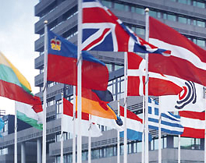




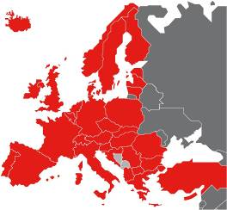
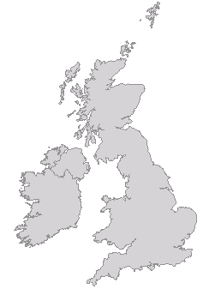
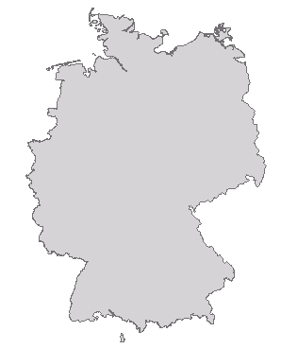
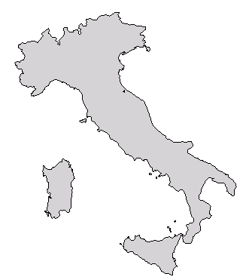
How to obtain patent protection in Europe (options 1 and 2)
The national route
The regional route: European Patent Convention
Separate procedures for each state
Procedures differ according to national law
One application filed at one office for up to 40 states
One procedure
Applicant selects the desired states
One European patent for up to 40 states
Results in a bundle of national patents
EP
DE
IT
UK
DE
UK
DE
IT
TR
IT
NO
FI
RO
16
Notes:
16
There are three main ways of obtaining patent protection in Europe.
The first is by filing with a national patent office. A national patent is valid only in the country for which it has been granted. You do not have to be a resident of a particular country in order to apply for a patent there. To obtain patents in several countries, applicants must file a separate patent application for each country. Each application has to fulfil the relevant national requirements.
The second route is via the European Patent Office. The European patent system was set up harmonise and streamline the patent granting process in Europe. With the grant of a European patent the applicant can obtain national patents in the European countries he chooses to designate. For this, he has to perform certain acts such as paying fees or translating the patent document.
Currently, patent protection can be gained in up to 40 countries by filing a single patent application with the EPO. The EPO has 38 member states. The latest countries to join were Albania and Serbia in 2010. A further two states – Montenegro and Bosnia and Herzegovina – recognise European patents upon request.
A further alternative, a European patent with unitary effect – or unitary patent – will be available from the date of entry into force of the Agreement on a Unified Patent Court.
The third option – applications under the Patent Cooperation Treaty – offers patent protection in countries worldwide. We will look at this option in a moment.

Slide 17






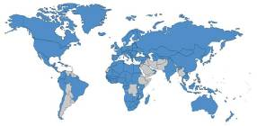
How to obtain patent protection in Europe (option 3)
The international route: Patent Cooperation Treaty (PCT)
PCT
One single application for up to 148 countries*
Harmonisation of formal standards (language, patent agent, fees)
Search report and opinion on patentability
After 30-31 months, decision by applicant on which countries to proceed in.
IN
AU
GB
US
CN
*December 2013
17
Notes:
17
Returning now to our options for patent protection in Europe, the third route is the Patent Cooperation Treaty or PCT. The PCT allows applicants to apply for patents in multiple member states by means of a single application, not just in Europe but worldwide too.
PCT applications do not lead to "international” patents. Instead, they branch into individual national patent applications.
There are a number of advantages for the applicant. In addition to the single application procedure at the beginning, the formal standards for the application are harmonised, including language, patent attorney and fees.
The applicant gets a search report and an opinion on the patentability of his invention, and has up to 30 months to decide in which countries he wants to proceed with his patent application.

Slide 18



What is infringement?
Making use of a patented product or process without the consent of the patent owner
Making, offering, putting on the market, importing or stocking the product
Making, offering, putting on the market, importing or stocking a product directly obtained from a protected process
Using a process or offering the process for use
Infringement is determined by the national courts or by the Unified Patent Court (once it enters into force)
What constitutes infringement in one country may differ from other countries
Patent proprietors can claim damages and other remedies from alleged infringers
EPO/OHIM Intellectual Property Teaching Kit – IP Advanced Part I Patents
18
Notes:
As a general principle, any person not having the patent proprietor's consent is prohibited from certain acts, and breach of those prohibitions will constitute patent infringement.
Patent proprietors can take legal action, including filing for injunctive relief and/or claiming damages from persons considered to be infringing their patent.
Precisely what constitutes infringement of a patent may differ in each jurisdiction, and is determined by the national courts with reference to the applicable national law.
The competence for infringement and revocation actions concerning European and unitary patents will generally lie with the Unified Patent Court, once it comes into force.
The courts in European countries have adopted provisions on infringement. Typically, the acts considered to undermine the right of the patent owner to prevent third parties' direct use of the invention include
making, offering, putting on the market or using a protected product or importing or stocking the product for these purposes,
using a process or offering the protected process for use, and
offering, putting on the market, using, or importing or stocking for these purposes the product obtained directly by a protected process.

Slide 19
Advantages and disadvantages of getting a patent
Advantages
Disadvantages
Exclusivity enables investment and higher returns on investment
Strong, enforceable legal right
Makes invention tradable (licence, sale)
Reveals invention to competitors (after 18 months)
Can be expensive
Grant may take 3-5 years
Patent enforceable only after grant; proceedings can be costly
19
Notes:
The advantages of getting a patent include the fact that patent owners can exclude others from using their inventions. In other words, competitors cannot make products with the same features without obtaining a licence. This gives patent owners a competitive advantage.
European patents offer strong legal protection, as they are examined rather than simply registered. Patent rights are therefore more certain than many other forms of legal protection.
In case of infringement, patent holders can sue the infringer or order customs to intercept imports of patented products.
Last but not least, a patent makes an invention tradable. Sellers can tell prospective buyers the details of the invention without running the risk of the invention being stolen.
The disadvantages of patenting include the fact that patent applications are published after 18 months, so everybody, including competitors, can find out about the invention. The information is available free of charge from online databases such as Espacenet. However, the published application does offer some limited protection, both legal and factual. Factual means that the prospect of a patent being granted might discourage competitors from investing in the commercialisation of a potentially infringing product.
Finally, patents can be very expensive if broad international protection is sought. And because of the time lag of several years from application to grant, by the time the patent is granted, the invention may already have become obsolete. Also, enforcing patent rights may mean going to court, and this can be expensive.
19

Slide 20
Alternatives to patenting
Disclose (publish) the information
Cheap
Prevents others from patenting the same invention
Does not offer exclusivity
Reveals the invention to competitors
Keep it a secret
Cheap (but there is the cost of maintaining secrecy)
Does not reveal the invention
No protection against reverse-engineering/duplication of invention
Difficult to enforce
Secrets often leak quite fast
Do nothing
No effort required
Does not offer exclusivity
Competitors will often learn details
EPO/OHIM Intellectual Property Teaching Kit – IP Advanced Part I Patents
20
Notes:
20
What are the alternatives to patenting?
One option is to publish the invention in any newspaper, magazine, journal, book or public prior art database. Publication prevents others from applying for a patent on the same invention - although other prior patents might effectively block its use. At the same time, it discloses the invention to competitors, so improvements might be patented by a third party and this might block the further development of the initial invention.
Another option is to keep the invention secret. This is frequently used, especially for inventions that do not qualify for patent protection, and for production processes that cannot be reverse-engineered by analysing the end product. In the latter case, patent infringement would be very difficult to prove, so a patent might not be very effective. This option is inexpensive, although there is some cost involved in the signing of non-disclosure agreements with employees and/or partners. Trade secrets are, however, difficult to enforce, and proof is needed that competitors have used unlawful means to find out the secret. On average, detailed technological information will leak out within a year.
The third option is to do nothing at all.
Other options have been found to be at least as important as patent protection and other legal instruments. These include lead-time advantages, in other words being the first to introduce the product to the market, learning curve effects, which involves starting to learn about the technology earlier and thus maintaining a technical advantage, network effects - creating a user base or a technical standard first - and customer relations. All of these options are often used in conjunction with patents, rather than to replace them.
20

Slide 21
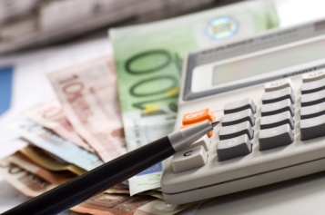


What to consider before filing an application
Should you patent your invention?
Cost/benefit analysis
New?
Is your invention patentable?
Conduct a prior art search
Get advice on legal requirements
Inventive?
Have you clarified the rights to the invention
with the company, its employees and business partners?
SEEK LEGAL ADVICE!
EPO/OHIM Intellectual Property Teaching Kit – IP Advanced Part I Patents
21
Notes:
21
21
What sort of things should you consider before deciding to file an application for a patent?
An invention may not always result in a commercially viable technology or product, so it is important to consider the advantages and disadvantages of patent protection. You should look into alternatives such as secrecy or utility models. You should also make a cost/benefit analysis. Is there a market for the invention? What kind of investment will it take to bring the invention to the market? Will you need technical and/or financial assistance from other companies to commercialise it?
You should get legal advice on whether the invention is patentable. You can of course perform a patent search yourself using free online databases such as Espacenet, or have the search done by a professional service. You can also search relevant technical and scientific journals, conference proceedings and websites of companies in the field. But professional legal advice is a must.
Last but not least, you should clarify ownership of the invention. National law in your country, or your employment contract, may require you to transfer your rights to the invention to your employer. Employees or business partners who have contributed financially or technically to the development of the invention may also have acquired rights, so it is important to clarify all outstanding issues before filing the application.

Slide 22
What might happen if I decide not to patent my invention?
Competitors might take advantage of it!
Somebody else might patent it!
Potential for licensing, selling or transferring the technology would be severely curtailed!
22
Notes:
22
Patenting may not always be the right solution for your business. It is therefore important to understand what might happen if you decide not to patent a patentable invention.
First of all, somebody else might patent it. The first person to apply has the right to the patent. If you do not patent your invention, somebody else might get a patent on it instead. The patent-holder would then be able to exclude you from the market and you would need a licence for the product.
Secondly, competitors may take advantage of your invention. They may well be tempted to make the same product by using your invention but without having to pay for the use. And as they would incur virtually no R&D costs, they would be able to compete at a lower market price.
And finally, the potential for licensing, selling or transferring the technology would be severely curtailed. Nobody is willing to pay for the right to use something that does not belong to anybody.

Slide 23
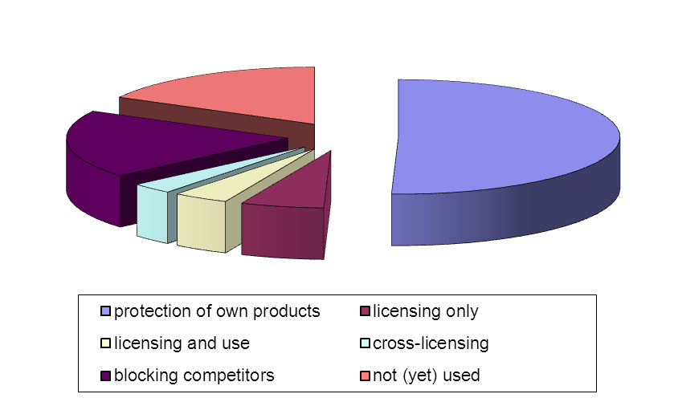
How patents are used
Protecting products and processes
increasing turnover and profits
attracting investors
Licensing
Cross-licensing
Blocking competitors
Building reputation
Not (yet) used
Survey of approx. 7 000 European patents in 2005
EPO/OHIM Intellectual Property Teaching Kit – IP Advanced Part I Patents
23
Notes:
23
A survey of more than 7 000 patents showed that 50% were used to protect companies’ own products and processes. 6% were used for licensing only, 4% for licensing and use, 3% for cross-licensing and 19% for blocking competitors and 17% had not yet been used.
It also established that there were substantial differences depending on country, industry sector and company size.
Cross-licensing is very important for certain industries. For example, ordinary mobile phones have to use technology protected by so many different patents that most mobile phone companies have made cross-licensing agreements to allow each other to use their respective patents.
23

Slide 24
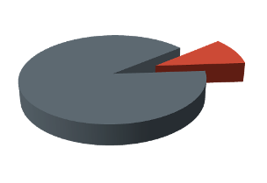
Solutions found in patent documents
In patents
Where do competitors publish their R&D?
Elsewhere
Approximately 80% of the information which can be found in patents is not available anywhere else in comparable detail.
90% in public domain
You can find many great solutions for free!
10%
protected
Reasons
Applications rejected/withdrawn or patent invalidated
Payment of renewal fees discontinued
Patents have lapsed
EPO/OHIM Intellectual Property Teaching Kit – IP Advanced Part I Patents
24
Notes:
24
Insome technical fields approximately 80% of the information that can be found in patents is not available anywhere else in comparable detail. Patents focus on how to make things work, while scientific articles focus on the scientific contribution.
Also, your competitors will "announce" their new products in patents if they want to have patent protection!
There are a number of reasons why most patent documents describe inventions that are free to use. Firstly, the application may have been rejected or withdrawn or the patent invalidated. Secondly, payment of the renewal fees may have been discontinued if the owner saw no further value in the patent. And finally, the patent may have lapsed.
"Old" solutions are not necessarily "outdated". Just think, for example, of antibiotics, superconductors or the internet, which was invented back in 1973.

Slide 25
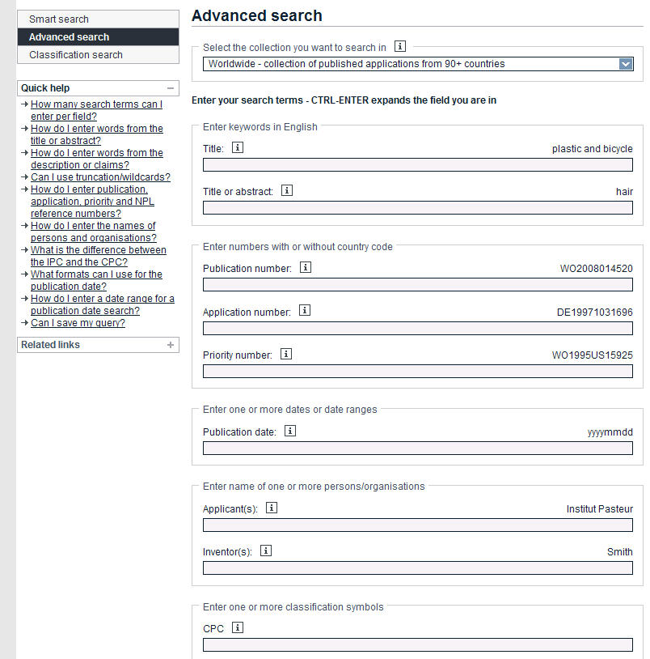


Searching for patents is easy
Free worldwide patent information at
www.espacenet.com
EPO/OHIM Intellectual Property Teaching Kit – IP Advanced Part I Patents
35
Notes:
25
Anyone involved in research and development activities needs to be aware of patents. Even if you have not yet reached the stage of filing a patent application, the technology described in the EPO’s free databases can be very valuable.
Espacenet is easy to use and contains more than 80 million documents from 80-plus countries, covering data from 1836 to today. It is probably the largest single source of information on technology in the world today. Free to use, it has forward and backward citations and an online translation tool providing machine translations between English and 22 other languages.
You can use Espacenet to watch new technologies emerge, find solutions to your technical problems, discover what your competitors are developing, and identify potential business partners.
25

Slide 26
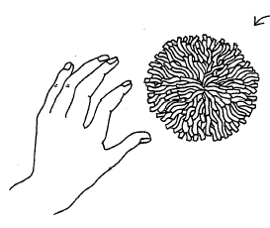
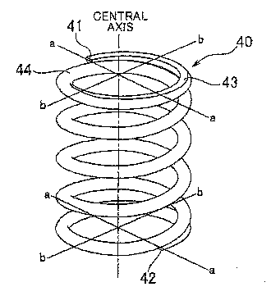
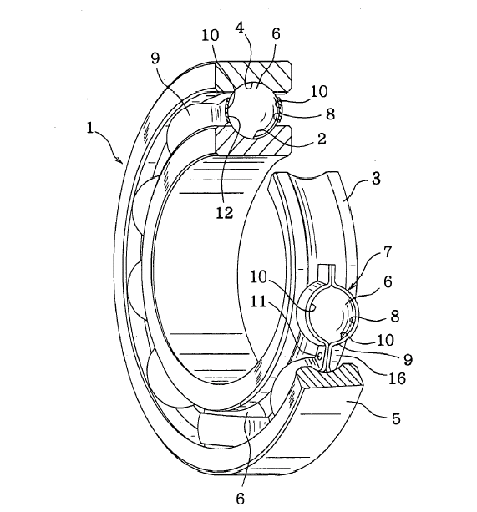
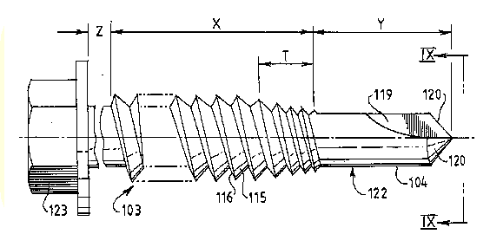
… but a basic knowledge of patent jargon is needed!
Optional
Beware of "naïve" keyword searches!
toy ball
spring
"spherical object with floppy filaments"
"energy-storing means"
Sometimes the applicant simply doesn't want his application to be found.
Patent jargon is used to broaden scope of the patent.
nail, screw, rivet
ball bearing
"plurality of balls"
"fastening means"
EPO/OHIM Intellectual Property Teaching Kit – IP Advanced Part I Patents
26
Notes:
Engineers like to call a spring a spring. But that’s not how patent attorneys necessarily see it. Let’s have a look at the kind of language they use.
Simple, "naïve" keyword searches have very limited effectiveness, because applicants and attorneys will often use the kind of jargon shown on the slide to broaden the scope of the patent or to deliberately make it harder to find.
26

Slide 27
Agenda
Definition: CII
Example: business methods
27

Slide 28
CII and Business Methods
A Computer Implemented Invention is an invention containing features realised wholly or partially by means of a computer program.
A business method has no clear definition, denotes commercial activities, marketing, financial strategies etc.
A business method can be a CII or not.
Method for selling toys in which toys are placed in low shelves easily accessible by young children.

Slide 29
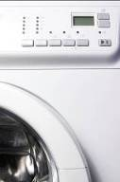

"Computer-implemented invention" - CII
- an invention whose implementation involves the use of a computer, computer network or other programmable apparatus
- with features realised wholly or partly by means of a computer program
Guidelines G-II, 3.6
Examples:
a program-controlled ...
- washing machine cycle;
- car braking system.
29
Notes:
29
In other words, an invention whose implementation involves the use of a computer, computer network or other programmable apparatus, the invention having one or more features which are realized wholly or partly by means of a computer program is termed a computer-implemented invention.
Definition is used by the proposed EU Directive:
Directive of the European Parliament and the Council on the patentability of computer-implemented inventions, 24 May 2004, 9713/04 PI 46 CODEC 56
Here are some examples of computer-implemented inventions:
a program-controlled ...
fault tolerance scheme; washing machine cycle; car braking system.

Slide 30
Computer-implemented Inventions
computer program
get inputs; compute maximum; return the result;
FindArrayMax (t[ ], minI, maxI)
{ for (I = minI; I<=maxI; I++)
if (max < t[ I ]) max = t [ I ];
return (max);
}
underlying
concept
A
l
g
o
r
i
t
h
m
software: diskette, CD, DVD,
manuals
30
Notes:
Let‘s start with the meaning of the terms computer program, software and algorithm used with respect to patentability of subject-matter in the field of information technology.
A computer program is a sequence of computational steps which may be effectively performed by a digital computer. The steps of a computer program are written in a systematic notation known as a programming language.
A computer program is often termed as "the code".
The term software is also often used as synonym for computer program. However, for some computer professionals the term software encompasses the media (e.g. diskette, CD or DVD) on which software is stored as well as all kinds of documentation such as books and manuals etc. that are delivered with the computer program.
The term 'algorithm' can be defined as a systematic procedure for accomplishing a task in a finite number of steps.
In the context of computers, the term algorithm is often used with respect to a set of ordered steps for solving a problem or providing an output from a specific set of inputs. In this context, an algorithm describes the concept underlying a computer program.

Slide 31
Computer-implemented Inventions
Algorithm
implementation
implementation
implementation
Program for
a standard computer
Program for
a standard computer
with specific circuits
Specific circuits
31
Notes:
There are typically many different possible computer implementations of an algorithm.
Since it is an algorithm which defines the concept underlying a computer-implemented invention, the scope of protection sought ideally encompasses all computer implementations of an algorithm.
In practice, the physical implementation of an algorithm can be performed either through a computer program running on a standard computer, potentially in combination with specific circuits, or through specific circuits alone.
As we will see, when an algorithm, wholly or partly implemented in a computer program, defines the underlying concept of an invention, that invention is termed a 'computer-implemented invention'.

Slide 32
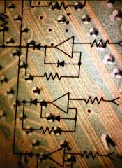

Computer Program - Technical Character?
A further technical effect is the result produced,
when the computer program is run on a computer,
which goes beyond the normal physical interactions between the program and the computer.
T1173/97 IBM
32
Notes:
32
Self evident really - if the only thing the program does is one of the other exclusions (e.g. a business method), there is no further technical effect and the program is a program 'as such' and then excluded.
In other words, it is decisive what the program does:
a game = no
a pretty picture = no
an image rendering with sharp edge enhancer = yes
control of a car diesel injection system = yes
A computer program has technical character if the method/ process it carries out has technical character.
It also applies to formulations such as a computer running the program or digital medium storing the program.

Slide 33
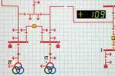


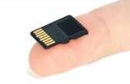
Technical is...
processing physical data parameters or control values of an industrial process
processing which affects the way a computer operates
saving memory, increasing speed
security of a process, rate of data transfer etc.
the physical features of an entity
memory, port etc.
33
Notes:
Based on Boards of Appeal decisions, here are some examples of what is considered to be technical:
processing physical data in a system which affects the control of an industrial process.
processing which affects the way in which a computer operates such as a file compression algorithm
Also any physical apparatus such as a computer or any of its components are considered to be technical.

Slide 34
Computer Programs
further technical effect
control of a brake in a car
faster communication between mobile phones
secure data transmission (encryption of data)
resource allocation in an operating system
no further technical effect
aesthetical effects of music or a video
new rules for an auction scheme
selling and booking sailing cruise packages
calculation of a pension contributions

Slide 35
Trivial requirement
"A method of encouraging customers to be loyal buyers by giving a discount on future purchases."
non-technical
"A computer implemented method with a database of customers who have previously purchased goods for applying a discount to any subsequent purchase."
technical

Slide 36
Example I: Exclusion
A method of controlling payment and delivery of content, the method comprising:
a provider receiving a request for content from a user;
the provider accessing content information describing the requested content;
the provider accessing regulation information describing at least one regulation that is related to the payment and the content information of the requested content and to geographical information of the user;
determining the geographic location of the user;
the provider determining whether the requested content satisfies the at least one regulation;
if so, delivering the requested content to the user for free;
if not, transmitting a payment request to the user.
Non-tecchnical process/ aspects
Clearly Technical Aspects
none
36

Slide 37
Example II: Computer-Implemented Business Method
A computer-implemented method of controlling payment and delivery of content within a computer system comprising a user terminal, a provider server and a database which are connected via a communication network, the method comprising:
the provider server receiving a request for content from the user terminal;
the provider server accessing in the database content information describing the requested content;
the provider server accessing regulation information in the database describing at least one regulation that is related to the payment and the content information of the requested content and to geographical information of the user;
determining the geographic location of the user;
the provider server determining whether the requested content satisfies the at least one regulation;
if so, delivering the requested content to the user terminal
if not, transmitting a payment request to the user terminal.
=
+
Does this merit a patent?
business process
37

Slide 38
Example II: Computer-Implemented Business Method
Clearly Technical Aspects
Non-Technical Aspects/ Process
A computer implemented method comprising:
- a server receiving data from a terminal over a communication network;
- the server accessing data in a database;
- the server processing the accessed and received data;
- the server transmitting the processing result to the terminal;
Same business process as in Example I
no technical interaction
=> does not contribute to technical character
The subject matter of the claim defines technical and non-technical aspects and thus has technical character.
assessment of novelty and inventive step
38
Notes:
In this example, a method of ordering is implemented on a computer where the method comprises the following steps: …
The claim therefore comprises a clearly technical aspect as well as apparently non-technical aspects.
The clearly technical aspect of the claim lies in the following: firstly, the method is implemented in a computer, the adaptation of a computer system for carrying out a method is a technical function; secondly the basic functions of the computer including inputting, storing, and transmitting data have technical character.
The method steps however, when considered in isolation from their implementation in a computer system define a business method. Such subject-matter is excluded from patentability under Article52(2)(c). The parts of the claimed features which describe these steps therefore make up these apparently non-technical aspects.
On further analysis it is determined that the apparently non-technical aspects do not contribute to the technical character of the invention, since the data processed does not constitute the operating parameters of a computer nor does the data affect the physical/ technical functioning of a computer and the claimed process does not cause a further technical effect and are therefore purely non-technical aspects.

Slide 39
Inventive step: problem-and-solution approach
Identify the closest prior art (CPA)
Determine the differentiating features and their technical effects
Formulate an objective technical problem in view of the CPA
Decide whether there is an inventive step
Guidelines in the EPO G-VII, 5
39
Notes:
39
G-VII,5:
Problem-and-solution approach In order to assess inventive step in an objective and predictable manner, the so-called "problem-and-solution approach" should be applied. Thus deviation from this approach should be exceptional. In the problem-and-solution approach, there are three main stages: (i) determining the "closest prior art", (ii) establishing the "objective technical problem" to be solved, and (iii) considering whether or not the claimed invention, starting from the closest prior art and the objective technical problem, would have been obvious to the skilled person.

Slide 40
Inventive Step
clearly technical aspects
non-technical aspects/ process
state of the art:
- state of technology
closest prior art:
always chosen from a field of technology
skilled person:
- skilled in the field of information technology
- aware of common general knowledge in information technology
- no knowledge of non-technical fields
T614/00 COMVIK
'requirements specification'
= instructions given to a data processing expert summarising the requirements of the customer
i.e. business or administrative process to be automated
IS NOT state of the art
T172/03 RICOH
40
Notes:
Once we have established what part of the claimed subject-matter contributes to its technical character and hence describes its technical content, the relevant prior art is established based on this technical content.
The Boards of Appeal have interpreted the term ”state of the art” (Article 54) in English text of the EPC to be understood as “state of technology” where it consists of prior art information relevant to some field of technology.
The Boards of Appeal therefore concluded that the closest prior art will be chosen from a field of technology and not from a field which belongs to the list of exclusions, like commerce and business methods.
A skilled person within the meaning of Article 56 EPC is skilled in a technical field. With respect to computer-implemented inventions typically he is an ordinary practitioner skilled in the field of information technology.
He is aware of common general knowledge in the field of information technology at the filing date of the application but has no knowledge whatsoever regarding non-technical fields.
Ricoh Headnotes 1 and 2
The term "state of the art" in Article 54 EPC should, in compliance with the French and German text, be understood as "state of technology", which in the context of the EPC does not include the state of the art in commerce and business methods. The term "everything" in Article 54(2) EPC is to be understood as concerning such kind of information which is relevant to some field of technology.
From these considerations it follows that anything which is not related to any technological field or field from which, because of its informational character, a skilled person would expect to derive any technically relevant information, does not belong to the state of the art to be considered in the context of Articles 54 and 56, even if it had been made available to the general public before the relevant priority date (see points 8 to 10 of the reasons).

