Slide 1

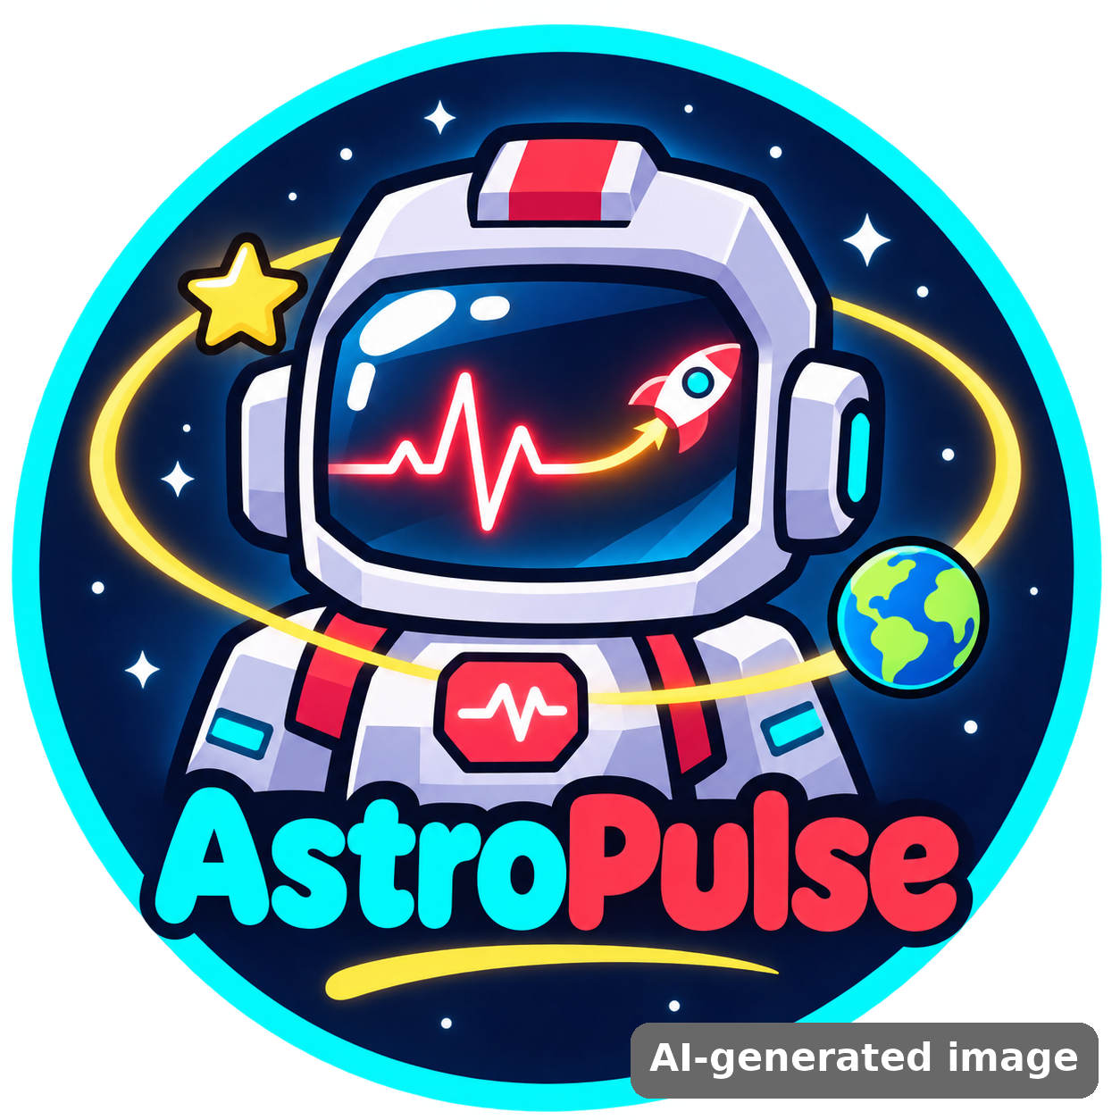
Astro Sağlık
NASA SPACE APPS CHALLENGE 2026
Space Station Health Mission
A 3D game where kids monitor an astronaut’s health, decide what is wrong and act fast to keep the crew safe.
Team: AstroPulse
Member: Azra Kurt (solo team)
Challenge: Create Health Monitoring Software for Astronauts on Space Missions
Project Demo · 7 slides
Notes:
Hi! I am Azra Kurt from team AstroPulse. Our challenge is "Create Health Monitoring Software for Astronauts on Space Missions". Our project is Astro Sağlık – Space Station Health Mission.
TR: Merhaba! Ben AstroPulse takımından Azra Kurt. Seçtiğimiz challenge: Astronotlar için sağlık izleme yazılımı. Projemizin adı Astro Sağlık.

Slide 2





The problem: space is hard on the human body
NASA’s Human Research Program names five hazards of human spaceflight (RIDGE):
Radiation
Isolation
Distance
Gravity
Hostile closed space
Higher cancer & tissue risk
Stress, mood, team conflict
No quick trip to a doctor
Bone & muscle loss, fluid shift
Germs, sleep, noise
Astronauts must notice problems early and act on their own. Our game teaches exactly that: watch the data, decide, act.
Notes:
In space, astronauts face five big hazards. Their bodies change and the doctor is far away, so they must monitor their own health.
TR: Uzayda astronotlar beş büyük tehlikeyle karşılaşır. Doktor uzakta olduğu için kendi sağlıklarını izlemeleri gerekir.

Slide 3
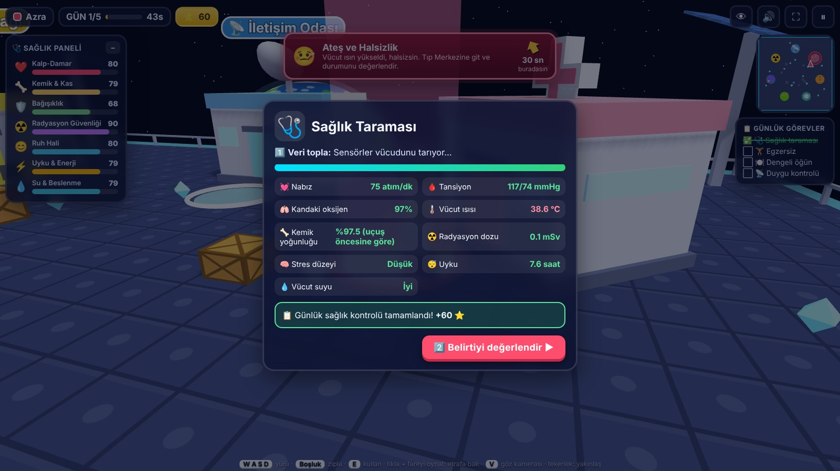



Our solution: Collect → Assess → Act
1 Collect data
Daily health scan: heart rate, blood pressure, SpO₂, temperature, bone density, radiation dose, stress, sleep, hydration
2 Assess
Read the numbers and choose the riskiest area or the right medical decision
In-game health scan (game UI is in Turkish)
3 Act
7 live health bars drop over time. If one reaches 0 → medical evacuation, mission over.
Go to the right module: exercise, eat, sleep, grow plants, call family, or shelter from radiation
Notes:
In our game, the player collects health data, decides what is wrong and goes to the right module to fix it.
TR: Oyuncu sağlık verisini toplar, sorunu değerlendirir ve doğru istasyona gidip harekete geçer.

Slide 4
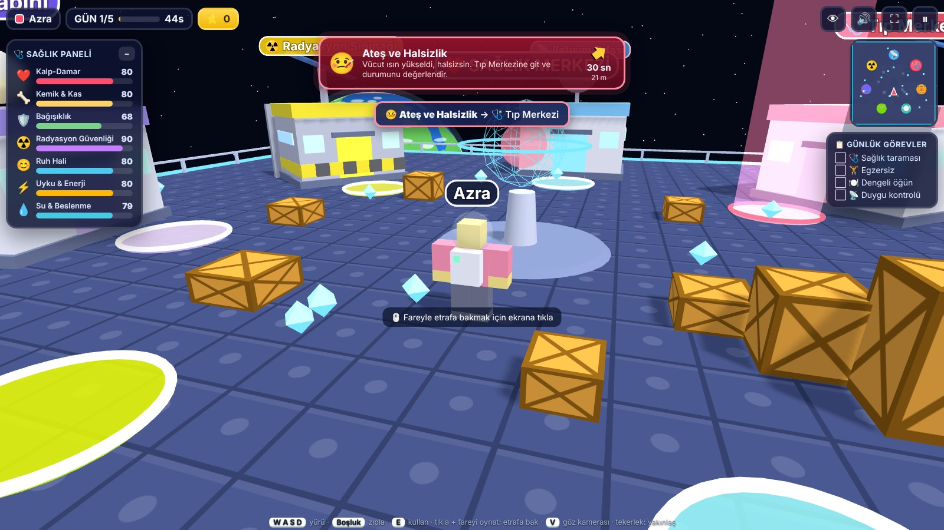
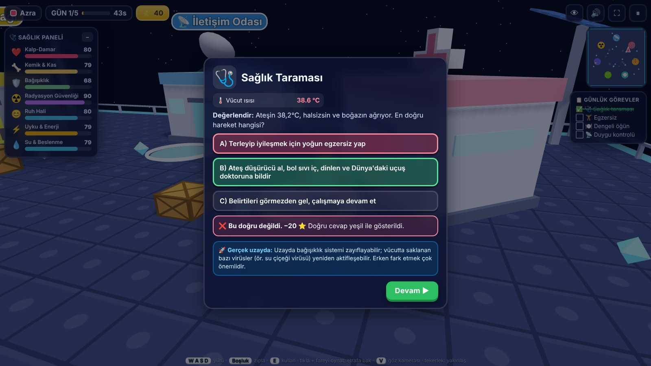
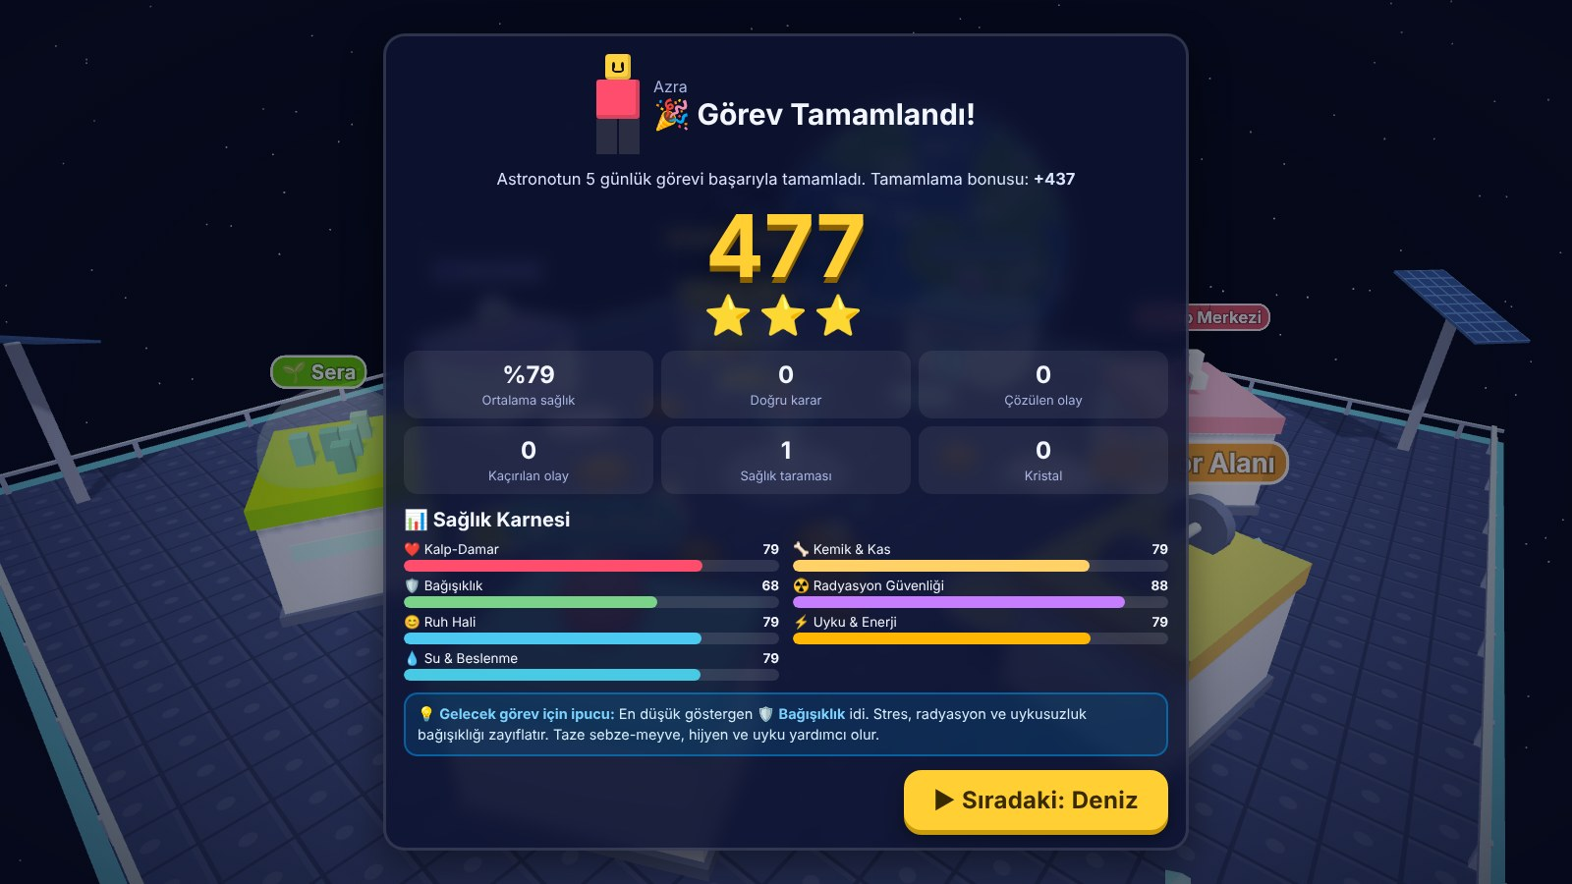
What the player experiences
A health alarm appears
Make the medical call
Get a Health Report Card
Fever, heart rhythm, vision, stress or a solar storm – reach the right module in time
Choose the best action and read a real space fact
Score, stars and every health bar at the end of the mission
Game UI shown in Turkish
Notes:
A health alarm appears, the player runs to the right module, makes a medical decision, learns a real fact, and gets a report card at the end. Friends take turns and compare scores.
TR: Bir alarm çıkar, oyuncu doğru istasyona koşar, karar verir, gerçek bir bilgi öğrenir ve sonunda sağlık karnesi alır.

Slide 5





Built on NASA science
Human Research Program
ISS exercise & ARED
SANS
5 hazards (RIDGE) → our 7 health indicators and events
~2 hours of exercise a day protects bone and muscle
Fluid shift → vision problems event
Immune changes
Veggie experiment
Solar particle events
Dormant viruses can reactivate → fever event
Astronauts grow lettuce → greenhouse module
Shelter + AstroRad vest tested on Artemis I
Every quiz ends with a “Real space” fact box, so players learn the real science behind each choice.
Notes:
All health events are based on NASA research: the Human Research Program hazards, ISS exercise, SANS, immune changes, the Veggie experiment and solar storms.
TR: Tüm olaylar NASA araştırmalarına dayanıyor.

Slide 6


How we built it & use of AI
How it is built
Use of AI
Three.js 3D graphics in one HTML file – no install
Works offline in any browser, on PC and tablets
Keyboard, mouse-look, first-person view, touch joystick
Take-turns mode for up to 8 players + leaderboard
AI coding assistant (Claude) helped write and test the code; the team designed the idea, content and gameplay
Logo & team picture made with an AI image tool and marked “AI-generated image”
No NASA logos used
1
0
8
HTML file
installs
players
Notes:
The game is one HTML file with Three.js. It works offline on computers and tablets. We used an AI coding assistant for the code and an AI image tool for our logo; these images are marked.
TR: Oyun tek bir HTML dosyası, internetsiz çalışıyor. Kodda yapay zekâ asistanı, logoda yapay zekâ görsel aracı kullandık ve işaretledik.

Slide 7


Impact & what comes next
Impact
Next steps
Kids learn how astronauts stay healthy – by playing
Teaches a real skill: read data → decide → act
Free, offline, runs on school tablets
English version of the game
Real wearable data (smartwatch heart rate)
Difficulty levels and a Mars mission mode
Downloadable health report
Thank you! Team AstroPulse · Azra Kurt
Notes:
Our game can help many students learn space health while having fun. Next we want an English version and real smartwatch data. Thank you!
TR: Oyunumuz öğrencilerin eğlenerek öğrenmesine yardım ediyor. Sırada İngilizce sürüm ve akıllı saat verisi var. Teşekkürler!

