Slide 1

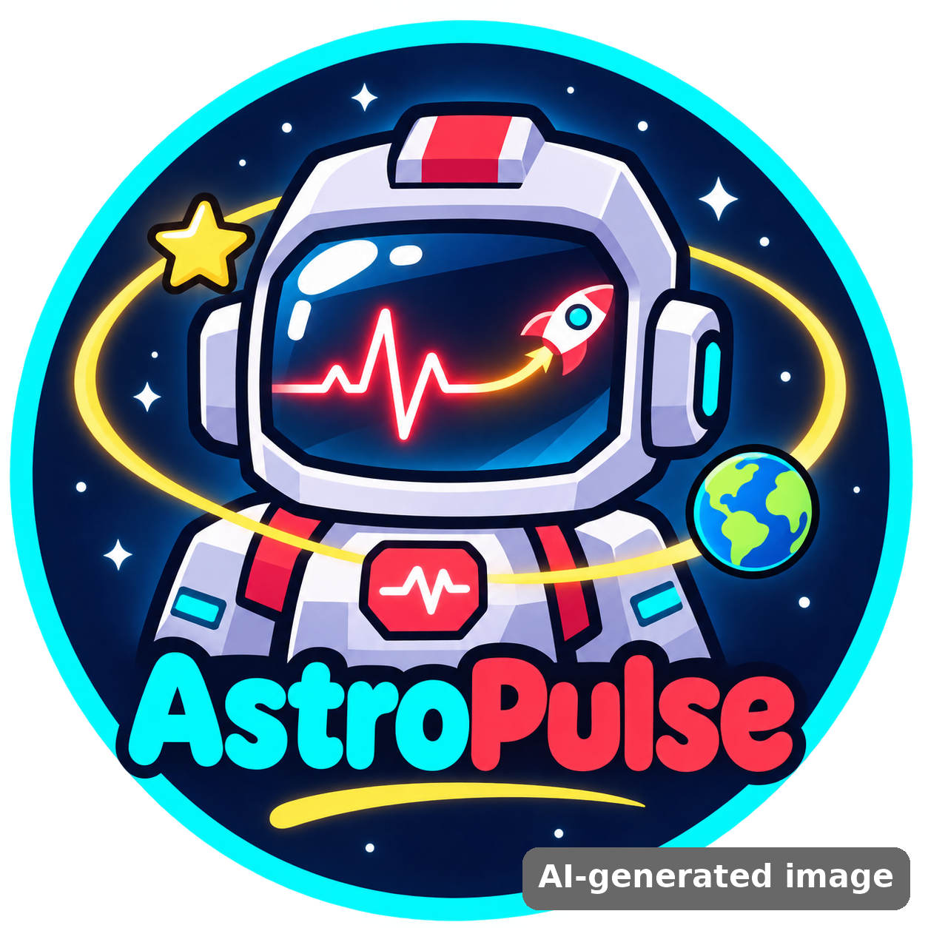
Astro Sağlık
NASA SPACE APPS CHALLENGE 2026
Space Station Health Mission
A 3D game where kids monitor an astronaut’s health, decide what is wrong and act fast to keep the crew safe.
Team: AstroPulse
Member: Azra Kurt (solo team)
Challenge: Create Health Monitoring Software for Astronauts on Space Missions
Full Presentation
Notes:
Hello, I am Azra Kurt from team AstroPulse. Today I will present Astro Sağlık – Space Station Health Mission, our project for the challenge "Create Health Monitoring Software for Astronauts on Space Missions".
TR: Merhaba, ben AstroPulse takımından Azra Kurt. Size Astro Sağlık projemizi anlatacağım.

Slide 2
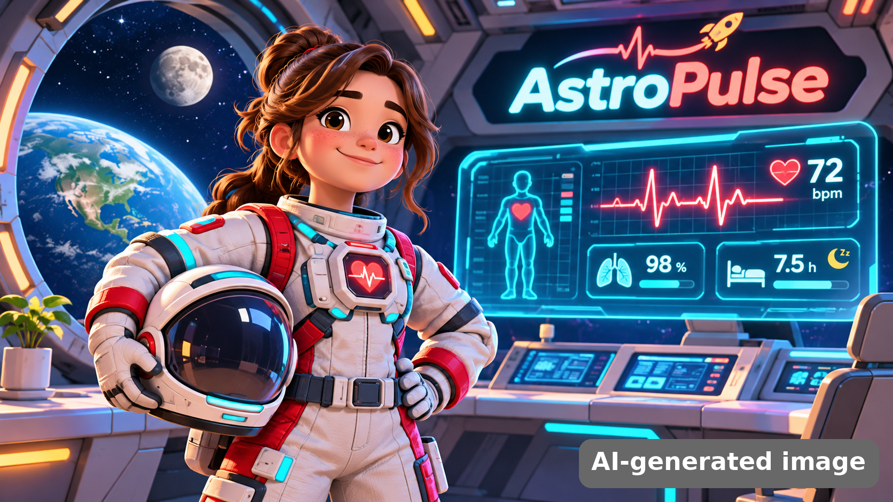
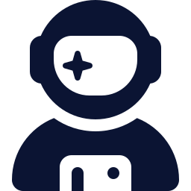
Meet the team
Azra Kurt
Solo team · Team AstroPulse
Our name: “Astro” = space, “Pulse” = heartbeat. We keep every astronaut’s pulse healthy.
Team picture is an AI-generated illustration
Notes:
I am a one-person team. Our team name AstroPulse joins space and heartbeat, because our project is about keeping astronauts healthy.
TR: Tek kişilik bir takımım. AstroPulse adı "uzay" ve "nabız" kelimelerinden geliyor.

Slide 3




Our challenge
Create Health Monitoring Software for Astronauts on Space Missions
Monitor
Understand
Teach
Track the key health signals of an astronaut
Turn numbers into a clear decision
Make it fun, so students learn space health
Notes:
Our challenge asks for software that monitors astronaut health. We decided to build it as a game, so it monitors, explains and teaches at the same time.
TR: Challenge astronot sağlığını izleyen bir yazılım istiyor. Biz bunu oyun olarak yaptık; hem izliyor hem öğretiyor.

Slide 4





Why it matters: 5 hazards of spaceflight
NASA’s Human Research Program names five hazards of human spaceflight (RIDGE):
Radiation
Isolation
Distance
Gravity
Hostile closed space
Higher cancer & tissue risk
Stress, mood, team conflict
No quick trip to a doctor
Bone & muscle loss, fluid shift
Germs, sleep, noise
Astronauts must notice problems early and act on their own. Our game teaches exactly that: watch the data, decide, act.
Notes:
NASA lists five hazards: radiation, isolation, distance from Earth, changing gravity and a hostile closed environment. Far from Earth, astronauts must watch their own health.
TR: NASA beş tehlike sayar: radyasyon, yalnızlık, uzaklık, yerçekimi ve kapalı ortam.

Slide 5




7 health indicators we monitor
Heart & vessels
Bone & muscle
Immune system
Radiation safety
Pulse, blood pressure
Bone density
Body temperature
Radiation dose
Mood
Sleep & energy
Water & food
Stress level
Hours of sleep
Body water
Bars slowly drop every mission day (faster as days pass). Below 25 → red alarm. At 0 → medical evacuation.
Notes:
We turned these risks into seven health bars. Each one is linked to real measurements from the daily health scan.
TR: Riskleri yedi sağlık göstergesine dönüştürdük. Her biri tarama verileriyle bağlantılı.

Slide 6
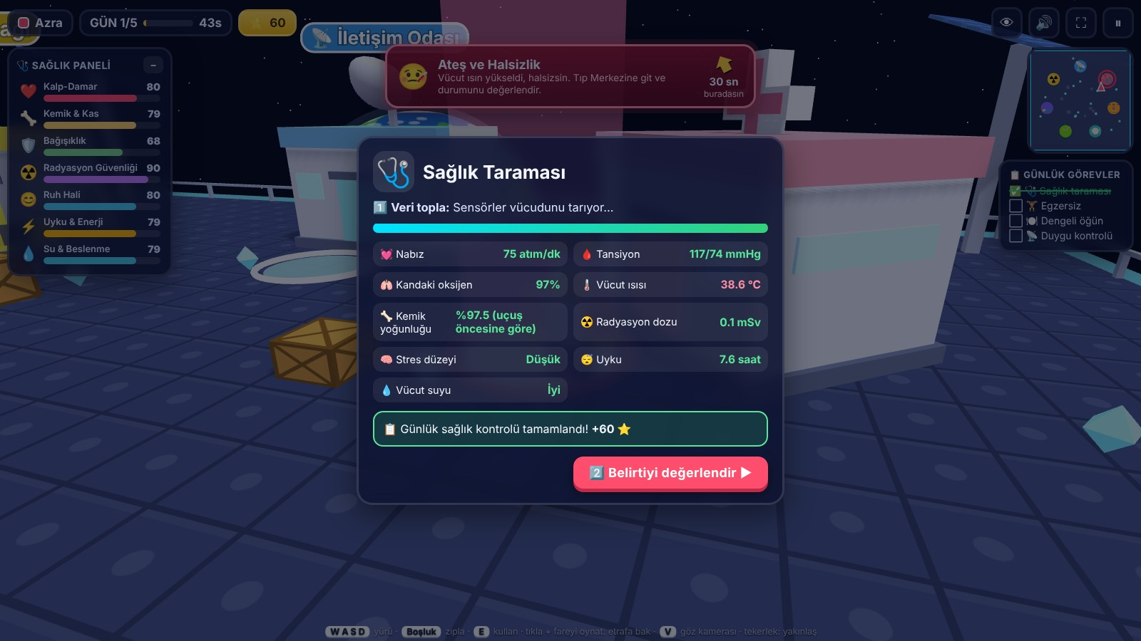



Our solution: Collect → Assess → Act
1 Collect data
Daily health scan: heart rate, blood pressure, SpO₂, temperature, bone density, radiation dose, stress, sleep, hydration
2 Assess
Read the numbers and choose the riskiest area or the right medical decision
In-game health scan (game UI is in Turkish)
3 Act
7 live health bars drop over time. If one reaches 0 → medical evacuation, mission over.
Go to the right module: exercise, eat, sleep, grow plants, call family, or shelter from radiation
Notes:
The core idea is a loop: collect data, assess it, and act. This is what real astronauts and flight doctors do.
TR: Ana fikir bir döngü: veri topla, değerlendir, harekete geç.

Slide 7
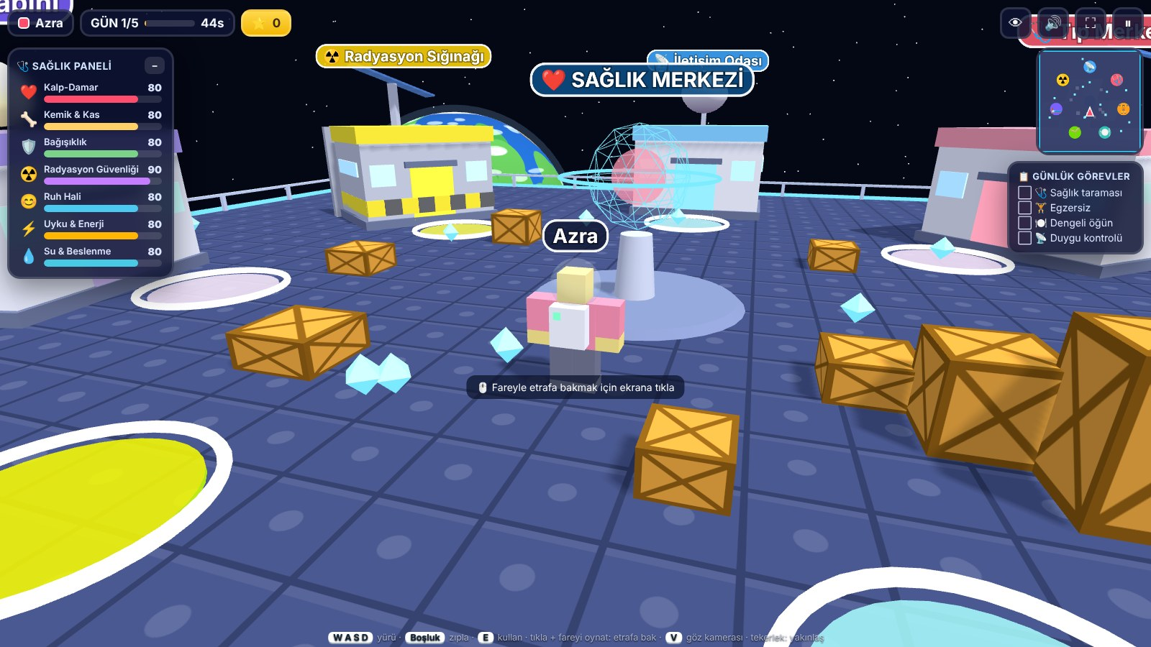





A space station with 7 health modules
Medical Center Health scan & diagnosis
Gym Treadmill & ARED workout
Kitchen Build a balanced meal
Greenhouse Water the plants
Comms Room Mood check & family call
Blocky astronaut in the 3D station
Sleep Pod Rest and recharge
Radiation Shelter Hide from solar storms
Notes:
The player walks a blocky astronaut around a 3D station with Earth and the Moon in view. Each module is a short mini-game that improves one or more health bars.
TR: Oyuncu 3B istasyonda yürür. Her modül, göstergeleri iyileştiren kısa bir mini oyun.

Slide 8
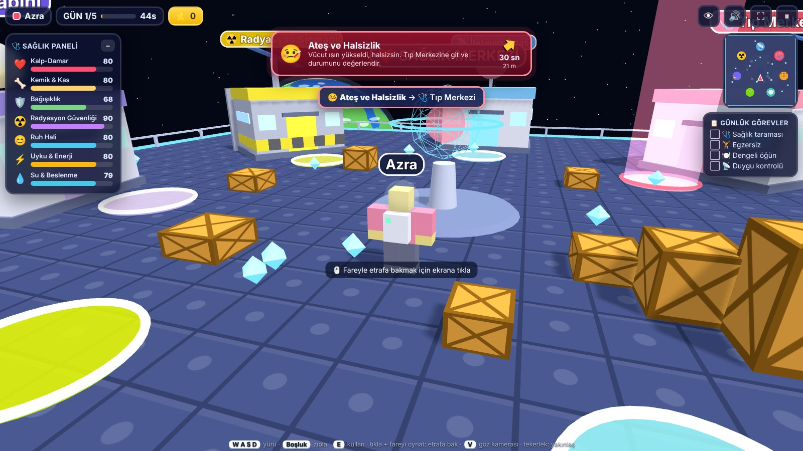
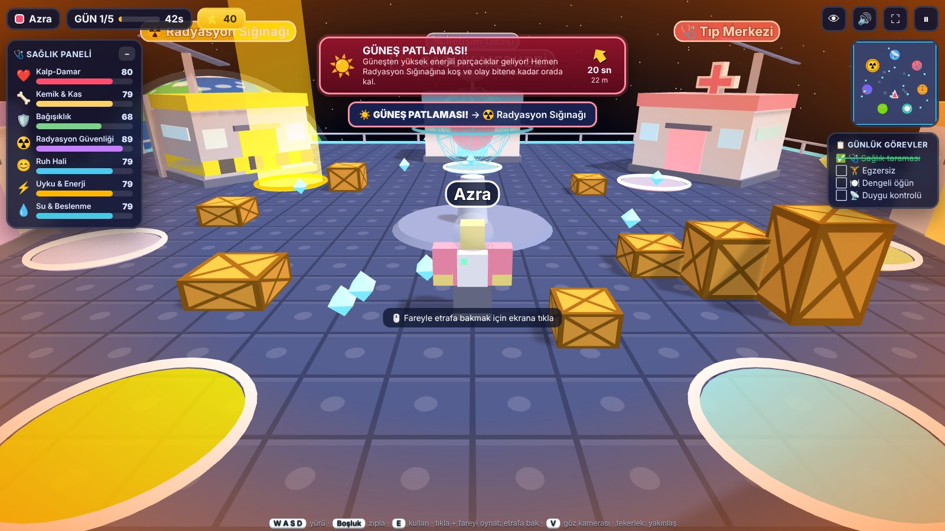
Health alarms and solar storms
Fever alarm: a beam and arrow show where to go
Solar flare: run to the shelter in 20 seconds
7 random health events: fever, heart rhythm, blurred vision (SANS), stress, bone pain, dehydration, insomnia
Solar flares on mission days 2, 4 and 6 – race to the Radiation Shelter
Notes:
Random health alarms appear with a countdown. A beam and an arrow guide the player. On some days a solar flare hits and the player must reach the shelter in time.
TR: Rastgele sağlık alarmları çıkar. Bazı günlerde güneş patlaması olur ve sığınağa koşmak gerekir.

Slide 9
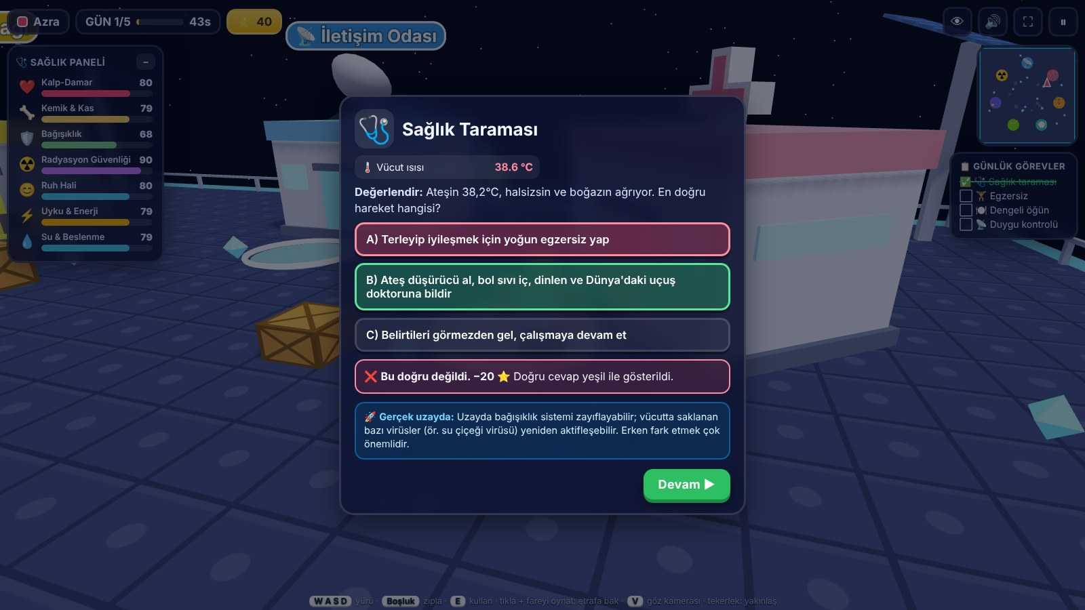
Make the right medical call
Example
“Fever 38.2 °C, tired, sore throat. What is the best action?”
Right answer: +150 points
Wrong answer: −20, correct one shown
Then a real NASA fact explains why
Decision question + “Real space” fact box
Players learn from mistakes, not just from success.
Notes:
At the medical center the player reads the scan and answers a decision question. Right answers give points; wrong answers show the correct choice and a real space fact.
TR: Tıp merkezinde oyuncu verileri okuyup karar verir. Yanlışta doğru cevap ve gerçek bir bilgi gösterilir.

Slide 10
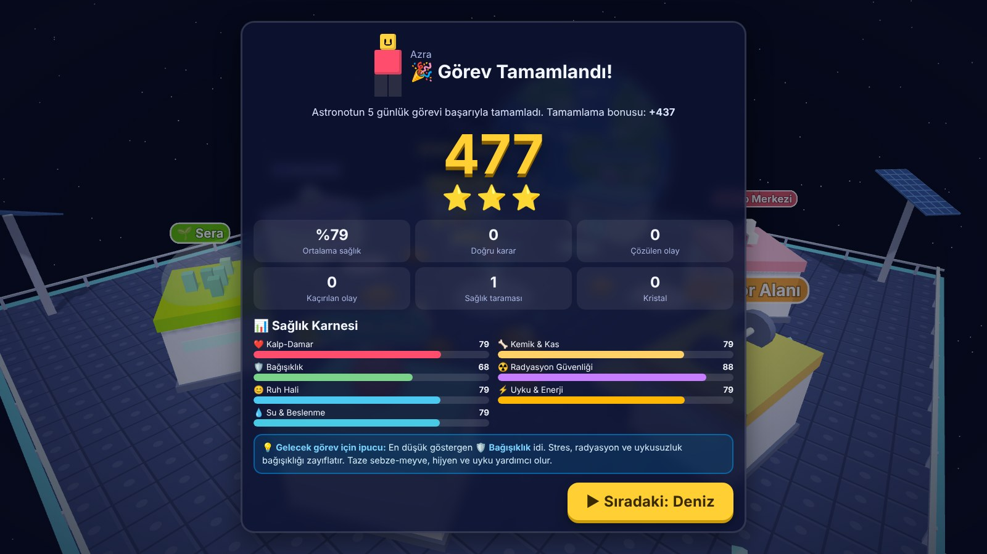
Health Report Card & scoring
Action | Points
Daily health scan | +60
Correct assessment | +80
Health event solved | +150
Shelter during solar flare | +150
All 4 daily tasks | +100
Mission complete | 200 + 3 × avg. health
End of mission: score, stars, all 7 bars and a tip
If a bar hits 0 the mission ends early, but the score is still saved.
Notes:
At the end each player gets a Health Report Card with the score, stars, all health bars, a daily chart and a tip for next time.
TR: Sonunda her oyuncu puan, yıldız ve tüm göstergeleri içeren bir Sağlık Karnesi alır.

Slide 11
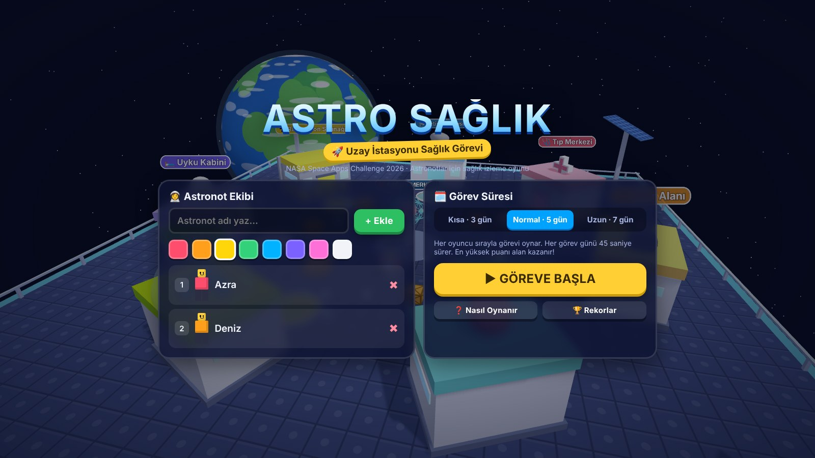


Play together in class
Take turns
Each player plays, then sees their own score
Podium
Final ranking + all-time records
First-person view
See through the astronaut’s eyes (V key)
Any device
Add up to 8 players and choose 3, 5 or 7 days
Keyboard & mouse or touch joystick
Notes:
A whole class can play on one computer or tablet. Players take turns, see their own report card, and at the end a podium shows the ranking.
TR: Bütün sınıf tek cihazda sırayla oynayabilir; en sonda podyum ve sıralama çıkar.

Slide 12


Built on NASA science
Human Research Program
ISS exercise & ARED
SANS
5 hazards (RIDGE) → our 7 health indicators and events
~2 hours of exercise a day protects bone and muscle
Fluid shift → vision problems event
Immune changes
Veggie experiment
Solar particle events
Dormant viruses can reactivate → fever event
Astronauts grow lettuce → greenhouse module
Shelter + AstroRad vest tested on Artemis I
Every quiz ends with a “Real space” fact box, so players learn the real science behind each choice.
Notes:
Our content comes from NASA research. For example, astronauts exercise about two hours a day, and NASA studies SANS, immune changes and solar storms.
TR: İçerik NASA araştırmalarına dayanıyor: günlük egzersiz, SANS, bağışıklık ve güneş fırtınaları.

Slide 13





How we built it
Three.js 3D
Works offline
PC & tablet
HTML + JavaScript, one single file
Library saved locally – no internet needed
Touch joystick, buttons, fullscreen
Sound
Tested
Development log
Made in code with Web Audio
Desktop and tablet views, every module
Every change recorded step by step
Notes:
The game is one HTML file with the Three.js library. It needs no installation and works without internet, which is important for schools.
TR: Oyun tek bir HTML dosyası; kurulum ve internet gerekmiyor.

Slide 14
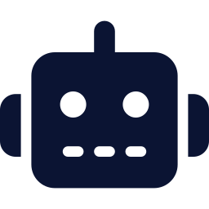
Use of Artificial Intelligence
Where and how AI was used
An AI coding assistant (Claude) helped write and test the game code (HTML, JavaScript, Three.js)
The team chose the challenge, the game idea, the health topics and the gameplay, and reviewed and tested every feature
The team logo and team picture were made with an AI image tool – each is marked “AI-generated image”
No NASA logos or mission insignia are used anywhere
Example: our AI-generated team picture with its watermark
Notes:
Space Apps asks us to say where AI was used. An AI coding assistant helped write and test the code. Our logo and team picture were made with an AI image tool and are marked as AI-generated.
TR: Yapay zekâ kullanımını açıkça belirtiyoruz: kodda yapay zekâ asistanı, logo ve takım görselinde yapay zekâ görsel aracı. Görseller işaretli.

Slide 15

Data & resources
NASA resources
Tools & other resources
Human Research Program – Hazards of Human Spaceflight (nasa.gov/hrp/hazards)
ISS exercise & ARED device
SANS (Spaceflight Associated Neuro-ocular Syndrome)
Immune system & latent virus research
Veggie plant growth experiment
Artemis I radiation research (AstroRad vest)
Three.js r149 (MIT license)
Fredoka font – Google Fonts (Open Font License)
Claude – AI coding assistant
AI image tool – logo & team picture (marked)
All sounds generated in code
Notes:
Here are all the resources we used. NASA research inspired every health event and fact in the game.
TR: Kullandığımız tüm kaynaklar burada. Her olay ve bilgi NASA araştırmalarından ilham aldı.

Slide 16

Impact & what comes next
Impact
Next steps
Students learn space health by playing
Builds a real skill: read data → decide → act
Free, offline, works on school tablets
Whole class can play and compare scores
English version of the game
Real wearable data (smartwatch heart rate)
Difficulty levels and a Mars mission mode
Downloadable health report (PDF)
Thank you! Team AstroPulse · Azra Kurt
Notes:
Our project can reach many students because it is free and works offline. Next we want an English version, real smartwatch data and a Mars mission. Thank you for listening!
TR: Ücretsiz ve internetsiz olduğu için çok öğrenciye ulaşabilir. Sırada İngilizce sürüm, akıllı saat verisi ve Mars görevi var. Dinlediğiniz için teşekkürler!

