Slide 1

Group 11 - DIVOC Forum
Team Members | Roles | Contributions
Carlos Salazar | Team Leader, Scrum Master, Back-End Developer | Handled sign in authentication and user profile page functionality
Zachary Goldstein | Product Owner, GitHub Master, Lead Back-End Developer | Handled commenting, searching, and Google Analytics to analyze web traffic
Alena Krause | Front-End Developer, Back-End Developer | Handled the creation of posts, liking/disliking, profile picture customization, and user interface for the website
Brandon Que | Front-End Developer | Handled the user interface for the website
Shannon Soulard | Lead Front-End Developer | Handled the user interface for the website
Notes:
Recording by Carlos

Slide 2
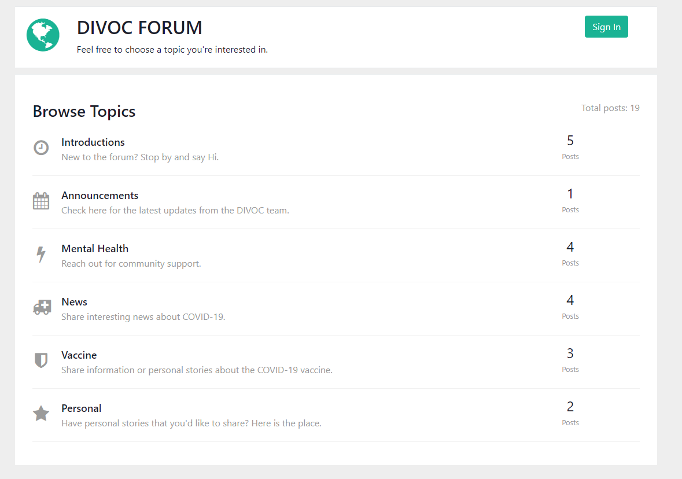
Live Website in Action
URL: https://lamp.cse.fau.edu/~cen4010_s21_g11/forum-topic-prototype/www/home.html
Notes:
Recording by Carlos

Slide 3
Purpose and Motivation
Motivation:
The Coronavirus changed a lot of people’s lives around the globe, we decided to do take action.
The DIVOC Forum aims to:
Connect people from around the world
Let users share experiences
Provide users with emotional support
Allow users to learn more about the virus
Provide news about the virus
Notes:
Recording by Brandon

Slide 4
Functionalities + target audience
Target audience:
People affected by the current Coronavirus Pandemic
Functionalities:
Account creation/Log in
Topic selection
Creating posts
Liking/disliking posts
Commenting
Search for keywords
Profile page
Notes:
Recording by Brandon

Slide 5
System implementation infrastructure
Languages
NoSQL and Javascript
Database
Firebase/Firestore
Library
Google’s firebase and analytics library was used to connect the website to the database.
Platform
Any device that supports a modern browser
Notes:
Recording by Zach

Slide 6
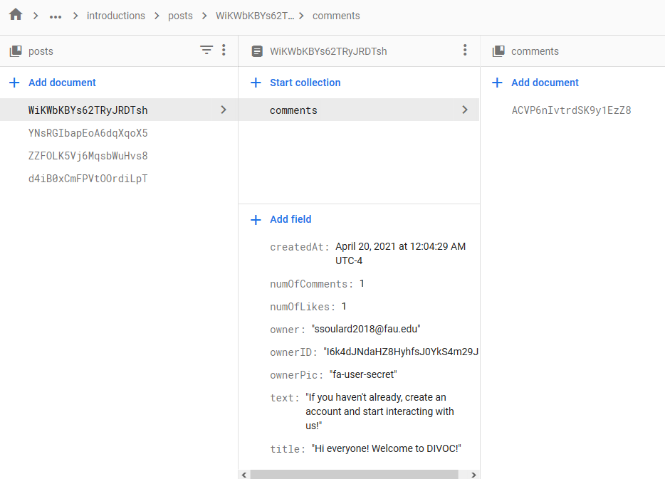
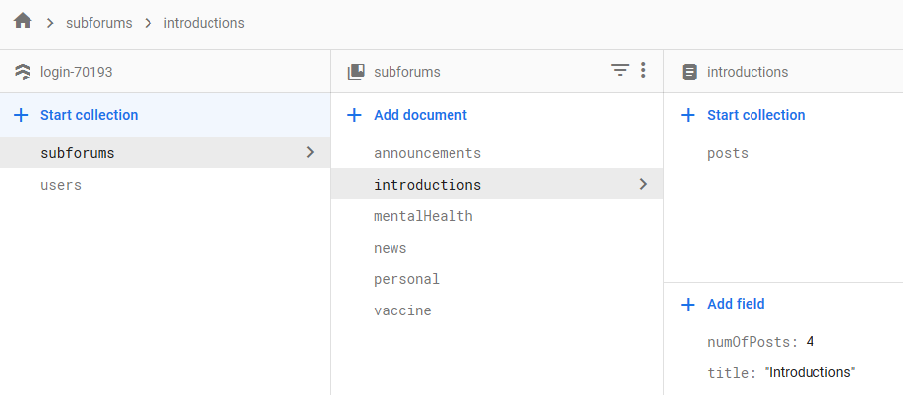
System implementation infrastructure
Database created with Firebase
Uses cloud firestore
Organized into collections, documents, and subcollections.
Notes:
Recording by Alena

Slide 7
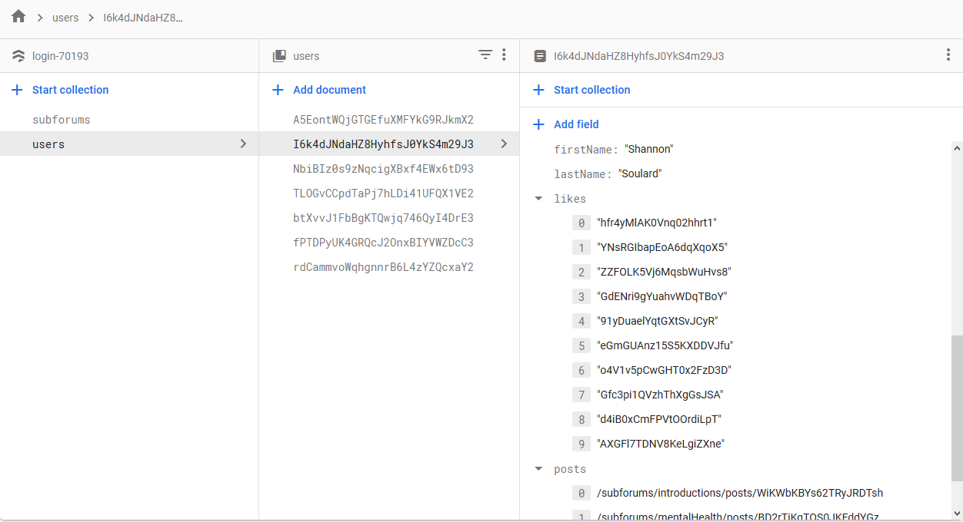
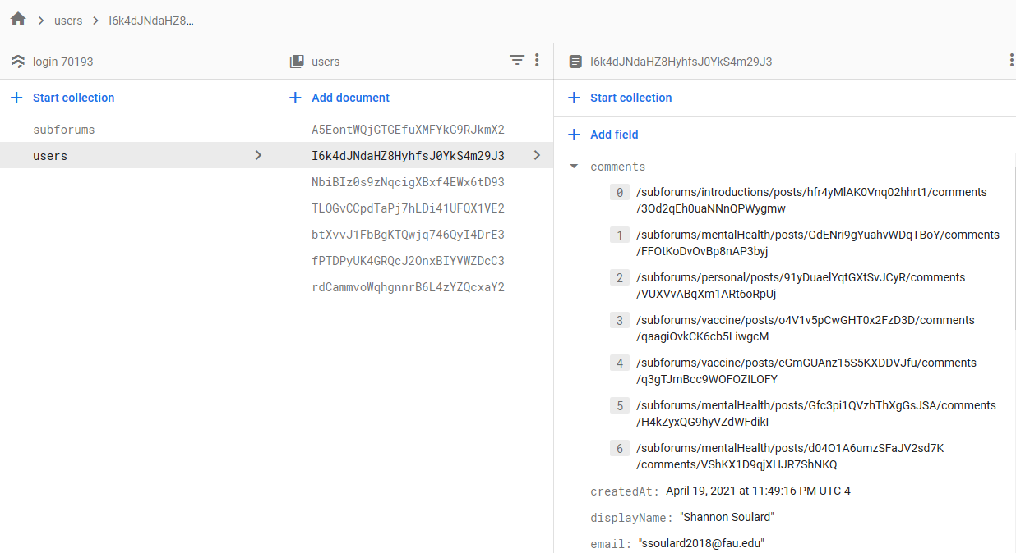
System implementation infrastructure
user info
collection
user IDs
user info
collection
user IDs
Notes:
Recording by Alena

Slide 8
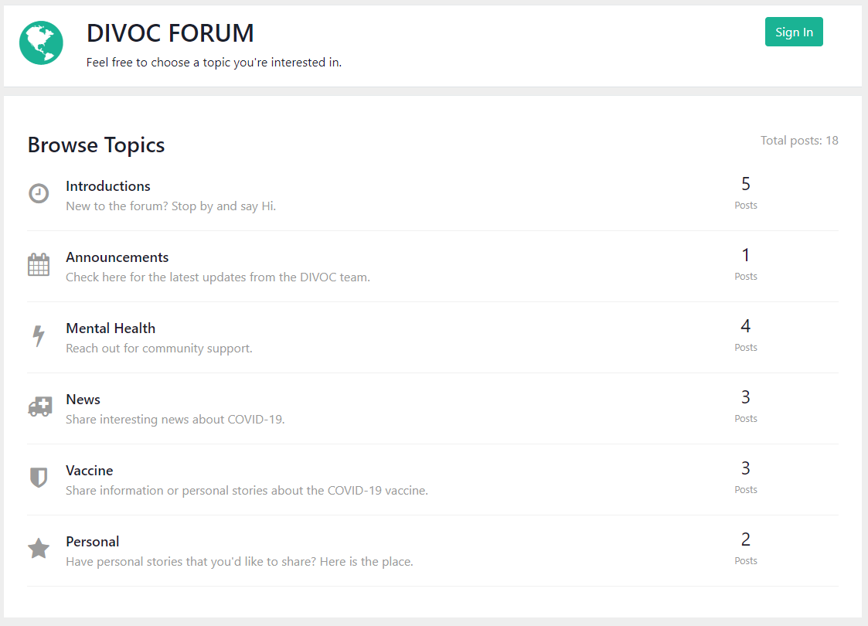
Main System - Home Page
Notes:
Recording by Alena

Slide 9
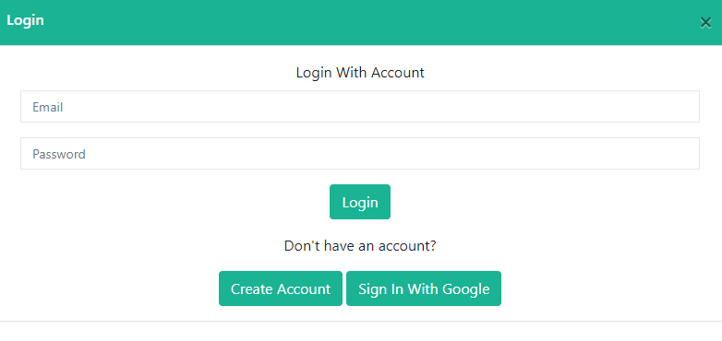
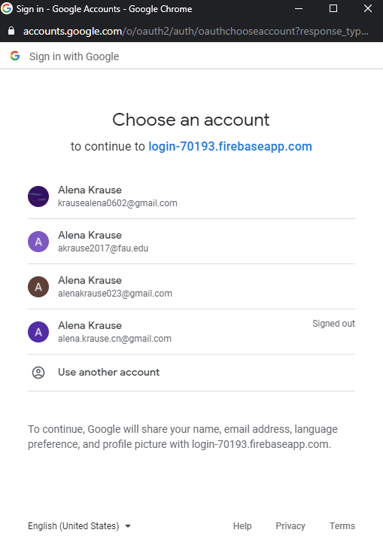
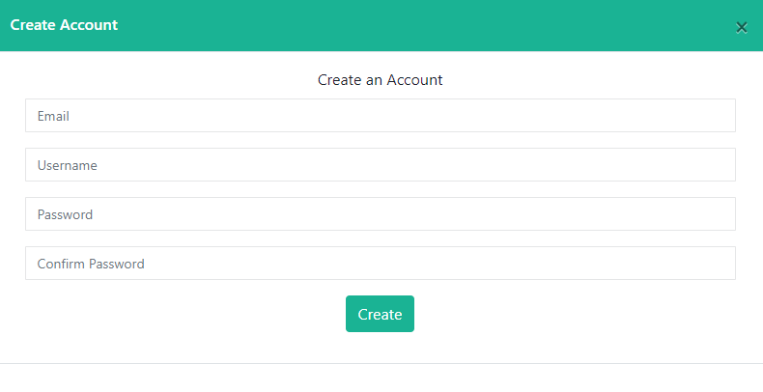
Main System - Sign In
Notes:
Recording by Alena

Slide 10
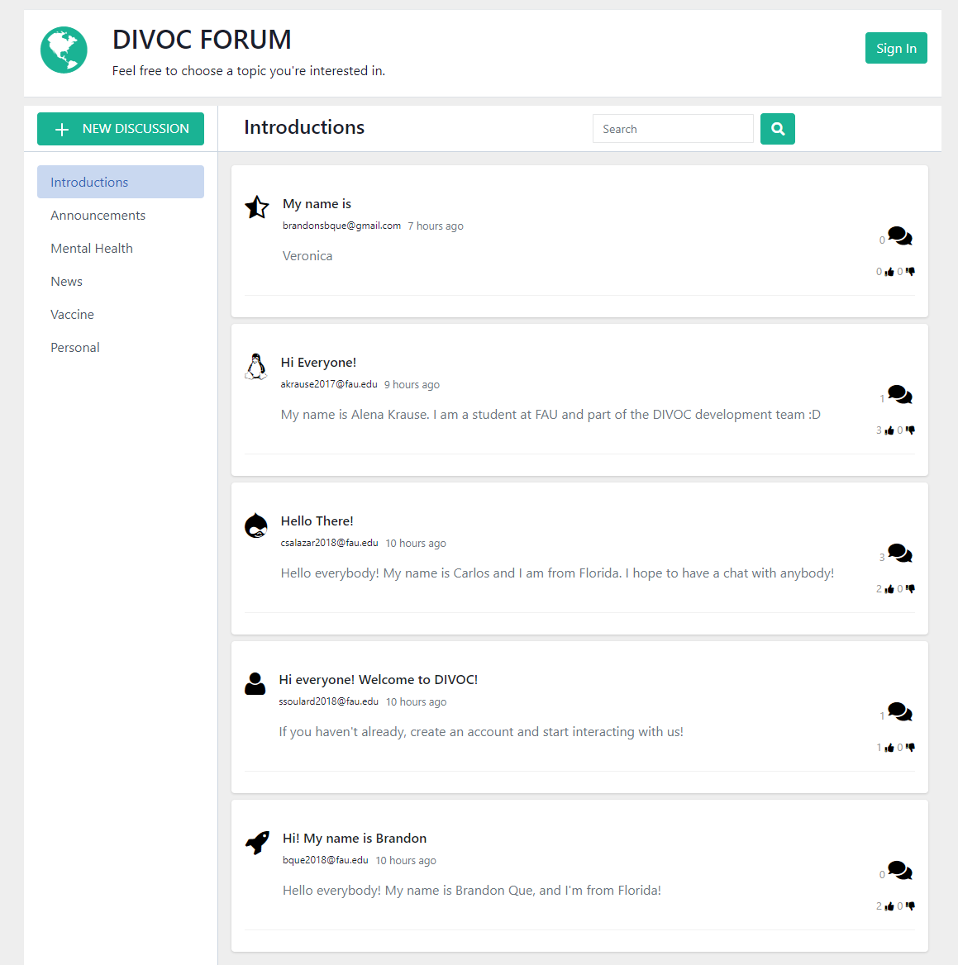
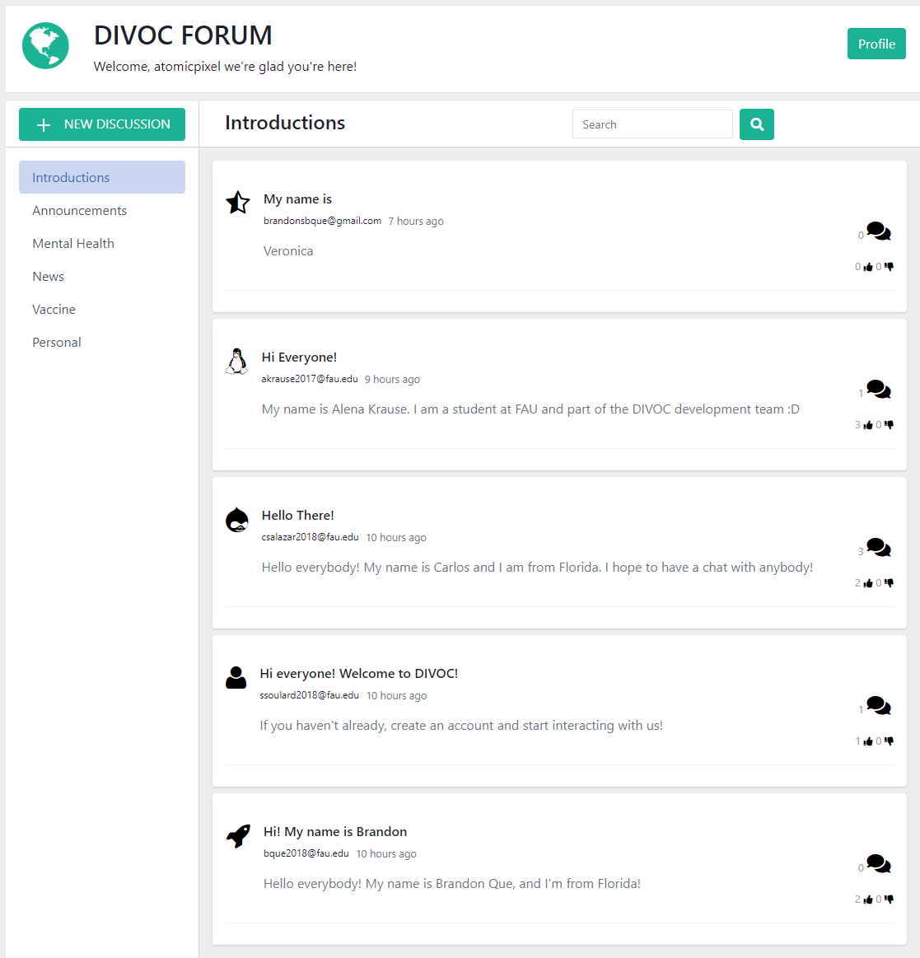
Main System - Topics (Signed In vs Not Signed In)
Notes:
Recording by Alena

Slide 11
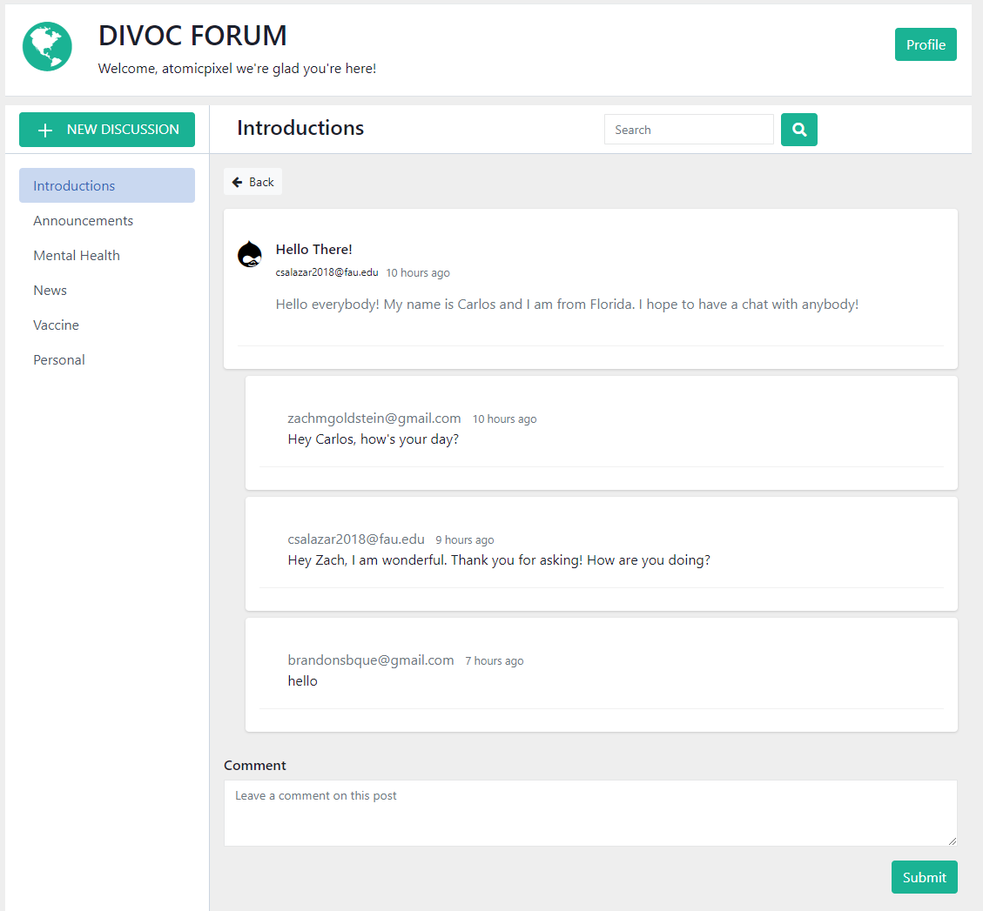
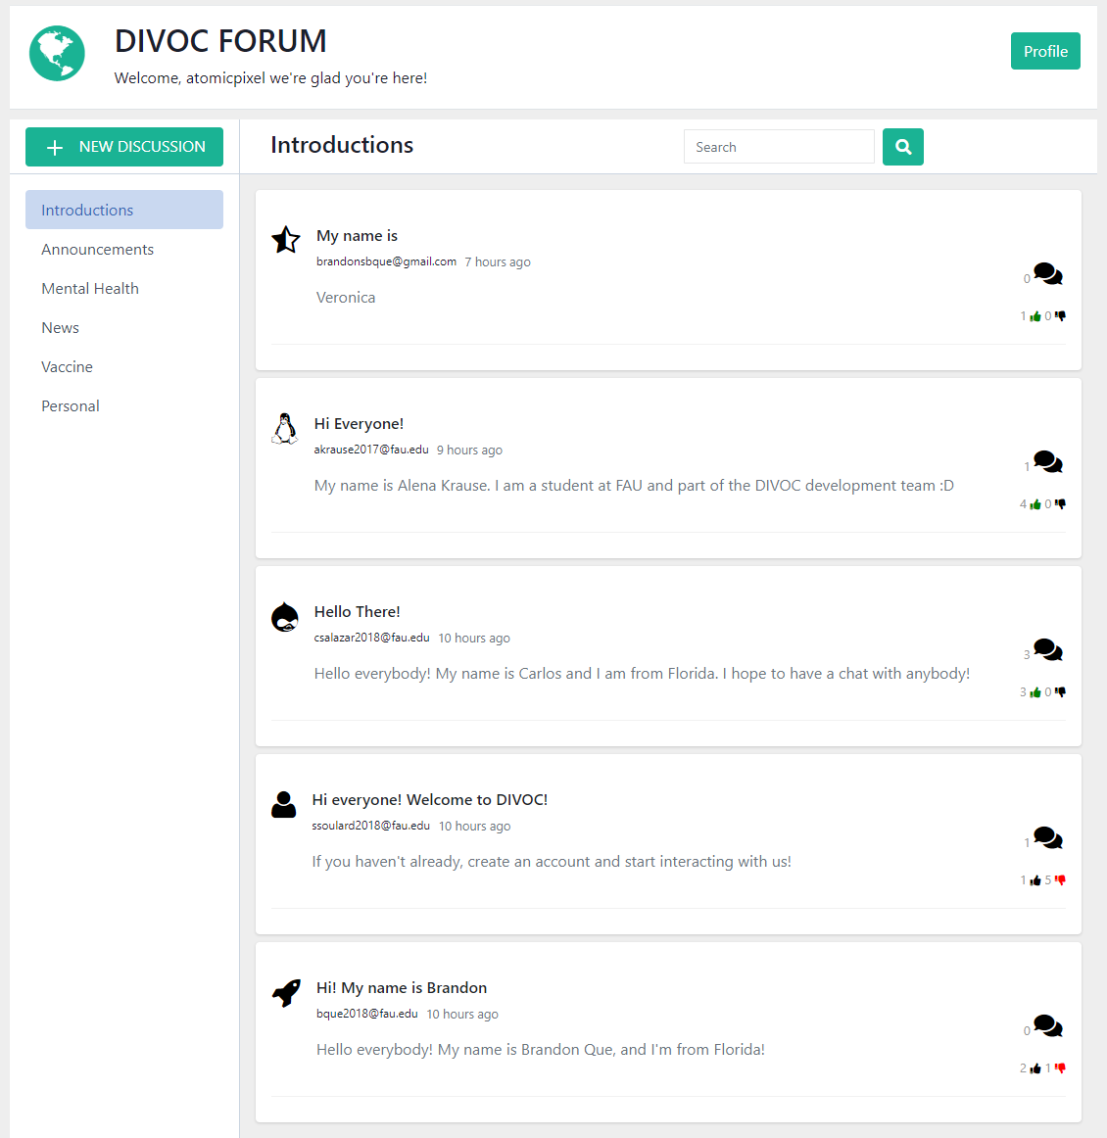
Main System - Topics (Commenting and Reactions)
Notes:
Recording by Alena

Slide 12
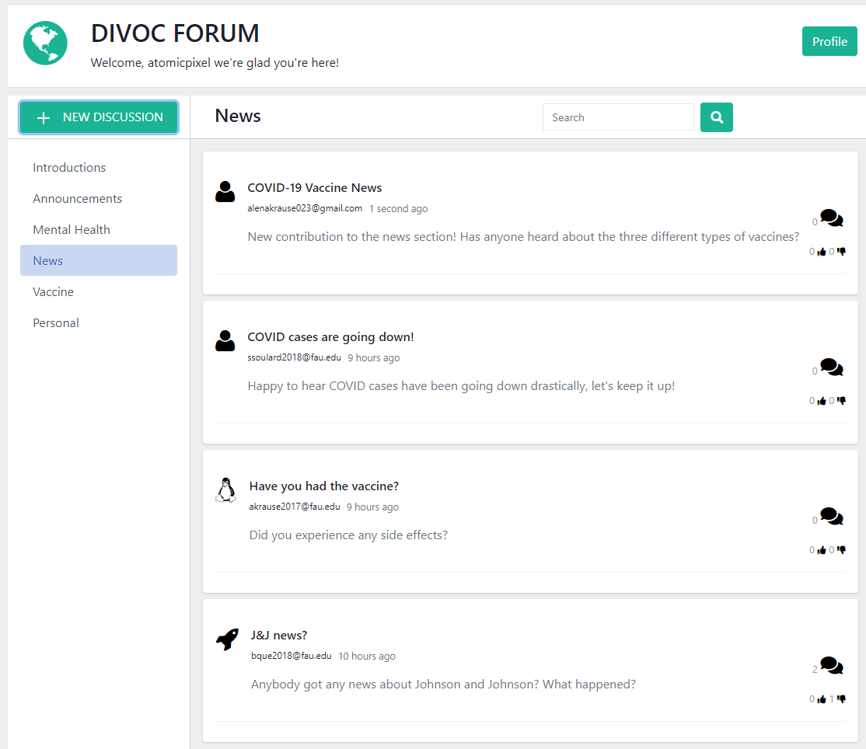
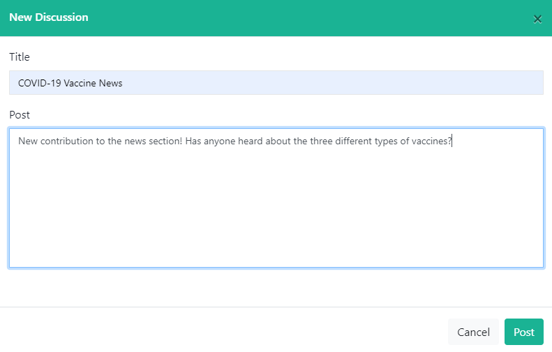
Main System - Topics (Post Creation)
Notes:
Recording by Alena

Slide 13
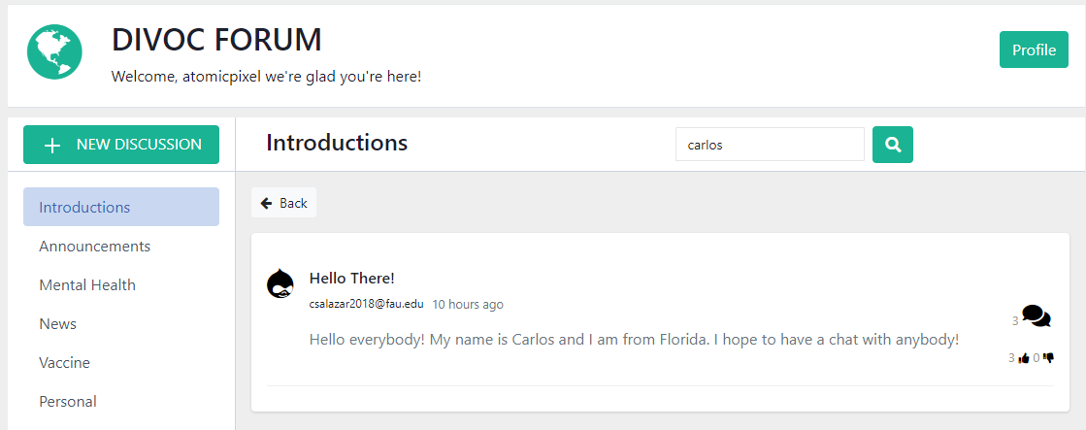
Main System - Topics (Searching)
Notes:
Recording by Alena

Slide 14
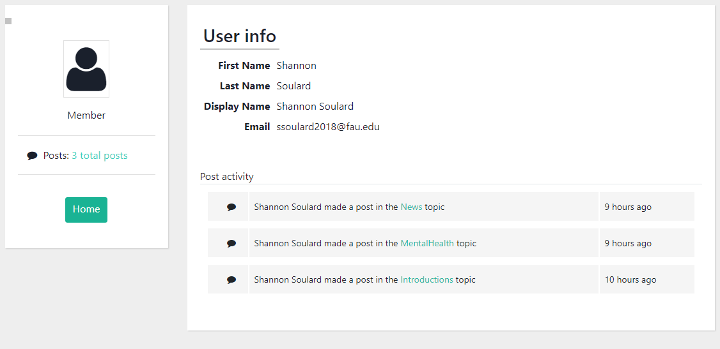
Main System - Viewing Profiles
Notes:
Recording by Alena

Slide 15
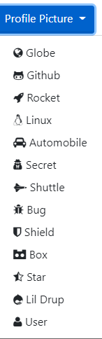
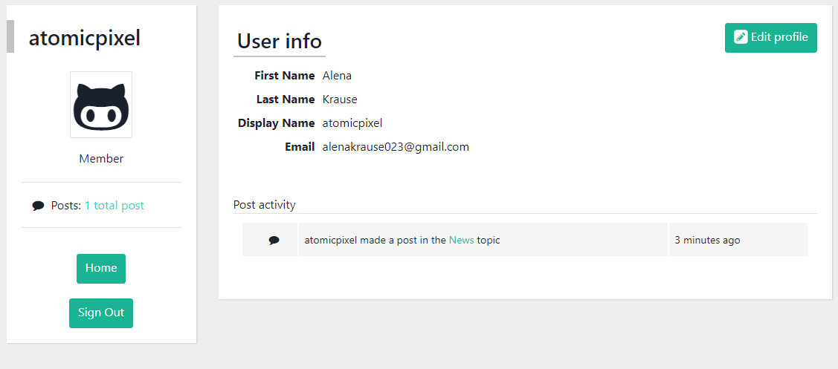
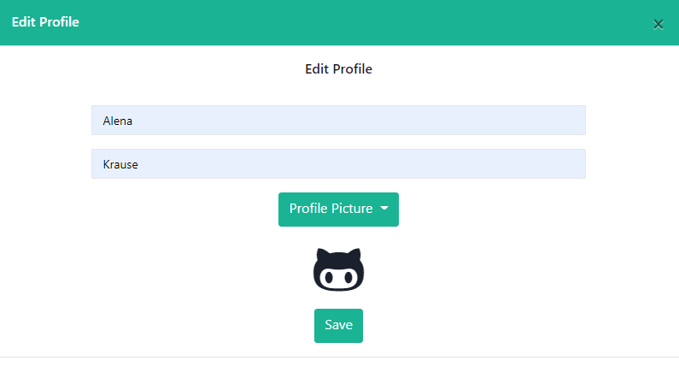
Main System - Personal Profiles
Notes:
Recording by Alena

Slide 16
Non-functional requirements
Security
Password hashing to ensure data security for users.
Portability
Website optimization for access on a personal computer or mobile device.
Compatible with all modern browsers including Firefox, Safari, Chrome, and Edge.
Expected Load
Limit the number of requests made by a single user to avoid server crashes due to high traffic (handled by firebase).
Usability
Information is available to any site visitor.
Features such as commenting on, liking/disliking, and creating posts are limited to only those who possess an account.
Storage
Data retained will be restricted to the capabilities of the Firebase Firestore Database.
Posts will have a 1,000 character limit.
Accessibility
Site is easy to use and intuitive for users of any age.
Aesthetically pleasing and organized UI.
Site will not require any specialized training for use.
Notes:
Recording by Shannon

Slide 17
Finished Features
The DIVOC Forum allows signed-out users to:
Create an account,
Search through posts using the search bar,
View basic user profiles.
View posts,
View comments.
While signed-in users can:
Search through posts using the search bar,
View basic user profiles,
Edit personal profiles,
Choose from a selection of icons to set as their profile picture,
Create a post within a specific topic,
Give the post a title and body of text,
Interact with posts by giving the post a “like” or “dislike”,
Or commenting on posts created by other users.
Notes:
Recording by Shannon

Slide 18
Future features
Emote/Emoji reaction to posts: time constraints
Liking and commenting history page through each personal user’s profile: time constraints
Clicking a user’s email address should take you to their profile page: time constraints
Tagged posts: time constraints
Personal inboxing and direct messaging: limited skillset
Notes:
Recording by Shannon

Slide 19
Knowledge gained and lessons learnt from our project and teamwork
Throughout the course of creating this product, our team has learned to:
Have a better structure for our database to make it more efficient and organized
Collaborate as a team more effectively to produce a high quality product
Understand each other’s strengths and weaknesses to help guide each other in the right direction
Organize our workflow to track our progress individually and as a team
Notes:
Recording by Carlos

Slide 20
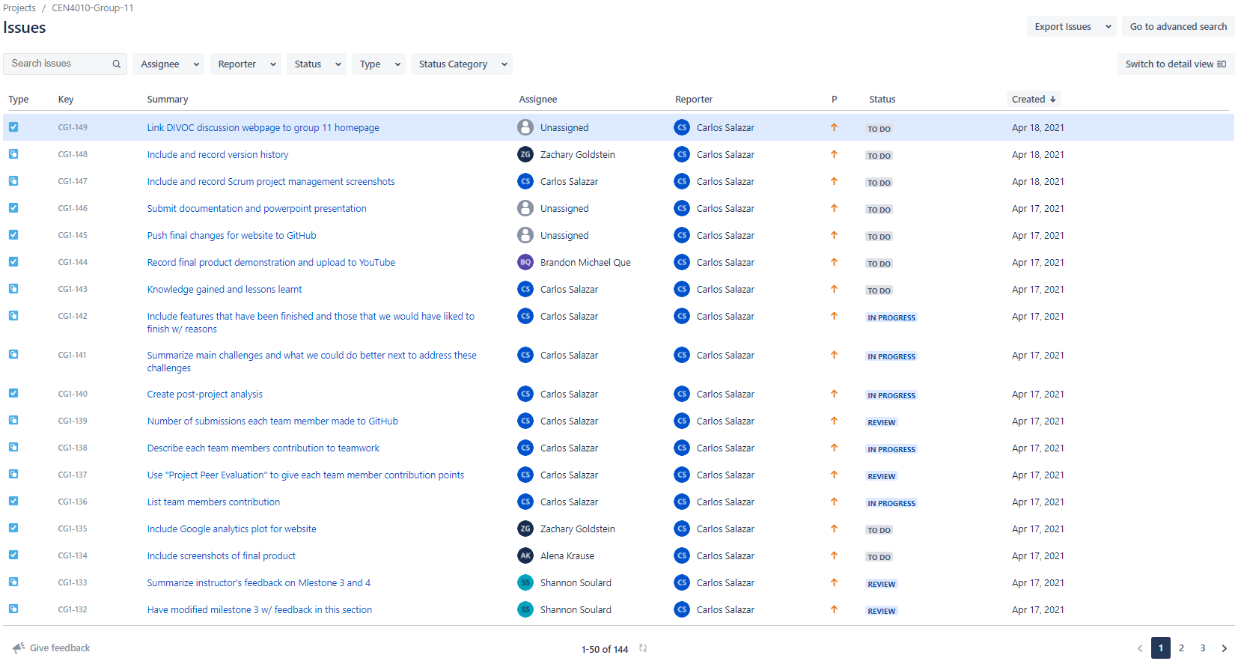
Project Management
Notes:
Recording by Carlos

Slide 21
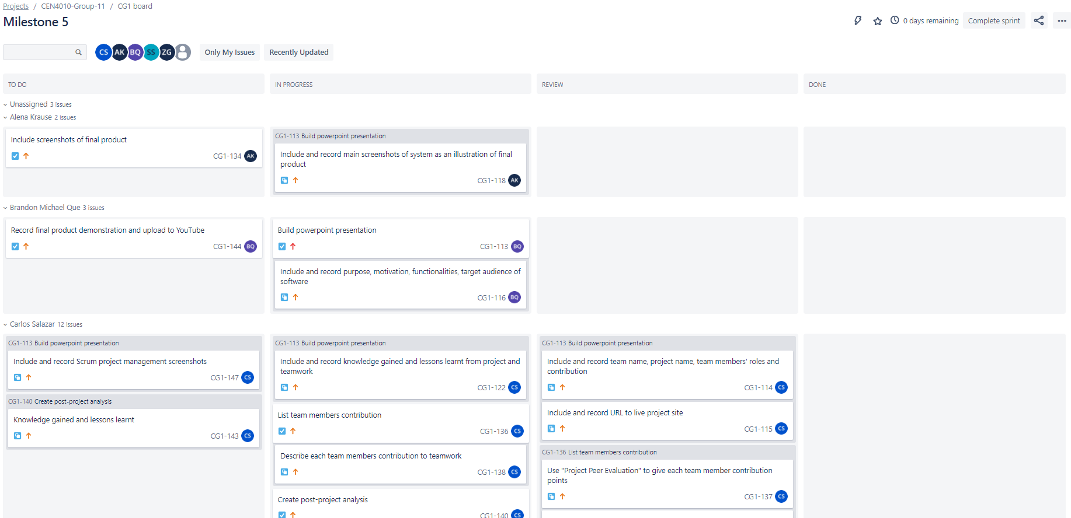
Project Management
Notes:
Recording by Carlos

Slide 22
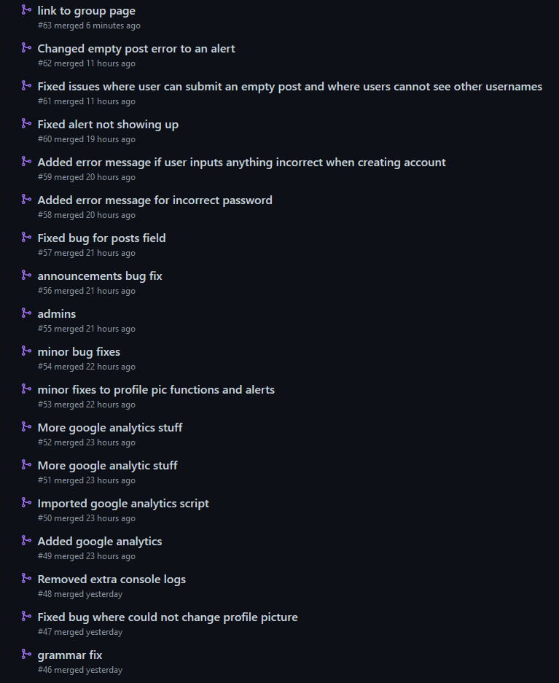
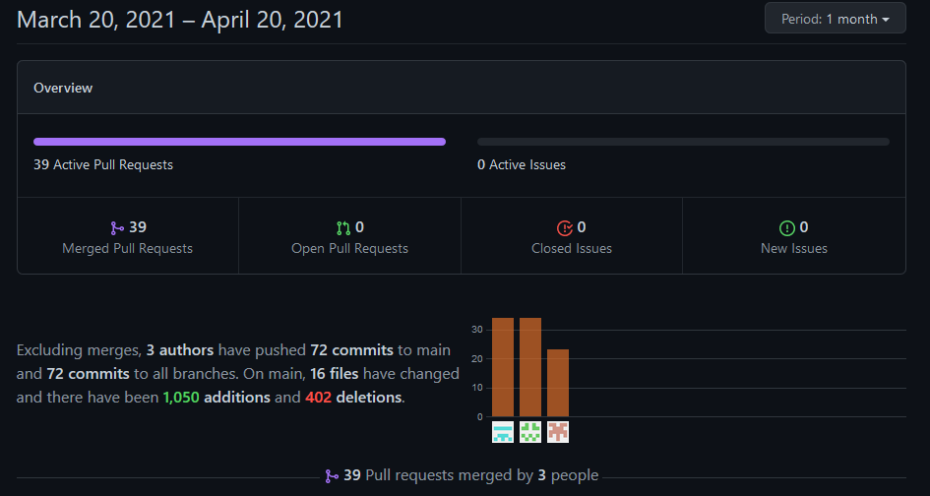
Version Control
Notes:
Recording by Zach

Slide 23
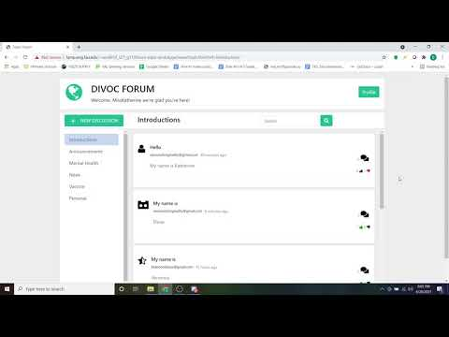
Final Product Demonstration
Notes:
Recording by Brandon

