Slide 1
GALLERY WALK
The
The one stop for local galleries and artists

Slide 2
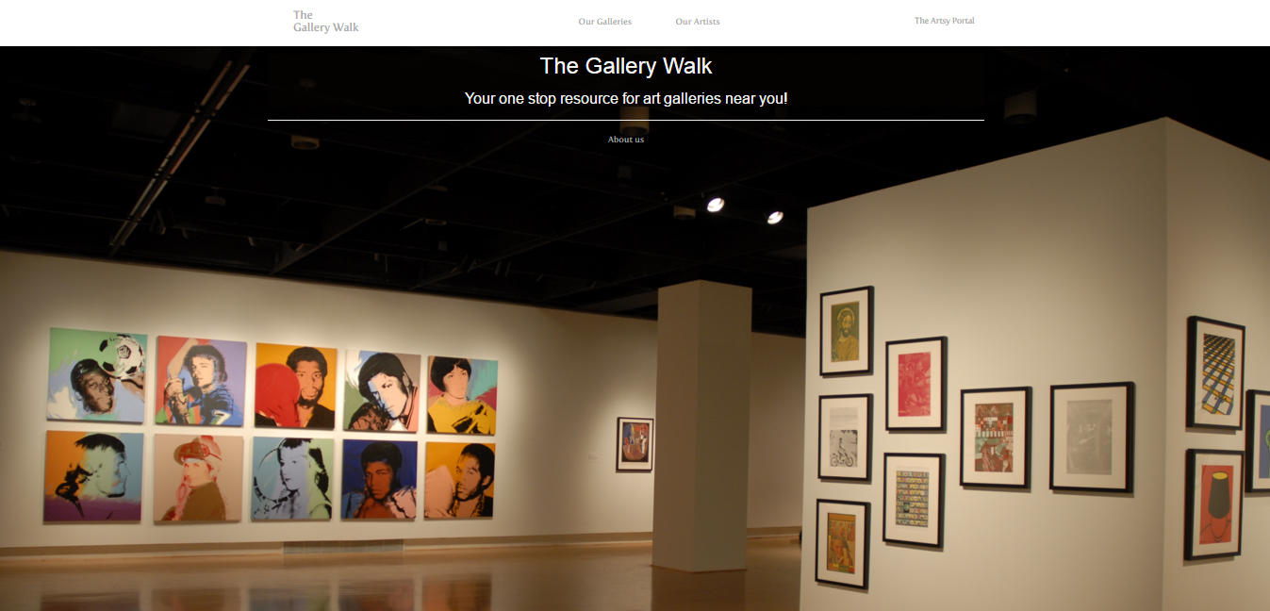
What is it?
Notes:
So, what is it? That was our first question too. We had to first figure out what The Gallery Walk was, and what it should be capable of. Fortunately our client, Dr. Adams, has experience with the art world. With his help, and the help of a few members of our target audience, we were able to gather a few main points.

Slide 3
What is it?
A free artwork hosting website for Galleries
Notes:
The main goal was the galleries, our designs should place the focus on promoting galleries and displaying their artwork.

Slide 4
What is it?
A free artwork hosting website for Galleries
A place for aspiring artists to show their talent
Notes:
The secondary focus should be artists, we want them to have a place where they can show their skills and display their portfoio.

Slide 5
What is it?
A free artwork hosting website for Galleries
A place for aspiring artists to show their talent
A social network for the Artsy community
Notes:
The Last piece of the puzzle is the interaction between the different users. Our end goal was allowing galleries the option to host artists they find on our website, so a social network seemed the best fit.

Slide 6
Why do we need it?
Notes:
So, why do we need it?

Slide 7


Too many great aspiring artists go undiscovered
Small Galleries can’t afford a website
Notes:
There are many social medias out there, but they’re cluttered with so much that an artist’s artwork is lost or unnoticed. We wanted a artistic community to promote artwork, and only artwork. So finding the next best piece is as easy as possible.
And Since professional websites can be too costly to have, We also wanted to give smaller galleries an online presence to better compete with larger galleries.

Slide 8
Architecture & Development Overview
Notes:
With these goals in mind, we could start designing the Architecture and organizing a development process.

Slide 9
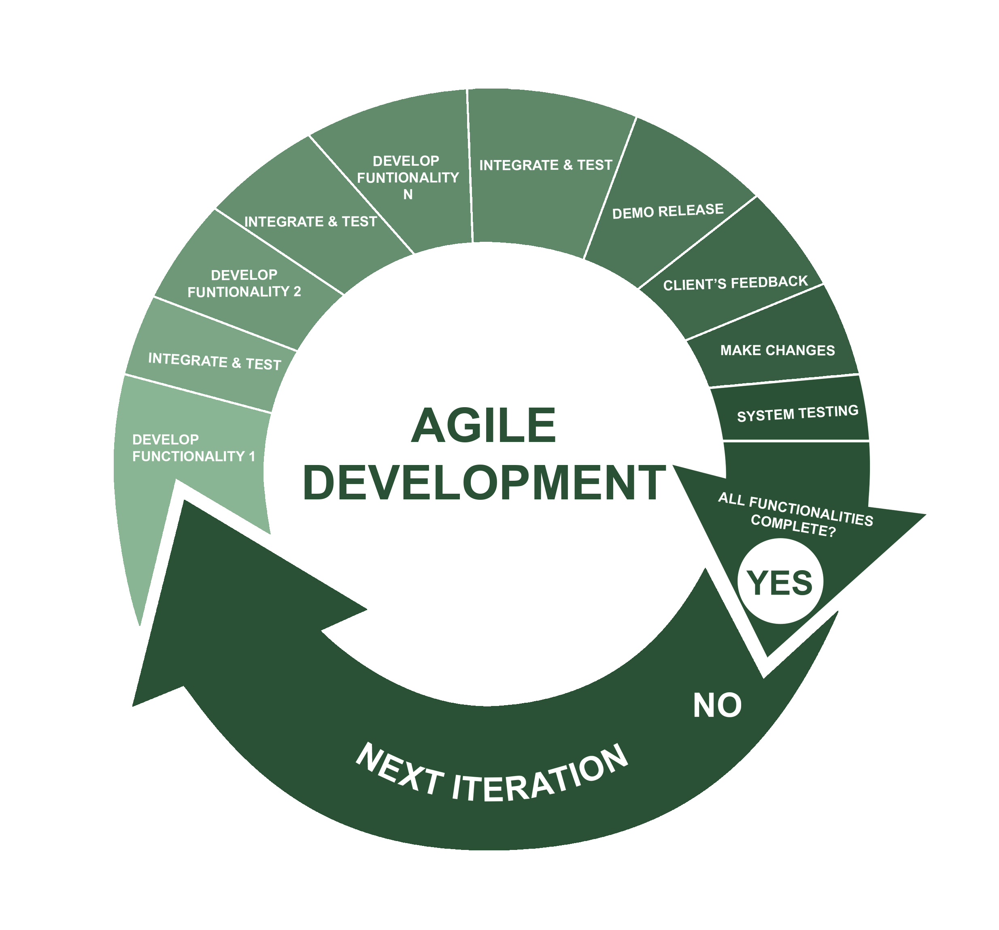
Development Process
Developed using Agile methodology
Notes:
In order to optimize our strengths, we adopted the agile methodology so each developer could take on tasks they felt the best prepared for.

Slide 10
Tools
Frontend
Backend
ASP.NET
Notes:
But first we needed to decide on what tools to use.
For our front end, we decided to use Microsoft’s ASP.NET Framework, it comes with many great tools for data validation and works great for developing websites that look good on a computer or mobile device.

Slide 11
Tools
Frontend
Backend
ASP.NET
Parse .NET SDK
Parse Server
MongoDB
MailGun
Notes:
For our backend we opted to use the open source Parse Server. it was an online service provided by Facebook, but has recently been shutdown and converted to an open source project.
We chose this because it simplifies creating, updating and removing data. But most importantly is it secures vulnerable information such as gallery owners login credentials or protected images
it’ built on a MongoDB and uses MailGun for email validation and password recovery.
It supports many interesting features that may be useful, such as location based queries
The Parse server also has a .NET SDK that allows us to easily create new data models from C# classes on the server, so there’s no need to modify the database for future additions.

Slide 12
Concepts & Concerns
Data Validation
User Validation
User Friendly
Model View Controller (MVC)
Notes:
Because of the nature of the project, the best approach was to use the Model View Controller organization. The Models allows us to validate the data, the controller validates the users, and the view that helps the user use the website.
This system checks all of our concerns off the list while being a great organization style.

Slide 13
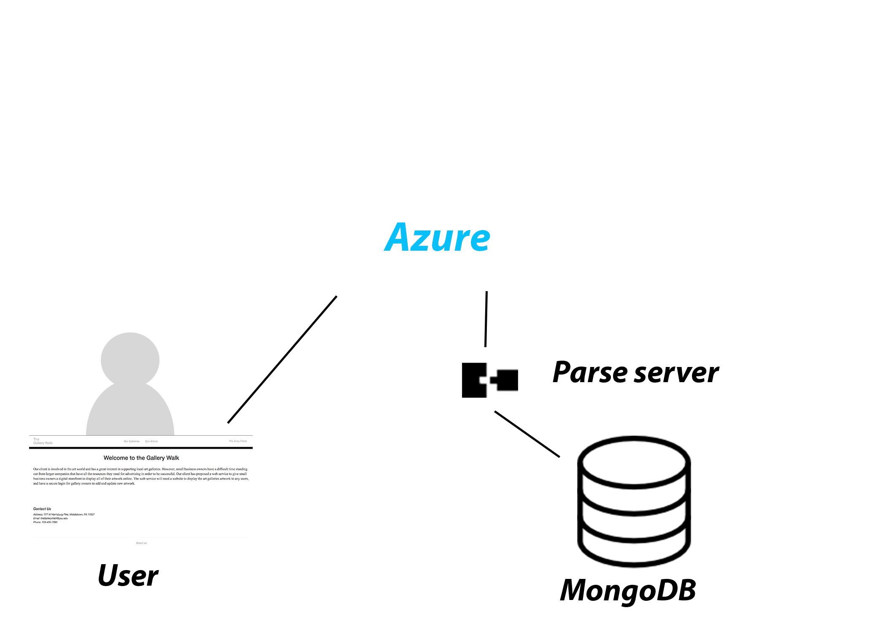
Architecture Overview
Notes:
With the questions answered and tools picked, we could start seeing the larger picture. In order to deliver a great experience to the end user, we would have 3 major components.
We have the ASP.NET server to handel user requests and delivering web pages, The Parse server to convert our C# class models to a data model, and finally a mongo database to persist the data.

Slide 14

Architecture Overview
Azure server
Notes:
So Why Azure?

Slide 15
Architecture Overview
Azure server
  Microsoft’s server, built for .NET
Notes:
It’s Made by Microsoft, for Microsoft. So it’s optimized to run ASP.NET projects fast and efficiently.

Slide 16
Architecture Overview
Azure server
  Microsoft’s server, built for .NET
  Constant Git integration
    Any changes on Github are applied to live website
Notes:
They offer constant Git integration, so any changes or additions pushed to the designated git branch are automatically deployed live for easy testing and updating.

Slide 17
Architecture Overview
Azure server
  Microsoft’s server, built for .NET
  Constant Git integration
    Any changes on Github are applied to live website
  Automatic load Balancing
Notes:
They offer Automatic load Balancing, so when traffic gets crazy we can be ready for it.

Slide 18
Architecture Overview
Azure server
  Microsoft’s server, built for .NET
  Constant Git integration
    Any changes on Github are applied to live website
  Automatic load Balancing
  Future scalability
Notes:
With their great Virtual Machine Model, Scaling up the server is as easy as adding more virtual servers. The automatic load balancer takes care of the rest!

Slide 19

Architecture Overview
Parse Server
Notes:
Why use the parse server?

Slide 20
Architecture Overview
Parse Server
  Feature Rich
Notes:
Its full of features some of which are location based queries, user registration, login validation, and even sending push notification to mobile devices.

Slide 21
Architecture Overview
Parse Server
  Feature Rich
  Very Fast
Notes:
Queries wont slow down as the database grows

Slide 22
Architecture Overview
Parse Server
  Feature Rich
  Very Fast
  Open Source
Notes:
It’s free for anyone to use, and since it’s open source you can extend it with your own functionality!

Slide 23
Architecture Overview
Parse Server
  Feature Rich
  Very Fast
  Open Source
  Uses MongoDB
Notes:
It runs with the no SQL database Mongo, a great open source database used on many Ubuntu databases for its reliability and extensibility.

Slide 24
Architecture Overview
Parse Server
  Feature Rich
  Very Fast
  Open Source
  Uses MongoDB
  Hosted On Ubuntu14.04
Notes:
It’s all designed to run on any Ubuntu 14.04 server, so you can run it in a fancy cloud or an old laptop in your basement.

Slide 25
Implementation
Notes:
With the overview figured out, we could start implementing the archetecture.

Slide 26
Implementation
ASP.NET Server
Central component of the system
Notes:
It’s the main component of the system, so its in charge of multiple compoenets.

Slide 27
Implementation
ASP.NET Server
Central component of the system
Generates unique webpages
Notes:
Each user is unique and needs a unique webpage based on their account, settings and current content. It’s up the the ASP.NET server to figure out what webpage to create and what content to send to the user.

Slide 28
Implementation
ASP.NET Server
Central component of the system
Generates unique webpages
Tracks user sessions
Notes:
For ASP.NET servers, there’s one shared instance that’s used for all requests. So it’s up to the server to track which requests are for which users, it does this by associating session IDs with users and caching them locally.

Slide 29
Implementation
ASP.NET Server
Central component of the system
Generates unique webpages
Tracks user sessions
Validates user Input
Notes:
Its also up to the server to validate user inputs, for most inputs it validates with regular expressions that define things like emails, phone numbers and illegal characters.

Slide 30
Implementation
ASP.NET Server
Central component of the system
Generates unique webpages
Tracks user sessions
Validates user Input
Creates & updates class models to persist in the database
Notes:
It’s last job is creating & updating the class models for the database. It’s up to the server to save the images and associate the image with the model, wheather it’s artwork, artists or galleries. Because of dealing with large images, it does this in several steps wrapped as a transaction. Or for short, everything has to be saved or nothing is saved at all and the user must retry.

Slide 31
Implementation
Parse Server
Fast and easy
Minimal configurations
Notes:
Parse was initially a Backend as a service (BaaS), so their SDK was designed for fast development. They managed to create a fast and easy system with SDK’s that convert our C# class models to entities to save in the mongo database.
We also saved time configuring the database, parse can add new properties and tables without modification. It automatically makes adjustments based on our C# models.

Slide 32


Slide 33

Challenges
Team had minimal experience with .NET and web development
Getting used to the interactions between JavaScript, C#, and HTML.

Slide 34

Challenges
Limitations on Parse API for logging in
Github problems
  Failed commits
  Broken branch
Using bootstrap menu
Visual Studio problems

Slide 35
Questions?

