Slide 1
GALLERY WALK
The
The one stop for local galleries and artists

Slide 2
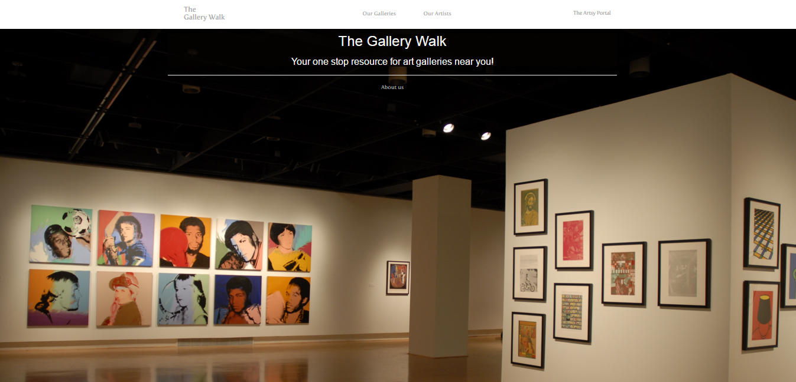
What is it?
A social network for the artsy types
Notes:
A way for gallery owners to discover new talent
A source for the newest local arts
An outlet to advertise artwork
A community for people to share their love of art

Slide 3
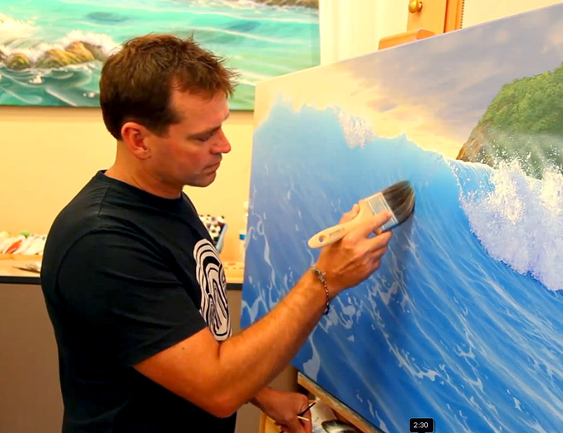

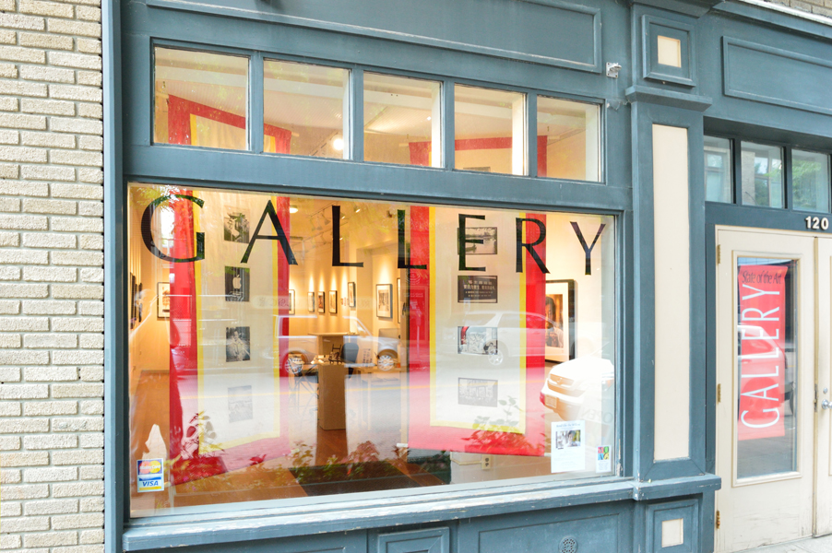
Why do we need it?
Too many great aspiring artists go undiscovered
Smaller Galleries cannot afford a website of their own
This service evens the playing field for such businesses and artists
Notes:
Too many great aspiring artists are undiscovered because their voice isn’t heard.
An online website is too expensive for most Galleries to host their artwork online.
This service evens the playing field for smaller galleries to compete for an online presence

Slide 4
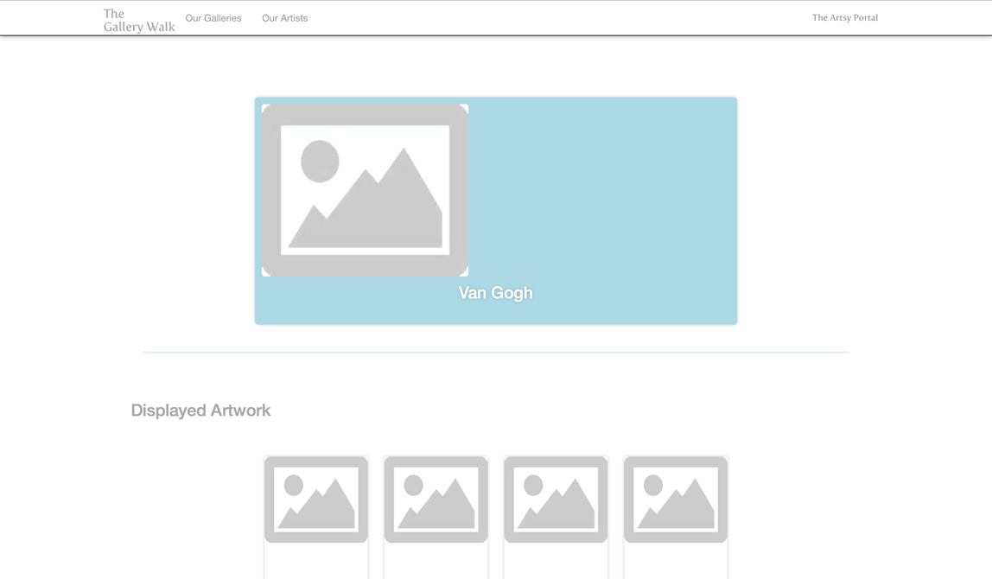
The Social Network
Galleries can find and follow artists they like and host the followed artist’s artwork

Slide 5
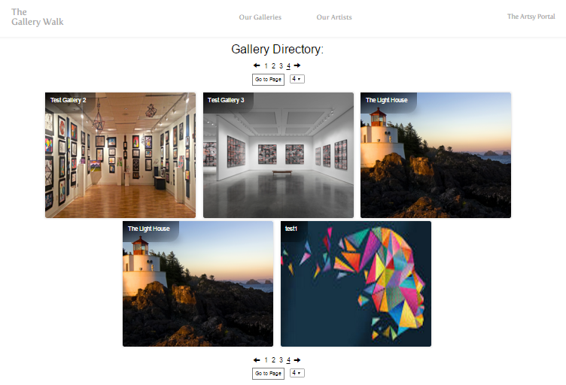
The Social Network
Anyone can browse our database of artists and galleries

Slide 6
Development
Developed using Agile methodology
Team collaborates using Github

Slide 7
Development
Microsoft’s ASP .NET framework
Parse API
  Online service provided by Facebook
  Simplifies and secures vulnerable information such as gallery owners login credentials or protected images
  Includes interesting features that may be useful such as location based queries.

Slide 8

Development

Slide 9
Challenges
Team had minimal experience with .NET and web development

