Slide 1
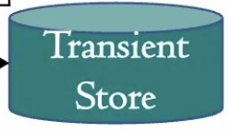
Committer
Purge DB
State DB
Pvtdata Dissemination
Endorser
Namespace per chaincode
Missing Pvtdata Reconciler
Public States
Gossip
Block Store
Block Queue
2
Hashed States
3
1
Private States
6
Private Data Store
4
9
Endorsement policy validator
History DB
5
Transient Store
Private data history
8
Private Data Collection
Config DB
Serializability validator
Missing eligible & ineligible data
7
Existing components
New components
All stores and DB uses levelDB storage library

