Slide 1

Electoral College
Cendy Lin
Lisa Minas
Scott Marler
Notes:
SCOTT

Slide 2
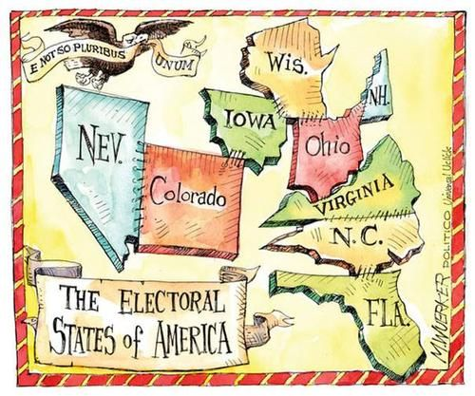
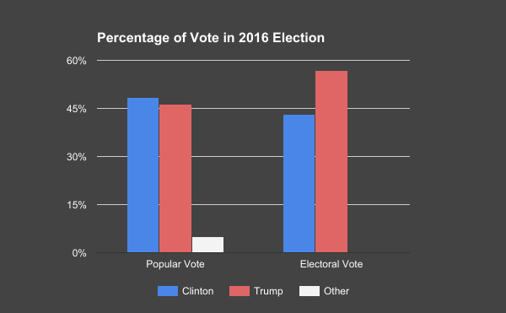

Does My Vote Count?
?
Notes:
SCOTT
The 2016 Presidential election ended with more drama than a daytime Telemundo show.
Donald Trump was elected to be president, but Hillary Clinton received nearly 3 million more votes. This has left many people wondering what the Electoral College is, why we have it, how it affects them, and how the results can be in stark opposition to what the majority of Americans wanted.
The Electoral College is prescribed by the US Constitution. It was conceived during a time when communication across the country was nearly impossible. Citizens were supposed to vote for someone to travel and represent them in deliberations about who the next President and Vice President should be. However, it's turned into something much different.
Our intent is to help you understand what a harmful and undemocratic thing the Electoral College has become. With elections being sealed by a handful of “swing states” and disproportionate voter representation, we hope you will agree that a national popular vote is more in line with our country’s values.
http://www.pewresearch.org/fact-tank/2016/12/20/why-electoral-college-landslides-are-easier-to-win-than-popular-vote-ones/
Image source: https://s-media-cache-ak0.pinimg.com/564x/6c/ed/3d/6ced3de02ba090462edfb588bf088b27.jpg

Slide 3

Focus on Increasing Voter Knowledge
How am I represented in the electoral college?
How would voting change with popular voting?
Does my vote have power?
Are all votes equal?
Notes:
CENDY
At a high-level, we’d like our viewers (typical voters) to be informed about how the electoral college affects their vote.
We’d like them to be able to answer the questions listed on this slide.
We assume the user has prior knowledge of the electoral college but that they’ve likely forgotten how it works.
Because the electoral college system can be somewhat complex, we want to make sure our interface is clean, user-focused, and engaging!
It is meant to educate about the Electoral College, and offer justification into why this system is worse than others.

Slide 4
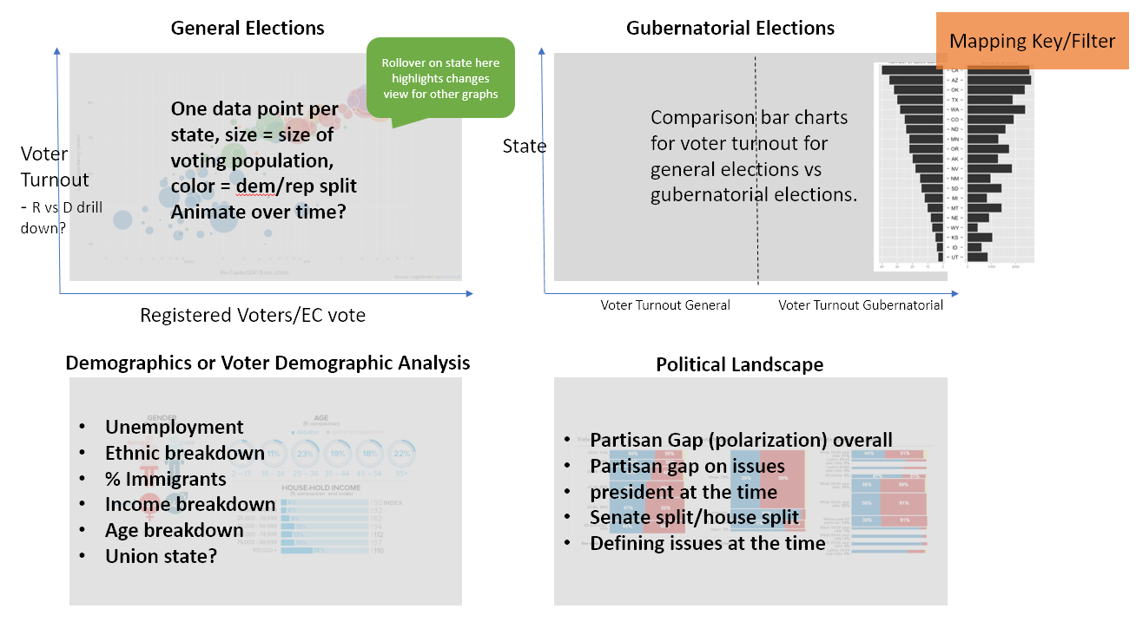
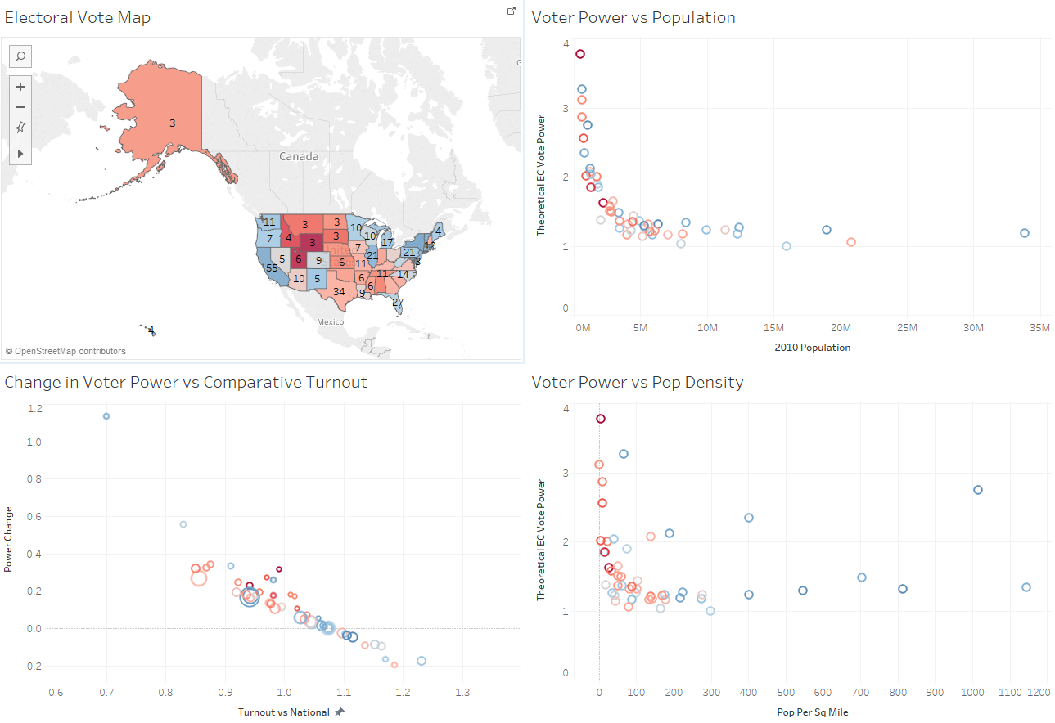
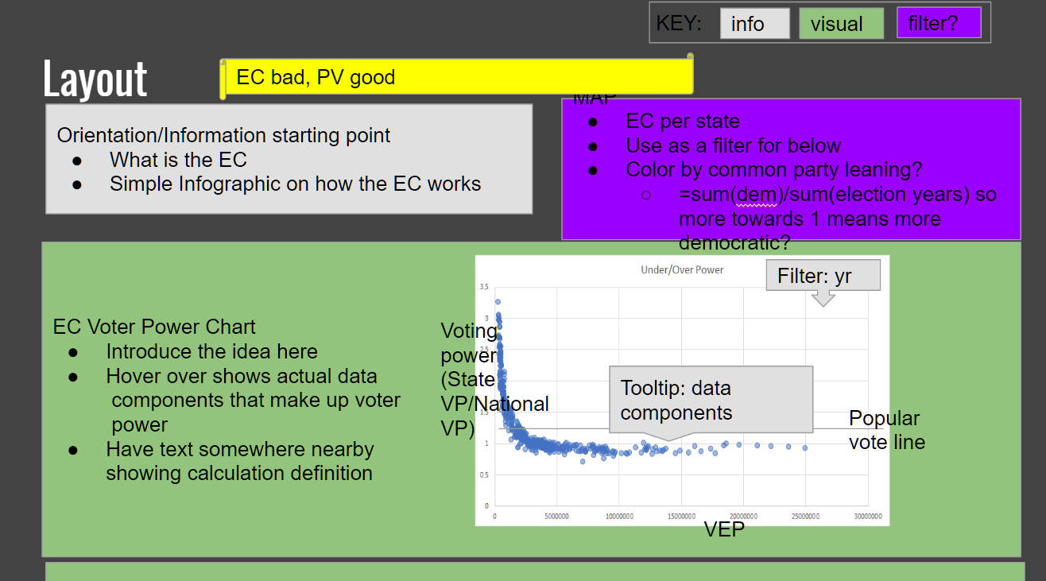
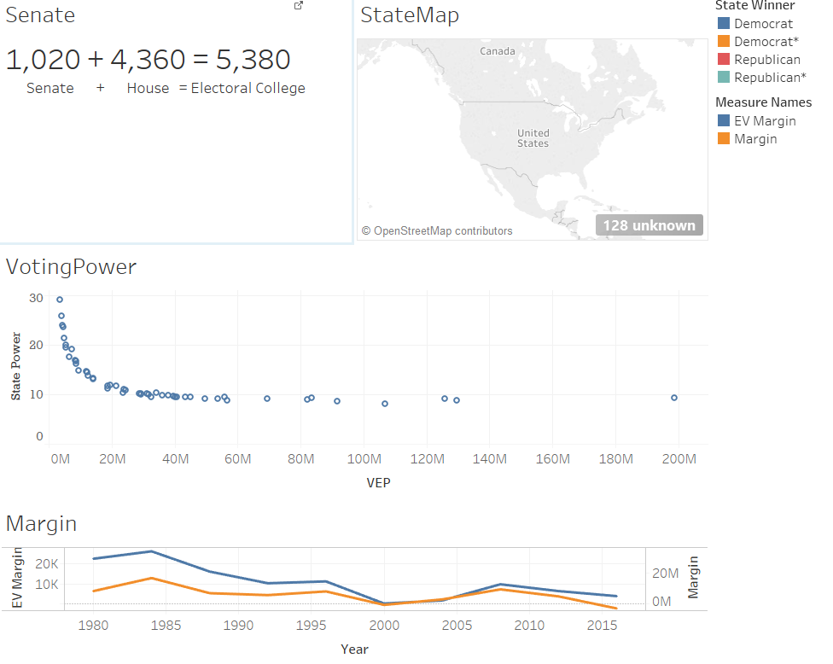
Iterations
First Draft
Idea Formation
Discuss at a high level what we wanted to show.
Second Draft
Examining Data
Look at trends in the data - what stories can we tell?
Third Draft
Layout
What is the narrative flow? Which main exhibits should we include?
Fourth Draft
Implementation
Implement the layout and charts in Tableau.
Notes:
CENDY
The iterations here show how we winnowed down the data and main points we wanted to show viewers.
In our first draft, we discussed high-level topics about election data and put down everything we could possibly show (demographics, political landscape, historical context, other elections etc.).
2nd draft: We narrowed down our perspective after looking at the data -- we decided to focus on the most interesting story -- how the electoral college affects voting power. The focus also helped prevent the real threat of scope-creep.
3rd draft: We then focused on narrative flow -- what is the best progression of information to lead the viewer?
We decided on “What is the electoral college” → “how does it affect my vote” → “how does it affect elections” → “what can I do about it?”
We asked ourselves what charts worked best, and what drill-down interactions (filters, brush & link, etc.) would be the most beneficial for viewers.
We tried to stick to our main narrative and provide only information that was relatable and usable for our viewer.
4th draft: This is when we implemented our layout in Tableau. Our next steps will be to incorporate your feedback, and to decide which software or language works best for our graphics.

Slide 5
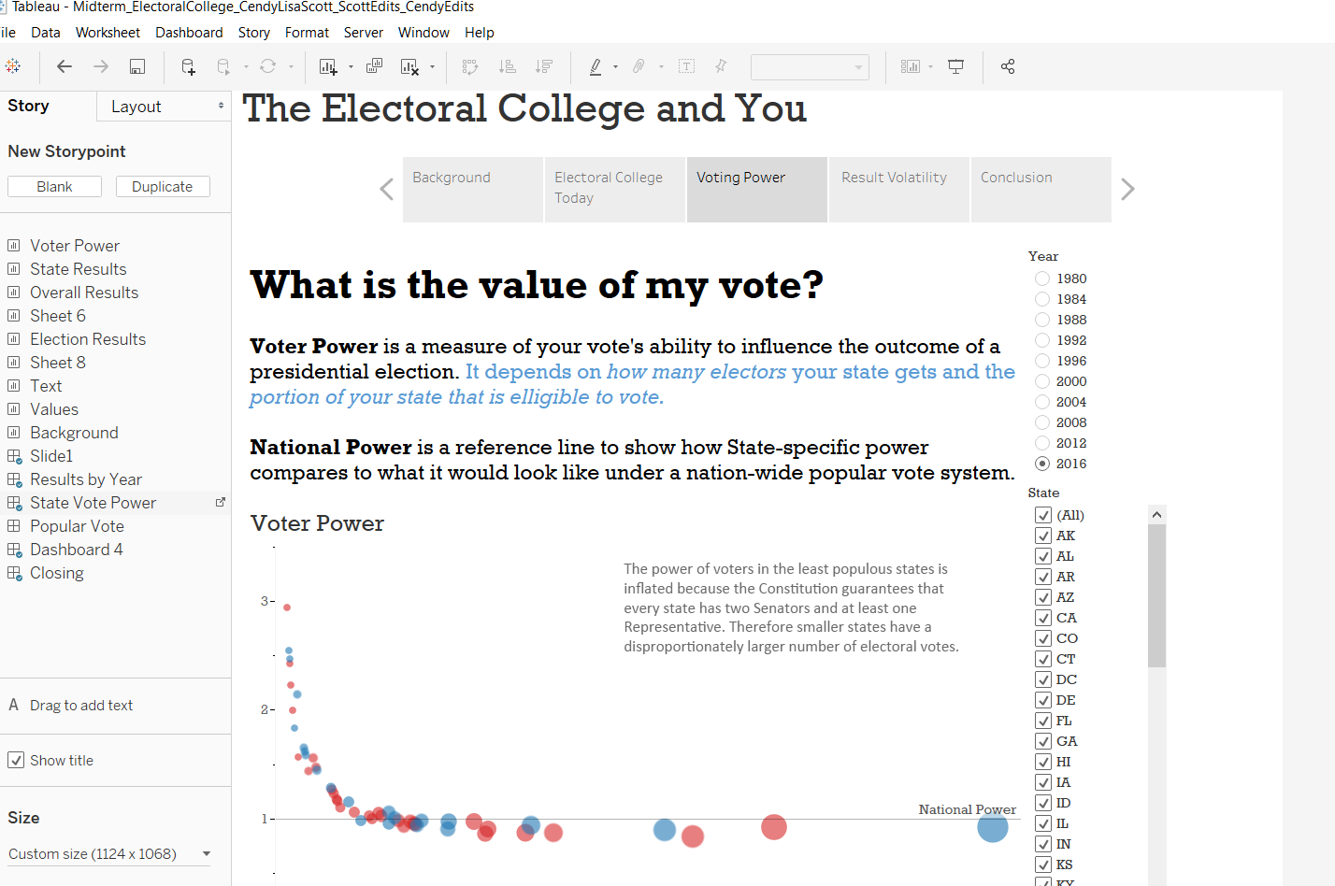
Mock-up and User Tasks
Sample User Tasks
How many electoral votes does your state have?
What is the general trend for State Power?
How does the voter power in VA compare to DC in 2016?
What was the margin under the EC system versus the Popular Vote system in 2000?
Challenge Question: Why does Florida have the lowest voter power?
Notes:
LISA
Friends and family: the best guinea pigs.
For the filters - use radial buttons

Slide 6
What’s our data?
Data Sources and Data
www.fec.gov
Electoral Votes and Popular Votes by state, 1996-2016
www.archives.gov
Electoral Votes by state, pre-1996
www.uselectionatlas.org
Popular votes by state, pre-1996
www.electproject.org
Voting eligible and voting age population, 1980-2016
Metrics
Voter Power: Used voting eligible population and electoral votes to calculated
EC/Popular Vote Margins: Used electoral votes and popular votes to calculate
Notes:
CENDY
Our data comes from a variety of sources, mostly because the government doesn’t keep certified election data in a usable format once you start going beyond 1980.
The main information we need is information on Electoral Votes, Popular Votes, and VEP by state and election year.
We then combined everything into one table as our “main source of truth”

Slide 7
Feedback and Comments
Please send feedback to
Cendy Lin: cendylin@ischool.berkeley.edu
Lisa Minas: lisajune@ischool.berkeley.edu
Scott Marler: scott.marler@ischool.berkeley.edu

