Slide 1
Electoral College
Cendy Lin
Lisa Minas
Scott Marler
Notes:
SCOTT

Slide 2
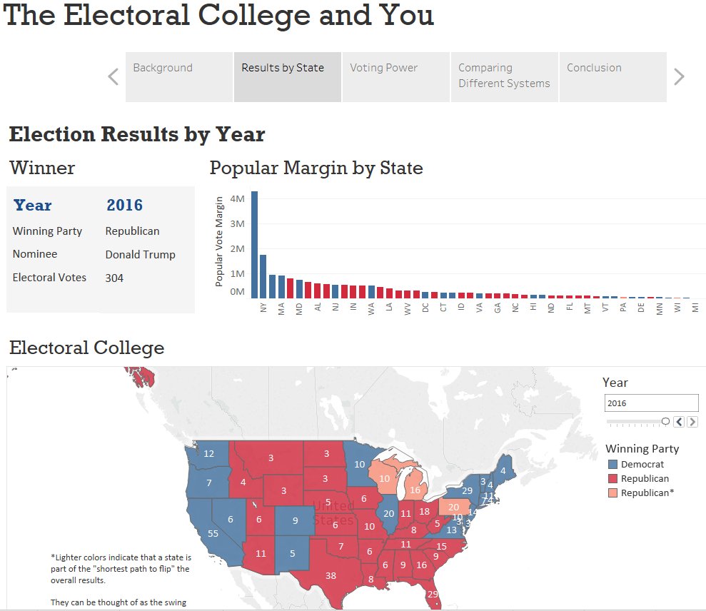
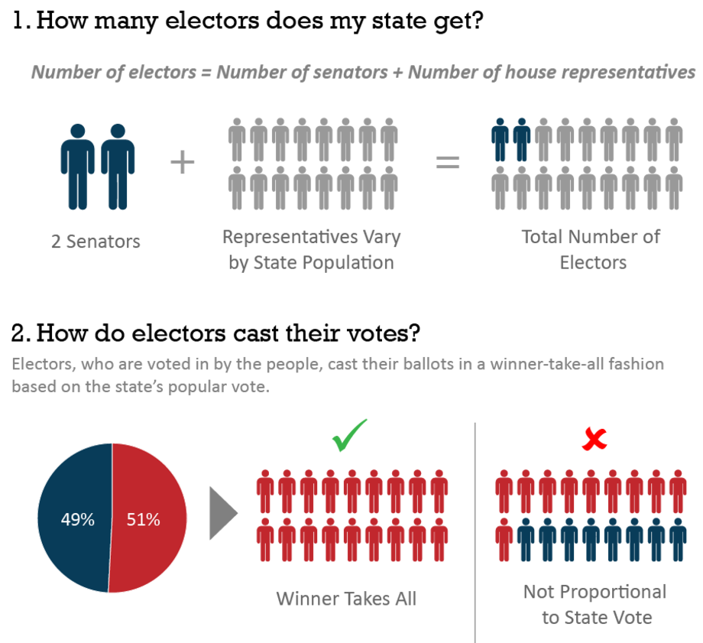
Review of Project
Notes:
SCOTT

Slide 3
Usability Testing
Pre-evaluation questions
In your own words, what is the Electoral College?
Do you have any opinion(s) about the Electoral College? If so, please share them.
Usability Test
How many Electors does your home state have as of 2016?
How many Electors did your state have in 1980?
What was the popular vote margin in your state in 2004?
Looking at the Election Results map for any year, describe what the three different state colors represent.
Which states had the highest and lowest voter power in 2008?
Since 1980, which years would have had different election results under a popular vote system?
Navigate to your state legislature’s webpage
Debrief
In your own words, what is “voter power”?
Do you feel like you understand any more about the Electoral College than you did initially?
Do you feel any differently now about the Electoral College than you did initially?
Did this visualization raise any questions for you that remain unanswered?
Notes:
SCOTT

Slide 4

User Feedback
Why does the map have three colors?
What’s that asterisk?
I misinterpreted Voter Power and Popular Margin.
Message is worded too strongly.
I don’t understand the gap table.
Notes:
LISA
Why does the map have three colors?
I can’t find popular margin by state.
Too strong of a message.
I don’t understand the gap table.

Slide 5


MoSCoW List
Must
Should
Could
Won’t
Move results and margin to top of map
Add state margin to tooltip in electoral map
Use scrollbar year for both viz, take out "ALL" from scroll bar
Be consistent with placement of year filter (on top) and party legend (bottom)
Asterisk of "swing state" should connect to footnote
Infographic - need to add footnote that Winner Takes All apples to most, not all states (Maine, Nebraska)
Embed into Berkeley server site!
Remove margin multiple
Need to emphasize the interactivity of the chart
Voter Power - Hard to see that FL is lower than CA (add light horizontal gridlines)
Infographic should be interactive - Or use state as an example
Provide explanation about what a negative number means in popular vote and emphasize
Show shortest path vs popular vote margin visually
Show winning candidate in system comparison chart
Add infographic for voter power?
Flip axes on voter power
Notes:
LISA

Slide 6
What Changed?
Demo
Notes:
CENDY

Slide 7
Tools Used
Tableau
Illustrator
HTML
Excel
Allows quick iterations
Dashboard functionality automatically adjusted with our iterations and allowed us to make a seamless interactive story
We knew how to use it
Good for mapping and graphs
Intuitive filtering
Easy to create and manipulate shapes and icons
Infographic did not require interaction
Extra information that doesn’t fit within the visualization
Need to have it on a website
Easy data manipulation
Common format (csv) between programs
Notes:
LISA
Friends and family: the best guinea pigs.
For the filters - use radial buttons

Slide 8
Thank you!
Questions?
Notes:
CENDY

