Slide 1
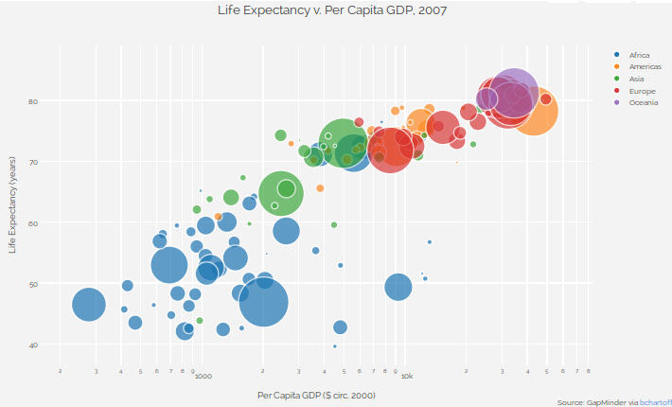
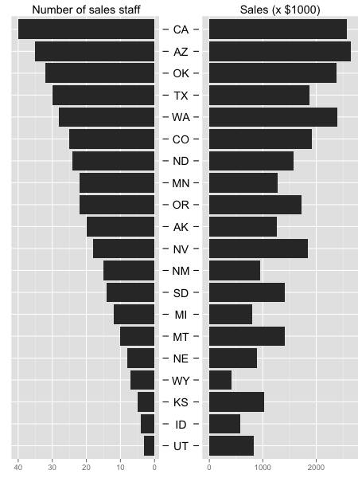
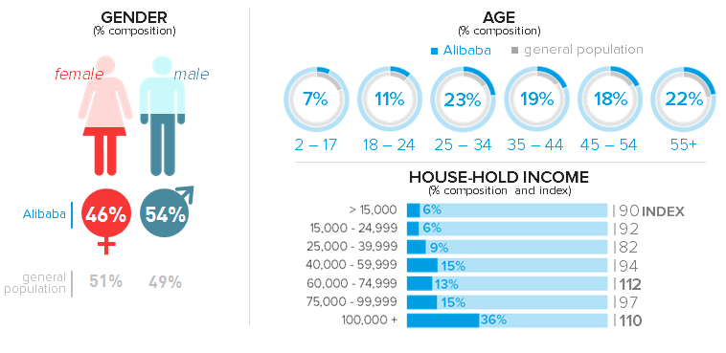
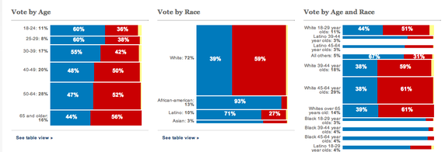
Mapping Key/Filter
General Elections
Gubernatorial Elections
Rollover on state here highlights changes view for other graphs
One data point per state, size = size of voting population, color = dem/rep split Animate over time?
Comparison bar charts for voter turnout for general elections vs gubernatorial elections.
Voter Turnout
- R vs D drill down?
State
Registered Voters/EC vote
Voter Turnout General
Voter Turnout Gubernatorial
Demographics or Voter Demographic Analysis
Political Landscape
Unemployment
Ethnic breakdown
% Immigrants
Income breakdown
Age breakdown
Union state?
Partisan Gap (polarization) overall
Partisan gap on issues
president at the time
Senate split/house split
Defining issues at the time

Slide 2
Resources
Electoral College Data: http://www.electproject.org/
Gubernatorial Elections (and a lot of other other election data): http://libguides.princeton.edu/elections#s-lg-box-1612384
US Census Burea: http://www.census.gov/data.html
Political issues (polling data, Gallup): http://www.gallup.com/poll/1675/most-important-problem.aspx
Political Polarization: http://www.people-press.org/2014/06/12/political-polarization-in-the-american-public/

