Slide 1

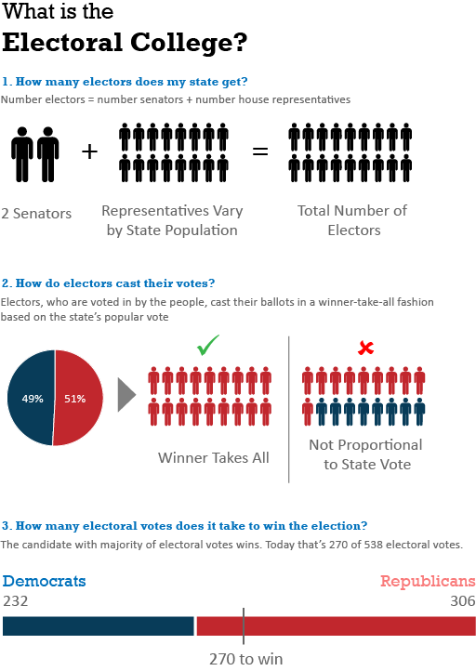
www.berkeley/.edu/241_electoralcollege
Insert between 2 and 3 = EC map? Number EC votes over time? Act as filter

Slide 2
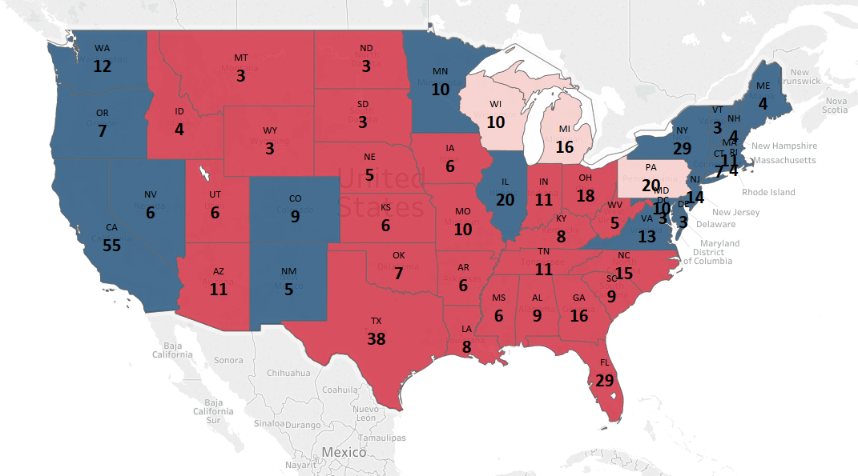
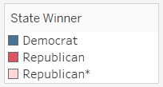
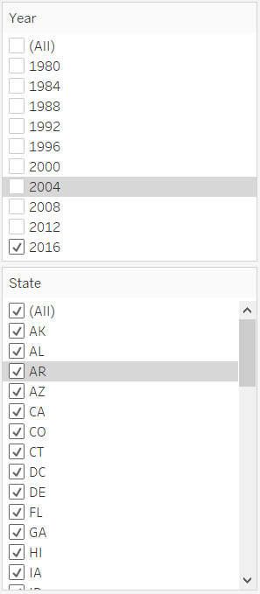
www.berkeley/.edu/241_electoralcollege
The Electoral College Today
Filters
Acts as a State, year filter for following exhibits?

Slide 3
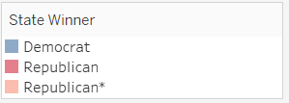
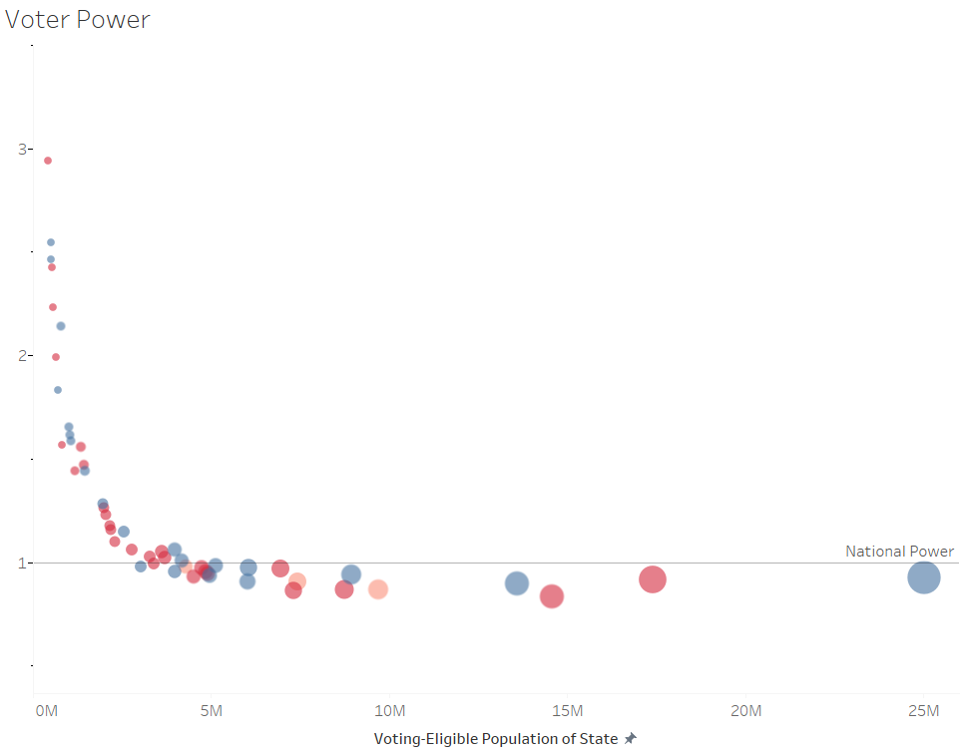
www.berkeley/.edu/241_electoralcollege
That’s great… but
Does My Vote Count?
Yes, but your Voter Power depends on which state you live in (specifically, how many electoral votes your state gets).
State Voter Power
Filters
Size = Electoral Votes
Voter power depends on how large your State’s Voting Eligible Population is. Larger states tend to be penalized compared to small states because even though the number of House Representatives change by population, the number of senators does not.
How is Voter Power Calculated?
Probably need a blurb interpreting what this means.
Voter Power = State Power / National Power
State Power = (1/VEP-S * (EV-S)/538) * VEP-N National Power = (1/VEP-N) * VEP-N
VEP-S = Statewide Voting Eligible Population
VEP-N = Nationwide Voting Eligible Population
EV = State Electoral Votes
Can we view by state over time?
Show state labels on data?

Slide 4
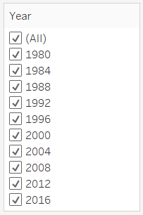

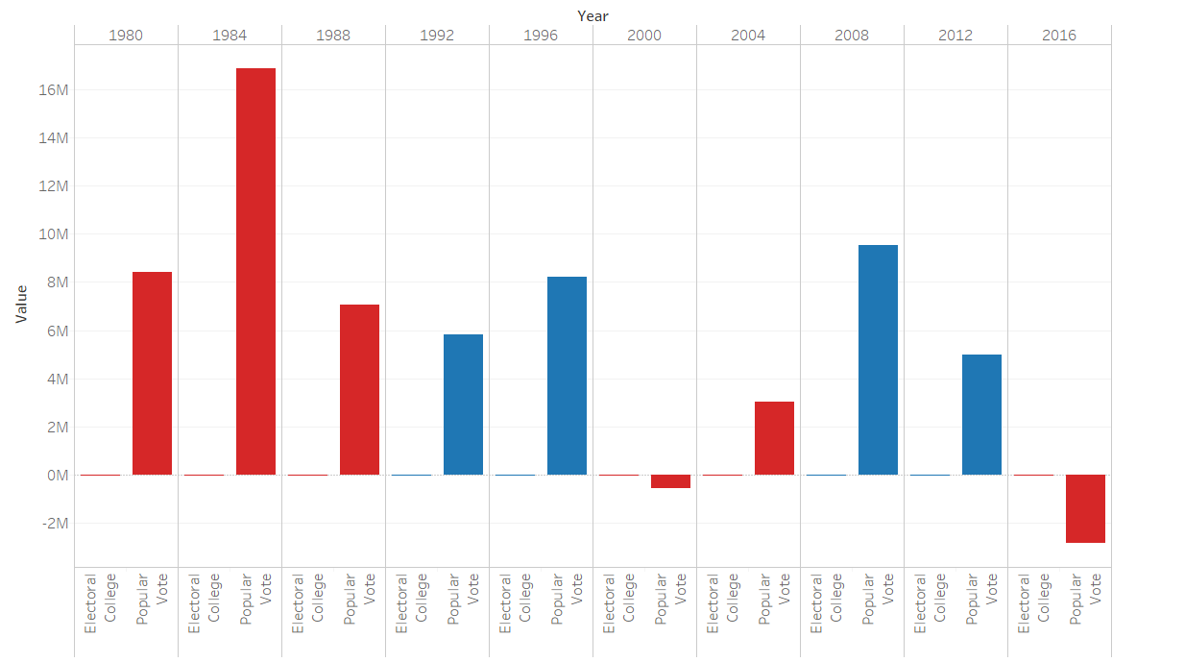
www.berkeley/.edu/241_electoralcollege
How Does the Electoral College System Compare Against a Pure Popular Vote?
Let’s take a look at the margins required to swing an election under both systems.
Needed to Flip
Electoral College vs. Popular Vote
Filters
The Electoral College margin show that very little people decide the election. Under a popular system, more votes would be required to swing an election.
Show national margins only or show margins by sate?
What am I looking at?
Votes needed by state to flip the election
Electoral College Margin = Sum of votes needed in the closest swing states to swing the state majority.
Popular Vote Margin = Popular votes needed nationally to flip the election.
EC margin too small – is there another way to make the comparison?

Slide 5
www.berkeley/.edu/241_electoralcollege
Closing Remarks
If you’re in a big state, your vote is being penalized
If you’re in a heavily right/left leaning state with a minority view, your vote is being penalized
Allows for a president to win despite not having majority popular votes
The election is decided by a small population of people within swing precincts in swing states
Call to action – write your senator!

