Slide 1

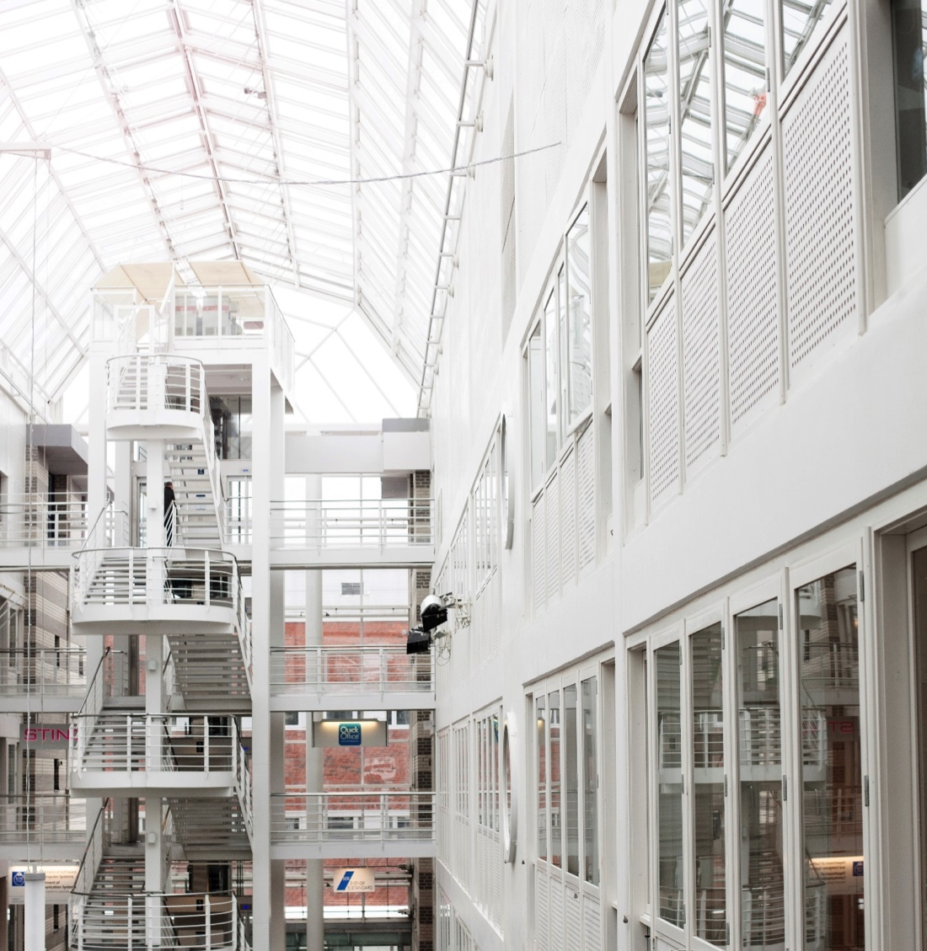
Python basic tutorial
Chen Huang
Safety and Transport

Slide 2
Outline
Why Python?
Lack of matlab license; a free alternative to matlab.
What is Python?
Powerful programming language: scientific computing, data analysis, data visualisation;
friendly to programmers and non-programmers;
open source
Installation
How can Python be useful for me?
Example 1: data analysis and visualisation of 4D data
Example 2:
Conclusions

Slide 3
Installation
Anaconda- platform
https://www.anaconda.com/download/
Choose python 3.7
Choose Spyder (IDE - integrated development environment for python) after installation of anaconda

Slide 4
Tack!
Presentatörens namn
E-post
Telefonnummer
DIVISION ENHET

