Slide 1
Python tutorial – 4D data analysis and Visualisation
Chen Huang
Safety and Transport

Slide 2
Outline
Why Python?
Lack of matlab license; a free alternative to matlab.
What is Python?
Powerful programming language: scientific computing, data analysis, data visualisation;
friendly to programmers and non-programmers;
open source
Installation
Example: 4D data analysis and visualisation
Conclusions

Slide 3
Installation
Anaconda- platform
https://www.anaconda.com/download/
Choose python 3.7
Choose Spyder (IDE - integrated development environment for python)

Slide 4
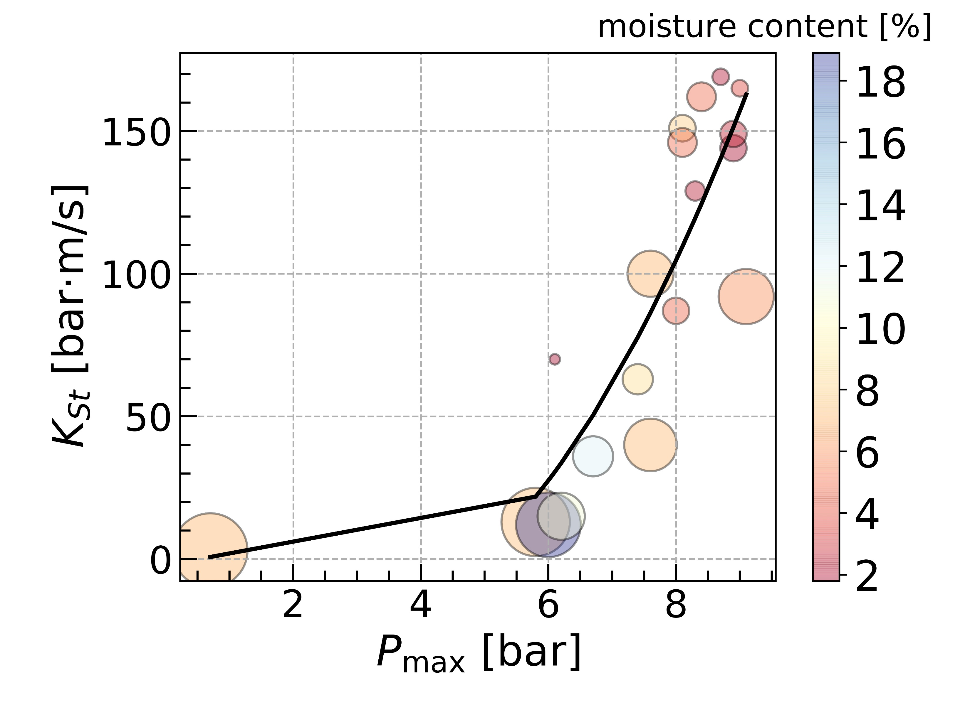

Example: 4D data analysis and visualisation
Aim: approximate data, and plot 4D data.
Link to download example: https://github.com/cenghu/python_tutorial
dust name | D50 [µm] | moisture content by mass [%] | Pmax | KSt [bar·m/s]
wood | 10 | 1.9 | 6.1 | 70
sandalwood | 25 | 3.8 | 9 | 165
wood | 25 | 2.2 | 8.7 | 169
wood | 34 | 2.3 | 8.3 | 129
wood | 250 | 7.2 | 7.6 | 40
wood | 63 | 4.8 | 8 | 87
wood (chips) | 500 | 7.1 | 0.7 | 3
wood (chip dust) | 63 | 1.8 | 8.9 | 144
Wood, from Filter | 201 | 11 | 6.2 | 15
Wood, from filter | 422 | 7.4 | 5.8 | 13
Wood, sawdust | 63 | 2.7 | 8.9 | 149
Wood, sawing, dust deposits | 378 | 18.9 | 6 | 12
Wood, sawing, dust deposits | 83 | 8.6 | 7.4 | 63
Wood, sawing, dust deposits | 145 | 12.2 | 6.7 | 36
white dust from white pellets | 75 | 5 | 8.1 | 146
bark dust from bark pellets | 75 | 5 | 8.4 | 162
forest residual (bark and wood) | 275 | 6 | 9.1 | 92
furniture wood dust | 64 | 7.9 | 8.1 | 151
balsa wood dust | 192 | 7 | 7.6 | 100
$$K_{St}=p\left[0\right]+p\left[1\right]P_{max}+p[2]P_{max}^{2}$$

Slide 5
Conclusion
Python is a powerful programming language and alternative to matlab without license limitation.
Useful links to learn python, e.g. google, stackoverflow.

Slide 6
Tack!
Chen Huang
E-post: chen.huang@ri.se
Safety and Transport

