Slide 1
MBB 243 - Lecture 6
Ryan Morin

Slide 2
Learning Objectives
Understand some of the basic applications of regular expressions in R
Create sequences of integers using :
Understand relationship between higher-level data structures
Provide example use cases for data frames versus matrices
Subset vectors and data structures using the [ and $ operator
Subset elements/rows/columns using logical operations or vectors and reorder vectors

Slide 3
Some new R functions
function name | What it does
mean | Calculate the mean (average) of numbers
min | Return the smallest number in a vector
max | Return the largest number in a vector
sum | Add together all numbers in a vector
table | Count and summarize unique occurrences of each value in a vector
unlist | Convert a list into a vector, collapsing nested data if necessary
order | Return the indexes of a vector in the order of the values
apply/lapply/sapply | Run the same function separately on each element in a list (or each row/column of a matrix or data frame)
grep/grepl/gsub | Use regex to find and/or substitute sequences based on pattern matching

Slide 4
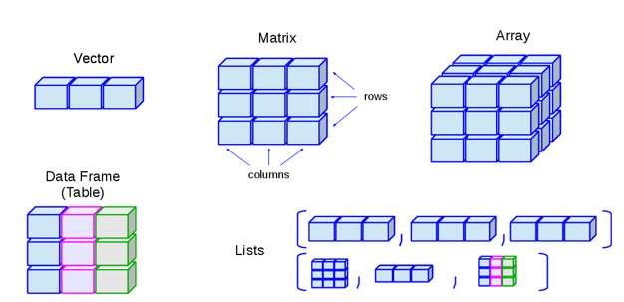
Data structures in R

Slide 5
Review and level up: subsetting
Accessing one element in a vector uses indexing or the names (for named vectors)
Accessing/subsetting into a vector of any length (usually <= the original) can be done using a
numeric vector of desired indexes
character vector of desired names
Can also use an equal length vector of logicals (TRUE and FALSE), where only indexes with TRUE in the corresponding position will be extracted

Slide 6
Review and level up: subsetting
things = c(c=333,d=4444,e=0,a=1,b=22) names(things)
## [1] "c" "d" "e" "a" "b"
things[2]
## d ## 4444
# things["d"] #same as above things[c(2,3)]
## d e ## 4444 0
# things[c("d","e")] #same as above some = c(FALSE,TRUE,FALSE,TRUE) things[some] #same as things[c(2,4)]
## d a ## 4444 1

Slide 7
Enforcing a specific order
The order of the indexes as specified forces the ordering of the extracted vector
order provides a convenient way to sort data when used used with subsetting
alphabet = c("d","c","b","a") order(alphabet) # indexes based on alphabetical order
## [1] 4 3 2 1
order(things) # indexes for ordered values
## [1] 3 4 5 1 2
ao = order(names(things)) # alphabetical order of names things[ao] # vector reordered based on names
## a b c d e ## 1 22 333 4444 0

Slide 8
“Subsetting” with a longer vector
You can extract the same element multiple times by specifying more than once in your vector
short_vec = c(0,1,2) long_vec = short_vec[c(1,2,3,3,2,1)] long_vec #contains the elements from short_vec once for each time specified in short_vec
## [1] 0 1 2 2 1 0

Slide 9
The List
Vectors in R must only contain values of one type (logical, numeric, character)
Lists don’t have this limitation and can even allow you to store vectors or other objects
list_example <- list(FALSE, TRUE, 3.0, "four") list_example
## [[1]] ## [1] FALSE ## ## [[2]] ## [1] TRUE ## ## [[3]] ## [1] 3 ## ## [[4]] ## [1] "four"

Slide 10
List with names
a_list <- list(title = "Numbers", numbers = 1:6, data = c(TRUE,FALSE)) # Here the : operator is used to make a range interpolating from 1 to 6 a_list
## $title ## [1] "Numbers" ## ## $numbers ## [1] 1 2 3 4 5 6 ## ## $data ## [1] TRUE FALSE

Slide 11
Lists: reference by name or indexes
$ is used to refer to list elements by name
Similar to how dictionaries work in Python (i.e. name/key:value)
Numeric index can also be used with [[]]
a_list$numbers #reference by name using $
## [1] 1 2 3 4 5 6
a_list["numbers"] #gives you a list, probably not what you want
## $numbers ## [1] 1 2 3 4 5 6
a_list[["numbers"]] #gives you a vector
## [1] 1 2 3 4 5 6
a_list[[2]] #gives you that same vector
## [1] 1 2 3 4 5 6

Slide 12
From list to vector
Sometimes you will need to convert a list or data frame row into a vector
unlist facilitates this but use with caution because R will try to flatten lists and name nested elements for you
a_vec = unlist(a_list) a_vec[c(1:4)]
## title numbers1 numbers2 numbers3 ## "Numbers" "1" "2" "3"
class(a_vec)
## [1] "character"

Slide 13
From list to vector
Sometimes you will need to convert a list or data frame row into a vector
unlist facilitates this but use with caution because R will try to flatten lists and name nested elements for you
a_vec = unlist(a_list) a_vec
## title numbers1 numbers2 numbers3 numbers4 numbers5 numbers6 data1 ## "Numbers" "1" "2" "3" "4" "5" "6" "TRUE" ## data2 ## "FALSE"

Slide 14
Lists of numeric data
Data “sets” may be structured conveniently in a list
If everything is the same data type this can be a convenient way to represent data of variable sizes
sample_1 = c(77,33,11) sample_2 = c(1234,5,678,9) sample_3 = c(11,1,0,3) m = list("S1"=sample_1, "S2"=sample_2, "S3"=sample_3)

Slide 15
For X do Y (but no looping!)
What is the mean/sum/max value in every sample stored in our list?
It’s tempting to use a loop to perform mathematical or other operations on each nested data element
R has better ways to do this
For lists, we should always try to use lapply or sapply
Syntax is identical, respectively return a list or vector

Slide 16
Applying a function to a list
sapply(m,mean) # calculate means, return vector
## S1 S2 S3 ## 40.33333 481.50000 3.75000
l = lapply(m,min) # calculate min, return list l
## $S1 ## [1] 11 ## ## $S2 ## [1] 5 ## ## $S3 ## [1] 0
unlist(l)
## S1 S2 S3 ## 11 5 0

Slide 17
How and why s/lapply?
The sapply/lapply functions allow you to “apply” non-vectorized functions to data in lists or other structures
They are vectorized, so automatically work on every element in your input and return an equal-length result
Can be combined with your own custom functions
# mean_vec = sapply(m,mean) is equivalent to this loop mean_vec = c() for(i in c(1:length(m))){ #annoying this_mean = mean(m[[i]]) #ugly mean_vec = c(mean_vec,this_mean) #inefficient }

Slide 18
Working with tabular data
As you saw in the last few labs, you can use Python to work with tabular data stored in files
Owing to vectorization and native data types for tabular data, R makes many common analysis tasks much more convenient
Paradigm we will use for this course:
Python/Command-line to manipulate data into a tabular form
R to perform all subsequent analyses on tabular data

Slide 19

The Matrix

Slide 20
The actual matrix
matrix_example <- matrix(1:24, ncol=6, nrow=4) matrix_example
## [,1] [,2] [,3] [,4] [,5] [,6] ## [1,] 1 5 9 13 17 21 ## [2,] 2 6 10 14 18 22 ## [3,] 3 7 11 15 19 23 ## [4,] 4 8 12 16 20 24
class(matrix_example)
## [1] "matrix" "array"
typeof(matrix_example)
## [1] "integer"

Slide 21
Matrix as a neatly folded vector
Notice the order the matrix is created, as if the vector is chopped up and lined up starting from the left
The order of the elements is maintained if you trace from top to bottom, starting in the first column
matrix(c("A","B","C","D","E","F"),nrow=3)
## [,1] [,2] ## [1,] "A" "D" ## [2,] "B" "E" ## [3,] "C" "F"

Slide 22
Assignment and operations
matrix_example[] = 0 # we can assign every position in a matrix to the same value! matrix_example
## [,1] [,2] [,3] [,4] [,5] [,6] ## [1,] 0 0 0 0 0 0 ## [2,] 0 0 0 0 0 0 ## [3,] 0 0 0 0 0 0 ## [4,] 0 0 0 0 0 0

Slide 23
Assignment and operations
matrix_example[,1] = 99 # or we can assign every position in a column matrix_example
## [,1] [,2] [,3] [,4] [,5] [,6] ## [1,] 99 0 0 0 0 0 ## [2,] 99 0 0 0 0 0 ## [3,] 99 0 0 0 0 0 ## [4,] 99 0 0 0 0 0

Slide 24
Assignment and operations
matrix_example[1,] = 3 # or we can assign every position in a row matrix_example
## [,1] [,2] [,3] [,4] [,5] [,6] ## [1,] 3 3 3 3 3 3 ## [2,] 99 0 0 0 0 0 ## [3,] 99 0 0 0 0 0 ## [4,] 99 0 0 0 0 0

Slide 25
Assignment and operations
matrix_example[] = matrix_example + 10 # or we can modify everything in a similar way matrix_example
## [,1] [,2] [,3] [,4] [,5] [,6] ## [1,] 13 13 13 13 13 13 ## [2,] 109 10 10 10 10 10 ## [3,] 109 10 10 10 10 10 ## [4,] 109 10 10 10 10 10

Slide 26
Assignment and operations
matrix_example[4,4] = 4 # or we can assign/reference individual positions # using both row and column index matrix_example
## [,1] [,2] [,3] [,4] [,5] [,6] ## [1,] 13 13 13 13 13 13 ## [2,] 109 10 10 10 10 10 ## [3,] 109 10 10 10 10 10 ## [4,] 109 10 10 4 10 10

Slide 27
Recycling in vector operations
Reminder: vectorized operations treat operations involving vectors of unequal length vs two equal length vectors differently
1 + c(1,1,1)
## [1] 2 2 2
c(1,1,1) + c(1,1,1)
## [1] 2 2 2
3 * c(1,2,3)
## [1] 3 6 9
c(3,0,1) * c(1,2,3)
## [1] 3 0 3

Slide 28
Recycling in matrix operations
Operations involving a matrix recycle along the first then second dimension
tiny = matrix(c(0,0,0,0,0,0),nrow=3) tiny
## [,1] [,2] ## [1,] 0 0 ## [2,] 0 0 ## [3,] 0 0
tiny + 2 #applied to every element in the matrix
## [,1] [,2] ## [1,] 2 2 ## [2,] 2 2 ## [3,] 2 2

Slide 29
Recycling in matrix operations
tiny + c(1,2)
## [,1] [,2] ## [1,] 1 2 ## [2,] 2 1 ## [3,] 1 2
# vector is used in the operation in order along the first dimension of the matrix (columns) # vector is then recycled until the operation has been applid to the entire matrix #Equivalent to #tiny[1,1] + 1 #tiny[2,1] + 2 #tiny[3,1] + 1 #tiny[4,1] + 2 #etc

Slide 30
Recycling in matrix operations
Operations involving a matrix and a vector are tricky but somewhat sensible
tiny
## [,1] [,2] ## [1,] 0 0 ## [2,] 0 0 ## [3,] 0 0
tiny + c(1,2,3)
## [,1] [,2] ## [1,] 1 1 ## [2,] 2 2 ## [3,] 3 3

Slide 31

Broke: loops, Woke: apply
Common to process two-dimensional data structures such as matrices to produce one-dimensional results
e.g. Summary statistic on every row or column
Another place loops may be tempting, but we must resist the temptation

Slide 32
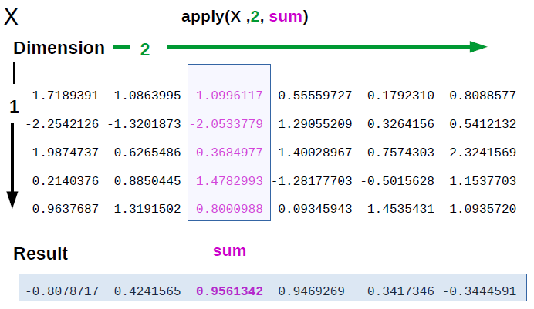
Apply a function to either dimension

Slide 33
Example: convert to percentages
If each row is a group, what % of the total does each column represent in that row?
e.g. 100 * 2 / (323 + 89 + 42)
mini = matrix(c(98,2,0,323,89,42,2,1,6,1,1,1), nrow=4,ncol=3,byrow = T) mini
## [,1] [,2] [,3] ## [1,] 98 2 0 ## [2,] 323 89 42 ## [3,] 2 1 6 ## [4,] 1 1 1

Slide 34
Step 1: denominator (row sums)
Usage: apply(X, MARGIN, FUN, ...)
Not intuitive, but “margin” is just the dimension
How I remember: [dimension1,dimension2]
denominators = apply(mini,1,sum) # equivalent shortcut: denominators = rowSums(mini) # for columns, the other dimension, it would be: apply(mini,2,sum) denominators
## [1] 100 454 9 3

Slide 35
Step 2: numerator
mini
## [,1] [,2] [,3] ## [1,] 98 2 0 ## [2,] 323 89 42 ## [3,] 2 1 6 ## [4,] 1 1 1
percents = 100 * mini/denominators # the rest can be done on the whole matrix at once thanks to recycling # What do you expect this to do? # mini[c(1,2),] # And this? # mini[order(denominators),]

Slide 36
Subsetting rows or columns
mini[c(1,2),] #regular subsetting using a vector
## [,1] [,2] [,3] ## [1,] 98 2 0 ## [2,] 323 89 42
denominators
## [1] 100 454 9 3
order(denominators)
## [1] 4 3 1 2
# sepecify row index in the desired order mini[order(denominators),]
## [,1] [,2] [,3] ## [1,] 1 1 1 ## [2,] 2 1 6 ## [3,] 98 2 0 ## [4,] 323 89 42

Slide 37
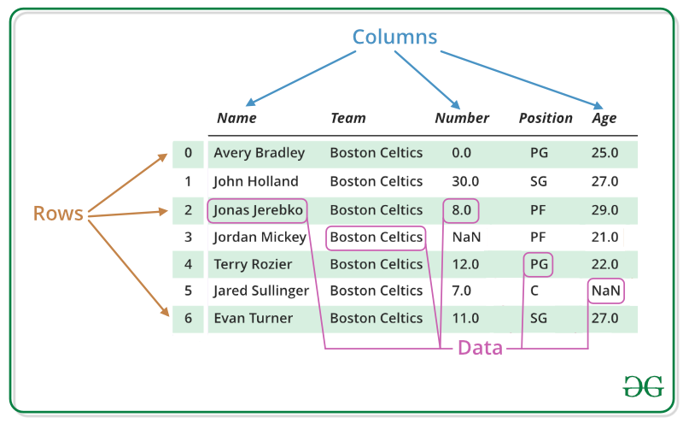
The data frame
A data frame is a two-dimensional array-like structure in which each column contains values of one variable and each row contains one set of values from each column
A data frame can be envisioned as the equivalent of a spreadsheet

Slide 38
characteristics of a data frame
Column names should be non-empty and R will assign (ugly) names when necessary
Row names and column names must be unique
The data stored in a data frame can be of numeric, factor or character type
Each column can have different data type
Each column must contain same number of elements

Slide 39
Loading tabular data
myfile="data/GSE125966_GOYA_mini.csv" gene_expression = read.csv(myfile,row.names = 1) class(gene_expression)
## [1] "data.frame"
#calling rownames/colnames will return a vector containing the current row/column names # Calling these function in an assignment context # will re-assign names to the rows/columns, replacing existing names colnames(gene_expression) = c("sample1","sample2") rownames(gene_expression)[c(1:5)] #first 5 names
## [1] "GeneID:1" "GeneID:10" "GeneID:100" "GeneID:1000" "GeneID:10000"

Slide 40
Rownames and Colnames
A matrix can also have row names and column names, which can be set the same way as data frames
Matrix row and column names do not have to be unique (potentially very problematic!)
mat <- matrix(1:4, ncol=2) rownames(mat)=c("ROW","ROW") colnames(mat)=c("COL1","COL2") mat["ROW",] #only first match is returned
## COL1 COL2 ## 1 3

Slide 41
Exploring the Data Frame
There are a number of functions that work well with data frames
The nrow() and ncol() functions count the number of rows and columns in the object
nrow(gene_expression)
## [1] 999
ncol(gene_expression)
## [1] 2

Slide 42
Peeking with head and tail
The head() and tail() functions are useful for extracting the first or last few rows in a data frame. These are especially useful for larger data frames.
head(gene_expression, 2)
## sample1 sample2 ## GeneID:1 0.4123009 1.330277 ## GeneID:10 -3.0091629 -4.118183
tail(gene_expression, 2)
## sample1 sample2 ## GeneID:100499227 -2.357086 -2.533221 ## GeneID:100499405 -2.116078 -1.615683
some_expression = head(gene_expression)

Slide 43
Another data frame to explore
geno_file = "data/Morin_genotypes.txt" genotype_df = read.csv(geno_file,sep="\t") # read without specifying a column for row names # default rows will be consecutive numbers represented as strings rownames(genotype_df)[c(1:10)]
## [1] "1" "2" "3" "4" "5" "6" "7" "8" "9" "10"
head(genotype_df,3)
## rsid chromosome position genotype ## 1 rs4477212 1 82154 -- ## 2 rs3094315 1 752566 AA ## 3 rs3131972 1 752721 GG

Slide 44
Extracting rows/columns
Rows and columns are indexed numerically
The two dimensions are always row,column
The most basic operation you can do is extracting/referencing a column
Option 1: use the $ operator and column name
Option 2/3: use the column name/index: object_name[,column_index]

Slide 45
Extracting rows/columns
some_expression$sample1
## [1] 0.4123009 -3.0091629 7.7458439 2.3978013 4.1621927 -5.8165178
#extract column using $ operator and column name some_expression[,1]
## [1] 0.4123009 -3.0091629 7.7458439 2.3978013 4.1621927 -5.8165178
#extract the first column some_expression[,"sample1"]
## [1] 0.4123009 -3.0091629 7.7458439 2.3978013 4.1621927 -5.8165178
#extract the column named sample1

Slide 46
Rows vs Columns
An extracted column from a data frame becomes a vector
Sadly, the same is NOT true of extracted rows
A single extracted row remains a data frame and must be converted
some_expression[1,] #extract the first row
## sample1 sample2 ## GeneID:1 0.4123009 1.330277
class(some_expression[1,])
## [1] "data.frame"
row_vec = unlist(some_expression[1,]) class(row_vec)
## [1] "numeric"

Slide 47
Summarizing the contents
Another useful function is called summary() which will display statistics for numeric columns and tabulate values in text columns.
summary(gene_expression)
## sample1 sample2 ## Min. :-5.817 Min. :-5.703 ## 1st Qu.:-5.817 1st Qu.:-5.703 ## Median :-5.817 Median :-5.703 ## Mean :-3.959 Mean :-3.848 ## 3rd Qu.:-3.009 3rd Qu.:-2.896 ## Max. :12.595 Max. : 8.160

Slide 48
Regex in R
R was designed for doing mathematical and statistical analyses
Working with text/character/string type data is much easier in Python and clunkier in R
Three common use cases for string operations:
string replacement using pattern or literal matching
string splitting using pattern or literal matching
searching for the existence of a pattern

Slide 49
Flavours of grep in R
Original | Desired | Function | Comment
GeneID:1000 | 1000 | sub/gsub | Replace or drop first/all matching portions of string
GeneID:1000 | TRUE/FALSE | grepl | check for existence of a match
ACATGC | ACATGC | grep | Obtain all matching values

Slide 50
Gsub example
What if we wanted to drop the redundant “GeneID:” part of our row names?
head(some_expression,3)
## sample1 sample2 ## GeneID:1 0.4123009 1.330277 ## GeneID:10 -3.0091629 -4.118183 ## GeneID:100 7.7458439 7.208059
original_rownames = rownames(some_expression) new_rownames = gsub("GeneID:","",original_rownames) rownames(some_expression) = new_rownames head(some_expression,3)
## sample1 sample2 ## 1 0.4123009 1.330277 ## 10 -3.0091629 -4.118183 ## 100 7.7458439 7.208059

Slide 51
Grep example
What if we wanted to find all rows that had a genotype that was homozygous A (i.e. AA)?
The table function tabulates the unique values in the resulting vector
table(grepl("AA",genotype_df$genotype))
## ## FALSE TRUE ## 816361 146685
# How many are homozygous of any of the four nucleotides? table(grepl("AA|GG|CC|TT",genotype_df$genotype))
## ## FALSE TRUE ## 325896 637150

Slide 52
Subsetting data frame with logicals
Revisiting the previous example, we’ll calculate the % of homozygous genotypes on autosomes
To accomplish this we need to ignore chromosomes MT, X and Y, negating grepl using !
tail(table(genotype_df$chromosome))
## ## 7 8 9 MT X Y ## 51032 49234 42982 3930 26008 1906
autosome_rows = ! grepl("X|Y|MT",genotype_df$chromosome) head(autosome_rows)
## [1] TRUE TRUE TRUE TRUE TRUE TRUE

Slide 53
Final steps: % homozygous
table(autosome_rows)
## autosome_rows ## FALSE TRUE ## 31844 931202
autosome_genotypes = genotype_df[autosome_rows,] homozygous_total = sum(grepl("AA|GG|CC|TT",autosome_genotypes$genotype)) all = length(autosome_genotypes$genotype) percent_homo = 100 * homozygous_total/all percent_homo
## [1] 68.38731

Slide 54
More Resources
http://swcarpentry.github.io/r-novice-gapminder/04-data-structures-part1
http://swcarpentry.github.io/r-novice-gapminder/06-data-subsetting
http://swcarpentry.github.io/r-novice-gapminder/09-vectorization

