Slide 1
MBB 243 - Lecture 3
Ryan Morin

Slide 2
When do you step away from interactive bash?
Eventually you will encounter data formats that require more sophisticated programming than is readily possible with the command line
Any process you want to apply to multiple individual files or only when certain conditions apply is not easily done interactively
e.g. if file contains X do Y
e.g. for every file do X, Y and then Z and make a new file with a different name
All theoretically possible in bash but there really are better ways

Slide 3
Programming in R and Python
The next few lectures will cover introductory concepts with syntax examples in both R and Python
Syntax: You will use each language in your labs so the syntax for both is important
Terminology: Languages sometimes use different terms to describe related concepts and the differences may be subtle
In situations when the concept is more easily illustrated in one language we will focus on a single language for consistency

Slide 4
Learning goals for the week
Learn the most common types of variables shared between R and Python
Understand the limitations of different variable types
Understand how to access object Methods and to call functions
Gain familiarity with manipulating variables directly and with appropriate functions
Learn how to find documentation for built-in functions and Methods in both languages

Slide 5
Interactive sessions
Most of your lab activities will be done in Rstudio
Code chunks are surrounded with sets of three backticks
The RStudio Console will automatically run an interactive R session
R variables you load/create are visible in the Environment pane
Python code run in Rstudio can be run in code chunks after loading the reticulate library
You can also launch an interactive Python session (REPL)

Slide 6
Interactive sessions
library(reticulate) repl_python() ## Python 3.6.13 (/Users/rmorin/miniconda3/envs/r-reticulate/bin/python) ## Reticulate 1.22 REPL -- A Python interpreter in R. ## Enter 'exit' or 'quit' to exit the REPL and return to R. # Let's enter some Python code and see the result ## >>> print("HELLO\nWORLD!") ## HELLO ## WORLD!

Slide 7
Variables
String/character variables: require quotes
Numbers in R are all represented by the numeric class
Python has a more nuanced set of variable types for numbers
int - a signed integer (+/-)
float - floating point numbers
The class of a R variable can always be determined with the class function
The type of a Python variable can always be determined with the type function

Slide 8
Functions/Methods
A function is a block of reusable code that is used to perform a similar or related action using a specific input or set of inputs
The code that defines what a function does when called is specified elsewhere in the program or can come with a built-in or user-installed module/library
We will explore how functions are made later
Consider them a convenient set of black-boxes for now, similar to how we use bash utilities grep, cut, sort without worrying about how they work

Slide 9
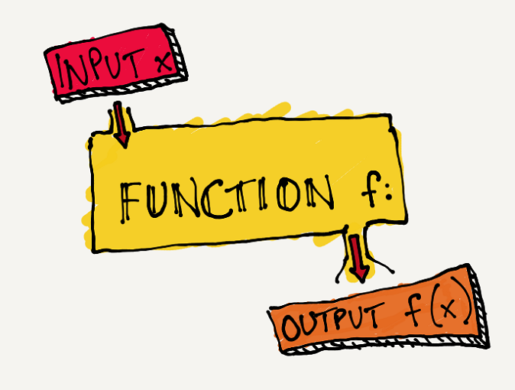
Functions/Methods

Slide 10
Syntax note: calling functions
In bash, we run a program with command-line arguments with this syntax:
program_name arg1_value arg2_value arg3_value
Within Python and R, we call a function with one or more variables as arguments using this syntax:
function_name(arg1_value,arg2_value,arg3_value)
In Python, this is true except when it involves a special type of function that belong to an object (to be revisited)

Slide 11
Syntax note: calling functions
Another common practice in both R and python is to explictly refer to the arguments you specify by their name:
# arguments are shown on separate lines hear for ease of documentation but this isn't required function_name(arg1_name=arg1_value, arg2_name=arg2_value, arg3_name=arg3_value) # each argument can be passed as a key/value pair # e.g. the first key is arg1_name and the first value is arg1_value # each key (left of =) must refer to an available argument # i.e. your function needs to be expecting the named arguments

Slide 12
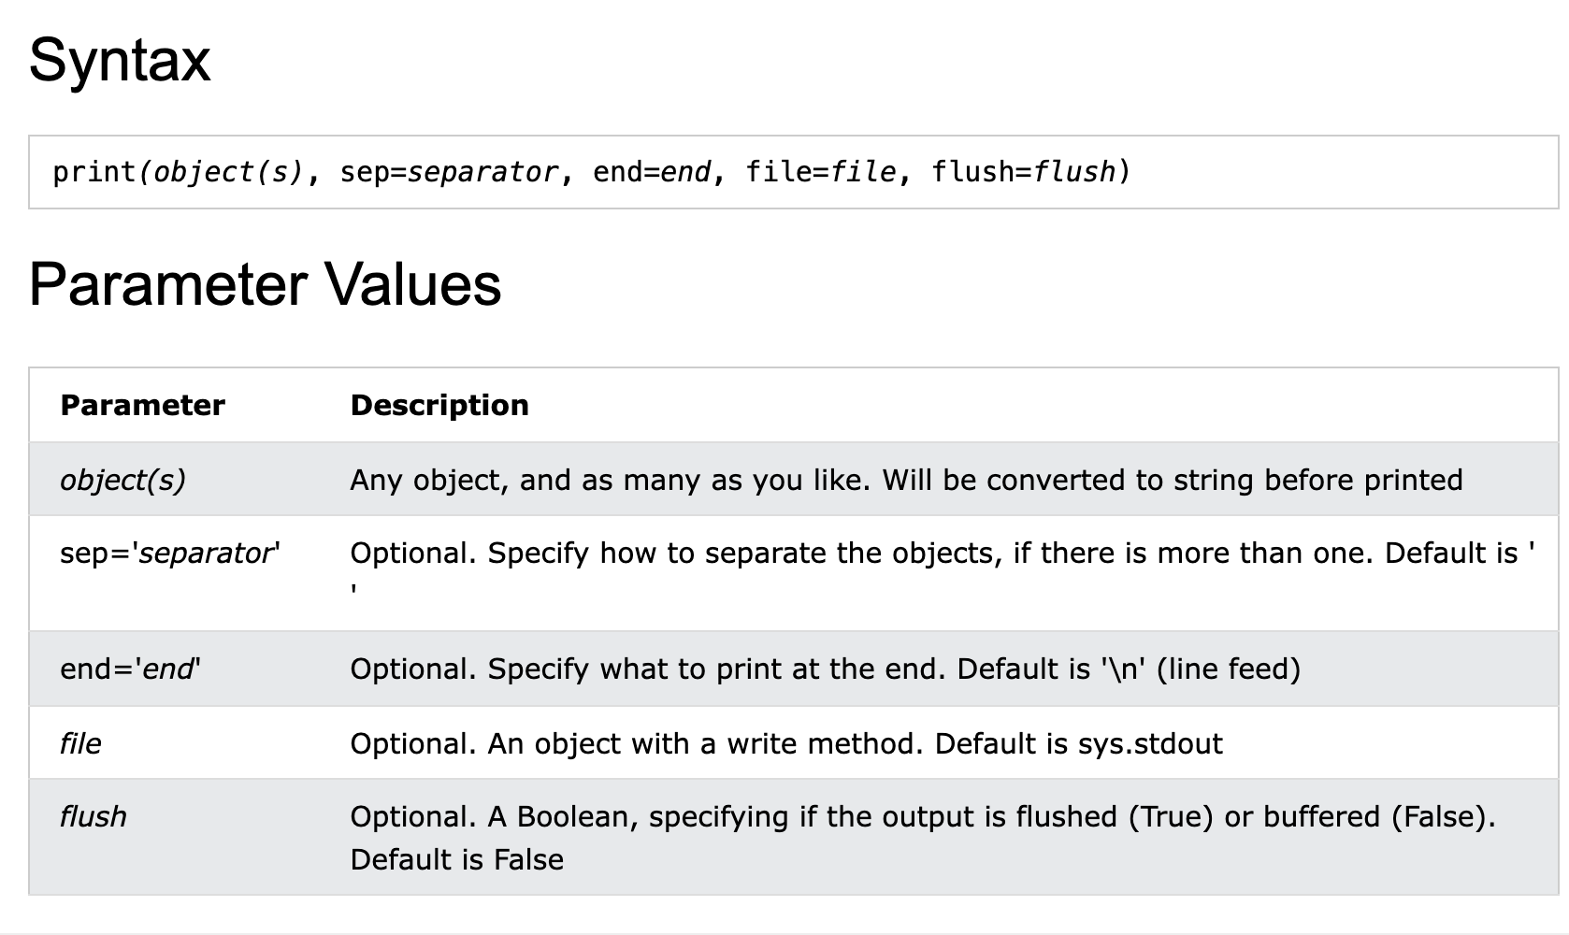
Example documentation of a function

Slide 13
Actual example of function call
Python’s print function has additional options for how it handles its inputs
sep specifies the separator that goes between the strings provided
end is the character optionally added to the end of the string it generates (e.g. \n)
print( "Hello", # First un-named argument "World", # Second un-named argument sep=" ", # First named argument end="!") # Second named argument
## Hello World!

Slide 14
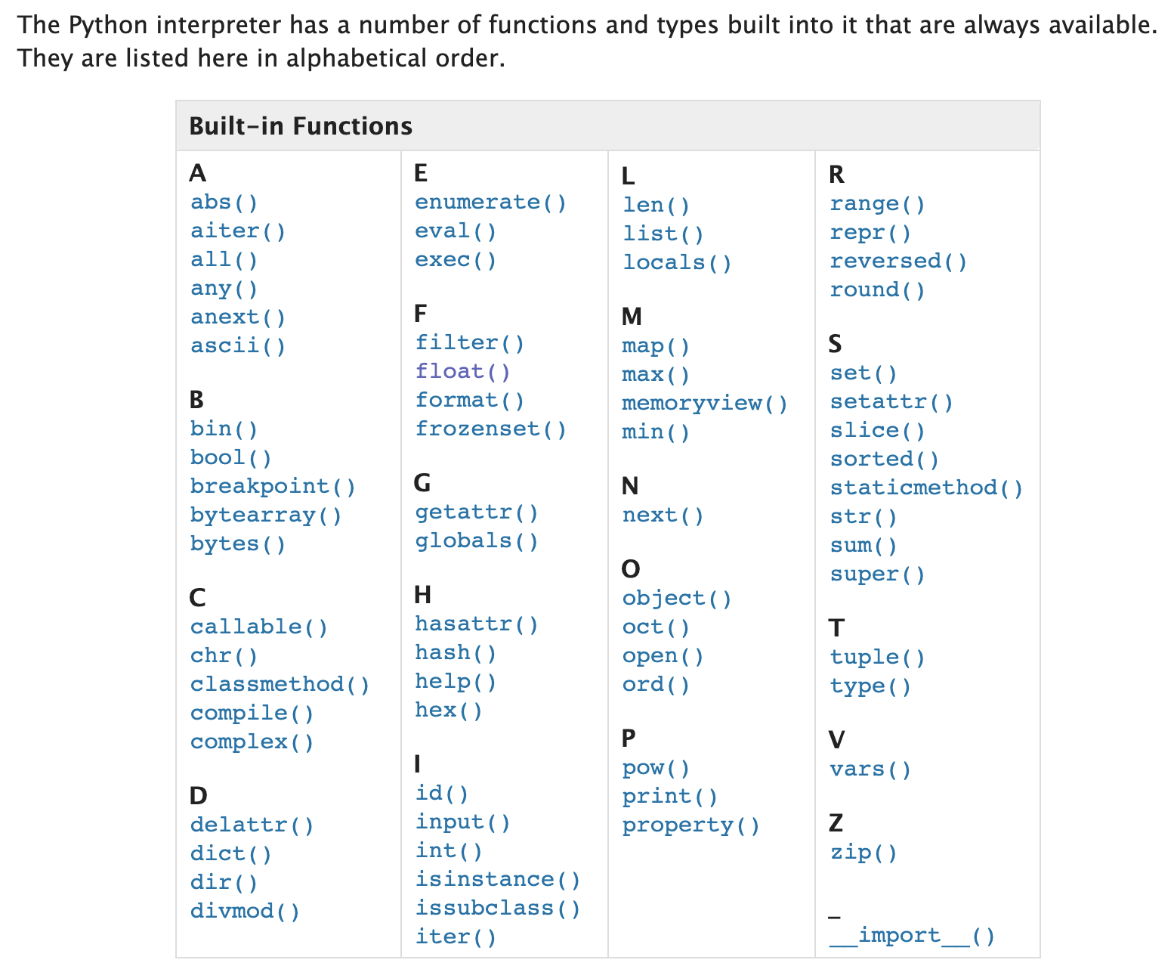
Python built-in functions

Slide 15
Syntax note: whitespace in Python
Compared to Python, most programming languages feature a lot more types of brackets and many semicolon characters ;
The exlimination of these characters came at a cost: confusing people new to the language
Whitespace in the wrong place is interpreted as having a specific meaning in the code
a_variable = 10 b_variable = 20 # throws Error: unexpected indent (<string>, line 2) c_variable = 30 # throws Error: unexpected indent (<string>, line 3) # only line 1 is valid because the other lines don't have the same indentation "level"

Slide 16
Syntax note: whitespace in Python
Newlines (\n), tabs (\t) and spaces (\s) are entirely ignored by most programming languages
Here is what the Python interpreter sees
a_variable = 10\n #<- newline means new line of code \s\s\sb_variable = 20\n #<- indent or space means nested code block \tc_variable = 30\n #<- never mix tabs and spaces in Python. Just don't!

Slide 17
Exploring basic Python variables
IMPORTANT: Python does not allow any decimal/dot (.) characters in variable names and yet R does allow this and it’s commonly used
# initializing variables in Python a_string = "Hey" # a new variable assigned quoted text will be initialized as a string and for numbers, it will automatically figure out if a variable should be a float one_integer = 3 one_float = 3.14 type(a_string)
## <class 'str'>
type(one_integer)
## <class 'int'>
type(one_float)
## <class 'float'>

Slide 18
Exploring basic R variables
# initializing variables in R a.string <- "Hey" one.number <- 3.14 class(a.string)
## [1] "character"
class(one.number)
## [1] "numeric"
a.string=9999 class(a.string) #reassigning will change the variable type accordingly
## [1] "numeric"

Slide 19
Variable types can change with assignment
# initializing variables in R a.string <- "Hey" class(a.string)
## [1] "character"
a.string=9999 class(a.string) #reassigning will change the variable type accordingly
## [1] "numeric"

Slide 20
Variable types can change with assignment
a_string="1" type(a_string)
## <class 'str'>
a_string=1 type(a_string) #because you set the value with a number it's now a numeric type
## <class 'int'>

Slide 21
Explicitly changing variable type
It’s common to need to change a variable’s type to allow certain functionality that only works on that type and often throws an error if used on the wrong type
e.g. You have a numeric value but need to combine it with some strings to produce a printed output
Converting a variable explicitly to a specific type is called “casting”
The built-in functions for this are int(), float(), str()

Slide 22
Explicitly changing the type
pi = 3.1415 pi_int = int(pi) # NOTE: This isn't rounding the value the way you probably want pi_int
## 3
pi_string = str(pi) pi_string
## '3.1415'
print(pi_string + " is pi")
## 3.1415 is pi
print(pi_int + 1)
## 4
print(pi + 1)
## 4.141500000000001

Slide 23
There’s a function for that!
Common manipulations are almost always problems other people have already solved (many times)
If not available as a built-in function it can probably be found in a Python library
pi = 3.1415 # first argument is the number to be rounded # second argument is the number of decimal places pi_3_dp = round(pi,3) pi_2_dp = round(pi,2) pi_3_dp
## 3.142
pi_2_dp
## 3.14

Slide 24
Sending something to STDOUT
In an interactive environment, R and Python REPL automatically returns the contents of a variable if you refer to it without assigning it to another variable
In a script, you need to explicitly tell the code to send this to STDOUT
some_string = "Are you still awake?" print(some_string) # Python syntax
## Are you still awake?
print("some_string") #why does this not do the same thing?
## some_string

Slide 25
Variables have their own functions
Python is an object oriented programming language
Virtually every variable type is an “object” with at least some of their own functions
Things called “classes” provide a blueprint for new objects
The syntax for using an object’s functions (known as methods) is different than for generic functions

Slide 26
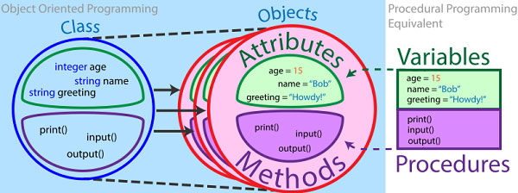
Object oriented programming concept

Slide 27
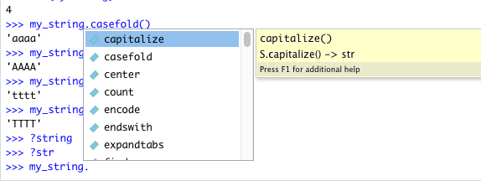
Finding an Python object’s methods
Strings have a lot of functions for manipulating text in convenient ways
In the Python REPL you can view the documentation for a class by specifying ?class_name
Similar approach to view documentation for an R function in Rstudio, e.g. ?print

Slide 28
Syntax comparison
Function: function_name(arguments)
Class method: object_name.method_name(arguments)
Behind-the-scenes, the method receives the object as an argument too, thus has access to the object’s attributes
some_string = "ATTAGGA" len(some_string) #generic function that returns the length of various variables and containers, not specific to strings
## 7
some_string.lower() #string object method
## 'attagga'

Slide 29
Using a Python object’s methods
my_string="AAAA" my_string.replace("A","T")
## 'TTTT'
my_string #note that the variable itself is unchanged
## 'AAAA'
my_string = my_string.replace("A","T") #We can assign the output to the same variable name or a new variable my_string #now the variable has been irreversably changed
## 'TTTT'

Slide 30
Operators in Python
Perform operations on variables and values, depending on the type
These are the Arithmetic operators but some have other effects in different contexts (e.g. strings)
e.g. + is not just for numeric addition
Operator | Name | Example
+ | Addition | x + y
- | Subtraction | x - y
* | Multiplication | x * y
/ | Division | x / y
% | Modulus | x % y
** | Exponentiation | x ** y

Slide 31
Doing some math
num_1 = 4 num_2 = 2 num_1 + num_2
## 6
num_1 - num_2
## 2
num_1 * num_2
## 8
num_1 / num_2
## 2.0
num_1 % num_2 #modulus returns zero if the first number is perfectly divisible by the second
## 0
num_1 ** num_2
## 16

Slide 32
Same code, different variable values
num_1 = 1.1 num_2 = 0.3 num_1 + num_2 #why is this not exactly 1.4?
## 1.4000000000000001
num_1 - num_2
## 0.8
num_1 * num_2
## 0.33
num_1 / num_2
## 3.666666666666667
num_1 % num_2 #modulus just returns the remainder
## 0.20000000000000012
num_1 ** num_2 # notice how all the numbers are now floating point decimals automatically
## 1.029005759421095

Slide 33
Same code, strings instead of numeric
num_1 = "1.1" num_2 = "0.3" num_1 + num_2 # This line will work num_1 - num_2 # This is the first line that throws an error num_1 * num_2 # This code doesn't run because of the error above # only the first operator works on strings and the rest will throw errors ## '1.10.3' ## TypeError: unsupported operand type(s) for -: 'str' and 'str' ## Detailed traceback: ## File "<string>", line 1, in <module>

Slide 34
Floating point arithmetic limitations
Internally Python represents a floating point number as a fraction of binary values
Explained here
Operations will return values that are exactly or near the correct answer, depending on how readily a number can be represented in binary fractions
inexact_result = 1.1 + 0.3 close_enough = format(inexact_result, '.2f') #format the number keeping only the first two decimal places close_enough
## '1.40'

Slide 35
What else can we do with strings?
print() is just one of many functions that does something useful with a string
Below are additional examples of functions that manipulate or summarize features a string
Reminder: Methods specific to the string object class are called using a different syntax
some_dna="AAGGTTCCGAATC" len(some_dna) #returns the length # lower(some_dna) #Doesn't work because this function belongs to the string class
## 13
some_dna.lower()
## 'aaggttccgaatc'

Slide 36
Operators in R
Very similar set of arithmetic operators
None of these will work on character variables
This error is the telltale sign you used one in the wrong context:
non-numeric argument to binary operator
Operator | Name | Example
+ | Addition | x + y
- | Subtraction | x - y
* | Multiplication | x * y
/ | Division | x / y
^ | Exponentiation | x ^ y

Slide 37
Variable types are treated differently
The type of a variable defines how it can be manipulated and what operators and functions will do with it
Python allows strings to be concatenated using the + operator
As you saw in Lab 1, R will complain if you try to do this because R doesn’t consider the + operator as meaningful for strings
dna1 = "TATA" dna2 = "CGCG" dna3 = dna1 + dna2 dna3
## 'TATACGCG'

Slide 38

See you in 5 minutes

Slide 39
Vectors and Arrays
R vectors and Python arrays are variables that can store one or more values at defined positions (indexes)
Convenient for storing related values in a specific order
Commonly used in conjunction with loops (to be covered soon)
The indexing of R vectors starts at 1
The indexing of Python arrays starts at 0

Slide 40
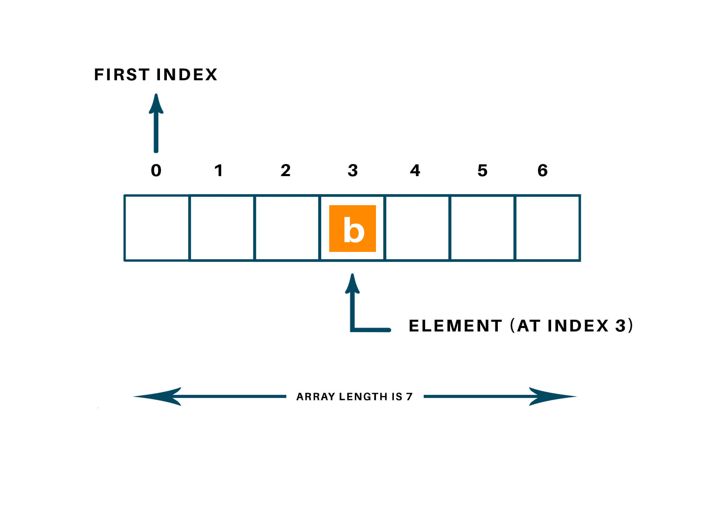
Python array

Slide 41
Arrays in Python
my_array = [1, 2, 4] #initialize array with all its elements my_array[0] = 30 #our index, is 0, the first element in this array my_array[1] = my_array[1] + 2 # our index is 1 i = 2 my_array[i] = 1/4 # our index is the value of the variable i, which is 2 my_array
## [30, 4, 0.25]
type(my_array)
## <class 'list'>

Slide 42
Python arrays can contain mixed types
diverse_array = [-0.34, 1/3, "Doctor", "Zoidberg"] #initialize array with all its elements diverse_array[1] + 1 #diverse_array[2] + 1 # running this line would throw: TypeError: must be str, not int
## 1.3333333333333333
diverse_array[2] + diverse_array[3]
## 'DoctorZoidberg'

Slide 43
Vectors in R
#assign a vector using only numeric values my.vec <- c(1, 2, 4) # NOTE: This is R class(my.vec)
## [1] "numeric"
my.vec
## [1] 1 2 4
#assigning a single non-numeric value makes it into a character vector other.vec=c("1", 3, 7, 11) class(other.vec)
## [1] "character"
other.vec
## [1] "1" "3" "7" "11"
my.vec * 10
## [1] 10 20 40
# If tried on other.vec: Error in other.vec * 10 : non-numeric argument to binary operator

Slide 44
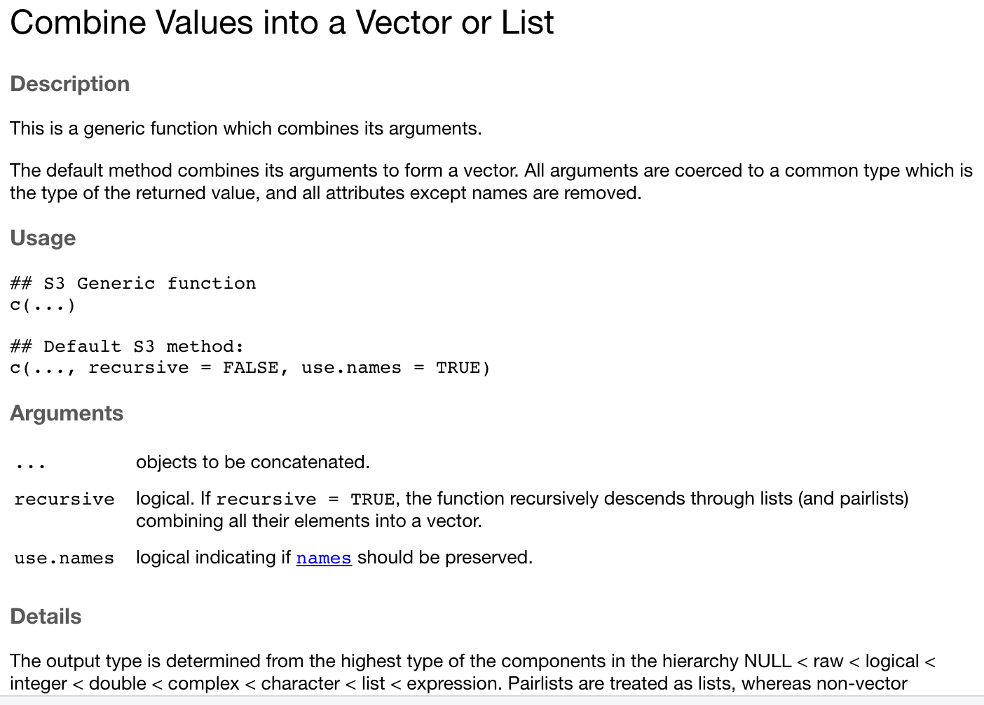
The c (combine) function

Slide 45
The oddity of R vectors
By default, R actually treats all variables as vectors with the simplest case being a length 1 vector
Somewhat convenient when you want to combine multiple variables into a longer vector
single_string = "D" # NOTE: This is R string_vector = c("A","B","C") is.vector(single_string)
## [1] TRUE
is.vector(string_vector)
## [1] TRUE
c(string_vector,single_string)
## [1] "A" "B" "C" "D"

Slide 46
Manipulating values by index
The value stored at an index i can be assigned, manipluated, or accessed for another purpose
my.vec <- c(1, 2, 4) # NOTE: This is R my.vec[1] <- 30 #our index, i here is 1, the first element in this vector my.vec[2] <- my.vec[2] + 2 # our index here is 2 i <- 3 my.vec[i] <- 1/4 # our index is the value of the variable i, which is 3 my.vec
## [1] 30.00 4.00 0.25
typeof(my.vec)
## [1] "double"

Slide 47
Appending to Python Arrays
You can make an array longer while adding a new value at a new index using the append method
Although rarely as useful, you can delete specific elements and shorten the array using the pop method and you can add an element at a specific place using insert, which affects the indexes.
diverse_array = [-0.34, "Doctor", "Zoidberg"] diverse_array.append("Good News!") diverse_array
## [-0.34, 'Doctor', 'Zoidberg', 'Good News!']
diverse_array.pop(0)
## -0.34
diverse_array
## ['Doctor', 'Zoidberg', 'Good News!']

Slide 48
Going out of bounds
Arrays and vectors have a set length
Referring to an index that is higher than the last available index is problematic
In Python, you will get IndexError: list index out of range
In R, you will get the value NA
Avoid this by determining the length and iterating over all (or some) elements using the last index as a stopping point
Add to the array using append (Python) or combine your vector with another vector (R)

Slide 49
Recap and Quiz 1 of 2
What is the last index in this_array?
# NOTE: Python this_thing = "XXXXX" this_array = [9, 99, 1, "&", this_thing]

Slide 50
Recap and Quiz 1 of 2
What is the last index in this_array?
What type of variable is stored at that position in this_array?
Can we treat all elements of this_array as the same type? If so, what type?
# NOTE: Python this_thing = "XXXXX" this_array = [9, 99, 1, "&", this_thing] len(this_array)
## 5

Slide 51
Recap and Quiz 1 of 2
# NOTE: Python this_thing = "XXXXX" this_array = [9, 99, 1, "&", this_thing] len(this_array) # Access the last element in the array using length - 1 (4)
## 5
this_array[4] # Or do it all in one step
## 'XXXXX'
this_array[len(this_array)-1]
## 'XXXXX'

Slide 52
Recap and Quiz 2 of 2
What is the last index in this_vector?
# NOTE: R this_thing = "XXXXX" this_vector <- c(this_thing, 99, 1, "&", 9)

Slide 53
Recap and Quiz 2 of 2
What is the last index in this_vector?
What type of variable is stored at that position in this_array?
Can we treat all elements of this_array as the same type? If so, what type?
this_thing = "XXXXX" # NOTE: R this_vector <- c(this_thing, 99, 1, "&", 9) this_vector[length(this_vector)]# access last element using length
## [1] "9"
typeof(this_vector[5])
## [1] "character"
#this_vector+1 # Error in this_vector + 1 : non-numeric argument to binary operator

Slide 54
Broke: Arrays. Woke: Dictionaries
Keeping variables/values in a specific order can be useful in certain scenarios
It is often preferrable to have a way to store two related things together
One acts as a means to “find” the associated value
Example: What is the amino acid encoded by every possible codon?

Slide 55
Broke: Arrays. Woke: Dictionaries
# NOTE: Python this_dict = {} #initialize empty, then populate this_dict['ATG'] = 'start' # or initialize and populate at the same time this_dict = {'ATG':'start','TGA':'stop'} # retrieve by using an available key: print("TGA codon means:",this_dict['TGA']) # This sort of error will be thrown if you use a key that doesn't exist: ## KeyError: 'TAA'
## TGA codon means: stop

Slide 56
Genetic code as a Python Dictionary
genetic_code = { 'ATA':'I', 'ATC':'I', 'ATT':'I', 'ATG':'M', 'ACA':'T', 'ACC':'T', 'ACG':'T', 'ACT':'T', 'AAC':'N', 'AAT':'N', 'AAA':'K', 'AAG':'K', 'AGC':'S', 'AGT':'S', 'AGA':'R', 'AGG':'R', 'CTA':'L', 'CTC':'L', 'CTG':'L', 'CTT':'L', 'CCA':'P', 'CCC':'P', 'CCG':'P', 'CCT':'P', 'CAC':'H', 'CAT':'H', 'CAA':'Q', 'CAG':'Q', 'CGA':'R', 'CGC':'R', 'CGG':'R', 'CGT':'R', 'GTA':'V', 'GTC':'V', 'GTG':'V', 'GTT':'V', 'GCA':'A', 'GCC':'A', 'GCG':'A', 'GCT':'A', 'GAC':'D', 'GAT':'D', 'GAA':'E', 'GAG':'E', 'GGA':'G', 'GGC':'G', 'GGG':'G', 'GGT':'G', 'TCA':'S', 'TCC':'S', 'TCG':'S', 'TCT':'S', 'TTC':'F', 'TTT':'F', 'TTA':'L', 'TTG':'L', 'TAC':'Y', 'TAT':'Y', 'TAA':'_', 'TAG':'_', 'TGC':'C', 'TGT':'C', 'TGA':'_', 'TGG':'W', }

Slide 57
Using the genetic code dictionary
# This is the DNA from our DNA to mRNA example in an earlier class cdna_seq = "ATGAAGGCGCTGAGCCCGGTGCGCGGCTGCTACGAGGC" cdna_codon1 = cdna_seq[0:3] #string slice to get the first three nucleotides cdna_codon1
## 'ATG'

Slide 58
Using the genetic code dictionary
# This is the DNA from our DNA to mRNA example in an earlier class cdna_seq = "ATGAAGGCGCTGAGCCCGGTGCGCGGCTGCTACGAGGC" cdna_codon1 = cdna_seq[0:3] #string slice to get the first three nucleotides cdna_codon1
## 'ATG'
cdna_codon2 = cdna_seq[3:6] #string slice to get the next three cdna_codon2
## 'AAG'

Slide 59
Using the genetic code dictionary
cdna_seq = "ATGAAGGCGCTGAGCCCGGTGCGCGGCTGCTACGAGGC" cdna_codon1 = cdna_seq[0:3] cdna_codon2 = cdna_seq[3:6] print("codon 1", cdna_codon1, "encodes", genetic_code[cdna_codon1], sep=" ")
## codon 1 ATG encodes M
print("codon 2", cdna_codon2, "encodes", genetic_code[cdna_codon2], sep=" ")
## codon 2 AAG encodes K

Slide 60
The versatility of R vectors
R vectors behave as dictionary-like variables
Involves assigning a unique “name” to each element in the vector
named_vec1 = c(a=12,b=33,c=21,d=0) named_vec1[3] # Can use name OR index
## c ## 21
named_vec1["c"]
## c ## 21
named_vec1["z"]=1000 #assign using a unique name named_vec1
## a b c d z ## 12 33 21 0 1000

Slide 61
Beware named vectors!
R doesn’t care if you use unique names
R lazily resorts to the first value matching the name
named_vec2 = c(a=12,c=-1,c=21,a=100) named_vec2["a"] # Can use name OR index
## a ## 12
named_vec2["c"]
## c ## -1
named_vec2["c"]=20 #assign using an existing name named_vec2
## a c c a ## 12 20 21 100
# Onus is on you to only use unique names!

Slide 62
Outlook
As usual, the examples above are not particularly useful in real-world applications
Strings have a lot of additional manipulations we can put to work for text/sequence data
Most code to perform a commonly-required manipulation or calculation has been written already by someone else
In the coming labs you will see how to apply some more advanced methods and convenient functions (via BioPython) to work with sequence data in Python

