Slide 1
MBB 243 - Lecture 2
Ryan Morin

Slide 2
Recap
Molecular biology data comes in various flavours
Numeric or textual data is very common (reference genome sequence, genotype)
Genomes have layers of information that contextualize the sequence
The command line is a useful tool for interacting with some of these
RStudio is the interface we will use this semester for learning to code in three different programming languages (Why?!?)
Each language has strengths and weaknesses

Slide 3
Learning goals for the week
Build on/expand Unix fundamentals
Become familiar with additional data types we encounter in molecular biology research
Get more familiar with some common applications of the command line for manipulating sequence and delimited text files
Begin working with simple annotations (continued in lab)

Slide 4

man: your best friend
$man which WHICH(1) BSD General Commands Manual WHICH(1) NAME which -- locate a program file in the user's path SYNOPSIS which [-as] program ...

Slide 5
Example man page
GREP(1) BSD General Commands Manual GREP(1) NAME grep, egrep, fgrep, zgrep, zegrep, zfgrep -- file pattern searcher SYNOPSIS grep [-abcdDEFGHhIiJLlmnOopqRSsUVvwxZ] [-A num] [-B num] [-C[num]] [-e pattern] [-f file] [--binary-files=value] [--color[=when]] [--colour[=when]] [--context[=num]] [--label] [--line-buffered] [--null] [pattern] [file ...] DESCRIPTION The grep utility searches any given input files, selecting lines that match one or more patterns. By default, a pattern matches an input line if the regular expression (RE) in the pattern matches the input line without its trailing newline. An empty expression matches every line. Each input line that matches at least one of the pat- terns is written to the standard output. grep is used for simple patterns and basic regular expressions (BREs); egrep can handle extended regular expressions (EREs). See re_format(7) for more information on reg- ular expressions. fgrep is quicker than both grep and egrep, but can only handle fixed patterns (i.e. it does not interpret regular expressions). Patterns may consist of one or more lines, allowing any of the pattern lines to match a portion of the input.

Slide 6
Lab logistics
Starting this Friday (Jan 22), we will have the lab in person on campus
Masks are required
Zoom will still be available for anyone who cannot attend due to illness
If you are still not done with the lab 1 activites please stay for office hours!

Slide 7
Lessons learned from the lab
Any file with “.” at the start of its name is hidden from display by default (e.g. ~/.bash_profile)
ls -a will show hidden files
File names and paths must be exact (including upper/lowercase)
README.txt is not the same as Readme.txt
.bash_profile is not the same as ~/.bash_profile unless your working directory is ~/
The reticulate package has some oddities in how it finds python

Slide 8
Lessons learned from the lab
Useful things to check when deciding if something was properly installed
To test if PROGRAM is available in your terminal and to check which one is being used, run which PROGRAM
If your environment has miniconda working you should see the environment name to the left of your prompt (base) [me@server ]$
If you change something in your environment, it is sometimes helpful to restart your R session

Slide 9
Variables don’t always vary
which reports the path to the program that gets run when you enter a given command without specifying the full path
You can override this to run a specific program instead by providing the full path
echo $PATH
## /Users/rmorin/Library/r-miniconda/envs/r-reticulate/bin:/usr/bin:/bin:/usr/sbin:/sbin:/usr/local/bin:/Library/TeX/texbin:/opt/X11/bin
which python
## /Users/rmorin/Library/r-miniconda/envs/r-reticulate/bin/python

Slide 10
Variables don’t always vary
As you have already seen in the lab, many variables will be set at the start of your bash session and never change (e.g. via your .bashrc and .bash_profile files)
Environment variables store information about your session that allows things to work the way you want
Example: PATH variable tells Linux where to find all the executables you have available
When you type a command such as python the exact program that is run will depend on the contents of PATH

Slide 11
From interactive sessions to scripts
any series of bash commands can be automated by putting the same commands into a plain text file that has a special line at the top to tell the computer what interpreter to use
More generally, the commands for any interpreted/scripting language work this way (bash, Python, R, Perl, Awk, etc)
The first line is our “shebang” line. This is the only time a line starting with # isn’t a comment!
#!/bin/bash echo "Hello World"

Slide 12
From interactive sessions to scripts
To run this, you simply have to save those lines in a plain text file of any name
Though not required, by convention you should end it with .sh to indicate it’s a shell script
One more thing: the file permissions must be set to “executable”
-rw-r--r--@ 1 me staff 31B 8 Jan 14:52 a.sh #won't run for anyone -rwxr--r--@ 1 me staff 31B 8 Jan 14:52 b.sh #only runs for the owner of the file (me) -rwxr-xr--@ 1 me staff 31B 8 Jan 14:52 c.sh #runs for the file owner and any member of the staff group

Slide 13
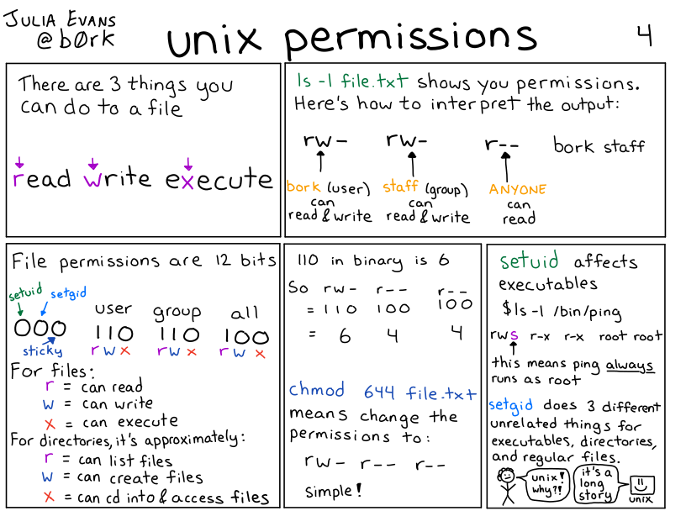
Permissions in UNIX/Linux

Slide 14
Changing file permissions with chmod
# a = all, u=owner, g=group, o=others # use +x to give -x to revoke executable permissions # other permissions: r=read, w=write/delete ls -l scripts/hello_world.sh
## -r--------@ 1 rmorin staff 31 10 Jan 15:08 scripts/hello_world.sh
chmod u+x scripts/hello_world.sh ls -l scripts/hello_world.sh
## -r-x------@ 1 rmorin staff 31 10 Jan 15:08 scripts/hello_world.sh
chmod o+x scripts/hello_world.sh ls -l scripts/hello_world.sh
## -r-x-----x@ 1 rmorin staff 31 10 Jan 15:08 scripts/hello_world.sh

Slide 15
What command would we need to
Allow any user to run the script a.sh?
-rw-r--r--@ 1 big_nerd1 scientists 31B 8 Jan 14:52 a.sh
Prevent people outside the students group from reading the contents of filez.gz?
-rw-r--r--@ 1 big_nerd2 students 31B 8 Jan 14:52 filez.gz

Slide 16
What command would we need to
Allow any user to run the script a.sh?
-rw-r--r--@ 1 big_nerd1 scientists 31B 8 Jan 14:52 a.sh
chmod a+x a.sh
-rwxr-xr-x@ 1 big_nerd1 scientists 31B 8 Jan 14:52 a.sh
Prevent people outside the students group from reading the contents of filez.gz?
-rw-r--r--@ 1 big_nerd2 students 31B 8 Jan 14:52 filez.gz
-rw-r-----@ 1 big_nerd2 students 31B 8 Jan 14:52 filez.gz

Slide 17
What command would we need to
Allow any user to run the script a.sh?
-rw-r--r--@ 1 big_nerd1 scientists 31B 8 Jan 14:52 a.sh
chmod a+x a.sh
-rwxr-xr-x@ 1 big_nerd1 scientists 31B 8 Jan 14:52 a.sh
Prevent people outside the students group from reading the contents of filez.gz?
-rw-r--r--@ 1 big_nerd2 students 31B 8 Jan 14:52 filez.gz
chmod o-r filez.gz
-rw-r-----@ 1 big_nerd2 students 31B 8 Jan 14:52 filez.gz

Slide 18
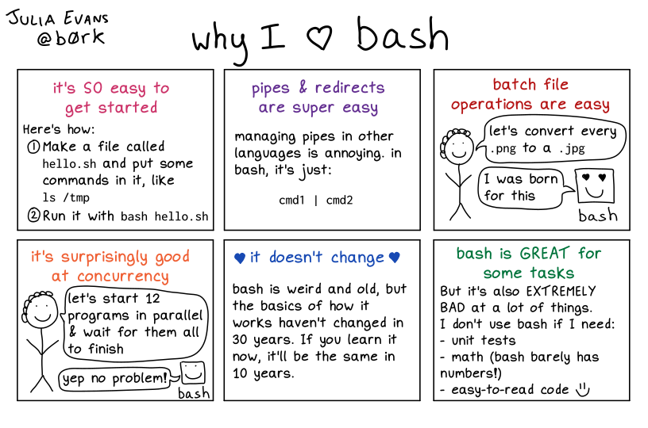
Self-explanatory

Slide 19
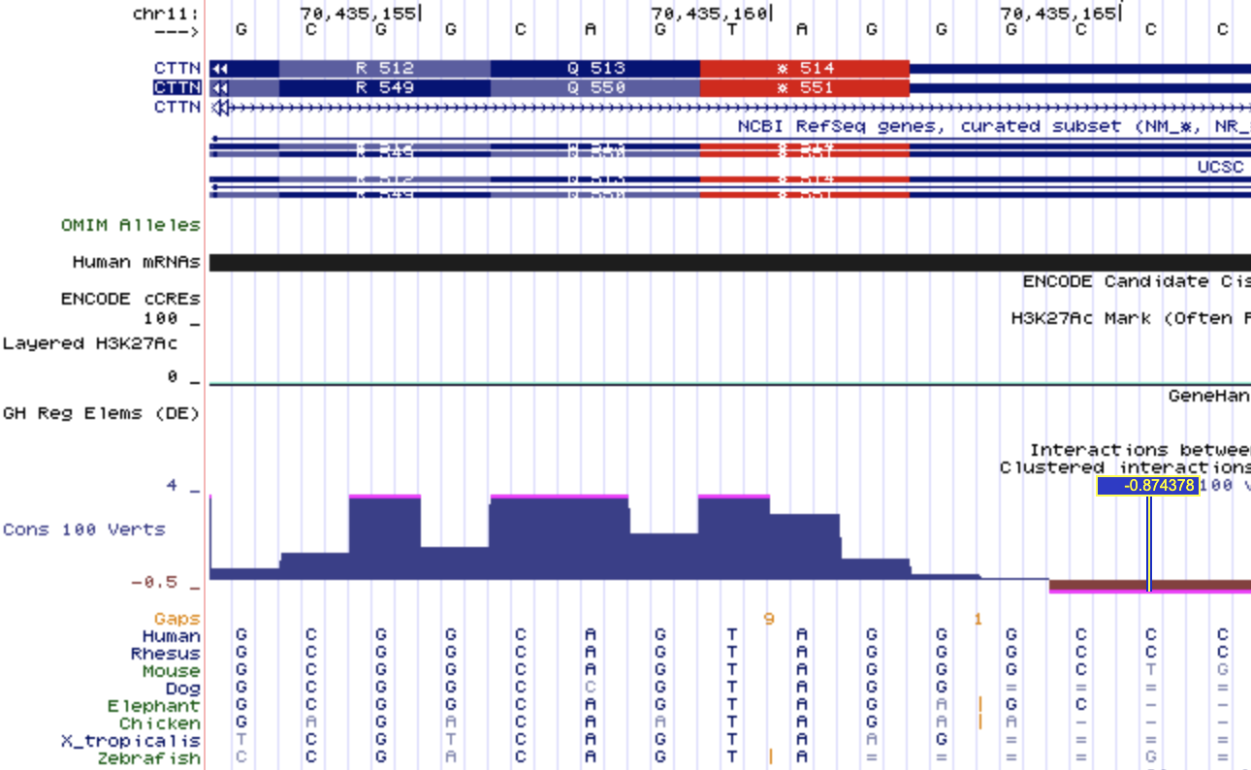
Many numeric genome annotations exist

Slide 20
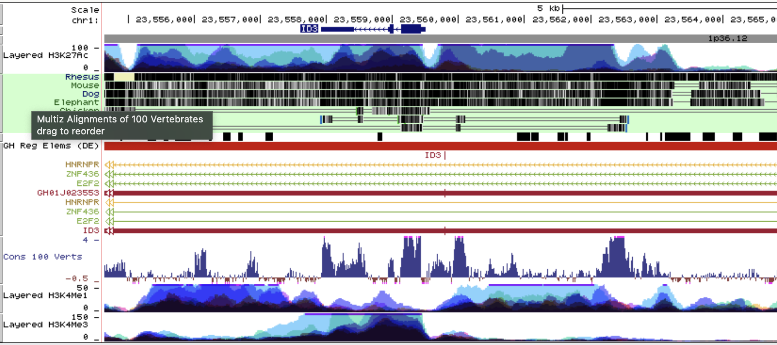
Many numeric genome annotations exist

Slide 21
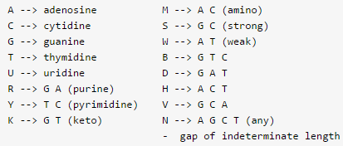
Annotations in the context of transcripts
Annotations relative to the genome are often more relevant in other contexts
e.g. Mutations and SNPs can be interpreted relative to their effect on the transcript (and coding DNA seqment) of the affected gene
Note the many effects a SNP or indel can have on coding sequence in this example!

Slide 22
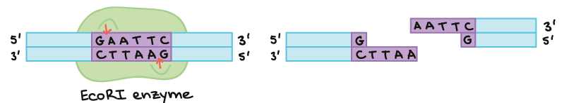
some “gotchas” in working with sequence files
Restriction enzymes cleave DNA at very specific sequences
Suppose you wanted to find all examples of a restriction enzyme cut site in a region of interest
What caveats do you need to worry about when writing a simple program to search for that sequence?

Slide 23
Searching for enzyme cut sites
Starting point:
reference genome sequence in fasta format
Can you find all the EcoRI sites (GAATTC)?
>chr1 AACATTAAGGATCCATTATCCGATACCATTGAA TTCCTGACTTGAATTCCCAATATCCATTCAGTA CCTCTTAAGCCTTCGTAGTTCAATTCGGATCCT

Slide 24
Searching for enzyme cut sites
Starting point:
reference genome sequence in fasta format
Can you find all the EcoRI sites (GAATTC)?
Do we need to worry about CTTAAG? Why/why not?
>chr1 AACATTAAGGATCCATTATCCGATACCATTGAA TTCCTGACTT*GAATTC*CCAATATCCATTCAGTA CCTCTTAAGCCTTCGTAGTTCAATTCGGATCCT

Slide 25
Searching for enzyme cut sites
Starting point:
reference genome sequence in fasta format
Can you find all the EcoRI sites (GAATTC)?
Do we need to worry about CTTAAG? Why/why not?
What about newlines/white space?
>chr1 AACATTAAGGATCCATTATCCGATACCATT*GAA TTC*CTGACTT*GAATTC*CCAATATCCATTCAGTA CCTCTTAAGCCTTCGTAGTTCAATTCGGATCCT

Slide 26
Doing it in Bash
# load everything but the header line using grep grep -v \> data/cutsite_ref.fa # problem: our sequence is broken by new lines # and this breaks potential matches of GAATTC
## AACATTAAGGATCCATTATCCGATACCATTGAA ## TTCCTGACTTGAATTCCCAATATCCATTCAGTA ## CCTCTTAAGCCTTCGTAGTTCAATTC

Slide 27
Doing it in Bash
# load everything but the header line using grep grep -v \> data/cutsite_ref.fa | perl -pe 's/\n//' # paste -sd '\0' - #this line could be used in place of the perl code # Now we have all the sequence on one line # we can pass that with a pipe for pattern matching
## AACATTAAGGATCCATTATCCGATACCATTGAATTCCTGACTTGAATTCCCAATATCCATTCAGTACCTCTTAAGCCTTCGTAGTTCAATTC

Slide 28
Doing it in Bash
# load everything but the header line using grep grep -v \> data/cutsite_ref.fa | perl -pe 's/\n//' | perl -pe 's/GAATTC/*GAATTC*/g' # both perl and sed use this syntax to find/replace strings: # /MATCH_PATTERN/REPLACEMENT_STRING/
## AACATTAAGGATCCATTATCCGATACCATT*GAATTC*CTGACTT*GAATTC*CCAATATCCATTCAGTACCTCTTAAGCCTTCGTAGTTCAATTC

Slide 29
Predicting restriction fragments
How would you modify this code to generate the sequence of all predicted restriction fragments after EcoRI digestion?
# load everything but the header line using grep grep -v \> data/cutsite_ref.fa | perl -pe 's/\n//' | perl -pe 's/GAATTC/*GAATTC*/g'
## AACATTAAGGATCCATTATCCGATACCATT*GAATTC*CTGACTT*GAATTC*CCAATATCCATTCAGTACCTCTTAAGCCTTCGTAGTTCAATTC

Slide 30
Predicting restriction fragments
How would you modify this code to generate the sequence of all predicted restriction fragments after EcoRI digestion?
grep -v \> data/cutsite_ref.fa | paste -sd '\0' - | perl -pe 's/GAATTC/GAA\nTTC/g' # Remember \n is how we specify a newline in most programming contexts
## AACATTAAGGATCCATTATCCGATACCATTGAA ## TTCCTGACTTGAA ## TTCCCAATATCCATTCAGTACCTCTTAAGCCTTCGTAGTTCAATTC

Slide 31
(im)practicality of this approach
There are way better ways to do this
How well would this scale to other applications?
Much longer sequences (e.g. genome/chromosome)?
A fasta file containing many individual sequences?

Slide 32
Don’t reinvent the wheel
If you’re encountering an annoying quirk of a common file format, you are never the first person
Search online for how to solve common problems (often you’ll end up in StackOverflow)
e.g. “remove newlines fasta” brings you to this post, which contains an easier way that allows you to skip some of these steps
seqtk has a lot of handy functions you may want to try
seqtk seq -l 0 data/cutsite_ref.fa
## >chr1 ## AACATTAAGGATCCATTATCCGATACCATTGAATTCCTGACTTGAATTCCCAATATCCATTCAGTACCTCTTAAGCCTTCGTAGTTCAATTC

Slide 33
(im)practicality of this approach
There are still way better ways to do this
How well would this scale to other applications?
Much longer sequences (e.g. genome/chromosome)?
The entire sequence is being processed at once by sed, which requires it to be stored as a variable, which consumes RAM
A fasta file containing many individual sequences?
Implementation above stripped the sequence header so we lost positional information and the name/context of all sequences

Slide 34
Additional considerations
Starting point Sanger sequencing data from a cDNA clone
Assume we know this cDNA is cut multiple times by the enzyme and we want to know why
How would you find the places most likely being cut by EcoRI (GAATTC)?
Imperfect/partial matches in sequence are more difficult to identify
Requires “fuzzy” matching or regular expressions (to be covered later in the course)

Slide 35
Searching for sequences of interest
What if you had a FASTA with sequences of many transcripts and you just wanted the records pertaining to certain genes?
grep -c \> data/human_genes_chr7.fa # how many sequence records are in this file? # count them with grep -c
## 11718

Slide 36
Searching within the headers
# Simpler to use this file after dropping line breaks seqtk seq -l 0 data/human_genes_chr7.fa | # Here we're using the -c option with head to limit the number of bytes printed! head -c 220
## >ENSG00000001626|ENSG00000001626.17|ENST00000003084|1280;2728;3788;3059;650;3539;4034;814;940;2690;235;71;560;4207;3438;4313;2561;1750;2979;3210;1463;344;124;1187;3944;1655;1837|1|CFTR ## GTAGTAGGTCTTTGGCATTAGGAGCTTGAGCCCAG

Slide 37
Searching within the headers
seqtk seq -l 0 data/human_genes_chr7.fa | grep -w "LHFPL3" # Why so many hits for this one gene name? # Something is going wrong with our search. Why?
## >ENSG00000187416|ENSG00000187416.13|ENST00000424859|860;623;178|1|LHFPL3 ## >ENSG00000226869|ENSG00000226869.6|ENST00000433514||-1|LHFPL3-AS1 ## >ENSG00000226869|ENSG00000226869.6|ENST00000411448||-1|LHFPL3-AS1 ## >ENSG00000226869|ENSG00000226869.6|ENST00000417290||-1|LHFPL3-AS1 ## >ENSG00000187416|ENSG00000187416.13|ENST00000401970|860;623;178|1|LHFPL3 ## >ENSG00000226869|ENSG00000226869.6|ENST00000416376||-1|LHFPL3-AS1 ## >ENSG00000226869|ENSG00000226869.6|ENST00000434579||-1|LHFPL3-AS1 ## >ENSG00000226869|ENSG00000226869.6|ENST00000450896||-1|LHFPL3-AS1 ## >ENSG00000226869|ENSG00000226869.6|ENST00000449764||-1|LHFPL3-AS1 ## >ENSG00000225329|ENSG00000225329.3|ENST00000453666||-1|LHFPL3-AS2 ## >ENSG00000187416|ENSG00000187416.13|ENST00000684090||1|LHFPL3 ## >ENSG00000225329|ENSG00000225329.3|ENST00000631061||-1|LHFPL3-AS2 ## >ENSG00000187416|ENSG00000187416.13|ENST00000683240|1;365|1|LHFPL3

Slide 38
Searching within the headers
seqtk seq -l 0 data/human_genes_chr7.fa | grep -w "LHFPL3$" # Even though we're asking grep to stop searching between "words" with -w, certain characters such as - are considered allowed components of words. Since we know there should be whitespace after the gene name we "anchor" our pattern with $.
## >ENSG00000187416|ENSG00000187416.13|ENST00000424859|860;623;178|1|LHFPL3 ## >ENSG00000187416|ENSG00000187416.13|ENST00000401970|860;623;178|1|LHFPL3 ## >ENSG00000187416|ENSG00000187416.13|ENST00000684090||1|LHFPL3 ## >ENSG00000187416|ENSG00000187416.13|ENST00000683240|1;365|1|LHFPL3

Slide 39

See you in 5 minutes

Slide 40
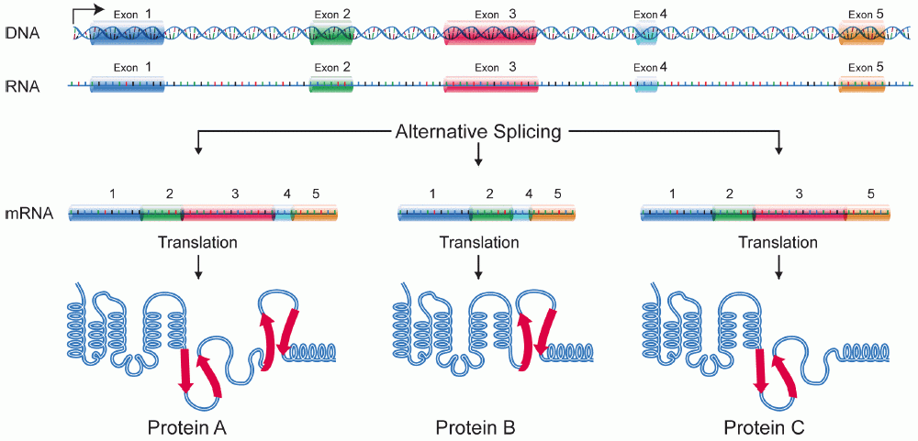
Most genes have multiple isoforms due to alternative splicing

Slide 41
What do you expect?
The example shown previously results in four separate sequences for the same gene
In what ways might you expect those three to differ?
How might they be similar?
Do you think all alternative transcripts encode different protein sequences?

Slide 42
How do we actually get the sequences?
# grep -A 1 tells the search to return the matching line along with one line AFTER it. # Unfortunately it also prints "--" after that (for some reason) but this can be dealt with by piping it to another grep to drop those lines seqtk seq -l 0 data/human_genes_chr7.fa | grep -A 1 -w "LHFPL3$" | grep -v "\-\-" > LHFPL3.fa
Think about how you might extend this to extract the sequence of a few different genes instead of just one. What would you need to change and how?

Slide 43
Success!
echo "file has $(wc -l LHFPL3.fa) lines" echo "file has $(grep -c \> LHFPL3.fa) headers" head -c 150 LHFPL3.fa
## file has 8 LHFPL3.fa lines ## file has 4 headers ## >ENSG00000187416|ENSG00000187416.13|ENST00000424859|860;623;178|1|LHFPL3 ## GCTCCCCCGCCCTCCTTCCGGGAGCGAGGATGCAGACTCTGAAACTGGTGCTGCTGGGCTGAGGCGGAGGCAGGGGA

Slide 44
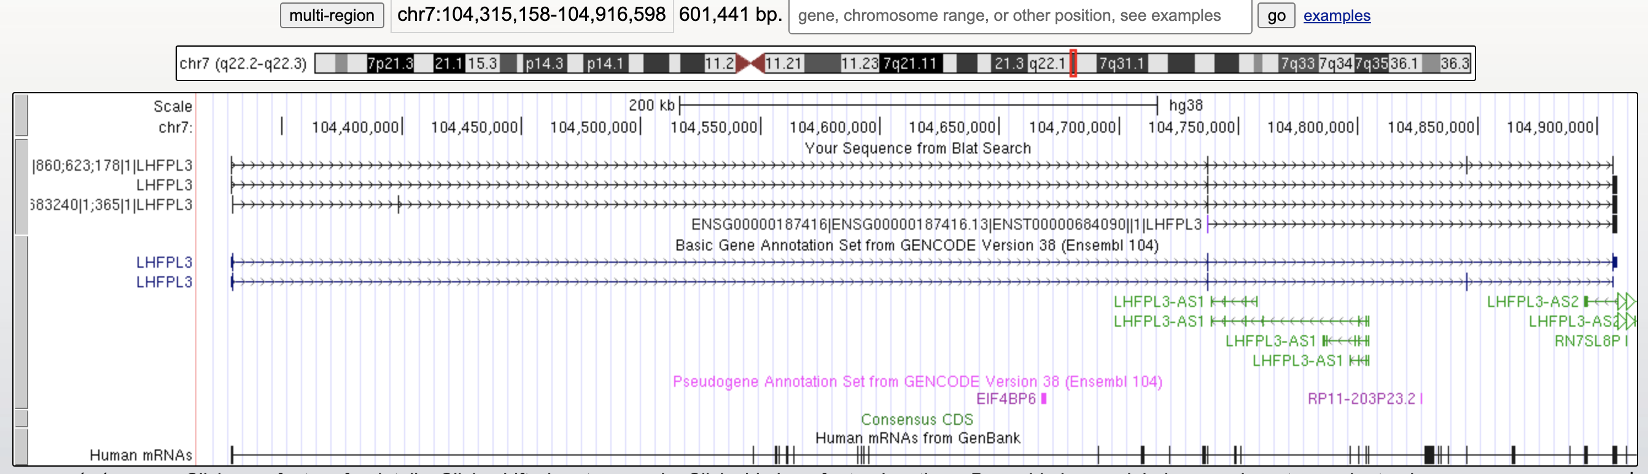
How do they compare?

Slide 45
Synopsis
It’s possible to subset a large multi-record FASTA file with a combination of a few commands
This example used a file containing the predicted cDNA for many genes
grep and some of these other tools have numerous surprises that can lead to new problems
Building your commands up one step at a time and sanity checking each allows you to ensure you get the result you want in the appropriate format

Slide 46
Quantitative annotations
Numeric values for every position in a sequence
You can think of this as a “wide” format representation
Each genomic position is a column (or string index) and each value is a row
1 <-genomic coordinate ->N Seq: AAAGCGCCGGGATTTTCCGTTTAAACCTCCCTC Value: 012345543210101234543211122334455 e.g. %GC ----5---- .. . .. ----4---- .... ... .... ----3---- ...... ..... ...... ----2---- ........ ....... ........ ----1---- .......... . ................... ----0---- .................................

Slide 47
Has benefits and drawbacks
May be super convenient for smaller sequences
Sequence and numeric values can easily be “split” into a list/array/vector
Inflexible for non-integer values (or larger than 9)
What if you wanted to order or filter based on some numeric threshold?
my_seq="AAAGCGCCGGGATTTTCCGTTTAAACCTCCCTC" scores="012345543210101234543211122334455" # What's the base and score/value at position 2? my_seq[2]
## 'A'
scores[2]
## '2'

Slide 48
Let’s rotate it

Slide 49
Quantitative annotations
Sequence positions converted to rows and row numbers are relative to the coordinate
Each column can contain different information about the sequence
pos Nt value 1 A 0 2 A 1 3 A 2 4 G 3 5 C 4 6 G 5 7 C 5 8 C 4 9 G 3 10 G 2 11 G 1 12 A 0 13 T 1 14 T 0 15 T 2 16 T 3

Slide 50
Quantitative annotations
Sequence positions converted to rows and row numbers are relative to the coordinate
Each column can contain different information about the sequence
Easy to perform operations per-row based on certain criteria
Think of this as the “tall” equivalent of the “wide” format shown previously
How many rows would this file contain if we had an annotation represented this way for the human genome?

Slide 51
Quantitative annotations
Sequence positions converted to rows and row numbers are relative to the coordinate
Each column can contain different information about the sequence
Easy to perform operations per-row based on certain criteria
How many rows would this file contain if we had an annotation represented this way for the human genome?
About 3 billion lines!

Slide 52
Lowering resolution and handling sparseness
Most annotations don’t span the entire genome and are usually much more sparse
Regions of the genome with values of zero don’t need to be explicitly represented
Single base resolution is rarely relevant and bins or windows (e.g. 1kb) are often used
start end value 1 1000 50 1001 2000 20 2001 3000 10 9001 10000 30 10001 11000 100

Slide 53
Lowering resolution and handling sparseness
Most annotations don’t span the entire genome and are usually much more sparse
Regions of the genome with values of zero don’t need to be explicitly represented
Single base resolution is rarely relevant and bins or windows (e.g. 1kb) are often used
Example is UCSC’s wiggle (.wig) format
start end value 1 1000 50 1001 2000 20 2001 3000 10 <-- implies 3001 to 9000 are zero 9001 10000 30 <-- 10001 11000 100

Slide 54
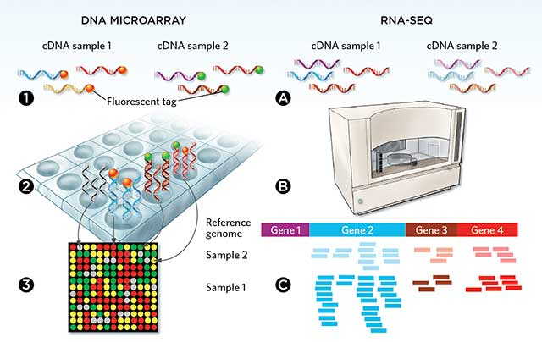
Sample-specific measurements: gene expression
Multiple methods are used to quantify the expression of many genes in a sample
digital approaches such as RNA-seq, NanoString
analog methods such as microarrays

Slide 55
Sample-specific measurements: gene expression
Although the underlying gene expression is a continuous variable, digital methods measure discrete values (integers), which represent how many times that mRNA was “observed”
Millions of measurments across many thousands of genes

Slide 56
Types of gene expression data
Raw data is either the signal per probe (microarray) or sequencing reads (RNA-seq)
Array data is not all comparable due to different microarray designs/versions
Various “probe sets” measure different combinations of genes
Example microarray data set in GEO. Platform: HG-U133_Plus_2
Example RNA-seq data set in GEO

Slide 57
Peeking at RNA-seq data
Typically you will encounter post-processed data in the form of per-gene counts
This example from GEO (GSE125966) is a comma-separated file with quoted values
## "","bo21005_bo2100500001_20160904","bo21005_bo2100500002_20160904" ## "GeneID:1",37,65 ## "GeneID:10",3,1

Slide 58
Peeking at RNA-seq data
Using cut (specifying a , delimiter) and head we can peek at the contents
This format is hard on the eyes but easy to convert to something useful in R
wc -l data/GSE125966.csv #Number of rows (genes) cut -d "," -f 1-3 data/GSE125966.csv | head -n 3
## 27676 data/GSE125966.csv ## "","bo21005_bo2100500001_20160904","bo21005_bo2100500002_20160904" ## "GeneID:1",37,65 ## "GeneID:10",3,1

Slide 59
Comma-separated values
## Meaning of columns: ## GENE,SAMPLE1_count,SAMPLE2_count, etc. ## ## "","bo21005_bo2100500001_20160904","bo21005_bo2100500002_20160904" ## "GeneID:1",37,65 ## "GeneID:10",3,1 ## "GeneID:100",6048,3851 ## "GeneID:1000",148,61 ## "GeneID:10000",504,563

Slide 60
Sorting numeric columns
Even with comma-delimited data the command line can be used to explore some features of the data
What are the top 10 most highly expressed genes in the first sample?
sort -t "," -k 2 -n -r data/GSE125966.csv | # tell the sort command we have an unusual delimiter with -t "," # Sort on column 2 with -k 2 # Peform numeric, instead of alphabetical sort using -n # Reverse the sort order to put the highest first using -r cut -d "," -f 1-4 | head # tell cut to use a comma delimiter and take columns 1-4 and view the top 10 lines

Slide 61
Sorting numeric columns
Even with comma-delimited data the command line can be used to explore some features of the data
What are the top 10 most highly expressed genes in the first sample?
## "GeneID:60",1014732,1217179,523223 ## "GeneID:378938",571855,1038688,828586 ## "GeneID:7503",230169,179473,157271 ## "GeneID:100423062",174286,1162,89134 ## "GeneID:71",163116,221330,113782 ## "GeneID:6023",154526,129758,153893 ## "GeneID:5660",137839,63459,52042 ## "GeneID:4288",118290,51533,41067 ## "GeneID:3312",107102,71837,66939 ## "GeneID:26986",103718,67184,56782

Slide 62
Layering on information with join
If we have another similarly structured file containing a shared column (e.g. gene ID) we can link them together using join
Here’s a simple file that contains the Entrez Gene ID and HGNC symbol of every human gene. It’s already been sorted on column 1 using sort.
## "GeneID:1","A1BG" ## "GeneID:10","NAT2" ## "GeneID:100","ADA" ## "GeneID:1000","CDH2"

Slide 63
Layering on information with join
If we have another similarly structured file containing a shared column (e.g. gene ID) we can link them together using join
cut -f 1,2 -d "," data/GSE125966.csv | sort -k 1 -t "," - | join -t "," - data/gene_id.sorted.txt > data/GSE125966_annotated.csv head -n 3 data/GSE125966_annotated.csv
## "GeneID:1",37,"A1BG" ## "GeneID:10",3,"NAT2" ## "GeneID:100",6048,"ADA"
This output contains the first two columns from our gene expression file attached to the first two columns of our gene ID file

Slide 64
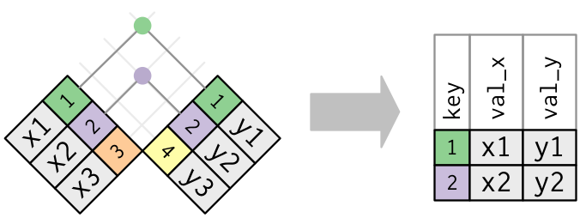
How does this work?
Combining data sets with shared properties is a common need
Here we performed what is called an “inner join” on these two files
Columns from any row in both tables that share an ID (or “key”) are brought together
Rows in either table that don’t share a key are dropped (lost)

Slide 65
Caveats with joining data
Inner joins will remove rows that don’t match (data loss!)
Other types of joins can be more conservative
e.g. left joins will be covered later in the course
# the original file has more lines than the new file. Why? wc -l data/GSE125966.csv
## 27676 data/GSE125966.csv
wc -l data/GSE125966_annotated.csv
## 25924 data/GSE125966_annotated.csv

Slide 66
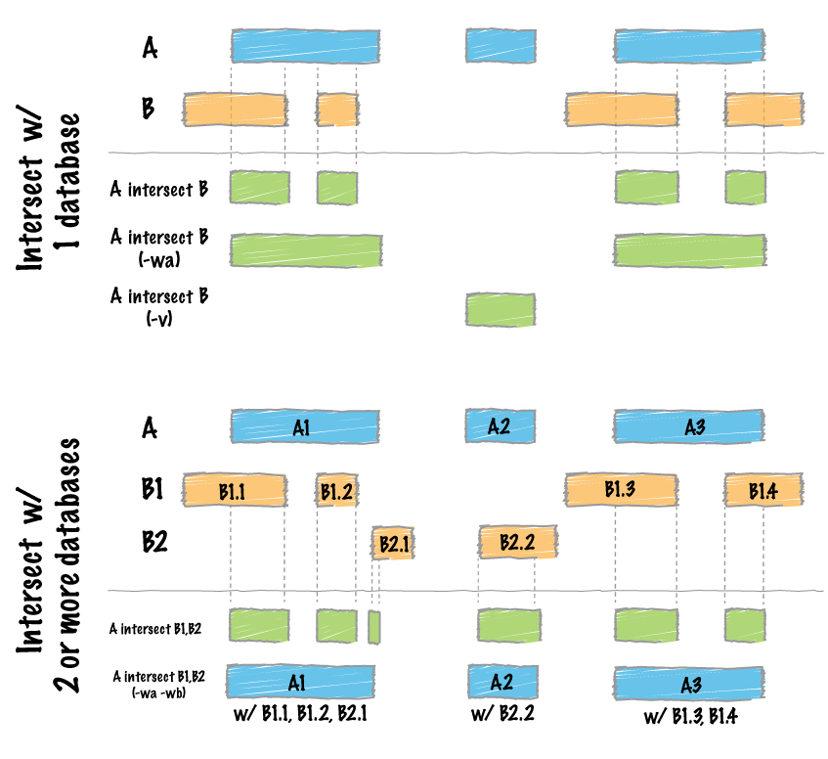
Manipulating annotations with bedtools
Joining is just one common operation we may want to apply to data with shared features or IDs
A similar concept can be applied to regional data using bedtools
overlap regions
intersect regions

Slide 67
Grep responsibly!
A naive attempt to use grep to search for the row for a gene of interest
returns many results we were probably not interested in. Only the first 10 are shown.
grep "GeneID:1000" data/GSE125966.csv | cut -d "," -f 1-3 | head -n 6
## "GeneID:1000",148,61 ## "GeneID:10000",504,563 ## "GeneID:100009613",0,0 ## "GeneID:100009676",7,1 ## "GeneID:10001",822,787 ## "GeneID:10002",0,3

Slide 68
Grep responsibly!
Searching with grep using the -w option specifies the grep treats your search pattern as a word
This often works to remove accidental nested matches, but it doesn’t always work exactly as expected
More sophisticated searching methods will be explored later in the course
grep -w "GeneID:1000" data/GSE125966.csv | cut -d "," -f 1-3 | head
## "GeneID:1000",148,61

Slide 69
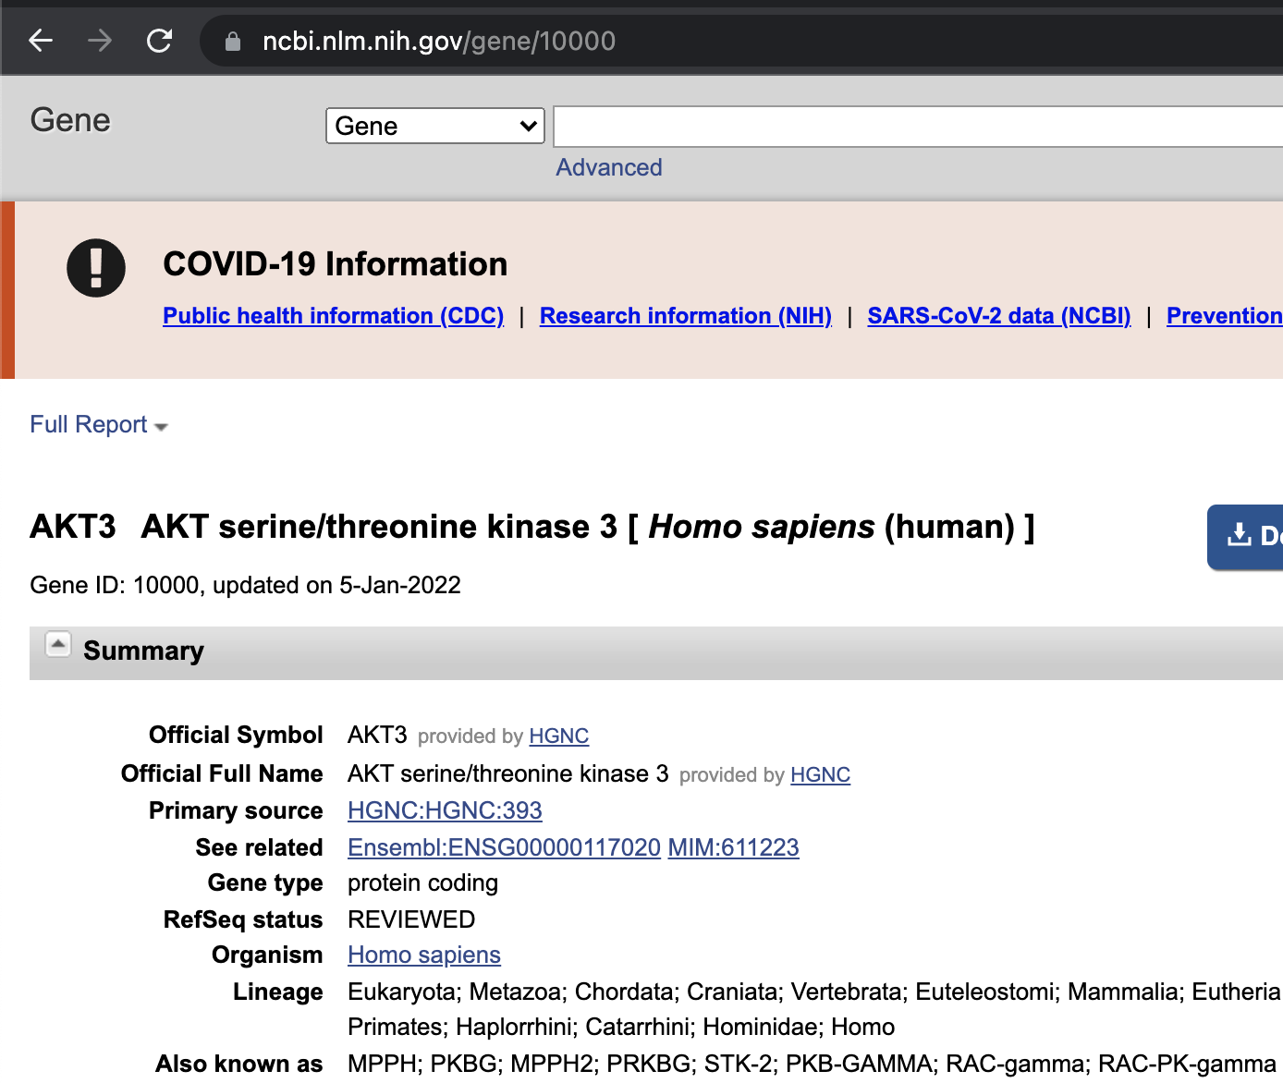
From GeneID to biology
This data set used Entrez Gene annotations
AKT3 has at least 8 other names!
Unique IDs such as Entrez, HGNC symbols (AKT3) and Ensembl IDs are unambiguous
Later in the course we will look at ways to connect IDs to useful information about the gene

Slide 70
Delimited files and pipelines
tab, space or comma-delimited files are by far the easiest to work with programmatically
Many workflows involve extracting the same column(s) or applying the same manipulation on every row
e.g. find matching rows and pass along to another step or alter the data in some consistent way before passing along
flowing data from one program to another this way (using pipes) is referred to as a “pipeline”

Slide 71
Summary and outlook
Bash is a useful environment to efficiently perform quick analyses on various delimited/tabular text formats
Anything we want to do once per line of a file is usually doable
Can also be useful for the manipulation of non-tabular data into a more convenient format
This can be useful as an intermediate step before further processing, e.g. within R or Python
Knowledge: how to use the command-line
Wisdom: when you should/shouldn’t use it

Slide 72
Bonus study material

Slide 73
Revisiting genome size
How would you calculate the number of nucleotides in the human genome?
ls -l data/hg38.fa
## -rw-r--r--@ 1 rmorin staff 3144230986 5 Jan 08:35 data/hg38.fa
Why is this number not equal to the number of nucleotides?
Hint: what else is in a FASTA file?

Slide 74
Revisiting genome size
Why is this number not equal to the number of nucleotides?
head -n 3 data/hg38.fa
## >chr1 AC:CM000663.2 gi:568336023 LN:248956422 rl:Chromosome M5:6aef897c3d6ff0c78aff06ac189178dd AS:GRCh38 ## NNNNNNNNNNNNNNNNNNNNNNNNNNNNNNNNNNNNNNNNNNNNNNNNNNNNNNNNNNNNNNNNNNNNNN ## NNNNNNNNNNNNNNNNNNNNNNNNNNNNNNNNNNNNNNNNNNNNNNNNNNNNNNNNNNNNNNNNNNNNNN

Slide 75
Revisiting genome size
What characters should we count/not count?
For simplicity, let’s count all A/C/T/G/N characters

Slide 76
Revisiting genome size
What characters should we count/not count?
For simplicity, let’s count all A/C/T/G/N characters
There are newline characters at the end of every line and wc and other programs consider them characters (because they are)!

Slide 77
Revisiting genome size
# The number of non-header lines in the file line_num=$(grep -v \> data/hg38.fa | wc -l) # The total number of characters in those lines character_num=$(grep -v \> data/hg38.fa | wc -m)

Slide 78
Revisiting genome size
# The number of non-header lines in the file line_num=$(grep -v \> data/hg38.fa | wc -l) # The total number of characters in those lines character_num=$(grep -v \> data/hg38.fa | wc -m) # subtract the line number from the full character number # Why? echo Genome has $(($character_num - $line_num)) nucleotides! ## Genome has 3099922541 nucleotides!

