Slide 1
MBB 243 - Lecture 1
Ryan Morin

Slide 2
Should I be recording these?

Slide 3

Welcome to the course
Instructor: Ryan Morin
Associate Professor (MBB)
Senior Scientist (BC Cancer)
Bioinformatics & Cancer Genomics lab
Office hour (zoom or in person): 4:30 – 5:30 PM Wednesdays (after class)

Slide 4

Welcome to the course
T.A. Casey Engstrom
Graduate student, Quarmby Lab
Office hour: tentatively Thursdays at 4-5
Bioinformatician, geneticist, snow algae enthusiast

Slide 5
Schedule
Lectures (Wednesday):
Introduce the nature of molecular biology data, molecular biology data analysis, and molecular biology data analysis result presentation
General programming and data analysis concepts
Labs (Friday): Apply the fundamentals of three “languages” commonly used for analysis of scientific data
Command-line interpreter (Bash)
A popular scripting language (Python)
A popular statistical programming language (R )

Slide 6
Getting started
Are you in the Slack Workspace?
Do you have a github account?
Do you have SFU Multifactor Authentication set up and working?
Do you have access to the course StackOverflow site?

Slide 7
Grading
20% In each lab, there is a list of tasks that should be accomplished in class and submitted by the end of each lab.
35% Lab assignments: For some labs, short assignments will be made available and due at the start of your lab one week later.
10% In-class midterm exam
25% cumulative final exam mixture of multiple choice, short answer and written questions
10% Attendance and participation in both lecture and lab

Slide 8
How to get a good grade
Come to class and labs and ask questions if you’re lost/stuck
Come to office hours to ask more questions, if necessary
Post questions to the course StackOverflow page or Slack using channels such as lab-discussion
Practice the things you are learning in class and not just within the context of lab assignments
This is the only effective way to learn programming/data analysis concepts!

Slide 9
Reading
NO REQUIRED TEXTBOOX
Reading material will be provided throughout the course as linked content
As we sink into R, this free book is an excellent resource

Slide 10
Other resources
All source code shown in lectures is in the associated Rmarkdown file
Individual code chunks should run on your lab server
Play with it, tweak it, break it, remix it, repurpose it!
Course glossary and “cheat sheet”
Suggestions for glossary terms I haven’t included are welcome
Submissions of new cheat sheet/glossary entries are highly encouraged and will be rewarded with participation marks

Slide 11
Important links
Lab landing page, with all this information
Zoom for class
Zoom for Dr. Morin’s office hours
TA office hours Thursdays 4-5 PM
Link for remote lab workstation connections This is only needed to connect to the lab server from off campus

Slide 12
Learning goals for the course
Molecular biology generates large volumes of data
Text-based (DNA/RNA/Protein Sequences)
Numeric/quantitative (measurements, observations)
Manipulate files and run individual tools interactively in a command-line environment
The basics of the Python language to perform some analyses and file manipulations
Become familiar with the statistical programming language R
Analyze numerical data of various types
Produce visualizations (plots) NOT using Excel

Slide 13
Learning goals for this week
Become familiar with some common data types we encounter in the life sciences, particularly molecular biology and biochemistry
Understand some basic computer science concepts relating to different data types
Know some basic ways we can represent and manipulate DNA (genome) sequences and their annotations
Become familiar with the command line and appreciate how it enables us to work with some of these data types

Slide 14
General data flavours in biology
Molecular biology experiments primarily lead to two major data types
Sequence (essentially text)
Numeric (quantitative or categorical)
Genome sequence carries your genetic information and identity
mRNA sequence is the portion of the genome that can be made into proteins
How many times a given mRNA is observed can inform on the expression of that gene

Slide 15
Types of sequences
DNA molecules are sequences in an alphabet of four nucleotides
A, C, T, G
Double-stranded, always complementary
RNA molecules are sequences of four nucleotides and are generally single-stranded
A, C, U, G
Protein molecules comprise 20 different amino acids that you have all studied and probably memorized (right?)

Slide 16
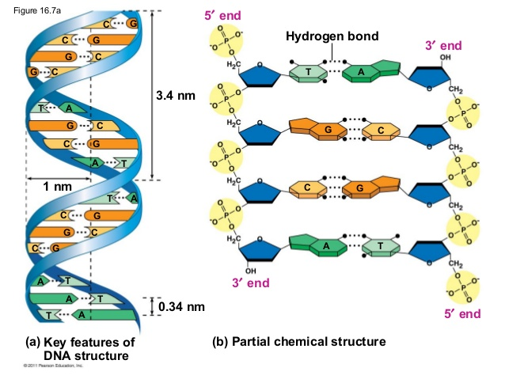
All DNA sequences have a partner
A DNA sequence is a succession of letters indicating the order of nucleotides on one of the complementary strands
For us it is redundant to represent both strands because the other can always be inferred using base pairing rules

Slide 17
DNA sequence as data
The minimal unit of data in computers is a bit, which has two states (0 or 1)
There are eight bits per byte
One byte can be used to encode any ASCII character in a plain text file
In programming, text-based information is represented as either character (length of 1) or string (arbitrary length) but can also be represented in other ways for efficiency
e.g. two bits are sufficient to represent each of the four nucleotide characters

Slide 18
(Alpha)Bits
Imagine the 4 nucleotides mapped to a 2D grid
The answer to two true/false questions can disambiguate any of these
Is it a purine?
purine | pyrimidine
A | C | A-or-C
G | T | not-A-or-C

Slide 19
(Alpha)Bits
Imagine the 4 nucleotides mapped to a 2D grid
The answer to two true/false questions can disambiguate any of these
Is it a purine?
TRUE
purine | pyrimidine
A | X | A-or-C
G | X | not-A-or-C

Slide 20
(Alpha)Bits
Imagine the 4 nucleotides mapped to a 2D grid
The answer to two true/false questions can disambiguate any of these
Is it a purine?
TRUE
Is it one of A or C?
FALSE
It must be G
purine | pyrimidine
X | X | A-or-C
G | X | not-A-or-C

Slide 21
Sequence as a variable
Storing a sequence as a variable uses a similar syntax in the three programming languages we will be using
DNA_seq="ACCTGACCT" # <- that is bash code. #This part is a comment
No spaces allowed when setting a variable!
DNA_seq = "ACCTGACCT" # Python code
White space here is OK but Python has its annoying formatting quirks
DNA_seq <- "ACCTGACCT" # R code
White space is unimportant in this case

Slide 22
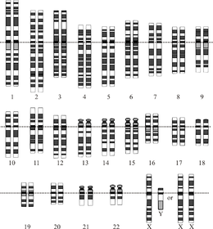
The human genome as data
The longest DNA molecule (chromosome) in the human genome is chromosome 1
249,250,621 base pairs (bp)
What size (in bytes) is a plain text file containing the sequence of human chromosome 1?

Slide 23
The human genome as data
The longest DNA molecule (chromosome) in the human genome is chromosome 1
249,250,621 base pairs (bp)
What size (in bytes) is a plain text file containing the sequence of human chromosome 1?
249,250,621 bytes!

Slide 24
File size of the genome
Let’s jump right in: the size of the human reference genome on disk can be determined with a simple bash command (ls -l)
ls -l data/hg38.fa
## -rw-r--r--@ 1 rmorin staff 3144230986 5 Jan 08:35 data/hg38.fa
Using ls -lh gives the same output but with the size in a more human readable format
ls -lh data/hg38.fa
## -rw-r--r--@ 1 rmorin staff 2.9G 5 Jan 08:35 data/hg38.fa

Slide 25
DNA sequence as plain text files
Most common way to store DNA sequences is FASTA format, which has two components
header lines begin with >
sequence lines are just sequence, usually split across multiple lines
Many more verbose formats available for different applications
harder to work with but can be more versatile
>NC_002516.2 TTTAAAGAGACCGGCGATTCTAGTGAAATCGAACGG GCAGGTCAATTTCCAACCAGCGATGACGTAATAGAT AGATACAAGGAAG

Slide 26
DNA sequence as plain text files
Example FASTA
>NC_002516.2 <-----This is the header line TTTAAAGAGACCGGCGATTCTAGTGAAATC <- sequence GCAGGTCAATTTCCAACCAGCGATGACGTA <- more sequence AGATACAAGGAAG <- end of this sequence >NCC1701-D <------- Header for the next sequence AAAAAAAAAAAAAAAAAAAAAAAAAA <- the next sequence AAAAAAAAAAAAAAAAAAAAAAAAAA <- and so on

Slide 27
How it looks to a computer
Whitespace is important to computers and this can be useful and annoying
Since we can’t see them, in programs we use special notation to represent them (e.g. \n means a line break/ newline)
>NC_002516.2\n TTTAAAGAGACCGGCGATTCTAGTGAAATC\n GCAGGTCAATTTCCAACCAGCGATGACGTA\n AGATACAAGGAAG\n >NCC1701-D\n AAAAAAAAAAAAAAAAAAAAAAAAAA\n AAAAAAAAAAAAAAAAAAAAAAAAAA\n

Slide 28
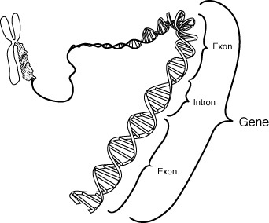
Genes and Chromosomes
A gene is a functional region that consists of one or more exon sequences, usually separated by introns
Exons and introns of a gene are all on the same strand
Genes can exist on the + or the - strand
Broad variability in gene size
e.g. CNTNAP2 is 2.3 Mb long.

Slide 29
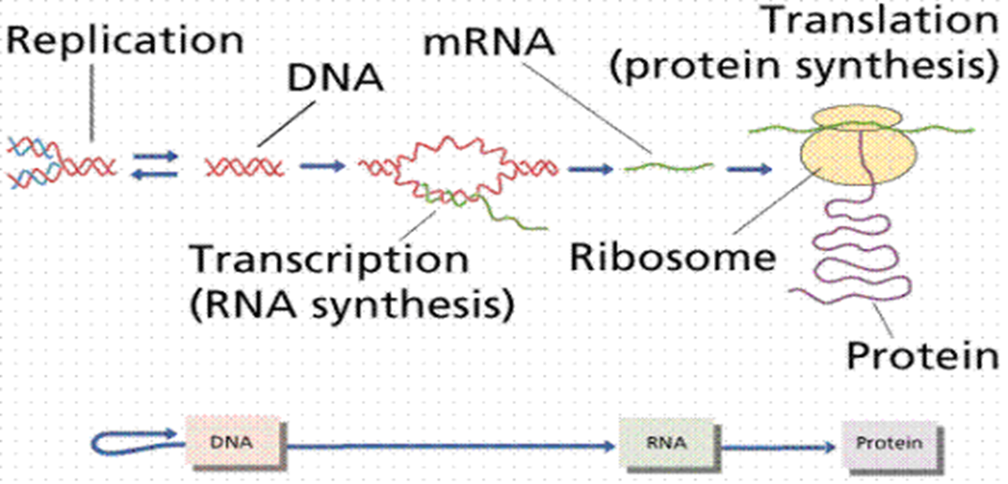
Central Dogma
DNA is copied to complementary DNA during replication
DNA is copied to complementary RNA during transcription
Genetic code is used to produce protein from mRNA through translation

Slide 30
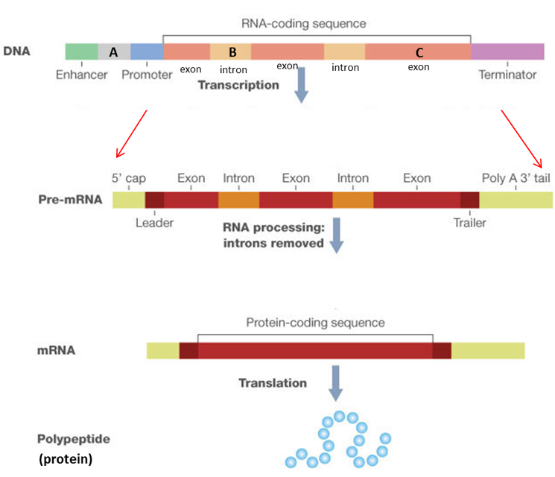
Genes and Transcripts
All genes have unique names
some have more than one name for historical reasons but can only have one official symbol
Exons and introns are transcribed but introns are spliced out
Terminal exons contain untranslated regions (UTR)

Slide 31
Genomic features as data
Every location in a genome can be referred to by a coordinate
The combination of chromosome name, position and strand (where relevant)
The transcription start site of the TTN gene is at chr2:178807423 on the - strand
The location of genes and their elements within the genome is one type of annotation
Most annotations have two positions (i.e. start and end)

Slide 32
What is the first number?
When storing multiple values in one variable (e.g. an array or list), each is retrieved/set using a unique index
Programming languages almost universally use 0 as the first available index (including Python) R is an exception
Genomic coordinate systems have a similar inconsistency
Zero-based vs 1-based systems
To be discussed in more detail later in the course

Slide 33
Genomic Features as Plain Text
Various formats exist for representing genomic annotations most are delimited plain text
Delimiters such as tab, comma or semicolon are treated as special characters to separate columns
Standardized formats dictate what data each column contains
e.g. BED format )
Example BED file:
chr7 7471196 7472363 chr7 7472363 7473530 chr7 7473530 7474697
columns must be separated by a tab (not space)
no column-defining header line

Slide 34
How it looks to a computer
Tabs (\t) separate each column, newlines (\n) separate each row
The meaning of each column is entirely dependent on knowing what file format you have
More generic delimited files will have a header line defining each column
chr7\t7471196\t7472363\n chr7\t7472363\t7473530\n chr7\t7473530\t7474697\n

Slide 35
From Features to Sequence
Extracting DNA sequence from a region of interest at the command line
# samtools is the program we are using # faidx tells it we want to extract sequence # data/hg38.fa is the file we will extract from # chr2:178807210-178807299 is our region samtools faidx data/hg38.fa chr2:178807210-178807299 #output is in fasta format and the header is auto-generated:
## >chr2:178807210-178807299 ## ACCTGATTTCTCAAGAGTGCCTAAAAAGGGTGGGACTAAGCCCAAGGTTGCTTCTGAAAC ## GACGTCCTATGGAGAGTTGGTTTTTCTGAC

Slide 36
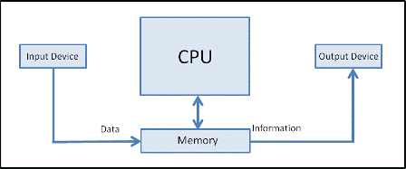
Respect your computer’s limits
The simple act of reading a file from disk into RAM (memory) can be noticeably slow
Storing text (strings) in RAM will consume more memory than you expect
The procedure on the previous slide uses indexing to allow you to rapidly skip to the place in the file you need without reading/storing the entire contents

Slide 37
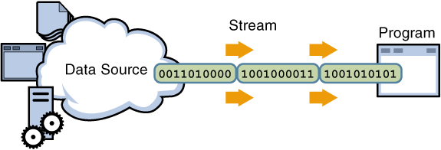
Respect your computer’s limits
It’s virtually never necessary to store large sequences as variables
Use an indexed file and skip to the data you need OR
Read from the start and don’t store until necessary (e.g. when you hit a specific line of text, e.g. a chromosome of interest) OR
read from the start and process data in a stream while also outputting results

Slide 38
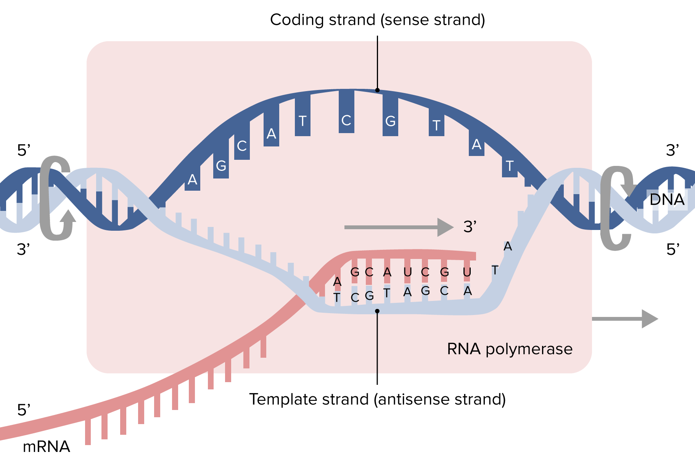
From DNA sequence to mRNA sequence
The rules of transcription are simple: the template strand of the DNA duplex becomes complementary RNA
The resulting mRNA has the same nucleotide sequence as the coding strand but with U in place of T

Slide 39
Transcription is “simple” to code
# get the sequence of the region, skipping header seq=$(samtools faidx data/hg38.fa chr1:23,559,389-23,559,426 | grep -v \> )

Slide 40
Transcription is “simple” to code
# get the sequence of the region, skipping header seq=$(samtools faidx data/hg38.fa chr1:23,559,389-23,559,426 | grep -v \> ) # reverse the sequence (- strand gene) reversed_seq=$(echo $seq | rev) # Complement sequence complemented=$(echo $reversed_seq | perl -pe 'tr/ACTG/TGAC/')

Slide 41
Transcription is “simple” to code
# get the sequence of the region, skipping header seq=$(samtools faidx data/hg38.fa chr1:23,559,389-23,559,426 | grep -v \> ) # reverse the sequence (- strand gene) reversed_seq=$(echo $seq | rev) # Complement sequence complemented=$(echo $reversed_seq | perl -pe 'tr/ACTG/TGAC/') # Substitute all T positions with U rna=$(echo $complemented | perl -pe 's/T/U/g') #print them all out for visual comparison echo "$seq<-DNA"; echo $reversed_seq; echo $complemented; echo "$rna <-mRNA!"
## GCCTCGTAGCAGCCGCGCACCGGGCTCAGCGCCTTCAT<-DNA ## TACTTCCGCGACTCGGGCCACGCGCCGACGATGCTCCG ## ATGAAGGCGCTGAGCCCGGTGCGCGGCTGCTACGAGGC ## AUGAAGGCGCUGAGCCCGGUGCGCGGCUGCUACGAGGC <-mRNA!

Slide 42
What just happened?
The sequence of a region was extracted and the output of that command was used to set a new variable named seq
The contents, $seq, were manipulated using several utilities and saved as a new variable each time: reversed_seq, complemented, rna.
Multiple steps used Perl, a programming language that has many convenient features for text manipulation
rev could be accomplished with perl -pe 'reverse'
We will see more examples of how to accomplish this in a single language (Python) later in the course

Slide 43
Outlook
The example on the previous slide could be done numerous ways at the command line
There is always more than one way to get the same (or similar) result
Tradeoff between code efficiency (CPU/memory usage), readability, ease of implementation
Once comfortable in bash, the interactive environment can be a handy way to accomplish many “one-off” analyses
Implementing full scripts or programs to do this involves more of a time investment

Slide 44
Thought experiment
Assume you were given a BED file with the exonic coordinates and strand information for a single gene
How could you reconstruct the mRNA (or cDNA) sequence for that gene?
Could you also determine the protein sequence (why/why not)?
Step 1: Use coordinates to extract DNA sequence for exon 1, then exon 2, then exon 3.
Check strand
Step 2:
Depending on if + or – strand gene: concatenate exon1 + exon 2 + exon 3
Step 3: Convert to mRNA sequence by swapping every T with U

Slide 45
Thought experiment
Assume you were given a BED file with the exonic coordinates and strand information for a single gene
How could you reconstruct the mRNA (or cDNA) sequence for that gene?
Could you also determine the protein sequence (why/why not)?
No because you need to know where the translation start site is (you need the right one)
…

Slide 46
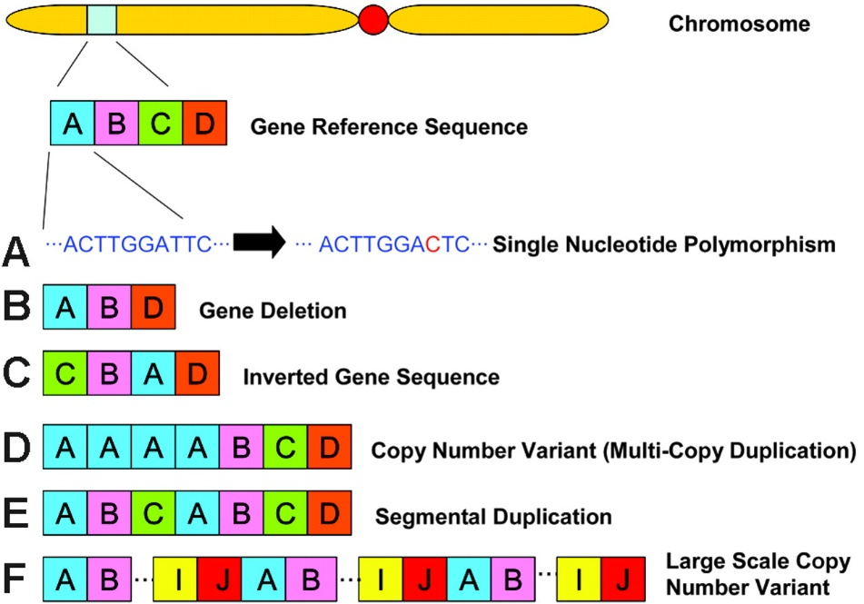
Genetic variation
Genomes continuously change due to mutations
Can be neutral, detrimental or beneficial
The driving force in evolution
Mutations fixed in the population are called single nucleotide polymorphisms (SNPs)
Any two unrelated genomes differ by >3 million SNPs

Slide 47
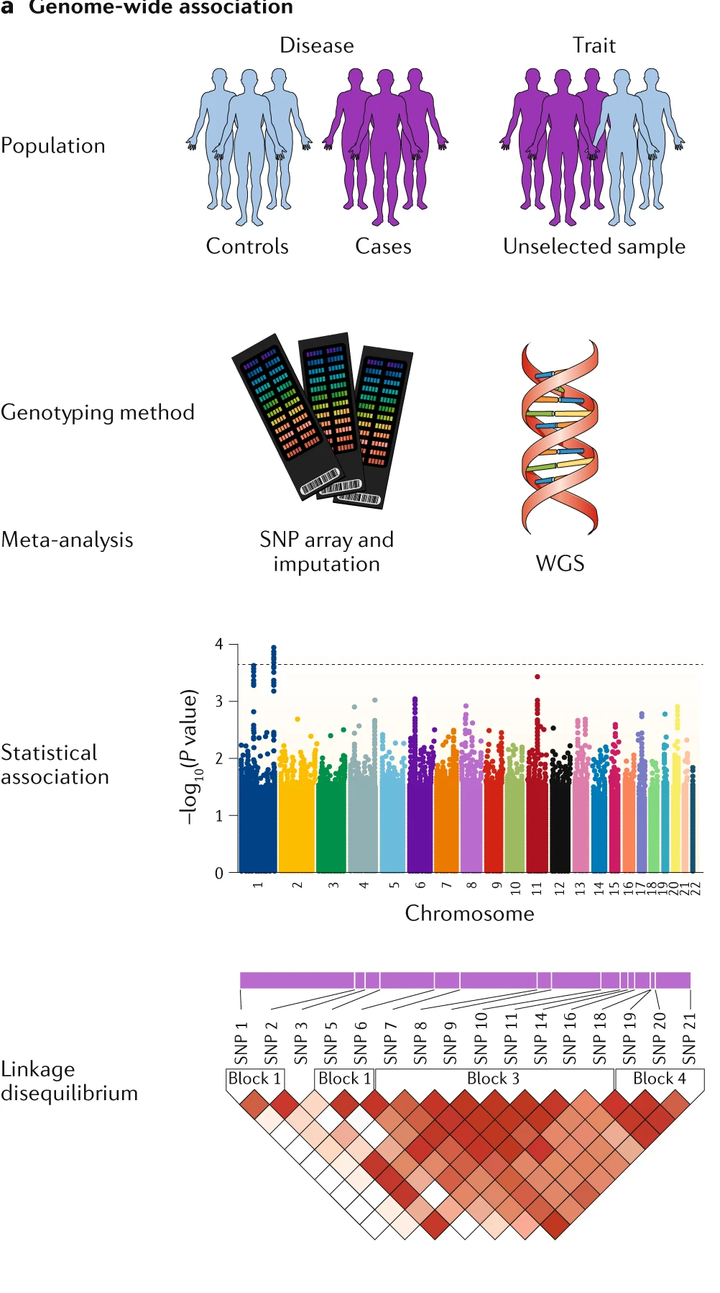
SNPs: the foundation of population genetics
High-throughput approaches allow genotyping at > 1 million positions
SNPs are commonly referred to by allele
A and B
AA, BB, AB (heterozygous)
Each corresponds to one of two nucleotide sequences at the corresponding position in the reference genome

Slide 48
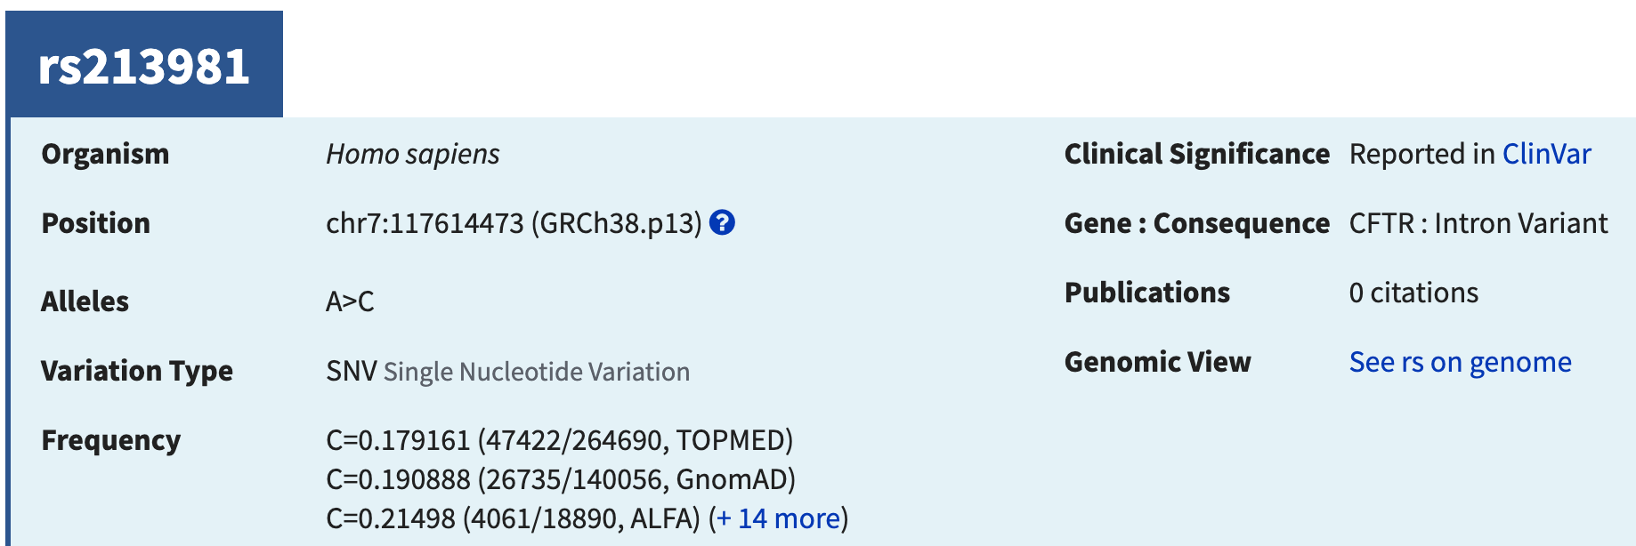
SNP database
Common SNPs all have unique identifiers in the SNP database (dbSNP)
Each allele is associated with one or more population frequencies
Lower minor allele frequency implies lower rate of heterozygotes (according to Hardy-Weinberg)

Slide 49
Example Biallelic SNP
In the reference genome this position is an A:T pair
The other allele is a C:G pair
The GnomAD population frequency of the C is 0.190888

Slide 50
Polymorphisms vs genotypes
SNPs are essentially a type of genome annotation relative to a population
usually have two possible alleles
Each allele has a frequency relative to any population in which the allele exists (i.e. how common it is among the individuals)
Genotypes are a feature of an individual
A concise representation of the most informative regions of a person’s genome
Every person can be described by their genotype at all/some SNPs

Slide 51
Genotypes as data
Sets of genotypes can be represented in a basic plain text, delimited format
23andMe result for Dr. Morin is below (about 960,000 rows)
#rsid chromosome position genotype rs4477212 1 82154 -- rs3094315 1 752566 AA rs3131972 1 752721 GG rs12124819 1 776546 -- rs11240777 1 798959 GG rs4970383 1 838555 AC rs4475691 1 846808 CC

Slide 52
Genotypes as data
Sets of genotypes can be represented in a basic plain text, delimited format
23andMe result for Dr. Morin is below (about 960,000 rows)
#rsid chromosome position genotype rs4477212 1 82154 -- <--- not called rs3094315 1 752566 AA <--- homozygous A rs3131972 1 752721 GG rs12124819 1 776546 -- rs11240777 1 798959 GG <--- homozygous G rs4970383 1 838555 AC <--- heterozygous

Slide 53
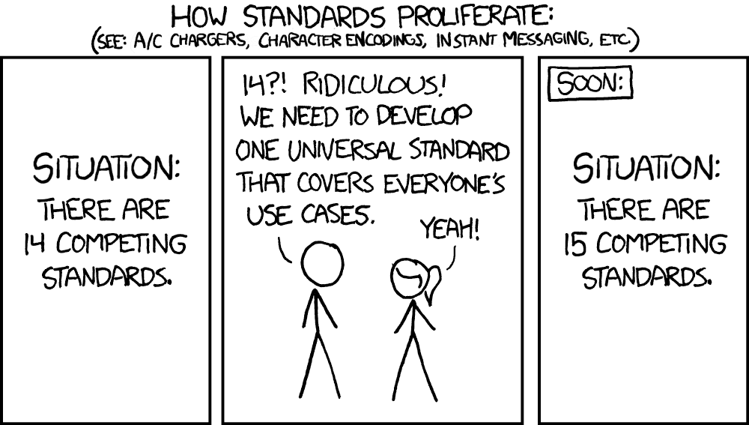
Standard format for variants
Bioinformatics community loves creating data standards
Bioinformaticians seem to be bad at adhering to them
Variant Call Format (VCF) is one such widely adopted and broadly despised standard
We will revisit this in a future lab and MBB 342, if you can wait that long

Slide 54
“Fun” exercise
What is the breakdown of heterozygous and homozygous positions in Dr. Morin’s genome?
Let’s solve this with the command line (bash)
tail -n +2 data/Morin_genotypes.txt | egrep -v "MT|X|Y|--" | cut -f 4 | head -n 2 # get non-header lines from the file with tail # drop non-autosome rows using egrep # keep only the fourth column (the genotype)
## AA ## GG

Slide 55
“Fun” exercise
What is the breakdown of heterozygous and homozygous positions in Dr. Morin’s genome?
Let’s solve this with the command line (bash)
tail -n +2 data/Morin_genotypes.txt | egrep -v "MT|X|Y|--" | cut -f 4 | sort | uniq -c | perl -pe 's/^\s+//' > genotype_counts.txt # get non-header lines from the file with tail # drop non-autosome rows using egrep # keep only the fourth column (the genotype) # Sort the rows so we can count them # Count the occurrences of each genotype # and redirect output to new file

Slide 56
Bash solution, continued
Math is awful in the command line because variables are all strings by default
Math is also annoying because the bc tool needs its input on one line and we usually don’t have things in this format
# crunch the numbers from the file we just created # egrep can keep or drop homozygous lines # the -v switches the behaviour # paste is a tool to combine rows into one line egrep "AA|CC|DD|GG|TT|II" genotype_counts.txt | cut -d " " -f 1 | paste -sd+ - | bc
## 637655

Slide 57
Bash solution, continued
Math is awful in the command line because variables are all strings by default
Math is also annoying because the bc tool needs its input on one line and we usually don’t have things in this format
# crunch the numbers from the file we just created # egrep can keep or drop homozygous lines # the -v switches the behaviour # paste is a tool to combine rows into one line egrep -v "AA|CC|DD|GG|TT|II" genotype_counts.txt | cut -d " " -f 1 | paste -sd+ - | bc

Slide 58
What did I just watch?
the command line is a powerful way to manipulate data in text files
Simple commands are often combined together with a pipe |, which allows the output of one command to be the input for another command
Output can also be “redirected” into a file with >
cut extracts a single column for subsequent steps
paste combines lines into one row
egrep and grep are searching plain text for exact or partial matches

Slide 59
egrep and |
egrep is the simplest way to match one of a number of different search criteria
Combining your search patterns is as simple as separating them with |
This is not acting as a pipe in this context, instead it’s interpreted as OR
egrep “A|B|C|D” will match any line containing A or B or C or D

Slide 60
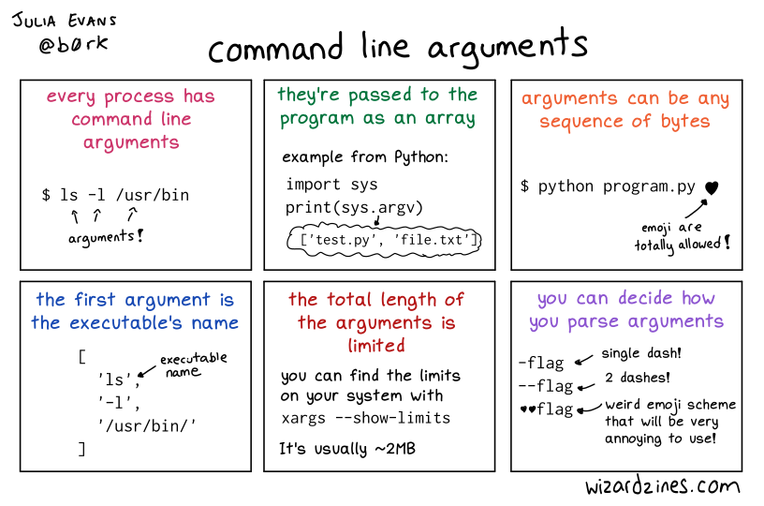
Command-line arguments

Slide 61
Wildcards and globbing
There are some characters that have special meaning and function in bash and thus, cannot be part of real file names or paths
These include ?, *, various forms of brackets, and /
The * is extremely useful because it acts as a shortcut to allow multiple files to be specified shorthand (this is called “globbing”)
*.txt matches all files ending with .txt in the working directory
/home/*/fasta* matches all files in any users home directory starting with “fasta”

Slide 62
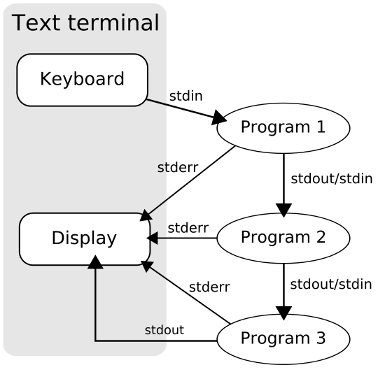
Input, Output and pipes
Data flows from the terminal or a file as STDIN (standard input)
STDOUT is the output and by default is printed to the terminal but can flow to other programs or redirected to a file
STDERR is a special output for error messages

Slide 63
Putting it all together
To store the result of a bash command as a new variable the syntax is NEW_VARIABLE=$(your bash commands)
#store the number of homozygous positions N_HOMO=$(egrep "AA|CC|DD|GG|TT|II" data/genotype_counts.txt | cut -d " " -f 1 | paste -sd+ - | bc) #store the number of heterozygous positions N_HETERO=$(egrep -v "AA|CC|DD|GG|TT|II" data/genotype_counts.txt | cut -d " " -f 1 | paste -sd+ - | bc) echo "100*$N_HOMO/($N_HOMO+$N_HETERO)" echo "100*$N_HOMO/($N_HOMO+$N_HETERO)" | bc
## 100*637655/(637655+269176) ## 70

Slide 64
Variables don’t always vary
As you will explore in the lab, many variables will be set at the start of your bash session and never change
Environment variables store useful information about your session that allows things to work the way you want
Example: PATH environment variable tells Linux where to find all the executables you may want to run
When you type a command such as python the exact program that is run will depend on the contents of PATH

Slide 65
Variables don’t always vary
The which program tells the user the path to the program that gets run when you enter a given command without the full path
echo $PATH
## /usr/bin:/bin:/usr/sbin:/sbin:/usr/local/bin:/Library/TeX/texbin:/opt/X11/bin:/Applications/RStudio.app/Contents/MacOS/postback
which python
## /usr/bin/python
which R
## /usr/local/bin/R

Slide 66
From interactive sessions to scripts
any series of bash commands can be automated by putting the same commands into a plain text file that has a special line at the top to tell the computer what interpreter to use
More generally, the commands for any interpreted/scripting language work this way (bash, Python, R, Perl, Awk, etc)
The first line is our “shebang” line. This is the only time a line starting with # isn’t a comment!
#!/bin/bash echo "Hello World"

Slide 67
From interactive sessions to scripts
To run this, you simply have to save those lines in a plain text file of any name
Though not required, by convention you should end it with .sh to indicate it’s a shell script
One more thing: the file permissions must be set to “executable”
-rw-r--r--@ 1 me staff 31B 8 Jan 14:52 a.sh #won't run for anyone -rwxr--r--@ 1 me staff 31B 8 Jan 14:52 b.sh #only runs for the owner of the file (me) -rwxr-xr--@ 1 me staff 31B 8 Jan 14:52 c.sh #runs for the file owner and any member of the staff group

Slide 68
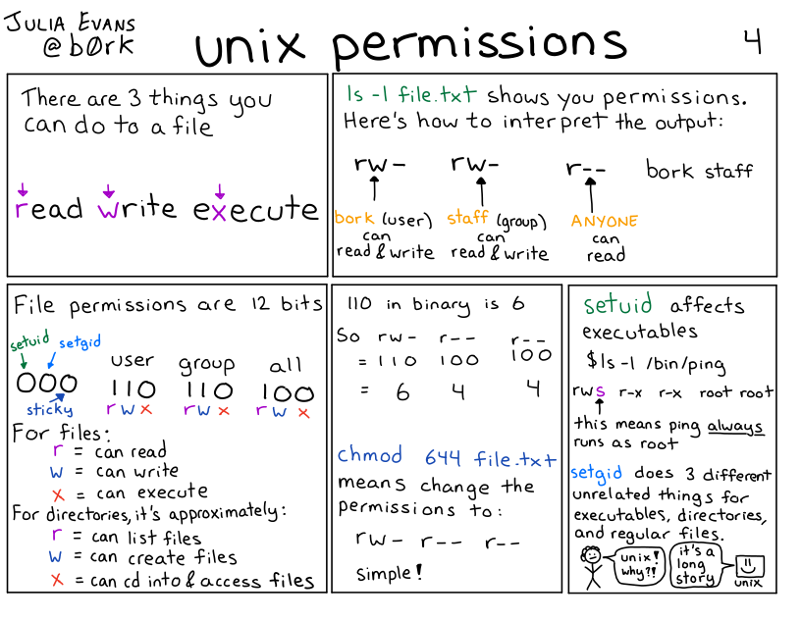
Permissions in UNIX/Linux

Slide 69
Changing file permissions with chmod
# a = all, u=owner, g=group, o=others # use +x to give -x to revoke executable permissions # other permissions: r=read, w=write/delete ls -l scripts/hello_world.sh
## -r--------@ 1 rmorin staff 31 10 Jan 15:08 scripts/hello_world.sh
chmod u+x scripts/hello_world.sh ls -l scripts/hello_world.sh
## -r-x------@ 1 rmorin staff 31 10 Jan 15:08 scripts/hello_world.sh
chmod o+x scripts/hello_world.sh ls -l scripts/hello_world.sh
## -r-x-----x@ 1 rmorin staff 31 10 Jan 15:08 scripts/hello_world.sh

Slide 70
What command would we need to
Allow any user to run the script a.sh?
-rw-r--r--@ 1 big_nerd1 scientists 31B 8 Jan 14:52 a.sh
Prevent people outside the students group from reading the contents of filez.gz?
-rw-r--r--@ 1 big_nerd2 students 31B 8 Jan 14:52 filez.gz

Slide 71
What command would we need to
Allow any user to run the script a.sh?
-rw-r--r--@ 1 big_nerd1 scientists 31B 8 Jan 14:52 a.sh
chmod a+x a.sh
-rwxr-xr-x@ 1 big_nerd1 scientists 31B 8 Jan 14:52 a.sh
Prevent people outside the students group from reading the contents of filez.gz?
-rw-r--r--@ 1 big_nerd2 students 31B 8 Jan 14:52 filez.gz
chmod o-r filez.gz
-rw-r-----@ 1 big_nerd2 students 31B 8 Jan 14:52 filez.gz

Slide 72
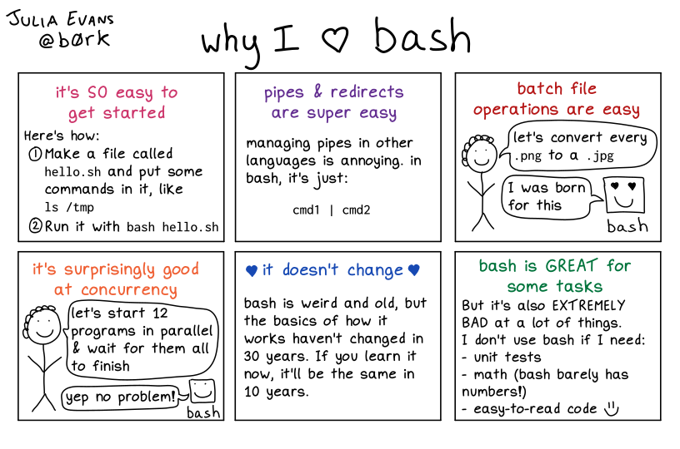
Closing thoughts before your lab

