Slide 1
Climate change analysis
A 2025 Data analysis project
Maximilián Cenkner

Slide 2
Analysis goals
1 Has any of these metrics changed? How?
Temperature (Celsius)
CO2 Emmissions (Mt)
Sea levels (mm)
Climate Risk Index — CRI
2 Which countries/ territories emit the most?

Slide 3
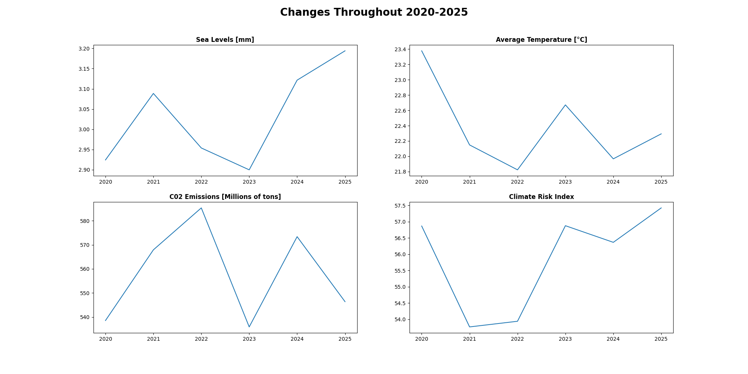
Objective one
Key insights: From 2020 to 2023, I can see a steady decline in almost all of the metrics on the right, which may indicate a slight improvement of the situation. From 2023, we can see an increase back to values before the pandemic or higher.
Factors: SARS-CoV-2 pandemic during 2020-2023

Slide 4
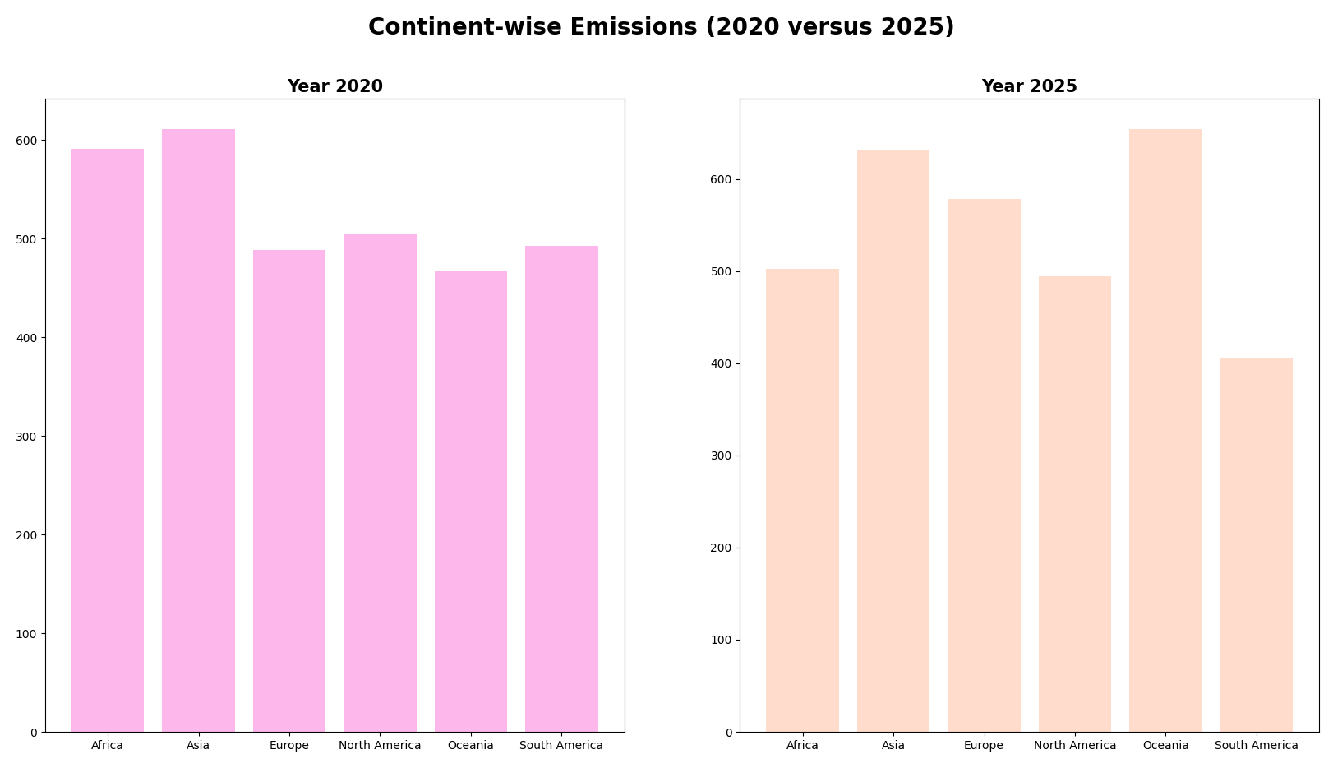
Objective two
Key insights: The results vary in this comparison. While some continents increased their emissions (e.g. Europe, Oceania and China – slightly), some have decreased them over the period. I suggest diving further deep into which countries emit the most and if they, for example, decreased their emissions during the pandemic.

Slide 5
Conclusion
While on average, countries reduced their emissions and other metrics during the period of the covid pandemic, after it, the values quickly returned back to values from before.
To draw any more conclusions, It‘d be ideal to have more information.

