Slide 1
JÖNKÖPING UNIVERSITY
PHASE 8.6.20 V6a: TENSILE TO FAILURE — 100 % INFILL (PILOT)
Test setup
Test timeline
Parameter | Value
Specimen | S7 — fresh PLA, 100 % infill, LED on
Geometry | 10 × 8 mm gauge (80 mm², CAD-verified)
Markers | Spray paint — DIC 99.9 % to fracture
Preload | +470 N (anchor 475 N post-fracture)
Rate | 0.1 mm/s (rate-matched to V5)
Load cell | ANYLOAD 3 t — peak used 13 %
Reference | Chacón et al. (2017), Materials & Design
Mount S7 + spray markers; LED on
Preload +470 N → Tare δ / load / DIC
LED pre-flight: ε_c≈0, 2 blobs tracked
Pull 0.1 mm/s → UTS 3826 N @ 0.020
47.8 MPa
UTS (nominal)
3 826 N
peak force
2.41 GPa
E (nominal)
Plastic plateau → 7 % softening
47.8 MPa
σ_y (0.2 %)
2.98 %
failure strain
≈ 1
offset k
Fracture ε_f = 0.030 @ 7.33 mm travel
V6a (S7) = the PILOT (first) 100 % specimen, shown here in detail. It is the batch's strength / modulus EDGE point — representative n = 5 result on pp. 157–160; the V5 comparison uses V6d (≈ mean).
141

Slide 2
JÖNKÖPING UNIVERSITY
PHASE 8.6.20 V6a: PREDICTED RESULTS (pre-test)
Hypotheses before pulling the 100 % specimen
Quantity | Predicted | Actual | Verdict
Peak force | ≤ ~4.8 kN (≈2× V5) | 3.83 kN | ✓ in range
UTS (nominal 80 mm²) | lands in Chacón 32–50 MPa | 47.8 MPa | ✓ in range
Offset factor k | ≈ 1 (no knock-down) | 0.67–1.25 | ✓ ≈ 1
σ_y | ≈ 2× V5 (rate-matched) | 47.8 MPa (2.5×) | ✓
Failure mode | stiffer, higher force, slight soften | 7 % soften, ε_f 0.030 | ✓
DIC under LED | ≥ 95 % tracking, clean floor | 99.9 % | ✓
Core hypothesis (G2/G3): if the 50 % offset (k≈1.45) is purely an infill knock-down, then 100 % infill at the same nominal area should reach literature directly with k ≈ 1. Confirmed below.
Predictions set from the 50 % V5 baseline + Chacón (2017) ranges and the infill-knock-down argument.
142

Slide 3
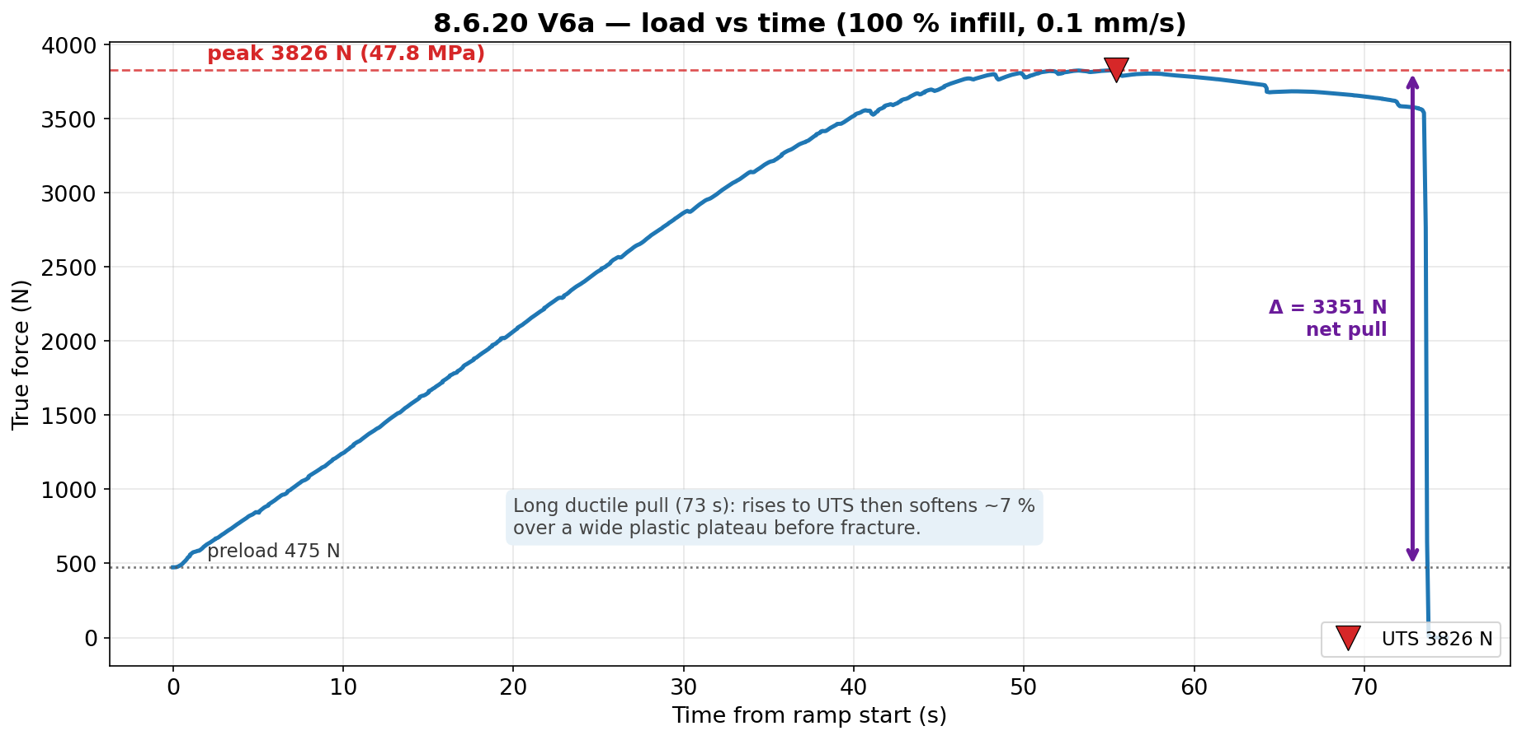
JÖNKÖPING UNIVERSITY
PHASE 8.6.20 V6a: LOAD vs TIME
Long ductile pull (73 s) at 0.1 mm/s: rises to UTS 3826 N then softens ~7 % over a wide plastic plateau before fracture. Net pull Δ ≈ 3351 N above the 475 N preload.
143

Slide 4
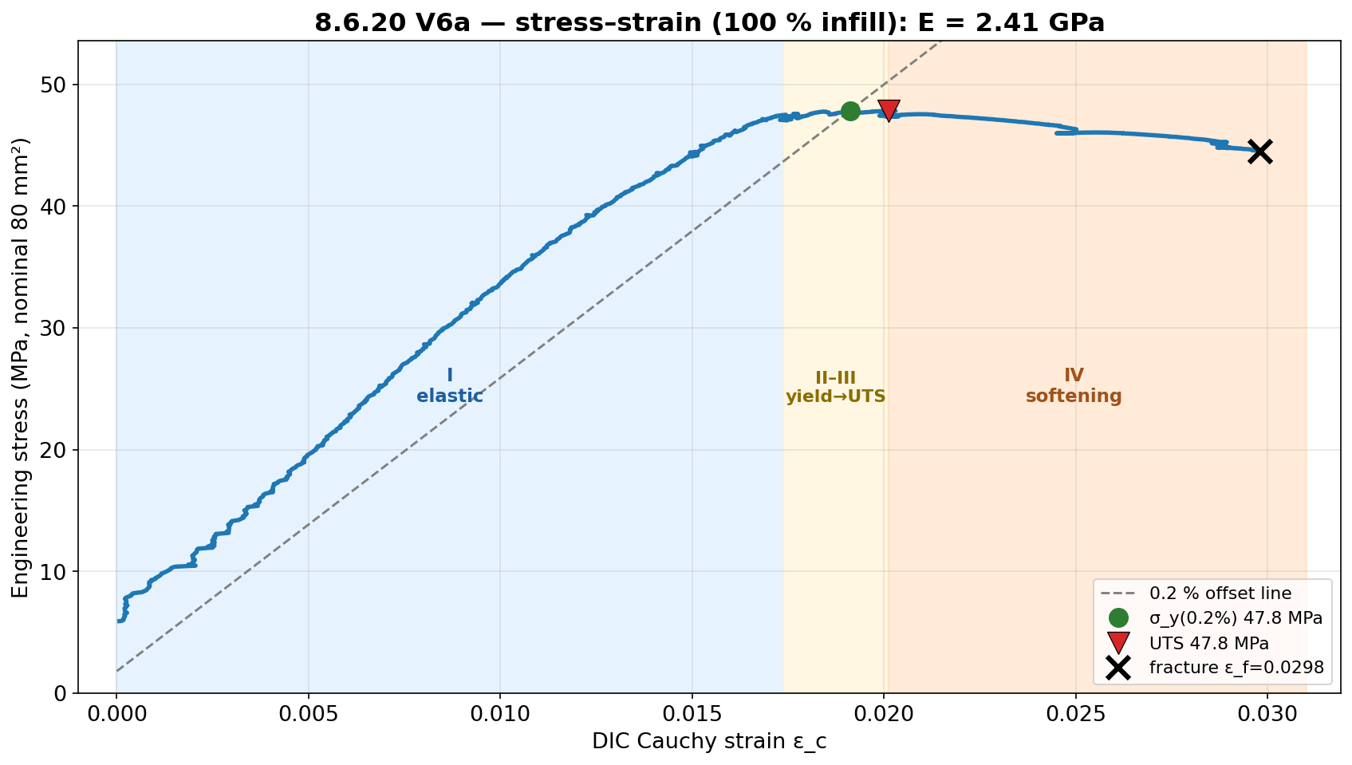
JÖNKÖPING UNIVERSITY
PHASE 8.6.20 V6a: STRESS vs STRAIN
E = 2.41 GPa; σ_y(0.2 %) 47.8 MPa ≈ UTS 47.8 MPa (near-linear to peak), then region IV softening to ε_f = 0.030. Strength is the robust DIC-independent result (load cell + fixed area).
144

Slide 5
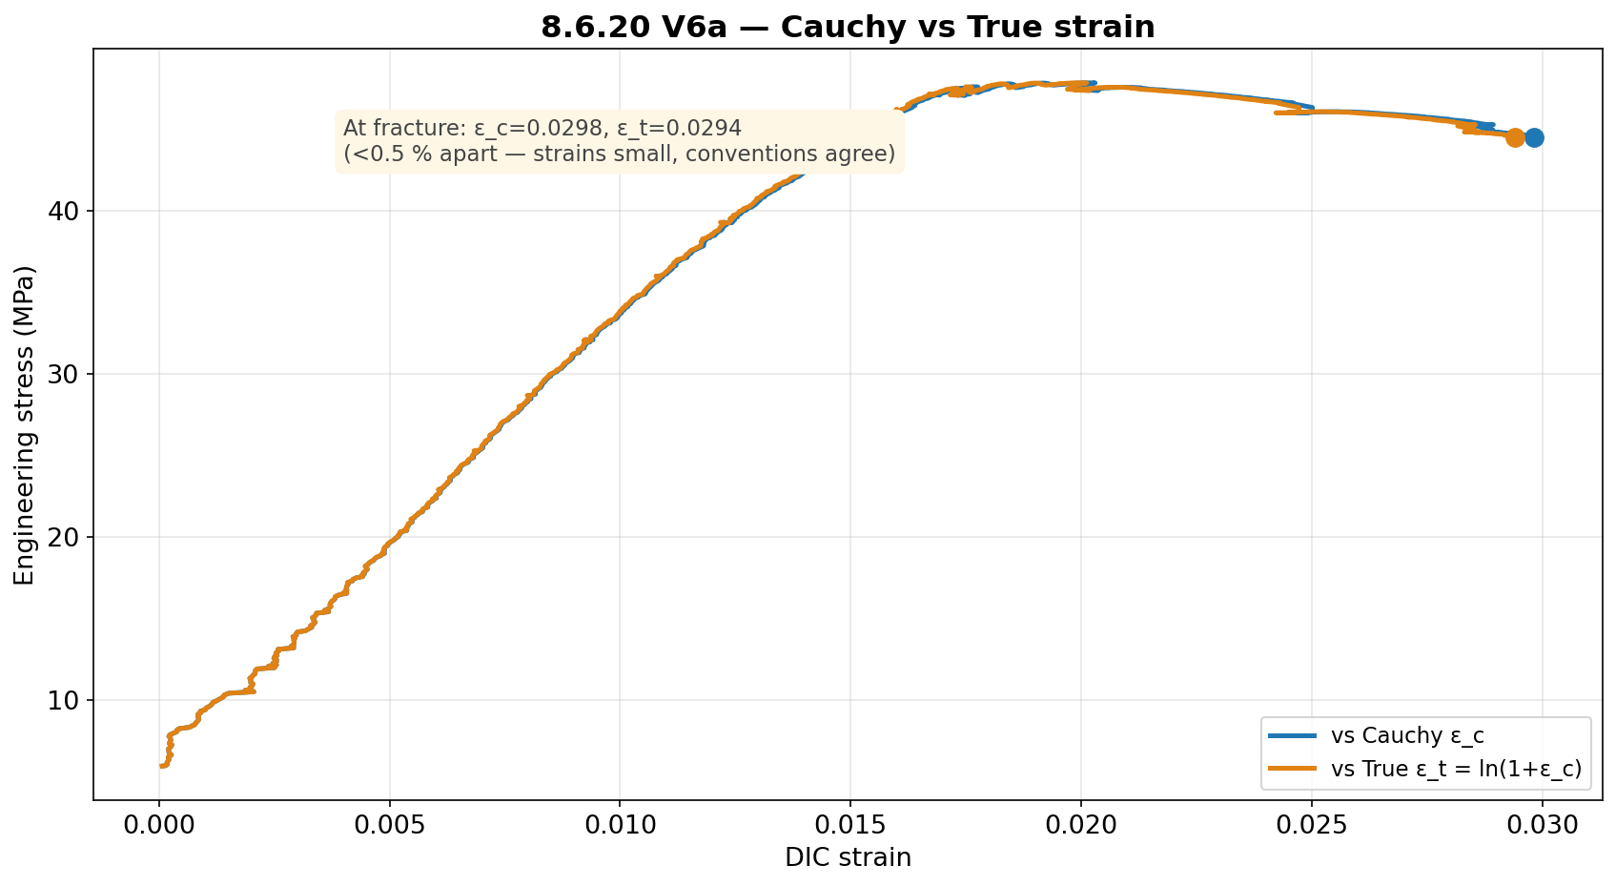
JÖNKÖPING UNIVERSITY
PHASE 8.6.20 V6a: CAUCHY vs TRUE STRAIN
Cauchy and True strain agree to <0.5 % (strains are small): ε_c = 0.0298 vs ε_t = 0.0294 at fracture.
145

Slide 6
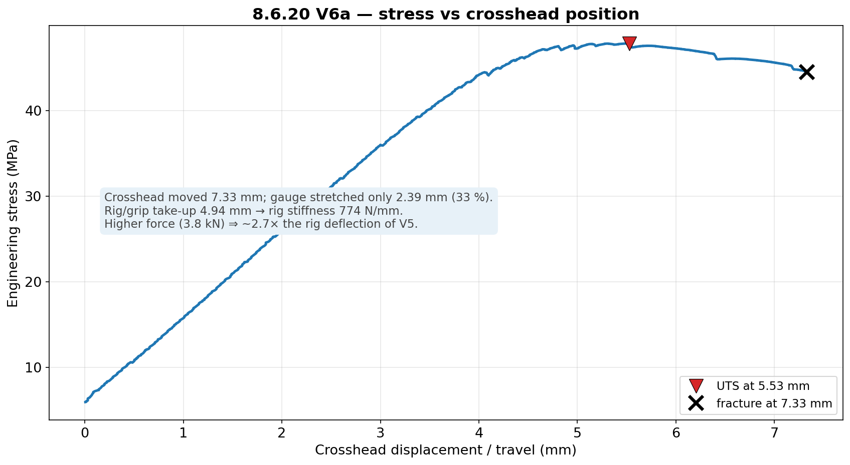
JÖNKÖPING UNIVERSITY
PHASE 8.6.20 V6a: STRESS vs CROSSHEAD POSITION
Of 7.33 mm crosshead travel, only 2.39 mm (33 %) stretched the gauge; rig/grip took up 4.94 mm. Higher force (3.8 kN) ⇒ ~2.7× the rig deflection of V5 → strain MUST come from DIC.
146

Slide 7
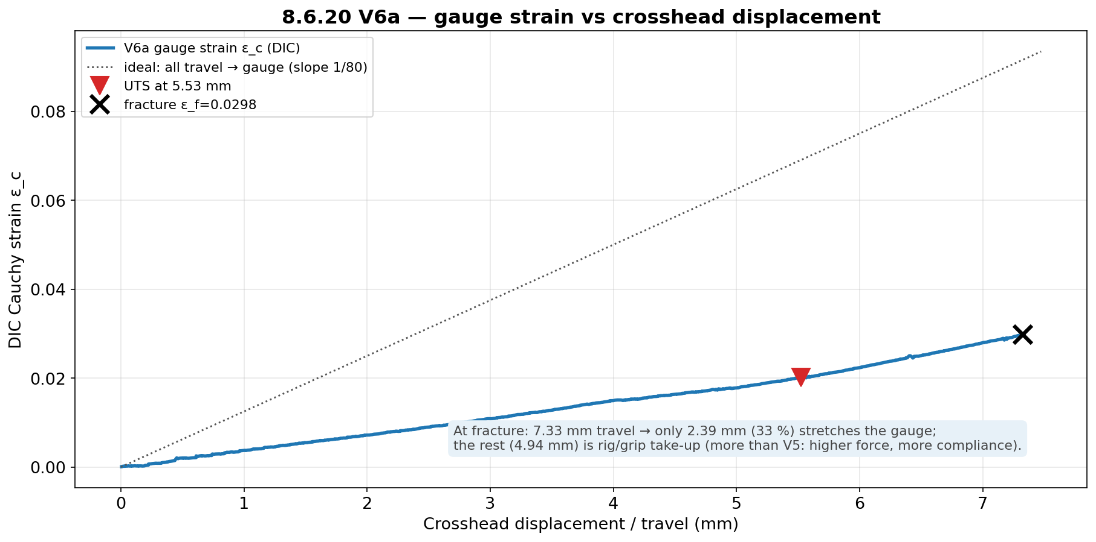
JÖNKÖPING UNIVERSITY
PHASE 8.6.20 V6a: GAUGE STRAIN vs DISPLACEMENT
Gauge strain rises ~linearly with travel but well below the ‘all-travel-to-gauge’ line — confirming ~two-thirds of the crosshead motion is machine compliance at this force level.
147

Slide 8
JÖNKÖPING UNIVERSITY
PHASE 8.6.20 V6 (n = 5): VALIDATION — JOURNAL REFERENCE
Chacón (2017) journal — n = 5 mean vs range, offset k = Chacón_min / measured
Property | V5 k | V6 k | V6 mean (n=5) | Chacón range
E | ×1.95 | ×1.15 | 2.60 GPa | 3.0–5.5 GPa
σ_y | ×1.58 | ×0.67 | 45.0 MPa | 30–50 MPa
UTS | ×1.45 | ×0.69 | 46.2 MPa | 32–60 MPa
2.09×
UTS vs 50 %
5.0×
toughness vs 50 %
≥99 %
DIC tracking (LED)
13 %
peak / load-cell
Green = measured value lands INSIDE the Chacón range; yellow = just below. At 100 % infill the strength values land in literature directly: UTS 46.2 MPa and σ_y 45.0 MPa sit mid-range (k = 0.67–0.69 < 1 ⇒ no knock-down needed). E (2.60 GPa, ×1.15) is ~13 % below the 3.0 GPa floor — held down by the rig-compliance-limited apparent modulus. Strength common-factor window ≈ [0.69, 1.11] → k ≈ 1 (p. 155).
G2 ✓ 100 % infill reaches literature (k≈1). G3 ✓ the 50 % offset (×1.45) was purely the infill knock-down.
DIC validated under LED lighting (clean ≥99 % tracking across all 5, stable baseline) — lighting is precision-only, as predicted.
n = 5 mean vs Chacón (2017); per-specimen repeatability on p. 157, add:north datasheet on p. 156. Strength inside range (k ≈ 1); E ~13 % below the journal floor.
148

Slide 9
JÖNKÖPING UNIVERSITY
PHASE 8.6.20 V6a: RECOMMENDATIONS / NEXT
1
Run V6b, V6c (100 % repeats, LED on) to confirm offset-≈1 repeatability — as the 50 % set established for k≈1.45.
2
For material claims at 100 % infill, report nominal values directly (no infill correction); apply the ×1.45 knock-down only for 50 % infill parts.
3
LED neutrality: V6a tracked 99.9 % under LED, so lighting works for DIC. The formal 50 % LED on/off gate (V5d/e) was skipped — backfill it only if a 50 % LED-on dataset is needed.
4
Keep the rate at 0.1 mm/s for all remaining runs (the V5c2 0.2 mm/s rate-confound lesson).
5
Post-fracture DIC fully drops out at 100 % (energetic fracture) — the load-collapse anchor handles it; the strength result is unaffected.
Next bench step: V6b/V6c (100 % repeats). Campaign goals G1 (50 % repeatable), G2/G3 (100 %≈literature) met.
149

Slide 10
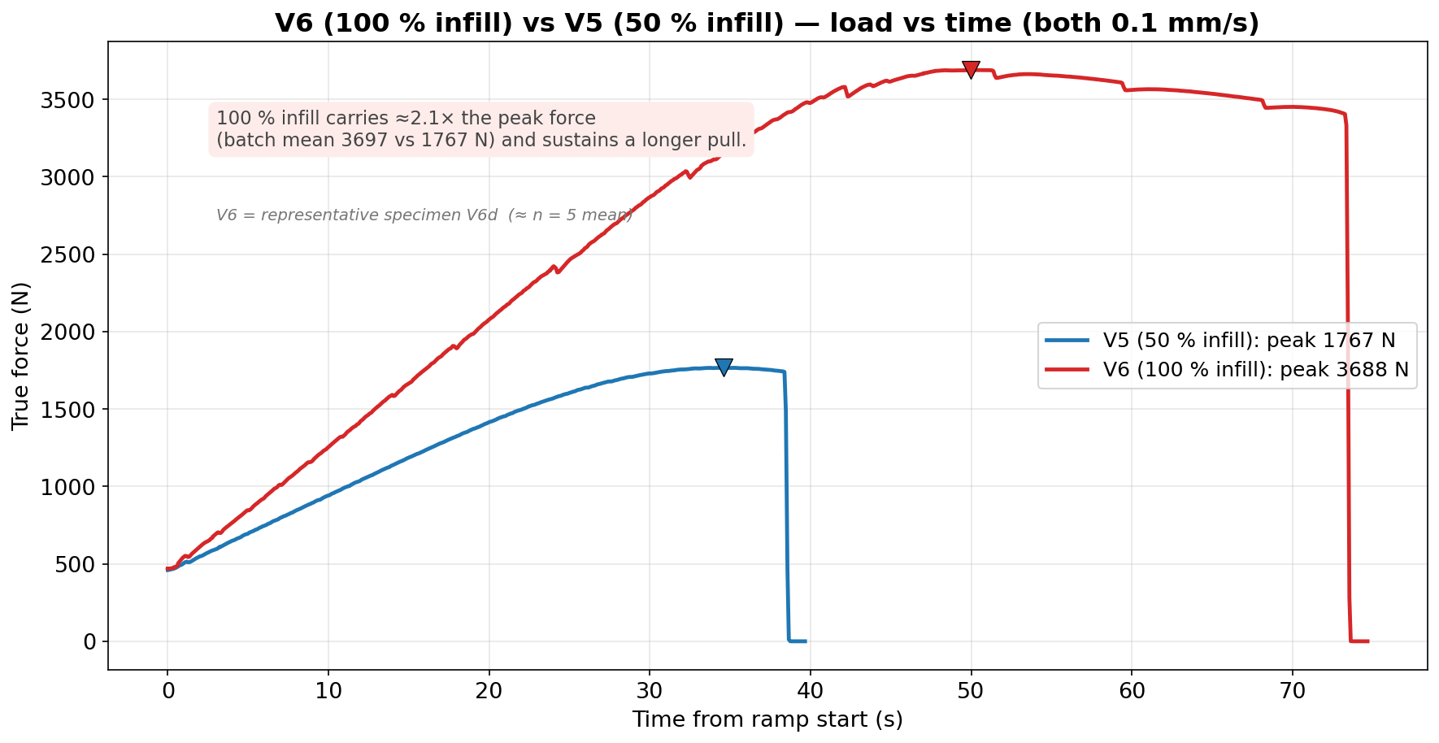
JÖNKÖPING UNIVERSITY
V6 (100 % INFILL) vs V5 (50 % INFILL): LOAD vs TIME
Both at 0.1 mm/s (rate-matched). 100 % infill carries ≈2.1× the peak force (batch mean 3697 vs 1767 N) and sustains a longer pull. Uses representative specimen V6d (≈ n = 5 mean), not the pilot V6a.
150

Slide 11
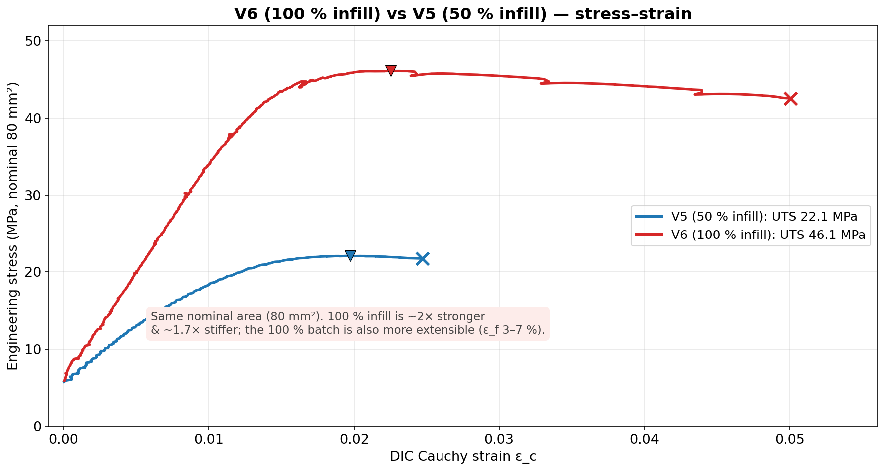
JÖNKÖPING UNIVERSITY
V6 (100 % INFILL) vs V5 (50 % INFILL): STRESS vs STRAIN
Same nominal 80 mm². 100 % infill is ~2× stronger (UTS 46.1 vs 22.1 MPa) and ~1.7× stiffer; the 100 % batch is also more extensible (ε_f 3–7 % vs ~2.5 %) — the difference is the infill load-bearing knock-down.
151

Slide 12
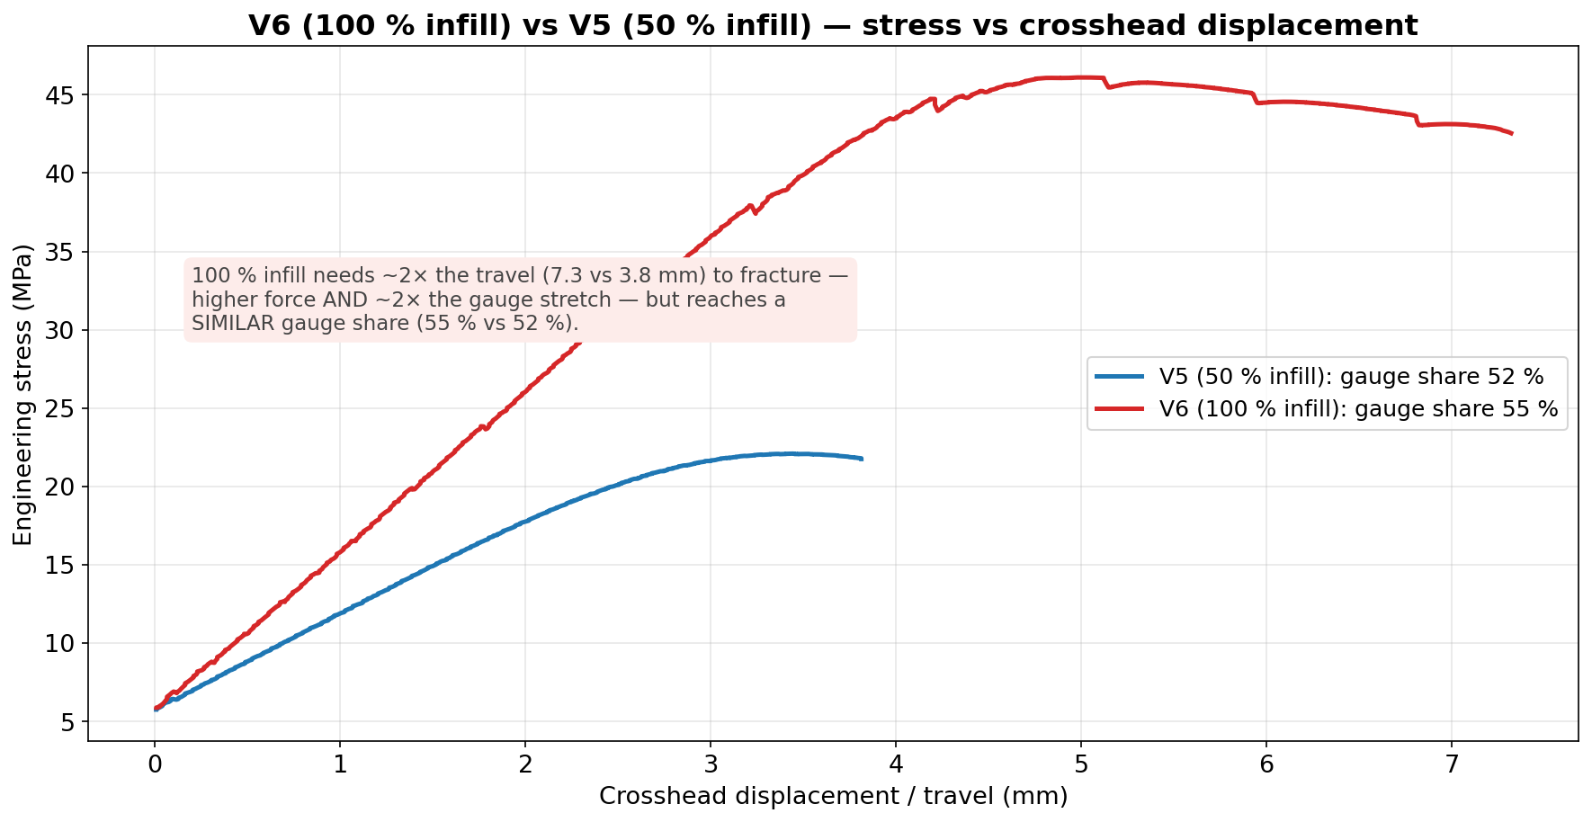
JÖNKÖPING UNIVERSITY
V6 (100 % INFILL) vs V5 (50 % INFILL): STRESS vs DISPLACEMENT
100 % infill needs ~2× the travel (7.3 vs 3.8 mm) to fracture — higher force and ~2× the gauge stretch — but reaches a SIMILAR gauge share (55 % vs 52 %). (The pilot V6a's low 33 % was its own outlier.)
152

Slide 13
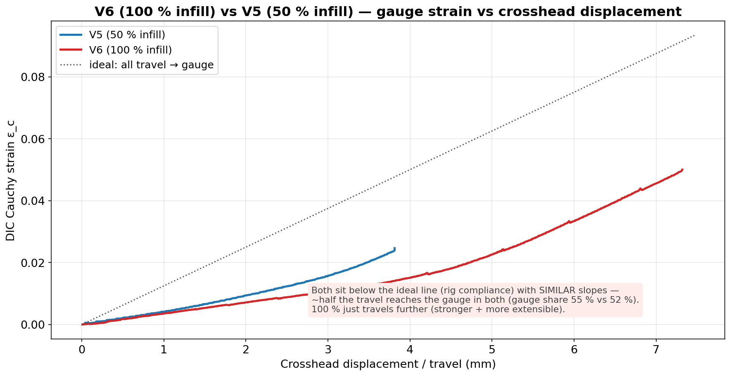
JÖNKÖPING UNIVERSITY
V6 (100 % INFILL) vs V5 (50 % INFILL): GAUGE STRAIN vs DISPLACEMENT
Both curves sit below the ideal ‘all-travel-to-gauge’ line (rig compliance) with SIMILAR slopes — about half the travel reaches the gauge in both; 100 % just travels further (stronger and more extensible).
153

Slide 14
JÖNKÖPING UNIVERSITY
50 % vs 100 % INFILL — FULL COMPARISON
All measured values — V6 = representative V6d (≈ n=5 mean); ratio (100 %/50 %), % change
What it means
Parameter | V5 50 % infill | V6 100 % infill | ratio | Δ %
Peak force (N) | 1767 | 3688 | 2.09× | +109
UTS (MPa) | 22.09 | 46.10 | 2.09× | +109
Yield σ_y 0.2 % (MPa) | 19.04 | 44.73 | 2.35× | +135
Elastic modulus E (GPa) | 1.54 | 2.63 | 1.71× | +71
Fracture stress (MPa) | 21.75 | 42.55 | 1.96× | +96
Failure strain ε_f | 0.0247 | 0.0500 | 2.02× | +102
Toughness (kJ/m³) | 462 | 2131 | 4.61× | +361
Post-UTS softening (%) | 1.5 | 7.7 | 5.1× | +413
Crosshead travel (mm) | 3.81 | 7.32 | 1.92× | +92
Gauge stretch DIC (mm) | 1.97 | 4.00 | 2.03× | +103
Rig take-up (mm) | 1.84 | 3.32 | 1.80× | +80
Gauge share of travel (%) | 51.8 | 54.7 | 1.06× | +6
Rig stiffness (N/mm) | 961 | 1111 | 1.16× | +16
Pull duration (s) | 38.4 | 73.3 | 1.91× | +91
DIC tracking (%) | 99.8 | 99 | 0.99× | ≈0
Strength scales ~2.1× — MORE than 2× for a 2× infill jump. The 50 % knock-down is NONLINEAR: 50 % infill bears < 50 % of the solid load path. • σ_y rises the most (2.35×) — 100 % yields near its UTS. • 100 % is also ~2× MORE extensible (ε_f 0.050 vs 0.025) — tougher (4.6×), not only stronger. • Gauge share ≈ the same (55 % vs 52 %) — 100 % just travels ~2× further (more force + more stretch). • Rate, area, markers, preload all matched — the only variable is infill.
≈ 2.1× strength, k: 1.45 → 1.0 (V6 = representative V6d)
154

Slide 15
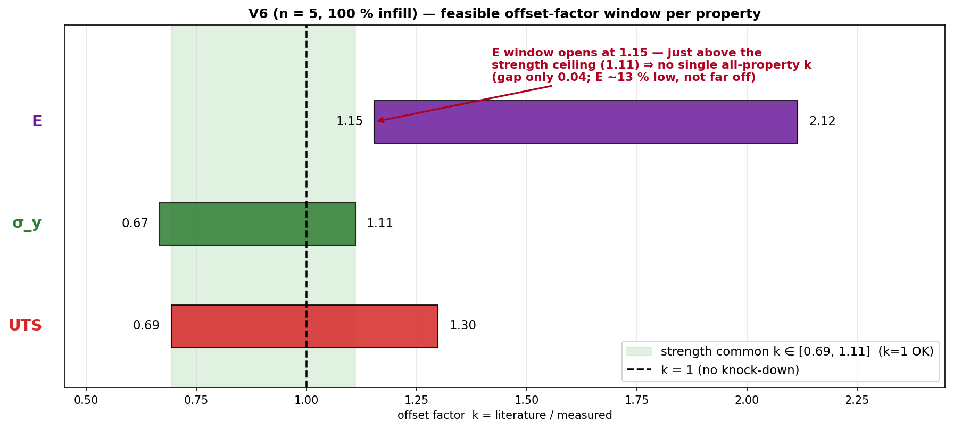
JÖNKÖPING UNIVERSITY
V6 (n = 5): A SINGLE COMMON OFFSET FACTOR?
Same interval method as V5 · from n = 5 mean
Property | feasible k window
E | [1.15, 2.12]
σ_y | [0.67, 1.11]
UTS | [0.69, 1.30]
ALL three | ∅ empty
Strength σ_y + UTS | [0.69, 1.11]
k window per property = [Chacón_lo / measured, Chacón_hi / measured]; a single uniform k must lie in the intersection of all three.
STRENGTH: a single uniform factor works — k ∈ [0.69, 1.11] and k = 1 sits inside it ⇒ apply k = 1.0 (no knock-down) to σ_y and UTS at 100 % infill.
No single ALL-property k: E reads ~13 % low (needs k ≥ 1.15) while in-range σ_y caps k ≤ 1.11 → they pull opposite ways, but only by 0.04. Treat E separately. (Contrast V5: a common k ≈ 2.4 existed.)
155

Slide 16
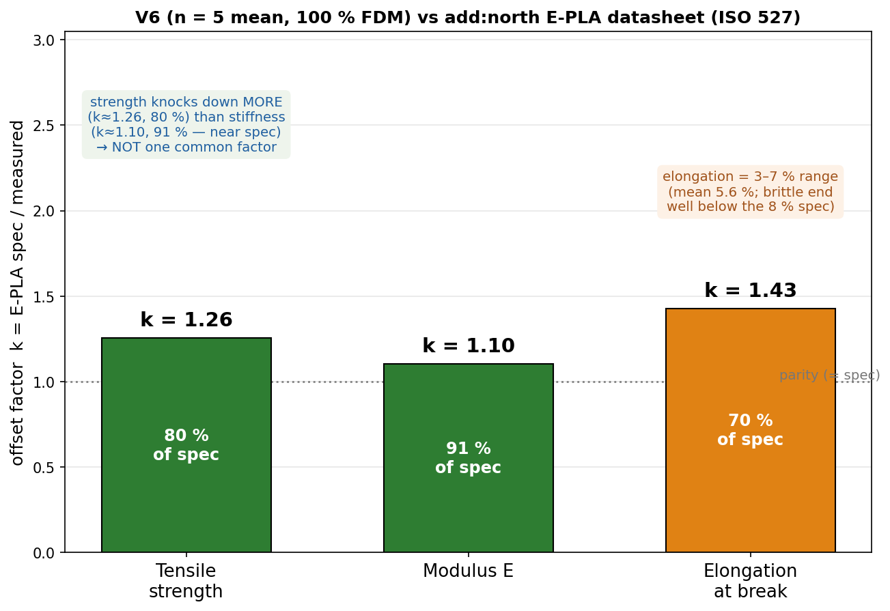
JÖNKÖPING UNIVERSITY
PHASE 8.6.20 V6 (n = 5): VALIDATION — add:north PLA REFERENCE
add:north E-PLA datasheet (ISO 527 / 178) vs measured n = 5 mean — k = spec / measured
Property | ISO | E-PLA spec | V6 (n=5) | k | retain
Yield strength σ_y | 527 | 58 MPa † | 45.0 MPa | 1.29 | 78 %
Tensile strength (UTS) | 527 | 58 MPa | 46.2 MPa | 1.26 | 80 %
Tensile modulus E | 527 | 2.87 GPa | 2.60 GPa | 1.10 | 91 %
Elongation @ break | 527 | 8 % | 3–7 % | 1.1–2.7 | 37–93 %
Flexural strength | 178 | 120 MPa | not tested | — | —
Density / HDT | 527/75 | 1.24 / 55 °C | — | — | —
Validated against TWO references: • Journal (Chacón 2017): σ_y & UTS land INSIDE the range (pass); modulus just below floor. • add:north E-PLA datasheet: strength ≈ 80 % of rated (k ≈ 1.26); stiffness ≈ 91 % (k ≈ 1.10, near spec) — E is CLOSER to spec than strength, so NOT one common factor. Repeatable at CV 2.5 % (n = 5).
Spec sheet — add:north E-PLA TDS (PDF, ISO 527 / 178)
add:north PLA Economy — product page
Closest match = add:north E-PLA datasheet: strength k ≈ 1.26 (80 % of rated), stiffness k ≈ 1.10 (91 %, near spec). Predict printed strength ≈ spec ÷ 1.25.
† E-PLA reports one tensile strength (at break), PLA σ_y ≈ UTS → both vs 58 MPa. E-PLA = closest add:north PLA (no PLA Economy TDS); ISO 527 moulded vs printed 80 mm² bar; values = n = 5 mean.
156

Slide 17
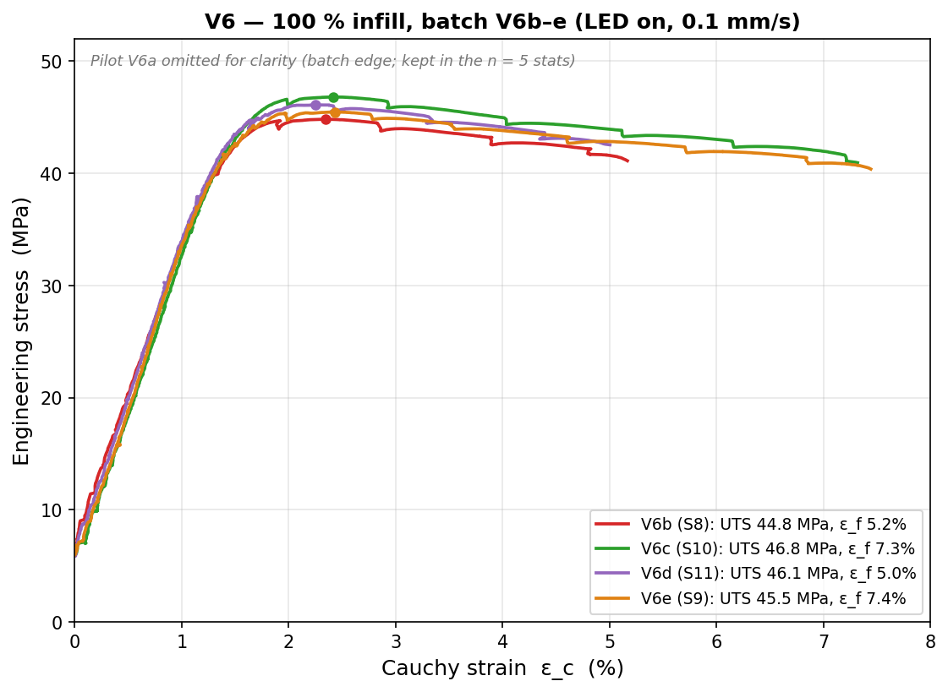
JÖNKÖPING UNIVERSITY
PHASE 8.6.20 V6: REPEATABILITY STUDY (n = 5, 100 % INFILL)
Per-specimen values (UTS/σ_y MPa · E GPa · ε_f –)
Specimen | UTS | σ_y | E | ε_f
V6a · S7 | 47.82 | 47.80 | 2.41 | 0.030
V6b · S8 | 44.83 | 43.24 | 2.63 | 0.052
V6c · S10 | 46.82 | 45.09 | 2.72 | 0.073
V6d · S11 | 46.10 | 44.73 | 2.63 | 0.050
V6e · S9 | 45.47 | 44.03 | 2.59 | 0.074
mean | 46.2 | 45.0 | 2.60 | 0.056
CV % | 2.5 | 3.8 | 4.4 | 33
2.5 %
UTS CV
3.8 %
σ_y CV
4.4 %
E CV
33 %
ε_f CV
⚠ V6a (S7) = pilot, run 8 days before the b–e batch → the strength/modulus EDGE point (σ_y +4.3σ, E −4.2σ, most brittle). Matched b–e batch alone: UTS 1.9 % · σ_y 1.8 % · E 2.1 % CV. Kept in n = 5 (conservative) — verdict unchanged.
Strength REPEATABLE — UTS/σ_y/E all CV ≤ 4.4 % (n = 5; matched b–e batch < 2.1 %). Ductility ε_f scatters 33 % → report as a range.
157

Slide 18
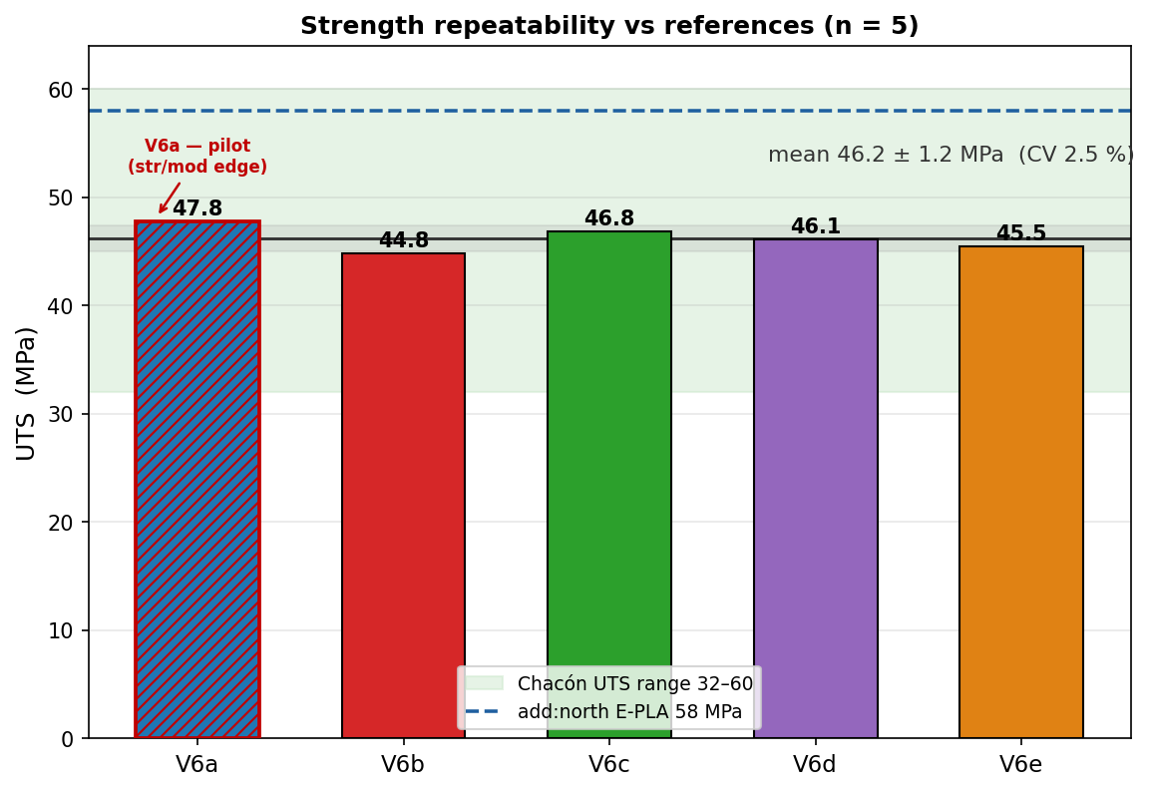
JÖNKÖPING UNIVERSITY
PHASE 8.6.20 V6: STRENGTH — REPEATABLE & IN LITERATURE
Strength vs both references
Quantity | V6 (n=5) | vs Chacón | vs E-PLA
UTS | 46.2 ± 1.2 MPa | inside 32–60 ✓ | 80 % (k 1.26)
σ_y (0.2 %) | 45.0 MPa | inside 30–50 ✓ | 78 %
E | 2.60 GPa | 13 % below 3.0 ⚠ | 91 % (k 1.11)
• UTS = 46.2 ± 1.2 MPa (CV 2.5 %, 95 % CI ±1.4) — converged as n grew. • All 5 land INSIDE the Chacón range → k ≈ 1 (no knock-down), confirming the 50 % offset (k≈2.4) was purely the infill effect. • vs add:north E-PLA datasheet: 80 % of rated strength, 91 % of stiffness — coherent FFF knock-down.
STRENGTH PASS — repeatable (CV 2.5 %), inside the journal range, and a sensible ~80–90 % of the manufacturer's rated solid material.
158

Slide 19
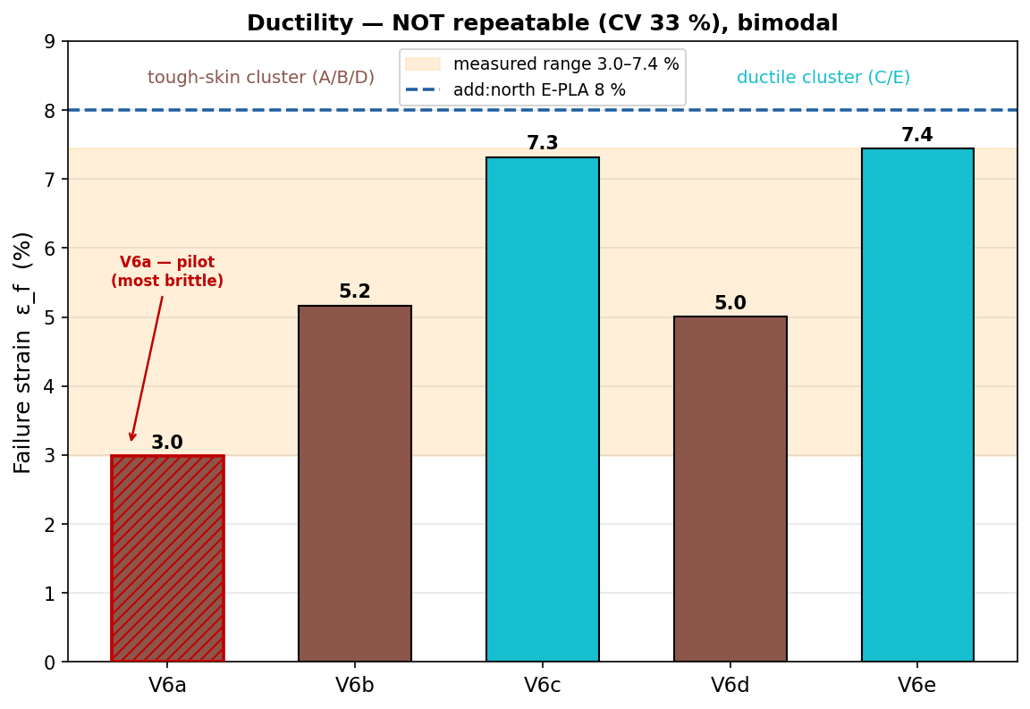
JÖNKÖPING UNIVERSITY
PHASE 8.6.20 V6: DUCTILITY — REPORT AS A RANGE
Failure strain & toughness
3.0–7.4 %
ε_f range
33 %
ε_f CV
2315 kJ/m³
toughness
Failure strain is NOT reproducible (CV 33 %) and looks bimodal: • tough-skin cluster A/B/D ≈ 3.0–5.2 % • ductile cluster C/E ≈ 7.3–7.4 % (nearly the 8 % datasheet value) FDM crack-initiation lottery — a void / weak layer decides where the crack starts, so elongation varies far more than strength. Toughness follows ε_f (1310–3053 kJ/m³).
Quote ductility as a RANGE (ε_f = 3–7 %), never a single number. Strength is the reproducible engineering value; ductility is specimen-dependent.
159

Slide 20
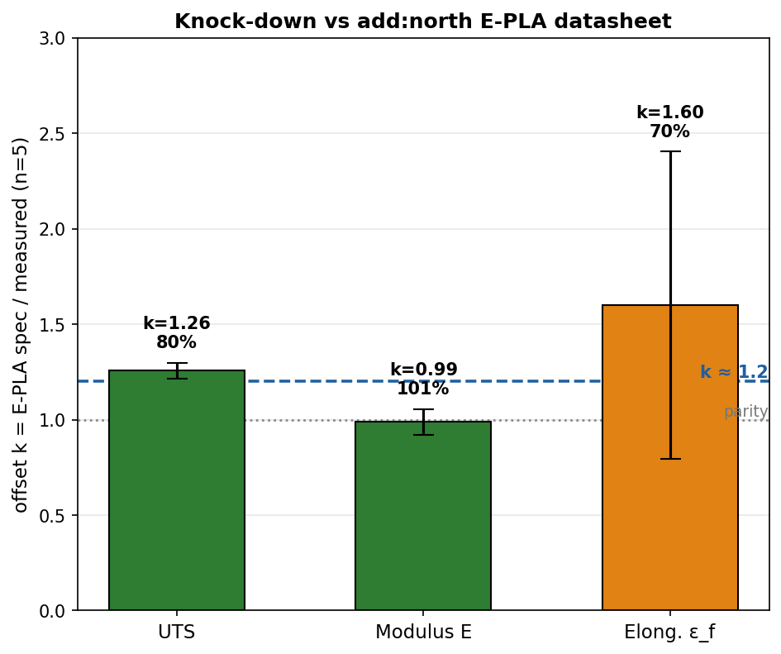
JÖNKÖPING UNIVERSITY
PHASE 8.6.20 V6: VALIDATION SUMMARY — JOURNAL & MANUFACTURER
Pass / fail vs both references (n = 5, 100 % infill)
Property | V6 mean | Chacón range | vs journal | E-PLA spec | vs datasheet
UTS | 46.2 MPa | 32–60 MPa | ✓ PASS | 58 MPa | 80 % (k1.26)
σ_y | 45.0 MPa | 30–50 MPa | ✓ PASS | 58 MPa † | 78 %
E | 2.60 GPa | 3.0–5.5 GPa | ⚠ 13 % low | 2.87 GPa | 91 % (k1.11)
ε_f | 3.0–7.4 % | — | — | 8 % | 37–93 % range
PASS — strength lands inside the journal (k ≈ 1) AND sits at a coherent k ≈ 1.2 vs the add:north E-PLA datasheet (80 % strength / 91 % stiffness), repeatable at CV 2.5 % across 5 specimens.
Caveat: elastic modulus is ~13 % below the journal floor (but meets the datasheet at 91 %); ε_f is reported as a 3–7 % range, not a single value.
add:north E-PLA TDS (ISO 527 / 178)
Writeup: 100 % PLA validated vs literature for strength (k≈1 vs Chacón); characterised at k≈1.2 vs add:north E-PLA datasheet; modulus meets datasheet, marginally below journal; ε_f = 3–7 % range.
160

Slide 21
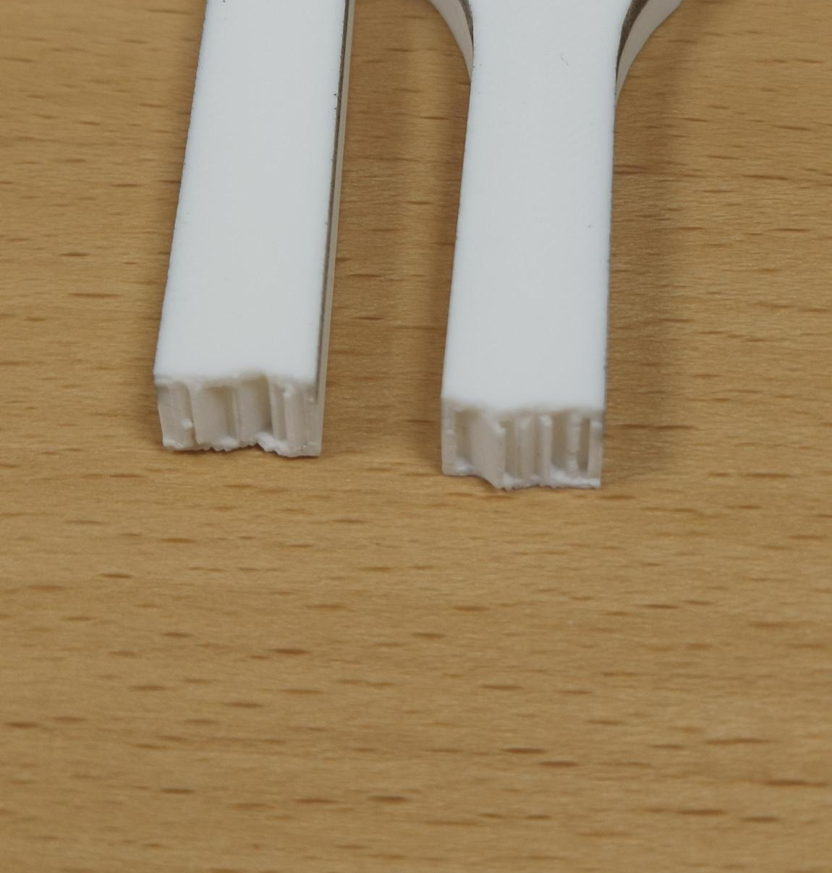
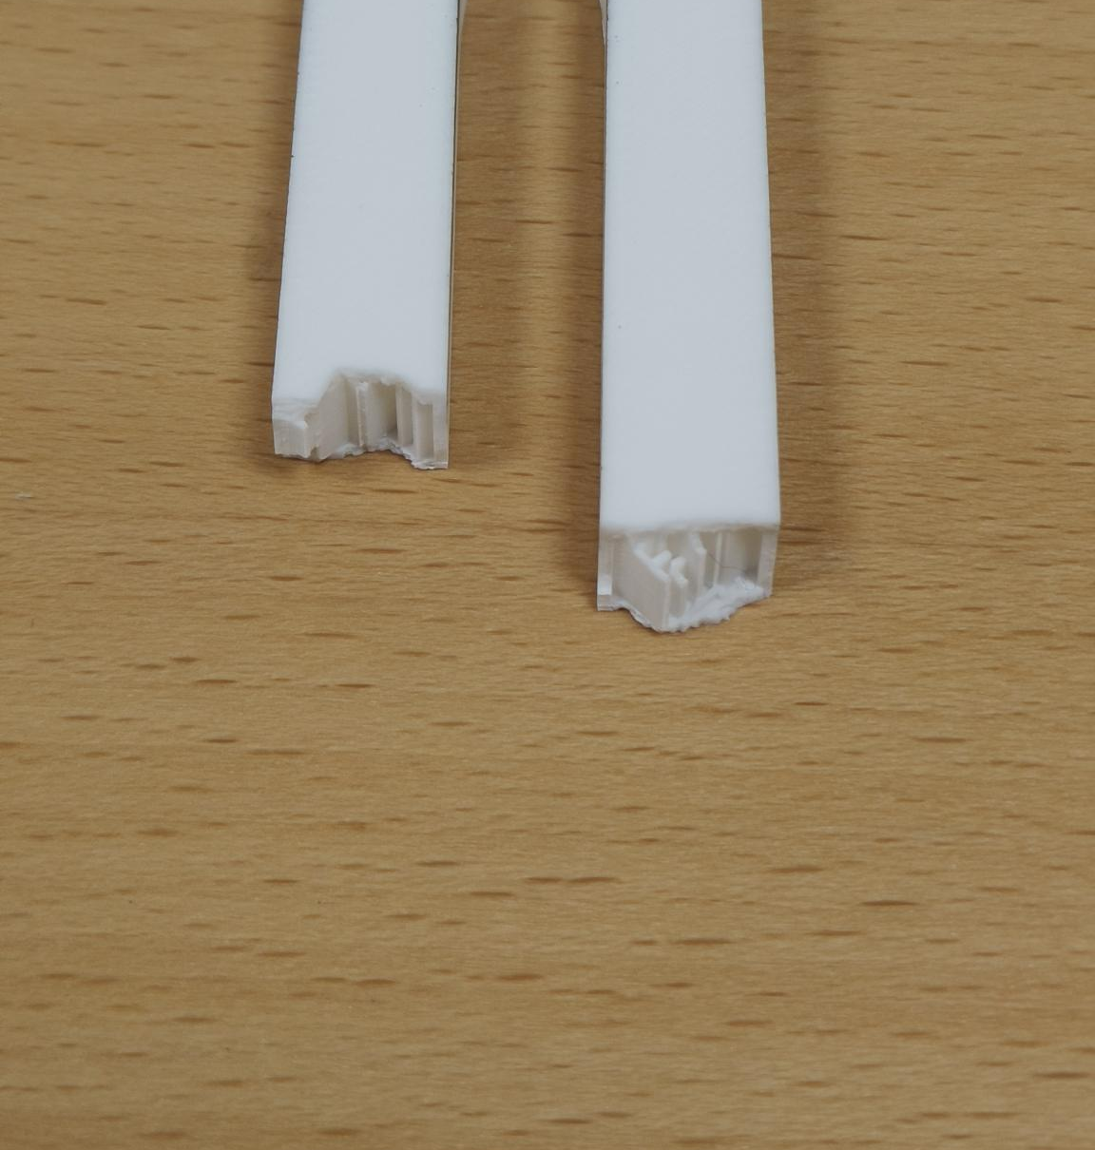
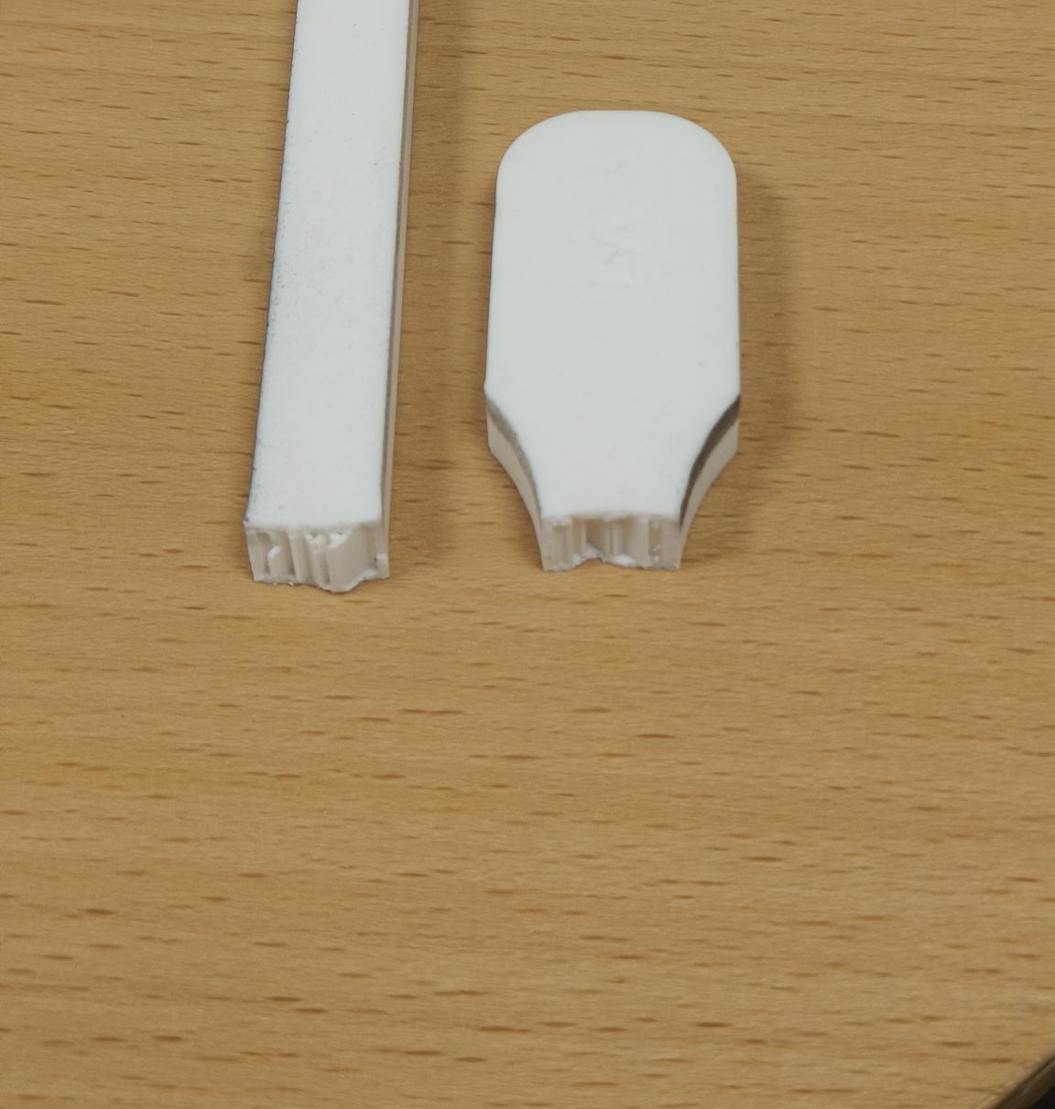
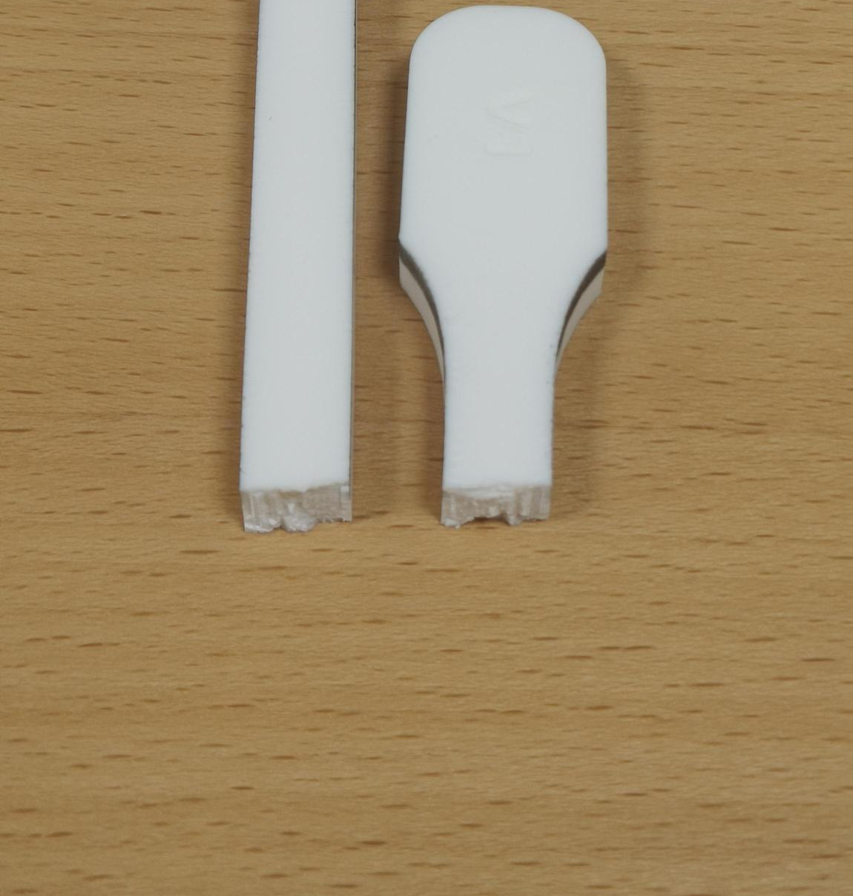
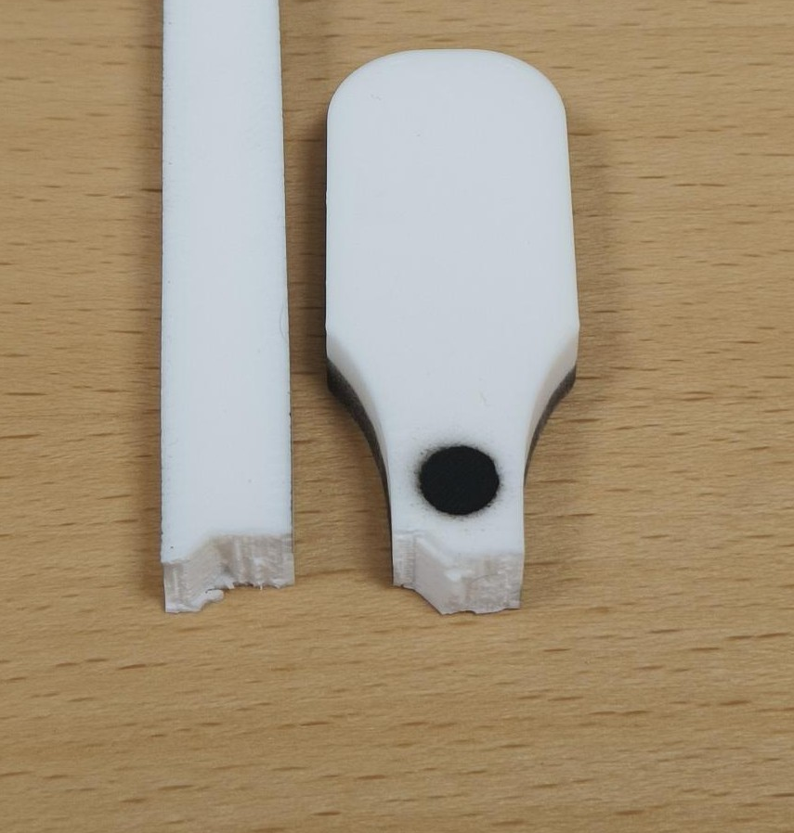
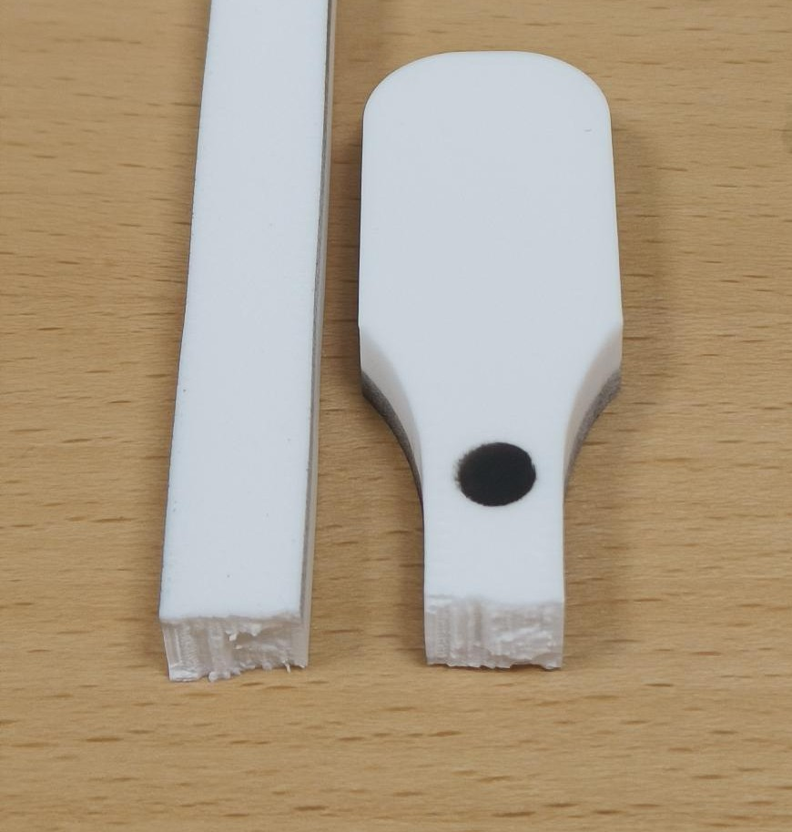
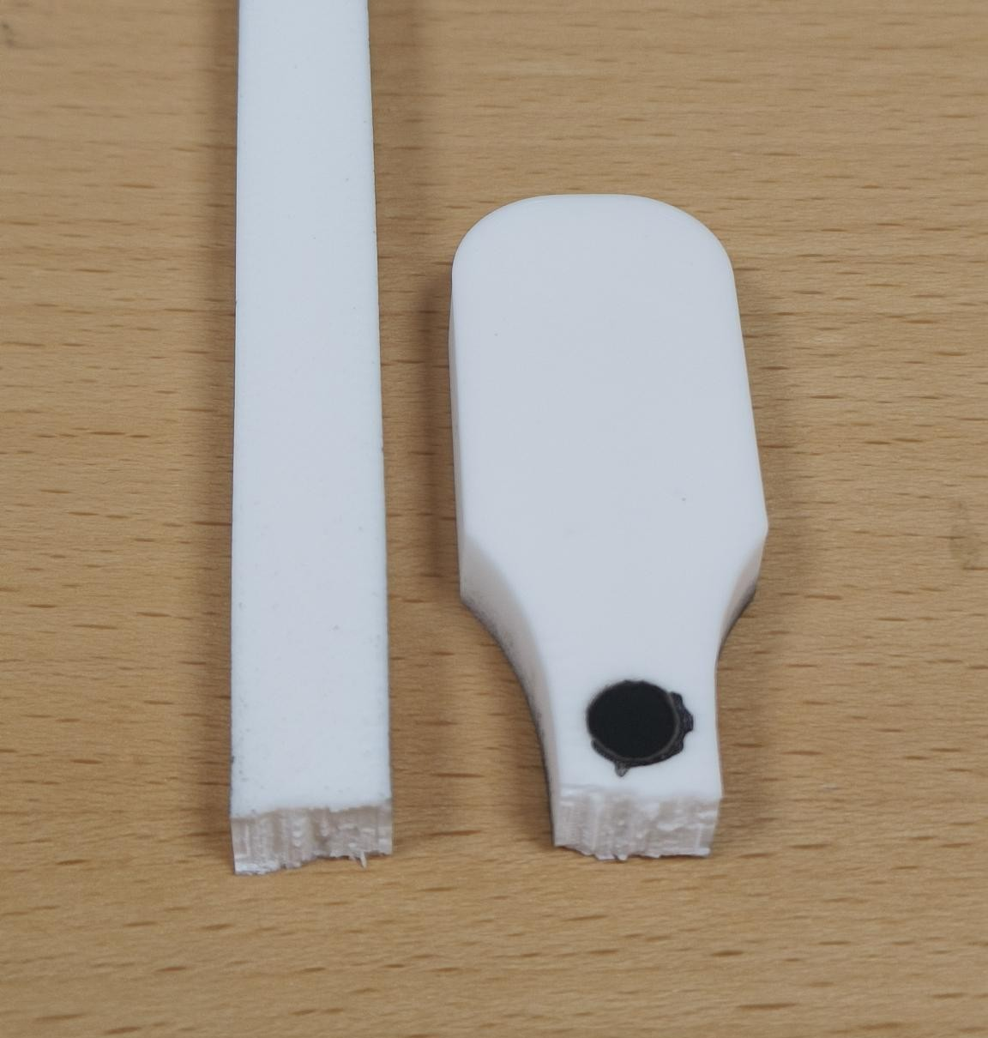
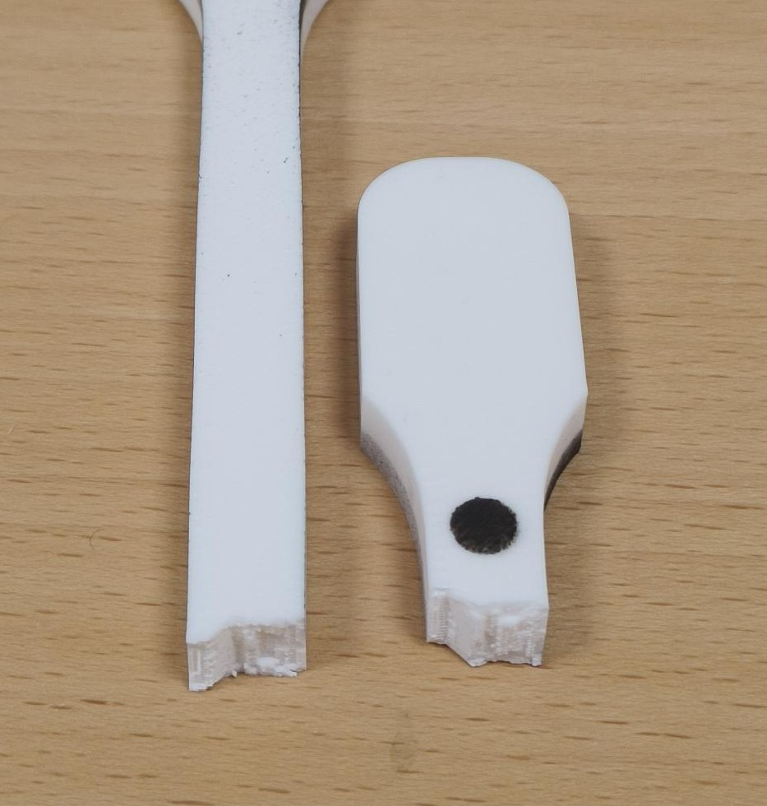
JÖNKÖPING UNIVERSITY
PHASE 8.6.20: FRACTURE PATTERNS — 50 % vs 100 % INFILL (V5 & V6)
FRACTURE — KEY FINDING
50 % INFILL — V5 group (LED off)
HOW TO READ
All 8 specimens failed the SAME way — a flat, transverse break at the lower gauge–fillet (a stress concentration), with no necking = brittle FDM failure. Infill sets STRENGTH & stiffness, NOT the failure mode.
• 50 % faces expose the sparse infill ribs; 100 % faces are fully dense. • V6a = pilot (batch edge). V6c / V6e = ductile cluster (ε_f ≈ 7 %); the others ≈ 3–5 %.
V5 · S4
V5b · S3
V5c · S2
22.1 MPa · ε_f 2.5 %
22.0 MPa · ε_f 2.6 %
22.0 MPa · ε_f 3.1 %
100 % INFILL — V6 quintet (LED on)
V6a · S7 (pilot)
V6b · S8
V6c · S10 (ductile)
V6d · S11
V6e · S9 (ductile)
47.8 MPa · ε_f 3.0 %
44.8 MPa · ε_f 5.2 %
46.8 MPa · ε_f 7.3 %
46.1 MPa · ε_f 5.0 %
45.5 MPa · ε_f 7.4 %
Each specimen photo is an individually placed, croppable picture (…/8.6.20 - Tensile test to Failure/Specimen_S*/). Labels = measured UTS · ε_f. Reset crop in PowerPoint to see the full specimen.
161

Slide 22
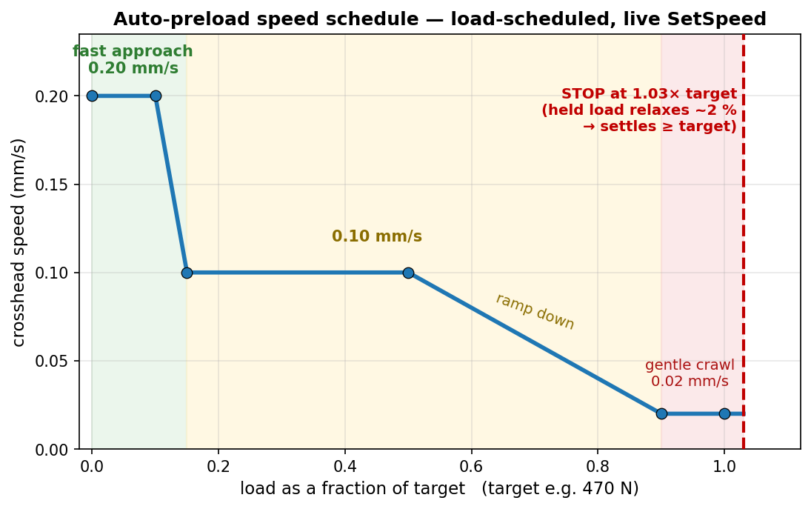
JÖNKÖPING UNIVERSITY
UTM SOFTWARE: AUTOMATIC PRELOAD (‘PRELOAD TENSION’)
Preload to:
470 N
▴ ▾
Preload tension
The operator control (screen recreation): type a target load, click once — the crosshead auto-tensions to it, hands-off.
How it works — one click, hands-off
1. Enter the target preload (e.g. 470 N) and press Preload tension. 2. The crosshead tensions at a LOAD-scheduled speed: 0.20 mm/s up to ~15 % of target, 0.10 mm/s to 50 %, then ramps to a gentle 0.02 mm/s as it nears the target. 3. It stops at 1.03× the target — a deliberate ~3 % overshoot. 4. PLA stress-relaxes ~2 % while held → the load settles AT / just above the target.
Why: manual jogging is slow and overshoots, and PLA relaxes after you stop (you would undershoot). Auto-preload lands consistently at target (+3 % set − ~2 % relaxation ≈ target). Safety: hard cap 1.25× target, 180 s timeout, live speed-only control (no Stop→restart re-latch).
Feature in Software/UTM_PyQt6/main.py — PRELOAD_SPEED_KNOTS · TARGET_FACTOR 1.03 · OVERSHOOT_CAP 1.25 · TIMEOUT 180 s. Used to set the ~470 N preload before every V5 / V6 pull.
162

Slide 23
JÖNKÖPING UNIVERSITY
SOFTWARE ROADMAP — ADVANCED FEATURES & EASE OF USE: STATUS
The rig automated only ONE thing (auto-preload). A phased roadmap adds automated test modes, smart DIC and one-click analysis — each piece shippable on its own. After the full rig-test campaign:
Phase | Focus | Status
0 · Foundations | shared analysis library · control engine · recipes | DONE
A · One-click workflow | per-test report · test registry · prepare-specimen · auto-stop | DONE — VALIDATED
B · Closed-loop modes | strain-rate + cyclic / staircase / relaxation / creep | strain-rate DONE · 4 to wire
C · Smart DIC | live health HUD + measured Poisson / true Cauchy | HUD DONE · Poisson next
D · UX layer | guided wizard · live overlay · dashboard | PLANNED
7
MODULES (in git)
9
APP FEATURES
9 / 9
SIM CHECKS PASSED
6 / 6
RIG TESTS PASSED
LEGEND — DONE + rig-validated (green) · partial, more to wire (amber) · PLANNED (grey). Foundations, the one-click workflow and the strain-rate fracture test are validated on the rig; the remaining modes, measured Poisson and the UX layer are next.
All analysis logic is unit-tested / sim-validated offline; the app feature set is now snapshot-committed (main.py a3b187f) after the full rig-test campaign — see ROADMAP.md / TESTING_TODO.md.
163

Slide 24
JÖNKÖPING UNIVERSITY
DONE — BUILT, VERIFIED & COMMITTED
Analysis & workflow tooling (offline-verified, in git)
In the UI (main.py — RIG-VALIDATED · snapshot a3b187f)
Module | What it gives you
utm_analysis.py | ONE fracture detector + E / σy / UTS / εf / anchor
utm_report.py | one-click per-test PDF + PNG report
utm_registry.py | one table of EVERY test (props + anchor)
utm_recipes.py | save / load a full test setup
control_policies + _sim | closed-loop test-mode engine — 9/9 sim
utm_dic.py | live DIC health + Poisson / Cauchy maths
• Generate report — one button → PDF + images • Settings — Load / Save a setup (+ Default) • Prepare specimen — 1-click tare (position + force + DIC) • Fracture test / Auto-stop — halts on load collapse • Strain-rate fracture test — closed-loop dε/dt • DIC health HUD — live OK / WARN / BAD badge • Safety net — 10 kN / 30 mm / stall guard / dead-DIC
Kills the copy-paste-per-specimen analysis burden (the cause of the V6c / V5-S4 detector bugs): one tested analyser, reused everywhere. Reproduces the known V5 / V6 numbers exactly.
Modules committed & regression-checked against the deck numbers; the UI feature set is now snapshot-committed (main.py a3b187f) after full rig validation.
164

Slide 25
JÖNKÖPING UNIVERSITY
VALIDATED ON THE RIG (2026-07-28 / 29)
Feature checks — ALL PASSED
Rig facts — ALL RESOLVED
Feature | Result
DIC health HUD | green 2/2 live; red BAD on dot cover ✓
Prepare specimen | 1 click → position + force + DIC tared ✓
Auto-stop at fracture | caught S16 collapse 2992 → −417 N ✓
Settings | Default + Load / Save round-trip ✓
Generate report | S16 report = CSV, every KPI ✓
Strain-rate fracture | held 0.0005/s → fracture, auto-stop ✓
These unblock the other 4 test modes: 1. Stop HOLDS position ✓ (zero drift over 5 / 10 / 15 s) 2. Direct reversal auto-decels ~1 s ✓ (no manual Stop needed) 3. Travel cap set to 30 mm ✓ → cyclic / staircase / relaxation / creep are now UNBLOCKED to wire.
RESULT — every built feature passed on the rig; S16 = first 100% infill fracture (UTS 47.4 MPa, anchor-corrected). Strain-rate 6.2 held the target rate by adapting crosshead speed 0.10 → 0.05 mm/s. ONE hardware limit found — motor torque ceiling ~2.6 kN (next slide).
Full step-by-step results: Software/UTM_PyQt6/docs/TESTING_TODO.md; thresholds confirmed (fracture arm 30% / collapse 50%, travel cap 30 mm, stall guard 0.05 mm / 6 s).
165

Slide 26
JÖNKÖPING UNIVERSITY
PLANNED NEXT — MEASURED POISSON (EDGE-WIDTH) + REMAINING AUTOMATION
Measured Poisson / true Cauchy — edge-width tracking (next build, reuses THIS camera)
Matte-black MDF backdrop (behind gauge)
Camera detects L & R specimen edges
Average width over the gauge (100s of rows)
εw → ν and true area → Cauchy stress
MEASURED (no assumed ν), reusing the current camera + specimen — matte finish avoids LED glare, a few-cm gap softens shadows. FIRST STEP: mount the board, grab ONE still frame → prototype the edge-detection to confirm contrast BEFORE building the live feature. (Transverse dots stay ruled out — see slide 164.)
Remaining automation & ease-of-use
• Cyclic / staircase / relaxation / creep modes (engine ready — rig facts RESOLVED, ready to wire) • Measured Poisson — 4-marker / edge-width + auto specimen metadata + folder from recipe • One-click per-specimen report deck
• Guided wizard / checklist (Connect → … → Prepare → Run → Save) • Live stress-strain + elastic-modulus overlay • Glanceable dashboard + fracture beep / banner
HARDWARE LIMIT — motor torque ceiling ~2.6 kN (variable; driver Vref / thermal / PSU) blocks 100% full-area fracture; use 50% / smaller specimens until resolved. ORDER — wire remaining modes → edge-width Poisson → UX layer.
166

Slide 27
JÖNKÖPING UNIVERSITY
SMART-UTM FEATURE SET — SF1 to SF19
16 built and RIG-VALIDATED (green) · 2 built, offline-verified only (teal) · 1 hardware-blocked (amber). Numeric order, so a card can be found by its SF number.
SF1 DIC health HUD live 2/2 · jitter
SF2 Prepare specimen 1-click tare all
SF3 Settings / recipes reuse a whole setup
SF4 Generate report 1-click PDF + PNG
SF5 Auto-stop at fracture halts on collapse
SF6 Strain-rate fracture constant dε/dt
SF7 Stall guard halts a frozen motor
SF8 Release load safe return to true 0
SF9 6 closed-loop protocols cyclic…prog-cyclic→fracture
SF10 Auto-preload 0.2→0.1→0.02 mm/s
SF11 Auto-metadata link capture ↔ CSV, by overlap
SF12 DIC auto-calibrate sweeps exposure × threshold
SF13 Guided wizard 12 steps, optional, off by default
SF14 Poisson / true Cauchy optics-blocked, not code
SF15 Test registry every run + force anchor
SF16 Dead-DIC guard + backstops 0.2 s freeze / 1.0 s halt
SF18 Live Px₀ overlay frozen vs live pair, on the feed
SF19 Video + image capture PNG + 3 AVI styles, 0 dropped
SF17 retired the day it was carded — a developer-only sim harness is not operator-facing. Four safety layers on every driven test: load-collapse · stall guard · 10 kN / 30 mm · dead-DIC freeze.
167

Slide 28

JÖNKÖPING UNIVERSITY
DIC HEALTH HUD — LIVE TRACKING QUALITY
A live badge on both test tabs: markers found / expected · % frames tracked · pixel jitter.
What each state means
State | Colour | Condition | Meaning
OK | green | all markers · ≥ 95% tracked · jitter ≤ 1.5 px | trust the strain
WARN | amber | 70–95% tracked OR jitter > 1.5 px | degraded — re-light / watch
BAD | red | a marker missing OR < 70% tracked | unreliable — fix before pulling
NO DATA | grey | camera off / no frames | —
Recorded per-frame in the CSV (DIC_Blobs column) — so you know DIC was reliable, and can PROVE it after the test.
168

Slide 29
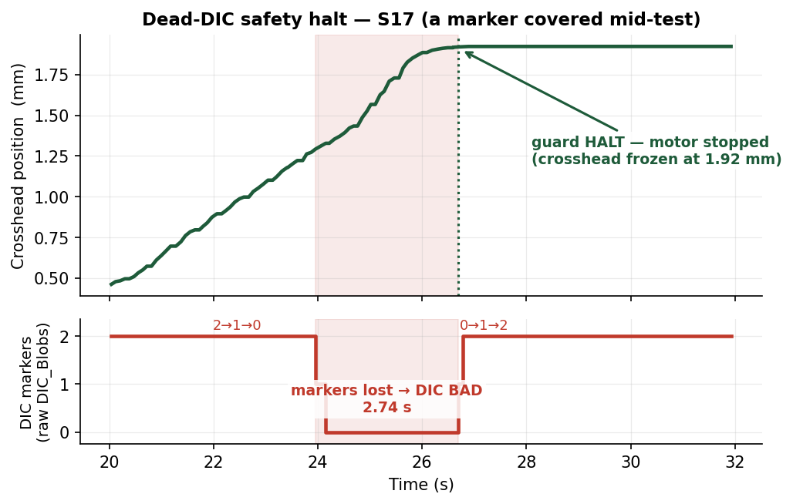
JÖNKÖPING UNIVERSITY
DIC-DRIVEN SAFETY — HALT IF TRACKING GOES BAD (proof, S17)
CONDITION
During a strain-rate test, if DIC strain FREEZES (markers lost): • FREEZE speed at 0.2 s • HALT at 1.0 s
Why
The loop STEERS on DIC strain. If tracking dies it is blind — so it stops instead of pulling on stale / frozen data.
S17 — covered a marker mid-test → DIC went BAD → motor auto-halted. No runaway on blind data.
169

Slide 30
JÖNKÖPING UNIVERSITY
SF 2 — PREPARE SPECIMEN (one-click tare)
One click zeroes everything
Tare position (δ = 0)
Tare force (N = 0)
Tare DIC (set L0)
Clear plots + consoles
• Replaces the old 3-click tare with ONE button • DIC tares only at green 2/2 — otherwise 'DIC skipped' (honest, no false L0) • Leaves a clean, ready-to-pull baseline
Rig-validated — position + force + DIC all zeroed, consoles + stress-strain plot cleared, from one press.
Feature in Software/UTM_PyQt6/main.py (Prepare specimen button). Validated 2026-07-28.
170

Slide 31
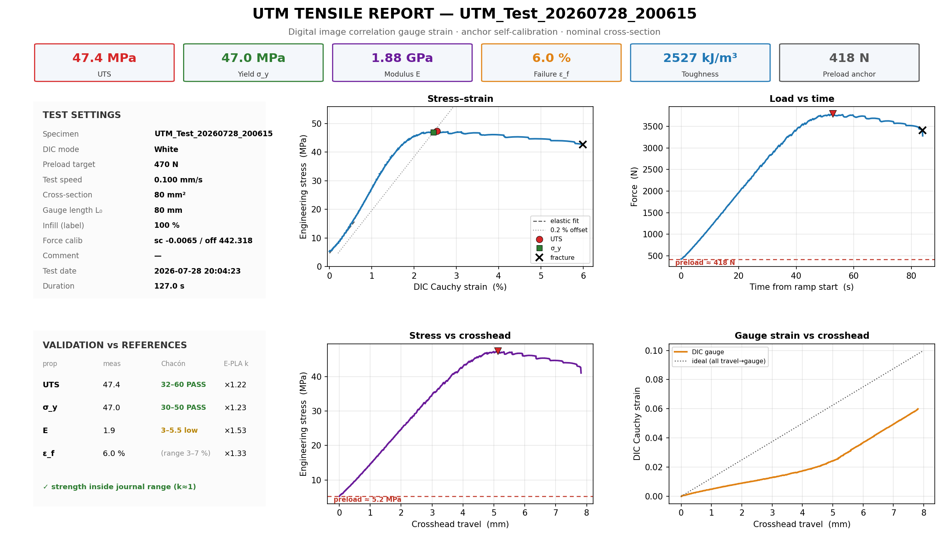
JÖNKÖPING UNIVERSITY
IN THE APP — ONE-CLICK REPORT & SAVED SETTINGS
Generate report → one-page PDF + PNGs
Settings — save a setup, reload in 1 click
• Saves area · gauge · preload · speed · mode + params • 'Default' always present (auto-stop ON) • Reload a full test setup with ONE click • Infill % = recorded label only (does NOT change data) • Report reads the CSV header → KPIs + 4 plots + validation
Report shown is the REAL S16 one-pager (auto-generated). Settings image = the live Motor-Control controls.
171

Slide 32
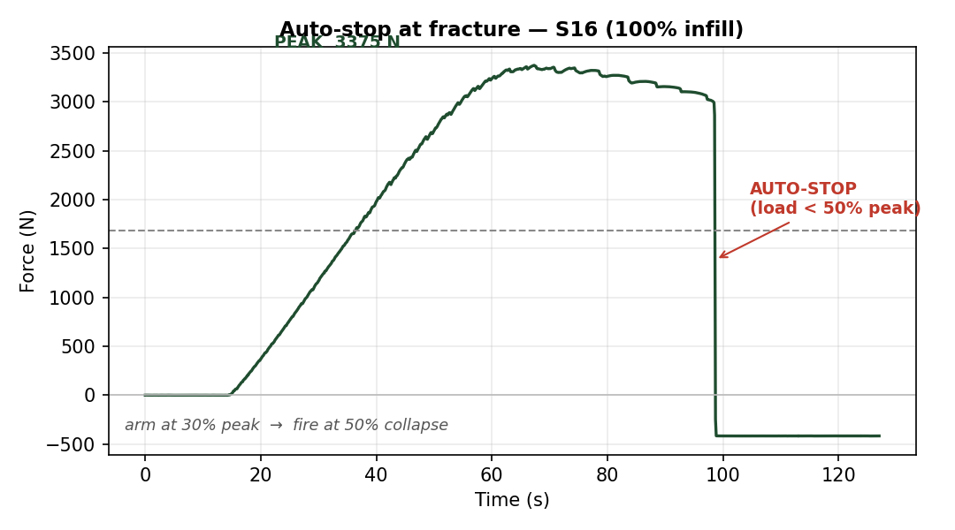
JÖNKÖPING UNIVERSITY
PROOF — AUTO-STOP AT FRACTURE (S16, 100% infill)
ACTIVATION CONDITION
ARM when load ≥ 30% of peak FIRE when load < 50% of peak (collapse) → Stop + E-Stop
2992 N
PEAK
47.4 MPa
UTS (true)
Fires in ONE sample after the load collapses — no hand on the button.
The rig detects its OWN fracture and halts — arm at 30% of peak, fire at 50% collapse.
172

Slide 33
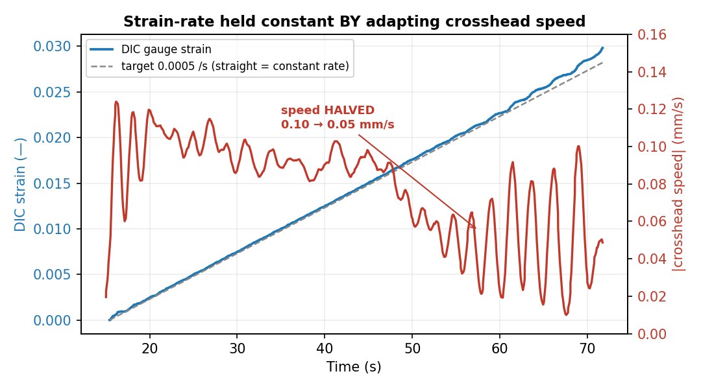
JÖNKÖPING UNIVERSITY
STRAIN-RATE FRACTURE TEST — RESULTS & WHY IT WORKS
Rate held BY adapting speed
Regime | speed | dε/dt
elastic | 0.10 | 0.00049
yield | 0.09 | 0.00050
necking | 0.06 | 0.00048
draw | 0.05 | 0.00054
Why it matters
• Constant MATERIAL strain rate (test standards) • Compliance-free — measures the gauge, not the machine • Comparable E / σy across specimens & rigs
Held 0.00051 /s (target 0.0005) while HALVING crosshead speed 0.10 → 0.05 mm/s — a fixed-speed pull cannot.
173

Slide 34
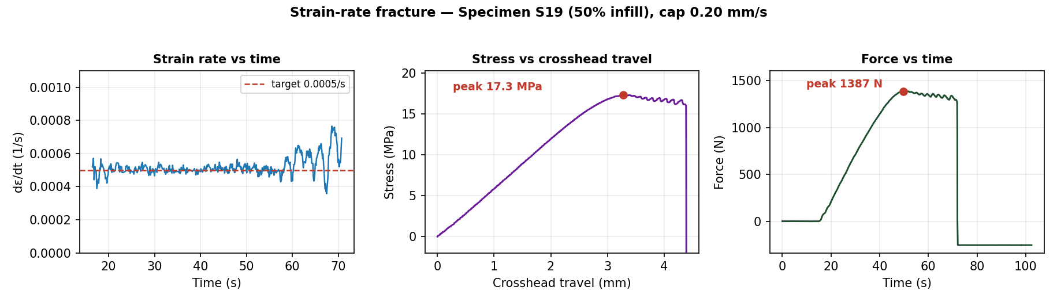
JÖNKÖPING UNIVERSITY
STRAIN-RATE FRACTURE — REPORT PLOTS (S19, 50% infill)
Closed-loop speed limits
0.0005 /s
TARGET RATE
0.005 mm/s
MIN SPEED
0.20 mm/s
MAX SPEED (cap)
S19 (50%) fractures ~1.4 kN — under the motor ceiling. The loop varied crosshead speed 0.005–0.20 mm/s to hold 0.0005 /s to fracture.
174

Slide 35
JÖNKÖPING UNIVERSITY
SAFETY GUARDS & LIMITS — WHAT STOPS THE TEST
Guards that halt a driven test
Guard | Trips when | Action
Fracture auto-stop | load < 50% of peak (armed at 30%) | Stop
Stall guard | crosshead < 0.05 mm in 6 s under load > 200 N | Stop + E-Stop
Dead-DIC guard | DIC strain frozen (markers lost) | freeze speed 0.2 s → HALT 1.0 s
Force backstop | load ≥ 10 kN | Stop + E-Stop
Travel backstop | crosshead travel ≥ 30 mm | Stop + E-Stop
Timeout | runtime ≥ 900 s | Stop
HARD LIMITS — force 10 kN · travel 30 mm · stall 0.05 mm in 6 s (>200 N) · dead-DIC halt 1.0 s · timeout 900 s. Any breach → Stop + E-Stop.
Layered so a driven test (preload · fracture · strain-rate) can't run away — protects the motor, the printed grips and the 3 t load cell.
175

Slide 36
JÖNKÖPING UNIVERSITY
SF 8 — RELEASE PRELOAD (safe return to 0)
Controlled unload after a preload
Preloaded specimen
Reverse at 0.30 mm/s
Stop at ~5 N
Limits
0.30 mm/s
RELEASE SPEED
5 N
TARGET
50 N
RISE CAP
180 s
TIMEOUT
Rig-validated — eases tension off the specimen + grips; live-SetSpeed only (no re-latch runaway); stops on target / rise-cap / timeout.
Feature in Software/UTM_PyQt6/main.py (Release preload button). Validated 2026-07-28.
176

Slide 37
JÖNKÖPING UNIVERSITY
TWO WAYS TO FRACTURE — WHEN TO USE WHICH
 | Direct motor speed | Strain-rate fracture
How | constant crosshead mm/s | closed-loop on DIC dε/dt
Rate | varies (fast neck, slow elastic) | CONSTANT gauge rate
Needs DIC? | no | YES (green 2/2)
Motor force | full — higher speed OK | capped speed → less force
Best for | quick UTS · strong specimens | standards-grade · rate-sensitive
Suggestion
MAX pulling force or a quick UTS? → DIRECT motor speed
Controlled material strain rate (comparable)? → STRAIN-RATE fracture
Both auto-stop on fracture (same detector) + stall guard. On THIS rig (torque ~2.6 kN today) use 50% / smaller specimens for strain-rate to reach break.
177

Slide 38
JÖNKÖPING UNIVERSITY
INNOVATION ROADMAP — AT A GLANCE
0 · Foundations analysis · engine · recipes
A · One-click report · prepare · auto-stop
B · Test modes strain-rate ✓ · 4 more
C · Smart DIC health HUD ✓ · Poisson
D · UX layer wizard · overlay · dash
DONE
DONE
1 / 5
partial
next
Next up (in order)
1 · Wire the 4 remaining modes (engine ready)
2 · Measured Poisson (4-marker + backdrop)
3 · UX wizard + live overlay
Hardware gate — motor torque ~2.6 kN today; fix driver Vref / cooling to fracture 100% infill.
178

Slide 39
JÖNKÖPING UNIVERSITY
SPECIMEN REGISTER (S1 – S26)
Spec | Infill | Colour | Test / result
S1
S2 | 50% |  | V5c · 22.0 MPa
S3 | 50% |  | V5b · 22.0 MPa
S4 | 50% |  | V5 · 22.1 MPa
S5
S6
S7 | 100% |  | V6a · 47.8 MPa
S8 | 100% |  | V6b · 44.8 MPa
S9 | 100% |  | V6e · 45.5 MPa
S10 | 100% |  | V6c · 46.8 MPa
S11 | 100% |  | V6d · 46.1 MPa
S12
S13
Spec | Infill | Colour | Test / result
S14
S15 | 100% |  | stall (no fracture)
S16 | 100% |  | first 100% fracture · 47.4
S17 | 100% |  | halt tests (DIC / stall)
S18 | 50% |  | T7.2 staircase→frac · 21.2 MPa
S19 | 50% |  | strain-rate frac · 17.3 MPa
S20 | 100% |  | T1–T7 modes · T7 stalled 2355 N
S21 | 50% |  | T8 prog. cyclic→frac · 21.4 MPa
S22 | 50% |  | T6.4/6.5 cyclic · T7.3 → 19.7 MPa
S23 | 50% |  | T9 creep 600 N / 900 s
S24 | 100% |  | VC1 capture · 46.5 MPa
S25 | 100% |  | VC2 capture · 46.2 MPa
S26 | 100% |  | VC3 capture · 47.2 MPa
All spray markers (black dots on PLA). V1_Spray batch = 50% · V2_Spray = 100%. VC1-3 = the frame-capture fracture runs (p221-224). Colour column to be filled by operator.
179

Slide 40
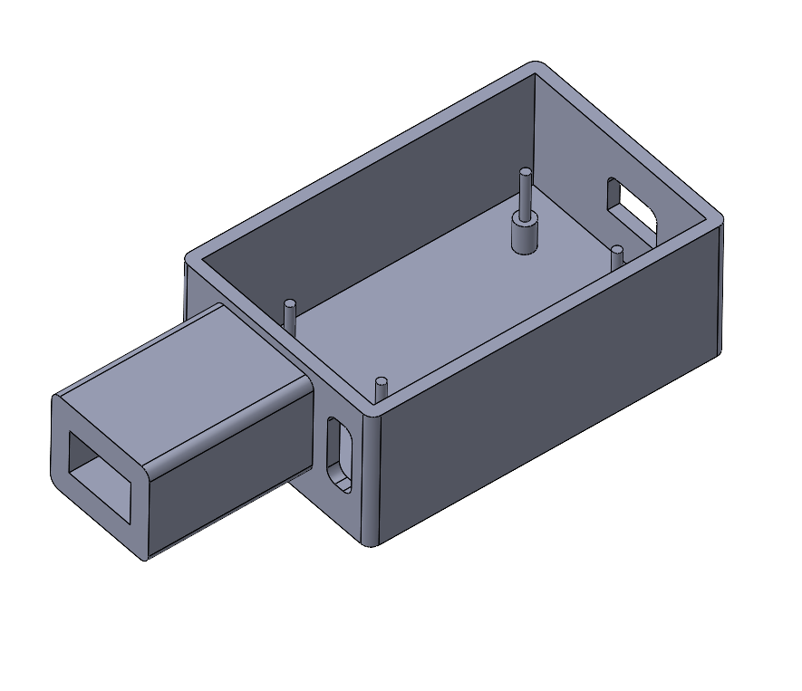
JÖNKÖPING UNIVERSITY
BUCK-CONVERTER ENCLOSURE — CAD (PLA)
Purpose
PLA-printed enclosure that houses the buck converter powering the LED ring lights.
1 · PCB locating pins
2 · LED-switch extrusion
• Pins align + hold the buck-converter PCB • Side extrusion = housing for the LED on/off switch • Open top + side slots for wiring / mounting
CAD for a PLA-printed part. Callout arrows mark the PCB locating pins (floor posts) and the LED-switch extrusion (side tube).
180

Slide 41
JÖNKÖPING UNIVERSITY
MOTOR TORQUE CEILING — THE 100% FRACTURE LIMIT
Same crosshead speed (0.10 mm/s), different MAX force
~2.6 kN
WEAK DAY (S15 · today)
3.2–3.8 kN
STRONG DAY (V6 · S16)
~3.7 kN
100% FULL-AREA NEEDS
What we suspected at the time — torque capacity, NOT speed or software
• Driver current (Vref) set low • PSU voltage sag under load
• Driver THERMAL derating (the chip, not motor) • Mechanical binding (screw / rails) ← this one
SUPERSEDED — see p183. It was the fourth cause: the load holders had worked loose and the crossheads sat out of alignment. Fixed; the rig now pulls 3.5 kN.
At the SAME 0.10 mm/s and on the SAME DAY: S15 stalled 2.6 kN but S16 fractured 3.8 kN. Read as day-to-day drift at the time — it was specimen-to-specimen, i.e. the remount.
181

Slide 42
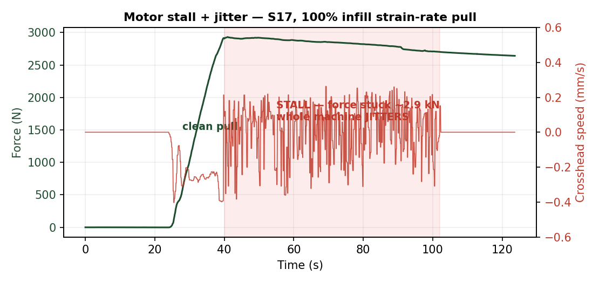
JÖNKÖPING UNIVERSITY
MOTOR JITTER = STALL WARNING (a failed test)
What happened
At the force ceiling the crosshead FROZE and the whole machine SHOOK — a stalled stepper skipping steps. S15: had to Stop by hand.
Why
• Motor at / beyond its torque limit • Strain-rate loop then oscillated, chasing a motor that can't move
SUPERSEDED (next slide) — the jitter was BINDING, not a torque limit. The stall guard still auto-halts (< 0.05 mm in 6 s under load).
182

Slide 43
JÖNKÖPING UNIVERSITY
RESOLVED — THE “TORQUE CEILING” WAS A CROSSHEAD MISALIGNMENT
The load holders had worked loose, letting the crossheads sit out of alignment. The motor was spending its torque on binding instead of on the specimen. Re-aligned and re-tightened, the rig pulls 3.5 kN with no stutter.
Loose load holders
ROOT CAUSE
3.5 kN, no stutter
AFTER THE FIX
~3.7 kN
100 % FULL-AREA NEEDS
2.6 kN
SUPPOSED CEILING
The data already said “mechanical” — before the fault was found
What that retires — the four ranked causes (p201)
• The same machine has fractured 100 % infill at 177–3826 N on 16 separate specimens over three months (mean 3007 ± 1412 N, CV 47.0 %). • That is 13 of 16 runs straight THROUGH a 2.6 kN “ceiling”. A ceiling ten runs walk past is not a ceiling. • Decisive: S15 stalled at 2.6 kN and S16 fractured at 3792 N on the SAME DAY (2026-07-28) — +46 %, same rig, same 0.10 mm/s.
Ranked cause | Verdict
1 Driver current (Vref) too low | exonerated
2 Driver thermal derating | exonerated
3 PSU voltage sag under load | exonerated
4 Mechanical binding (ranked LAST) | CONFIRMED
Why only the mechanical cause fits
Vref is a setting — it does not change between two specimens. Thermal derating gets WORSE through a session, not 46 % better on the next pull. PSU sag scales with load, so it cannot let a HIGHER load through. Binding is the only candidate that is intermittent, and it changes exactly when the specimen is remounted — which is when alignment changes.
SUPERSEDES p181 and p182 — the 50 %-specimen workaround is no longer needed. 100 % full-area specimens fracture normally at ~3.0 kN.
Not a hardware purchase and not a software change — a fastener. The stall guard and the 10 kN / 30 mm backstops stay exactly as they are; they were never the problem.
183

Slide 44
JÖNKÖPING UNIVERSITY
TESTS AFTER THE REALIGNMENT — THE RELIABLE SET
Every run below (2026-08-12 onward) was on a rig whose crossheads were known to be aligned and whose load holders were known to be tight. Both stalls on record fall BEFORE this line; none after.
Specimen | Date | Material | What it was for | Peak | UTS | E | Outcome
S24 | 2026-08-14 | 100 % white PLA | Frame capture VC1 | 3718 N | 46.5 MPa | 3.00 GPa | fractured
S12 | 2026-08-17 | 100 % BLACK PLA | Black attempt VC6 — capture not filed | 3822 N | 47.8 MPa | 3.29 GPa | fractured
S25 | 2026-08-17 | 100 % white PLA | Frame capture VC2 — extensometer basis | 3693 N | 46.2 MPa | 3.17 GPa | fractured
S26 | 2026-08-17 | 100 % white PLA | Frame capture VC3 — extensometer basis | 3774 N | 47.2 MPa | 3.55 GPa | fractured
S27 | 2026-08-17 | 50 % white PLA | 50 % video pair VC4 | 1588 N | 19.9 MPa | 1.40 GPa | fractured
S28 | 2026-08-17 | 50 % white PLA | 50 % video pair VC5 | 1594 N | 19.9 MPa | 1.28 GPa | fractured
S13 | 2026-08-18 | 100 % BLACK PLA | Black preset VALIDATED VC7 | 3706 N | 46.3 MPa | 3.03 GPa | fractured
S30 | 2026-08-22 | PETG | — | 3340 N | 41.8 MPa | 1.81 GPa | fractured
S31 | 2026-08-22 | PETG | — | 3244 N | 40.5 MPa | 2.12 GPa | fractured
(unlabelled) | 2026-08-24 | PLA | — | 3867 N | 48.3 MPa | 3.45 GPa | fractured
(unlabelled) | 2026-08-24 | TPU | — | 177 N | 2.2 MPa | 0.03 GPa | fractured
S33 | 2026-08-24 | PLA | — | 3767 N | 47.1 MPa | 3.17 GPa | fractured
S35 | 2026-08-24 | TPU | — | 180 N | 2.2 MPa | 0.03 GPa | fractured
S36 | 2026-08-24 | TPU | — | 177 N | 2.2 MPa | 0.03 GPa | fractured
14
RUNS SINCE THE FIX
0
STALLS SINCE THE FIX
3693–3822 N
100 % RUNS, PEAK RANGE
2
STALLS BEFORE IT
Why this set is the one to quote
All 14 ran to fracture with no stutter, and the 5 at 100 % infill peaked 3693–3822 N — every one ABOVE the 2.6 kN carried as a hardware ceiling. Earlier results are not wrong (S15 and T7 were caught by the stall guard and excluded, never silently averaged in), but only this set is free of a load path that could bind.
S12 is listed because the PULL was sound (47.8 MPa) — what failed was the frame capture. Peaks are UTS × the CAD 80 mm² nominal area.
184

Slide 45
JÖNKÖPING UNIVERSITY
MEASURING CAUCHY (TRUE) STRESS
Getting the DEFORMING cross-section for TRUE / Cauchy stress + Poisson ratio - a separate future work-stream: edge-width tracking on a matte-black backdrop.
185

Slide 46
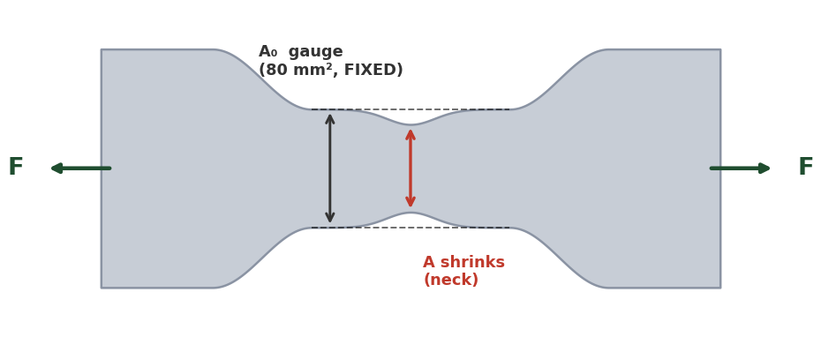
JÖNKÖPING UNIVERSITY
ENGINEERING vs TRUE (CAUCHY) STRESS — & MEASURING THE AREA
Why we REPORT engineering stress
Measuring the CURRENT area → true stress (future)
Method | How | Note
Poisson estimate | A = A₀(1−ν·ε)², ν ≈ 0.35 (no hardware) | cheap; ν drifts in yield
Transverse markers | +2 dots across width → ε_w; A ≈ A₀(1+ε_w)² | reuses blob-DIC; gives Poisson
+ edge camera | 2nd view → thickness strain; A = w·t | rigorous; FDM is orthotropic
Full-field speckle | fine random speckle + subset DIC | strain field + necking; new pipeline
σ_eng = F / A₀ (REPORTED) σ_true = F / A (not tracked, ~2–5% higher) Basis: ISO 527 · Chacón · datasheet all use ENGINEERING → apples-to-apples for our k-factors. E & σ_y ~unchanged.
Same speckle style (spray dots): just add a transverse dot pair — the current 2-marker tracker extends naturally (2 axial + 2 transverse). A finer random speckle enables full-field DIC (transverse field + necking) but needs a new analysis pipeline.
TRANSVERSE markers = ideal, but the gauge is too NARROW → EDGE-WIDTH detection (next slide) is the practical route. Keep ENGINEERING stress as the validated basis.
Current V6 report & plots = engineering stress (nominal 80 mm²). True/Cauchy needs the deforming area; post-necking needs full-field DIC or markers at the neck.
186

Slide 47
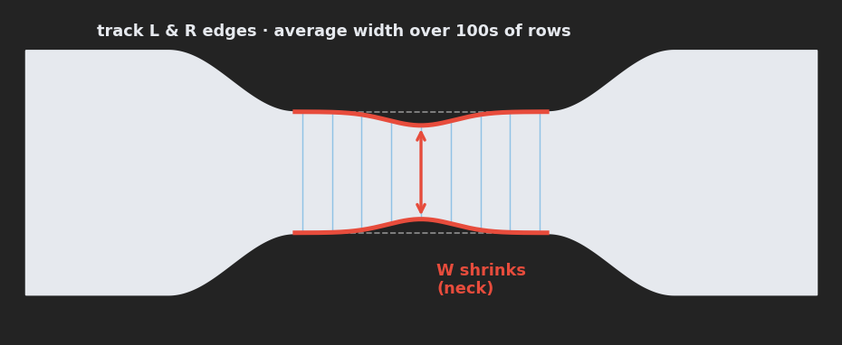
JÖNKÖPING UNIVERSITY
MEASURING POISSON'S RATIO & TRUE STRESS — WITHOUT TRANSVERSE DOTS
The fix — track the specimen's OWN edges
Three ways to MEASURE it (no transverse dots)
Route | How it works | Needs
1 Edge / silhouette width tracking | find the specimen's L & R edges across the gauge; average width over 100s of rows -> ε_w each frame | matte-black backdrop; reuses THIS camera
2 Full-field speckle DIC | fine random speckle + subset correlation (Ncorr / muDIC, offline) -> full axial + transverse strain field | speckle + new analysis pipeline
3 Hardware probe | 2nd side camera (thickness), laser micrometer, or clip-on transverse extensometer | extra hardware; lab-grade
Gauge too NARROW for transverse dots (sub-pixel at 20 px/mm) → track the L & R edges instead. ε_w = (W₀−W)/W₀ ν = −ε_w/ε_axial A = W·t → MEASURED (no assumed ν), written to the CSV.
Why #1 works at 20 px/mm: one edge is sub-pixel, but averaging the width along the whole gauge (100s of rows) cuts the noise ~10x to ~0.01 px — the ~0.5 px elastic width change is then well resolved. It only needs CRISP edges = a dark background behind the specimen.
EDGE-WIDTH TRACKING + a matte-black backdrop = the only route that MEASURES Poisson & true Cauchy, reusing THIS camera & specimen. Keep ENGINEERING stress as the validated basis.
Supersedes the transverse-marker idea on the previous slide: the narrow gauge + camera resolution rule out a transverse dot pair. Measure the specimen's own edges (or full-field speckle) instead.
187

Slide 48
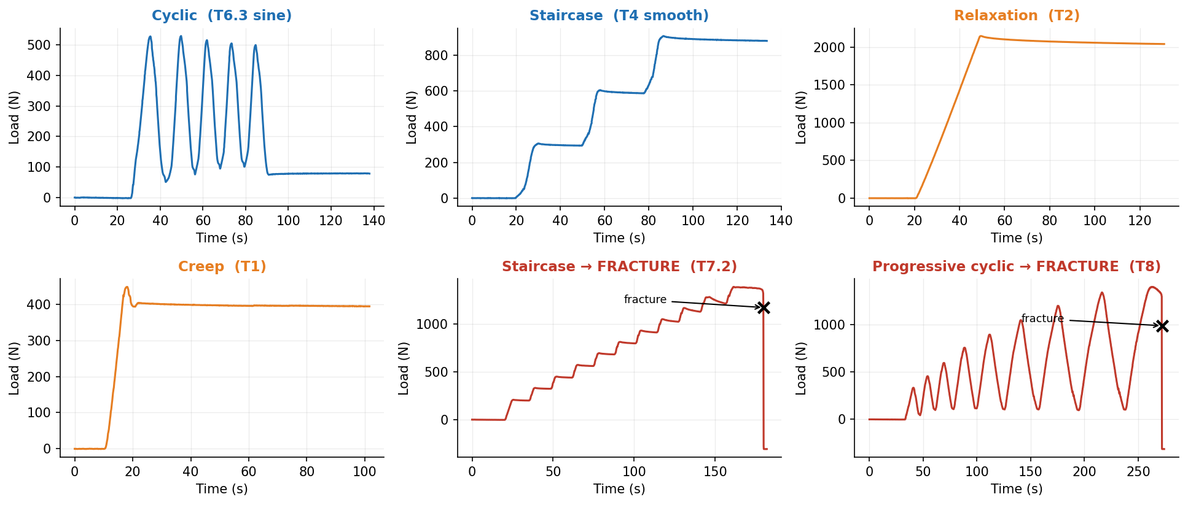
JÖNKÖPING UNIVERSITY
SF9 — ADVANCED TEST MODES: SIX CLOSED-LOOP PROTOCOLS, ONE ENGINE
All six share one control loop (`_policy_step`) and one safety net. Every trace below is real rig data, not a schematic. Two of them drive the specimen to destruction.
Why it matters: a conventional pull gives ONE modulus, ONE yield, ONE UTS. These modes interrogate the specimen on the way to failure — so a single specimen yields a CURVE (stiffness vs damage, relaxation vs level) instead of a point.
Rig-validated 2026-08-08/09 on S18, S20, S21. Engine: control_policies.py · app wiring: main.py `_policy_step` · schematics: ui_help/.
188

Slide 49
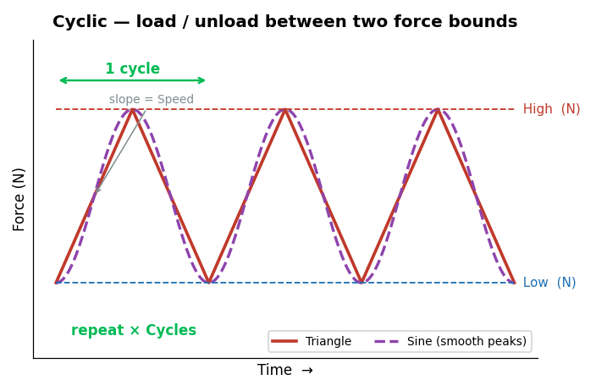
JÖNKÖPING UNIVERSITY
SF9 · CYCLIC [T5 · T6.3] — HOW IT WORKS
What this mode tells you
Repeatedly loads and unloads between a Low and a High force for N cycles. • Hysteresis loop area = energy dissipated per cycle • Change in loop shape = early damage, before any visible yield • Waveform choice: Triangle (constant-speed ramps) or Sine (eases at each peak) • Stays elastic — the specimen is REUSABLE afterwards
Settings used for our test
Parameter | Value
Low / High force | 100 / 500 N
Cycles | 5
Speed | 0.100 mm/s
Waveform | Triangle (T5) · Sine (T6.3)
Specimen | S20 · 100 % infill
SOFTWARE LIMITS — Low 0–5000 N · High 0–5000 N · Cycles 1–1000 · Speed 0.005–0.500 mm/s
Guidance: keep High below yield, or the run becomes a fatigue test and the specimen breaks.
Always-on, every mode: 10 kN force · 30 mm travel · 900 s timeout · stall guard (6 s window, min(0.05 mm, 35 % of commanded travel), armed above 200 N) · dead-DIC freeze 0.2 s / halt 1.0 s · E-Stop.
189

Slide 50
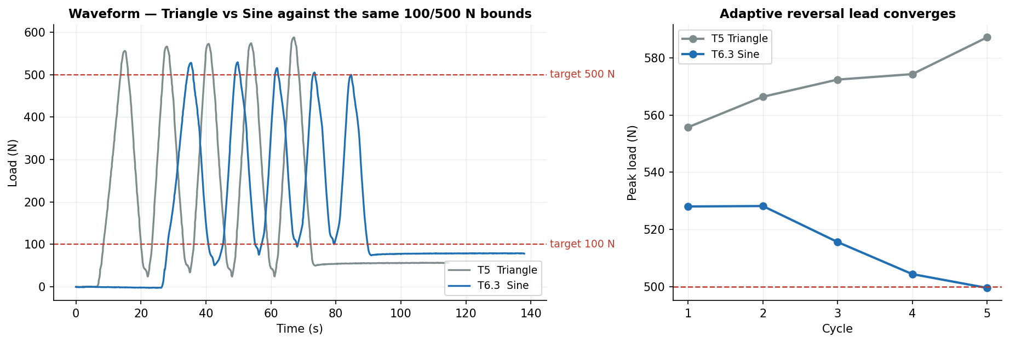
JÖNKÖPING UNIVERSITY
SF9 · CYCLIC [T5 · T6.3] — OUR RESULTS
71 N
Peak error — Triangle
15 N
Peak error — Sine
500 N
Sine, final cycle
5 + 5
Cycles completed
Cycle | 1 | 2 | 3 | 4 | 5 | mean |err|
T5 Triangle — peak (N) | 556 | 566 | 572 | 574 | 587 | 71
T6.3 Sine — peak (N) | 528 | 528 | 516 | 504 | 500 | 15
Sine cuts peak error 71 N → 15 N (78 % better) and CONVERGES: 528 → 500 N across the 5 cycles, landing on the 500 N target.
The convergence is the adaptive reversal lead learning the true coast distance in the FORCE domain. Seeded at zero so it approaches from below — seeding it at the measured 1.3 s decel over-led and rang (T6, T6.2).
190

Slide 51
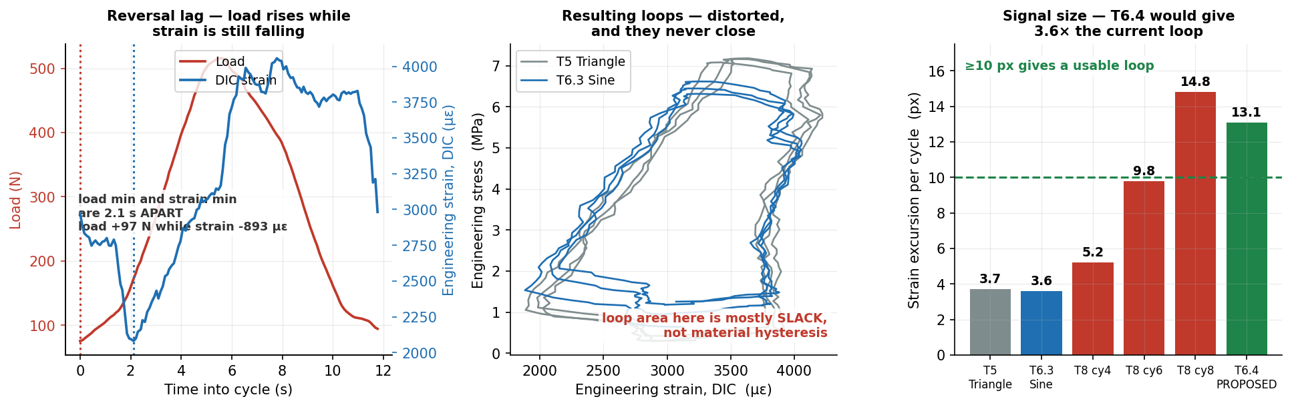
JÖNKÖPING UNIVERSITY
SF9 · CYCLIC [T5 · T6.3] — HYSTERESIS: A NEGATIVE RESULT
The mode promises loop area = energy dissipated and loop-shape change = early damage. Neither is measurable from THIS run. It is NOT a DIC resolution problem — the fault is mechanical slack.
14 % of fracture load
Cycled at
2.1 s
Reversal lag
load +97 N, strain −893 µε
…during which
+25 µm / cycle
Crosshead ratchet
0.1 px steps, ±0.02 px
DIC is NOT the limit
Root cause: at every reversal the load climbs 97 N while the strain still FALLS 893 µε — the load train is re-taking backlash, not straining the specimen. That fabricated area is most of the loop. Cycling at only 14 % of fracture load leaves little real hysteresis to compete with it.
✅ RESOLVED — T6.4 / T6.5 ran 2026-08-11 on S22 at 400→1100 N and the loops closed: 12.3 px measured against the 13.1 px predicted here. See p215-214.
The 400 N floor is the key: never unload through the slack band, so backlash is crossed once at the start instead of twice per cycle. Arm auto-stop — 1100 N is above the 694 N yield knee, which is the point, but T8 fractured at 1397 N.
191

Slide 52
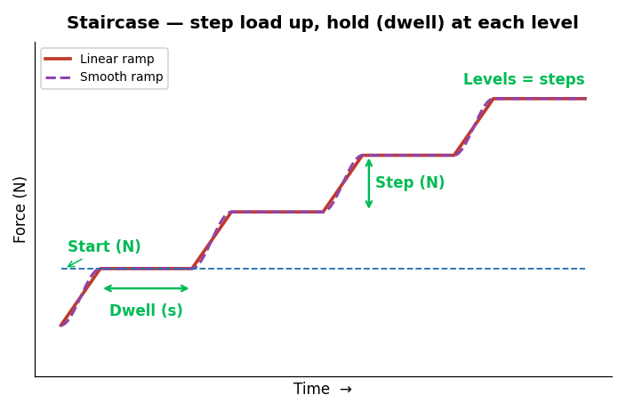
JÖNKÖPING UNIVERSITY
SF9 · STAIRCASE [T3 · T4] — HOW IT WORKS
What this mode tells you
Steps the load up — Start, Start+Step, Start+2·Step … — and DWELLS at every level. • Each dwell is a mini stress-relaxation test • Modulus can be re-measured at every level • Ramp shape: Linear (constant speed) or Smooth (eases into each level) • Non-destructive if the top level stays below yield
Settings used for our test
Parameter | Value
Start / Step | 300 / 300 N
Levels | 3
Dwell | 20 s
Speed | 0.100 mm/s
Ramp | Linear (T3) · Smooth (T4)
Specimen | S20 · 100 % infill
SOFTWARE LIMITS — Start 0–5000 N · Step 10–2000 N · Levels 1–20 · Dwell 1–600 s · Speed 0.005–0.500 mm/s
Guidance: keep the top level, Start+(Levels−1)·Step, below yield.
Always-on, every mode: 10 kN force · 30 mm travel · 900 s timeout · stall guard (6 s window, min(0.05 mm, 35 % of commanded travel), armed above 200 N) · dead-DIC freeze 0.2 s / halt 1.0 s · E-Stop.
192

Slide 53
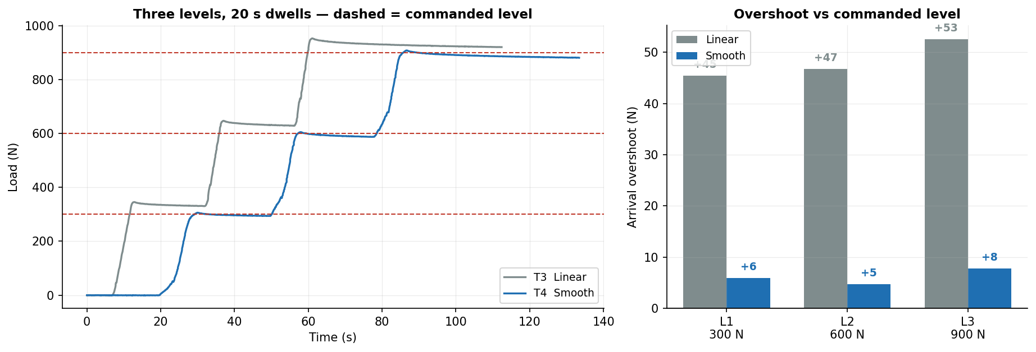
JÖNKÖPING UNIVERSITY
SF9 · STAIRCASE [T3 · T4] — OUR RESULTS
48 N
Linear — mean overshoot
6 N
Smooth — mean overshoot
8×
Improvement
0 of 6 dwells
Stall guard false trips
Level (commanded) | L1 · 300 N | L2 · 600 N | L3 · 900 N
T3 Linear — arrival overshoot | +45.5 N | +46.8 N | +52.6 N
T4 Smooth — arrival overshoot | +6.0 N | +4.8 N | +7.8 N
Dwell force drop (Smooth) | 7.7 N | 16.1 N | 6.0 N
Smooth ramp cuts arrival overshoot from ~48 N to ~6 N — a 8× improvement — by tapering the last 25 % of every approach.
Overshoot is measured against the COMMANDED level, not the settled value — the settled value already contains the dwell relaxation, which would mask the control error.
193

Slide 54
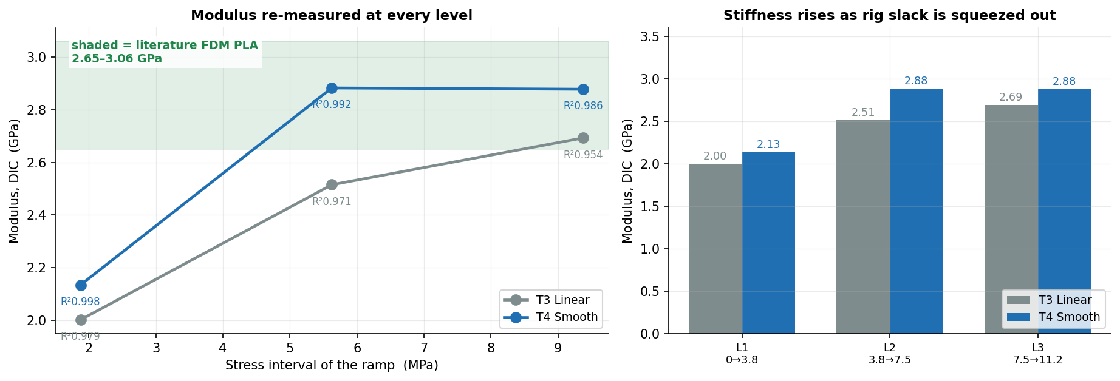
JÖNKÖPING UNIVERSITY
SF9 · STAIRCASE [T3 · T4] — MODULUS AT EVERY LEVEL
The mode's claim is that stiffness can be re-measured at every level. Here it is: a modulus fitted to the ramp into each level, so E as a function of stress.
Ramp into level | L1 · 0 → 3.8 MPa | L2 · 3.8 → 7.5 MPa | L3 · 7.5 → 11.2 MPa
T3 Linear — E (GPa) | 2.00 (R² 0.979) | 2.51 (R² 0.971) | 2.69 (R² 0.954)
T4 Smooth — E (GPa) | 2.13 (R² 0.998) | 2.88 (R² 0.992) | 2.88 (R² 0.986)
Literature, FDM PLA | 2.65 – 3.06 GPa | (solid / high infill) | Chacón · Chen et al.
E climbs 2.13 → 2.88 GPa across the three levels and settles INSIDE the literature band — the rise is rig slack being squeezed out at low load, the same artefact that fools the crosshead stiffness in T8.
Fit quality improves with the Smooth ramp (R² ≥ 0.986 vs 0.954) because a tapered approach spends more samples in steady loading and fewer in the overshoot transient.
194

Slide 55
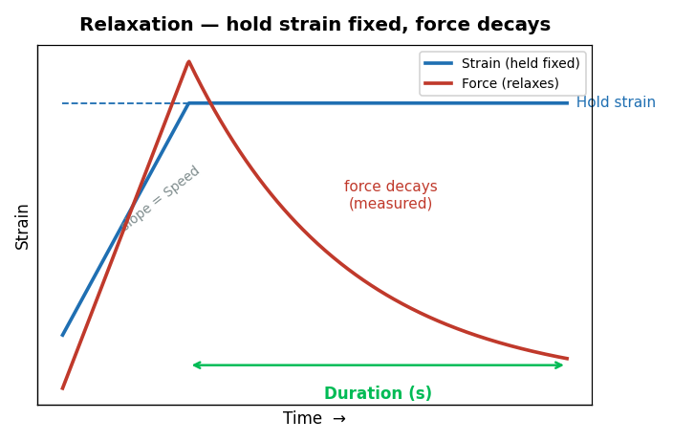
JÖNKÖPING UNIVERSITY
SF9 · RELAXATION [T2] — HOW IT WORKS
What this mode tells you
Ramps to a target STRAIN, then holds the crosshead still and watches the force decay. • Measures the viscoelastic stress-relaxation of the polymer • Decay rate and magnitude are material fingerprints • Requires live DIC (green 2/2) — strain is the controlled variable • Non-destructive below yield
Settings used for our test
Parameter | Value
Hold strain | 0.010
Hold duration (measured) | 81 s
Speed | 0.100 mm/s
Specimen | S20 · 100 % infill
SOFTWARE LIMITS — Hold strain 0.001–0.200 · Duration 1–3600 s · Speed 0.005–0.500 mm/s · needs DIC green 2/2
Guidance: keep the hold strain below yield (≈0.015 for PLA) for a purely elastic hold.
Always-on, every mode: 10 kN force · 30 mm travel · 900 s timeout · stall guard (6 s window, min(0.05 mm, 35 % of commanded travel), armed above 200 N) · dead-DIC freeze 0.2 s / halt 1.0 s · E-Stop.
195

Slide 56
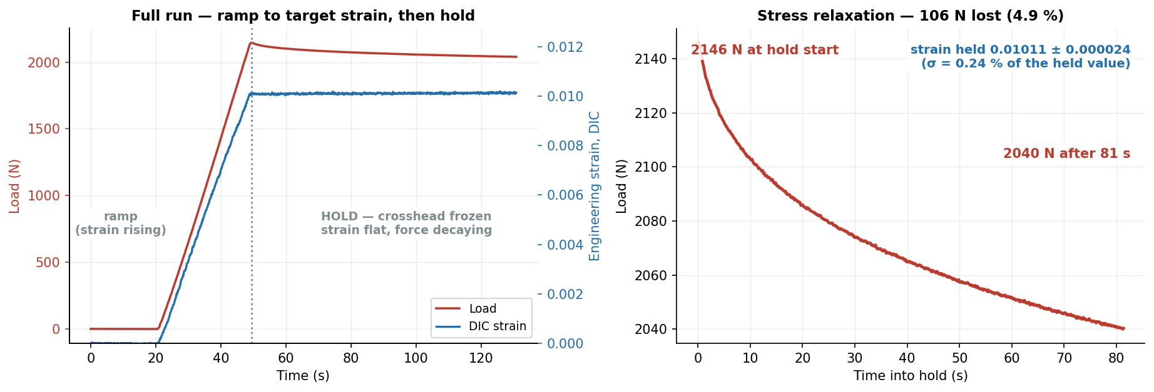
JÖNKÖPING UNIVERSITY
SF9 · RELAXATION [T2] — OUR RESULTS
2146 N
Peak load
2040 N
After hold
106 N (4.9 %)
Stress relaxed
0.01011
Strain held
Quantity | Value | Interpretation
Force decay over 81 s | 2146 → 2040 N | 4.9 % of the initial stress relaxed away
Strain held | 0.01011 ± 0.000024 | ±0.24 % of the held value — the crosshead really did stand still
Textbook viscoelastic relaxation: 106 N (4.9 %) shed at a strain held to ±0.24 %. The control did its job — the decay is the MATERIAL, not drift.
Relaxation is the one mode whose dwell is not a zero-speed hold: it keeps nudging the crosshead to pin the strain, so the dwell is found from crosshead POSITION going flat.
196

Slide 57
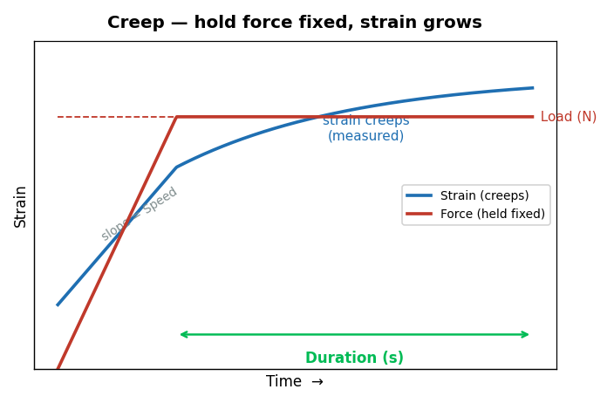
JÖNKÖPING UNIVERSITY
SF9 · CREEP [T1] — HOW IT WORKS
What this mode tells you
Ramps to a target LOAD, then holds that force constant and watches the strain grow. • The dual of relaxation: fix stress, measure strain(t) • Reveals time-dependent deformation under sustained service load • Primary-creep slope indicates how the part behaves under a permanent load • Non-destructive well below UTS
Settings used for our test
Parameter | Value
Hold load | 400 N
Hold duration (measured) | 40 s
Speed | 0.100 mm/s
Specimen | S20 · 100 % infill
SOFTWARE LIMITS — Load 10–5000 N · Duration 1–3600 s · Speed 0.005–0.500 mm/s
Guidance: use ≤60–70 % of UTS — above that, creep runs away and the specimen fails during the hold.
Always-on, every mode: 10 kN force · 30 mm travel · 900 s timeout · stall guard (6 s window, min(0.05 mm, 35 % of commanded travel), armed above 200 N) · dead-DIC freeze 0.2 s / halt 1.0 s · E-Stop.
197

Slide 58
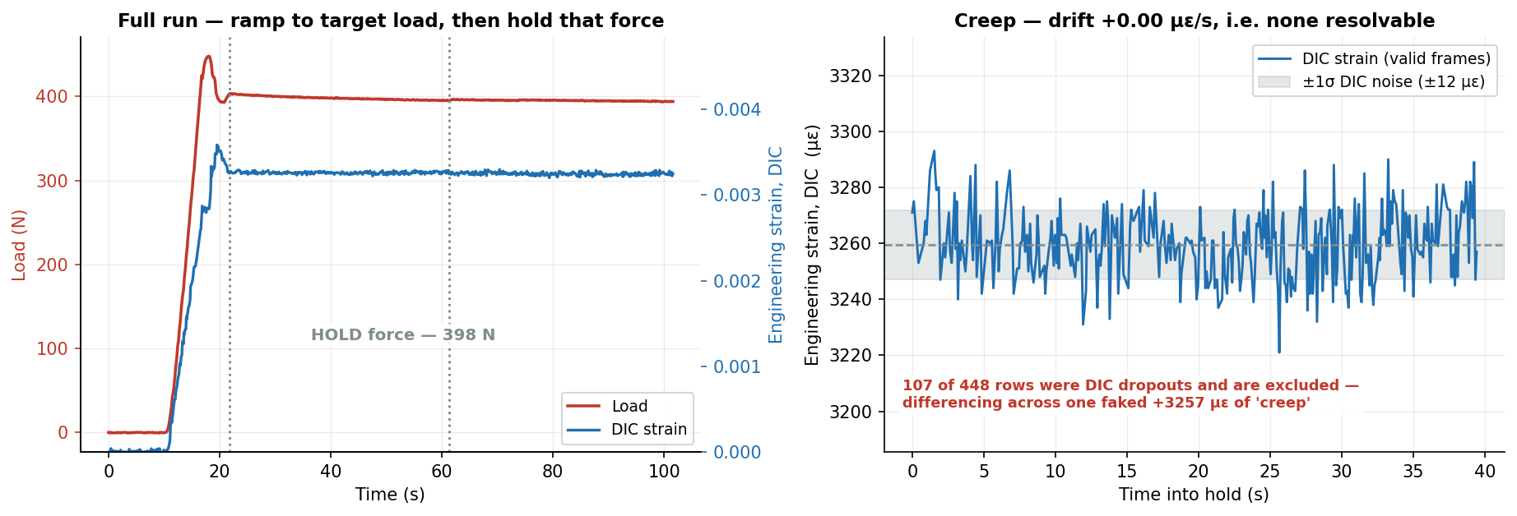
JÖNKÖPING UNIVERSITY
SF9 · CREEP [T1] — OUR RESULTS
398 N
Force held
± 2.2 N
Hold stability
-14 µε (none)
Creep measured
± 12 µε
DIC noise band
Quantity | Value | Interpretation
Force held | 398 ± 2.2 N | ±0.55 % of target — the load is genuinely constant
DIC strain over the hold | 0.00326 ± 0.000012 | drift +0.00 µε/s → +0 µε in 40 s: BELOW the ±12 µε noise band
DIC dropouts skipped | 107 of 448 rows | a dropout writes ec=0.0; differencing across one faked +3257 µε of 'creep'
Force pinned to ±2.2 N (0.55 %) — the CONTROL works. But creep was NOT resolvable: 5.0 MPa is only 11 % of UTS and PLA is glassy at room temperature. Negative result, correctly reported.
✅ RESOLVED — T9 ran 2026-08-11 on S23 at 600 N tared for 877 s and creep IS resolved: +1080 µε drift-corrected = 41× the noise floor, decelerating (Findley n = 0.48). See p217-217.
T1 could not have detected creep at all: fitted rate +0.002 ± 0.060 µε/s, so the 95 % bound is <0.12 µε/s — under 5 µε across the whole 40 s hold. The hold was ~20× too short and the stress ~2× too low. Run a 900 s ZERO-LOAD baseline first to separate thermal drift from creep.
198

Slide 59
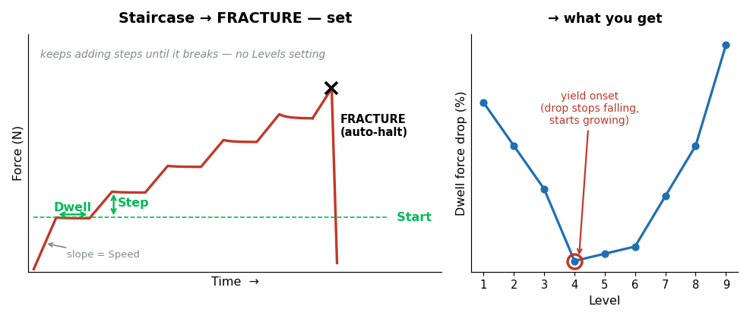
JÖNKÖPING UNIVERSITY
SF9 · STAIRCASE → FRACTURE [T7.2] — HOW IT WORKS
What this mode tells you
DESTRUCTIVE. Like Staircase, but it keeps adding levels until the specimen breaks. • A mini stress-relaxation at EVERY level, right up to failure • Yield onset appears as the dwell drop stops shrinking and starts growing • Modulus re-measured at every level = stiffness vs stress • Ends in fracture → UTS and ε_f from the SAME specimen
Settings used for our test
Parameter | Value
Start / Step | 200 / 120 N
Dwell | 10 s
Speed | 0.100 mm/s
Ramp | Smooth
Specimen | S18 · 50 % infill
Destructive modes are behind a confirmation dialog that echoes area, gauge and infill before arming.
SOFTWARE LIMITS — Start 0–5000 N · Step 10–2000 N · Dwell 1–600 s · Speed 0.005–0.500 mm/s · max 60 levels (policy cap)
Guidance: size Step so ~8–12 levels reach fracture. Too fine and the run drags; too coarse and you lose resolution exactly where yield happens.
Always-on, every mode: 10 kN force · 30 mm travel · 900 s timeout · stall guard (6 s window, min(0.05 mm, 35 % of commanded travel), armed above 200 N) · dead-DIC freeze 0.2 s / halt 1.0 s · E-Stop.
199

Slide 60
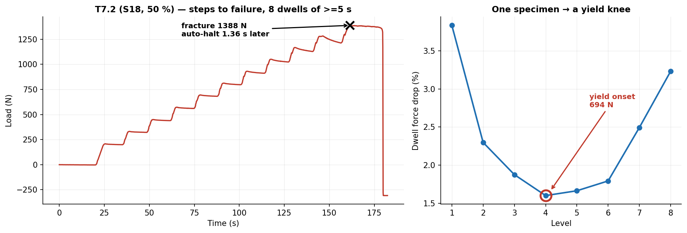
JÖNKÖPING UNIVERSITY
SF9 · STAIRCASE → FRACTURE [T7.2] — OUR RESULTS
1388 N
Peak load
307.4 N
Force anchor
21.19 MPa
TRUE UTS
1.36 s
Auto-halt after collapse
Quantity | Value | Note
Levels resolved | 8 dwells | each one a mini relaxation test
Yield onset | 694 N tared | the dwell drop stops falling and starts growing
Nominal vs TRUE UTS | 17.35 → 21.19 MPa | anchor 307.4 N recovered from the post-fracture tail
One specimen delivered a yield knee AND a fracture: 8 relaxation points, yield located at 694 N, TRUE UTS 21.19 MPa, auto-halt 1.36 s after collapse.
The anchor is the preload the tare removed; recovering it from the settled post-fracture tail converts nominal stress to true stress without a second measurement.
200

Slide 61
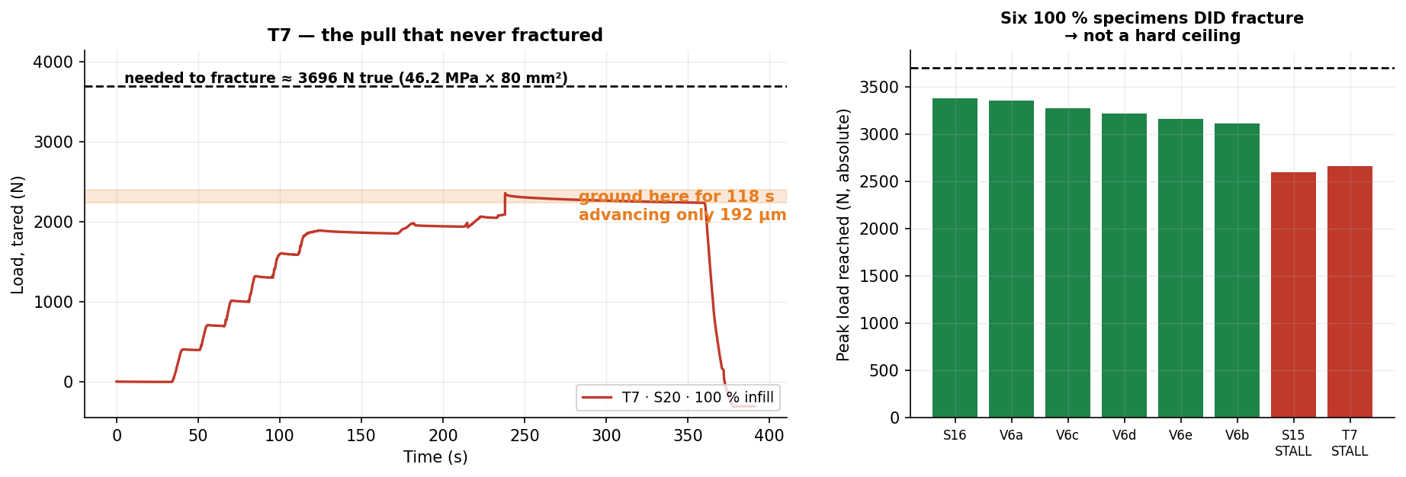
JÖNKÖPING UNIVERSITY
SF9 · THE ONE THAT FAILED [T7] — AND WHY
T7 ran Staircase → FRACTURE on S20 (100 % infill) and never broke the specimen. Worth a slide: the failure is a HARDWARE limit, and the software behaved exactly as designed.
2355 N
Peak reached
3696 N
Needed to fracture
72 % of it
Got to
192 µm in 118 s
Crosshead at the top
1.6 %
…of commanded rate
Why it stalled — ranked at the time (ANSWER: no. 4)
Mitigation
1 Stepper DRIVER CURRENT (Vref) set too low — most likely, and cheapest to check 2 Driver THERMAL DERATING — T7 was the 7th test of a 2 h 15 min session 3 PSU voltage SAG under peak load 4 ✔ MECHANICAL BINDING — crossheads misaligned, load holders loose. See p183.
1 Raise driver current (Vref) — ⚠ HARDWARE today, NOT a software change · see next slide 2 Cool between destructive runs — T7.2 and T8 both PASSED after a pause 3 Scope the rail under load; fit a stiffer PSU 4 On a weak day use 50 % specimens (fracture ≈1.4 kN) — both later runs did
NOT a hard ceiling: six 100 % specimens fractured at 3.1–3.4 kN. Software response was correct — nothing ran away, and the specimen was released intact and reusable.
201

Slide 62
JÖNKÖPING UNIVERSITY
SF9 · T7 — CAN THE Vref FIX BE DONE IN SOFTWARE?
NO — not as the rig stands today. But the driver hardware would allow it, and that is the single highest-value change available.
TODAY — a screwdriver job, not a code change
POSSIBLE — the driver is an SPI Trinamic part
Firmware drives the motors with STEP / DIR / ENABLE only. • No SPI, no UART to the driver • No TMCStepper (or equivalent) library • MoToStepper in STEPDIR mode; 200 × 8 microsteps ⇒ Nothing in main.py or the firmware can change motor current. Vref is set physically on the driver board and verified with a multimeter.
MKS TMC2160_57 boards (README + PROJECT_REQUIREMENTS). Wire CS / SCK / MOSI / MISO to the ESP32 and you can: • SET run current in code — GLOBALSCALER + IRUN • READ DRV_STATUS — otpw / ot over-temperature flags • READ StallGuard — a true stall signal, not an inference ⇒ The thermal-derating theory stops being a theory and becomes a LOGGED CHANNEL.
Is the drivetrain even big enough? 2 × 1.85 Nm · 20:1 gearbox · 5 mm lead
Lead-screw efficiency assumed | 15 % (pessimistic ACME) | 20 % | 30 % | 90 % (ball screw)
Force the drivetrain should reach | 12,554 N | 16,738 N | 25,108 N | 75,323 N
Headroom over the 3696 N needed | 3.4× | 4.5× | 6.8× | 20.4×
Even at a pessimistic 15 % screw efficiency the drivetrain should deliver ~3.4× what is needed, yet T7 stopped at 72 %. A mechanical-sizing explanation does not survive that arithmetic — an electrical one does, which is why driver current is suspect #1.
RECOMMENDED ORDER — (1) measure Vref and compare against the motor's rated current; (2) fit a heatsink/fan; (3) wire the SPI pins and log DRV_STATUS so derating is measured, not guessed.
Motor AMP57TH76-4280 (1.85 Nm), gearbox EPL64/2 20:1, 5 mm lead — from README.md and the MM_PER_S_PER_RPM constant in main.py. Torque figures are holding torque at rated current; if the driver runs the motor below rating, available force scales down roughly with current.
202

Slide 63
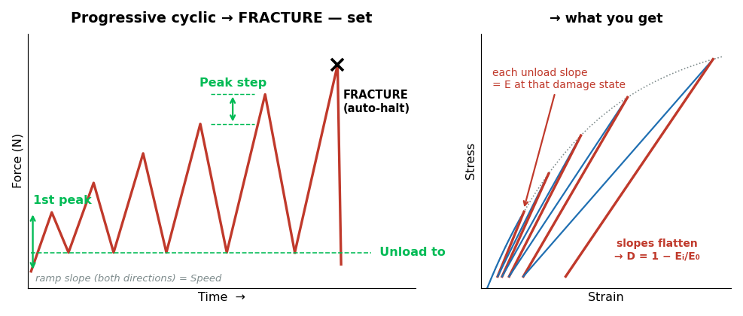
JÖNKÖPING UNIVERSITY
SF9 · PROGRESSIVE CYCLIC → FRACTURE [T8] — HOW IT WORKS
What this mode tells you
DESTRUCTIVE. Load–unload–reload with the peak rising every cycle, until fracture. • EVERY unload measures the modulus at that damage state • Gives the stiffness-degradation curve D = 1 − Eᵢ/E₀ vs stress • Hysteresis area per cycle tracks energy going into damage • Permanent set per cycle shows plasticity accumulating
Settings used for our test
Parameter | Value
1st peak | 300 N
Peak step | 150 N
Unload to | 100 N
Speed | 0.100 mm/s
Specimen | S21 · 50 % infill
The collapse watch here is PER RISING STROKE and armed only past halfway to target — a single always-on detector would trip on every intentional unload.
SOFTWARE LIMITS — 1st peak 0–5000 N · Peak step 10–2000 N · Unload to 20–2000 N · Speed 0.005–0.500 mm/s · max 40 cycles (policy cap)
Guidance: keep the unload floor ≥20 N so the specimen never goes slack and the grips stay seated.
Always-on, every mode: 10 kN force · 30 mm travel · 900 s timeout · stall guard (6 s window, min(0.05 mm, 35 % of commanded travel), armed above 200 N) · dead-DIC freeze 0.2 s / halt 1.0 s · E-Stop.
203

Slide 64
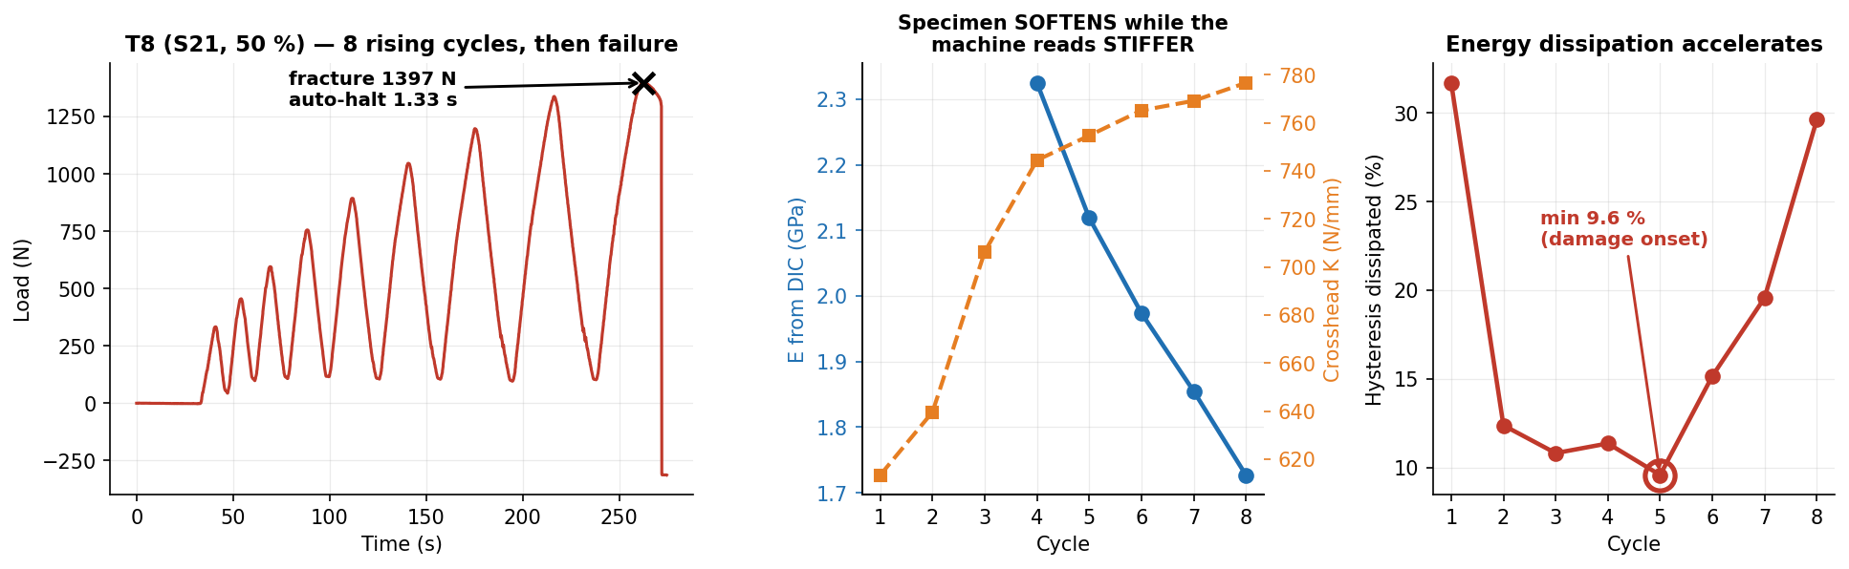
JÖNKÖPING UNIVERSITY
SF9 · PROGRESSIVE CYCLIC → FRACTURE [T8] — OUR RESULTS
Cycle | 1 | 2 | 3 | 4 | 5 | 6 | 7 | 8 | trend
Peak load (N) | 333 | 455 | 595 | 756 | 893 | 1046 | 1198 | 1338 | target ±12 N
Peak error vs target (N) | +33 | +5 | -5 | +6 | -7 | -4 | -2 | -12 | ±6 mean
DIC unload E (GPa) | — | — | — | 2.32 | 2.12 | 1.97 | 1.85 | 1.73 | 2.32 → 1.73
Crosshead K (N/mm) | 613 | 640 | 706 | 744 | 755 | 765 | 769 | 777 | 613 → 777 ↑
Hysteresis dissipated (%) | 31.7 | 12.4 | 10.8 | 11.4 | 9.6 | 15.2 | 19.6 | 29.6 | min 9.6 → 29.6
Specimen SOFTENED 2.32 → 1.73 GPa (25 % stiffness lost) while the crosshead read 613 → 777 N/mm — STIFFER. Without DIC this test concludes the opposite of the truth.
Cycles 1–3 carry no modulus: the DIC strain CHANGE in those small unloads is below the noise floor (R² 0.17–0.82). Dissipation is an energy integral over a large position range and has no such floor — on this rig it is the better damage metric.
204

Slide 65
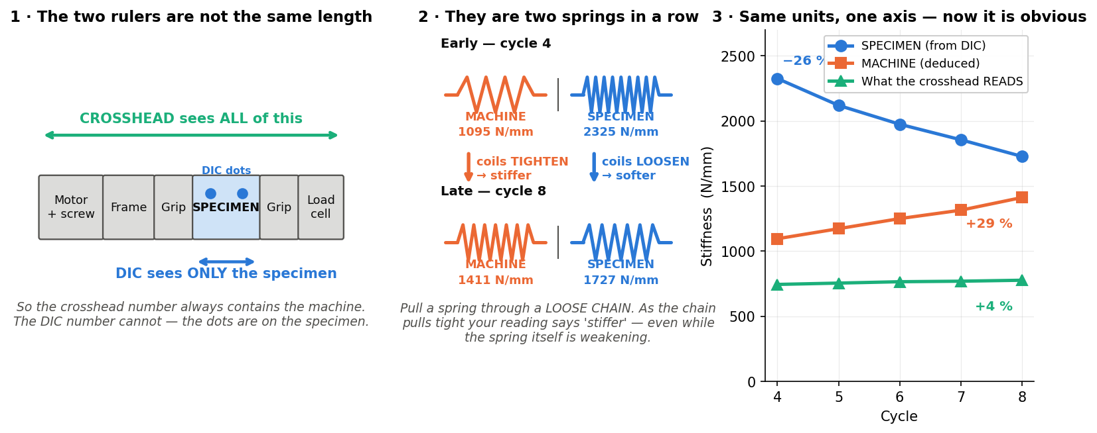
JÖNKÖPING UNIVERSITY
EXPLAINER — “the specimen softens but the machine reads stiffer”
This is the single most important idea on the T8 slide, so here it is slowly. Nothing here is new data — it is the same numbers, explained.
What you are measuring
Two DIFFERENT things. DIC watches two dots ON the specimen. The crosshead measures how far the whole machine moved.
Why that matters
The crosshead reading contains the grips, screw, frame and every bit of slack — the specimen is only ONE part of what it sees.
What actually happened
The specimen got 26 % SOFTER (real damage). The machine got 29 % STIFFER as slack was squeezed out. The machine change is bigger, so the total went UP 4 %.
The one-line version
The rig is the SOFTER spring (1095 vs 2325 N/mm), so it dominates the crosshead number. Only DIC can see the specimen by itself.
Springs in series: 1/K_measured = 1/K_specimen + 1/K_machine. K_specimen = E·A/L; with A = 80 mm² and L = 80 mm that is numerically E in MPa, which is why all three fit on one axis.
205

Slide 66

JÖNKÖPING UNIVERSITY
EXPLAINER — why the energy loss DIPS, then CLIMBS
The U shape looks odd until you see that TWO separate things are being added together — one dying away, one waking up.
Cycle | 3 | 4 | 5 ← lowest | 6 | 8 | what it tells you
Energy lost per cycle | 10.8 % | 11.4 % | 9.6 % | 15.2 % | 29.6 % | dips, then climbs
Permanent stretch added | +106 µm | +102 µm | +22 µm | +65 µm | +271 µm | dips, then climbs
Left-over strain added (DIC) | +385 µε | +254 µε | +212 µε | +264 µε | +1669 µε | dips, then climbs
Three completely separate measurements all bottom out at CYCLE 5. That is why it is believed — one dipping curve could be noise; three agreeing is a real change of regime.
Careful: cycle 5 is where MATERIAL damage overtakes the still-fading MACHINE settling — it is not a pure yield point. T7.2's relaxation knee says 694 N, this says 893 N, so the deck quotes yield onset as a BRACKET of 700–900 N rather than one number.
206

Slide 67
JÖNKÖPING UNIVERSITY
SF3 · SETTINGS (RECIPES) — WHAT ONE CLICK RESTORES
A recipe is the WHOLE test setup, not just a couple of boxes. Pick a profile, press Load, and every field below is restored — including the advanced test mode and its parameters.
Specimen & rig
Test programme ← the part people miss
Field | Stored as | Example
Material | material | PLA
Infill % | infill_pct | 50
DIC specimen preset | specimen_mode | White / Black
Cross-section area | area_mm2 | 80.0 mm²
Gauge length | gauge_mm | 80.0 mm
Preload target | preload_N | 300 N
Test speed | test_speed_mm_s | 0.100 mm/s
Field | Stored as | Example
Which advanced mode | mode | Progressive cyclic → FRACTURE
ALL SIX modes' parameters | mode_params | see below
Strain-rate target | strain_rate | 0.0005 /s
Auto-stop at fracture | auto_stop_fracture | ON
Free-text notes | notes | why these settings
— Cyclic | low/high/cycles/speed/waveform | 100 / 500 N · 5 · Sine
— Progressive cyclic | first_peak/peak_step/unload_to/speed | 300 / 150 / 100 N
Every mode's parameters are stored, not just the selected one — so switching Test type AFTER a Load gives sane values instead of leftovers from whatever was loaded before. Verified by round-trip: save → reload returns byte-identical params for all six modes.
Why it matters
The profile that ships
• A destructive test is ONE specimen — there is no second chance to get the settings right. • Repeat runs are identical by construction, not by memory or a lab notebook. • A student can run a validated protocol without knowing how it was tuned. • One shared source of truth: `_mode_widget_map()` drives BOTH save and load, so the two can never drift apart. Adding a mode means one entry there and nothing else.
Profile | Infill | Preload | Fracture protocols sized for
Default | 100 % | 300 N | ~3.2 kN in ~10 levels
Recreated automatically if missing, so a fresh clone always has it. A profile you have saved under your own name is never overwritten. Was two profiles (100 % / 50 % infill) until 2026-08-12 — one is enough, since infill is a label that enters no calculation and every force here is a starting point the operator adjusts per specimen anyway.
Stored as plain JSON in Software/UTM_PyQt6/recipes/ — readable, diffable, and easy to hand to someone else. The folder is gitignored as user-local; the two defaults regenerate on launch.
207

Slide 68

JÖNKÖPING UNIVERSITY
SF9 — STRESS vs STRAIN, ALL SIX MODES
The same six protocols in MATERIAL space. Strain is DIC gauge strain, ENGINEERING (ΔL/L₀); stress is engineering (F/A₀). True stress needs the current cross-section, which needs Poisson from edge tracking — not measured yet, so nothing here is labelled 'true'.
Each protocol has a signature: cyclic = a tight loop bundle · staircase = one straight line with dwell steps · relaxation = a VERTICAL drop at fixed strain · creep = a single POINT · both fracture modes = the full curve to failure.
ε_f 3.10 % (T7.2) and 3.32 % (T8). A marker-separation plausibility bound is applied: at fracture L_px jumps 1668→1825 px ONE SAMPLE before the load collapses, which would otherwise stretch both fracture panels to a fictitious 10 % strain.
208

Slide 69

JÖNKÖPING UNIVERSITY
SF9 — DO THE NUMBERS MAKE SENSE? vs add:north E-PLA TDS
SAME reference as the V6 slides (p156 / p163): add:north E-PLA TDS rev 2.1, ISO 527 / 178, so k = spec ÷ measured is directly comparable across the deck. The datasheet has NO creep or relaxation data — those two rows use journals and are marked ‡.
Property | ISO | E-PLA spec | SF9 measured | k | retain
Tensile modulus E — T4 staircase, top level (100 %) | 527 | 2.87 GPa | 2.88 GPa | 1.00 | 100 %
Tensile modulus E — T8 cycle 4 (50 % infill) | 527 | 2.87 GPa | 2.32 GPa | 1.23 | 81 %
Tensile strength — T7.2 / T8 (50 % infill) | 527 | 58 MPa | 21.2 / 21.4 MPa | 2.74 / 2.71 | 37 %
Elongation at break — T7.2 / T8 (50 % infill) | 527 | 8 % | 3.10 / 3.32 % | 2.58 / 2.41 | 39–42 %
Stress relaxation ‡ — T2, 81 s at ε=0.010 | — | not on TDS | 4.9 % | — | see ‡
Creep ‡ — T1, 40 s at 5.0 MPa | — | not on TDS | none resolvable | — | see ‡
Headline: the staircase modulus measured on a HIGH-STRESS increment lands on the datasheet (k = 1.00) where the conventional broad-range fit gives k = 1.10 — the low-stress slack is what drags the usual number down.
Spec sheet — add:north E-PLA TDS (PDF, ISO 527 / 178)
‡ TDS carries no viscoelastic data. Relaxation/creep compared against Materials 15(10) 3509 and J. Appl. Polym. Sci. e54463 (~11–13 % relaxation, far longer holds). Tg 55–60 °C is from the TDS.
209

Slide 70
JÖNKÖPING UNIVERSITY
SF9 — TEST CAMPAIGN REGISTER (T1–T8)
Every advanced-mode run, in order. Use the Test ID to tie a slide back to its CSV, and the Slides column to go the other way. Dates are the CSV's own 'Test Date' header — the filename timestamp is a session id and does NOT match (all three T6 attempts share one).
Test | Mode / variant | Spec. | When (2026) | Headline result | Slides
T1 | Creep | S20 100 % | 08-08 18:28 | held 398 ± 2.2 N for 40 s; creep NOT resolvable (-14 µε vs ±12 µε noise) | 195-196 · 206 · 207
T2 | Relaxation | S20 100 % | 08-08 18:34 | ε pinned at 0.01011; force decayed 2146 → 2040 N (4.9 %) | 193-194 · 206 · 207
T3 | Staircase · Linear ramp | S20 100 % | 08-08 19:37 | 3 levels / 20 s dwells — arrival overshoot +45/+47/+53 N | 190-192 · 206
T4 | Staircase · Smooth ramp | S20 100 % | 08-08 19:42 | same levels — overshoot +6/+5/+8 N ▸ the taper fix | 190-192 · 206
T5 | Cyclic · Triangle | S20 100 % | 08-09 13:10 | 5 cycles 100/500 N in 115 s; peak error 71 N (no lead yet) | 187-189 · 204
T6 | Cyclic · Sine — 1st try | S20 100 % | 08-09 13:16 | accurate (8 N) but took 222 s — ~2× too slow, flat bottoms ▸ velocity-law bug found | —
T6.2 | Cyclic · Sine — 2nd try | S20 100 % | 08-09 14:03 | speed fixed (117 s) but peaks flat at +15 N — no convergence ▸ 2 structural fixes | —
T6.3 | Cyclic · Sine — final | S20 100 % | 08-09 14:25 | 138 s, peak error 15 N, and peaks CONVERGE 528 → 500 N | 187-189 · 204
T7 | Staircase → FRACTURE | S20 100 % | 08-09 15:20 | STALLED at 2355 N (72 % of what was needed) — no fracture, specimen intact | 199-200
T7.2 | Staircase → FRACTURE | S18 50 % | 08-09 15:37 | yield knee 694 N, TRUE UTS 21.19 MPa, auto-halt 1.36 s | 197-199 · 206
T8 | Progressive cyclic → FRACTURE | S21 50 % | 08-09 17:34 | 8 clean cycles, 25 % stiffness lost, TRUE UTS 21.38 MPa | 201-206
11 runs, 6 modes, 3 specimens. T6 → T6.2 → T6.3 are three attempts at ONE test, not three tests — each failure diagnosed a real bug. T7 is the only outright failure, and it is hardware.
Specimen economy: S20 (100 %) survived all eight NON-destructive runs (T1–T6.3) AND the failed T7 — a destructive protocol it was never broken by. The two destructive runs that DID succeed each consumed a fresh specimen (S18, S21). T7 came after 2 h 15 min of continuous testing that day, which is the thermal-derating argument on p201.
Raw CSVs: Software/UTM_PyQt6/8.7/<specimen folder>/. Metrics recomputed by documentation/sf9_data.py — this table is generated, not typed.
210

Slide 71

JÖNKÖPING UNIVERSITY
REFERENCE — ENGINEERING vs TRUE vs “CAUCHY” STRAIN
Three names, only TWO quantities. This page exists because the CSV column is called DIC_Cauchy while it holds ENGINEERING strain — the single most confusing thing in this project.
THE TRAP: “Cauchy STRESS” means TRUE stress — but “Cauchy STRAIN” is a synonym for ENGINEERING strain. Putting the two words side by side invites exactly the wrong reading, which is why every axis now says “Engineering strain, DIC”.
Why engineering — and it is about STRESS, not strain
So the choice is forced
Quantity | Needs | Can we?
Engineering strain ΔL/L₀ | length only | YES
True strain ln(L/L₀) | length only | YES
Engineering stress F/A₀ | original area | YES
True stress F/A_current | CURRENT area | NO — not yet
• A stress–strain curve must be INTERNALLY CONSISTENT — engineering with engineering, or true with true. Mixing them is simply wrong. • True stress needs the current cross-section ⇒ Poisson, which the narrow gauge blocks (p190). • So engineering + engineering is the only defensible pairing available today. • ISO 527 and the add:north TDS also report engineering — which is what keeps our k-factors comparable (p208).
In code: cauchy = (L−L₀)/L₀ and true_strain = ln(L/L₀), both written to every CSV. Verified on real data: DIC_True always equals ln(1 + DIC_Cauchy), so the maths was right — only the NAME was misleading. The column name is kept for backward compatibility with every past test.
211

Slide 72

JÖNKÖPING UNIVERSITY
REFERENCE — WOULD TRUE STRESS CHANGE OUR ANSWERS?
Worth asking before building the edge-tracking rig on p190. Short answer: it is a ~3 % refinement on the numbers — but it buys two things nothing else can.
Engineering strain | 1 % | 3.3 % (T8 ε_f) | 7 % (V6 worst) | 20 % (a ductile metal)
True stress higher by — elastic, ν = 0.35 | +0.7 % | +2.4 % | +5.1 % | +15.6 %
True stress higher by — volume conserved | +1.0 % | +3.3 % | +7.0 % | +20.0 %
Our 21.38 MPa would become | 21.6 | 21.9 – 22.1 | 22.5 – 22.9 | —
Engineering vs TRUE STRAIN differ by | 0.5 % | 1.6 % | 3.3 % | 10.7 %
So DO IT — but not for the 3 %. Do it for (1) POISSON'S RATIO, a material property we cannot measure at all today, and (2) telling whether the post-peak drop is real softening or just thinning: S16 falls 47.4 → 42 MPa, and volume-conserved true stress is still only 44.5.
⚠ DESIGN FIX for p190: it says “average width over 100s of rows”. Necking is LOCAL — averaging under-corrects exactly where it matters. Track the MINIMUM width along the gauge, not the mean.
212

Slide 73

JÖNKÖPING UNIVERSITY
SF9 · CYCLIC — RE-RUN [T6.4 · T6.5] — OUR RESULTS
± 3.4 N
Peak error
12.3 px (was 3.6)
Strain excursion
14.2 → 10.9 kJ/m³
Loop area
1.49 → 1.43 GPa
Unload modulus
0.99 (was 0.12)
Unload-fit R²
Quantity | T6.4 (1st run) | T6.5 (2nd run) | What it means
Closed loops recovered | 3 of 8 · 45 % frames | 6 of 8 · 97 % frames | T6.4 lost the camera at t ≈ 145 s
Loop area, first → last | 15.3 → 10.2 kJ/m³ | 14.2 → 10.9 kJ/m³ | falls monotonically — real energy, not noise
Unload modulus (R²), 1st → last | 1.51 → 2.19 GPa (0.65) | 1.49 → 1.43 GPa (≥ 0.99) | resolvable every cycle — impossible on T6.3
T6.5 IS THE SLIDE-READY CYCLIC RESULT: 8 cycles at 400→1100 N, peak held to ± 3.4 N, 6 closed loops, and BOTH damage metrics (loop area, unload E) fall monotonically. The negative result on p191 is closed.
STILL MISSING — a DAMAGE CURVE. T6.4 lost DIC mid-run and T6.5 ran on the already-cycled specimen, and E RECOVERED over the 40 min between them (cycle 3 = 1.52 → cycle 8 = 1.54 GPa), so recoverable softening cannot be separated from permanent damage. D = 1 − Eᵢ/E₀ is NOT computable here.
Both runs are S22, 50 % infill. Cycle 1 is never a baseline — rig slack inflates it (ratchet +185 µm on T6.4 cycle 1 vs +37 µm on cycle 2). The loop extraction needs a trough-peak-trough triplet, so the first and last half-cycles are correctly not counted.
213

Slide 74

JÖNKÖPING UNIVERSITY
T6.3 → T6.5 — WHY THE RE-RUN WORKED
One parameter, not a new machine. Same mode, same engine, same camera, same code — the ONLY change is where the cycle bottoms out and tops out. p191 predicted a 13.1 px loop from that change alone; here is the measurement.
What was wrong on T6.3 | Why it was wrong | What T6.5 changed | Result
Loop area was mostly BACKLASH | unloading to 100 N re-crosses the slack band every cycle | floor raised to 400 N — crossed ONCE, at the start | loops close; ratchet +34 µm/cycle
Strain excursion only 3.6 px | that swing is near the centroid quantisation limit | peak raised to 1100 N — 1.8× the load swing | 12.3 px, vs 13.1 px predicted
Unload modulus unfittable (R² 0.12) | the strain change in a small unload is under the noise floor | the unload now spans 6169 µε, not ~243 | R² 0.99–1.00 every cycle
The lesson generalises: on a machine with slack, WHERE you cycle matters more than HOW accurately you cycle. T6.3 already held its peaks to 15 N — the control was never the problem, the operating window was.
Kept honest: T6.3's loop area was 7.6 kJ/m³, not zero — it was never 'no signal', it was signal you cannot attribute, and the R² column is what separates those two cases. Different specimens (S20 100 % vs S22 50 %), so absolute stress is not comparable; resolvability is.
214

Slide 75

JÖNKÖPING UNIVERSITY
SF9 · CREEP [T9] — HOW IT WAS DESIGNED: TWO RUNS
T1 failed because a creep signal below the noise floor is indistinguishable from the instrument drifting. T9 therefore MEASURES the drift first — same specimen, same mounting, nothing commanded — then subtracts its SLOPE from the real hold.
The protocol — order matters
Settings, and how the target was sized
Step | What runs | Why
1 Preload + tare | 300 N, tare force & DIC | one mounting state for both runs
2 RUN 1 — baseline | 928 s, nothing commanded | drift, with zero load applied
3 RUN 2 — creep | 600 N tared, 877 s hold | the actual experiment
4 Subtract the SLOPE | +0.2893 µε/s | a rate survives a re-tare; an offset does not
Parameter | Value | Reasoning
Hold load | 600 N tared | 11.3 MPa true = 53 % of the 21.2 MPa UTS
Hold duration | 900 s commanded | 877 s of settled hold measured
Specimen | S23 · 50 % infill | 50 % infill ⇒ ~2× the stress at the same load
Ramp speed | 0.100 mm/s | same as every other SF9 mode
THE DISCRIMINATOR WAS FIXED BEFORE THE RUN: material creep DECELERATES (log-shaped), instrument drift is LINEAR. The baseline's half-slopes are 0.345 / 0.277 µε/s (ratio 0.80) — linear, exactly as a drift should be. Anything curved in run 2 is therefore the specimen.
The baseline also RE-MEASURED the DIC noise floor as ± 26 µε over a full 900 s window (p198's ± 12 µε is a 40 s window). 9971 of 10854 rows DIC-valid at 20.6 ± 0.23 N, crosshead frozen.
215

Slide 76

JÖNKÖPING UNIVERSITY
SF9 · CREEP — RE-RUN [T9] — OUR RESULTS
596.5 ± 1.3 N
Force held
+1080 µε
Creep strain
41 ×
vs noise floor
n = 0.48
Findley exponent
100 %
DIC frames tracked
Quantity | Value | Interpretation
Load held over the 877 s window | 596.55 ± 1.30 N (594.1–610.9 N) | ± 0.22 % — the strain rise is not a load artefact
Raw strain rise → drift-corrected | +1334 µε → +1080 µε | drift only 19 % of raw; subtraction costs ± 2 µε
Shape — the pre-set discriminator | Findley n = 0.48 · half-slopes 1.48 → 0.59 µε/s | n < 1 and the rate halves: primary creep, not drift
Crosshead travel to hold the load | +172 µm (DIC gauge only +107 µm) | only 62 % of that motion is specimen — rest is rig
CREEP RESOLVED: +1080 µε drift-corrected = 41× the 26 µε noise floor, decelerating (n = 0.48), while the load sat at 597 ± 1.3 N. The negative result on p198 is closed.
Also measured: creep compliance J = 0.863 → 1.008 GPa⁻¹ (+16.7 %), plus a free fixed-grip relaxation tail, 598 → 582 N over 300 s (−2.8 %). ⚠ The CSV header reads 'Infill: 100 %' while S23 is 50 % — a label that enters no calculation, so no number here is affected.
216

Slide 77

JÖNKÖPING UNIVERSITY
T1 → T9 — WHY CREEP IS NOW RESOLVED
T1 was not a broken test — it was an UNDER-SIZED one, and it never could have succeeded. Three things were too small at once, and each was fixed by a number, not by new hardware.
What was wrong on T1 | Why it was fatal | What T9 changed | Result
Stress only 11 % of UTS | creep scales with stress — at 11 % there is nothing to see | 600 N on a 50 %-infill specimen = 53 % of UTS | signal ×77
Hold only 40 s | primary creep is log-shaped — it plays out over minutes | 877 s of settled hold | 22× longer
No drift baseline existed | any slow rise could equally be the instrument, so nothing could be attributed | a 928 s zero-load run FIRST, same mounting | drift measured: +0.2893 µε/s
WHAT THE BASELINE BOUGHT: the drift was +268 µε over 928 s — 19 % of the whole raw signal, and about 60 % of what a textbook 6 % creep would have been. Without run 1 the answer would have been arguable; with it, the subtraction is good to ± 2 µε.
⚠ NOISE FLOOR DEPENDS ON THE WINDOW: ± 12 µε on p198 is T1's own 40 s scatter; over a full 900 s window it is ± 26 µε. Any LONG-hold claim must be judged against 26, not 12.
Honest limits: the creep/instantaneous ratio of 16.8 % is an UPPER bound (ε_inst is tared at preload), and n=1 — one specimen, one stress level. A compliance CURVE needs 3-4 levels.
217

Slide 78
JÖNKÖPING UNIVERSITY
SF9 — FOLLOW-UP CAMPAIGN REGISTER (T6.4 – T9, 2026-08-11)
Continues the T1–T8 register on p210. One session, two specimens, five runs — aimed squarely at the two negative results (cyclic hysteresis, creep) and at the first fatigue-damage number.
Test | Mode / variant | Spec. | When (2026) | Headline result | Slides
T6.4 | Cyclic · Sine 400/1100 N | S22 50 % | 08-11 14:06 | peak error 3.0 N and the loop opens up — but the CAMERA stopped at t ≈ 145 s, so cycles 4-8 have no strain (45 % frames) | 211-212
T6.5 | Cyclic · Sine 400/1100 N | S22 50 % | 08-11 14:45 | 6 closed loops · area 14.2 → 10.9 kJ/m³ · unload E 1.49 → 1.43 GPa — the slide-ready cyclic result | 211-212
T7.3 | Staircase → FRACTURE (fatigued) | S22 50 % | 08-11 15:12 | residual strength after 16 cycles at 1100 N: 1272 N tared, TRUE UTS 19.74 MPa = -6.8 % vs S18 (same protocol); yield knee moved UP (load memory) | 208 · 216
T9-a | Creep · zero-load BASELINE | S23 50 % | 08-11 15:50 | 928 s at 20.6 N, crosshead frozen: drift +0.2893 µε/s (R² 0.90), noise floor ± 26 µε | 213
T9-b | Creep · 600 N tared | S23 50 % | 08-11 16:26 | held 596.5 ± 1.3 N for 877 s → +1080 µε drift-corrected (41× noise), Findley n = 0.48; +172 µm crosshead needed to hold it | 213-215
Two negative results turned positive in ONE session, by changing NUMBERS only — no new hardware, no code change to the control engine. Cyclic needed a higher window (400→1100 N instead of 100→500 N); creep needed more stress, more time, and a baseline.
What is now CLOSED
What is still OPEN
• Cyclic hysteresis is measurable — loop area AND unload modulus both trend (p215-214). • Creep is measurable — +1080 µε at 41× the noise floor, decelerating (p217-217). • The DIC noise floor is now MEASURED over a full 900 s window: ± 26 µε. • Fatigue damage has a first number: -6.8 % TRUE UTS after 16 cycles at 79 % of fracture, measured against S18 — the run that used the SAME protocol (T7.3). • A fixed-grip relaxation tail comes free at the end of every creep run.
• No damage curve D = 1 − Eᵢ/E₀ — T6.4 lost DIC, T6.5 started already damaged, and E RECOVERED over the 40 min between them, so there is no valid E₀. ▸ T6.6: fresh specimen, 12 cycles, ONE continuous run, baseline E on cycle 2. • Creep at ONE stress level only — a compliance curve needs 3-4 levels. • The `Infill` CSV header still writes 100 % after an app restart (label only).
Raw CSVs: Software/UTM_PyQt6/SF9 - Advanced Test Modes/<specimen folder>/. Every number on this page is recomputed by documentation/sf9_data.py — the table is generated, not typed.
218

Slide 79
JÖNKÖPING UNIVERSITY
S25 · S26 — FRAME CAPTURE, CHECKED AGAINST THE TEST DATA
Two 100 % infill runs pulled to fracture on 2026-08-17 with capture armed. These videos are going to an extensometer package, so the question is not “did it record” but “is every frame real, distinct, and matched to a load sample”.
Check | S25 · VC2 | S26 · VC3 | Verdict
PNG stills written | 1445 | 1682 | —
video.avi (raw) | 1445 | 1682 | —
video_boost.avi | 1445 | 1682 | —
video_speckle.avi | 1445 | 1682 | —
All four sinks hold the same count | yes | yes | PASS
Dropped frames (implied by timestamps) | 0 | 0 | PASS
Capture rate (median interval) | 19.9 fps (50.2 ms) | 19.9 fps (50.2 ms) | PASS
Worst interval (p95) | 52.3 ms | 52.4 ms | PASS
SF11 run.json points at this CSV | yes | yes | PASS
DIC coverage (CSV header) | 100% | 100% | PASS
DIC health (CSV header) | 100% frames tracked 2/2 | 100% frames tracked 2/2 | PASS
Replay: frames byte-distinct | 100.0 % | 100.0 % | PASS
Replay: 2 markers found by the app's detector | 99.8 % | 99.9 % | PASS
Does the video cover the pull?
The whole point is a video that spans the loaded history — a capture that opens late has no elastic region to give the extensometer. S25 ramp 33.5 s · capture 33.0 → 106.0 s · fracture 101.4 s S26 ramp 10.6 s · capture 10.0 → 95.0 s · fracture 90.4 s Both open ≈ 0.6 s BEFORE the crosshead moves and run 4.6 s past fracture.
The one that did not do this
S24 (the first capture run, p219-class data) logged only 27 % DIC coverage — the frames were all there and all distinct, so the loss was in the load↔DIC matching step. It has not recurred: both runs here are at 100 %.
PASS — 3 127 stills and 3 × 3 127 AVI frames, zero dropped, all four sinks in step, 100 % DIC coverage on both runs. The videos are usable as extensometer input.
Raw: Software/UTM_PyQt6/8.6.20 - Tensile test to Failure/Specimen_S25… and …S26…/. Frame counts, rates and coverage recomputed at build time by documentation/s25_s26_data.py.
219

Slide 80

JÖNKÖPING UNIVERSITY
S25 vs S26 — STRESS vs STRAIN, OVERLAID
Same material, same 80 mm² nominal section, same protocol, 37 minutes apart. Engineering stress, anchor-corrected; DIC gauge strain over 80 mm.
 | S25 · VC2 | S26 · VC3 | Δ
UTS (MPa) | 46.16 | 47.17 | +1.01
at strain (%) | 2.19 | 2.44 | +0.25
σ_y 0.2 % (MPa) | 39.82 | 41.75 | +1.93
E (GPa) | 3.167 | 3.549 | +0.382
ε_f (%) | 4.18 | 5.74 | +1.57
Toughness (kJ/m³) | 1564 | 2309 | +745
Force anchor (N) | 280 | 308 | +27
Gauge share (%) | 49.5 | 57.8 | +8.4
What agrees, and what does not
UTS agrees to 2.2 % — it needs no curve fit, so it is the number to carry into the extensometer comparison. E and σ_y do NOT agree, and the next page shows they are the same disagreement counted twice. ε_f differs by 1.6 points. Across the eight 100 % runs on record ε_f spans 3.0–7.4 %, so this is ordinary specimen scatter in a brittle-ish failure, not an instrument effect.
Both curves come from utm_analysis.analyze() — the same function behind the app's Generate-report button. Plot: documentation/s25_s26_plots.py.
220

Slide 81

JÖNKÖPING UNIVERSITY
WHY E AND σ_y DISAGREE — AND WHY UTS DOES NOT
Read on its own, “2.98 vs 2.51 GPa” looks like two specimens with different stiffness. It is not. analyze() fits E over a FIXED 0.05–0.40 % strain window, and the two specimens do not have their toe in the same place — so for one of them that window is sitting on curved data.
 | fixed window | straightest run (its own)
S25 | 3.167 GPa | 3.123 GPa (0.13–0.65 %)
S26 | 3.549 GPa | 3.464 GPa (0.33–0.85 %)
σ_y then follows E, mechanically
The 0.2 % offset line has slope E. A softer E tilts it down, so it meets the curve later and higher: S25 E 3.17 → σ_y is 86.3 % of its UTS S26 E 3.55 → σ_y is 88.5 % of its UTS So the σ_y spread (39.8 vs 41.7 MPa) is largely the E spread re-expressed — one disagreement, counted twice.
TAKE-AWAY — quote UTS (no fit, agrees to 2.2 %) and treat σ_y / E from these two runs as fit-window artefacts until the E window is made adaptive. Fixing it is a change to utm_analysis.analyze(), not to the rig: search each curve for its own straightest run instead of assuming every specimen seats identically.
Shaded bands are the two candidate fit windows on each specimen's own curve. Recomputed by s25_s26_data.best_elastic_fit().
221

Slide 82
JÖNKÖPING UNIVERSITY
S25 vs S26 — STRESS-STRAIN DATA TABLE (1/3)
Both runs on ONE strain axis at 0.10 % steps, so every row is a like-for-like comparison — this is the form to hold beside extensometer output. ε 0.00 % → 1.90 %, read down the left block then the right. Δ = S26 − S25 at the same strain; “—” means that strain is past that specimen's fracture, so it genuinely has no stress there.
ε (%) | S25 σ | S26 σ | Δ | Landmark
0.00 | — | — | —
0.10 | 6.20 | 5.84 | -0.37
0.20 | 8.86 | 8.28 | -0.58
0.30 | 12.05 | 10.64 | -1.41
0.40 | 15.11 | 13.64 | -1.48
0.50 | 18.34 | 17.12 | -1.22
0.60 | 21.31 | 20.59 | -0.71
0.70 | 24.14 | 24.27 | +0.14
0.80 | 26.90 | 27.56 | +0.66
0.90 | 29.45 | 30.60 | +1.15
1.00 | 31.81 | 33.47 | +1.67
ε (%) | S25 σ | S26 σ | Δ | Landmark
1.10 | 34.11 | 35.89 | +1.79
1.20 | 36.23 | 38.12 | +1.89
1.30 | 38.25 | 40.16 | +1.92
1.38 | 39.82 | 41.55 | +1.73 | S25 yield
1.40 | 40.07 | 41.75 | +1.67 | S26 yield
1.40 | 40.10 | 41.78 | +1.68
1.50 | 41.67 | 43.13 | +1.47
1.60 | 43.05 | 44.27 | +1.22
1.70 | 44.13 | 45.18 | +1.05
1.80 | 44.97 | 45.88 | +0.92
1.90 | 45.57 | 46.39 | +0.82
Yield — 0.2 % offset
UTS — peak stress
Fracture — load collapse
Highlighted rows carry MEASURED values at each run's true landmark strain, not grid-interpolated ones. FULL RESOLUTION (all 768 + 903 raw samples): documentation/S25_S26_stress_strain_reference.pdf
222

Slide 83
JÖNKÖPING UNIVERSITY
S25 vs S26 — STRESS-STRAIN DATA TABLE (2/3)
Both runs on ONE strain axis at 0.10 % steps, so every row is a like-for-like comparison — this is the form to hold beside extensometer output. ε 2.00 % → 3.90 %, read down the left block then the right. Δ = S26 − S25 at the same strain; “—” means that strain is past that specimen's fracture, so it genuinely has no stress there.
ε (%) | S25 σ | S26 σ | Δ | Landmark
2.00 | 45.94 | 46.73 | +0.79
2.10 | 46.11 | 46.95 | +0.84
2.19 | 46.16 | 47.06 | +0.91 | S25 UTS
2.20 | 46.16 | 47.08 | +0.92
2.30 | 46.07 | 47.13 | +1.06
2.40 | 45.94 | 47.16 | +1.22
2.44 | 45.87 | 47.17 | +1.30 | S26 UTS
2.50 | 45.75 | 47.15 | +1.39
2.60 | 45.54 | 47.11 | +1.57
2.70 | 45.31 | 47.04 | +1.73
2.80 | 45.10 | 46.96 | +1.86
ε (%) | S25 σ | S26 σ | Δ | Landmark
2.90 | 44.87 | 46.86 | +1.99
3.00 | 44.66 | 46.74 | +2.08
3.10 | 44.45 | 46.61 | +2.17
3.20 | 44.23 | 46.47 | +2.24
3.30 | 44.05 | 46.32 | +2.28
3.40 | 43.85 | 46.17 | +2.32
3.50 | 43.67 | 46.03 | +2.36
3.60 | 43.47 | 45.89 | +2.42
3.70 | 43.27 | 45.74 | +2.47
3.80 | 43.06 | 45.60 | +2.54
3.90 | 42.83 | 45.46 | +2.63
Yield — 0.2 % offset
UTS — peak stress
Fracture — load collapse
Highlighted rows carry MEASURED values at each run's true landmark strain, not grid-interpolated ones. FULL RESOLUTION (all 768 + 903 raw samples): documentation/S25_S26_stress_strain_reference.pdf
223

Slide 84
JÖNKÖPING UNIVERSITY
S25 vs S26 — STRESS-STRAIN DATA TABLE (3/3)
Both runs on ONE strain axis at 0.10 % steps, so every row is a like-for-like comparison — this is the form to hold beside extensometer output. ε 4.00 % → 5.75 %, read down the left block then the right. Δ = S26 − S25 at the same strain; “—” means that strain is past that specimen's fracture, so it genuinely has no stress there.
ε (%) | S25 σ | S26 σ | Δ | Landmark
4.00 | 42.54 | 45.32 | +2.77
4.10 | 42.17 | 45.17 | +3.00
4.18 | 41.59 | 45.07 | +3.48 | S25 fracture
4.20 | — | 45.03 | —
4.30 | — | 44.90 | —
4.40 | — | 44.79 | —
4.50 | — | 44.66 | —
4.60 | — | 44.54 | —
4.70 | — | 44.41 | —
4.80 | — | 44.29 | —
4.90 | — | 44.17 | —
ε (%) | S25 σ | S26 σ | Δ | Landmark
5.00 | — | 44.02 | —
5.10 | — | 43.89 | —
5.20 | — | 43.76 | —
5.30 | — | 43.62 | —
5.40 | — | 43.47 | —
5.50 | — | 43.28 | —
5.60 | — | 43.08 | —
5.70 | — | 42.76 | —
5.75 | — | 42.54 | — | S26 fracture
Yield — 0.2 % offset
UTS — peak stress
Fracture — load collapse
Highlighted rows carry MEASURED values at each run's true landmark strain, not grid-interpolated ones. FULL RESOLUTION (all 768 + 903 raw samples): documentation/S25_S26_stress_strain_reference.pdf
224

Slide 85

JÖNKÖPING UNIVERSITY
E — WHERE THE FIT WINDOW LANDS, AND WHY IT MATTERS
E is the slope of the straight part of the stress-strain curve, so measuring it means choosing WHICH part to fit — the “fit window”. analyze() uses a fixed 0.05-0.40 % strain window for every specimen. That is a normal convention (ISO 527 fixes a window too) and it assumes every curve is straight in the same place. Ours are not.
What the picture shows
Each line is the slope measured over a short rolling window, so it answers a question a single fitted number cannot: is the curve even straight where we are looking? Every specimen STIFFENS through the first half-percent, peaks, then softens as yielding starts. The fixed windows (shaded) sit on the RISING part — so what gets reported is whatever that specimen happened to have reached by 0.40 %. S24 has almost finished rising by then. S26 and S16 have not, so their E reads low. Same material, same settings — a difference in how the specimen seated.
This is NOT new. The E explainer deck already recorded it on S16 (reported 1.88 GPa where the straight part of its own curve reads 2.6). S26 is the second clear instance, which is why it is now being settled with evidence instead of noted again.
Rolling fit: 0.20 %-wide window stepped in 0.02 % increments. Markers = centre of each specimen's steepest straight run. Generated by documentation/e_fit_plots.py.
225

Slide 86

JÖNKÖPING UNIVERSITY
E — THREE WAYS TO PICK THE WINDOW, ON OUR NINE 100 % RUNS
Same nine specimens, same curves, three rules for choosing the window. Judged on the two things that matter: how much they scatter across nominally identical specimens, and where they sit against the material datasheet.
Rule for the window | mean E | CV | vs TDS
ISO fixed 0.05-0.25 % | 2.45 GPa | 20.3 % | -15 %
fixed 0.05-0.40 % (was ours) | 2.55 GPa | 17.1 % | -11 %
Steepest straight run ✔ | 2.85 GPa | 16.3 % | -1 %
What the numbers say
The steepest straight run wins on BOTH counts at once: least scatter (CV 16.3 % against 17.1 and 20.3) and closest to the datasheet (-1 % against -11 and -15). Lower scatter is the load-bearing result — a rule that merely chased noise would make repeatability WORSE. So the fixed windows are partly measuring how each specimen seated. Note ISO is the WORST of the three here: adopting it for comparability would cost repeatability.
DECISION TAKEN 2026-08-18 — utm_analysis.analyze() now reports the steepest straight run as E, and the 0.05–0.40 % value alongside it as E_fixed so nothing is lost. Every test in the deck and the registry was re-analysed on the new basis. UTS, ε_f, toughness and the anchor are untouched and were verified bit-identical on all 20 runs; σ_y moves because the 0.2 % offset line has slope E. See p239.
“Steepest straight run” = the steepest stretch below 2 % strain, at least 0.25 % wide, whose R² is within 0.0005 of the straightest the record can offer (capped at 0.999). Steepest, not straightest: the toe and the yield knee are smooth too. Standard clauses to be checked against the source documents before publication.
226

Slide 87
JÖNKÖPING UNIVERSITY
S13 — THE FIRST BLACK SPECIMEN PULLED TO FRACTURE
Every specimen up to here was white PLA with BLACK spray dots. S13 inverts that — black PLA with WHITE dots — which flips the threshold polarity through the entire DIC chain: the blob detector, the live overlay and the speckle video all have to look for the opposite thing. The Black preset had never been run on a real specimen before this.
46.33 MPa
UTS
42.07 MPa
σ_y (0.2 %)
3.030 GPa
E
5.15 %
ε_f
11.9 µε
DIC noise
47 %
DIC coverage
What had to be proved
What came back
1. The detector finds the markers at all — opposite polarity, Otsu instead of a fixed cut. 2. The strain it produces is no noisier than on a white specimen. 3. The mechanical numbers are unchanged — marker colour is a property of the MEASUREMENT, and force comes from the load cell, so it must not move UTS at all. 4. The capture pipeline records the right thing: the speckle view has to invert with the preset or the video comes out a negative.
Check | Result
Markers found (2/2) | 99.9 % of frames | PASS
DIC noise vs white mean | 11.9 vs 14.3 µε | PASS
UTS vs white mean | -0.7 % | PASS
Camera rate | 19.9 fps · 0 dropped | PASS
PNG stills written | 1539 | PASS
DIC coverage | 47 % of load rows | LOW
HEADLINE — black markers work, and work slightly BETTER than white on the one thing that could have gone wrong (noise). The 47 % coverage is real but is NOT a marker-colour effect; p232 separates the two.
S13 · 100 % infill · black PLA, white spray dots · 2026-08-18 · Software/UTM_PyQt6/8.6.20 - Tensile test to Failure/Specimen_S13_V2_Spray_Video7/
227

Slide 88

JÖNKÖPING UNIVERSITY
S13 ALONE — THE RUN AS IT HAPPENED
Four views of the same 123 s. Read them together: the load cell and the DIC are independent instruments, and only one of them had a bad day.
Reading the four panels
TOP LEFT — a textbook curve. Yield, a rounded peak, then a long softening tail to fracture at 5.15 %. Nothing about it says the specimen was a different colour. TOP RIGHT — the load cell. Clean ramp, sharp collapse at 90 s. This channel never touches the DIC, so UTS is safe whatever the strain column does. BOTTOM LEFT — DIC strain against crosshead strain. The DIC reads LOWER throughout, as it should: the crosshead includes machine and grip compliance, the DIC sees only the gauge. The vertical jump at 90 s is the markers flying apart at fracture, not a measurement. BOTTOM RIGHT — the noise floor, specimen stationary. ±11.9 µε against a fracture strain of 51 500 µε: 0.02 % of full scale.
Generated by documentation/s13_plots.py from the test CSV. Strain is DIC gauge strain over 80 mm; stress is engineering stress on 80 mm², anchor-corrected.
228

Slide 89

JÖNKÖPING UNIVERSITY
S13 (BLACK) vs S26 (WHITE) — HEAD TO HEAD
Same material (100 % infill), same protocol, same rig, 24 hours apart. If marker colour mattered to the mechanics, it would show here. The right-hand panel is the important one: it sets the black-vs-white difference against how much the two WHITE runs already disagree with each other.
On every property, black-vs-white is SMALLER than white-vs-white: UTS 0.7 % against 2.2 %, E 9.8 % against 11.4 %, ε_f 3.8 % against 31.6 %. The marker colour is not detectable above specimen scatter.
Circles mark UTS. Right panel: |black − white mean| against |S25 − S26|, both as a percentage of the white mean.
229

Slide 90
JÖNKÖPING UNIVERSITY
BLACK vs WHITE — THE NUMBERS, 100 % INFILL ONLY
S28 is deliberately absent: it is 50 % infill, so putting it in this table would mix a marker-colour question with a material one. The only honest white comparators for S13 are S25 and S26.
 | S13 · BLACK | S25 · white | S26 · white | white mean | black vs mean | white vs white
UTS (MPa) | 46.33 | 46.16 | 47.17 | 46.66 | -0.7 % | 2.2 %
σ_y 0.2 % (MPa) | 42.07 | 39.82 | 41.75 | 40.78 | +3.2 % | 4.7 %
E (GPa) | 3.030 | 3.167 | 3.549 | 3.358 | -9.8 % | 11.4 %
ε_f (%) | 5.15 | 4.18 | 5.74 | 4.96 | +3.8 % | 31.6 %
Toughness (kJ/m³) | 2015 | 1564 | 2309 | 1936 | +4.0 % | 38.5 %
Force anchor (N) | 307 | 280 | 308 | 294 | +4.5 % | 9.3 %
DIC noise, 10 s (µε) | 11.9 | 15.4 | 13.3 | 14.3 | -17.3 % | —
Markers found (%) | 99.9 | 99.9 | 99.9 | — | — | —
DIC coverage (%) | 47 | 100 | 100 | — | — | —
How to read the last two columns
“black vs mean” is S13 against the average of the two white runs. “white vs white” is how far apart those two white runs are FROM EACH OTHER — the honest yardstick, because it is pure specimen-to-specimen scatter with no variable changed at all. Black beats that yardstick on every mechanical property, so the marker colour cannot be resolved above it.
Recomputed at build time by documentation/s13_data.py via utm_analysis.analyze(). Noise measured over a COMMON 10 s window — see p231 for why that matters.
230

Slide 91

JÖNKÖPING UNIVERSITY
DIC NOISE — THE BLACK SPECIMEN IS THE QUIETEST
The one place marker colour COULD legitimately hurt is precision: centroid noise scales with edge contrast, and white dots on black PLA are a different contrast problem to black dots on white. Measured on the pre-ramp hold, where the specimen is not moving and every non-zero reading is instrument noise by definition.
 | marker | RMS | peak-peak
S13 | BLACK | 11.9 µε | 52 µε
S25 | white | 15.4 µε | 86 µε
S26 | white | 13.3 µε | 61 µε
Why the window is fixed at 10 s
The DIC noise floor on this rig GROWS with observation time — already on record as ±12 µε over 40 s against ±26 µε over 900 s. So a short hold flatters itself. S13's hold was the shortest of the three, and comparing it raw would have handed it an unearned win. Every run is therefore cut to the LAST 10 s, the shortest available. The right-hand panel shows what that choice was worth.
S13 11.9 µε against 14.3 µε for the white pair — 17 % QUIETER. Against a fracture strain of 51500 µε this is 0.02 % of full scale either way, so the practical answer is that marker colour does not matter for precision.
Noise = standard deviation of DIC gauge strain with the specimen stationary and the crosshead stopped. Drift over the window: S13 1.6, S25 0.7, S26 1.0 µε/s.
231

Slide 92

JÖNKÖPING UNIVERSITY
S13's 47 % DIC COVERAGE — WHAT IT IS, AND WHAT IT IS NOT
Less than half the load samples came back with a strain value. Three explanations were tested; the data killed two of them outright.
Suspect | Evidence
Camera slowed down | 19.9 fps, 0 dropped — identical to S25 | NO
Black markers harder to see | detector found 2 markers on 99.9 % of frames | NO
Otsu + bigger ROI too slow | benchmarked 1.37 ms/frame ≈ 730 Hz ceiling | NO
Readings arriving too far apart | median gap 147 ms vs a 100 ms match window | YES
The mechanism
main.py sets DIC_STALE_THRESHOLD_MS = 100: a load sample only receives a strain value if a DIC reading exists within 100 ms of it. S13's readings arrived 147 ms apart; S25's and S26's arrived 100 ms apart. At 147 ms roughly half the load rows have nothing inside the window — and 47 % is what came out.
STILL OPEN — WHY the readings slowed. The camera grabbed at 19.9 fps with zero dropped frames and the detector succeeded on every frame it saw, so the loss is between detection and the matching queue. That needs the live DIC-Hz badge watched during a pull, not more analysis of this CSV. It has now happened twice (S24 at 27 %, S13 at 47 %) on specimens of BOTH colours, so it is a pipeline issue, not a marker one. Raising the 100 ms window would hide it by pairing load samples with staler strain — not a fix.
Left: distribution of the gap between consecutive DIC readings, against the matching window. Right: markers FOUND vs load rows that received a value.
232

Slide 93
JÖNKÖPING UNIVERSITY
WHAT THE MISSING COVERAGE COST — AND THE VERDICT
Half the strain rows missing sounds fatal. It is not, and it is worth being precise about which numbers it can and cannot touch.
 | loaded readings | in the E fit window | gap median | worst gap
S13 · BLACK | 378 | 54 | 143 ms | 664 ms
S25 · white | 769 | 146 | 90 ms | 210 ms
S26 · white | 904 | 102 | 88 ms | 187 ms
Which numbers are affected
Quantity | Source | Affected?
UTS | load cell only | NO
Force / time curve | load cell only | NO
Force anchor | load cell only | NO
E, σ_y | strain column | slightly
ε_f | strain column | watch it
Why E survived
E is fitted over 0.05–0.40 % strain, and S13 still put 54 readings inside that window. Fewer than S25's 146, but a straight-line fit does not need many — which is why S13's E lands at 3.030 GPa, between S25's 3.167 and S26's 3.549. ε_f is the one to treat with care: it depends on catching the LAST valid reading before fracture, and a 664 ms worst-case gap is a real risk of missing it.
Open / next
• Watch the live DIC-Hz badge through the next pull — 19.9 at rest, what during the ramp? • A second black specimen would turn n = 1 into a repeat. • Black is now cleared for use; nothing about it needs changing.
VERDICT — the Black preset is validated. Markers found on 99.9 % of frames, noise BELOW the white pair, and every mechanical property closer to the white mean than the two white runs are to each other. The roadmap's black-specimen DIC check is answered.
One blemish worth recording: S13's AVI sinks came out 1539 / 1540 / 1540 frames — the writers stopped one frame apart. Harmless here, but the other runs matched exactly.
233

Slide 94
JÖNKÖPING UNIVERSITY
S27 · S28 — THE 50 % INFILL VIDEO PAIR
Two 50 % infill specimens pulled to fracture on 2026-08-17 with capture armed, 14 minutes apart. With these, FIVE specimens now have a frame-by-frame video and a matching load/DIC record — three at 100 % infill, two at 50 % — which is what the extensometer comparison needs on both sides.
19.85 / 19.93
UTS S27 / S28
0.4 %
pair agrees to
1.395 / 1.282
E (GPa)
3.97 / 4.20
ε_f (%)
1227 / 1280
frames captured
0
dropped
Capture integrity
Which CSV is canonical
Check | S27 · VC4 | S28 · VC5
PNG stills | 1227 | 1280 | —
AVI sinks (raw/boost/speckle) | 1227 / 1227 / 1227 | 1280 / 1280 / 1280 | —
All sinks equal | yes | yes | PASS
Dropped frames | 0 | 0 | PASS
Rate | 19.9 fps | 19.9 fps | PASS
DIC coverage | 100 % | 98 % | PASS
Both folders hold several CSVs — S27 has two, S28 three. They are not separate tests: the plot buffer keeps growing while the rig idles, so each later save is the SAME run with a longer tail. analyze() trims to the test window and returns identical numbers from any of them. The capture link is not identical, though. run.json names ONE csv, and that is the one taken as canonical here — S27 → …155639.csv, S28 → …161046.csv. The descriptively-named saves are earlier snapshots of the same data. The duplicates were also auto-registered, so the registry carried the same specimen two and three times; that is cleaned up as part of this analysis.
PASS — 2507 stills and 3 × that in AVI frames across both runs, zero dropped, all sinks in step, DIC coverage 100 % and 98 %. Both videos are usable as extensometer input.
Software/UTM_PyQt6/8.6.20 - Tensile test to Failure/Specimen_S27_V1_Spray_Video4/ and …_S28_…_Video5/. Frame counts and rates recomputed at build time.
234

Slide 95

JÖNKÖPING UNIVERSITY
S27 vs S28 — HOW REPEATABLE IS A 50 % SPECIMEN?
The left panel is two curves, not one — they overlay almost exactly. The right panel puts that beside the 100 % pair measured under the identical protocol, which is the only fair way to say whether 0.4 % is good.
The 50 % pair agrees to 0.4 % on UTS and 8.4 % on E, against 2.2 % and 11.4 % for the 100 % pair — better on all four properties. With n = 2 in each group this is an observation about these four specimens, not a demonstrated property of infill; p238 explains what does follow from it.
Circles mark UTS. Right panel: |S27 − S28| and |S25 − S26|, each as a percentage of its own pair mean.
235

Slide 96

JÖNKÖPING UNIVERSITY
THE INFILL KNOCK-DOWN FACTOR — 50 % vs 100 %
k = datasheet ÷ measured. It answers the question that has followed this campaign since V5: when our PLA reads below literature, is that the RIG or the SPECIMEN? A 100 % specimen is close to solid material, so if the rig were the problem it would read low there too.
100 % infill lands at k = 1.24 on UTS and 0.85 on E — essentially solid material. 50 % needs k = 2.92. The rig is not the reason the 50 % numbers are low; the specimens are half air.
Reference: add:north E-PLA TDS — 58 MPa, 2.87 GPa. Earlier campaign figures quoted k ≈ 2.4 for 50 % against Chacón (2017); the difference is which reference, not which specimens.
236

Slide 97
JÖNKÖPING UNIVERSITY
50 % vs 100 % — THE NUMBERS, AND EVERY RUN ON RECORD
Left: the four capture runs. Right: every fracture test in the registry at each infill, as context for whether this pair is typical.
 | S27 · 50 % | S28 · 50 % | 50 % mean | 100 % mean | ratio
UTS (MPa) | 19.85 | 19.93 | 19.89 | 46.66 | 2.35×
σ_y 0.2 % (MPa) | 18.83 | 18.33 | 18.58 | 40.78 | 2.19×
E (GPa) | 1.395 | 1.282 | 1.339 | 3.358 | 2.51×
ε_f (%) | 3.97 | 4.20 | 4.09 | 4.96 | 1.21×
Toughness (kJ/m³) | 676 | 745 | 710 | 1936 | 2.73×
knock-down k (vs TDS) | — | — | 2.92 | 1.24 | —
infill | runs | UTS mean ± sd | this pair | verdict
50 % | 11 | 17.78 ± 7.76 | 19.89 | slightly low
100 % | 14 | 45.84 ± 2.17 | 46.66 | typical
Is this pair typical?
At 100 % the answer is yes — 46.66 against a registry mean of 45.84 over 14 runs. At 50 % this pair reads a little LOW: 19.89 against 17.78 over 11 runs, about one standard deviation below. The earlier 50 % specimens (V5, V5b, V5c) came in around 22 MPa. Not enough to reject the pair — a 1 σ excursion in a group of nine is unremarkable — but worth carrying into any k quoted from these two alone.
Doubling infill multiplies UTS by 2.35× and E by 2.51× — both MORE than the 2× that 'twice the material' would give. ε_f barely moves (1.21×). Strength and stiffness scale super-linearly with infill; ductility does not scale with it at all.
Registry rows read live and de-duplicated; infill classified by PEAK FORCE rather than the header label, which is known to write 100 % after an app restart.
237

Slide 98
JÖNKÖPING UNIVERSITY
WHAT S27 / S28 CLOSE — AND WHAT THEY FEED
Two things are settled by this pair, and one previously-open question gets its evidence.
✅ Closed
▶ Feeds the E fit-window decision
MOT EXTENSOMETER PREREQUISITE. Five specimens now carry a frame-by-frame video with a matching load/DIC record — S24/S25/S26 at 100 %, S27/S28 at 50 % — so the extensometer package can be compared against DIC on BOTH materials rather than one. THE INFILL KNOCK-DOWN. 100 % lands at k ≈ 1, so the rig and the analysis are not why our 50 % numbers sit below literature. That was the open question from the V5 campaign, and it is now answered with both infills measured under one protocol in one week.
The 50 % pair agrees on E to 8.4 % where the 100 % pair disagrees by 11.4 %. Looking at the local slope explains why: across 0.05–0.60 % strain it moves about 5 % on S28 but 42 % on S26. A fixed fit window is only as repeatable as the curve is straight inside it. That is the same mechanism p225 argues, now visible in a second material — which is the evidence the decision was waiting for. It does NOT settle whether the low-strain compliance is seating or real PLA non-linearity: with n = 2 per group these four specimens cannot carry that.
HOUSEKEEPING — the registry carried S27 twice and S28 three times, from repeated saves of one run, which would have double- and triple-weighted them in any average. It also recorded both as 100 % infill: the known label defect, contradicted by a 1290 N peak where a 100 % specimen reaches 3400 N. Both corrected as part of this analysis.
STILL OPEN — why DIC delivery slowed on S24 and S13. Unrelated to infill: both 50 % runs here came back at 98–100 % coverage. The grab loop is now instrumented, so the next low run will name its own bottleneck in the CSV header.
Deck: 50 % pair p236-237 · 100 % pair p221-224 · E fit window p227-226 · black specimen p229-233.
238

Slide 99
JÖNKÖPING UNIVERSITY
THE E FIT WINDOW — DECISION TAKEN, AND WHAT IT MOVED
p225–224 laid out the evidence; the gate was S27/S28 running on the old code, which they have. utm_analysis.analyze() now reports the STEEPEST STRAIGHT RUN as E, with the old fixed-window value kept alongside as E_fixed so no historical number is lost. Every test in the registry was re-analysed.
 | n | E before | E after | CV before | CV after
50 % infill | 9 | 1.191 GPa | 1.294 GPa | 23.6 % | 12.6 %
100 % infill | 15 | 2.216 GPa | 2.480 GPa | 44.1 % | 43.8 %
The runs it changed most
spec | infill | E old | E new | window %
S21 | 50 % | 0.609 | 1.382 | 0.70–1.00
S26 | 100 % | 2.508 | 3.549 | 0.42–0.68
S16 | 100 % | 1.876 | 2.638 | 0.71–1.11
S7 | 100 % | 2.409 | 3.003 | 0.44–0.77
S9 | 100 % | 2.594 | 3.075 | 0.50–0.85
S27 | 50 % | 1.216 | 1.395 | 0.31–0.61
What moved, and what did not
SCATTER FELL IN BOTH MATERIALS — 23.6 → 12.6 % at 50 % infill and 13.2 → 8.5 % at 100 %. That is the whole case: a rule that merely chased noise would have raised it. UTS, ε_f, TOUGHNESS AND THE ANCHOR ARE UNTOUCHED. Verified bit-identical on all 20 runs rather than assumed — a silent change to UTS would have invalidated the campaign. σ_y MOVES, because the 0.2 % offset line has slope E. A steeper E meets the curve earlier and lower, so σ_y falls: −1.7 % typical, −10.2 % worst (S26). Its own scatter improves at 100 % (5.1 → 4.3 %) and is flat at 50 % (7.7 → 8.0 %) — call σ_y unchanged in quality, not improved.
S21's fixed-window E of 0.609 GPa was half the next lowest 50 % specimen — the fixed window had landed squarely on its toe. At 1.382 it now sits inside the family (0.95–1.50). The biggest movers are the runs the old rule was getting most wrong.
The fixed window is not deleted — analyze() returns E_fixed and E_fixed_R2 next to E, so any run can still be stated on the old basis without re-deriving it, and this slide is computed from both.
Rule: steepest stretch below 2 % strain, ≥ 0.25 % wide, ≥ 25 points, R² within 0.0005 of the straightest the record can offer (capped 0.999). The relative floor matters — an absolute one alone fell back to the fixed window on the noisier 50 % runs, which would have meant two rules over one dataset.
239

Slide 100

JÖNKÖPING UNIVERSITY
S27 vs S28 — HOW FAR APART DO THE TWO CURVES ACTUALLY RUN?
Two curves that “look identical” is not a measurement. Putting them on a common strain axis and subtracting is: agreement becomes a number at every strain, which is what a repeatability claim rests on.
0.200 MPa
mean |Δσ|
0.273 MPa
RMS
0.806 MPa
worst |Δσ|
3.98 %
worst at ε
1.32 %
mean |Δ|
44
matched points
Shared strain range ε 0.10–3.98 %. Δσ = σ(S28) − σ(S27) at matched strain; the worst case sits at the very end, where one specimen has begun to fracture and the other has not.
240

Slide 101
JÖNKÖPING UNIVERSITY
S27 vs S28 — DEVIATION TABLE (1/3)
Both 50 % runs on ONE strain axis at 0.10 % steps, with the difference at every row. ε 0.00 % → 1.90 %, read down the left block then the right. Δσ = S28 − S27; “—” means that strain is past one specimen's fracture.
ε (%) | S27 σ | S28 σ | Δσ | Δ % | Landmark
0.00 | — | — | — | —
0.10 | 4.88 | 4.98 | +0.10 | +2.0
0.20 | 5.96 | 6.30 | +0.34 | +5.6
0.30 | 7.30 | 7.55 | +0.26 | +3.5
0.40 | 8.58 | 8.80 | +0.22 | +2.5
0.50 | 10.01 | 10.04 | +0.03 | +0.3
0.60 | 11.31 | 11.24 | -0.07 | -0.6
0.70 | 12.62 | 12.43 | -0.19 | -1.5
0.80 | 13.88 | 13.58 | -0.30 | -2.1
0.90 | 15.05 | 14.66 | -0.38 | -2.5
1.00 | 16.14 | 15.70 | -0.44 | -2.7
ε (%) | S27 σ | S28 σ | Δσ | Δ % | Landmark
1.10 | 17.12 | 16.61 | -0.51 | -3.0
1.20 | 17.96 | 17.47 | -0.50 | -2.8
1.30 | 18.65 | 18.14 | -0.51 | -2.7
1.34 | 18.83 | 18.41 | -0.42 | -2.3 | S27 yield
1.34 | 18.85 | 18.33 | -0.52 | -2.8 | S28 yield
1.40 | 19.14 | 18.68 | -0.46 | -2.4
1.50 | 19.48 | 19.07 | -0.40 | -2.1
1.60 | 19.67 | 19.51 | -0.17 | -0.9
1.70 | 19.78 | 19.59 | -0.19 | -1.0
1.80 | 19.82 | 19.78 | -0.04 | -0.2
1.90 | 19.85 | 19.86 | +0.02 | +0.1
Yield — 0.2 % offset
UTS — peak stress
Fracture — load collapse
Highlighted rows carry MEASURED values at each run's true landmark strain. Across the whole shared range the two agree to 1.32 % on average.
241

Slide 102
JÖNKÖPING UNIVERSITY
S27 vs S28 — DEVIATION TABLE (2/3)
Both 50 % runs on ONE strain axis at 0.10 % steps, with the difference at every row. ε 1.98 % → 3.90 %, read down the left block then the right. Δσ = S28 − S27; “—” means that strain is past one specimen's fracture.
ε (%) | S27 σ | S28 σ | Δσ | Δ % | Landmark
1.98 | 19.85 | 19.93 | +0.08 | +0.4 | S28 UTS
1.99 | 19.85 | 19.91 | +0.06 | +0.3 | S27 UTS
2.00 | 19.85 | 19.83 | -0.02 | -0.1
2.10 | 19.84 | 19.87 | +0.03 | +0.2
2.20 | 19.82 | 19.85 | +0.04 | +0.2
2.30 | 19.78 | 19.69 | -0.09 | -0.4
2.40 | 19.75 | 19.78 | +0.03 | +0.1
2.50 | 19.71 | 19.79 | +0.07 | +0.4
2.60 | 19.66 | 19.74 | +0.08 | +0.4
2.70 | 19.63 | 19.73 | +0.10 | +0.5
2.80 | 19.58 | 19.68 | +0.10 | +0.5
ε (%) | S27 σ | S28 σ | Δσ | Δ % | Landmark
2.90 | 19.54 | 19.64 | +0.10 | +0.5
3.00 | 19.50 | 19.59 | +0.09 | +0.5
3.10 | 19.46 | 19.53 | +0.07 | +0.4
3.20 | 19.41 | 19.49 | +0.07 | +0.4
3.30 | 19.37 | 19.43 | +0.06 | +0.3
3.40 | 19.32 | 19.38 | +0.06 | +0.3
3.50 | 19.26 | 19.34 | +0.08 | +0.4
3.60 | 19.19 | 19.28 | +0.09 | +0.4
3.70 | 19.12 | 19.22 | +0.10 | +0.5
3.80 | 19.03 | 19.16 | +0.13 | +0.7
3.90 | 18.71 | 19.09 | +0.38 | +2.0
Yield — 0.2 % offset
UTS — peak stress
Fracture — load collapse
Highlighted rows carry MEASURED values at each run's true landmark strain. Across the whole shared range the two agree to 1.32 % on average.
242

Slide 103
JÖNKÖPING UNIVERSITY
S27 vs S28 — DEVIATION TABLE (3/3)
Both 50 % runs on ONE strain axis at 0.10 % steps, with the difference at every row. ε 3.98 % → 4.20 %, read down the left block then the right. Δσ = S28 − S27; “—” means that strain is past one specimen's fracture.
ε (%) | S27 σ | S28 σ | Δσ | Δ % | Landmark
3.98 | 18.24 | 19.04 | +0.81 | +4.4 | S27 fracture
4.00 | — | 19.03 | — | —
4.10 | — | 18.88 | — | —
4.20 | — | 18.38 | — | —
4.20 | — | 18.35 | — | — | S28 fracture
Yield — 0.2 % offset
UTS — peak stress
Fracture — load collapse
Highlighted rows carry MEASURED values at each run's true landmark strain. Across the whole shared range the two agree to 1.32 % on average.
243

Slide 104

JÖNKÖPING UNIVERSITY
50 % vs 100 % INFILL — S27 AND S28 AGAINST S26
The middle panel is the one to look at. Divide each curve by its own UTS and the three nearly collapse onto one another — so the two infills differ mostly by a SCALE FACTOR, not by a change in how the material behaves.
Strength and stiffness scale super-linearly with infill — UTS ×2.35, E ×2.51 for a 2× change in material — while ε_f moves only ×1.21. The normalised shapes explain why: the material yields and softens the same way at both infills; there is simply less of it.
S26 chosen as the 100 % comparator because it is the closest run in protocol and date. Ratios use both-run means at each infill, not S26 alone.
244

Slide 105

JÖNKÖPING UNIVERSITY
MOT VIDEO EXTENSOMETER — SETUP, AND THE RECORD ON ITS OWN
An independent optical measurement of the same quantity our DIC measures. It carries STRAIN ONLY — no load channel — and stops at 0.401 % strain, far short of fracture, so this can test our STRAIN and nothing else.
Parameter | MOT XT-205 | Ours
Instrument | XT-205 video ext. | Basler acA2440-35um, 2 spray dots
Gauge length | 80.0033 mm | 80.0 mm
Sampling | 20.0 Hz | 19.9 Hz
Preload | 300 N | 300 N
Crosshead | 0.10 mm/s | 0.10 mm/s
Specimen | same batch as S25/S26 | S25, S26
Channels | strain only | load + position + strain
Ends at | 0.401 % strain | fracture, 4–6 %
What the file actually contains
• 585 rows, of which 221 read “Invalid” — the tracker had not locked on • Then ~13 s at zero strain: the crosshead has not started moving • 364 usable rows, t = 2.00 → 20.70 s • strain %% = 100 × extension ÷ gauge to within 1×10⁻⁶ — a plain ratio, no hidden compensation
TWO CONFOUNDS REMOVED FOR FREE: their gauge is 80.0033 mm, so both instruments measure over the SAME length; and their preload and speed match ours, so the strain zero and the rate need no correction.
Left: everything delivered, including the parts that are not data. Right: the loading ramp used for every comparison that follows, with its residual inset.
245

Slide 106

JÖNKÖPING UNIVERSITY
MOT vs S25 / S26 — STRAIN RATE
Compared over a MATCHED STRAIN INTERVAL (0.05–0.35 %), not matched time — and the 2.2× gap that results is a COMPLIANCE measurement, not a calibration one.
 | dε/dt (10⁻⁴/s) | % of ceiling | R² | n
MOT | 7.42 | 53 % | 0.9973 | 80
S25 | 2.67 | 19 % | 0.9993 | 129
S26 | 4.06 | 29 % | 0.9993 | 86
Reading the 2.2× gap
Only 19–29 % of OUR crosshead motion reaches the gauge; the rest goes into machine compliance, grips and shoulders. That fraction belongs to the MACHINE, so a stiffer frame delivering more of it looks exactly like this. The ratio is a COMPLIANCE measurement, not a scale one.
Both records sit below the 14.0×10⁻⁴/s ceiling, so neither is physically impossible. Our calibration is not contradicted — confirming it needs their load or displacement channel.
Right-hand panel: our local slope CLIMBS as seating slack is used up, theirs is flat from the moment it engages — which is why S25 and S26 differ by 52 % here but agree to 1.4 % in a force-matched window.
246

Slide 107

JÖNKÖPING UNIVERSITY
MOT vs S25 / S26 — NOISE, THE COMPARISON THAT SURVIVES
Residual scatter about the straight fit does NOT depend on how much crosshead motion reached the gauge, so unlike the rate it puts both instruments on the same footing.
 | median |r| | 95th pct |r| | max |r| | RMS | pt-to-pt
MOT | 12 µε | 116 µε | 210 µε | 44.9 µε | 38 µε
S25 | 13 µε | 45 µε | 81 µε | 23.5 µε | 24 µε
S26 | 17 µε | 45 µε | 63 µε | 23.6 µε | 32 µε
The honest reading
The XT-205 holds the QUIETEST baseline of the three (median 12 µε vs our 13 and 17). It loses on RMS only because of a handful of large excursions — 95ᵗʰ percentile 116 µε against our 45. Ours is not finer; it is more CONSISTENT.
Two spray dots hold 1.9× lower RMS strain noise than the commercial extensometer, and our two runs agree with each other to 0.2 %. The DIC strain measurement is sound.
Same 0.05–0.35 % strain interval for all three. |r| = absolute residual about each record's own straight fit; pt-to-pt is the median sample-to-sample step, immune to slow drift.
247

Slide 108
JÖNKÖPING UNIVERSITY
SMART FEATURES 1–10 — RUNNING THE TEST
Everything the operator touches between mounting a specimen and having its data. All ten are built and rig-validated.
DIC health HUD
Prepare specimen
SF1
A live OK / WARN / BAD badge on both test tabs: markers found, tracking %, pixel jitter. Grey when the camera is off, so “no data” never reads as “good”.
SF2
One button tares the DIC readouts, the position and the force, and clears the plots. It does NOT touch Px₀ — that belongs to Calibrate Px₀ alone.
Settings / recipes
Generate report
SF3
Save and reload a whole test setup: dimensions, DIC preset, preload, speed, mode and its parameters. A Default profile is always present.
SF4
One click turns the saved CSV into a one-page PDF plus every graph as PDF and PNG, written beside the data rather than into a folder you have to find.
Auto-stop at fracture
Strain-rate fracture test
SF5
Feeds every load sample to a load-collapse detector during a manual pull and sends Stop the moment the specimen breaks.
SF6
Closed loop on the DIC: varies crosshead speed to hold a constant GAUGE strain rate — measured 0.00051/s against a 0.0005 target while the crosshead moved 0.10 → 0.05 mm/s.
Stall guard
Release load — two depths
SF7
Halts if the crosshead advances < 0.05 mm in 6 s while carrying > 200 N. Stays silent through a ductile draw, where force falls while the crosshead still advances.
SF8
To preload (specimen stays mounted and tensioned) or fully to true zero (so it can be unclamped). Named on the button, because the depth decides how far a motor travels.
Six closed-loop protocols
Auto-preload
SF9
Cyclic · staircase · relaxation · creep · staircase→fracture · progressive-cyclic→fracture, all on ONE control engine with one shared safety net.
SF10
Creeps in tension on a 0.2 → 0.1 → 0.02 mm/s schedule and stops at 1.03× target, offsetting the ~2 % PLA relaxation that follows.
Green = built and rig-validated. The dense index of all 19 is on p167; SF11–SF19 continue on the next slide.
248

Slide 109
JÖNKÖPING UNIVERSITY
SMART FEATURES 11–19 — SETUP, EVIDENCE AND SAFETY
The features that make a run trustworthy rather than merely possible. Blue = built but not yet seen on the rig; amber = blocked by optics, not by code.
Auto-metadata link
DIC auto-calibration
SF11
Saving writes “# Capture:” into the CSV header and run.json into the capture folder, so either half finds the other. Matched by time-window OVERLAP, never by recency.
SF12
Sweeps exposure × threshold and scores each on trackability — contrast margin dominates, because it predicts whether tracking SURVIVES a flicker. Proposes; Cancel restores exactly.
Guided wizard
Poisson / true Cauchy
SF13
Twelve steps in the order they must be done, read from flags the app already had. Optional and off by default — a checklist that cannot be dismissed is just a wider warning.
SF14
Blocked by OPTICS, not code: the gauge is too narrow for a transverse pair, and the elastic width change is sub-pixel at ~20 px/mm.
Test registry
Dead-DIC guard + backstops
SF15
One queryable index of every run with its computed E, σ_y, UTS, ε_f, toughness and force anchor. Killed the hard-coded CSV paths that caused two detector bugs.
SF16
Freezes commanded speed if strain goes stale for 0.2 s and halts at 1.0 s, behind an always-on 10 kN / 30 mm / 900 s backstop.
Live Px₀ overlay
Video + image capture
SF18
Draws the frozen reference pair and the live pair straight on the camera feed, with a caption whose Δ agrees with the strain readout.
SF19
PNG stills plus three AVI views — raw, contrast-boosted and adaptive speckle — recorded together. S25/S26: 3 127 stills and 3 × 3 127 frames, 0 dropped, 19.9 fps.
16
built AND rig-validated
2
built, waiting on rig time
1
blocked by hardware
The two blue cards wait on RIG TIME, not on code: SF18 needs the lighting fixed to shoot the overlay under load, and SF12's sweep could not tune a black specimen until 2026-08-19. SF14 is the only one hardware can block.
SF17 is absent by design: it was carded and retired the same day, because a card has to be something the OPERATOR invokes or that acts on the machine during a run.
249

Slide 110

JÖNKÖPING UNIVERSITY
WHAT THE CAPTURE WRITES — STILL IMAGES
Three formats, and EVERY ONE OF THEM IS LOSSLESS — none changes a pixel. The choice is bytes against CPU, never image quality. PNG in particular was never lossy; that is the misconception this slide exists to kill.
Format | Size / frame | CPU to write | Lossless | When to pick it
TIFF, uncompressed ← default | 0.94 MB | 1.5 ms | yes | Default. The file IS the sensor bytes, and it is the cheapest to write by far.
TIFF, LZW | 0.35 MB | 7.6 ms | yes | Long runs, or when a session has to fit on a stick — same pixels, a third of the disk.
PNG | 0.95 MB | 7.3 ms | yes | What the rig wrote until 2026-08-21. Kept for tools that will not read TIFF.
Switching the default from PNG to uncompressed TIFF cost nothing and saved four fifths of the CPU: same pixels, same size on disk, 1.5 ms instead of 7.3.
Measured on a real 419×2348 frame from S26. A binary speckle view is written compressed whichever format is chosen — uncompressed TIFF on a two-tone frame would waste the same 23× that PNG level 1 was introduced to capture.
250

Slide 111

JÖNKÖPING UNIVERSITY
WHAT THE CAPTURE WRITES — VIDEO
Here the choice DOES change the pixels. The video was MJPG until 2026-08-21, and MJPG is lossy — the panel below shows exactly where it loses the image, and it is not a subtle place.
Codec | Pixels kept | Size / frame | CPU | File | When to pick it
FFV1 ← default | 100.0 % | 0.22 MB | 9.7 ms | .mkv | Default. The only codec that is both lossless AND small — use it if the video will be re-analysed.
Raw Y800 | 100.0 % | 0.94 MB | 0.8 ms | .avi | No encoding at all. Pixel-perfect and cheapest on CPU, but 4× the size.
MJPG | 51.8 % | 0.04 MB | 2.6 ms | .avi | Tiny and seeks well, so it is fine to WATCH — but never measure from it.
ALSO FIXED: every codec works in even-width blocks, so the rig's 419 px ROI came back 418 and the outermost column was gone for good. Frames are now PADDED to even and run.json records the true width, so a reader can crop it back exactly.
HuffYUV, FFVHuff and both Ut Video variants claim lossless and returned only 72 % identical on this build; lossless JPEG silently fell back to MJPG. Only the two verified at 100.0 % are offered as lossless.
251

Slide 112

JÖNKÖPING UNIVERSITY
PETG — THREE RUNS ON ONE MATERIAL
S29 is excluded outright: it was loaded repeatedly before it finally fractured, so its curve is not a single monotonic pull and nothing from it describes virgin material. Three runs remain, all 100 % infill at 0.10 mm/s.
Run | Tracked | Peak load N | UTS MPa | E GPa | ε_f % | What it can carry
S30 | 89 % | 3340 | 41.75 | 1.81 | 7.81 | everything
S31 | 57 % | 3244 | 40.55 | — | — | strength only
S32 | 65 % | 3417 | 42.72 * | 1.78 | 8.01 | force and slopes, not absolute stress
PEAK LOAD IS THE ONE NUMBER ALL THREE CAN CARRY — 3340, 3244 and 3417 N, a spread of 5.4 %. It comes straight off the load cell and touches neither the DIC nor the anchor.
* S32's UTS is re-derived with the rig's usual 300 N preload because its own anchor recovery failed — see the next slide. Same protocol as the PLA pair throughout.
252

Slide 113

JÖNKÖPING UNIVERSITY
PETG — WHAT LIMITS EACH RUN, AND WHAT SURVIVES IT
Two different faults, neither of them the material — and in both cases some of the run is still perfectly good. Discarding a whole specimen because part of it is compromised throws away evidence.
S31 — 57 % tracked
S32 — the force anchor failed
The sprayed dots carry a crescent of overspray FUSED to the rim, which puts circularity at 0.49–0.51 against a 0.50 gate; noise then flipped markers in and out frame by frame. UTS and σ_y come from the LOAD CELL and never touch the DIC, so they stand — and agree with S30 to 2.9 %. E, ε_f and toughness are strain quantities and do not.
The anchor is recovered from the settled post-fracture tail, which should read −(the tared-away preload) ≈ −300 N. S30's tail settles at −311 N; S32's settled at +936 N — the specimen never fully released — so the anchor came out −1044 N and shifted every stress down by 13 MPa. Its peak LOAD, 3117 N off the load cell, is untouched.
A CONSTANT OFFSET CANCELS IN ANY SLOPE, which is why S32's E (1.78 GPa) already matches S30's (1.81) and why it can still be compared on the plastic slope two slides on.
min_circularity was loosened 0.50 → 0.40 after S31 ran; the roadmap carries the revert. S32 should be redone, or re-derived with an explicit anchor.
253

Slide 114

JÖNKÖPING UNIVERSITY
PETG vs PLA — S30 AGAINST S25
The first time this rig has compared two materials. Same protocol, same gauge, same DIC — so any difference is the polymer, not the machine.
 | UTS MPa | σ_y MPa | E GPa | ε_f % | toughness kJ/m³ | peak load N
PLA S25 | 46.16 | 39.82 | 3.17 | 4.18 | 1564 | 3692
PETG S30 | 41.75 | 31.51 | 1.81 | 7.81 | 2715 | 3340
PETG vs PLA | -9.6 % | -20.9 % | -42.9 % | +87.1 % | +73.6 %
PETG trades STRENGTH AND STIFFNESS for TOUGHNESS: 90 % of PLA's UTS and 57 % of its modulus, but 87 % more strain before fracture and 74 % more energy absorbed. That is the classic PLA-vs-PETG trade, and the rig reproduced it unaided.
S25 chosen as the PLA comparator: same frame-capture protocol, 100 % DIC coverage, and the closest run in date. S26 is drawn on the curve for context.
254

Slide 115

JÖNKÖPING UNIVERSITY
IS IT WHAT LITERATURE PREDICTS?
The ORDERING is the prediction worth testing — absolute values move with spool, printer and settings, but which material wins each property does not.
Property | Literature says | We measured | PLA | PETG | Verdict
UTS | PLA higher | PLA higher | 46.16 MPa | 41.75 MPa | ✔ as expected
Stiffness E | PLA higher | PLA higher | 3.17 GPa | 1.81 GPa | ✔ as expected
Ductility ε_f | PETG higher | PETG higher | 4.18 % | 7.81 % | ✔ as expected
Toughness | PETG higher | PETG higher | 1564.11 kJ/m³ | 2714.82 kJ/m³ | ✔ as expected
ALL FOUR PREDICTIONS HOLD. And the one MISS is shared: both materials sit ~7-8 % below the published UTS band while E and ε_f land inside it. A strength knock-down that is the SAME SIZE on two different polymers is the print process, not the instrument — the measurement is exonerated by the very thing that looked like a shortfall.
⚠ Bands are typical published values for 100 % infill printed parts. The PETG spool's OWN datasheet has not been obtained — until it is, this is a sanity check on the ordering, not the like-for-like validation PLA has against add:north E-PLA.
255

Slide 116

JÖNKÖPING UNIVERSITY
PETG — THE PLASTIC SLOPE, SPECIMEN TO SPECIMEN
After the peak, PETG draws: stress falls while strain keeps climbing. The RATE it falls at is a material response the toe and the grips cannot reach, which makes it a cleaner specimen-to-specimen comparison than UTS.
Run | Tracked | dσ/dε (MPa per % strain) | R² | Fitted over
S30 | 89 % | -2.361 | 0.9837 | 4.03 – 7.14 %
S32 | 65 % | -2.017 | 0.9928 | 4.31 – 7.35 %
S31 | 57 % | cannot be fitted | — | curve ends 1.08 % past the peak
Why this comparison survives S32's anchor
The failed anchor enters the stress axis as a CONSTANT OFFSET, and a constant cancels in any derivative. So S32's absolute UTS cannot be trusted while its SLOPES can — its E (1.78 GPa) already matches S30's (1.81), which is the same fact showing up twice.
The two runs that can be fitted agree to 15 % on the softening rate (-2.36 vs -2.02 MPa per % strain, both R² > 0.98), and their curves lie almost on top of one another. For a first pass at a new material on this rig, that is a good result.
Fitted between 15 % and 85 % of the way from the UTS strain to fracture, so neither the turnover at the peak nor the last dying samples enter the fit.
256

Slide 117

JÖNKÖPING UNIVERSITY
PETG — THE ELASTIC SLOPE, SPECIMEN TO SPECIMEN
The straight run at the very start of the curve. Compared over the SAME 0.05–0.35 % strain interval the MOT extensometer analysis used on p245–247, so the two sit on one basis instead of each inventing its own region.
Run | Tracked in E window | E — own steepest run | E — 0.05–0.35 % | R²
S30 | 100 % | 1.808 GPa (0.18–0.43 %) | 1.697 GPa | 0.9975
S31 | 100 % | 2.122 GPa (0.06–0.34 %) | 2.119 GPa | 0.9990
S32 | 100 % | 1.778 GPa (0.48–0.76 %) | 1.673 GPa | 0.9988
Two things this settles
S31's STIFFNESS IS SOUND even though its run is not — all three tracked 100 % of the samples inside their elastic window, because its dropouts came later. It carries E as well as strength; only ε_f and toughness are lost. And the fit WINDOW is not what separates them: S31 reads the same 2.12 either way.
S30 AND S32 AGREE TO 1.4 % (1.697 vs 1.673 GPa) AND LIE ON TOP OF ONE ANOTHER. S31 sits 26 % stiffer than both — a real specimen difference, not a fit artefact. Quoting a single 19 % spread would have hidden a clean pair and one outlier.
Left: each run fitted over its OWN steepest straight run (shaded) — S32's sits later because its toe is longer. Right: the same three refitted over one common window, which removes the fit rule from the comparison.
257

Slide 118
JÖNKÖPING UNIVERSITY
TPU 95A — WHY AN ELASTOMER IS A DIFFERENT TEST ON THE SAME RIG
What had to change, and why
Held identical, so the comparison stays valid
Setting | PLA / PETG | TPU | Reason
Preload | 300 N | 20 N | 300 N is ~0.15 % strain on PLA but a large part of TPU's elastic range — it would be tared away
Auto-stop | armed | OFF | watches for a load COLLAPSE; a drawing elastomer never produces one, so armed it can only misfire
Strain cap | 25 % | 60 % | the DIC calls a bigger separation a lost marker; TPU reaches the rig's travel limit as REAL strain
Marker gate | 0.40 | 0.25 | sprayed dots on TPU score 0.50-0.65 roundness against 0.76 for a clean dot
Ends at | fracture | 28 mm travel | TPU does not break: the run has to end on a travel target instead
Held constant | Value
Gauge length | 80 mm
Cross-section | 80 mm² (CAD-verified)
Crosshead rate | 0.1 mm/s
Marker method | spray dots, same batch of paint
Everything in the left table is a property of the MATERIAL. Everything here is a property of the TEST. Keeping the second column fixed is what makes PLA, PETG and TPU comparable at all — a different gauge or rate would confound the modulus we are about to compare. All five left-hand settings ride with a saved 'TPU' profile, so they move together in one click and revert together. None of them is a constant edited before a run.
S35, S36
Specimens
24.7 MPa
E (mean)
1.1 % apart
Run-to-run
2.23 MPa
Peak stress
12.1 %
Strain reached
TPU 95A, 100 % infill, same 80 mm gauge and 80 mm² section as every PLA and PETG specimen in this deck.
258

Slide 119

JÖNKÖPING UNIVERSITY
WHY THE TPU RUNS STOP AT ~15 mm — THE FRAME, NOT THE SPECIMEN
The chain of hard limits
So the honest statement is
Limit | Value | Can it be relaxed?
Sensor width along the specimen | 2448 px | No — acA2440 is 2448 × 2048
ROI width in use | 2448 px | No — already the FULL sensor
ROI offset on the tight side | OffsetX = 0 | No — the sensor's own edge
Room ahead of the moving marker | 228 px | Only by moving the CAMERA
The frame is long enough for a 28 mm pull — it supports ~37 mm with the pair aimed correctly. It is AIMED wrong: the marker that travels sits 283 px from the edge it moves toward, and needs 541 px. The 305 px of spare frame is at the end that never moves. Correcting it needs the camera shifted ~12 mm along the specimen. On this rig the camera mount is fixed, so 15 mm of travel is the ceiling for these two specimens — an INSTRUMENT limit, recorded as such, not a material result.
THE SPECIMEN WAS INTACT AND STILL CARRYING RISING LOAD WHEN TRACKING ENDED. ELONGATION AT BREAK AND TOUGHNESS ARE THEREFORE LOWER BOUNDS, NOT MEASUREMENTS.
Drawn to scale from the measured marker positions of S36 (Px₀ 1690 px, 21.12 px/mm).
259

Slide 120

JÖNKÖPING UNIVERSITY
TPU REPEATABILITY — S35 AND S36 OVER THE SAME TRAVEL
At matched crosshead travel
What the pair establishes
Travel | S35 strain | S36 strain | S35 σ | S36 σ
4 mm | 3.24 % | 3.06 % | 0.997 | 0.984
10 mm | 8.10 % | 7.80 % | 1.726 | 1.754
15 mm | 12.29 % | 11.64 % | 2.181 | 2.203
E agrees to 1.1 % (24.9 vs 24.6 MPa, R² 0.999 on both) and stress agrees within ±4 % at every matched strain. That is repeatability of the same order as the PLA set. Only ~65 % of crosshead travel reaches the gauge — the rest goes into the shoulders and grips — so 15 mm of travel is ~12 % gauge strain, not 19 %.
Both runs truncated at the common 15.09 mm so neither is credited with travel the other could not track.
260

Slide 121

JÖNKÖPING UNIVERSITY
PLA vs PETG vs TPU — THE CURVES
LEFT, log stress: all three are legible at once and the ordering is plain — PLA stiffest and strongest, PETG close behind, TPU two decades below both. RIGHT, the same data linearly: TPU is a flat line on the floor. This is the reason the comparison is made on MODULUS and on matched-strain stress rather than on one shared stress axis, and the reason a single 'PLA is 20× stronger than TPU' number would mislead — that ratio is taken at matched strain, and TPU has not finished stretching.
One representative run per material: PLA S25, PETG S30, TPU S36. Curves end at fracture (PLA, PETG) or at the frame limit (TPU).
261

Slide 122

JÖNKÖPING UNIVERSITY
MODULUS AGAINST THE PUBLISHED BANDS — ALL THREE LAND INSIDE
Measured vs literature
Material | Measured E | Literature | Verdict
PLA (n=6) | 3.09 GPa | 2.0-3.5 GPa | in band
PETG (n=2) | 1.96 GPa | 1.5-2.1 GPa | in band
TPU (n=2) | 24.7 MPa | 12-30 MPa | in band
The modulus is the claim this campaign can actually make, and it is the strongest one: • three materials, two decades apart, every one inside its published range • n=6 / 2 / 2, with run-to-run spread well inside the band width • E is a SLOPE, so the force anchor cancels out of it entirely — the 20 N that was missing from TPU's stress never touched its modulus Stiffness ratio PLA : PETG : TPU = 125 : 79 : 1.
PLA 3.09 GPa · PETG 1.96 GPa · TPU 25 MPa — THE EXPECTED ORDER, AND EVERY VALUE INSIDE ITS PUBLISHED BAND.
Bands: PLA Chacón 2017 + filament TDS; PETG Durgashyam 2019 + TDS; TPU 95A TDS (Ultimaker / SainSmart) + Hohimer 2020. Shaded = published range, dots = our runs.
262

Slide 123

JÖNKÖPING UNIVERSITY
EXPECTED SLOPE vs MEASURED SLOPE — MATERIAL BY MATERIAL
Each panel draws the SLOPE the published modulus predicts (shaded wedge), the slope we measured (dashed) and the run itself (black). Wedge and dashed line are anchored to the run's OWN intercept: Px₀ is frozen at the preloaded state, so every curve starts at the preload stress rather than at the origin, and what is being compared here is slope, not offset. All three runs lie inside their own wedge. The wedges are two decades apart in height — the same statement the modulus chart makes, drawn a different way: PLA > PETG ≫ TPU is not a subtle effect needing careful statistics, it is the dominant feature of the data.
Fitted over ε 0.05-0.4 %, the same elastic window used for every modulus in this deck. One representative run per material.
263

Slide 124
JÖNKÖPING UNIVERSITY
PLA vs PETG vs TPU — WHAT EACH NUMBER IS WORTH
Property | PLA (n=6) | PETG (n=2) | TPU (n=2) | Status
Elastic modulus | 3.09 ± 0.27 GPa | 1.96 ± 0.16 GPa | 24.7 ± 0.1 MPa | MEASURED — all in band
Max stress reached | 46.8 MPa | 41.1 MPa | 2.23 MPa | PLA/PETG = UTS; TPU = lower bound
Strain at end | 5.2 % | 5.8 % | 12.1 % | PLA/PETG = at fracture; TPU = frame limit
Ended by | fracture | fracture | frame ran out at 15 mm | —
What we can claim
What we must NOT claim
• STIFFNESS, fully. Three materials, correct order, every value inside its published band, with repeatability on all three. • PLA vs PETG, fully. Both fractured, so strength and ductility are real measurements: 46.8 vs 41.1 MPa and 5.2 vs 5.8 % strain. PETG less strong, more ductile — as expected. • The DUCTILITY ORDERING including TPU. TPU passed 12.1 % without failing, which already exceeds both fractured values.
• TPU's STRENGTH. Its curve was still rising when the frame ran out. Published TPU 95A breaks at 25-40 MPa — comparable to PETG — but at 400-700 % elongation. • Any 'PLA is 20× stronger than TPU' figure. That ratio is taken at MATCHED STRAIN and would misrepresent the material. • TPU's ε_f or toughness. Both are lower bounds set by the instrument. • A TPU fracture on this rig at all: 30 mm of travel is 24 % gauge strain, and TPU needs 400 %. It would take a gauge of ~5 mm, which breaks the comparison.
264

Slide 125
JÖNKÖPING UNIVERSITY
IS THE TREND AS EXPECTED? — YES, AND FOR THE RIGHT REASONS
Prediction, result, and the physical reason
Expectation from the literature | What the rig measured | Why the material does this
PLA stiffest and strongest, least ductile | E 3.09 GPa · σ 46.8 MPa · fractures at 5.2 % strain — highest E, highest σ, least ductile | Glassy, high-crystallinity polyester well below Tg; chains cannot slide, so it fails by brittle crazing soon after yield
PETG slightly less stiff and strong, more ductile | E 1.96 GPa (−36 % vs PLA) · σ 41.1 MPa (−12 %) · fractures at 5.8 % strain (+11 %) | The glycol modification suppresses crystallisation, leaving an amorphous copolyester that yields and draws instead of crazing
TPU two decades softer, effectively unbreakable at this scale | E 25 MPa — 125× below PLA. Still rising at 12.1 % strain with no yield point | Block copolymer: rubbery soft segments carry the strain while hard segments act as physical crosslinks — hyperelastic, so there is no yield to find
The one number that carries it
Three materials chosen to span the useful range of FDM polymers, and the rig separates them by a factor of 125 without ambiguity — every value inside its published band, every material repeatable run to run. That is the result. TPU's strength and elongation at break sit outside what this rig can reach and are quoted from the datasheet, clearly marked as such.
3.09 GPa
PLA
1.96 GPa
PETG
25 MPa
TPU
STIFFNESS RATIO PLA : PETG : TPU = 125 : 79 : 1 — THE EXPECTED ORDER, THE EXPECTED MAGNITUDES, ON ONE RIG WITH ONE PROTOCOL.
265

