Slide 1
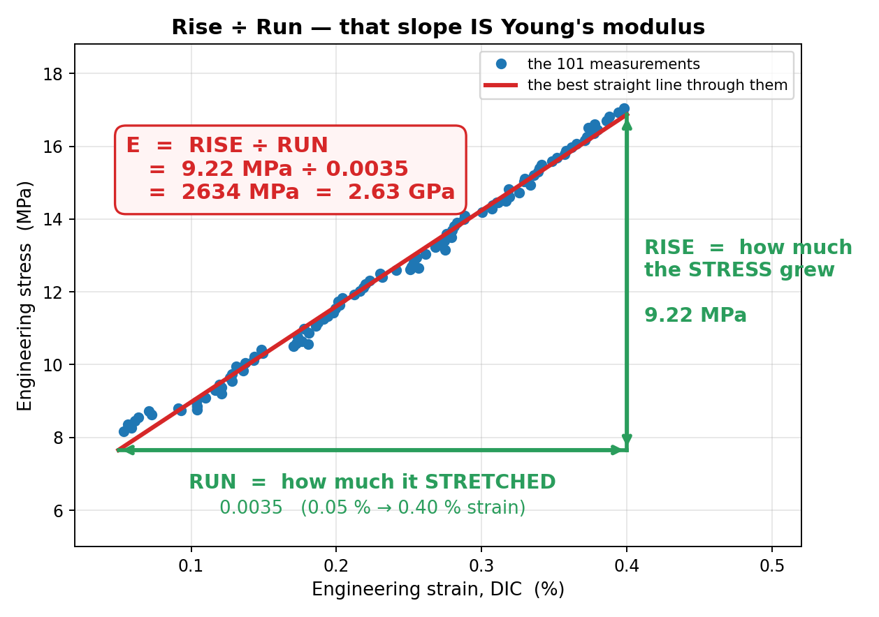
JÖNKÖPING UNIVERSITY
Young's modulus E — the slope of the ELASTIC region
Elastic = the specimen would spring back if you let go. E is the slope of the graph there, and nowhere else.
STRESS = how hard you are pulling ÷ how thick the specimen is. Units MPa.
STRAIN = how much the gauge stretched ÷ how long it was. Just a fraction — no units.
E = the SLOPE of the elastic region: how much the STRESS went up, divided by how much it STRETCHED to get there.
RISE = 16.87 - 7.65 = 9.22 MPa
RUN = 0.0040 - 0.0005 = 0.0035
E = 9.22 / 0.0035 = 2634 MPa
2634 MPa = 2.63 GPa. A stiffer material gives a steeper line and a bigger E; a floppier one gives a shallower line.
Slope of the ELASTIC region = stiffness. Nothing past the elastic region is used for E.
V6d · S11 · 100 % infill — the real measurements, not an illustration
1

Slide 2
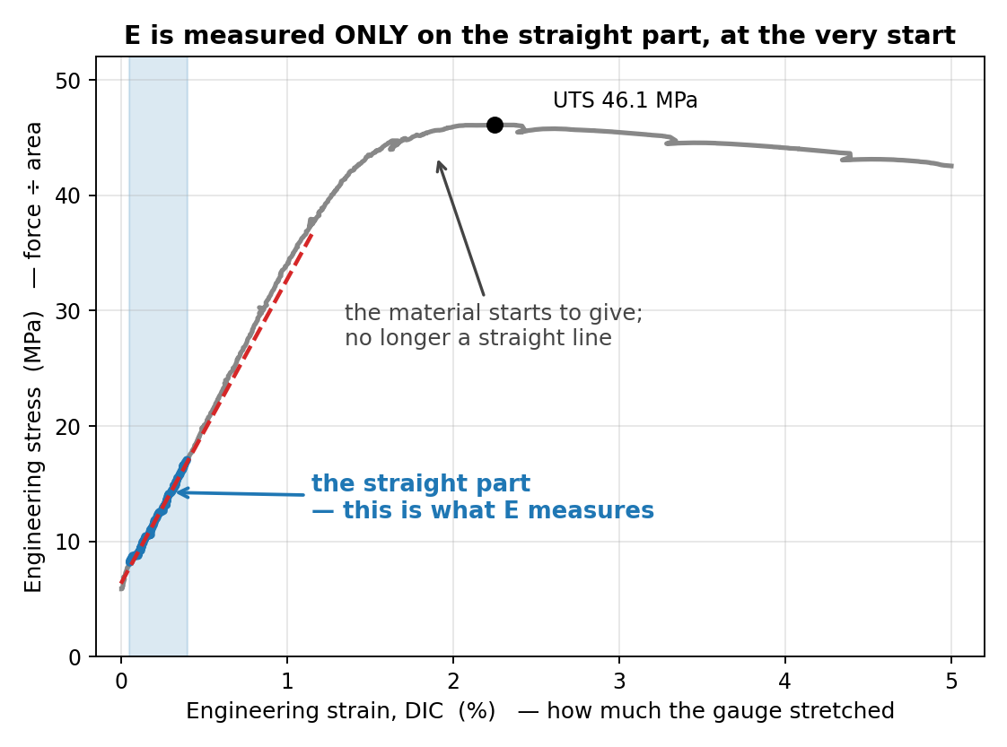
JÖNKÖPING UNIVERSITY
The formula the code actually uses
Two points would do — but 101 were measured, so all 101 are used. That is all "least squares" means.
Best-fit slope through all the points:
n·Σ(ε·σ) − Σε · Σσ
E = ─────────────────────────
n·Σ(ε·ε) − (Σε)²
Add up four columns over the 101 points:
n = 101
Σε = 0.237696
Σσ = 1266.1435 MPa
Σ(ε·ε) = 0.000657593
Σ(ε·σ) = 3.238406 MPa
Put the numbers in:
top = 101·3.2384 − 0.2377·1266.14 = 26.1218
bottom = 101·0.0006576 − 0.2377² = 0.0099175
E = 26.1218 / 0.0099175 = 2634 MPa = 2.63 GPa
σ = 2634 × ε + 6.34 R² = 0.9936 the 6.34 MPa offset is the preload the curve starts from, not an error
utm_analysis.analyze() · fit window 0.05 %–0.40 % strain · σ = (F + 470 N anchor) / 80 mm²
2

Slide 3
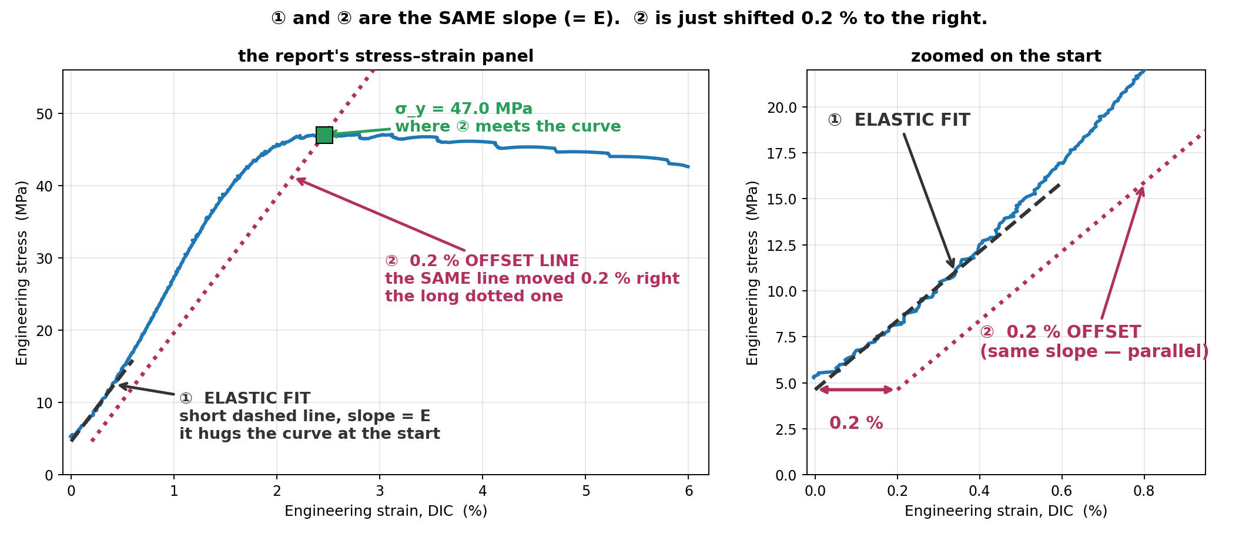
JÖNKÖPING UNIVERSITY
The two grey lines on the report's stress–strain graph
Both have the SAME slope — the one E you measured. Neither of them is used to compute E.
1 Fit E first — least squares over the points from 0.05 % to 0.40 % strain.
2 Draw ① with that slope: the short dashed line that hugs the start of the curve.
3 Copy it and slide it 0.2 % to the right — that copy is ②, the long dotted line.
4 Where ② meets the curve is σ_y, the 0.2 % offset yield stress.
The line is not an extrapolation FROM the yield point — the yield point is defined BY the line. S16 · E 1.88 GPa · σ_y 47.0 MPa
3

Slide 4
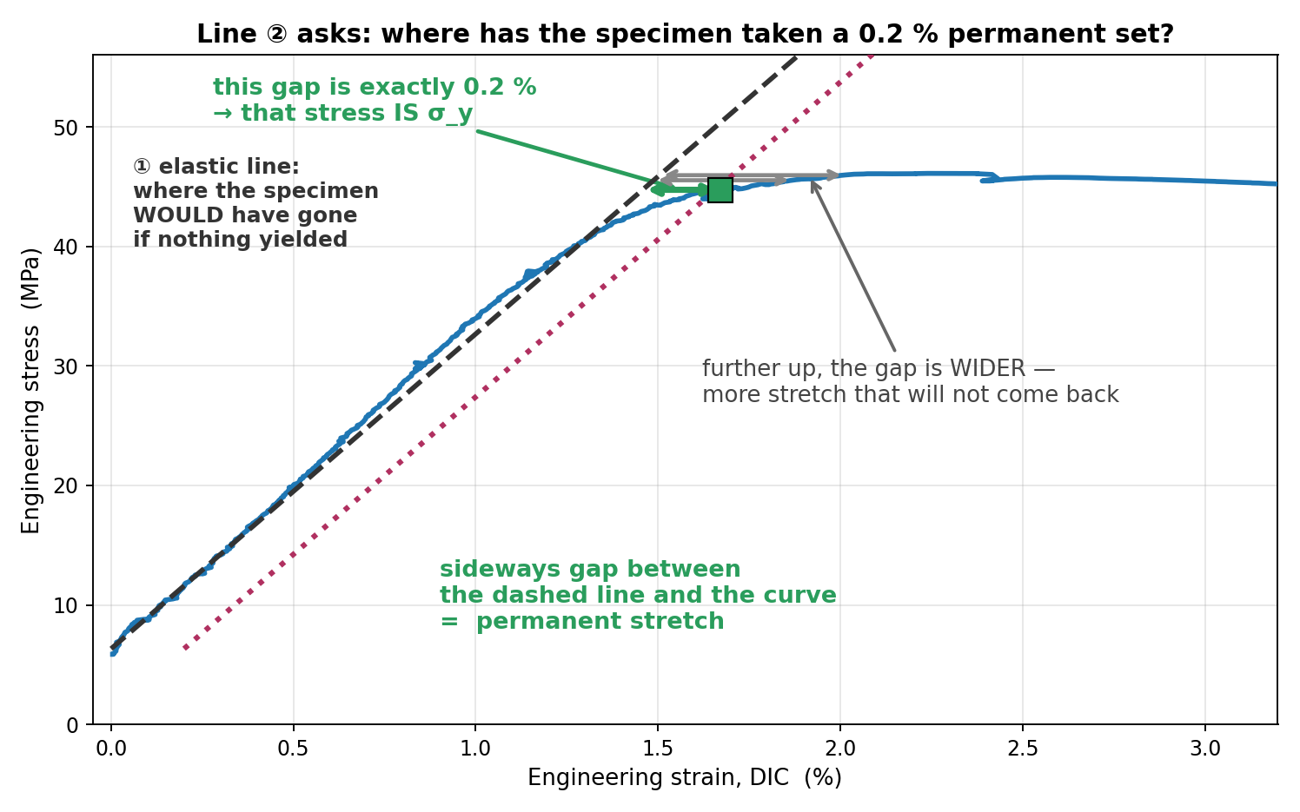
JÖNKÖPING UNIVERSITY
Why line ② is needed: PLA has no obvious yield point
Steel snaps to a clear yield. PLA just bends over gradually — so "where did it yield" has to be DEFINED, not read off.
What ② depicts: the elastic response of a specimen that has ALREADY been permanently stretched by 0.2 %.
Why sideways: at any stress, the horizontal distance from the elastic line to the curve is the stretch that will NOT spring back when you unload.
So σ_y is: the stress at which that permanent stretch first reaches 0.2 %. That is where ② meets the curve.
elastic line reaches 44.7 MPa at 1.46 %
the CURVE reaches 44.7 MPa at 1.67 %
difference 0.21 % ✓
Without this convention there is no yield number at all — the curve never gives you one.
σ_y is a DEFINITION, not a feature of the graph. 0.2 % is the agreed convention (ISO 527, ASTM E8).
V6d · S11 — σ_y 44.7 MPa @ 1.67 % · the 0.2 % gap is exact by construction
4

Slide 5
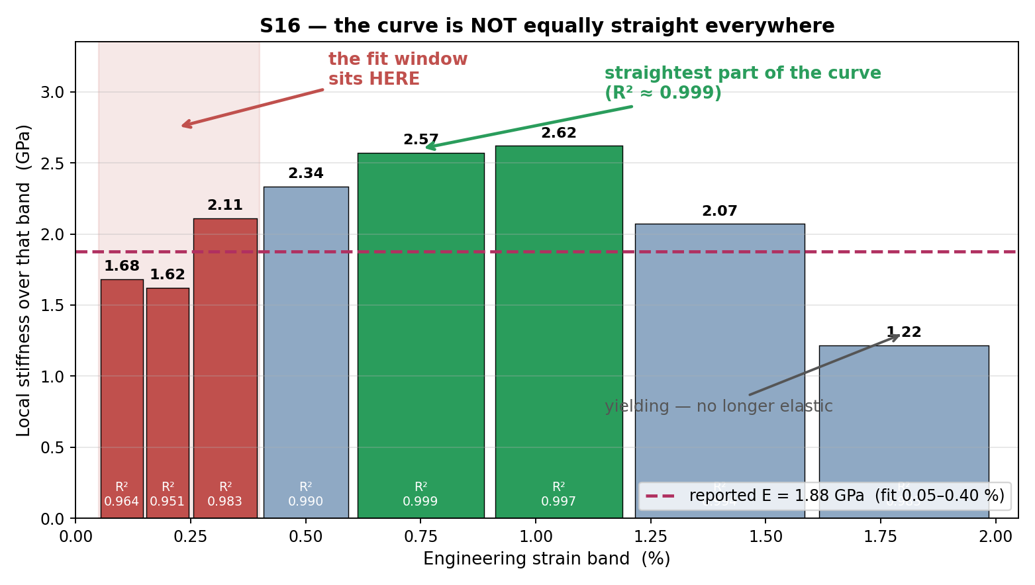
JÖNKÖPING UNIVERSITY
Why the fit stops at 0.40 % — and what that costs us
Past the elastic region the curve is no longer straight, so a slope measured there would not be a modulus at all.
Why not further? beyond ~1.2 % the material is yielding. Its slope collapses (2.62 → 2.07 → 1.22 GPa). Including that would average elastic and plastic behaviour together.
Why not from 0 %? the first fraction of a percent is grip take-up and specimen settling, not material response — the noisiest part of the whole test.
0.05–0.40 % is the convention (ISO 527 uses 0.05–0.25 %). It is chosen to sit safely inside the elastic region.
BUT on S16 that window lands on the toe, not the elastic region: it reads 1.62–2.11 GPa, where the straightest part of the curve (0.6–1.2 %, R² ≥ 0.997) reads 2.57–2.62 GPa. Reported E = 1.88 GPa is therefore an UNDER-estimate.
Open question for the campaign: move the window to 0.25–0.60 %, or keep ISO comparability? It changes every published E.
S16 · local slope fitted in each band separately · R² printed inside each bar
5

