Slide 1
JÖNKÖPING UNIVERSITY
8.6.20: V5 / V5b / V5c REPEATABILITY — 50 % INFILL
Three specimens, identical conditions
Repeatability across the 3 specimens
Test | Specimen | Preload | Role
V5 | S4 | 463 N | baseline (8.6.20)
V5b | S3 | 472 N | repeat
V5c | S2 | 466 N | repeat
Metric | Mean | Spread | CV
UTS | 22.03 MPa | 0.4 % | 0.2 %
Peak force | 1763 N | 0.4 % | 0.2 %
σ_y (0.2 % offset) | 19.86 MPa | 6.4 % | 3.6 %
Elastic modulus E | 1.38 GPa | 20.5 % | 10.3 %
Failure strain ε_f | 0.027 | 23.2 % | 12.6 %
All: fresh PLA, 50 % infill (grid pattern), LED off, spray markers, 0.1 mm/s continuous to fracture, 80 mm² nominal area, preload anchored from post-fracture zero.
22.0 MPa
UTS (CV 0.2 %)
1 763 N
peak force (CV 0.2 %)
99.7 %
DIC tracking
Strength (UTS, peak force) is outstandingly repeatable — CV < 0.5 %. Modulus E and ε_f scatter more: E is a slope fit over a short low-strain window (most noise-sensitive), and S2 (V5c) stretched ~25 % further before fracture.
19.9 MPa
σ_y (CV 3.6 %)
1.38 GPa
E (CV 10 %)
0.027
ε_f (CV 13 %)
Strength repeatable to < 0.5 % across 3 specimens — the 50 % infill response is stable and reproducible.
134

Slide 2
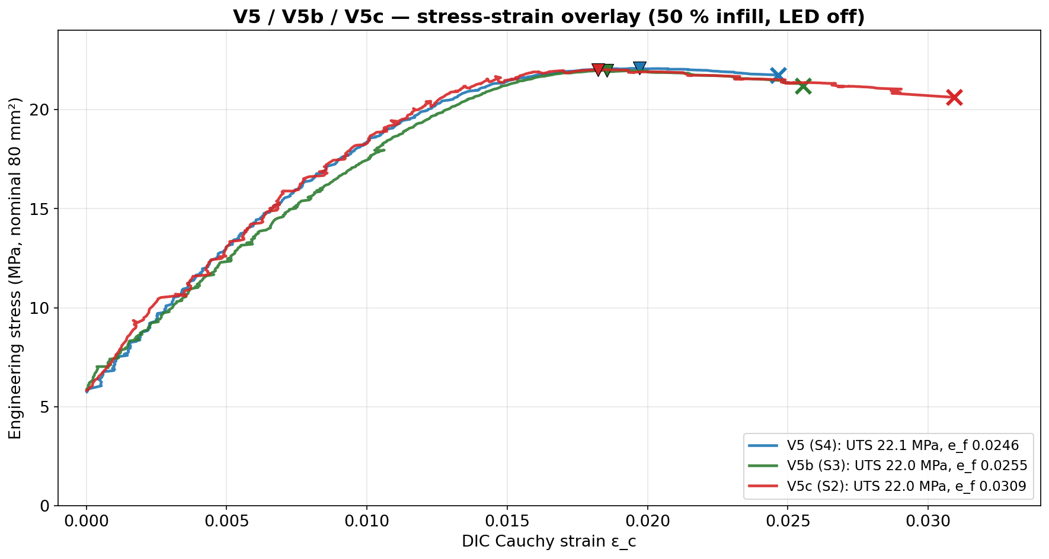
JÖNKÖPING UNIVERSITY
8.6.20: V5/V5b/V5c — STRESS-STRAIN OVERLAY
Why the curves look “noisy”
The fine ripple/steps are MEASUREMENT noise, not material: • Strain axis (dominant): DIC marker-centroid jitter — the blob centroid wobbles ~0.1–1 px between frames over a ~1675 px gauge → ε noise floor ≈ 1.4×10⁻⁵ (the small staircase steps). • Stress axis: load-cell ADC noise. The 3 t (29.4 kN) cell runs at < 6 % of range, so ±0.2–1.6 N baseline = only ±0.003–0.02 MPa ripple. • Force–DIC timing jitter: per-sample lag varies 0–140 ms (Lag_ms column), smearing points where the curve is steep. None of it shifts the results: E is a slope fit, σ_y the offset construction, UTS a peak — all average or ignore the scatter.
Near-coincident curves: identical elastic slope and UTS plateau (~22 MPa); only V5c (S2) stretches to a higher failure strain (0.031 vs ~0.025).
135

Slide 3
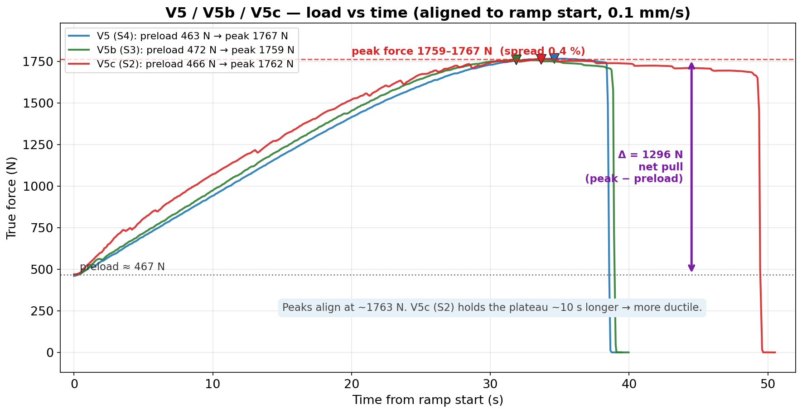
JÖNKÖPING UNIVERSITY
8.6.20: V5/V5b/V5c — LOAD vs TIME
Aligned to ramp start (all 0.1 mm/s). Peak force is repeatable to 8 N (1759–1767 N, 0.5 %); V5c (S2) sustains the peak ~10 s longer before fracture — its extra ductility.
136

Slide 4
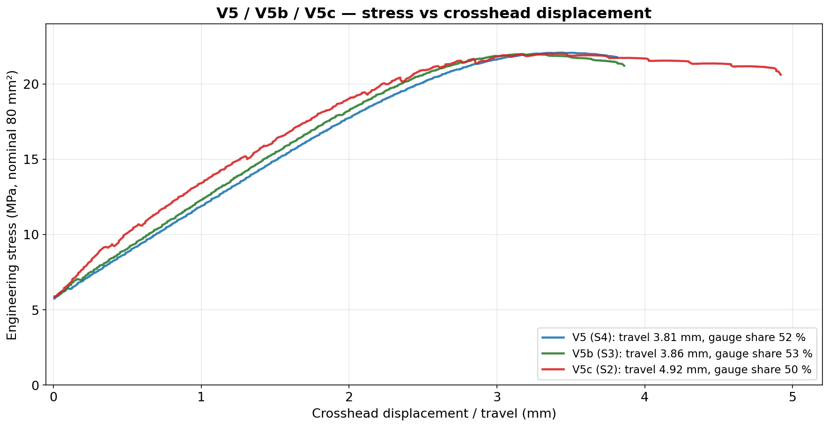
JÖNKÖPING UNIVERSITY
8.6.20: V5/V5b/V5c — STRESS vs DISPLACEMENT
Gauge share of crosshead travel: V5 52 %, V5b 53 %, V5c 50 % (range 2.6 pts) — consistently ~half the travel stretches the gauge, half is rig/grip take-up. V5c needed 4.9 mm travel (vs 3.8) to fracture.
137

Slide 5
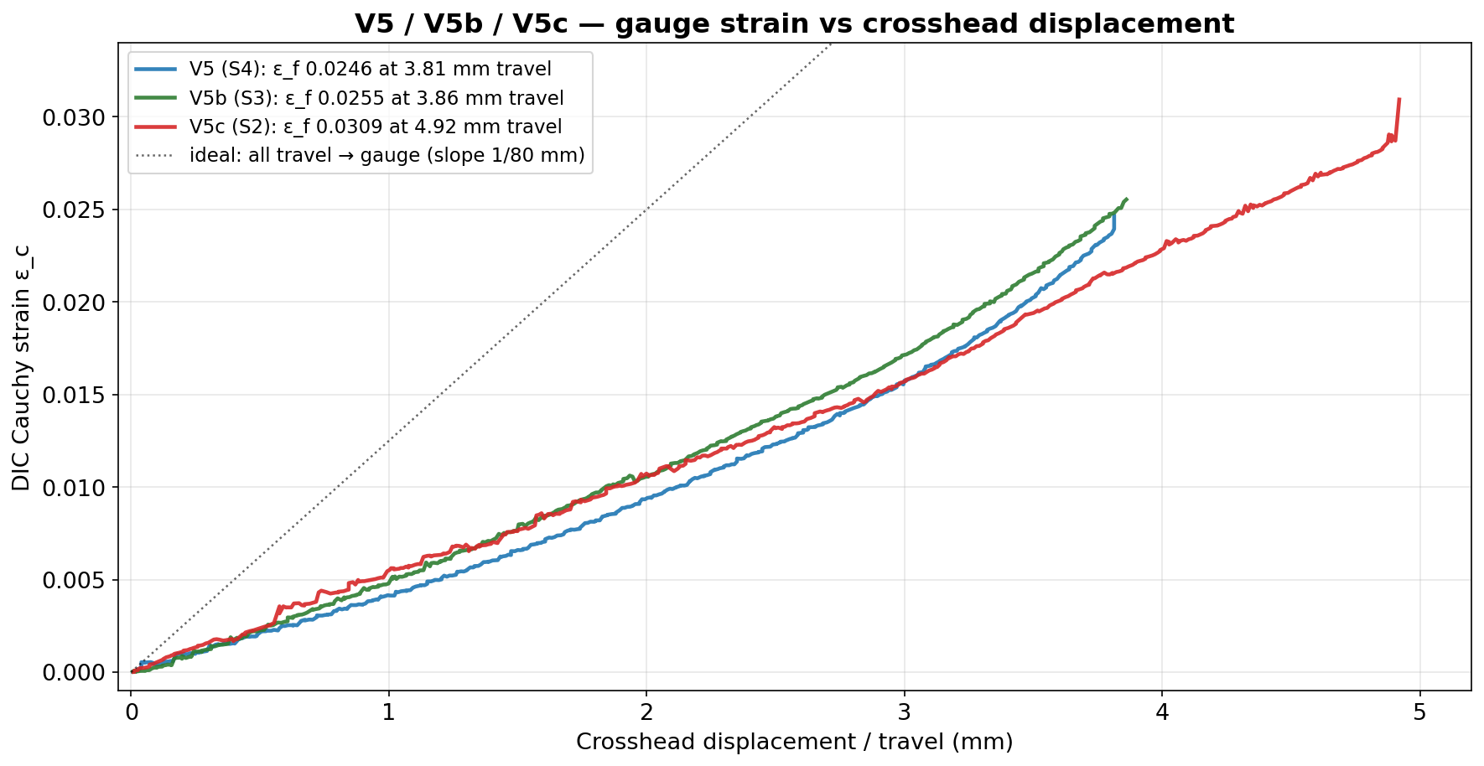
JÖNKÖPING UNIVERSITY
8.6.20: V5/V5b/V5c — GAUGE STRAIN vs DISPLACEMENT
All three sit well below the dotted ‘all travel → gauge’ line, confirming ~half the travel is rig compliance. Slopes overlay closely; V5c continues to 0.031 strain at 4.9 mm before fracture.
138

Slide 6
JÖNKÖPING UNIVERSITY
8.6.20: V5/V5b/V5c — PARAMETER COMPARISON
Values and % deviation relative to V5 (S4)
Reading it
Parameter | V5 (S4) | V5b (S3) | V5c (S2) | Δ% V5b | Δ% V5c
Elastic modulus E (GPa) | 1.54 | 1.25 | 1.36 | −18.4 | −11.5
E fit R² | 0.994 | 0.995 | 0.937 | — | —
Yield σ_y 0.2 % (MPa) | 19.04 | 20.25 | 20.30 | +6.4 | +6.6
UTS (MPa) | 22.09 | 21.99 | 22.02 | −0.4 | −0.3
Peak true force (N) | 1767 | 1759 | 1762 | −0.4 | −0.3
Failure strain ε_f | 0.0246 | 0.0255 | 0.0309 | +3.6 | +25.5
Fracture stress (MPa) | 21.75 | 21.22 | 20.62 | −2.4 | −5.2
Toughness (kJ/m³) | 462 | 488 | 692 | +5.6 | +49.7
DIC tracking (%) | 99.8 | 99.7 | 99.7 | −0.1 | −0.1
• UTS & peak force: ±0.4 % — essentially identical. • σ_y: +6 % (both repeats higher), tight band. • E scatters −12…−18 %: short-window slope fit; V5c's elastic R² = 0.94 (more DIC scatter) drives its E down. • V5c (S2) failed at higher ε_f → larger toughness & post-UTS softening. Specimen ductility variation, not a rig effect (DIC tracked 99.7 %).
Green = excellent repeatability (strength). Yellow = scatter sources (modulus fit, S2 ductility).
139

Slide 7
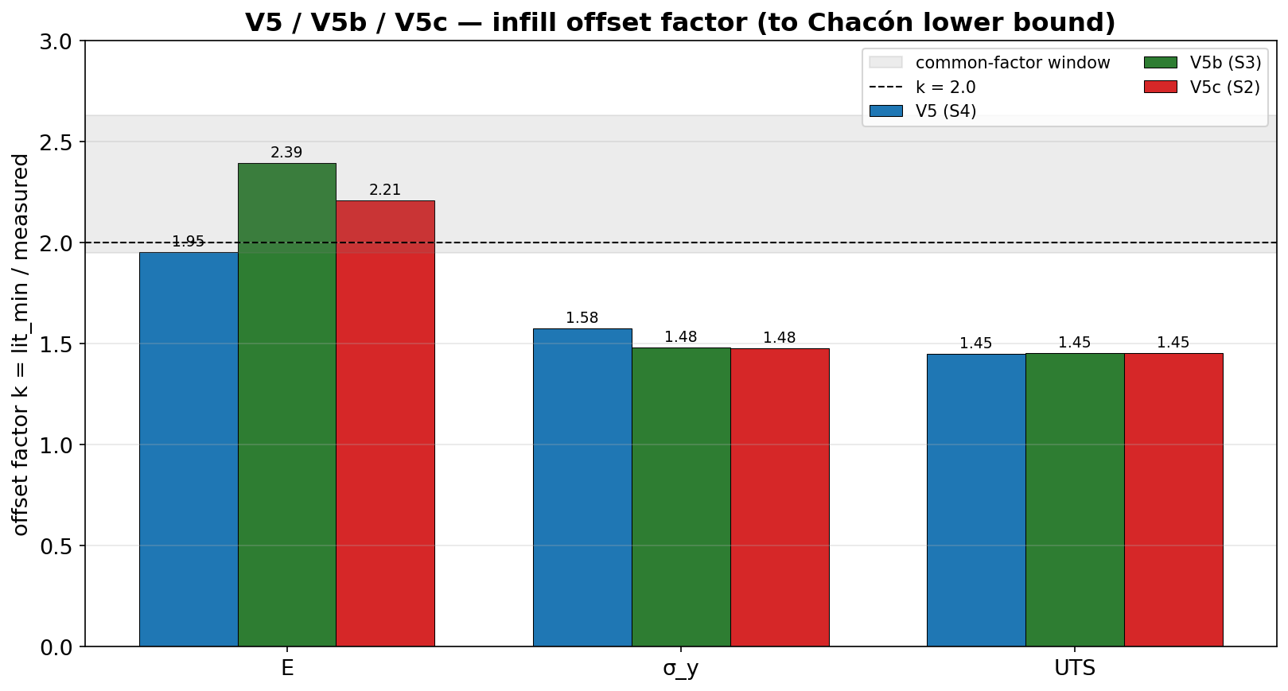
JÖNKÖPING UNIVERSITY
8.6.20: INFILL OFFSET FACTOR — REPEATABILITY
Offset factor k = Chacón_min / measured
Property | V5 | V5b | V5c | mean
E | ×1.95 | ×2.39 | ×2.21 | ×2.18
σ_y | ×1.58 | ×1.48 | ×1.48 | ×1.51
UTS | ×1.45 | ×1.45 | ×1.45 | ×1.45
UTS knock-down is identical (×1.45) on all 3 specimens; σ_y tight (×1.5). E scatters (×1.95–2.39) — it tracks the noisy modulus fit.
Single common factor for all 3 specimens: k ≈ 2.4 (window [2.39, 2.46]). Apply k ≈ 2.4 → E, σ_y, UTS all land in Chacón ranges.
(V5 alone gave [1.95, 2.63], k = 2.0; adding V5b/V5c tightened the window — now bound from below by modulus.)
The infill offset is REPEATABLE — a stable, calibratable knock-down (strength ×1.45–1.5). Next: V5d/e (LED on) and V6 (100 % infill, expect k ≈ 1).
140

