Slide 1
JÖNKÖPING UNIVERSITY
PHASE 8.6.20: TENSILE TEST TO FAILURE — V5
Test setup
Test timeline
Parameter | Value
Specimen | S4 — fresh PLA, 50 % infill (grid pattern)
Geometry | 10 × 8 mm gauge (80 mm², CAD-verified)
Markers | Spray paint — held to fracture
Preload | +463 N (anchored from post-fracture zero)
Rate | 0.1 mm/s, continuous to fracture
Load cell | ANYLOAD 3 t (29.4 kN) — used at 6 %
Reference | Chacón et al. (2017), Materials & Design
t = 0 s Preload +463 N → tare load + DIC
0 – 96 s Baseline hold (noise σ_F=1.6 N, σ_ε=1.4×10⁻⁵)
96 s Ramp start — 0.1 mm/s
107.8 s Proportional limit — 12.8 MPa, ε=0.005
118.7 s Yield (0.2 % offset) — σ_y = 19.0 MPa
22.1 MPa
UTS (nominal)
2.46 %
failure strain
1 767 N
peak force
130.6 s UTS — 22.1 MPa (1 767 N), ε=0.020
1.54 GPa
E (nominal)
19.0 MPa
σ_y (0.2 %)
99.8 %
DIC tracking
134.5 s FRACTURE — gauge section, ε_f=0.0246
134.5 – 270 s Post-fracture: display −463 N ⇒ preload
126

Slide 2
JÖNKÖPING UNIVERSITY
PHASE 8.6.20: PREDICTED RESULTS (PRE-TEST)
Expected for solid PLA — Chacón et al. (2017)
Adjusted for 50 % infill (nominal 80 mm²)
Quantity | Predicted | Basis
Elastic modulus E | 3.0 – 5.5 GPa | Chacón, FDM PLA
Yield σ_y (0.2 %) | 30 – 50 MPa | Chacón, orientation-dep.
UTS | 32 – 60 MPa | Chacón, orientation-dep.
Failure strain ε_f | 0.01 – 0.08 | PLA elongation at break
Peak force | 2.6 – 4.8 kN | UTS × 80 mm²
Curve shape | elastic→yield→plastic→fracture | ductile-brittle polymer
Failure location | gauge section | valid-test requirement
DIC tracking | ≥ 90 % | robustness target
S4 is 50 % infill, so at the CAD-verified 80 mm² the readings are predicted to fall LOW by a load-bearing knock-down of ≈ 2× (see verdict slide). Pre-test nominal expectation:
Quantity | Dense (Chacón) | ÷ ≈2 infill | → nominal expected
E | 3.0 – 5.5 GPa | × 0.5 | 1.5 – 2.8 GPa
σ_y | 30 – 50 MPa | × 0.5 | 15 – 25 MPa
UTS | 32 – 60 MPa | × 0.5 | 16 – 30 MPa
PASS = results land inside these ranges. Actual (next slides): E = 1.54 GPa, σ_y = 19.0 MPa, UTS = 22.1 MPa, ε_f = 0.025 — all inside the infill-adjusted expectation, confirming the prediction.
Predictions fixed before the pull. The 50 % infill knock-down was anticipated — the verdict slide quantifies it as a single offset factor k ≈ 2.
127

Slide 3
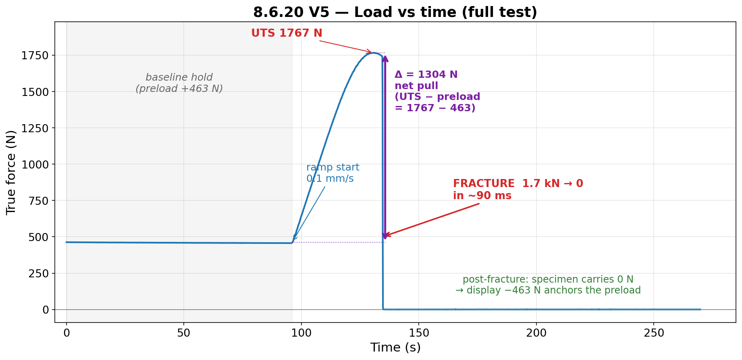
JÖNKÖPING UNIVERSITY
PHASE 8.6.20: LOAD vs TIME
Δ = 1304 N is the net pull applied during the test (UTS 1767 N − preload 463 N). Smooth rise, zero slip events (max dip 0.18 %) — drive + grips validated at 6× previous max load.
128

Slide 4
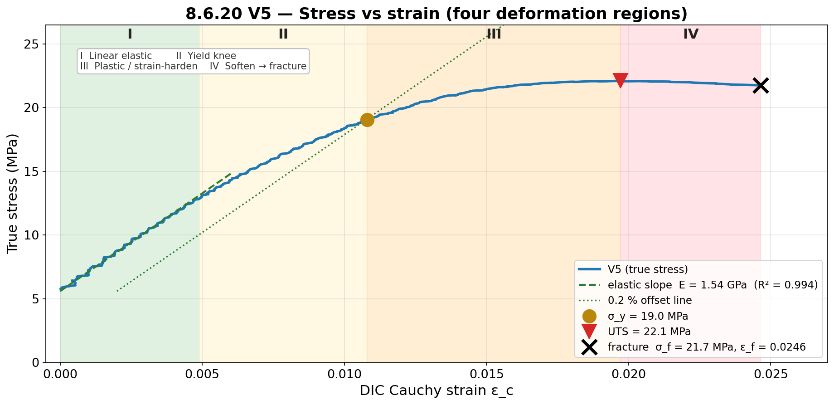
JÖNKÖPING UNIVERSITY
PHASE 8.6.20: STRESS vs STRAIN
How σ_y is found — 0.2 % offset
Draw a line parallel to the elastic
slope E, shifted right by 0.002 strain.
Where it crosses the curve = σ_y.
→ σ_y = 19.0 MPa at ε = 0.0108.
E = 1.54 GPa
elastic modulus (R² 0.994)
UTS = 22.1 MPa
ultimate strength @ ε=0.020
σ_f = 21.8 MPa
fracture (failure) stress, at ε_f = 0.0246
Four constitutive regions captured: linear-elastic → gradual polymer yield → UTS plateau → brittle fracture (only 1.5 % softening between UTS 22.1 and fracture 21.8 MPa).
129

Slide 5
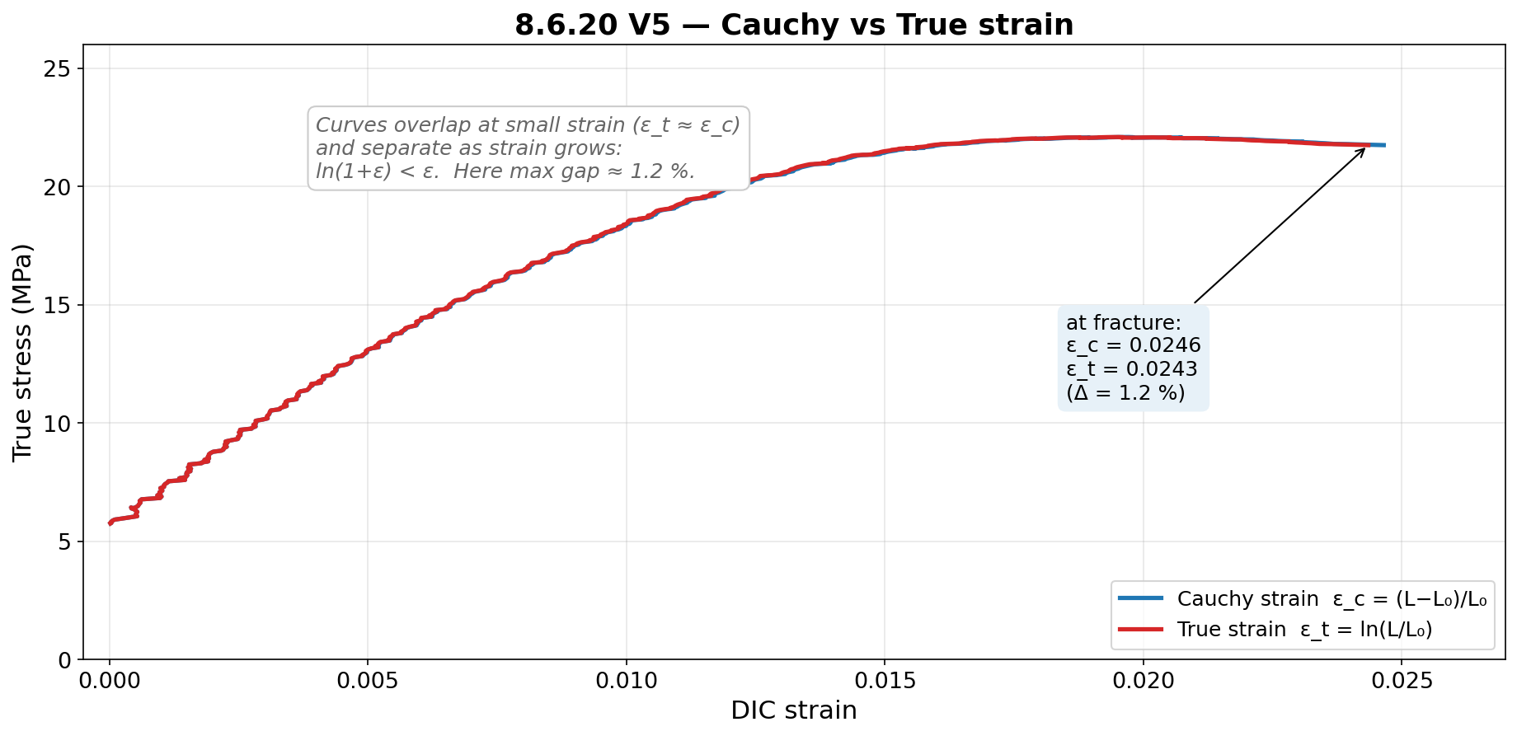
JÖNKÖPING UNIVERSITY
PHASE 8.6.20: CAUCHY vs TRUE STRAIN
Definitions
ε_c (Cauchy) = (L − L₀) / L₀
ε_t (True) = ln(L / L₀)
Identical at small strain; true
strain is always slightly lower
because ln(1+ε) < ε.
0.0246
ε_c at fracture
0.0243
ε_t at fracture
Why it matters here
Max gap only 1.2 % at ε_f = 0.025,
so for PLA (small failure strain)
Cauchy and True are interchangeable.
Both strain measures are reported straight from the DIC channels (DIC_Cauchy, DIC_True) — no post-processing.
130

Slide 6
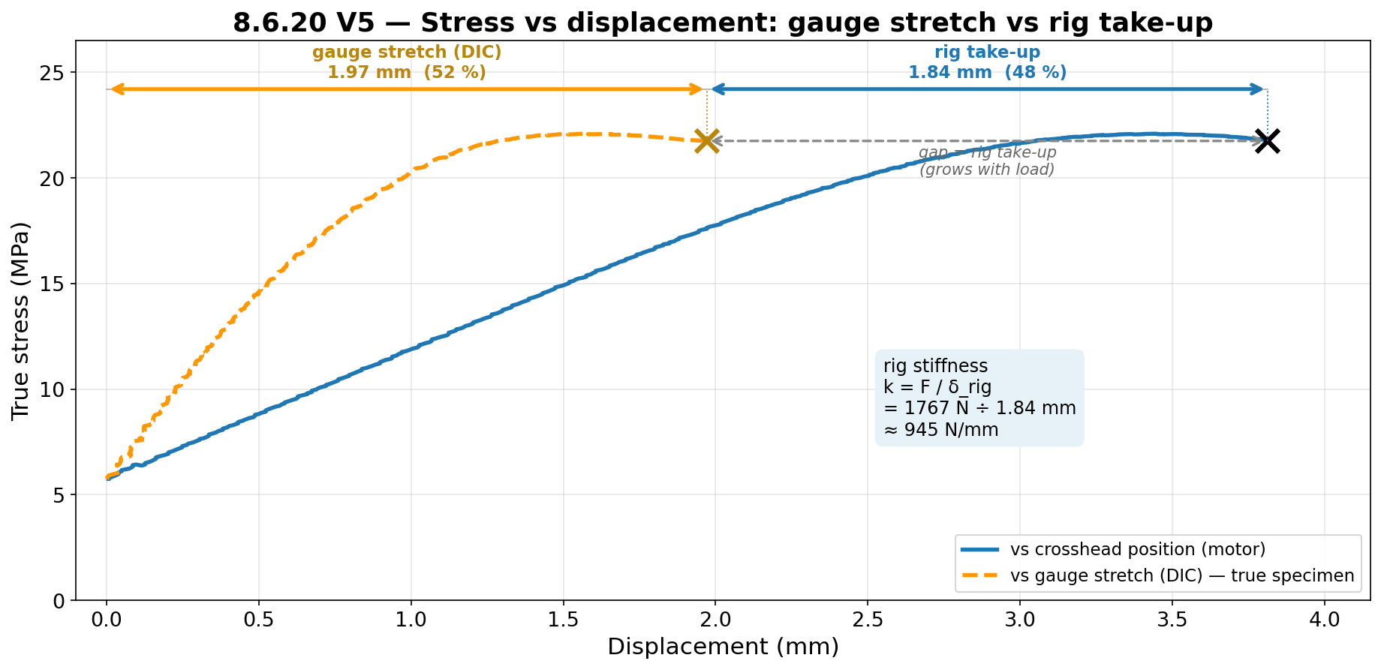
JÖNKÖPING UNIVERSITY
PHASE 8.6.20: STRESS vs CROSSHEAD POSITION
945 N/mm
rig stiffness k = F/δ
52 %
gauge share of travel
What the split means
Crosshead moved 3.81 mm, but the
specimen gauge only stretched
1.97 mm (measured by DIC).
• 1.97 mm = real specimen strain
• 1.84 mm = rig + grip + load-train
elastic take-up (machine, not part)
Rig stiffness k = F/δ
= 1767 N ÷ 1.84 mm ≈ 945 N/mm.
Why important: ~48 % of crosshead
motion is machine compliance — so
strain MUST come from DIC, never
from crosshead position. (Confirms
the 8.6.3 compliance finding.)
Gauge travel 52 % = fraction of crosshead motion that actually strained the specimen (1.97 / 3.81 mm).
131

Slide 7
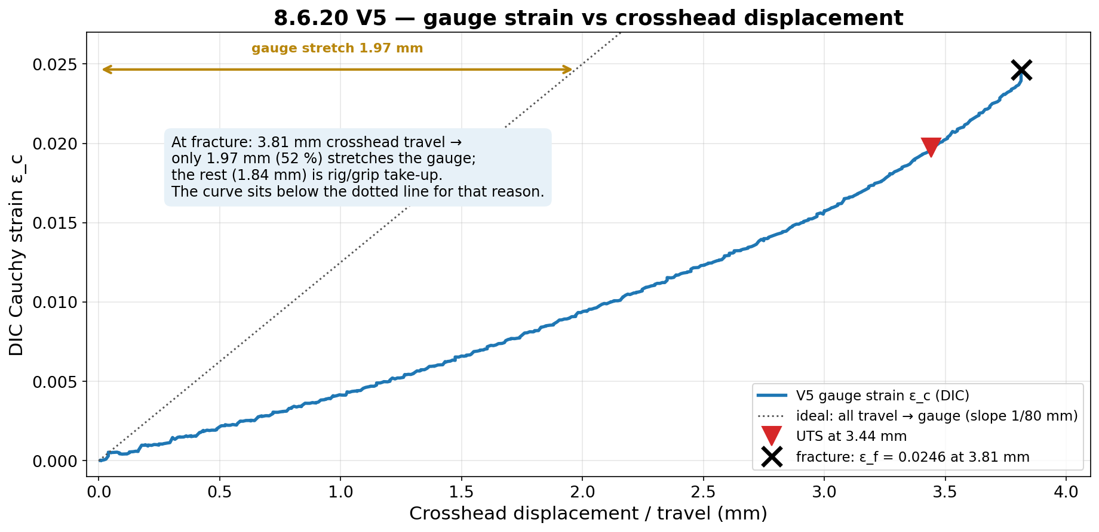
JÖNKÖPING UNIVERSITY
PHASE 8.6.20: GAUGE STRAIN vs CROSSHEAD DISPLACEMENT
Gauge strain (DIC) rises ~linearly with crosshead travel but stays well below the dotted 'all-travel-to-gauge' line — at fracture only 1.97 mm of the 3.81 mm travel (52 %) is real gauge strain; the rest is rig/grip take-up.
132

Slide 8
JÖNKÖPING UNIVERSITY
PHASE 8.6.20: VERDICT
Pass criteria
Material vs literature — offset corrections
Criterion | Result | ✓
Reaches fracture, gauge section | yes (photos) | ✓
Curve: elastic→yield→UTS→fracture | all 4 regions | ✓
Failure strain 0.01 – 0.08 | 0.0246 | ✓
Force monotonic to UTS (no slip) | max dip 0.18 % | ✓
DIC tracking ≥ 90 % | 99.8 % | ✓
Drive applies load, no stall | 1 767 N steady | ✓
E / σ_y / UTS vs Chacón | via offset → | ✓*
Area kept at CAD-verified 80 mm². Two ways to apply the 50 % infill offset:
(a) Per-property offset — each to its own literature minimum
Quantity | Meas. (80 mm²) | Offset× | After offset | Chacón | ✓
E | 1.54 GPa | ×1.95 | 3.00 GPa | 3.0–5.5 | ✓
σ_y | 19.0 MPa | ×1.58 | 30.0 MPa | 30–50 | ✓
UTS | 22.1 MPa | ×1.45 | 32.0 MPa | 32–60 | ✓
(b) Single common offset factor k = 2.0 (area-ratio basis)
Quantity | Meas. (80 mm²) | × k | After offset | Chacón | ✓
E | 1.54 GPa | ×2.0 | 3.08 GPa | 3.0–5.5 | ✓
σ_y | 19.0 MPa | ×2.0 | 38.0 MPa | 30–50 | ✓
UTS | 22.1 MPa | ×2.0 | 44.2 MPa | 32–60 | ✓
What is “DIC tracking = 99.8 %”?
% of the loading phase for which both markers were located and a valid
gauge length L_px was returned. From the timestamps: valid strain from
ramp-start (96.0 s) to 80 ms before fracture (134.43 of 134.51 s) = 99.8 %.
Only the post-separation frames were invalid.
One factor is valid because the offset is an area ratio and E, σ_y, UTS are all force/area. The single k that fits all three ranges = [1.95, 2.63] → k = 2.0 chosen (E sets the lower limit). Cross-checks: dense V2–V4 bar E-ratio = 2.71; geometric area ratio = 1.47 — both bracket k ≈ 2.
8.6.20 PASSED — rig + DIC validated through fracture at 1.77 kN; material properties pass once the 50 % infill offset is applied.
133

Slide 9
JÖNKÖPING UNIVERSITY
PHASE 8.6.20: RECOMMENDATIONS & NEXT STEPS
Actions
1
Print 100 % infill for hard-criterion material work
A fully dense specimen removes the offset entirely — E / σ_y / UTS can then be compared directly to literature at the nominal 80 mm², with no correction factor.
2
Run 2 more 50 %-infill specimens (S5, S6) — identical conditions
Test whether the offset factor is repeatable. If E / σ_y / UTS knock-downs cluster at the same ~1.5–2× across S4/S5/S6, the infill offset becomes a calibrated correction usable with confidence.
3
Record print parameters for every specimen
Infill %, pattern, perimeter count, orientation. Properties are NOT comparable between specimens without them — the V2–V4 bar gave E = 4.18 GPa at nominal area; S4 (50 %) gave 1.54 GPa on the same rig.
4
Adopt the post-fracture force reading as the standard preload anchor
Once the specimen breaks it carries 0 N, so the residual display (−463 N here) is a self-calibrating measure of the tared preload — more reliable than the pre-test screen value.
Phase 8.6 status: 8.6.3 ✓ 8.6.4 ✓ 8.6.19 ✓ 8.6.20 ✓ | Remaining: 8.6.15–18 + main.py log cleanup.
134

